Slide 1
Modern Day Marine
1 May 2025
Notes:
Col Clarkson

Slide 2
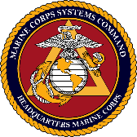
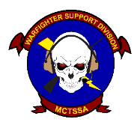
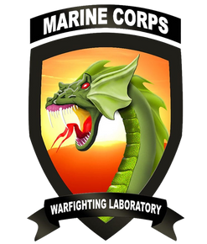
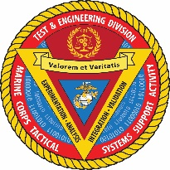
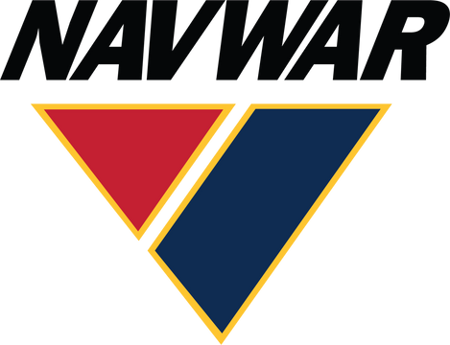
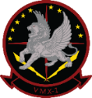
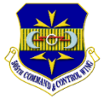
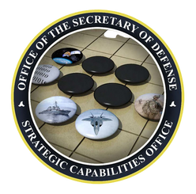
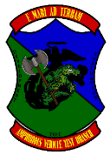
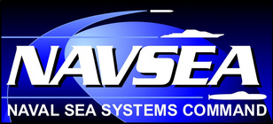
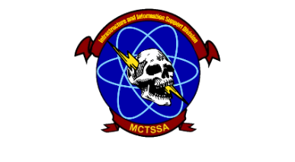
Unclassified
Command Overview
MISSION: MCTSSA provides 24/7 global technical support for C5I systems; and conducts engineering, testing and evaluation, and supports experimentation on C5I systems and amphibious platforms to inform acquisition decisions and make the FMF more capable
Warfighter Support Division (WSD) - Provide 24-hour global support to the FMF utilizing program and non-program of record equipment and provide feedback to Program Offices in order to support USMC unit operations and exercises and inform acquisition stakeholders on the health of USMC programs. Produce software in response to immediate FMF needs.
Current Partnerships
Test and Engineering Division (TED) - Perform Program Engineering, Developmental, Cyber, Shipboard, and concept-based testing and experimentation of existing and emerging USMC C5I systems in support of the acquisition community and the naval enterprise. Provide Military Standards expertise to achieve interoperable, integrated, and certified solutions to meet USMC, Joint, and Mission Partner requirements.
Amphibious Vehicle Test Branch (AVTB) - Plan, execute, analyze, and report developmental and integrated test and evaluation events to characterize the performance of amphibious and ground combat vehicle systems, autonomous and robotic systems, and other platforms that operate in the littorals to enable informed acquisition decisions.
Infrastructure and Information Support Division (I2SD) – Provide compute, transport, storage services, critical IT infrastructure and Cybersecurity Authorizations as well as Cryptologic Services to support developmental testing and engineering of USMC C5I systems.
Priorities: Support to Program Offices – Support to the Warfighter– Support to Force Design
Notes:
Col Clarkson

Slide 3
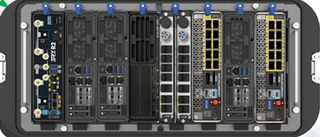
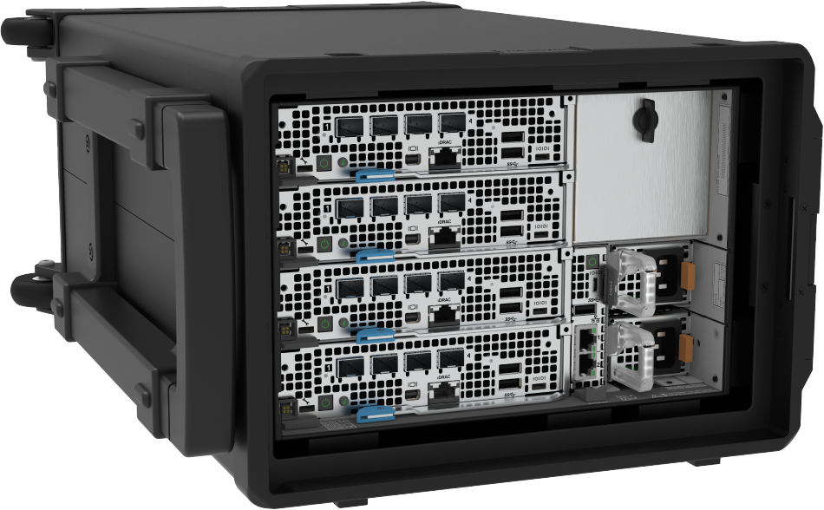
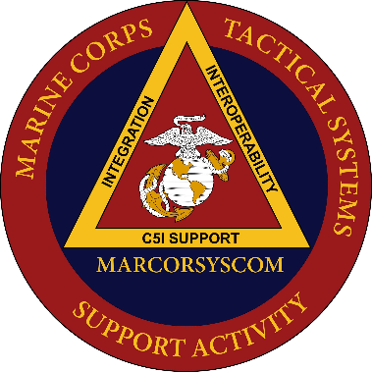
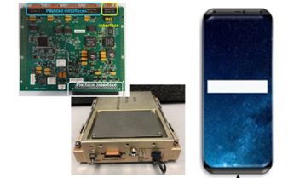
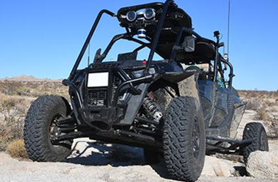
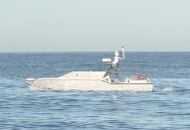
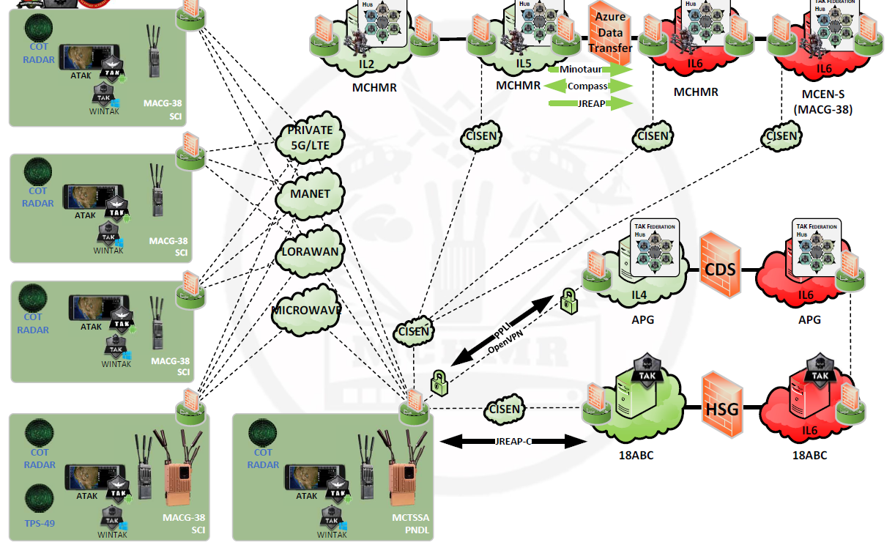
Unclassified
MCTSSA
CJADC2 Contributions
CJADC2 EXPERTISE
Prototypes
US MARINE CORPS
COALITION & MISSION PARTNERS
A
NATIONAL,
DoD, & JOINT
STAFF
VALIDATION
F
B
EXPERIMENTATION
E
D
C
US ARMY
US NAVY
NAVAL R&D ESTABLISHMENT
US AIR FORCE
Autonomy
Software Development/SBUe
RACER
DIU PRIME Saronic Corsair
Notes:
Col Clarkson

Slide 4
Questions ?

