Slide 1
MARINE CORPS SYSTEMS COMMAND
Col Bradley Sams
PM GWS
May 2025
Program Manager Ground Weapons Systems
Program OVERVIEW
Distribution Statement A. Approved for public release: distribution is unlimited.

Slide 2
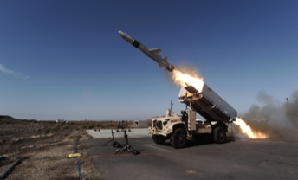
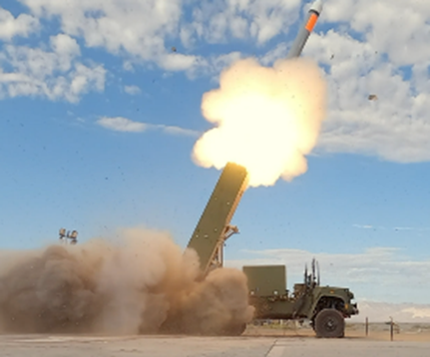
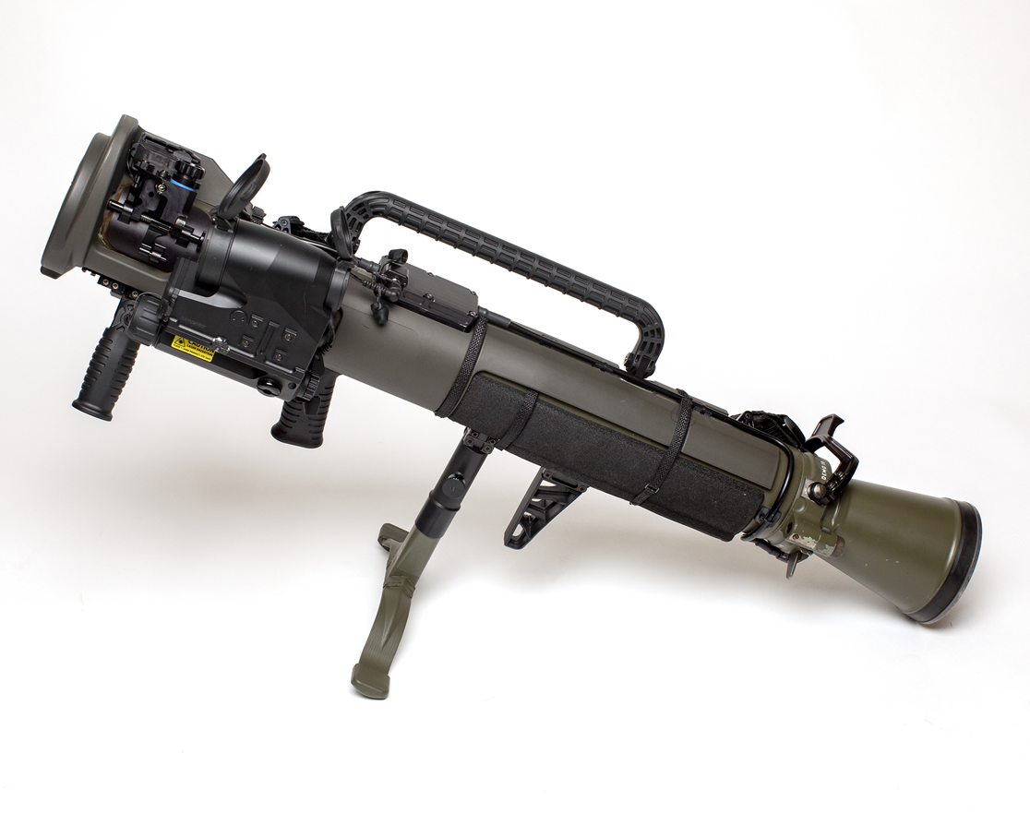
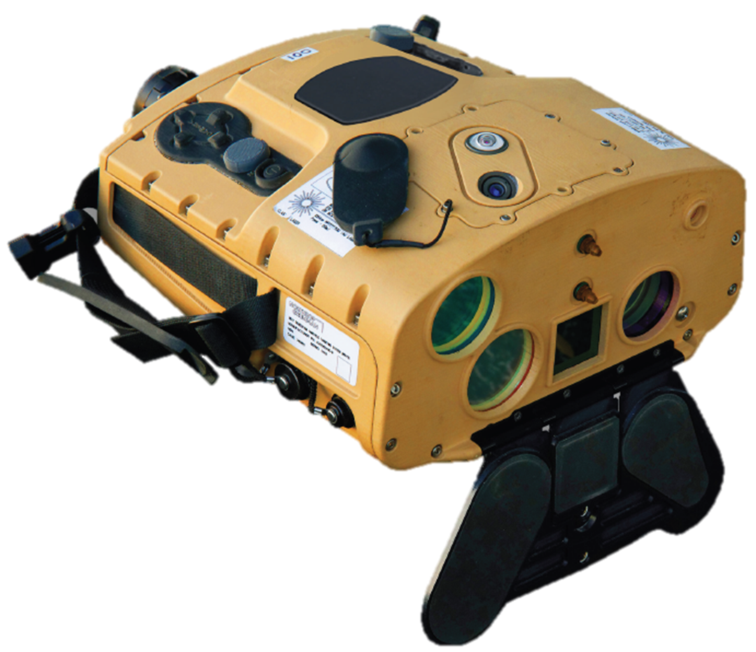
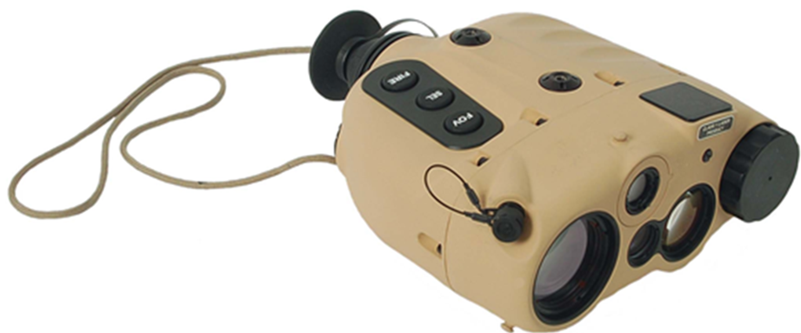
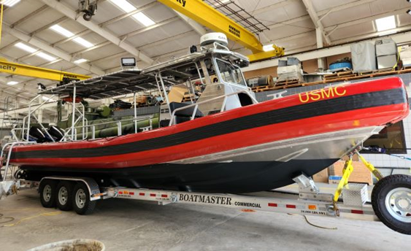
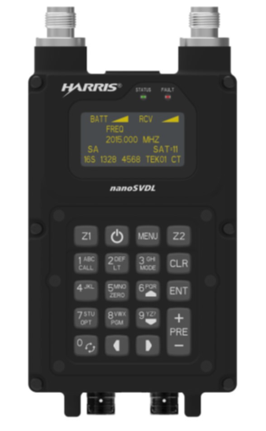
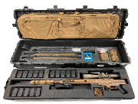
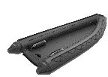
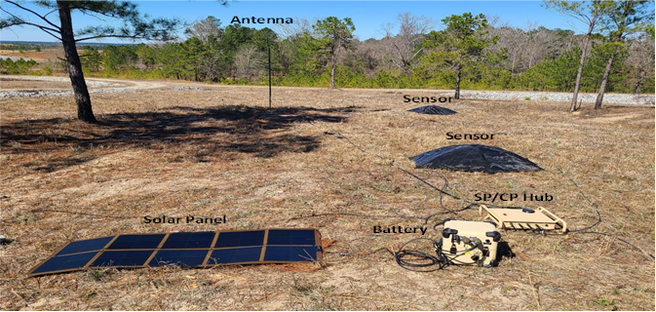
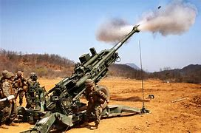
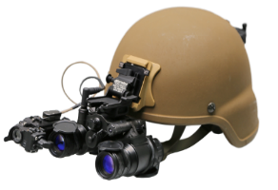
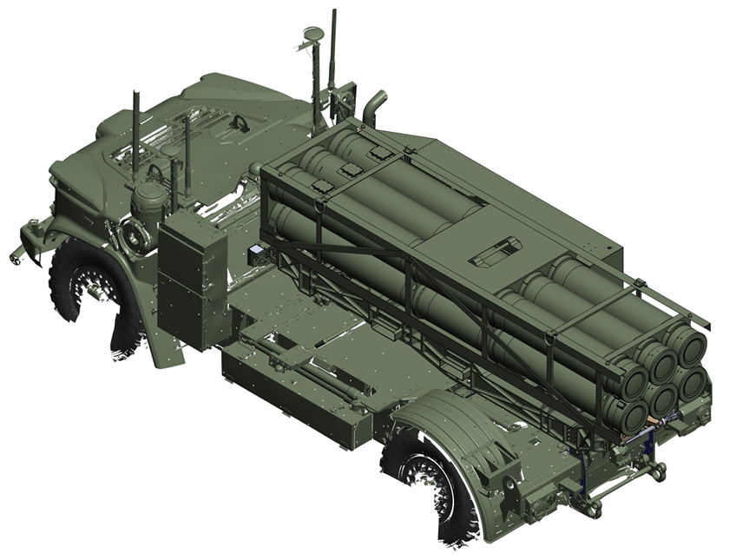
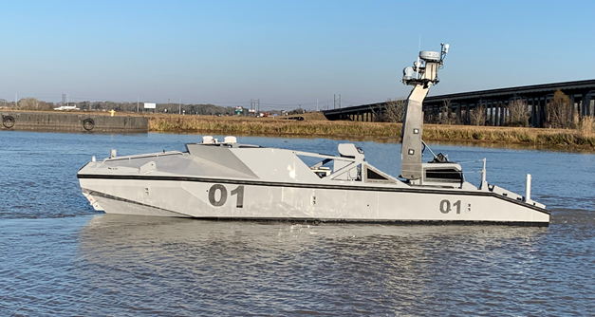
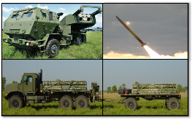
PM GWS Portfolio
Pm GWS portfolio overview
NMESIS
OPF-L
Product Manager
Navy/Marine Expeditionary Ship Interdiction System
LRF
Product Manager Organic Precision Fires
Product Manager Long Range Fires
MAAWS
Product Manager Infantry Weapons
Product Manager Fires Support Systems
NGHTS
Javelin
CLRF-IC
AASB
SASS
Product Manager High Mobility Artillery Rocket System
Product Manager Long Range Unmanned Surface Vessel
HH-VDL
ASR
E-CRRC
SPARTN
SBNVG
LW155
JPADS
MLU
MCV
LRUSV
HIMARS

Slide 3
Areas where industry can help
Loitering Munitions and fires capabilities:
High-capacity lithium batteries
Ability to charge and maintain charge of lithium battery separate from the warhead
Shipboard munition storage for systems using electric propulsion
Improved autonomous and semi-autonomous target recognition, and tracking.
Reduce operator workload and provide capability to control multiple loitering munitions simultaneously from single ground control station
Modular payloads/warheads

Slide 4
Areas where industry can help
Improved small arms capabilities:
Suppressors--reduced sound, flash, and thermal signature
Weight reduction in heavy and medium machine guns
Sensors:
Navigational tracking of jumpers and cargo parachute systems
Tactical Ranging Devices
Passive ranging
Ranging utilizing uncommon wavelengths
Lightweight multi-spectral imagers and rangefinders

Slide 5
Areas where industry can help
Missiles:
Missile subcomponents that will increase range and lethality
(engines, fuels, and data links, etc.)
Coatings or removable coverings for missile cannisters that can provide camouflage and concealment
Improved designs for missile handling equipment for the NSM to allow for safe and rapid reload

Slide 6
Areas where industry can help
Technologies for vehicles, boats, and munitions:
Low-cost comms for small mid-sized unmanned systems that provide:
Beyond Line of Sight
High bandwidth (off-load sensor data)
Low probability of detection/interception
Common controllers and interfaces to enable easier training /integration of different platforms
Multi-sensor/platform data and track correlation
Remote health monitoring of autonomous systems
Compact, marinized, electro-optical and radar sensors
Submersible outboard engine for inflatable boats (ECRRC)

Slide 7
Areas where industry can help
Other:
Highly experienced general systems trainers
Improved autonomous navigation in GPS denied environments
Emerging commercial technologies (COTS/COTS NDI) that will assist our portfolio in addressing capability gaps.
Opportunities to improve contracting and production timelines in delivering critical capabilities.

Slide 8
EQUIPING OUR

