Slide 1
Modern day marine
unclassified
Col Marcus J. Reynolds
Program Manager Training Systems
17 April 2025
unclassified

Slide 2
UNCLASSIFIED
OVERVIEW
PROGRAM MANAGER’S MISSION
Rapidly Field Training Systems to the Warfighter in support of Force Design.
138 Marines, Civilians & Contractors
Located in 5 States; Japan & Guam
~ $368.5 Annually ($1.9B FYDP FY24-28)
(FY 24)RDT&E $26.1M; PMC $88.9M;
OMMC $5.2M; OCF $248.3M
ACAT | Pre-MDD | Post-MDD | EMD | P&D | O&S | TOTAL
IV | 0 | 0 | 1 | 5* | 0 | 6
AAP +Other Pre JCIDS | 0 | 2 | 1 | 3 | 12 | 19
TOTAL | 0 | 2 | 2 | 8 | 12 | 24
Portfolio CLS Efforts* –
GTSS East (~$40M), GTSS West (~$22M), GTSS CONUS, GTSS OCONUS (~$15M), RP/IIT SME Consolidation (~$14M), MTSS (~$245M), PDSC (~$44M), ECS (~$238M), ERS-S (~$249M)
* Amounts represented are total contract value
9

Slide 3
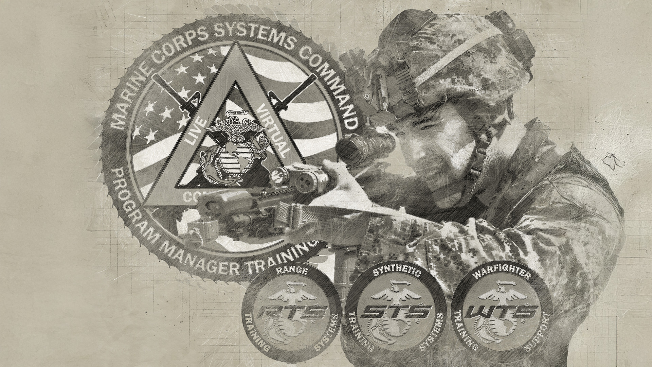
UNCLASSIFIED
RTS

Slide 4
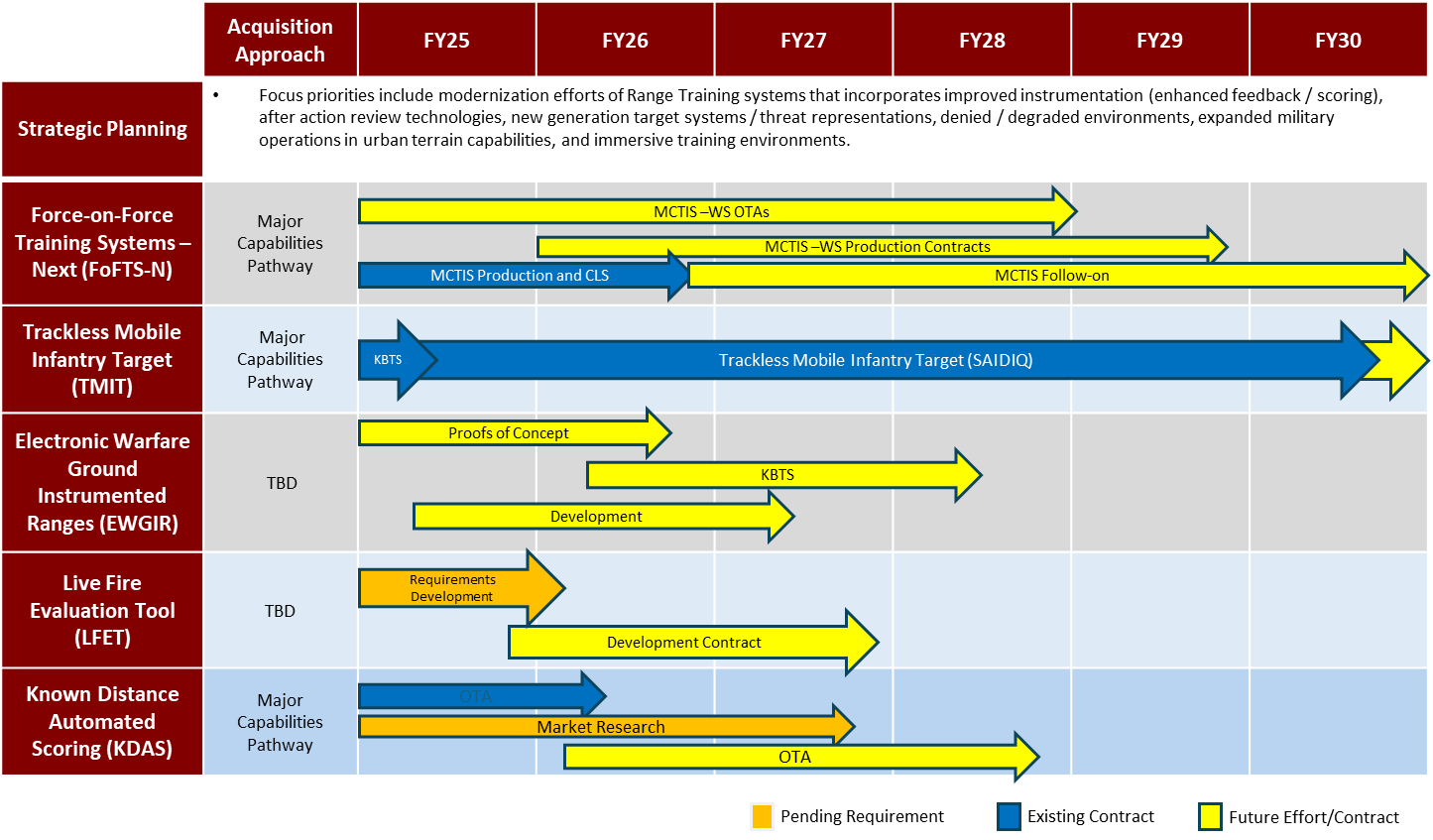
UNCLASSIFIED
RTS

Slide 5
UNCLASSIFIED
STS

Slide 6
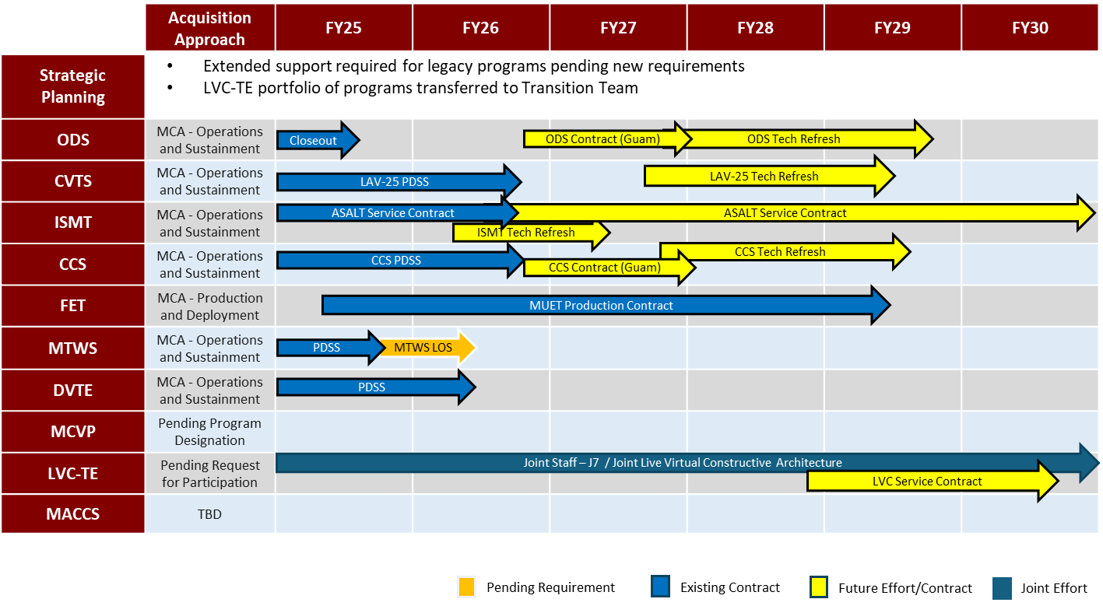
UNCLASSIFIED
STS

Slide 7
UNCLASSIFIED
WTS

Slide 8
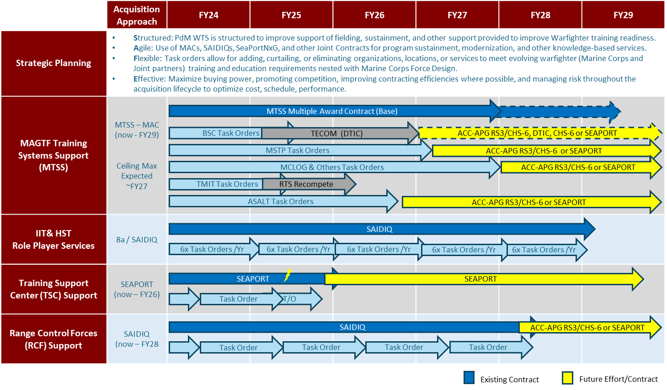
UNCLASSIFIED
WTS

Slide 9
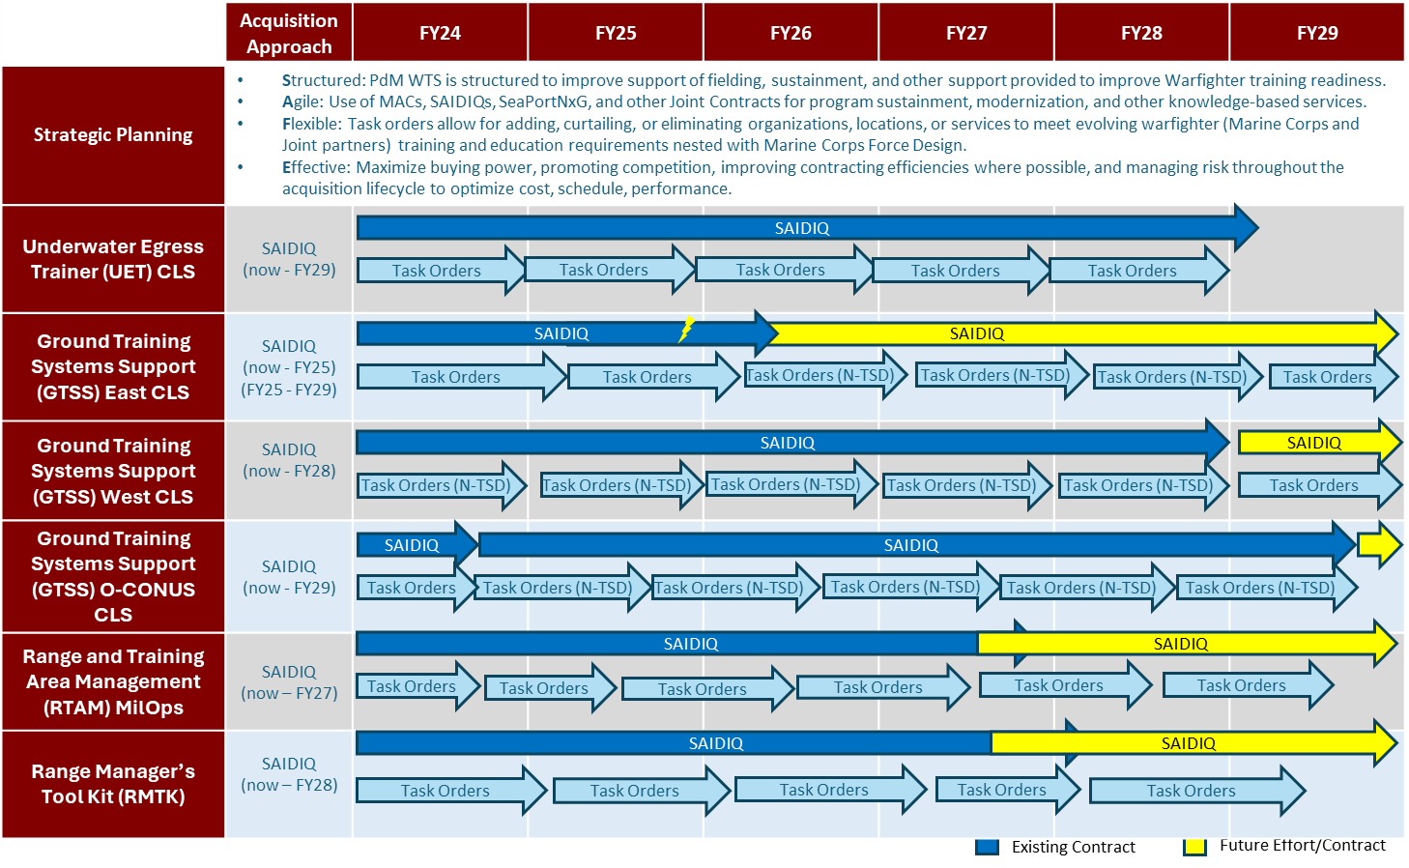
UNCLASSIFIED
WTS

Slide 10
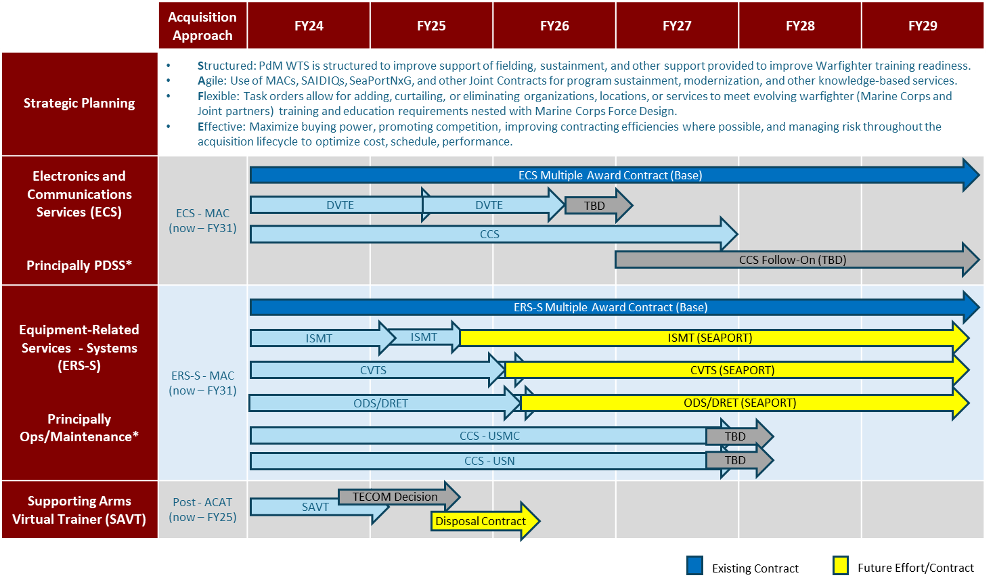
UNCLASSIFIED
WTS

Slide 11
UNCLASSIFIED
QUESTIONS
Questions
Contact PM TRASYS at
PMTRASYS@USMC.MIL
(407) 381-8762
https://www.marcorsyscom.marines.mil/Program-Managers/Training-Systems

