Slide 1
PM Light Tactical Vehicles NDIA Tactical Wheeled Vehicle Conference
Presented by:
Jennifer Moore
30 April 2025
Controlled by: DoN
Controlled by: PEO Land Systems
CUI Categories: Public Release
Limited Distribution Control: FEDCON
POC: Neal White

Slide 2
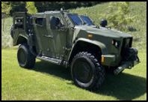
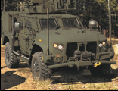
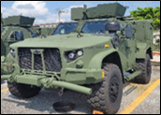
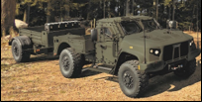
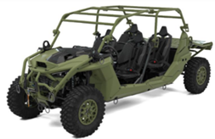
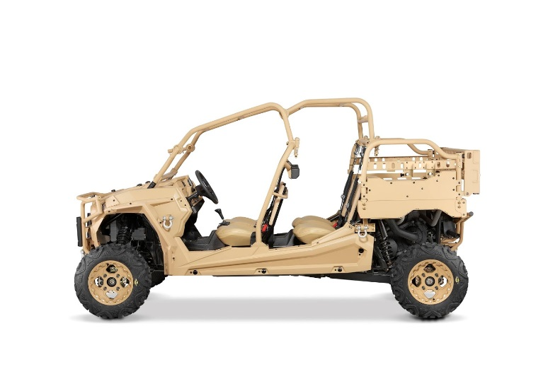
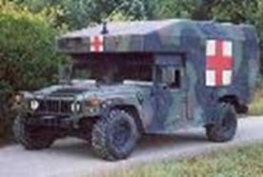
PM TV Tactical Vehicle Overview
Two Teams:
205.1 Light Tactical Vehicles and Trailers (LTV&T)
UTV and ULTV
Gunner Protection Kit Systems
205.2 Joint Light Tactical Vehicle (JLTV)
JLTV Family of Vehicles
HMMWV Family of Vehicles
Successes and In Progress:
Procured half of required JLTVs as we fully replace HMMWV fleet
Integrating over 45 capabilities onto the JLTV and several onto the ULTV
Added an exportable power variant to ULTV fleet which provides up to 5kW on the move to integrating capabilities
New Equipment Training for JLTV and ULTV
Production, Fielding and sustainment of JLTV, ULTV, UTV, GPKs
Sustainment and Divestment of HMMWV and obsolete GPKs
Challenges:
Corrosion
Supply chain across the portfolio
Transparent armor delamination
Modern automotive troubleshooting tools/aides for technicians
Opportunities:
Obsolete parts and assembly replacements across portfolio
Increase the resilience of supply chain (faster delivery to fleet)
Simple, low-cost corrosion prevention and TA delamination solutions
Technician troubleshooting tools/aides for JLTV
GP
HGC
CCWC
UTL and Trailer
ULTV
UTV
4 Litter Ambulance
RHGPK

Slide 3
Future Contracting Events
Program Office Support Services
Jul 2025 Request for Proposal Release

Slide 4
Questions and Points of Contact
Program Manager for Light Tactical Vehicles
Jennifer Moore
jennifer.a.moore3@usmc.mil
PEO Land Systems Public Affairs
PEOLSPAO@usmc.mil

