Slide 1
PM MHTV PROGRAM OVERVIEW
Ms. Lorrie Owens
Program Manager Medium and Heavy Tactical Vehicles (MHTV)
30 April 2025
DISTRIBUTION STATEMENT A. Approved for public release. Distribution is unlimited.

Slide 2
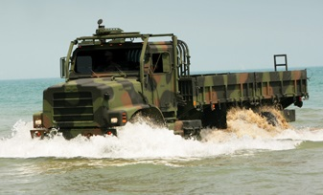
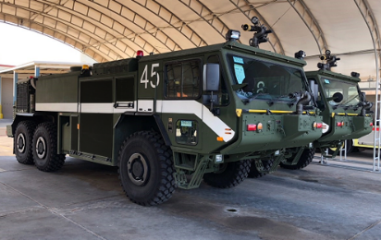
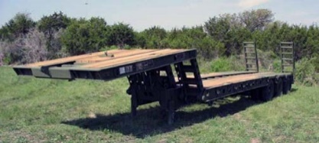
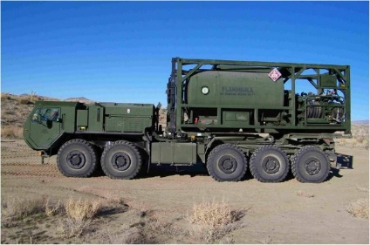
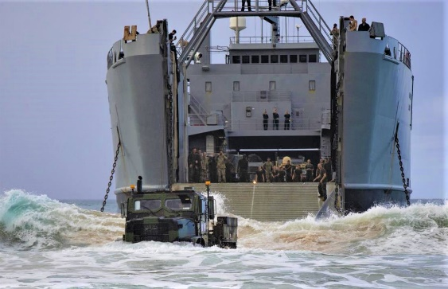
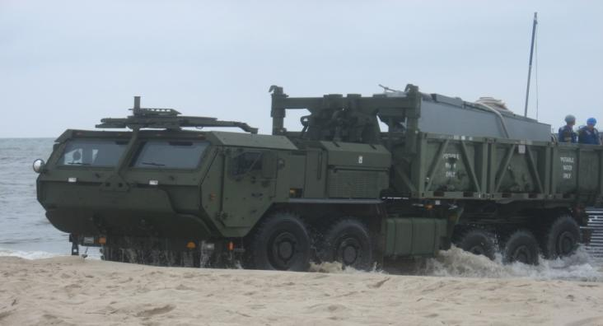
PM MHTV Tactical Vehicle Overview
Four Teams Pressing Forward:
209.1 Medium & Heavy Trailers (M&HT)
209.2 Medium Tactical Truck (MTT)
209.3 Logistics Vehicle System Replacement/Aircraft Rescue Fire Fighting (LVSR/P-19R)
209.4 Medium Tactical Vehicle Replacement (MTVR)
FY25 Focus Areas:
Modernization of Medium and Heavy Tactical Vehicle platforms
Diminishing Manufacturing Sources and Material Shortages
LVSR Anti-Idle V2 development
Fielding Medium and Heavy Trailers to the FMF
MTT prototype phase II (Build)
P-19R Forward Looking Infrared
Challenges:
Resources - Manpower
Funding shortfalls
Commercial parts obsolescence for equipment with legacy requirements resulting in deadline vehicles
Supply chain constraints
Opportunities:
Divestment
Release of Sources Sought and Requests for Information
DISTRIBUTION STATEMENT A. Approved for public release. Distribution is unlimited.

Slide 3
PM MHTV: Areas where Industry can help
Obsolescence management
FLIR
NIWC is currently conducting market research
DISTRIBUTION STATEMENT A. Approved for public release. Distribution is unlimited.

Slide 4
PM MHTV Opportunities
Title | Planned RFP
MTT Engineering & Manufacturing Development (EMD) Phase (FY28 – FY30) | TBD
PM MHTV Obsolescence/Diminishing Resources Contract | 2QFY26
DISTRIBUTION STATEMENT A. Approved for public release. Distribution is unlimited.

Slide 5
Points of Contact
Program Manager, Medium and Heavy Tactical Vehicles
Lorrie Owens; email: lorrie.owens@usmc.mil
Deputy Program Manager, Medium and Heavy Tactical Vehicles
Ryan Smith; email: ryan.b.smith@usmc.mil
DISTRIBUTION STATEMENT A. Approved for public release. Distribution is unlimited.

