Slide 1
Modern Day Marine: PMA-275
V-22 Joint Program Office (PMA-275)
Colonel Robert Hurst “Timmy”
Controlled by: Department of the Navy/NAVAIR/PEO(A)/PMA-275​​​ Dissemination Control: Distribution Statement A POC: PMA-275 Public Affairs, 240-434-3302

Slide 2
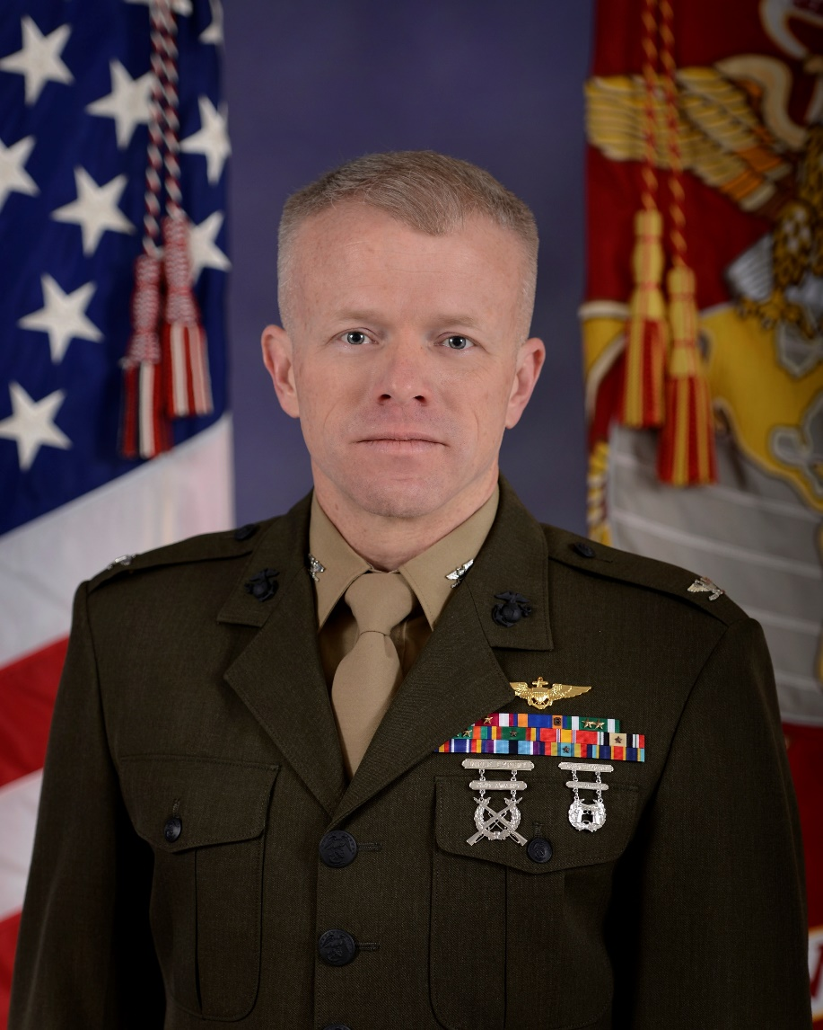
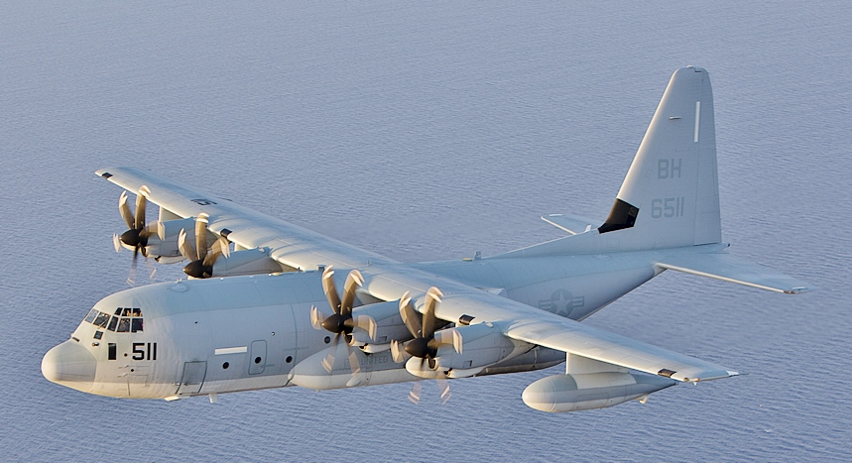
Marine Aviation Acquisition Officer

Slide 3
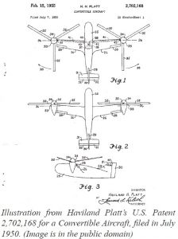
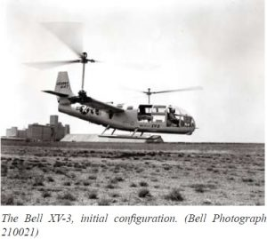
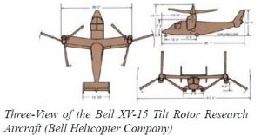
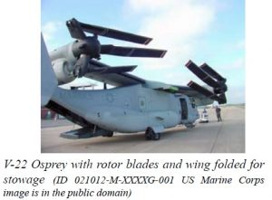
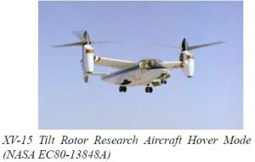
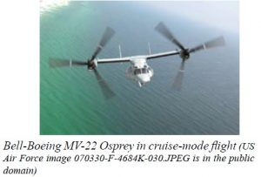
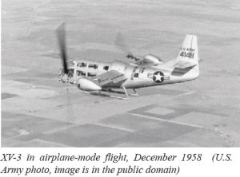
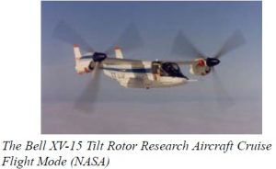
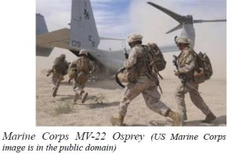
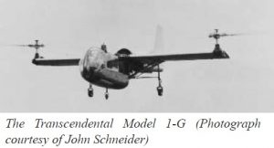
A Brief History of Tiltrotor Technology

Slide 4
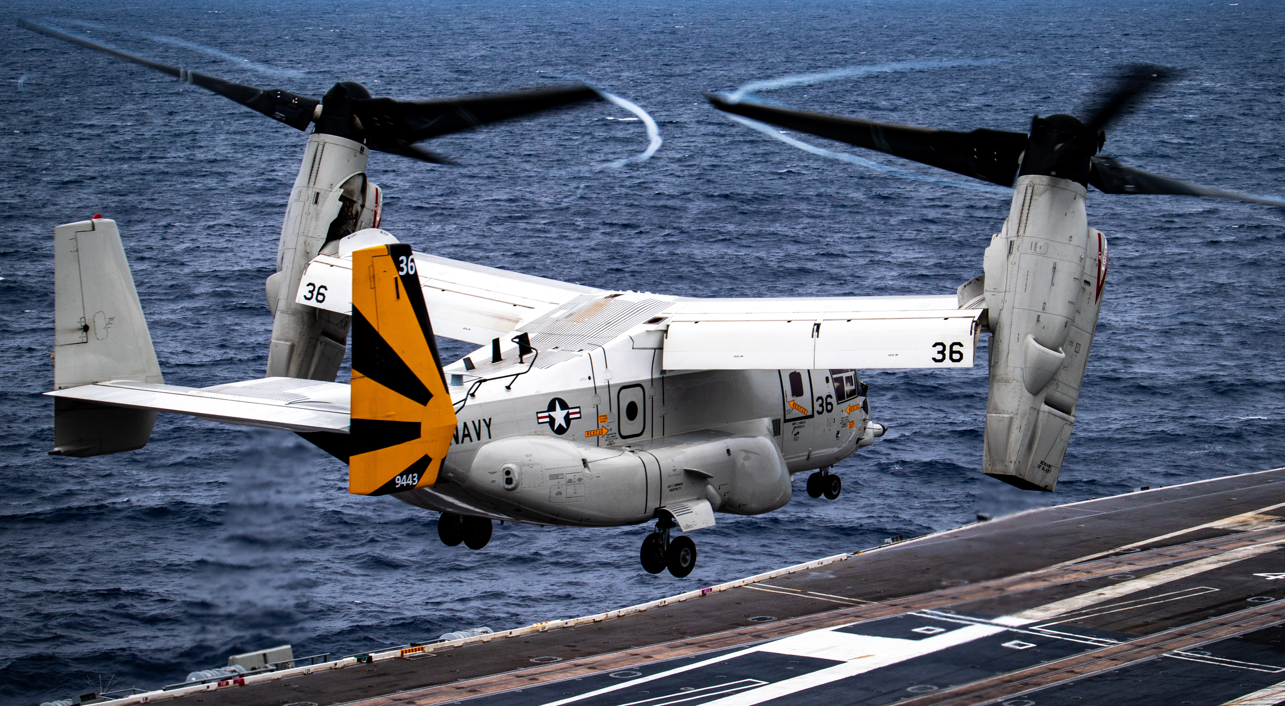
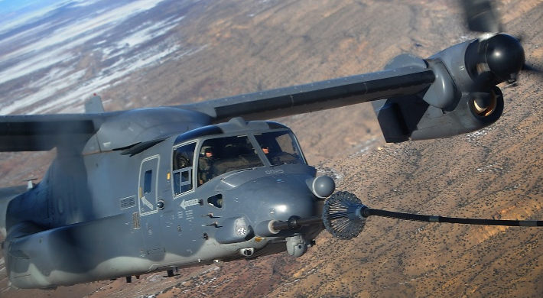
V-22, An Unmatched Capability
A multi-engine, dual-piloted, self-deployable, medium lift, vertical takeoff and landing (VTOL) tilt-rotor aircraft designed for combat, combat support, combat service support, and special operations missions worldwide.
USMC’s MV-22B
USN’s CMV-22B
AFSOC’s CV-22B
Assault-support/medium-lift for ground forces in multiple theaters of operation from expeditionary sites to afloat
Long-range/medium-lift for intra-theater aerial logistics and Carrier Onboard Delivery (COD) mission.
Long-range infiltration, exfiltration and resupply across the spectrum of competition and conflict.

Slide 5
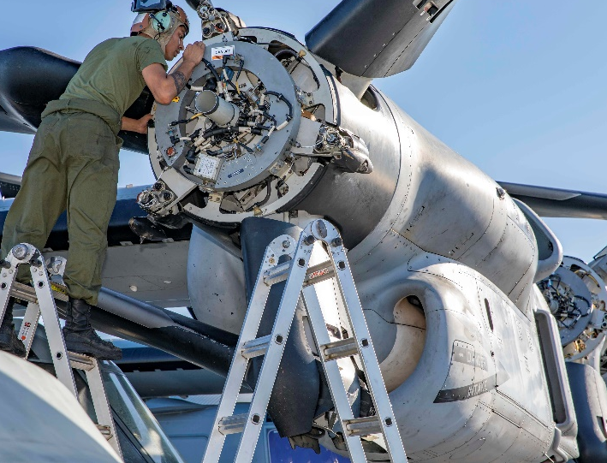
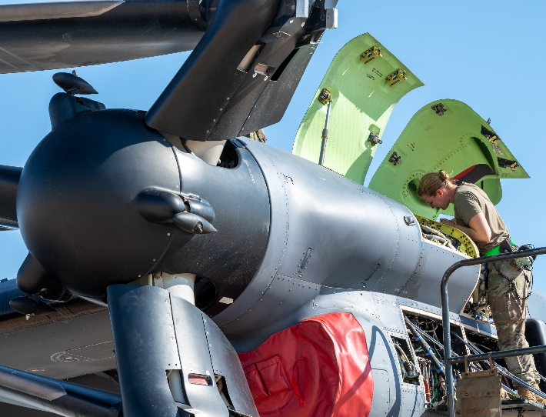
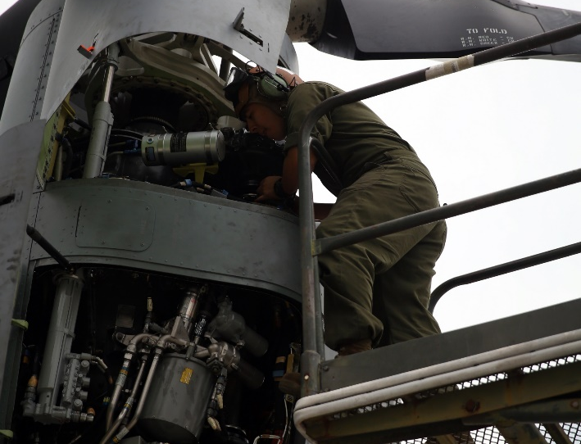
Pursuing PRGB Improvement Initiatives
X-53 Steel
IQA
ODSSHI
Triple-Melt steel will be the source material for the internal components of the PRGB which will drastically reduce the likelihood of material defects in critical gears and bearings.
A redesigned Input Quill Assembly (IQA) will reduce the incidence of the wear-out mode observed in previous IQA failures that led to aircraft Hard Clutch Engagement (HCE) occurrences.
Osprey Drive System Safety & Health Instrumentation (ODSSHI) will provide continuous drive system component monitoring allowing for predictive maintenance actions and logistics planning.
Enhanced aircraft safety and improved component reliability and durability

Slide 6
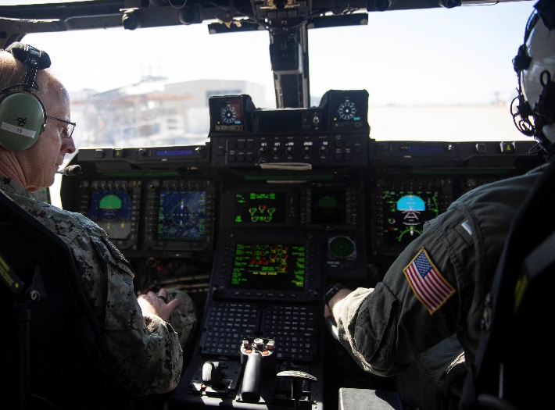
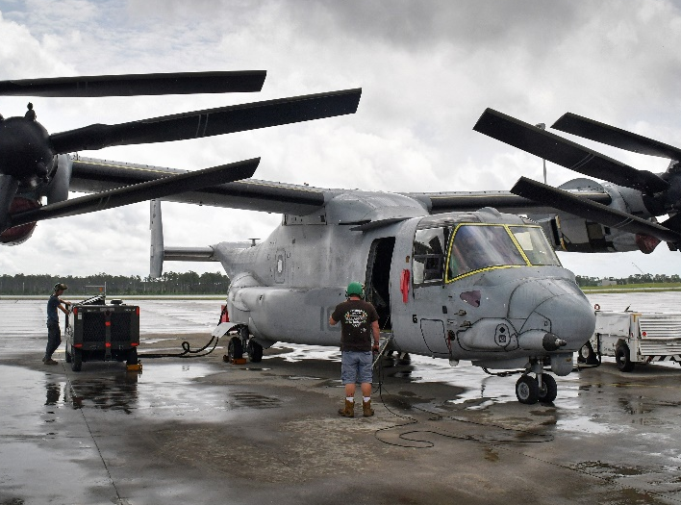
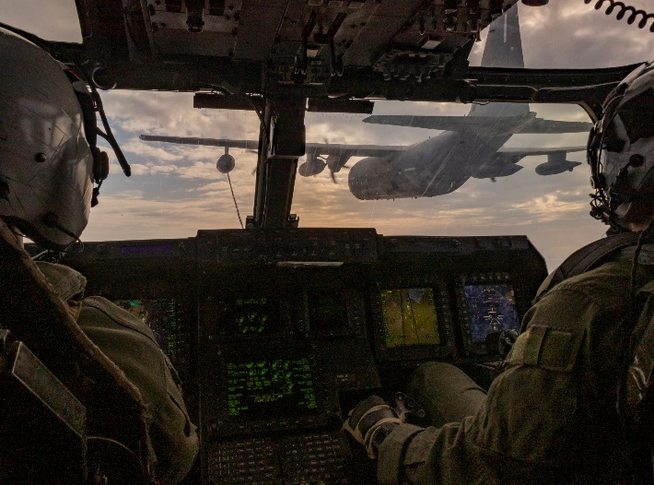
Modernization Improvements
VeCToR
ReVAMP
FCC
V-22 Enhanced Cockpit Technology Replacement (VeCToR) implements necessary obsolescence mitigation for critical systems while providing for future technology upgrades and a pathway to faster, agile, affordable modification efforts.
Renewed V-22 Aircraft Modernization Plan (ReVAMP) will ensure platform relevance until the end of its service life and the development and fielding of the Next Generation Assault Support (NGAS) aircraft.
Flight Control Computer (FCC) Re-design replaces the obsolete FCC with a modern processor with capacity to expand automation and augmentation flight capabilities to increase mission success rates and improve aircraft safety.

Slide 7
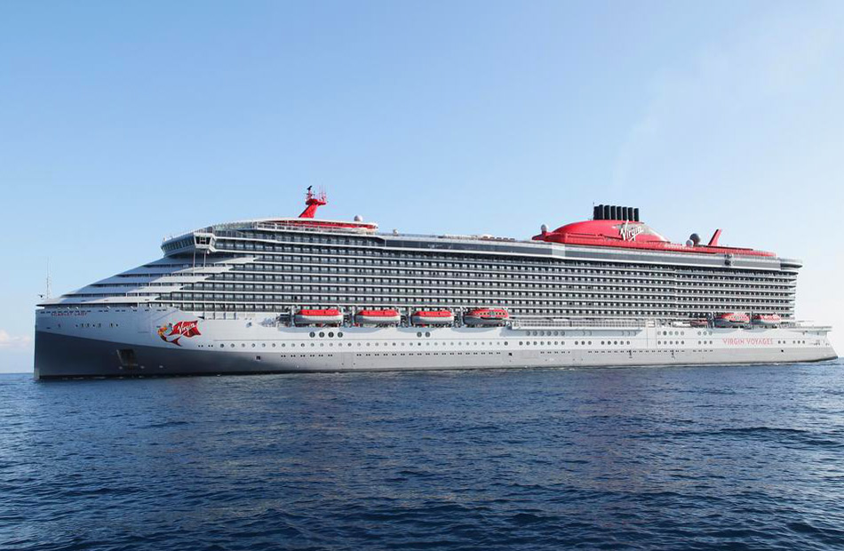
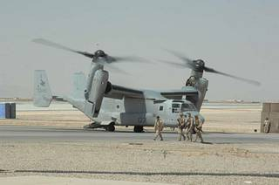
Stories of Unmatched Capability
Virgin Cruises Resilient Lady

Slide 8
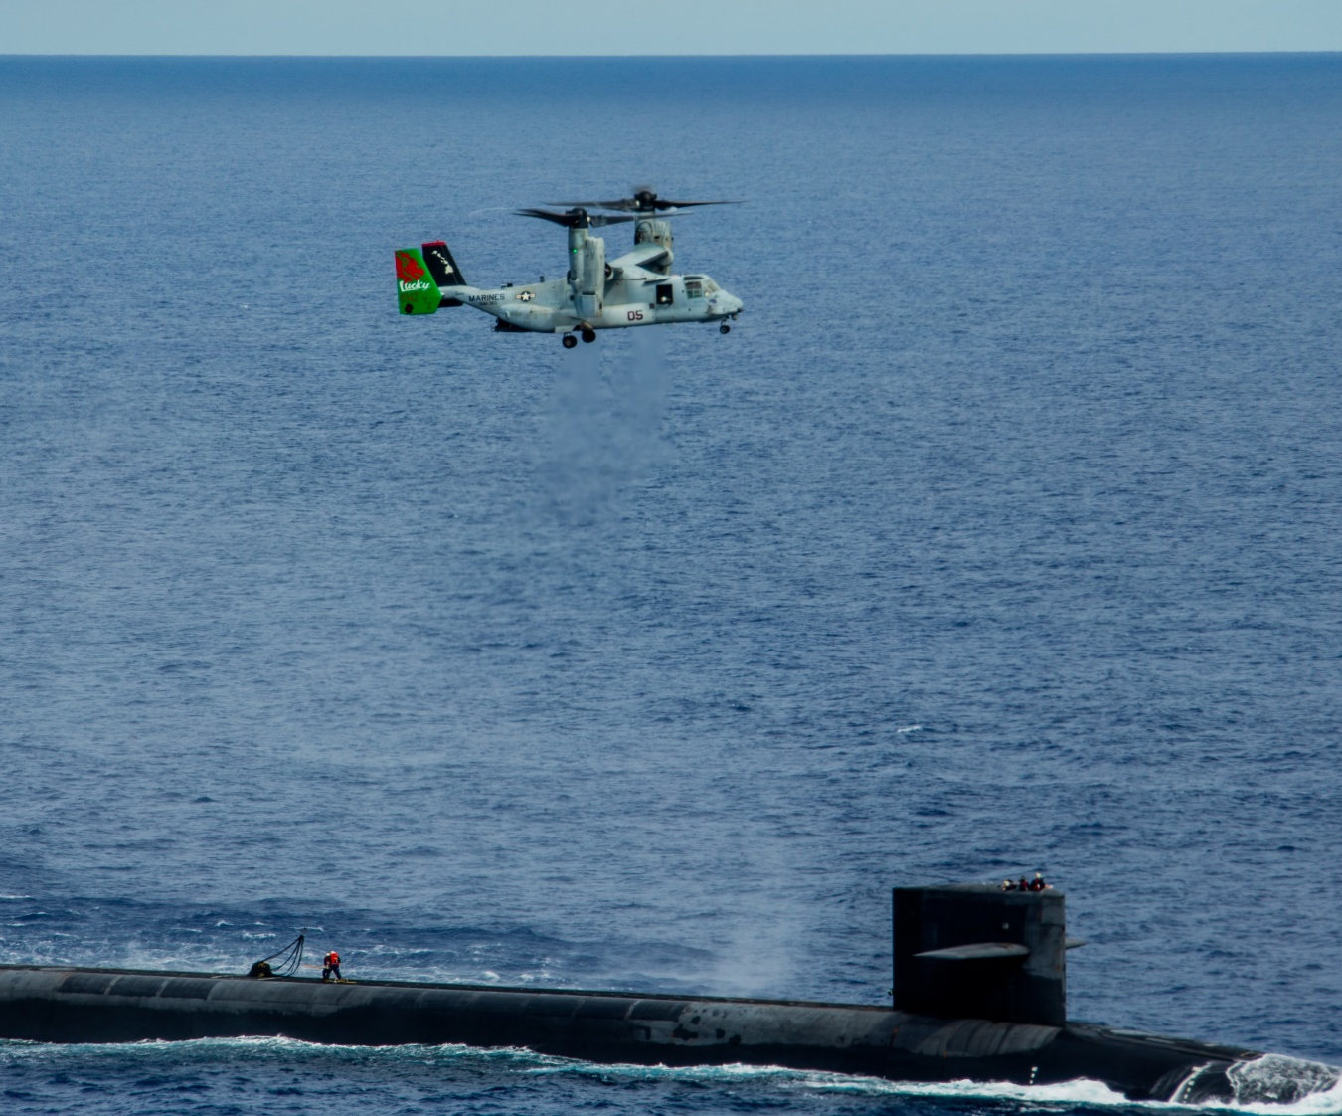
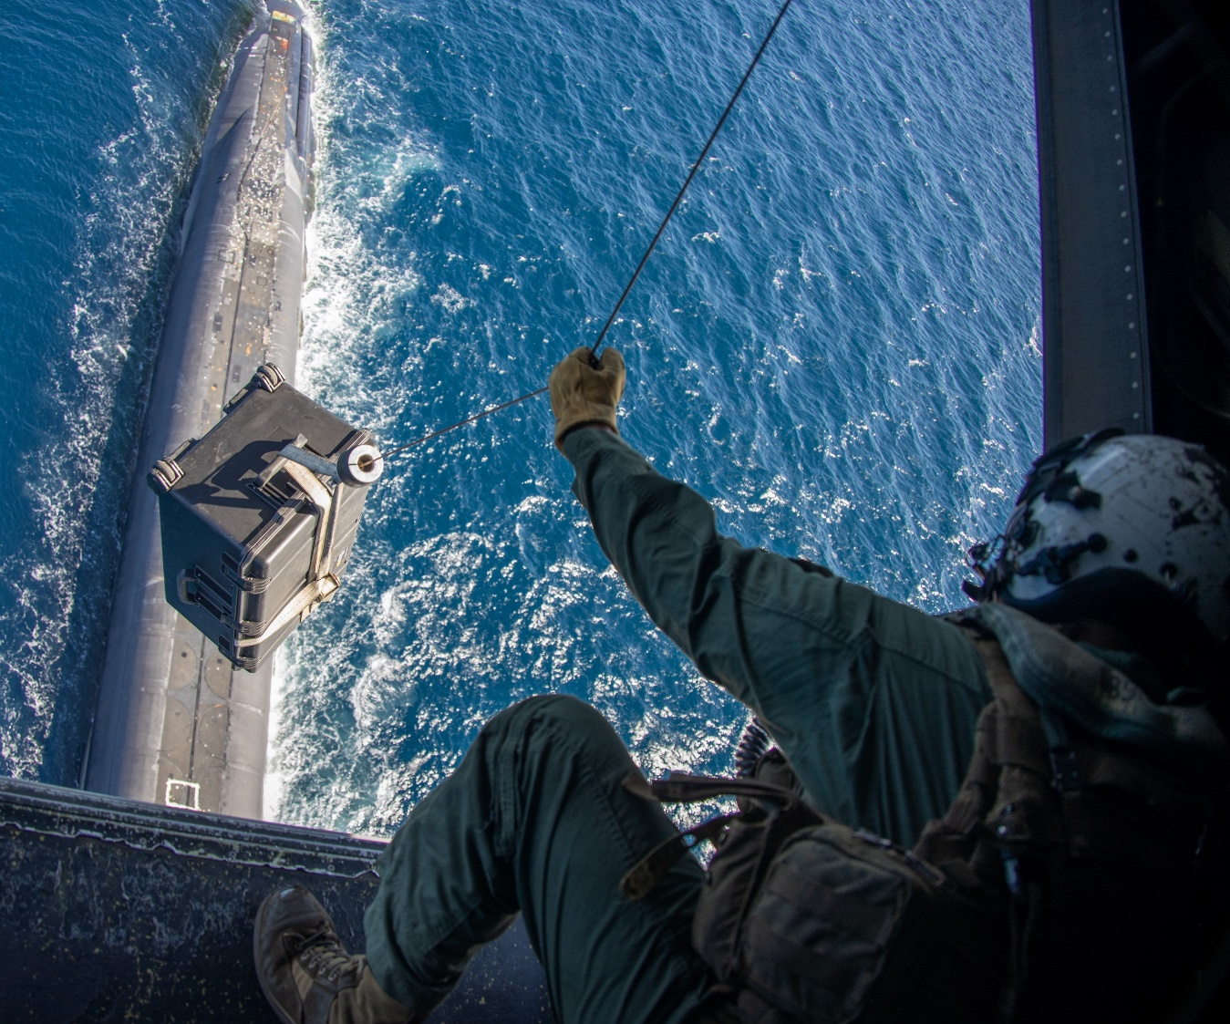
Questions & Comments

