Slide 1
Combat Support Systems​
OVERVIEW
Col Paul Gillikin
Program Manager
29 April – 1 May 2025
Distribution Statement A. Approved for public release: distribution is unlimited.

Slide 2
Pm combat support systems (PM CSS) ORG CHART
Program Manager (PM)
Combat Support Systems (CSS)
Col Paul Gillikin
Mission: Equips and sustains the Fleet Marine Force with Combat Engineer Equipment, Individual Combat Equipment, Ammunition, Medical, and Maintenance systems and solutions to enable lethality
Deputy Program Manager
Mr. Jason Miller
Product Manager
Maintenance Support Systems
Product Manager
Ammunition
Product Manager
Engineer Systems
Product Manager
Combat Service Support Equipment
Deputy Product Manager
Deputy Product Manager
Deputy Product Manager
Deputy Product Manager
Team Lead
Corrosion Prevention
and Control
Team Lead
Maneuver Ammunition
& Missile Programs
Team Lead
Power Systems
Team Lead
Expeditionary Medical
Systems
Team Lead
Advanced Manufacturing Sys
Team Lead
Close Combat & Combat
Ammunition Programs
Team Lead
Fuel and Water
Team Lead
Clothing & Equipment
Team Lead
General Purpose Tools and
Test Systems
Branch Head
Environmental and
Explosives Safety
Team Lead
Explosive Hazard Defeat
Team Lead
Individual Armor
Team Lead
Automatic Test Systems
Branch Head
Inventory Management
Team Lead
Material Handling Equipment/
Construction Equipment
Team Lead
Shelters, Combat Field Feeding,
and Containers
Branch Head
Plans, Operations
& Systems

Slide 3
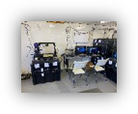

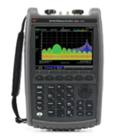

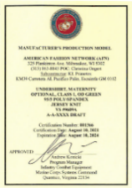
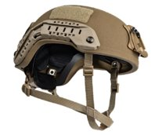
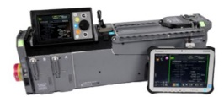


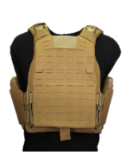


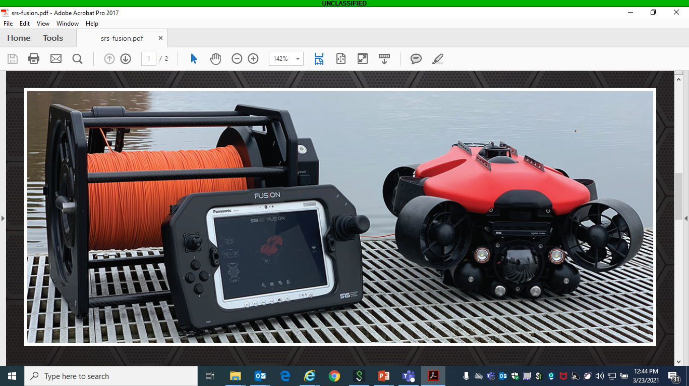
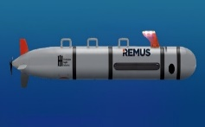


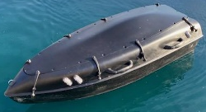
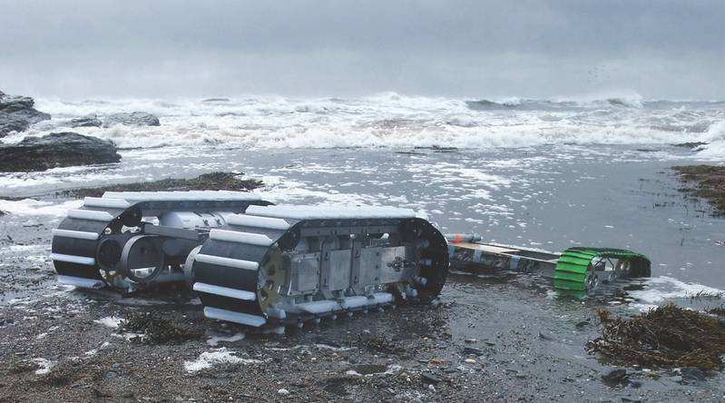
Pm combat support systems portfolio overview
Hand-held Radio Test Set
Advanced Manufacturing Data Warehousing / Parts Approval – per MCO 4700.4
Microwave Radio Test Set
USMC Uniform Certification Program
Calibration and Maintenance Program - per MCO 4733.1D
Expeditionary Fabrication (XFAB)
Corrosion Prevention & Control
Execute Enterprise Explosive Safety Management Program per MCO 5100.29C (Vol 8)
Product Manager
Maintenance Support Systems
Inventory Control Point for all Class V Ground (W) Ammunition Stocks
High-Cut, Enhanced Combat Helmet
Portable Patient Transport Life Support System (PPTLSS) 2.0
Ammunition procurements via the Single Manager for Conventional Ammunition (SMCA)
Product Manager Combat Service Support Equipment
Product Manager Ammunition
Manage all Class V(W) for Prepositioning Programs
Inventory Control Point for all Class VIII Expeditionary Medical Supplies
.50 Caliber Polymer Ammunition
Plate Carrier Generation III
Product Manager
Engineer Systems
Maintain the Marine Ammunition Knowledge Enterprise (MAKE) DBS and it’s associated applications (e.g. OIS-MC, Explosives Safety Portal, etc.)
Ultra Lightweight Camouflage Net System Inc I
Littoral Explosive Ordnance Neutralization (LEON)
Increment 2:
Dive Gear & Neutralization Kits
Author/maintain Multiple MCO’s governing Class V(W) policy and procedures.
NexGen Marine Corps Combat Utility Uniform
Increment 1: Remote Operated Vehicle (ROV)
Increment 3: Unmanned Underwater Vehicle (UUV)
Tractor Rubber-tired Articulated Steering Multipurpose (TRAM)
Lightweight Direct Current Generator (LDCG)
Increment 4: Unmanned Surface Vehicles (USV)
Increment 5: Amphibious Unmanned Ground Vehicle (AUGV)
Backhoe Loader (BHL)

Slide 4
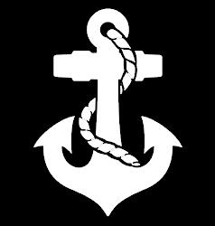

Pm combat support systems focus areas
PM CSS
Respond to Force Design
Engagement, Divestment & Investment
Logistics in a Contested Environment
PdM Maintenance Support Systems
  Fiber Optic Repair Kit
  Calibration and Maintenance Program (CAMP)
  Condition Based Maintenance Plus (CBM+)
  Fuel Automated Reporting System (FARS)
  Automated Circuit Card Test System (ACCTS)
  Tactical Radio Intermediate Maintenance Activity Test Set (TRITS)
  Advanced Manufacturing (Metal Printing)
PdM Ammunition
  Reducing Blast Overpressure Exposure
  Fielding Ordnance Information System-Marine Corps NEO Platform
  .50 Cal Polymer Lightweight Ammunition
PdM Engineering Systems
Tractor Rubber Tired Articulated Steering Multi-Purpose (TRAM)
Backhoe Loader (BHL)
Extendable Boom Forklift (EBFL)
PdM Combat Service Support Equipment
  Damage Control Resuscitation, Damage Control Surgery, Battalion Aid Station, Patient Staging and Holding
  Signature Management, Flame Resistance, Ballistic Protection
  Alternatives to PFAS for stain resistance and water repellency
  Cold Weather & Mountaineering Equipment
  Fielding Ultra Lightweight Camouflage Net System Increment I (ULCANS Inc 1)
Test Measurement Systems
Tools & Diagnostic Systems
Advanced Manufacturing Systems
Corrosion Prevention & Control
Ground Ammunition
Explosive Safety
Power Systems
Fuel & Water Systems
Explosive Hazard Defeat Systems
Material Handling & Construction Equip
Expeditionary Medical Systems
Individual Clothing & Equipment
Individual Armor
Shelters, Field Feeding, and Containers
FY25
FOCUS AREAS

Slide 5
Product manager - Maintenance support systems: Areas where industry can help
Expeditionary Fabrication / Advanced Manufacturing
Expeditionary metal printing technologies
AI & ML Technologies to enable predictive maintenance and Improve Productivity, Quality and the User Experience for the Marine Corps Maintenance Community
Commercial off-the-shelf intermediate Tactical Radio Intermediate Test Set (TRITS)

Slide 6
Product manager - Maintenance support systems opportunities
Title | Planned RFP
Okinawa Corrosion Repair Facility | FY25
Automated Circuit Card Test System | FY26
Tele-Maintenance / AR/VE | FY26
Condition Based Maintenance Plus | FY26
Electronic Maintenance Support System Technical Refresh | FY26
Tactical Radio Intermediate Test Set | FY26

Slide 7
Product manager ammunition:
Areas where industry can help
Reducing exposure to blast overpressure
Lightweight ammunition
Lightweight ammunition packaging
Increased range for all munitions
Increased lethality with 40mm weapons systems
3D printable munitions and energetics
3D printable packaging
Reduced acoustic, thermal, and visual signatures of small arms ammunition
Less hazardous combustion gases
Rocket motor improvements

Slide 8
Product manager – Ammunition
opportunities
Title | Planned RFP
Fleet Munitions Contract | June 2025

Slide 9
Product manager - engineer systems:
Areas where industry can help
Next Generation Battery & Micro Power Systems
Low Power Water Purification Systems
Autonomous Pallet Loader & Pioneer Systems
Lithium-Ion Batteries
  Higher Density/Lower Weight/Faster Charge Rate

Slide 10
Product manager - engineer systems opportunities
Title | Planned RFP
Tractor Rubber Tired Articulated Steering Multi-Purpose (TRAM) | April 2025
Extendable Boom Forklift (EBFL) | FY26

Slide 11
Product manager – combat service support equipment: Areas where industry can help
Supporting the Golden Hour Paradigm shift of En Route Care capabilities to a contested environment with extended patient holding times
Medical Equipment with Extended Battery Life of up to 72 Hours
Disposable Surgical Packs Customized for Various Medical Procedures
Ballistic Protection – Weight Reduction
Hearing Protection/Enhancement
Developments in Conformable Body Armor – Potential FY26 SBIR
Signature Management (Individual Clothing & Equipment)
Flame Resistance
Alternatives to PFAS (forever chemicals) for stain resistance and water repellency
Intelligence Community Directive – 705 compliant expeditionary shelters

Slide 12
Product manager – combat service support equipment opportunities
Title | Planned RFP
Cold Weather Cap | 4QFY25 (DLA Contract)
Mesh Base Layer | 4QFY25 (DLA Contract)
Marine Corps Tropical Combat Uniform, Tropical Boots | 4QFY25 (DLA Contract)
Trigger Finger Mitten | 4QFY25 (DLA Contract)
Quadruple Containers | 3QFY26 (MCSC Contract)
Deployable Secure Shelter-Scalable | 3QFY27 (MCSC Contract)

