Slide 1
Ground Based Air Defense (GBAD)
Modern Day Marine
Program Executive Officer Land Systems
PM GBAD: Col Andrew Konicki
April 2025

Slide 2
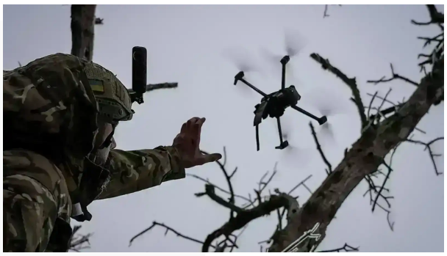
The Threat is Now…
Drone Swarms Pose New Threat to US Bases, Official Says
May 8, 2024
Notes:
NFL, members of Congress alarmed by drone incidents over packed sports stadiums (nbcnews.com)
We all watch and read the news – we see what’s happening not just around the world, but here in the US.
Drones are becoming increasingly accessible and affordable, with off-the-shelf models being adapted for military purposes. Non-state actors, such as the Houthis in Yemen, and state actors, like Russia in Ukraine, are using commercially available drones for surveillance and attack missions. These low-cost, easily modified drones can be armed with explosives or used as kamikaze weapons, presenting a serious threat.
The rise of swarm drone tactics, particularly demonstrated by China’s People’s Liberation Army, showcases the ability to deploy large numbers of drones simultaneously.
Modern drones are increasingly resistant to electronic warfare measures, such as jamming and spoofing, which were previously effective. These advancements make it imperative for the Marine Corps to develop new C-UAS technologies that combine electronic, kinetic, and autonomous solutions to address drones that evade traditional defenses.
The use of drones by adversaries such as Russia and the Houthis demonstrates how these systems can provide tactical advantages. Drones are being deployed for reconnaissance, artillery spotting, and direct attacks, including kamikaze missions targeting infrastructure and troops. This asymmetric use of drones forces militaries to rapidly develop C-UAS capabilities.

Slide 3
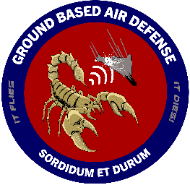
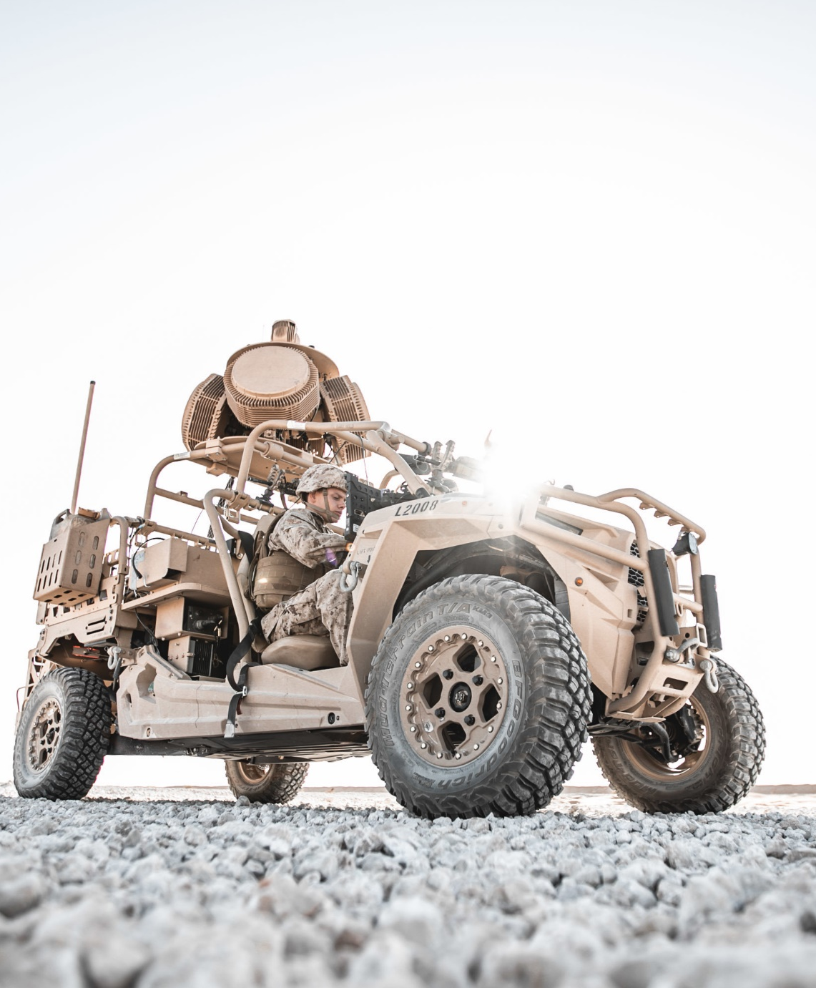
PM Ground Based Air Defense (PM GBAD)
April 2025
GBAD Mission
To field and sustain fully integrated ground to air defense solutions that detect, track, defend and defeat the enemies' air threat that seek to harm or kill Marines and other high value assets.
Vision
To deliver the most capable equipment, at the right time, that provides Marines an advantage over the enemy in combat effectiveness and lethality.
Notes:
We were established in 2018 so we’re still fairly young, but we’ve accomplished a lot.
Fielded mobile Counter-small Unmanned Air Systems (C-sUAS) to Marine Expeditionary Units (MEUs) as an Urgent Capability Acquisition (UCA)
Fielded fixed-site C-sUAS to select Marine Corps Installations as an UCA
Our Mission statement may say we field and sustain ground to air defense solutions, but we’re looking at a broad spectrum of unmanned system threats in all operational environments.
It is important to know what our counterparts are doing in other domains such as surface to water.

Slide 4
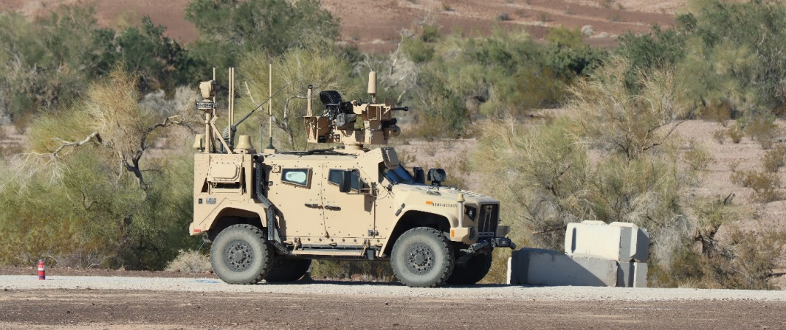
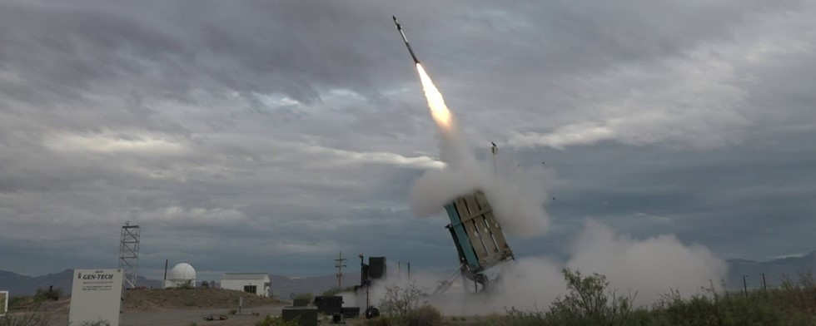
GBAD Capabilities
Fielding FY 2025
Marine Air Defense Integrated System (MADIS)
Ongoing – met Initial Operational Capability Dec 2024
Medium Range Intercept Capability (MRIC) counter cruise missile system
Residual Prototype fielding
Light-Marine Air Defense Integrated System (L-MADIS)
Replacing urgent capability with Program of Record (PoR)
Installation C-sUAS (I-CsUAS)
Replacing urgent capability with PoR – expanding capacity
Organic C-sUAS for “non-Air Defenders”
Notes:
Marine Air Defense Integrated System (MADIS)
Fielding MADIS to 3d MLR this December and we are beginning systems integration with the FRP vehicles.
As for what’s next (besides our fielding) we recently awarded a contract for the C-UAS Engagement System which will be integrated with MADIS and mounted onto a JLTV trailer.
Medium Range Intercept Capability (MRIC) counter cruise missile system
Recently completed the Quick Reaction Assessment
We were able to provide initial training to the Marines on the MRIC system, and conducted a live fire evolution in which the Marines demonstrated the ability to execute the full kill chain against highly relevant target sets.
Light-Marine Air Defense Integrated System (L-MADIS)
Recently completed System Verification Testing
L-MADIS is a key enabler for deterrence and is still on track to be fielding in FY25.
Installation C-sUAS (I-CsUAS)
Contract award expected FY25
All these systems will be fielded in FY25 – the program office is moving fast, accepting the risk, and getting capabilities to the warfighter.
We conduct continual product development, enhancement, and implementation – the work never stops.
The fight is coming, and our Marines will be ready.

Slide 5
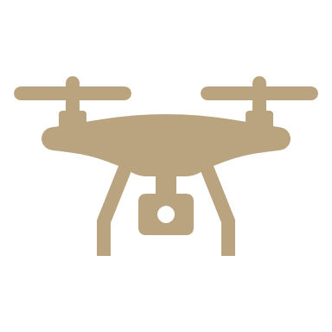
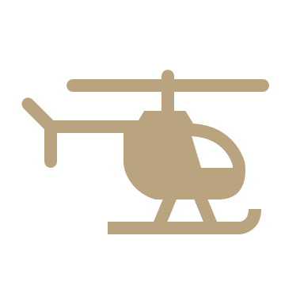
Focus Areas
Produce systems that:
Counter–Unmanned Air Systems (C-UAS) (Groups 1-3)
Counter Fixed-Wing and Rotary-Wing Aircraft (Groups 4 – 5)
Counter Cruise Missiles
PEO LS Capability Portfolio Manager for Ground Based Air Defense
Counter UXS across domains

Slide 6
Opportunities
Continual product development, enhancement, and implementation
Areas of focus:
Counter-Swarm
Munition agnostic launching system
Enhanced sensing solution - passive
Dismounted capabilities – sensing and defeat
Training support capabilities – virtual and live
Notes:
We recently completed an industry for Dismounted Counter-UAS systems to support ‘every’ Marine’s ability to conduct self defense threats against Groups 1 and 2 small UAS. We’re continuing to identify requirements and need industry’s help.

Slide 7
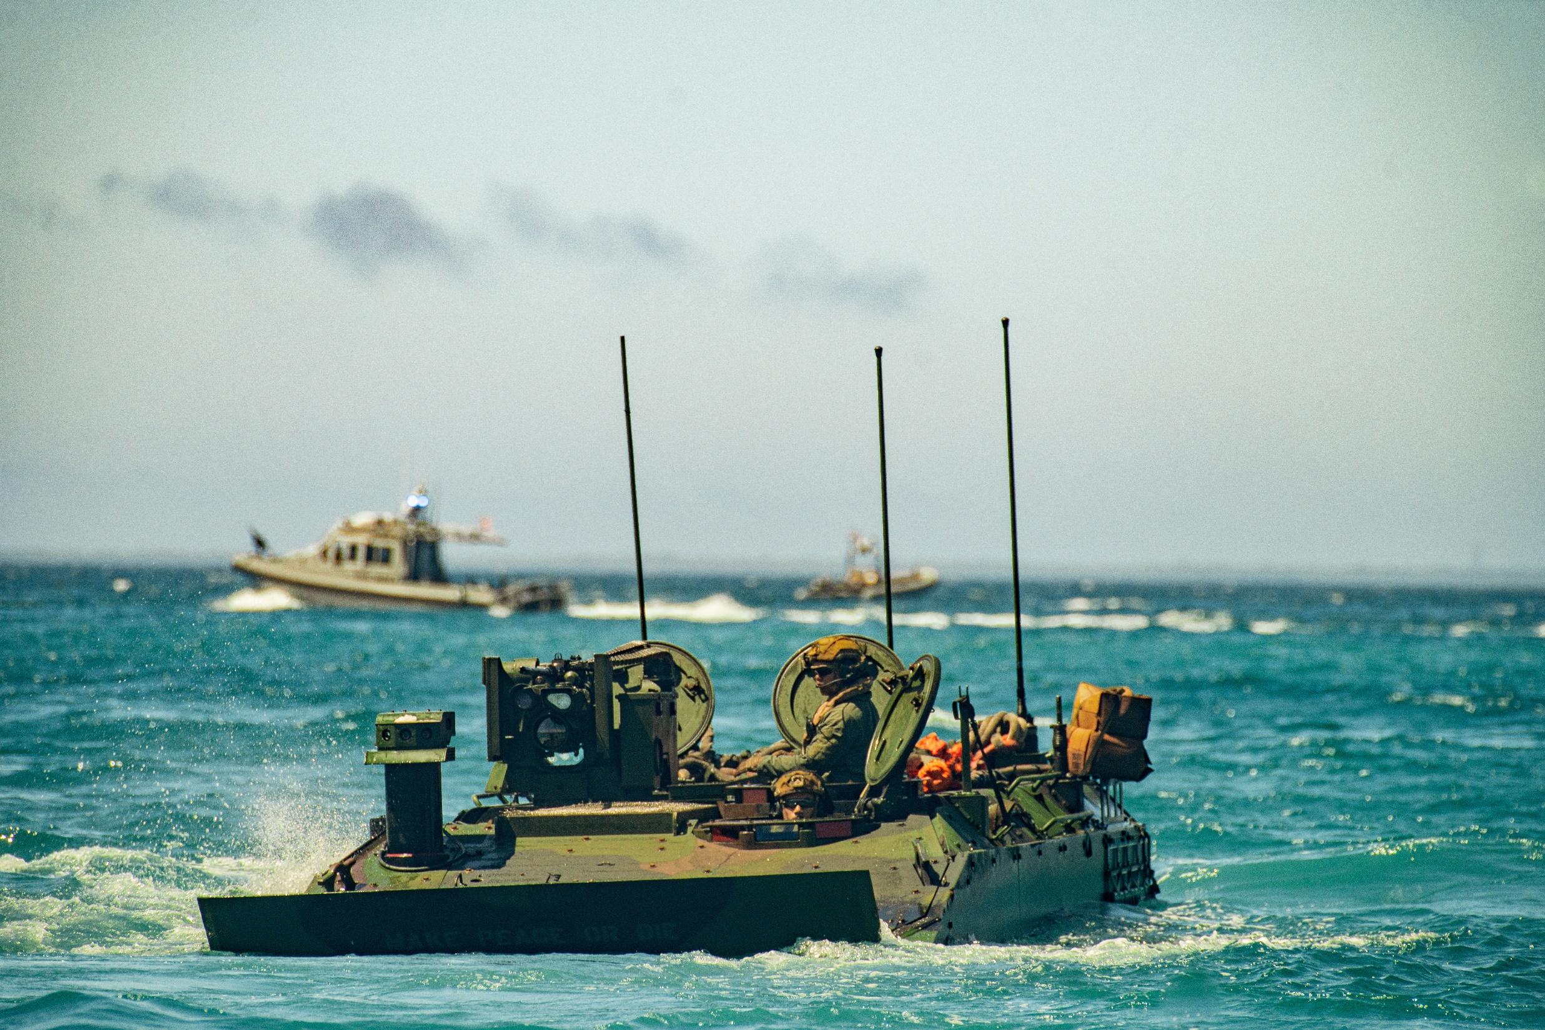
PEOLSPAO@usmc.mil
IT’S ALL ABOUT THE
WARFIGHTER

