Slide 1
Commercial Solutions for Classified (CSfC)
Major Kyle Britt, CSfC Team Lead
Cybersecurity and Operational Services (CaOS)
Digital & Enterprise Services

Slide 2
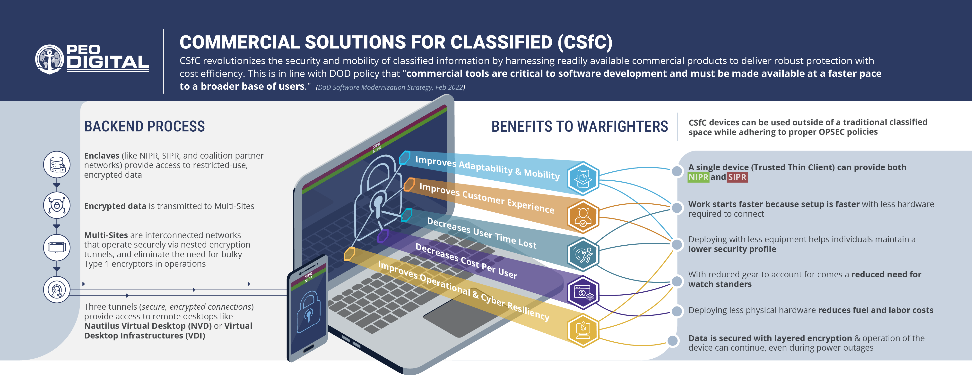

PROGRAM GOALS
Timeline is subject
to change
2025
2026
Install MARFORPAC Hub
Upgraded 5430s Distribution
Decommission & Reimage 5420s
MVP User
Onboarding Complete
Reimage 5430s to 3.1
Base to Base MS CP FSTR-CLJN
End Pathfinder Transition
Publish Tech Support Manual
Annual Security Review
Begin Transitioning KBAZ Hub to MCCOG
Receive NSA Re-Accreditation
CDSA Accreditation
Deploy 3rd Hub
Send Reaccreditation Package to NSA
Receive NSA
Re-Accreditation
End Field User Evaluation
Begin Transitioning Pathfinder users
CLJN Upgrade OS to 3.1
Post-MVP User Onboarding
AAO Onboarding Complete
Begin Transitioning CLJN Hub to MCCOG
Replace RDs in all CSfC EUDs
Install Okinawa Spoke
CDSA Accreditation
MAR
APR
MAY
JUN
JUL
AUG
SEP
OCT
NOV
DEC
JAN
FEB
MAR
APR
MAY
JUN
CHALLENGES
Challenges are loosely aligned to when they are expected to arise or be addressed
NSA CSfC EUD spec requirements
Garrison and tactical identified needs
Base Data Center infrastructure challenges
Alignment with Marine Corps movement to True Black
Movement away from traditional VDI
Future alignment with A9100
Out stripping resource availability
Installation upgrades are generally required for CSfC installs
Future alignment with A9100
Move to Azure Virtual Desktop (AVD)

Slide 3
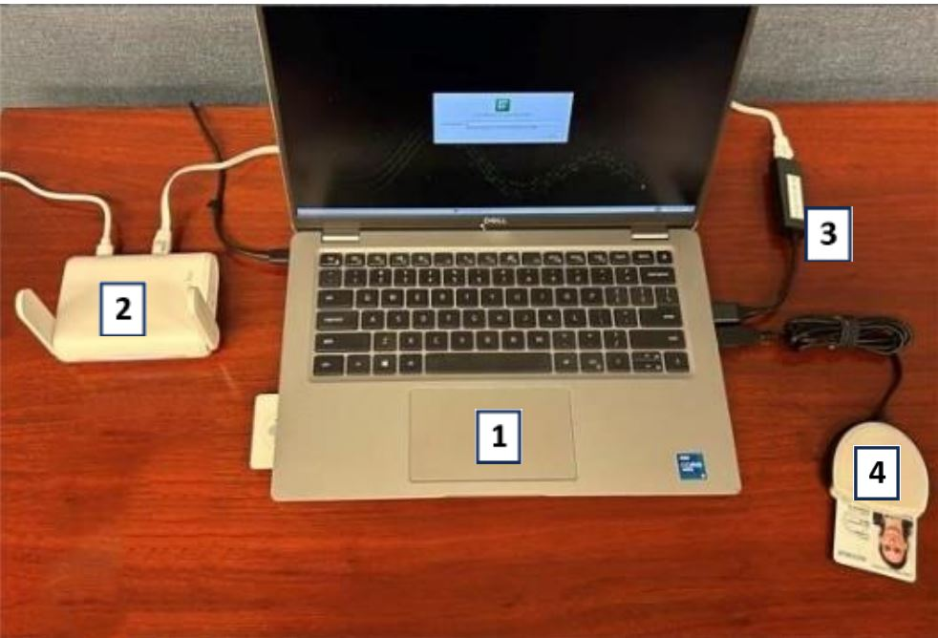
PEO Digital Caos: Demo
Demo the following capabilities
The ability to log on to SIPR/NIPR
Show NIPR/SIPR side by side
  Not able to copy and paste from SIPR to NIPR
Show Device Allocation
Show Enterprise Services (Teams Outlook…)
EUD Items list
1. Laptop/End User Device (EUD) w/ Power Cable
2. GL.iNet Retransmission Device (RD)
3. USB-to-RJ45 Ethernet Dongle
4. CAC Reader

Slide 4


