Slide 1
Wargaming capability (wgc) Program​ OVERVIEW
Col Wynndee Young, USMC
Program Manager
29 APRIL 2025

Slide 2
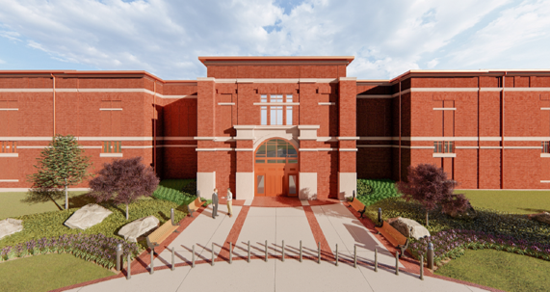
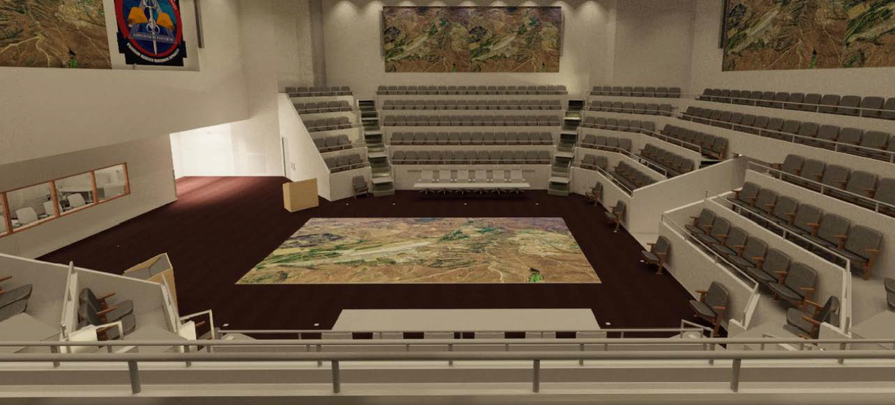
General Robert B. Neller Center for Wargaming & Analysis
Use Cases
Primary
Concept Development
Capability Development
Operational Decisions and Plans
Secondary
Science and Technology
Senior Leader Engagement
Training and Education
Facility Project Description
Largest 2 story secure facility within the National Capital Region
First Floor- Auditorium (300 persons), Meeting Rooms, Server Room, Administrative Offices
Second Floor- Wargaming Arenas, Executive Conference Rooms, Breakout Rooms
Access to UNCLAS, SECRET, TS, SAP, CAP, STO
Cloud and On-Premise Network Capability
Graphics/Video Production
Over 200 Permanent Staff
Project Schedule
Building Construction
May 2021 – Mar 2024
Building IT/AV Infrastructure Install
Nov 2023 – Mar 2025
Building IT/AV Infrastructure Authorization
Feb 2025 – Mar 2026
Initial Operational Capability
Jul 2027
The Neller Center provides senior leadership with a state-of-the-art venue to wargame within future operating environments at multiple classification levels to examine complex problems and support decision-making.

Slide 3
Overview
General Robert B. Neller Center for Wargaming and Analysis
Requirement: CMC directed the development of a “world class” modernized and flexible wargaming facility
Mission: Provide a significant enhancement to the USMC wargaming capability by providing a comprehensive digital environment to conduct the full spectrum of data enabled wargames that lead to defensible positions based on insights and analytical findings

Slide 4
Wargame Software Solution: PIONEER
Wargame Software Solution: PIONEER
Wargame Software Solution: PIONEER
PIONEER is the material solution under development to meet the requirements stipulated in the wargaming capabilities development document. Pioneer employs integrated means of data ingest, model federation, and in-stride analytics which synthesize the computational (machine) and cognitive (human) analyses to produce a comprehensive assessment of wargame outcomes.
Fully integrated wargaming/analytics process​
Cornerstone of PIONEER artificial intelligence architecture is the linguistic geometry language
Simulation engines integrated for specific warfighting domains​
Land, air, surface, subsurface, space, cyber
Unclassified, Secret, Top Secret, SAP, STO, and coalition​
Data ingestion from multiple authoritative sources​
Real-time adjudication; in-stride and post-game analytics​
Simulates millions of people and platforms in real-world conditions​
Defensible positions based on rigorous, deep quantitative analytics​

Slide 5
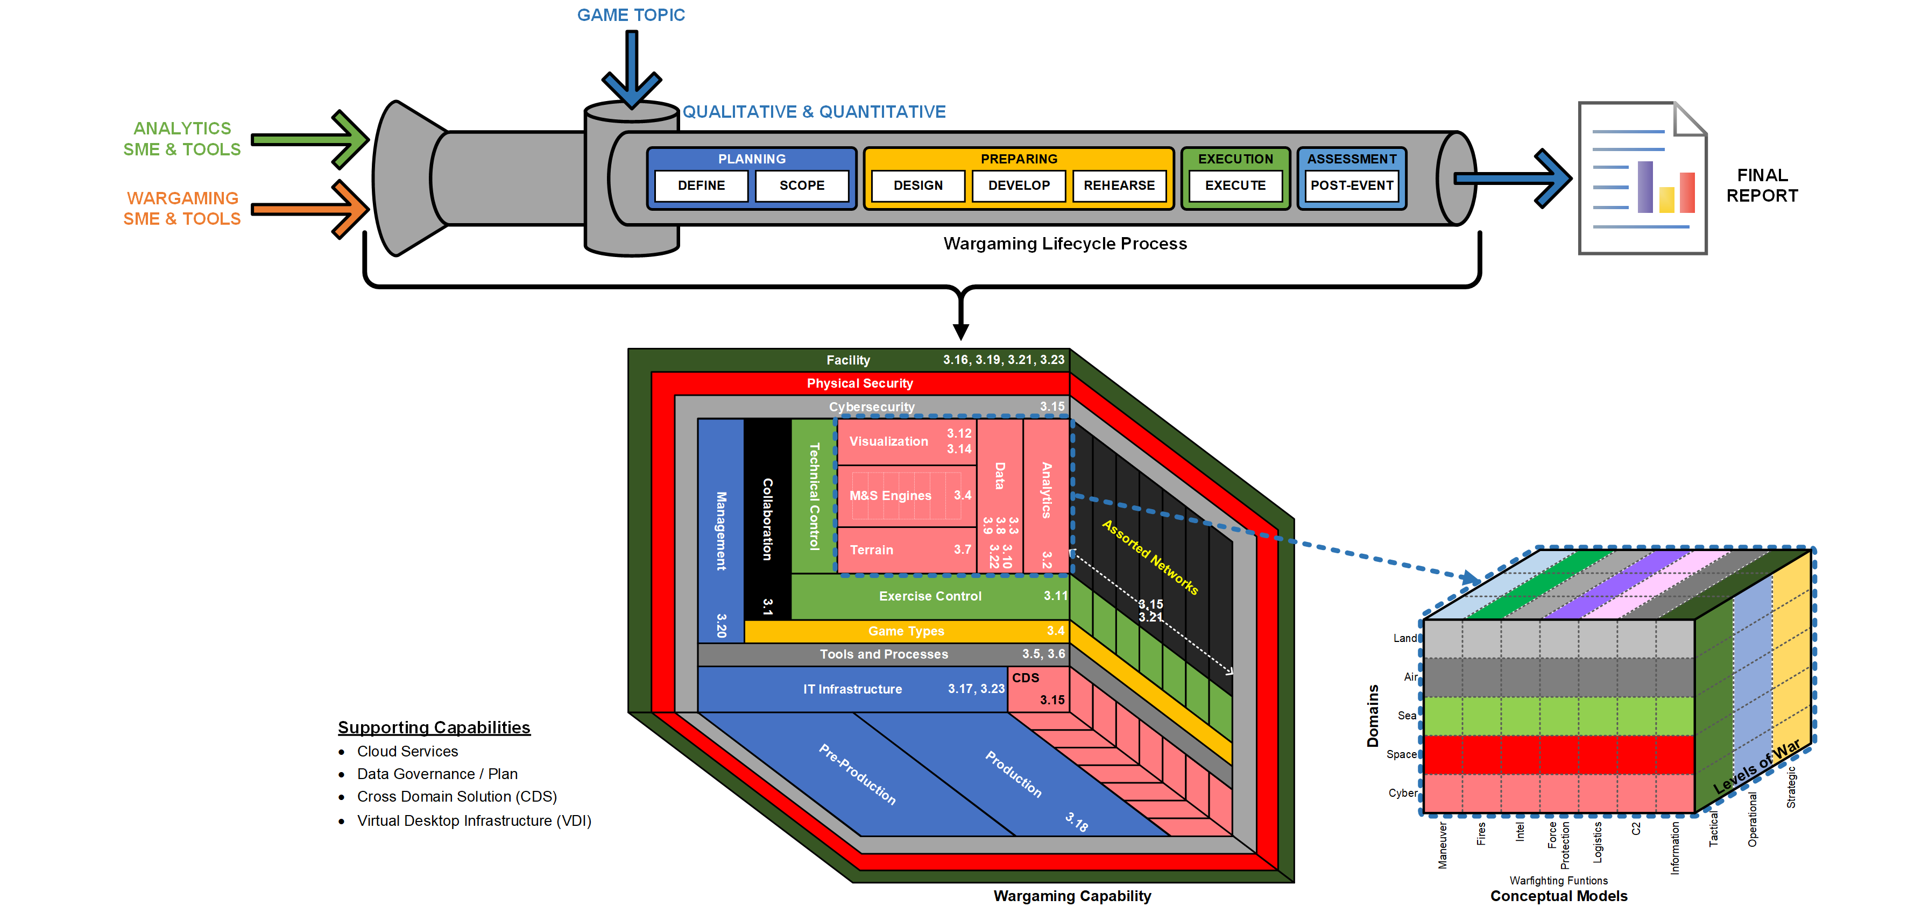
Wargaming Capability / Process

Slide 6
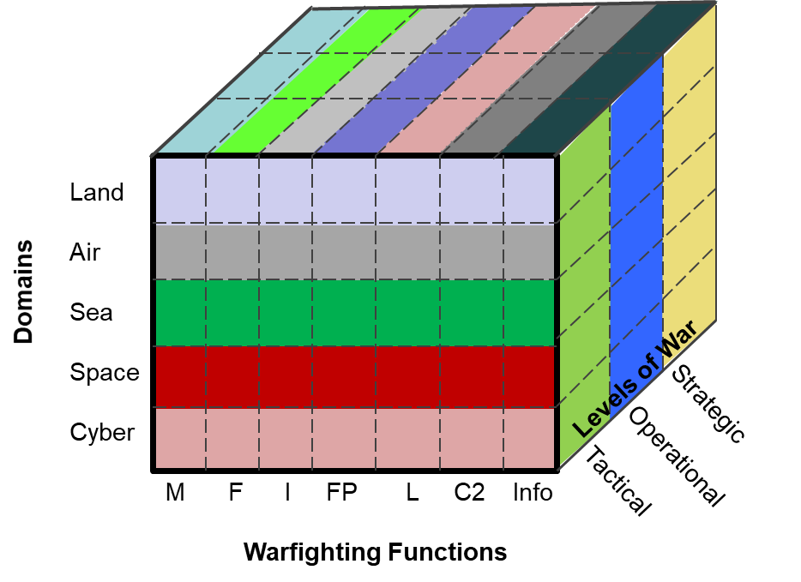
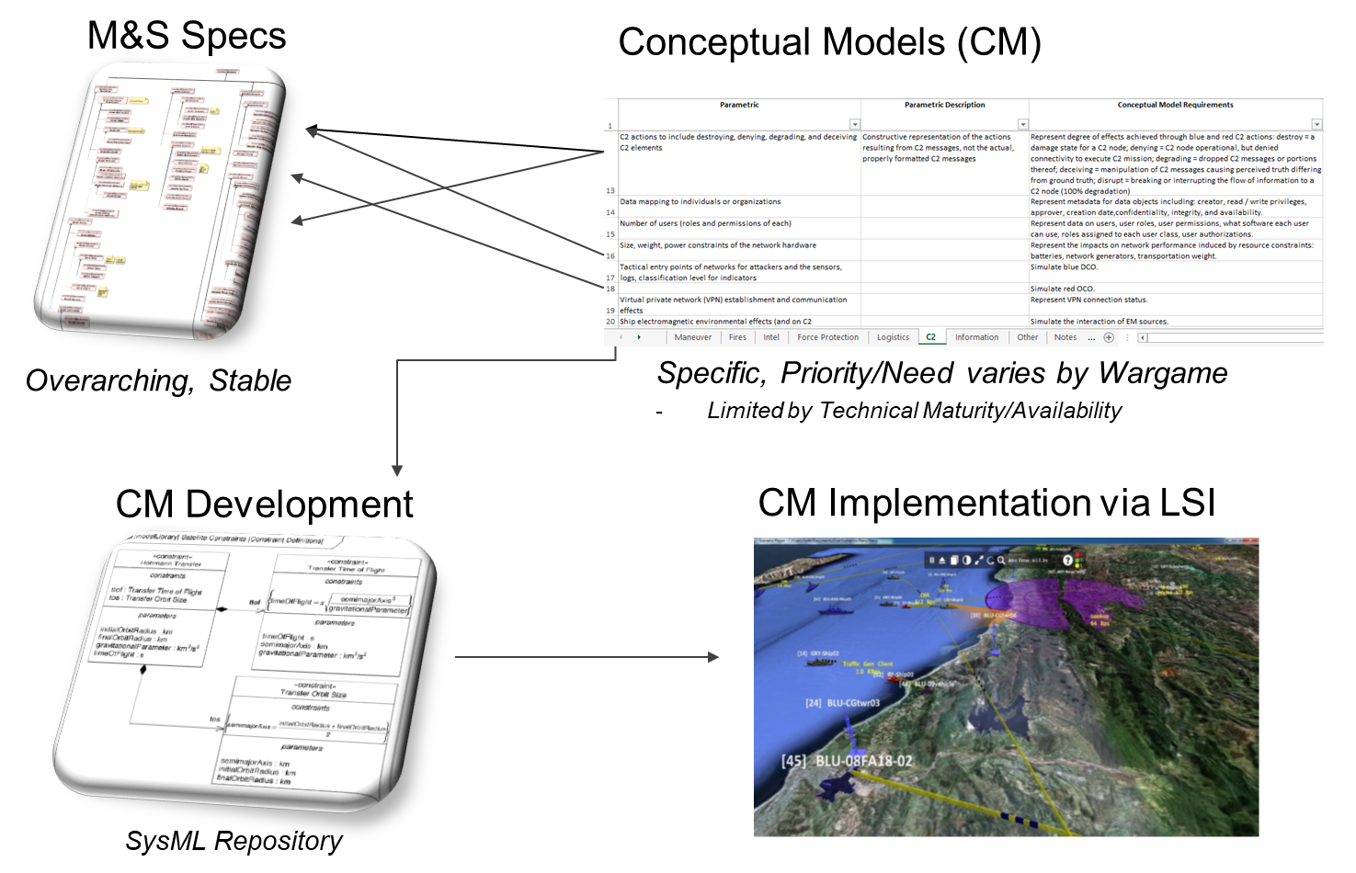
Pm Wgc: Areas where industry can help
Conceptual Model Requirements (CMRs)
Provide the overall Modeling & Simulation scope for the Wargaming Capability.
Span the warfighting domains, warfighting functions, and levels of war.
Determine the “input dials” and output metrics, along with corresponding algorithms to connect inputs to outputs.
Examples (2 out of 456 total)
Easy: Calculate changes in direction, altitude, and velocity of air entities.
Hard: Simulate changes to daily civilian location based on anomalous circumstances.
Each CMR…
Implies its own set of required data sources.
Must stand up to potential external technical scrutiny.
Identify adjacent services and/or industry partners to acquire Conceptual Models.
WF Functions
Maneuver
Fires
Intel
Force Protection
Logistics
C2
Information

Slide 7
Pm WGC opportunities
Current efforts (success)
Title | Dates
Small Business Innovation Research (SBIR) Phase 2 efforts: Develop conceptual models for civilian pattern of life. | FY25-26
Future opportunities
Title | Planned RFP
Neller Center Contractor Support Services (Classified Contract) | 4QFY25
Development and Evaluation Environment for Models (DEEM) Prize Challenge (Central Florida Tech Grove) | 3QFY25
PM WGC recompete for program office contractor support services | 3QFY25

