Slide 1
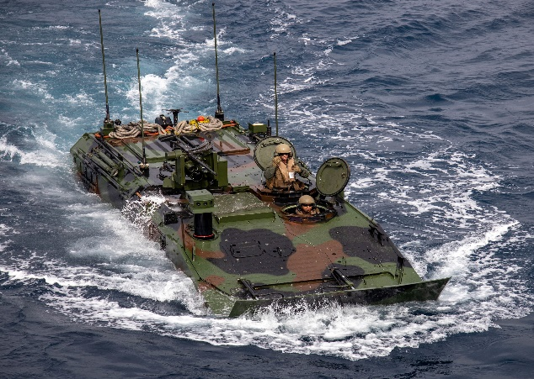
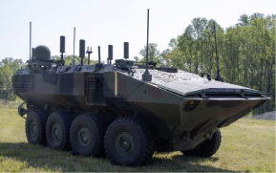
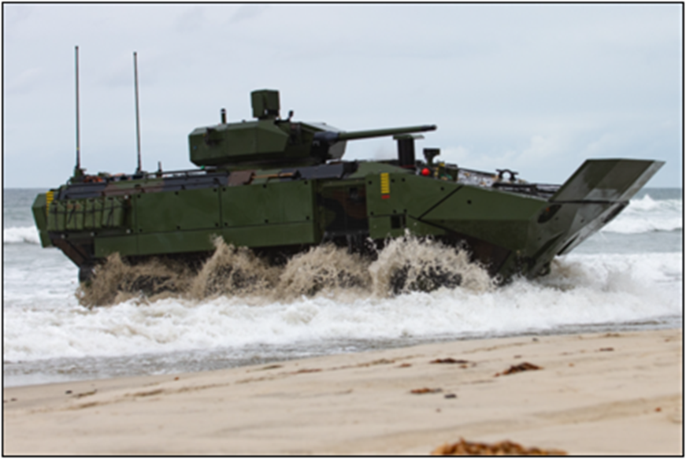
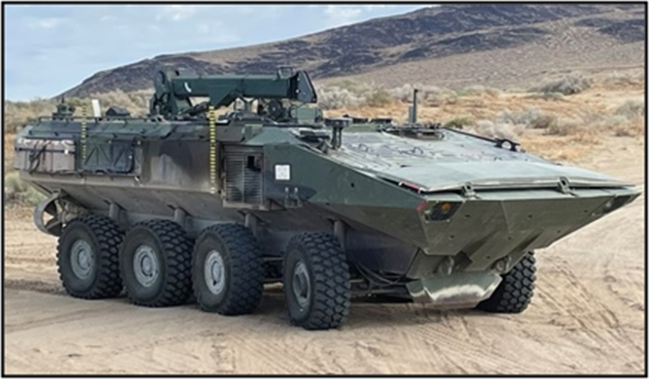
Amphibious Combat Vehicle (ACV) Modern Day Marine
ACV-P
Col Tim Hough
Program Manager
Advanced Amphibious Assault
29 April 25
ACV-C
ACV-30
ACV-R

Slide 3
Program Manager Advanced Amphibious Assault (PM AAA)
Mission
Program Description
Provide and support amphibious combat capabilities that enable our Marines to win.
Full replacement for the legacy AAV in the Marine Division’s Assault Amphibian Battalions
Maneuvers the surface assault elements of the landing force and their equipment from assault shipping during amphibious operations
Provides support to seven standing MEUs and Force Design
A Family of Vehicles program comprised of four variants
Program Status
Key Events & Focus Areas
Acquisition Phase: Production and Deployment Phase including design and development efforts
Capabilities:
Ship-to-Shore from 12 nm
Future variants include Command & Control, 30mm Cannon, and Recovery
Risks/Opportunities:
Lower than anticipated readiness and long lead times for spares negatively impacting readiness
13 Nov 20: Initial Operating Capability (IOC) – P Variant
8 Dec 20: Full Rate Production Decision
8 Oct 24: IOC – Command & Control Variant
4QFY24: Fielded Driver’s Training System
3QFY26: IOC – 30mm Cannon Variant
1QFY28: IOC – Repair & Recovery Variant
New Equipment Training Team (NETT) 2.0
Transition Training Unit (TTU)
Proficiency
Testing
DISTRIBUTION STATEMENT A. APPROVED FOR PUBLIC RELEASE. DISTRIBUTION IS UNLIMITED.

Slide 4
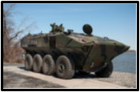
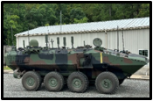
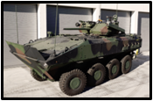
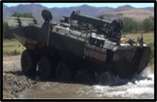
Amphibious Combat Vehicle FoV
ACV Variants
ACV-P (Personnel – IOC 2020)
Carries up to 13 embarked troops during amphibious operations from ship to shore and to inland objectives; has a remote weapon station that supports a MK-19 or 50 cal
ACV-C (Command – IOC 2024)
Provides a mechanized task force combat operations center; supports C2 of the ground-based assault forces in the MAGTF during ship to shore operations and to inland objectives. Carries up to 7 embarked battle staff and has a medium machine gun for vehicle defense.
ACV-30 (30mm Cannon – IOC 2026)
ACV-30 provides a medium caliber weapon system that is optimized towards infantry support but includes lethality up to the ability to destroy adversary armored vehicles. Supports dismounted maneuvers while embarking 8 infantry Marines.
ACV-R (Repair/Recovery – IOC 2027)
Recovers similar or smaller size vehicles and carries basic maintenance equipment to provide field support maintenance to vehicles in the field

Slide 5
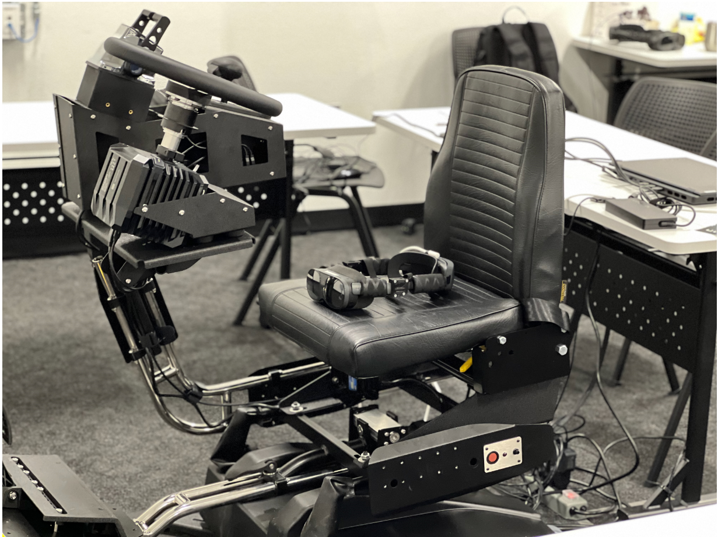
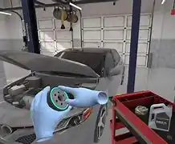
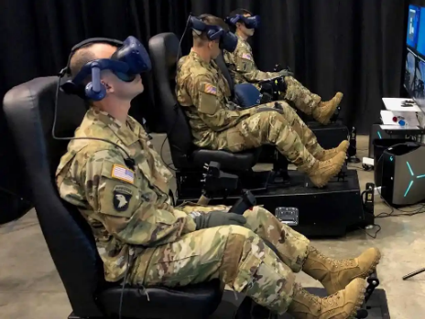
ACV Suite of Training Systems
NEW SLIDE
Electronic Classroom (EC)
Diagnostic Task Trainer
Part Task Trainer
Crew Gunnery Trainer (CGT)
ACV Driver’s Training System (DTS)
Electronic Classroom – Operator & Maintenance Trainer
ACV Driver’s Training System (DTS)
Diagnostic Task Trainer
Crew Gunnery Trainer (CGT)

Slide 6
PM AAA Modernization Plan
Areas where industry can assist PM AAA efforts
Shoot
Increase lethality support to infantry with increased accuracy for call-for-fire missions
Improved fire control system autonomous tracking algorithm to improve target tracking and engagement performance
Increased sensing and processing for threat awareness, target prioritization, and engagement
Move
Water propulsion and control – provide directional thrust control to increase water mode maneuverability, responsiveness, and speed
Increase driver proficiency in surf zone environments
Driver aides and crew situational awareness for both land and water operations – increase vehicle safety in challenging terrain
Increased automation of driver tasks
Communicate
Intercom capability improvements for the crew
Carry
Environmental control system improvement
Noise reduction
Protect
Counter UAS and overhead protection
DISTRIBUTION STATEMENT A. APPROVED FOR PUBLIC RELEASE. DISTRIBUTION IS UNLIMITED.
DISTRIBUTION STATEMENT A. APPROVED FOR PUBLIC RELEASE. DISTRIBUTION IS UNLIMITED.

Slide 7
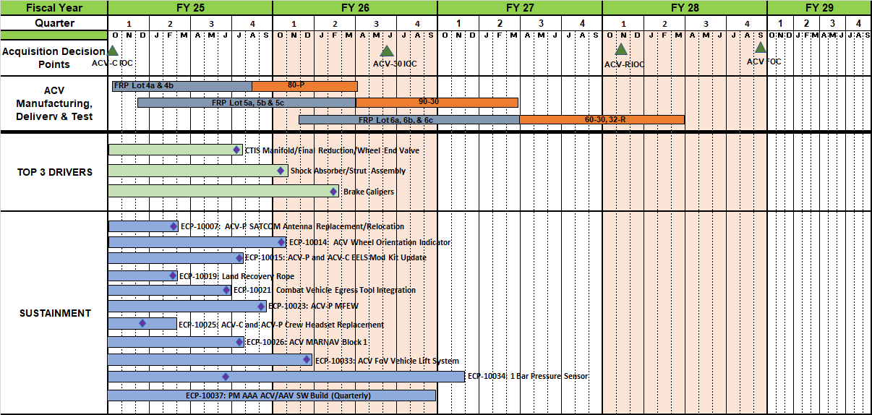
Sustainment & Readiness Schedule Sustainment (w/ Top 3 Drivers)
NEW SLIDE
ECP Approval
* as of 29 Jan 2025

Slide 8
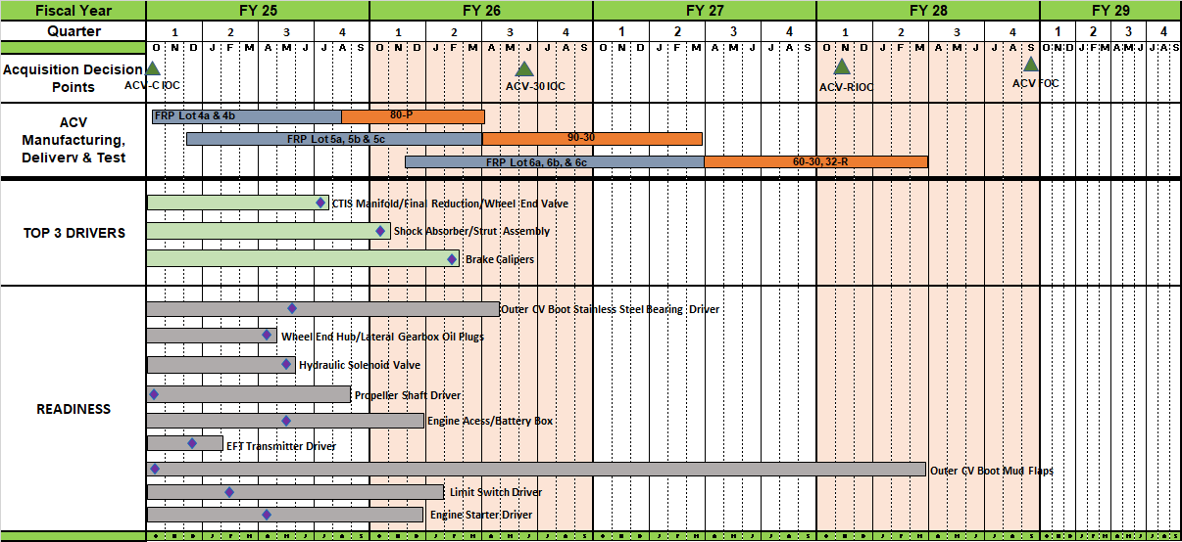
Sustainment & Readiness Schedule Readiness (w/ Top 3 Drivers)
NEW SLIDE
ECP Approval
* as of 29 Jan 2025

Slide 9
Sustainment & Readiness Schedule Other/Modernization (w/Top 3 Drivers)
NEW SLIDE
ECP Approval
* as of 29 Jan 2025

Slide 10
PM AAA Opportunities
Title | Planned RFP
New Equipment Training (recompete via Navy SeaPort-NXG) | 2QFY25
ACV Suite of Training Systems including maintenance trainers, operator trainers, digital classrooms, and an increment 2 of the driver training system | 1QFY25
AAV FoV FMS support, spare parts / support equipment, and new equipment training | 1QFY25
Initial Modernization Strategy developed
Develop and field solutions for readiness drivers, improve performance, leverage advancing technology, and counter evolving threat that range across all ACV essential functions
Prioritization and project scoping underway
FY24&25 – Anticipate focused RFI’s supporting market surveys on specific items and capabilities that range across all ACV essential functions
Define acquisition approach informed by RFI responses and S&T developments leading to initial RFPs in FY26
Development and production starting in FY27
DISTRIBUTION STATEMENT A. APPROVED FOR PUBLIC RELEASE. DISTRIBUTION IS UNLIMITED.

Slide 11
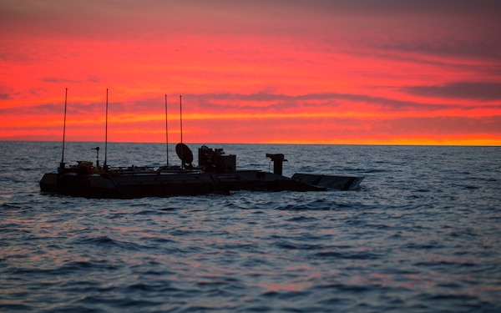
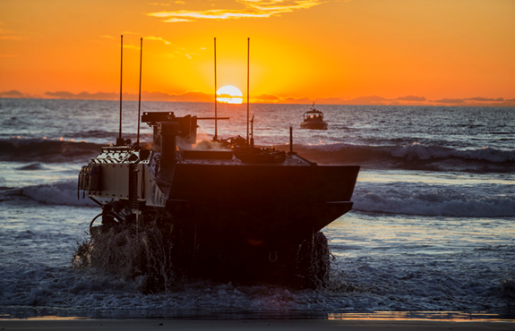
Questions
DISTRIBUTION STATEMENT A. APPROVED FOR PUBLIC RELEASE. DISTRIBUTION IS UNLIMITED.

