Slide 1
Logistics Integrated Information Solutions Marine Corps
Margaret “Peggy” Toth
Program Manager
Logistics Integrated Information Solutions – Marine Corps

Slide 2
Portfolio Overview

Slide 3
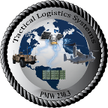
Focus of Effort
Delivering Capabilities & Services
Moving to Data-Centric Architecture
DC I&L
Advocate
DC CD&I
Requirements
Fleet User
Feedback
DC I
Cyber Requirements
LI2S-MC System Architecture
Funding ~$185M
Model Based Systems Engineering
Data & Interfaces
Traceable - Gaps and Overlaps (JCAs, BEA, Capabilities)
Visualize Analytics
Data Flow
Recommend Optimization Solutions
3 Product
Teams
29 Agile Product Lanes
Analyze &
Recommend
Develop Portfolio Architecture
Optimization
Naval Intergraded Modeling Environment (NIME)
13 DBS & 4
Joint Programs
Monthly deliveries
Phase I - Initial system design changes
Phase II - Technical Roadmap
Phase III - Continuous Optimization
130K Users
Optimized Portfolio

Slide 4
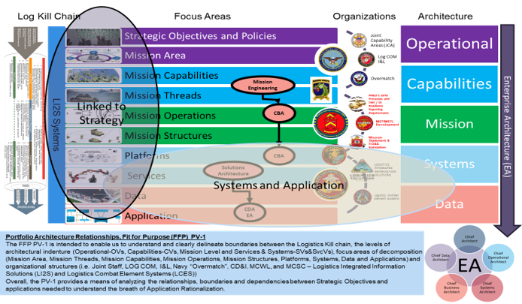
Alignment to MAGTF Logistics Support

Slide 5
Outcomes
Transition from system- to capability-centric planning and delivery
Fully integrated requirements and delivery approach
Enhanced flexibility to meet evolving operational needs
Enhanced opportunities for technology insertion
Improved cost efficiencies and budget planning

