Slide 1
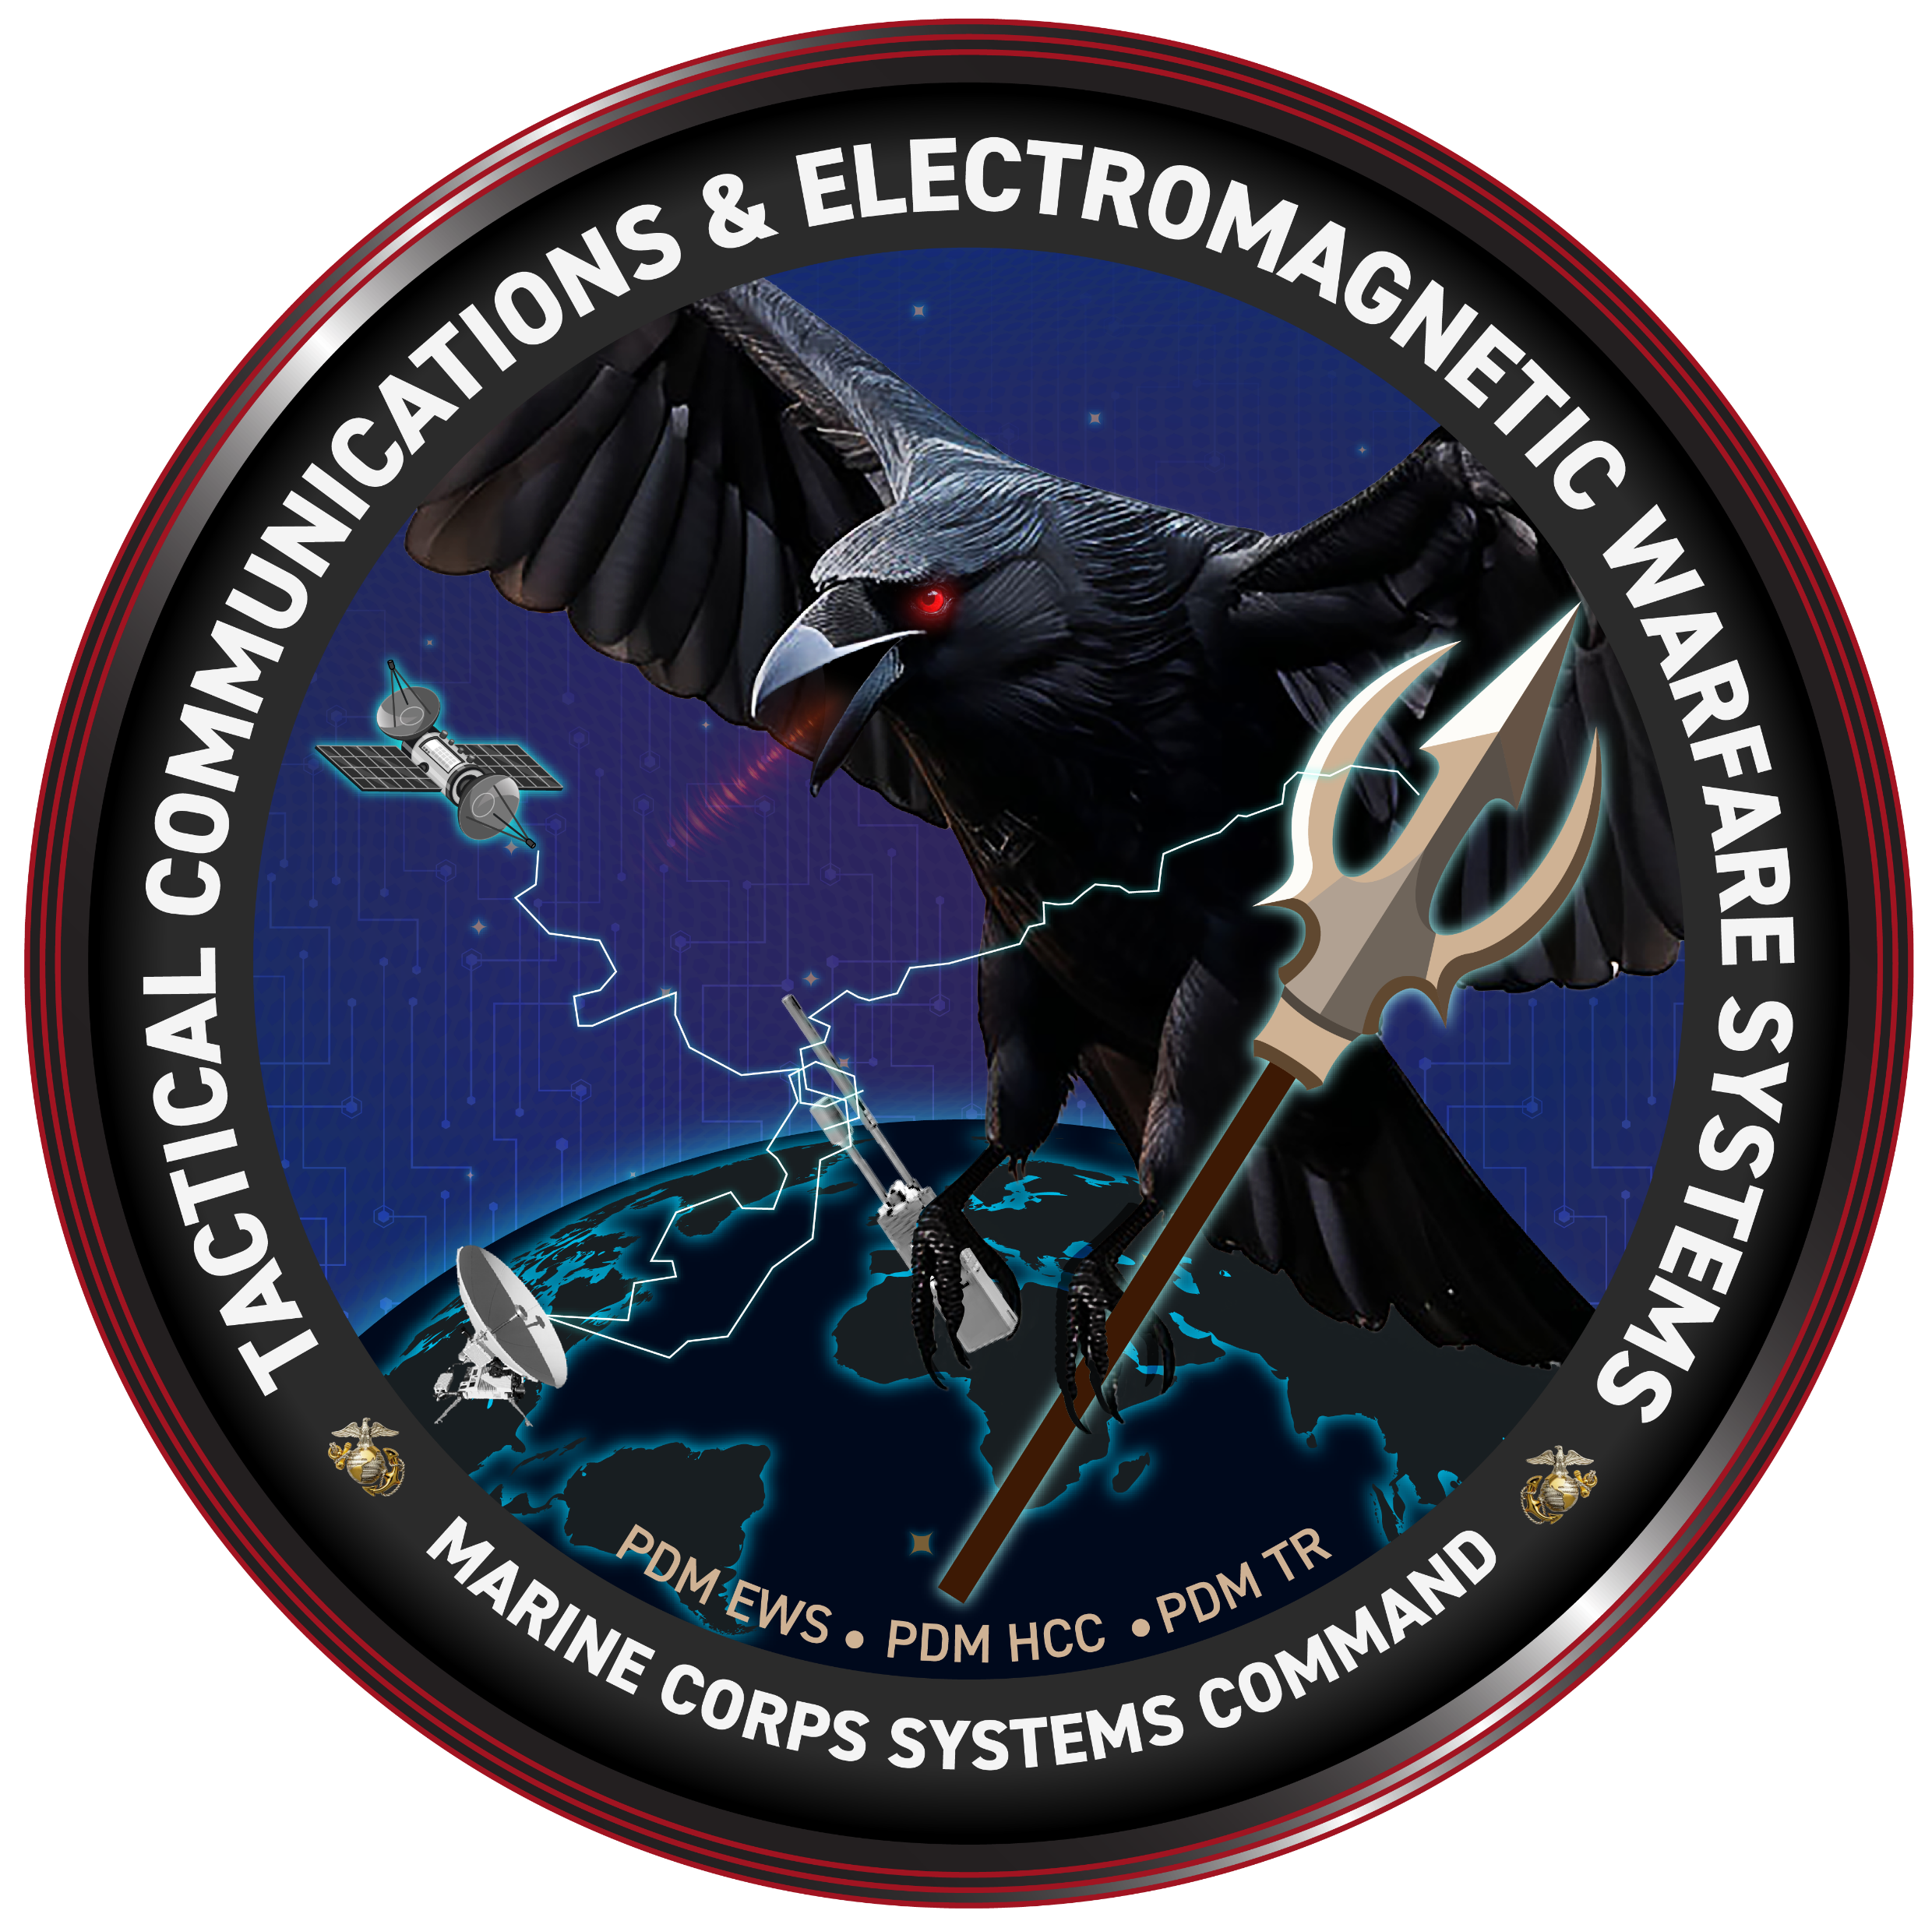
The Future of Electromagnetic Spectrum Hardware
PM TCE
Mr. John Mithun
Controlled by: USMC
Controlled by: MCSC, PM TCE
CUI Category: PROURE, BUDG, FEDCON
Limited Dissemination Control: FEDCON
POC: Mr. Mathew Sergent, matthew.r.sergent.civ@usmc.mil

Slide 2
Who are we?
Tactical Communications and Electromagnetic Warfare Systems (TCE)
Program Manager (PM) (PMM 160)
John Mithun
Deputy Program Manager (DPM)
Frank Mello
APM-ENG
APM-TEST
APM CT
APM-FM
APM-COST
APM-PM
APM-LOG
Tactical Radios (TR)
Product Manager (PdM)
(PMM 161)
High-Capacity Communications (HCC)
Product Manager (PdM)
(PMM 162)
Electromagnetic Warfare Systems (EWS)
Product Manager (PdM)
(PMM 163)
Ground Radios
Team Lead (TL)
(PMM 161.1)
Communications &
Security (CAS)
Team Lead (TL)
(PMM161.2)
Wideband-SATCOM
(W-SATCOM)
Team Lead (TL)
(PMM 162.1)
Terrestrial High-Capacity
Communications (THC2)
Team Lead (TL)
(PMM 162.2)
Electromagnetic
Effects (EME)
Team Lead (TL)
(PMM 163.1)
Psychological/Civil
Info Systems (P/CIS)
Team Lead (TL)
(PMM 163.2)
Position, Navigation,
& Timing (PNT)
Team Lead (TL)
(PMM 163.3)
HFR
HFR II
MBR
MBR II
MCR FoS
Waveforms
HF Storm (future)
MARA/MOSA (future)
COMSEC
GL-16
HH Link 16
IISR
JCSE
SCC
THHR
THHR (V) 3
THHR-SV A
THHR Maritime
IISR Replacement (future)
GBS
MCWS FOS
SCAR
VSAT FOS
AN/TRC-170A
EAGL
LRS
NGT
SMART-T
TEAMS I/II
MSAT (future)
CVRJ
MEGFoS – Dis
MEGFoS – Mtd
MEGFos-TP (future)
MFEW – Dis
MFEW – Mtd
DMS
FABS
MARCIMS
MISO FOS
TIPS NG
DAGR
MARNAV
MGUE Inc II
Last updated: 31 MAR 2025

Slide 3
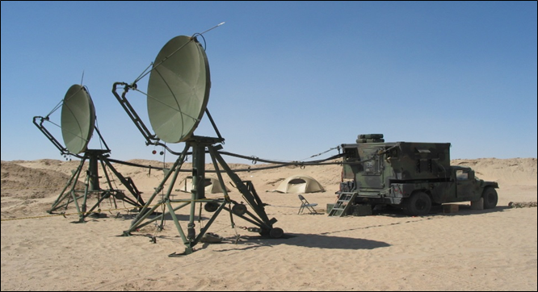
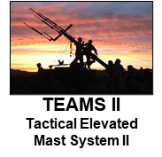
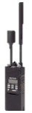

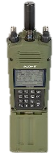
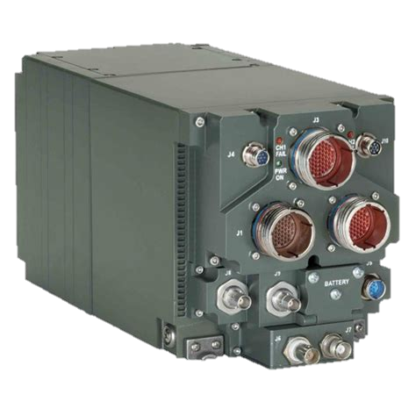


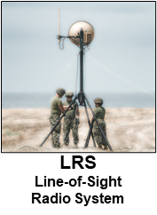
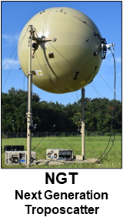
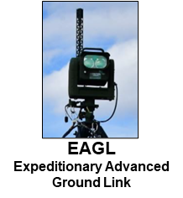




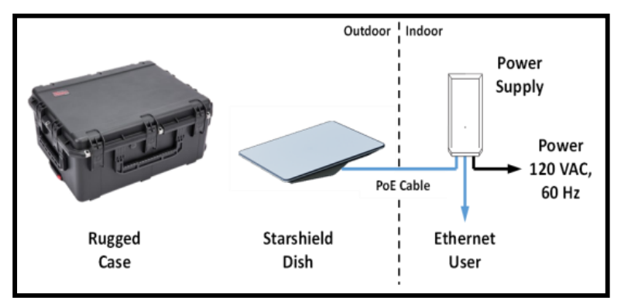

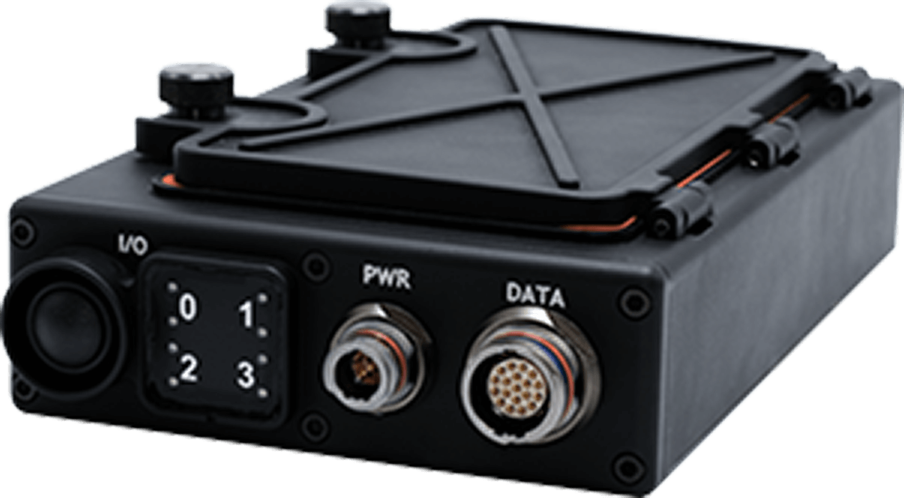

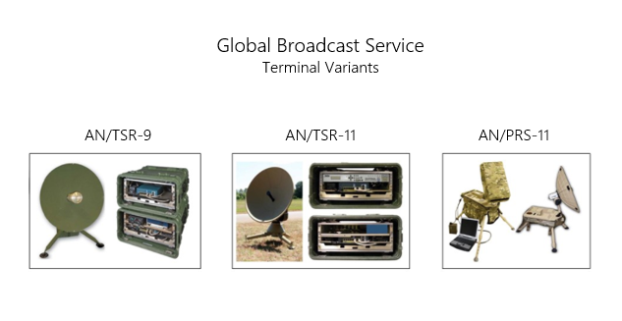
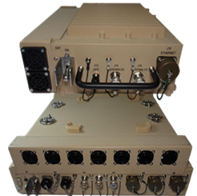
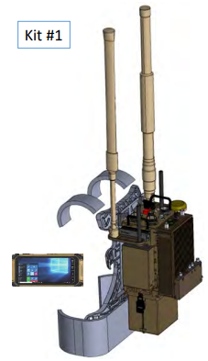
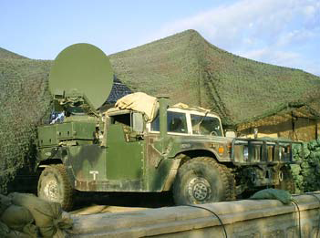
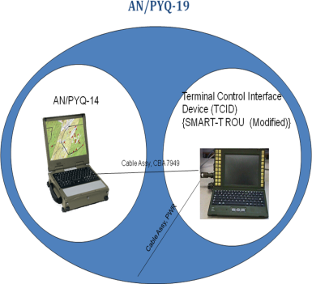
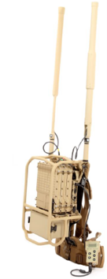
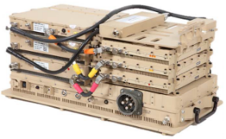
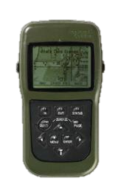
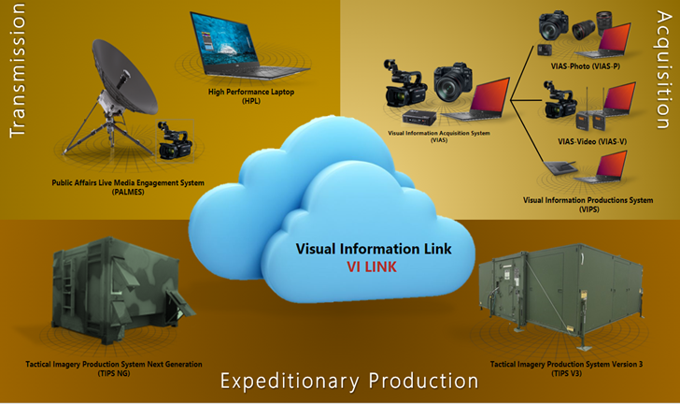
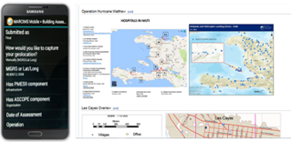
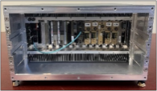


Where are we today?
AN/TRC-170
Ground Link-16 System of Systems
THHR (V) 3
MCR FoS
Product Manager
High-Capacity
Communications
(HCC)
Product Manager
Ground Radios
(GR)
HFR II
MBR II
MCWS L/H
SCAR
COMSEC
Product Manager Electromagnetic Warfare Systems (EWS)
SCC
GBS
SMART-T
FABS
MVPA
MEGFoS Dismounted Backpack
DAGR
DMS
MARCIMS
MARNAV
Modi II
MEGFoS Team Portable
04162025
MGUE Inc 2

Slide 4
Where are we going?
CMOSS/SOSA compliance is a must for end state
EWOK Software
MORA/MOSA Hardware/Software

Slide 5
Tools
Partnerships – Long term partners for the duration of the need
GO FASTER!! – Operating within the constraints of the law, understanding risks, and where they are acceptable
OTA – Opportunities for teaming and development
MTA – Opportunities for developing bleeding edge technology
Procurement for Experimental Phase
  Gets capability out, but the risks should be known
Collaborations with Industry and Collegiate partners – The needs will not be met if you don’t know what I do
Plug and play events – You have something that meets my need, lets test it and see

Slide 6
Why is it Important
Best Possible Product
Acquisition Speed
Delivering at the speed of Need
Longevity
DoD determines the hardware
solution and interface controls
Relevance
Pacing the Threat
Real time need to anticipate
the threat and mitigate it in real time
Cost
Long term leasing agreement
between us and the vendor?
Integration
Of capability and on platforms
Capability in the box
Modularity
Battlefield Commander can
Configure based on NEED
Partnerships with multiple vendors
Long term agreements with capability providers
to continue to deliver capability at the speed of need

Slide 7
What do we need?
An Industry Partner who can integrate the capabilities and ensure the product continues be non-proprietary regarding both the hardware and the software.

Slide 8
Questions?
John Mithun
PM TCE
John.Mithun@usmc.mil

