Slide 1
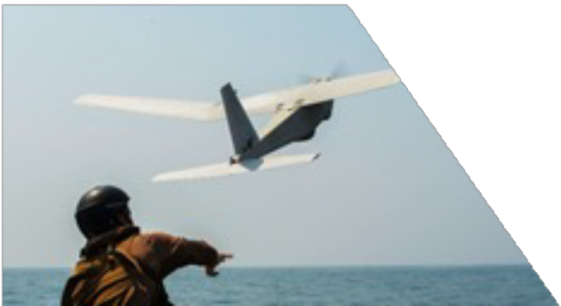
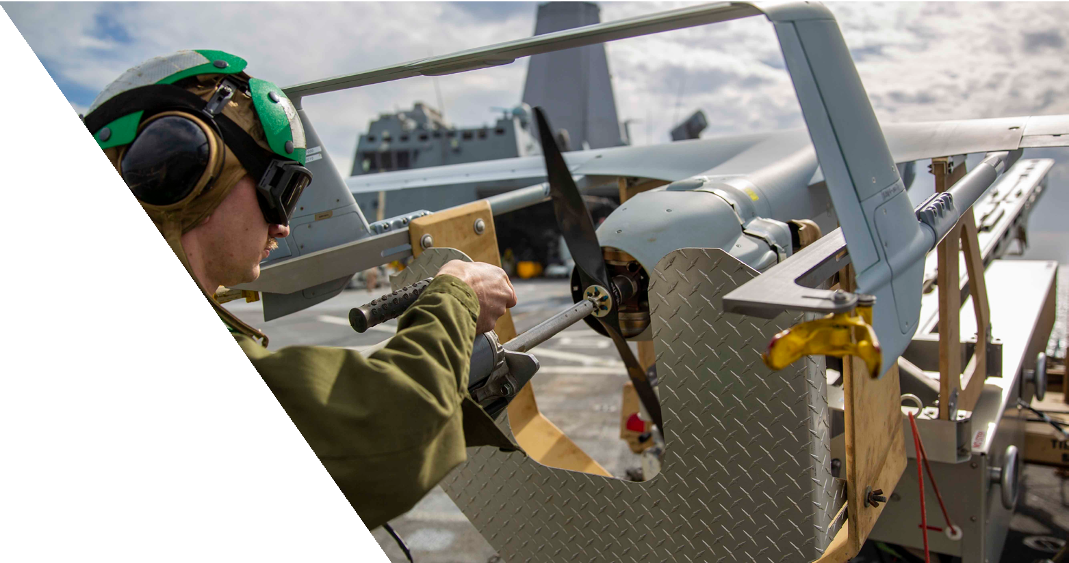
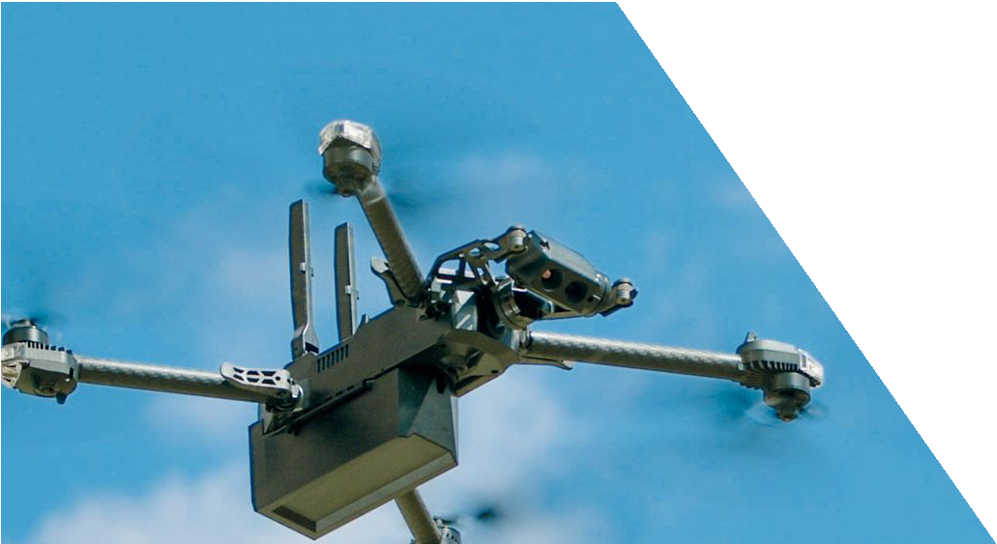
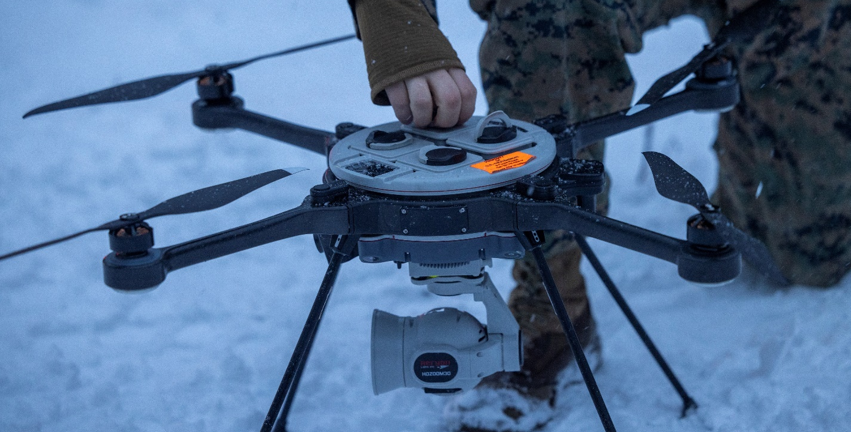
Navy & Marine Corps Small Tactical Unmanned Aircraft Systems​
Modern Day Marine
April 29, 2025
NAVAIR Public Release SPR-2024-0597. Distribution Statement A - "Approved for public release; distribution is unlimited"

Slide 2
VIDEO

Slide 3
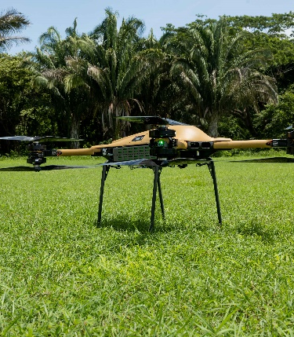
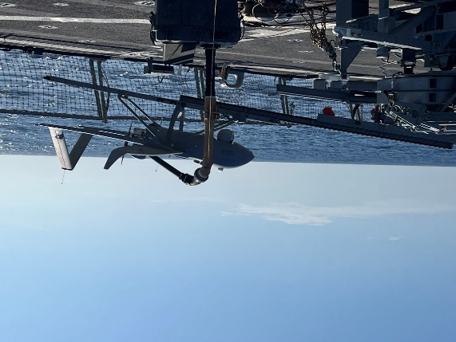
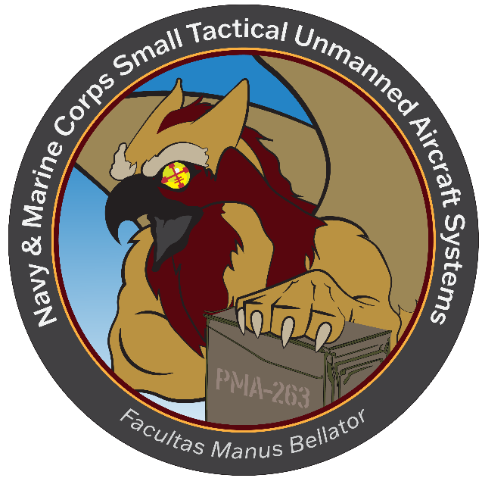
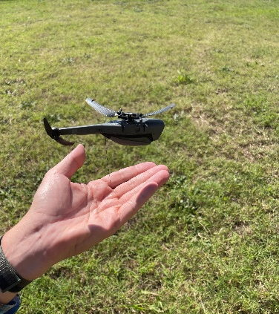
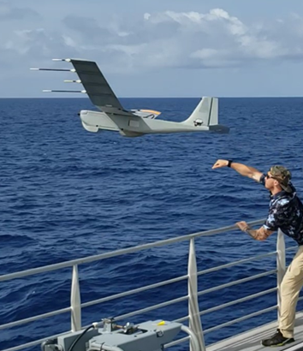
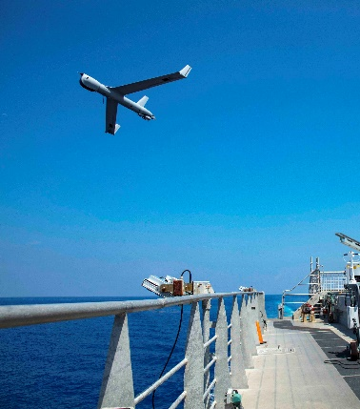
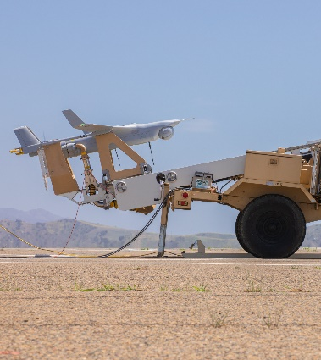
PMA-263 Portfolio
Unmanned Logistics
Small and Medium tactical resupply efforts
Emerging cargo requirements
Contested logistics focused
Payloads
Bloodhound – SIGINT/ES
Common Sensor Workstation – tactical data processing
Comms Relay – AN/PRC-163 radio/antennae, Transceiver
Dead Center – AI/ML processing
Mod Payload A-kit – hardware, brackets, cables for mounting
MODSAR – NSP-2 radar for SAR and MTI capabilities
TIPS – cross domain solution for full motion video
ViDAR – Wide area surveillance sensor
ISR Services
Ship and Land based requirements
Emerging Requirements
Maritime Targeting
Family of Small UAS
Short, Medium and Long Range Tactical
Reconnaissance, Surveillance, and Target Acquisition
Foreign Military Sales

Slide 4
Training and Logistics Support Activities
Navy TALSA-E
NSW Schoolhouse
JEB Little Creek Fort Story, VA
NSW
NECC
I MEF
TALSA-29 Palms
MCB 29 Palms, CA
TALSA ICP
Camarillo, CA
Depot
II MEF
I MEF
NSW
NECC
TALSA-E
MCB Lejeune, NC
TALSA-W
NAVY TALSA-W
MCB Pendelton, CA
NSW
NECC
Navy TALSA-E Annex
In development
Gulfport, MS
III MEF
TALSA-PAC
MCB Kaneohe Bay, HI
Various locations
Attend TALSA-E/W Sites
Or Mobile Training Teams
Reserves

Slide 5
Unmanned Logistics Systems - Air
“Every day we ask, ‘How can we keep trucks off the road and save on resources?’ We’re using the system as much as possible.”
Voice of the Customer
NAVAIR Public Release SPR-2024-0597. Distribution Statement A - "Approved for public release; distribution is unlimited"

Slide 6
Why Services?
COCO
GOCO
GOGO
To satisfy Warfighter needs, all contracting options are explored and utilized to inform future Organic material solutions.
Land Based: CENTCOM
Sea Based: 4th, 5th, 6th, and 7th Fleet
Expeditionary Tactical UAS

Slide 7
Warfighter Needs
Group 5
Group 2
Group 1
Payloads
Endurance
Airspeed
Size
Weight
Cost
Power
Advanced unmanned technology requires equally modern solutions for improving battlefield performance.

Slide 8
Innovation and Adoption
Improved AI
Common Architecture
Additive Manufacturing
Contested Operations
Pursuing innovative ways to expedite new capability to the Warfighter

Slide 9
Questions?
NAVAIR Public Release SPR-2024-0597. Distribution Statement A - "Approved for public release; distribution is unlimited"

