Slide 1
Leveraging Uncrewed Systems Across The Evolving Battlespace
LtCol. Eric DuChene
MUX/MALE MQ-9A Combat Capabilities,
L1 IPT Lead
NAVAIR SPR 2025-0208 is approved for public release; distribution is unlimited“
POC: PMA-266; PMA-266_Operations@us.navy.mil

Slide 2
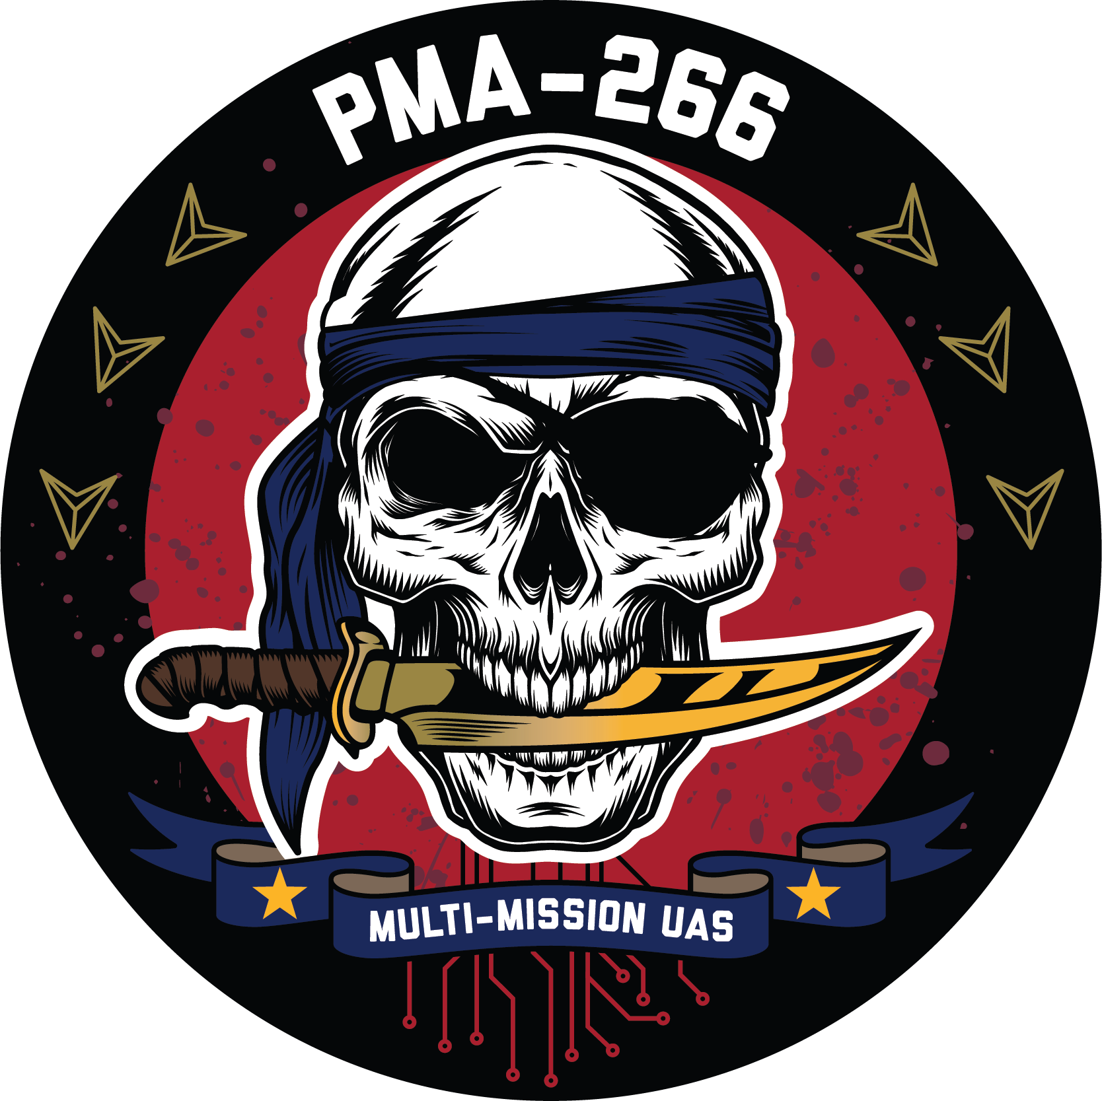
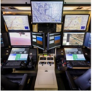
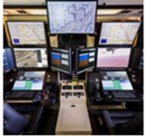
PORTFOLIO CHART
MQ-9A Block 5 air vehicles,
Block 30 Ground Control Stations
Mission systems: SkyTower I Pods
Family of sensors
. Capability/Pods can be fielded independently
. Capabilities/Pods will be integrated onto air vehicle as Class 1 ECPs
. Plan leverages existing technology and partnerships
. Capabilities Include:
. Sky Tower II (STII), Electronic Warfare (EW) Pod,
Detect and Avoid System (DAAS), and Maritime Domain Awareness
(MDA),PLEO, Smart Sensor
Sky Tower I Pod
Block 30
Ground Control Station
Secure MCE
NAVAIR Public Release SPR-2025-0208. Distribution Statement A - "Approved for public release; distribution is unlimited.”

Slide 3
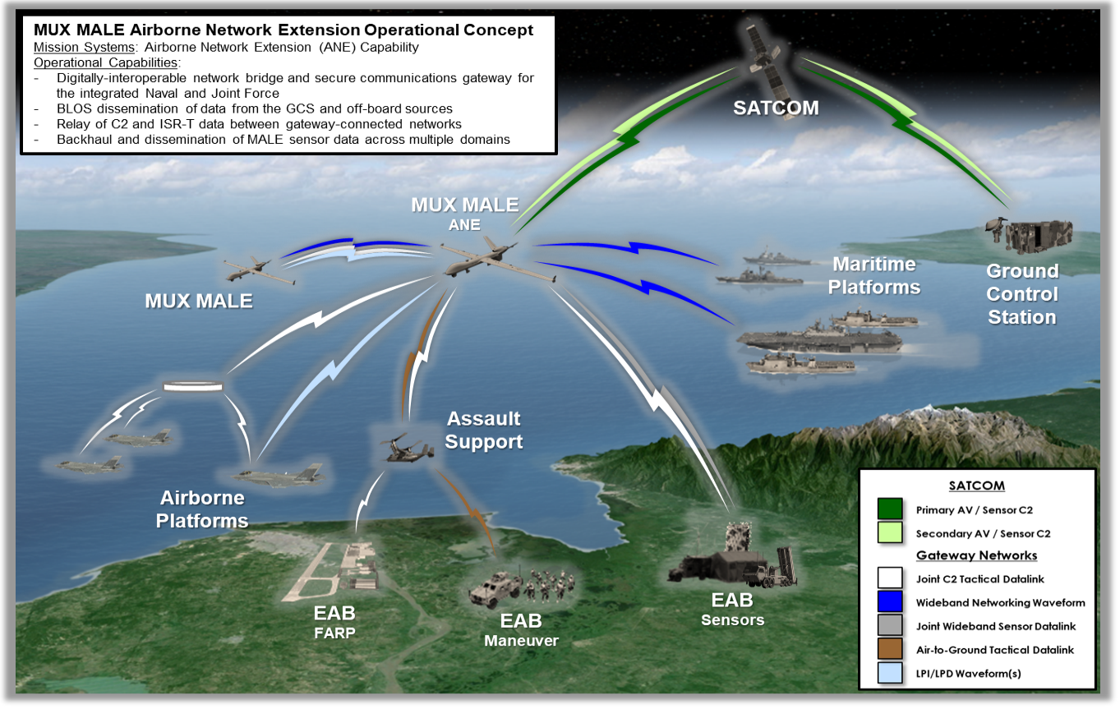
MUX/MALE - AIRBORNE NETWORK EXTENSION
Network connectivity upgrade to support emerging Marine Corps, Naval, and Joint Force operational objectives across ground, air, and maritime domains.
Securely disseminates mission critical data across gateway-connected network and provides numerous resilient paths for these data exchanges.
Provides mission-critical data exchanges within denied/contested environments.
NAVAIR Public Release SPR-2025-0208. Distribution Statement A - "Approved for public release; distribution is unlimited.”

Slide 4
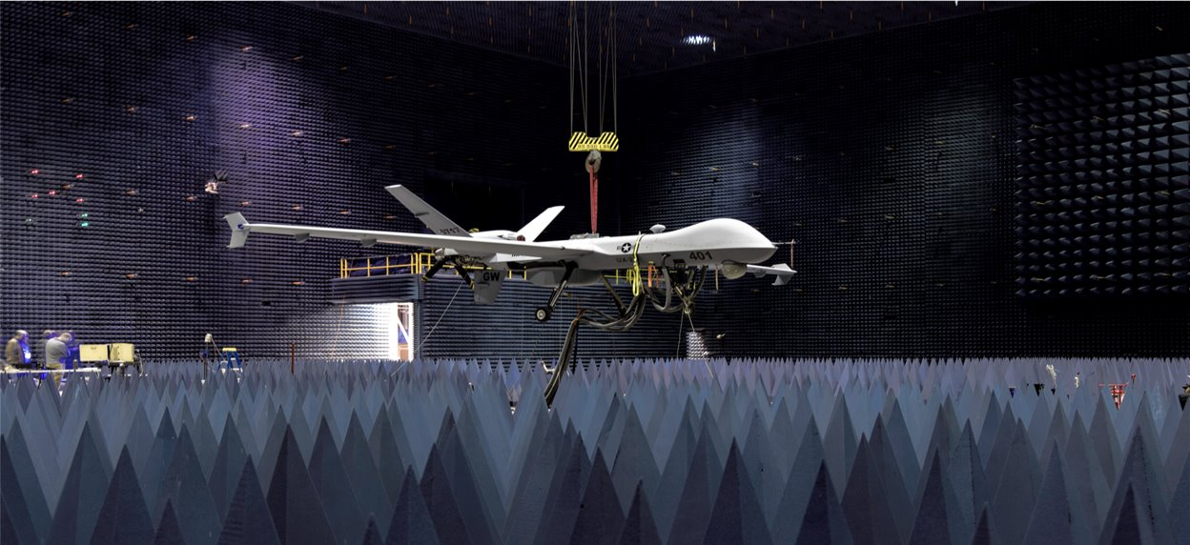
MUX/MALE - Detect and Avoid System (DAAS)
DAAS on MUX MALE enables separation and collision avoidance from other aircraft in International, US and Foreign national airspace
Detects, identifies, and tracks airborne traffic
Provides airspace awareness and recommended actions and alerts for the pilot to remain well clear, with collision avoidance displayed on Heads Up Display (HUD)
NAVAIR Public Release SPR-2025-0208. Distribution Statement A - "Approved for public release; distribution is unlimited.”

Slide 5
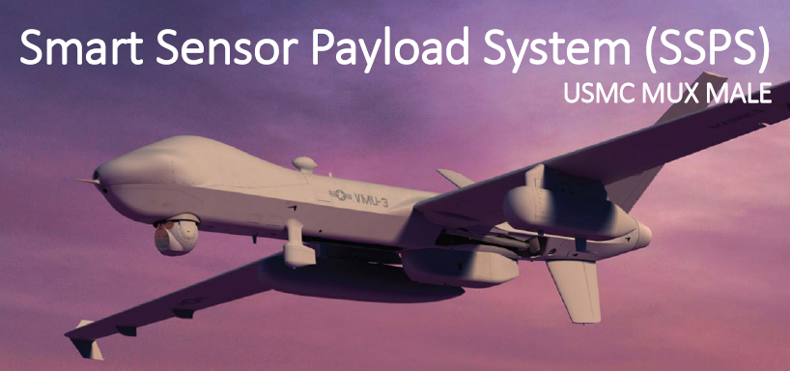
MUX/MALE – Smart Sensor
Autonomous System Platform (ASP) controls sensors and payloads to maximize efficiency and real-time processing of data on the tactical edge.
Provides sensor autonomy to reduce aircrew workload and enhance target tracking identification/correlation/reporting.
Organic AI/ML Pipeline
NAVAIR Public Release SPR-2025-0208. Distribution Statement A - "Approved for public release; distribution is unlimited.”

Slide 6
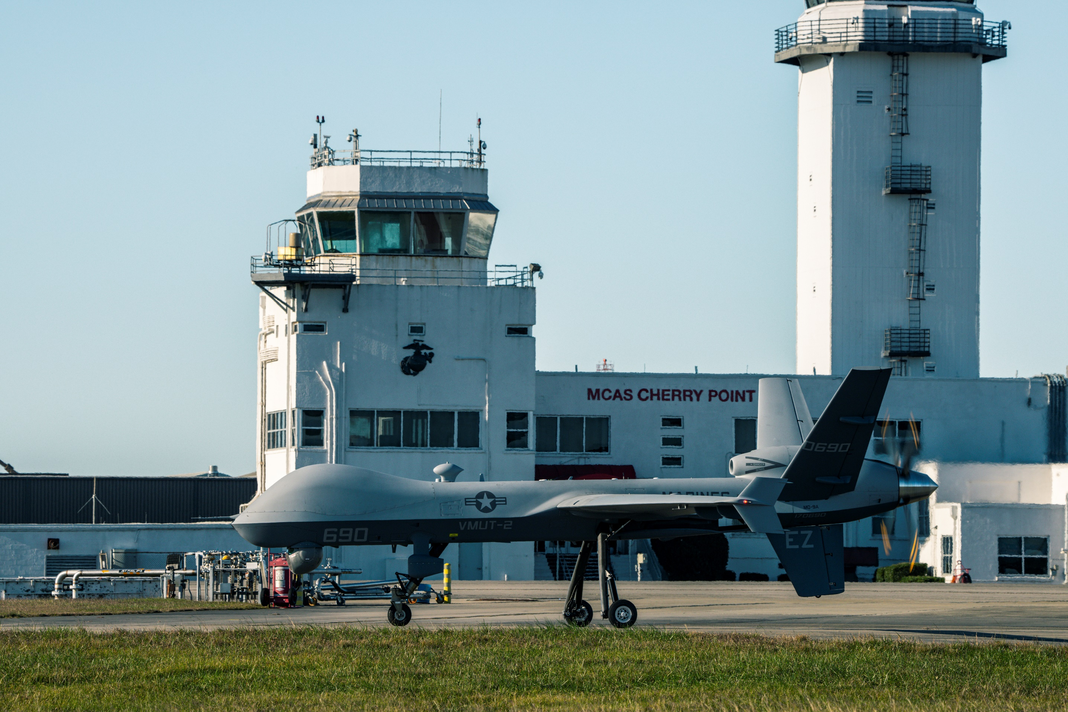
MUX/MALE – Accomplishments
21 Nov 2024: Marine Unmanned Aerial Vehicle Training Squadron (VMUT) 2, conducts first MQ-9A flight aboard Marine Corps Air Station (MCAS) Cherry Point.
Service Organic Group 5 UAS training
NAVAIR Public Release SPR-2025-0208. Distribution Statement A - "Approved for public release; distribution is unlimited.”
Notes:
Image Source: https://www.dvidshub.net/image/8765468/marine-unmanned-aerial-vehicle-training-squadron-2-conducts-first-flight

Slide 7
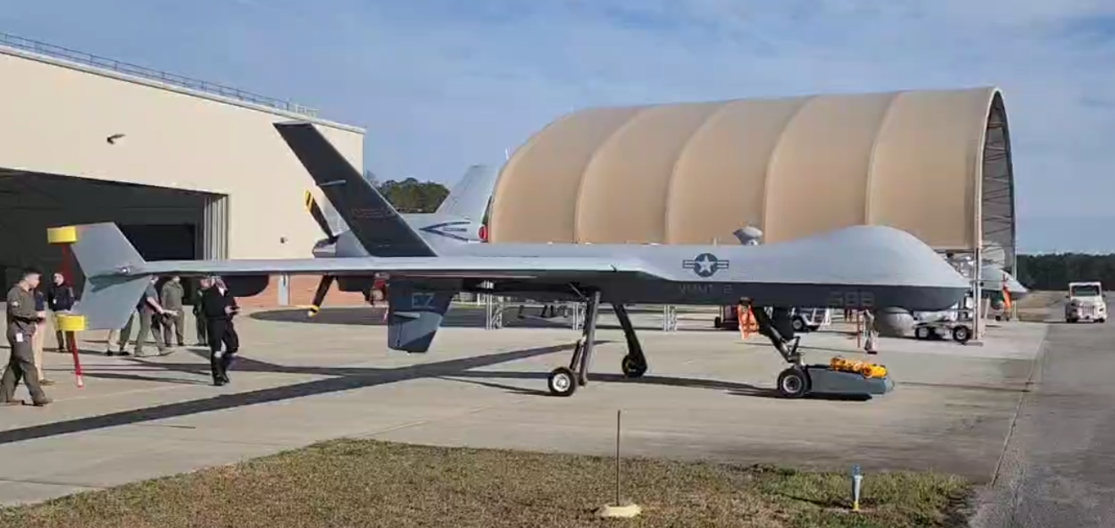
MUX/MALE – Accomplishments
Partnering with SupplyCore, the delivered the TowFLEXX TF-3 Milspec, a remote-controlled aircraft tug, that allows a single operator to maneuver military aircraft with unprecedented precision, maintaining the aircraft's nose wheel alignment while enabling 360-degree turns in confined spaces.
Rapidly respond to urgent fleet requirements
NAVAIR Public Release SPR-2025-0208. Distribution Statement A - "Approved for public release; distribution is unlimited.”
Notes:
https://www.navair.navy.mil/news/Marines-fast-track-new-tug-MQ-9-Reaper/Thu-04032025-0843

Slide 8
What’s Next
Capability
Spiral development
MOSA / SOSA
Next generation
Technology Insertion
Autonomy Insertion
Business
Agile workflows
AI based workflows
Agile contracting
Keeping pace with innovative tool sets
Work with non-traditional vendors
NAVAIR Public Release SPR-2025-0208. Distribution Statement A - "Approved for public release; distribution is unlimited.”

