Slide 1
Col Morina Foster
Commanding Officer
Operationalizing Wounded Warrior Regiment: Scalability and Flexibility
Updated: 08 Apr 2026

Slide 2
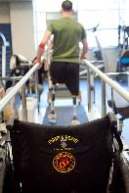
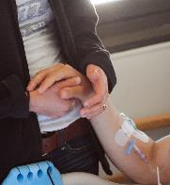
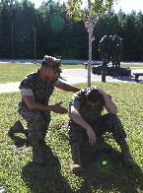
Wounded Warrior Regiment Mission
Provides leadership and ensures compliance with laws and DoD regulations related to the support, recovery, and non-medical care of combat and non-combat Wounded, Ill, and Injured (WII) Marines, sailors attached to Marine units, and their family members to maximize their recovery as they return to duty or transition to civilian life.
“Keeping the faith, and still in the fight “Etiam In Pugna”
Our Mission
The only official Marine Corps unit charged with providing medical case management and non-medical care to WII Marines and Sailors assigned to Marine Units.
Serves the total force – active duty, reserve, retired, and veteran Marines and Sailors assigned to Marine Units.
Wounded
Ill
Injured
IED Blast
Gunshot
Traumatic Brain Injury
Cancer
Chronic Illness
Mental Health
Training Mishap
Vehicle Accident
Our Population
Our Population
Post-traumatic stress
Notes:
Projected Talking Points: WHAT WE DO
Here at WWR we service the entire force which includes our retirees and veterans if/when needed.
Majority of our supported population is active duty and as we serve our Wounded, Ill and Injured, Post traumatic Stress is exist across our population.

Slide 3
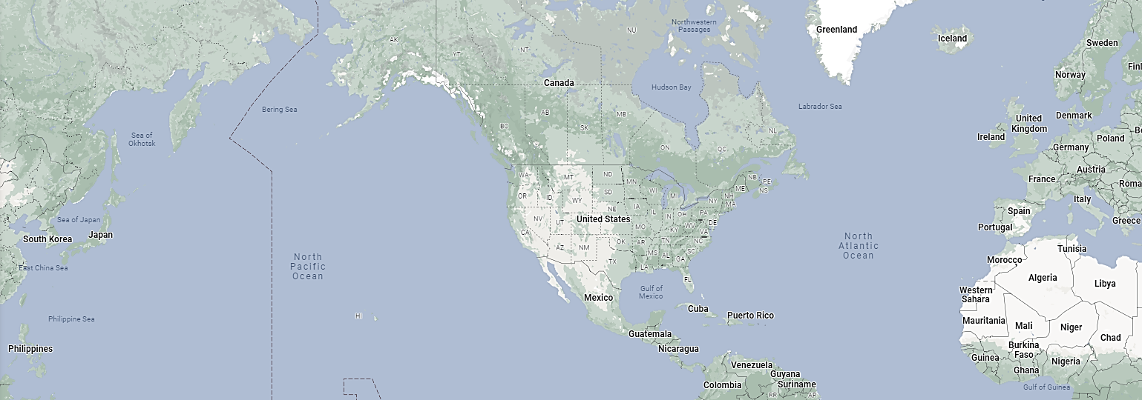
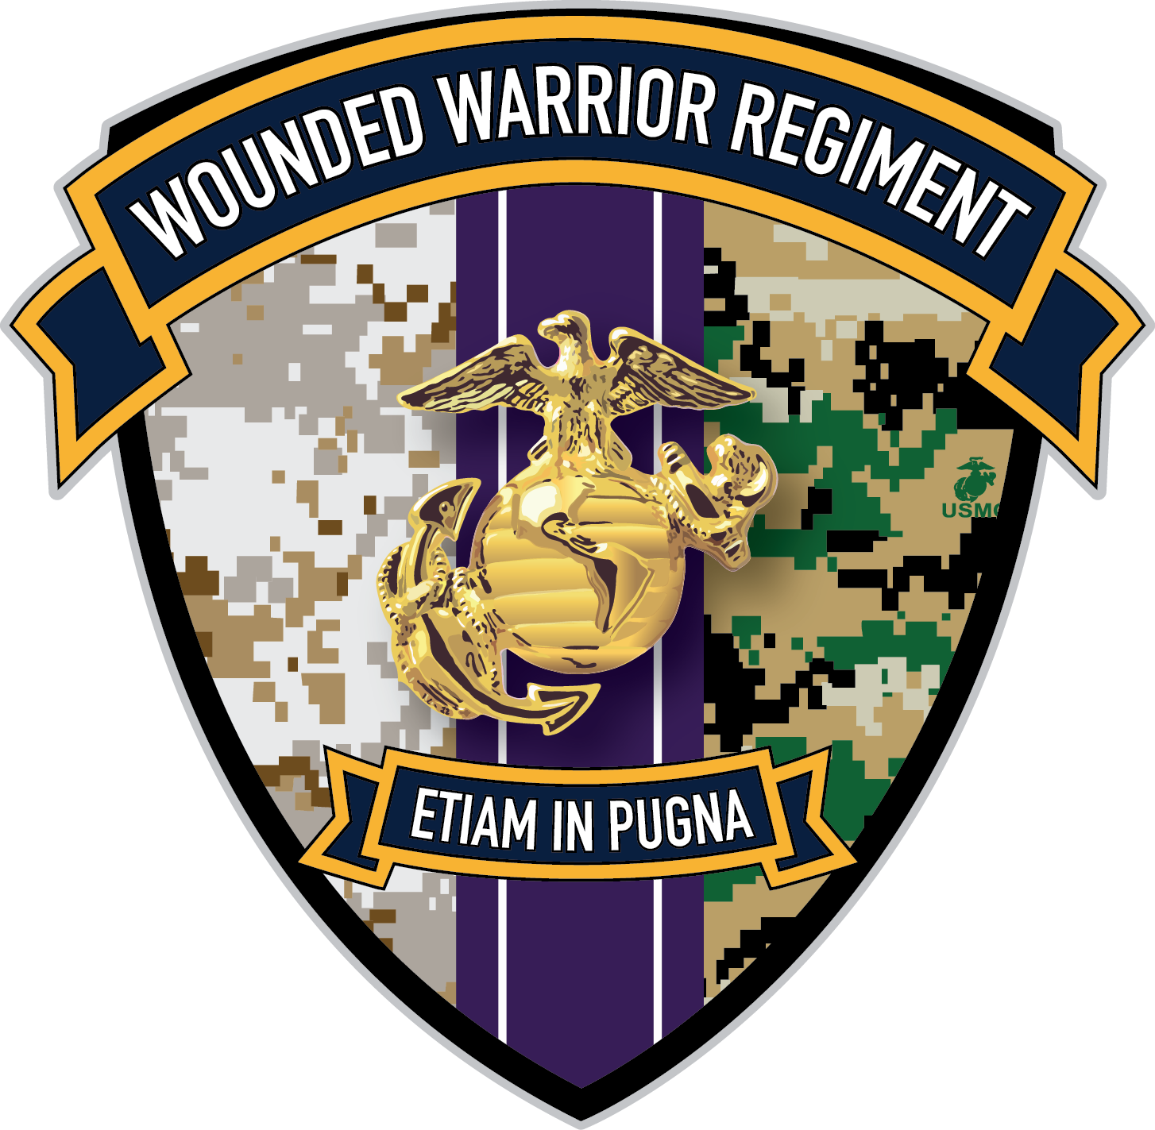


WWR “Steady-state” Operations
DASN M&RA
HQMC
Warrior Care Executive Council*
Policy / Advocacy Coordination
DC M&RA
Pay / Entitlements Issuer
Office of Secretary of War / Defense Health Agency
Reporting / Policy Chain
Department of Veteran Affairs
Veterans Support Organizations
Transition Coordination
Recovery Care
Coordination
INDOPACOM Casualties + Overseas Integrated Disability Evaluation System (OIDES)
CENTCOM and EURAF Casualties + OIDES
*USMC is the only service that organizes its Warrior Care Programs in a centralized chain of command
Legend
DISC
Detachment

Slide 4
WWR “Surge” Operations
Patient Movement
Point of Injury
Role 1 Care
Role 2 Facility
Role 3 Facility
Role 4/5 (CONUS)
Intra-theater patient tracking / movement (CCMD)
Inter-theater movement (TRANSCOM)
Integrated CONUS Medical Operations Plan (NORTHCOM)
USMC Patient Tracking (Casualty Branch)
Post-Stabilization Recovery Care Coordination and NDMS Integration (WWR)
INDOPACOM Casualties + OIDES
CENTCOM and EURAF Casualties + OIDES
Legend
DISC
Detachment

Slide 5
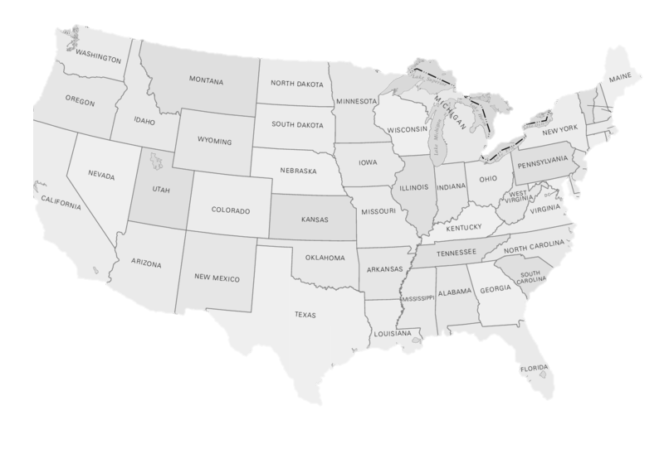

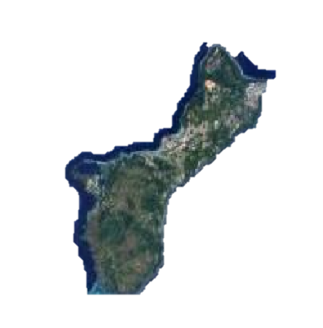







Locations and Capabilities
Wounded Warrior Regiment Headquarters
Guam
Landstuhl
Wounded Warrior Battalions (East & West)
Quantico
Wounded Warrior Detachments
Camp Pendleton
Camp Lejeune
Hawaii
Okinawa
District Injured Support Coordinators & Field Service Representatives
WWBn-West, Camp Pendleton, CA
Naval Medical Center San Diego, CA
VA Polytrauma Center Palo Alto, CA
Naval Hospital Twenty-nine Palms, CA
Naval Health Clinic Kaneohe Bay, HI
Camp Butler Okinawa, Japan
U.S. Naval Hospital Guam
WWBn-East, Camp Lejeune, NC
Walter Reed National Military Medical Center, MD
Ft Belvoir Community Hospital, Fairfax, VA
Brook Army Medical Center, TX
Naval Medical Center Portsmouth, VA
VA Polytrauma Center Richmond, VA, Tampa, FL, and
Minneapolis, MN
Landstuhl Regional Medical Center, Germany
Notes:
Wounded Warrior recovery complexes at each Wounded Warrior Battalion offer Battalion Headquarters, ADA-compliant barracks, and Hope and Care Centers to support WII Marines’ physical rehabilitation/ reconditioning and provide transition assistance in one location.
Detachments are located at military treatment facilities or VA facilities with a substantial population of Marines receiving treatment.
DISCs are mobilized reserve Marines and FSRs are contractors who provide assistance to Marines recovering away from military bases, transitioning from active duty or reserve to veteran status, or medically retired.

Slide 6



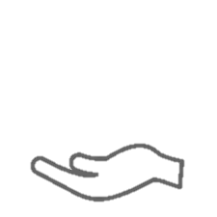
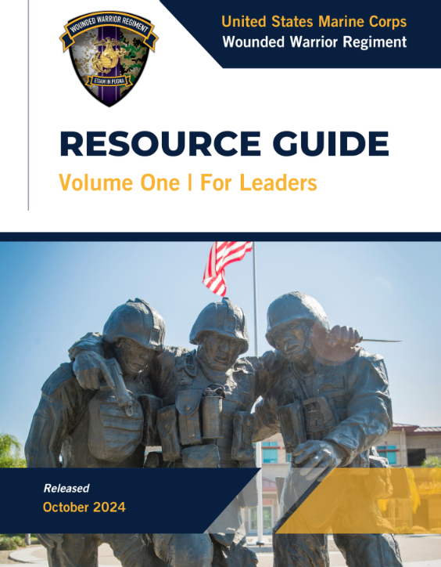
WWR Assignment
Identify
Assess
Support
More Information
Daily review of every PCR/SIR/CCIR generated across USMC and provide outreach to commanders
Maintain a presence at military medical facilities supporting Marines
Conduct initial needs assessment
Conduct outreach to affected Marines’ unit commanders to offer support
Assign SI/VSI a WWR asset, generally a Recovery Care Coordinator (RCC)
Determine appropriate level of support and potentially assign WWR asset; some cases may require immediate intervention
Receive referral packets for complex care cases
Available at:
https://www.woundedwarrior.marines.mil/Refer-a-Marine/
Suggested support may be:
Referral / assignment to WWBn
Recovery Care Coordinator
Non-medical care manager
Call center representative
Clinical care advocate
Notes:
Projected Talking Points: HOW THEY ARE ASSIGNED SUPPORT
Once identified through the Personnel Casualty Report or self referral process, our staff engages in a systematic evaluation
Those who are seriously injured or very seriously injured will received an outreach call from our battalion leadership and assignment of a RCC to do an assessment, at a minimum
These steps are essential in us expressing to the commanders and leaders how and when to access WWR

Slide 7
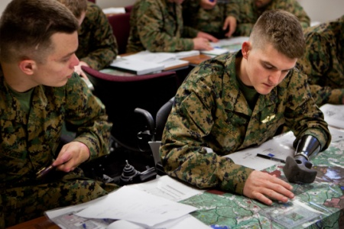
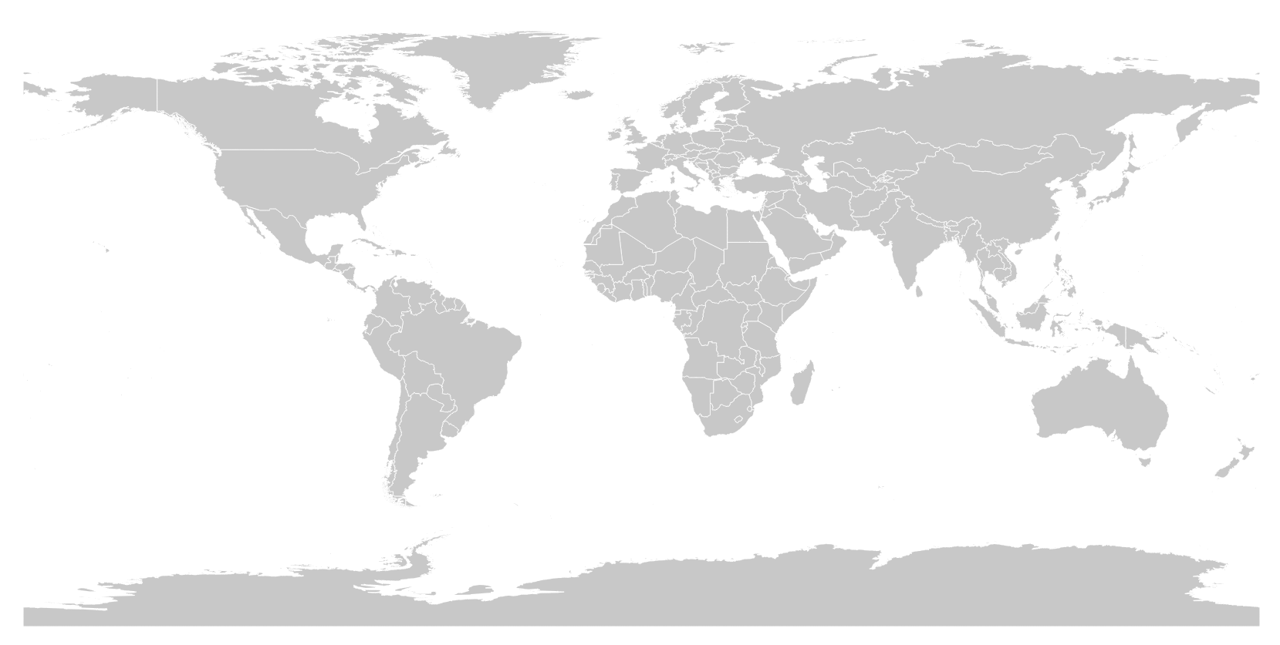
DISCs & FSRs | Outreach and Veteran Support
Both DISCs and FSRs are available to support veterans in crisis and are dispatched through regiment operations.
District Injured Support Coordinator (DISCs)
DISCs are mobilized Marine Reservists located throughout the country to assist RSMs and their families:
Transition from active duty or reserves to veteran status
Identify and solve problems related to VA support and services
Facilitate support regarding benefits and entitlements
Respond rapidly in cases of emergency
Field Service Representatives (FSR)
FSRs are contractor support assigned through the Wounded Warrior Operation Center (WWOC). FSRs function the same as DISCs – supporting the most complex care cases as they transition to veteran status.

Slide 8
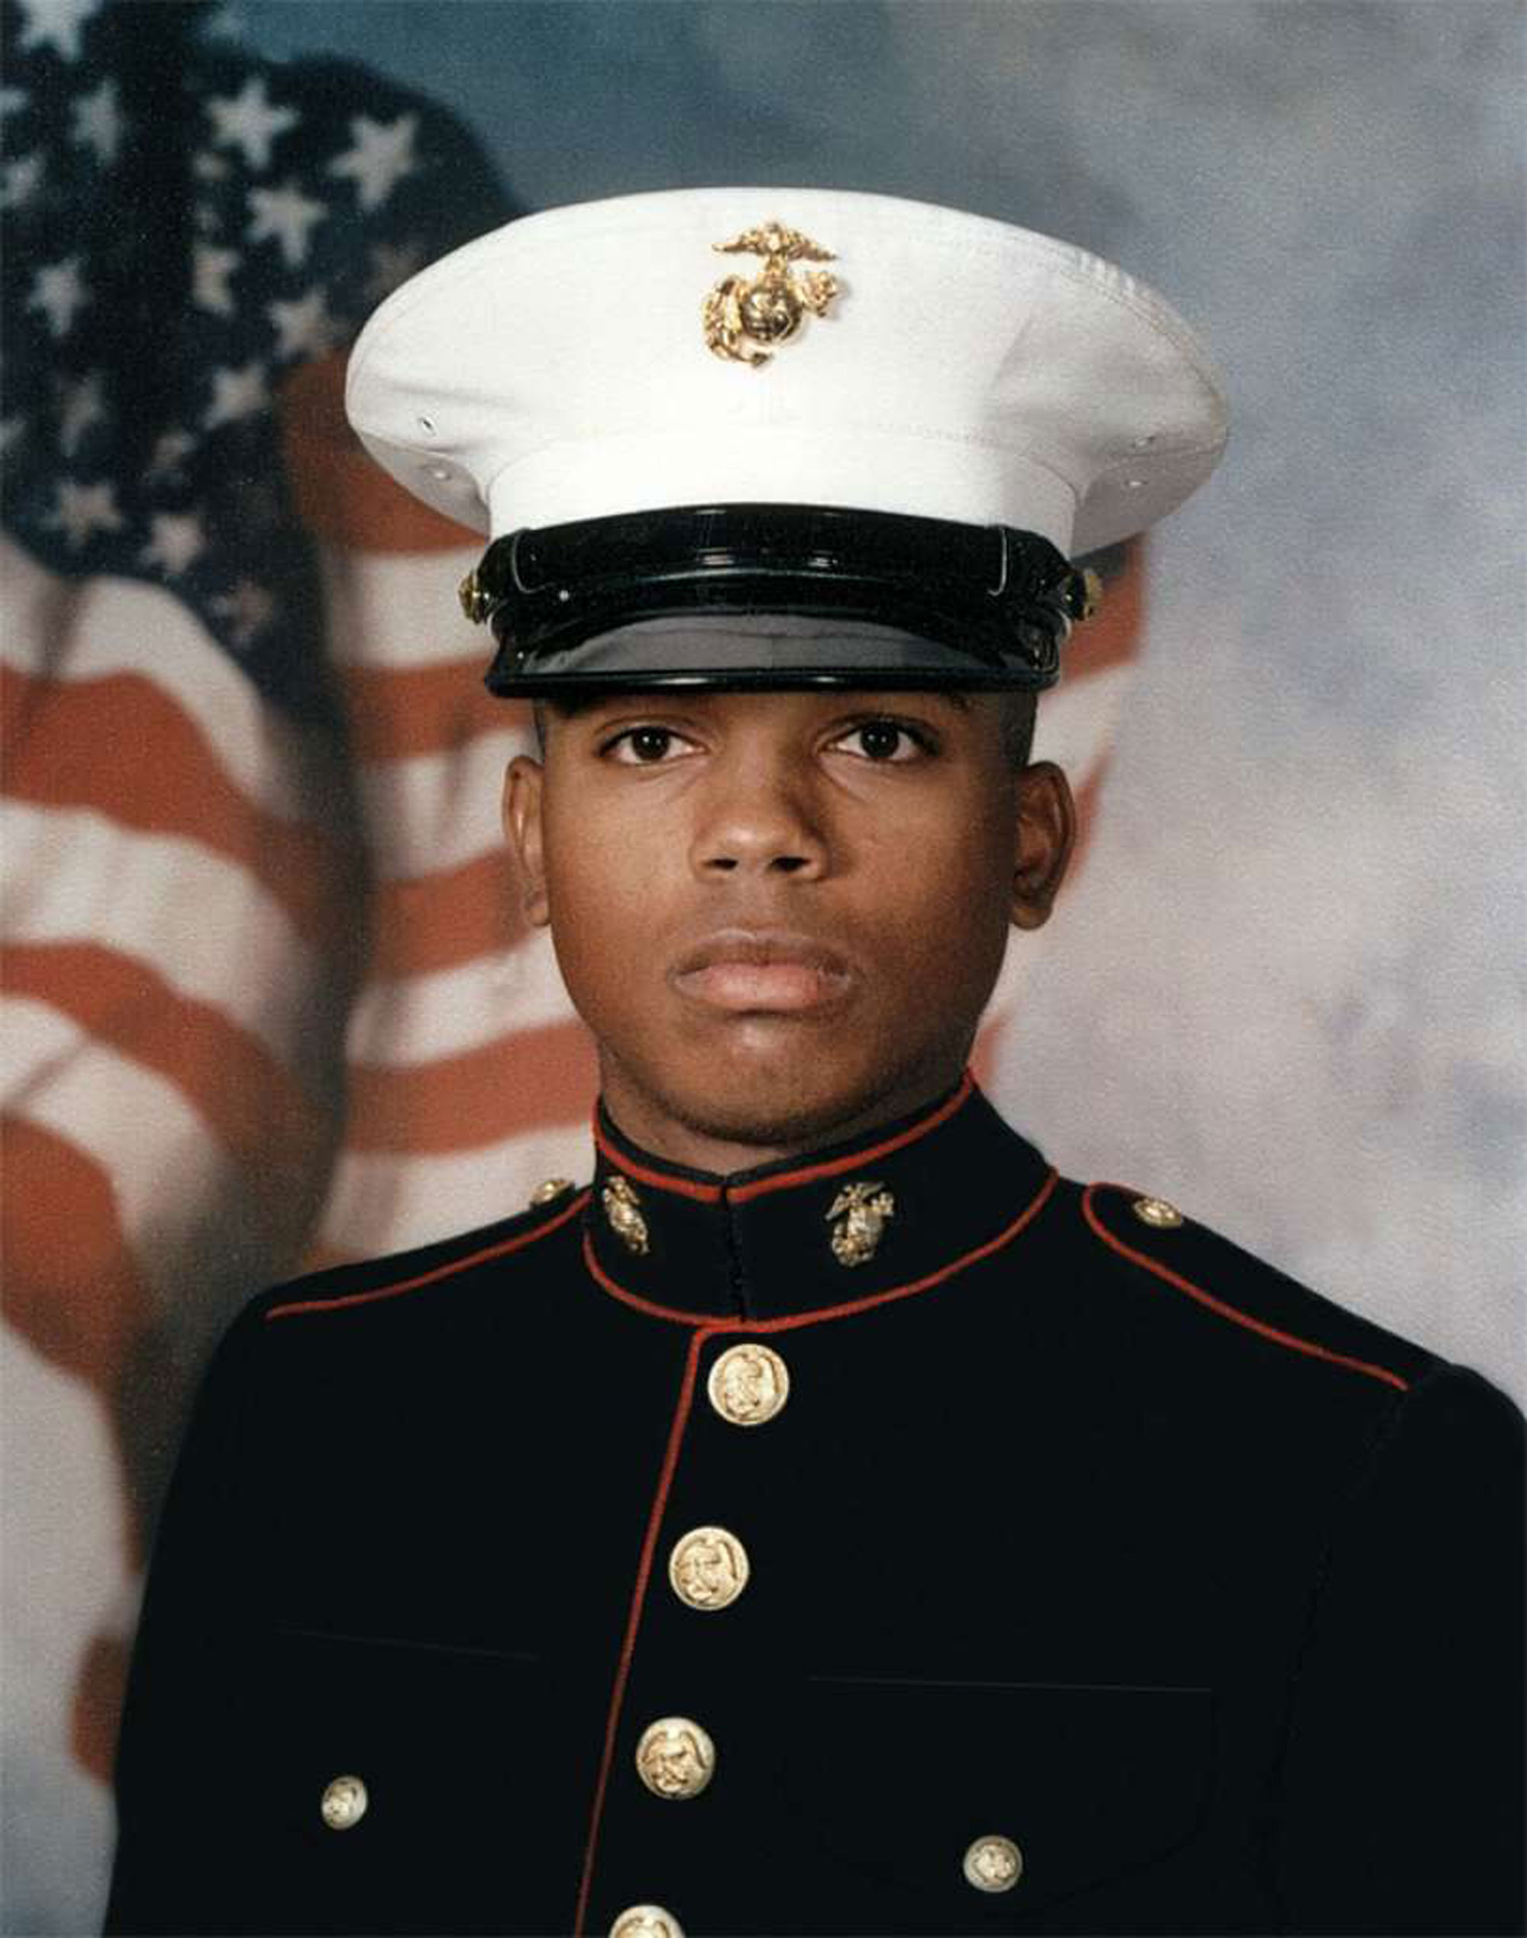
WWCC | Outreach and Veteran Support
The Sergeant Merlin German Wounded Warrior Call Center (WWCC) is available 24/7 to make and receive calls and render assistance to RSMs, Marine veterans, and their families with:
Benefits and Entitlements
Counseling on a variety of issues
GI Bill
Traumatic Servicemembers’ Group Life Insurance
Employment/ Education
Social Security Disability Insurance
Traumatic Brain Injury
Awards (e.g., Purple Hearts)
Post Traumatic Stress Disorder
Veterans Administration
IDES outreach during each phase
To support the active duty WII Marines who remain with or have returned to their parent command, each WWBn has a contact center. Hours for both Contact Centers are Mon - Fri from 0800-1600 (local time) excluding holidays.
Battalion - West Contact Center
(Area of Responsibility – West of the Mississippi River, including Japan, Guam and Hawaii)
Ph. 888-738-7044
Battalion - East Contact Center
(Area of Responsibility – East of the Mississippi River, including Europe and Texas)
Ph. 910-451-1202, 910-451-4812, 910-449-9573

Slide 9
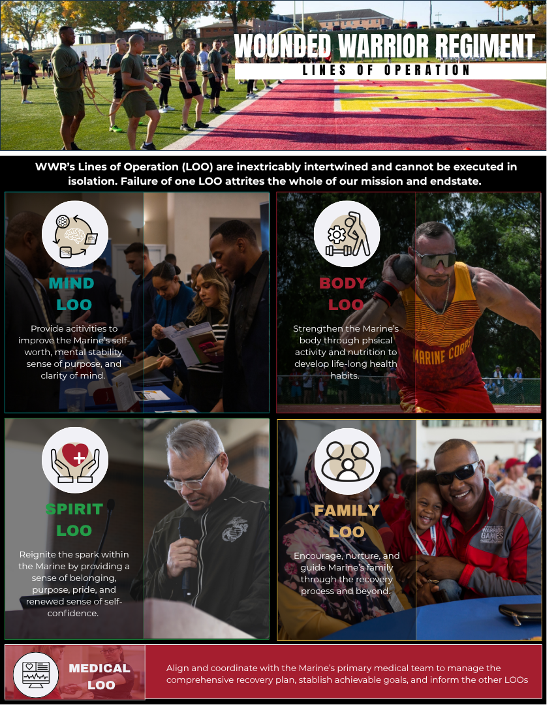
Marine Corps Total Fitness and WWR Ops
Healing is more than just medical
Notes:
The BLUF is WWR is here to support you when you have Marines in your formations that meet the requirements to be transferred to our regiment for care.
Because we see every personnel casualty report, PCR across the Marine Corps and know certain elements of the PCR unlock specific services afforded to wounded ill and or injured, I would encourage you to report all serious cases via PCR especially those requiring 5 or more days of hospitalization. It does not mean we will automatically provide care but certain elements within a PCR will trigger to our SME's that their may support programs available to assist in the recovery care depending on the injury.
And ultimately when in doubt, give us a call or go to website or give us a call. Because a Marine's recovery support should not be a factor of luck or location and not only do we care we have subject matter experts on our staffs to assist.

Slide 10
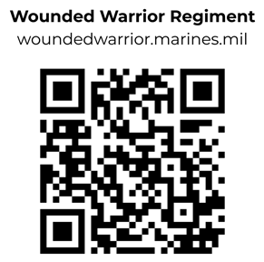
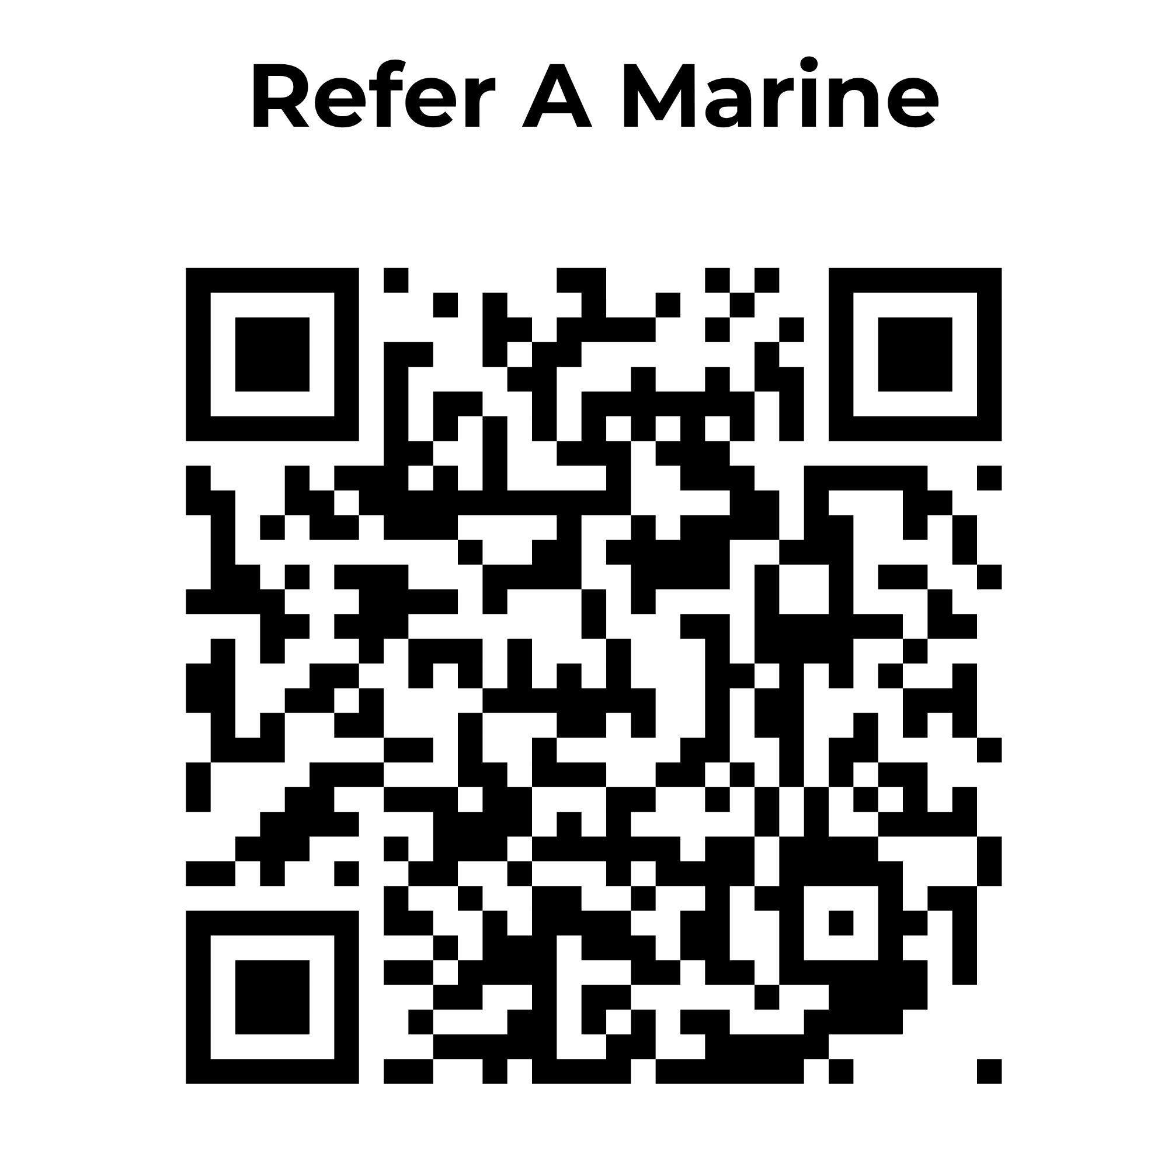
Questions?

