Slide 1
Wingmen of the Future: Uncrewed & Autonomous
LtCol Link & Maj Zbonack

Slide 2
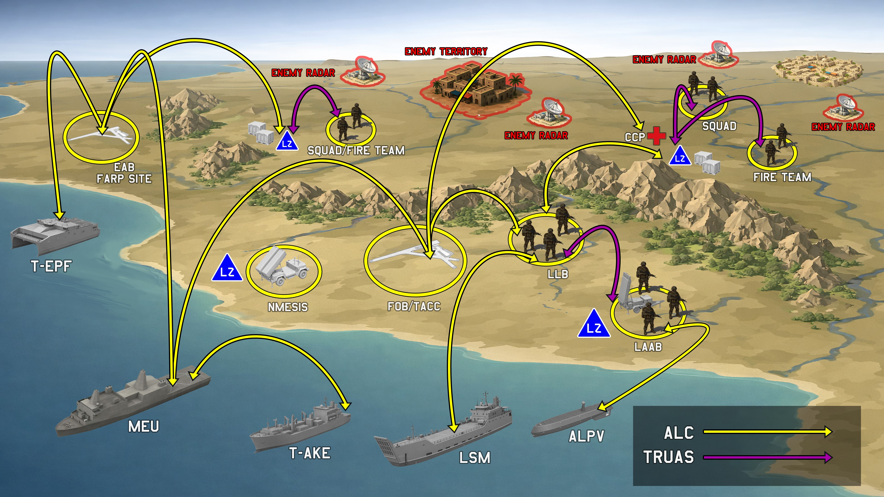

Slide 3
