Slide 1

1
MARINE CORPS TOTAL FITNESS
MCTF Directorate, MF Division, M&RA
Brad Brimhall, M.Ed., CSCS, TSAC-F, USAW L2
Branch Head, Warrior Athlete Readiness & Resilience-Semper Fit (WARR-SF)

Slide 2





2
THE DIVISION 1 MODEL
TREATING THE WARFIGHTER LIKE AN ELITE ATHLETE
TRADITIONAL MODEL
THE WARR MODEL
Commercial fitness center model
Reactive medical care
Isolated training
No integration of resources or support
Integrated WARR Center – HUB
Integrated WARR Team
Proactive injury prevention
Holistic support
Built to support the modern warfighter—D1, professional sports, and Olympics.

Slide 3
3
PHYSICAL
THE OVERARCHING FRAMEWORK
MCTF is an integrated system involving all commands, divisions, and programs. It is a way of thinking, leading, operating, living.
CORE TENET
The individual Marine and their family are the most important asset. Family well-being and quality of life are inseparable from mission successes.
CORE TENET
It's science-based, evidence-led, and prevention-focused.
SOCIAL
MENTAL
SPIRITUAL

Slide 4
4
MARINE CORPS TOTAL FITNESS
The four domains of MCTF and WARR stand on these foundational building blocks.
All four domains are interdependent.
PHYSICAL
MENTAL
SPIRITUAL
SOCIAL
SLEEP
NUTRITION
EXERCISE
RECOVERY
MEDICAL/ DENTAL
FINANCIAL
ENVIRONMENTAL
OCCUPATIONAL
MEANING, FAITH, PURPOSE
APPLIED MENTAL SKILLS & COGNITIVE PERFORMANCE

Slide 5

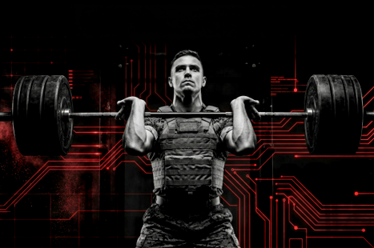
THE PIVOT
5
WARR IS THE ACTION ARM OF MCTF
MCTF (THE HEAD)
WARR (THE MUSCLE)
Focus: Integrated capabilities, polices, and practices
Role: System design, resourcing, standards (M&RA/ TECOM)
Output: Charter and strategy
Focus: Prevention in real time
Role: Direct delivery of services, facilities, and SMEs
Output: Building the Warrior Athlete and Family

Slide 6
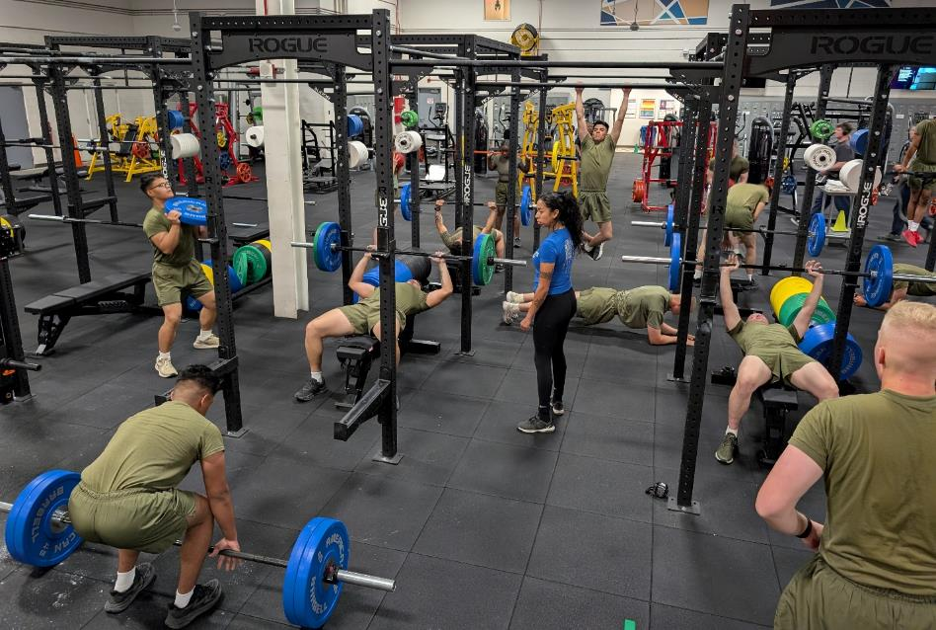
6
THE WARR CENTER: ONE-STOP SHOP
TREATING THE WARFIGHTER LIKE AN ELITE ATHLETE
THE WARR MODEL
Converting 47 traditional fitness centers to WARR Centers
Co-locating internal and external resources
Providing a space for traveling professionals

Slide 7
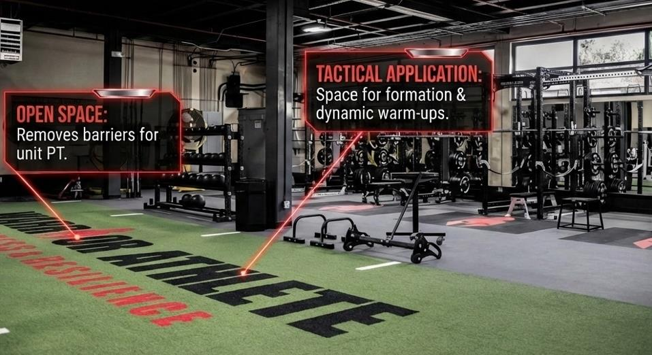
7
THE WARR CENTER: ONE-STOP SHOP
TREATING THE WARFIGHTER LIKE AN ELITE ATHLETE
OPEN-SPACE CONCEPT
THE WARR MODEL
Large Unit Training
Indoor turf
Integrated resources:
ATC Clinic
Recovery Space
Classrooms
Combative Space
Fueling Stations
Cognitive Performance
Shooting Simulators

Slide 8








8
THE WARR TEAMS: 349 BILLETS
101 Strength &
Conditioning Coaches
47 Performance Dieticians
49 Mental Skills Coaches
62 Athletic Trainers
33 Resilience
Wellness Specialists
16 Performance Educators
14 Culinary Health Instructors
16 Performance Scientists

Slide 9



FUTURE STATE
9
Sports Medicine/
Athletic Training
Cognitive
Performance
Recovery
ATCs at all WARR Centers
Reduced wait times to see a provider
Centers/Rooms/Spaces
Optimize performance
Accelerate recovery
Performance focused
Go in strong and ready
More lethal and greater survivability

Slide 10



10
INTEGRATION + ACCESSIBILITY
Mobile, Virtual, &
Deployed Capabilities
AI & Technology
USMC Integration
ONR collaboration readiness monitoring
AI tools, virtual education for CONUS & OCONUS
Combative spaces
Integration with FFI & MCMAP to run courses/PT in WARR Centers
Resources and capabilities for geographically displaced and deployed units

Slide 11
11
MCTF + WARR INTEGRATION
Individual:
Morning/night routines, peer mentorship, utilize WARR SMEs
Unit Command:
Weekly WARR
Integrated PT,
OSCAR integration
via BTN Commanders
UNIT COMMAND
INDIVIDUAL
INSTALLATION
HIGHER COMMAND
Installation:
Cross domain fitness challenge, integrated wellness campus
Higher Command: Deployment cycle integration, policy for work/ life balance, protected family time

Slide 12
12
TIMELINE OF EXCELLENCE
FEB 2022
MAR 2022
OCT 2023
FY 25
JAN 2026
FY 27
FY 28
Charter signed by ACMC
Working group began
MCTF strategy signed by CMC
Rollout of WARR teams
to all installations
Full staffing complete
MCTF Directorate established

Slide 13
13
INTEGRATED NETWORK OF SUPPORT
WHEN YOU CONNECT TO ONE, YOU CONNECT TO ALL
Warrior performance and quality of life intertwined
Seamless fabric of support where Marines, work, train, and play
Prevention in real life

