Slide 1
Wargaming Capability (WGC) Program Overview
LtCol Joseph Taylor, USMC
Program Manager
30 April 2026

Slide 2
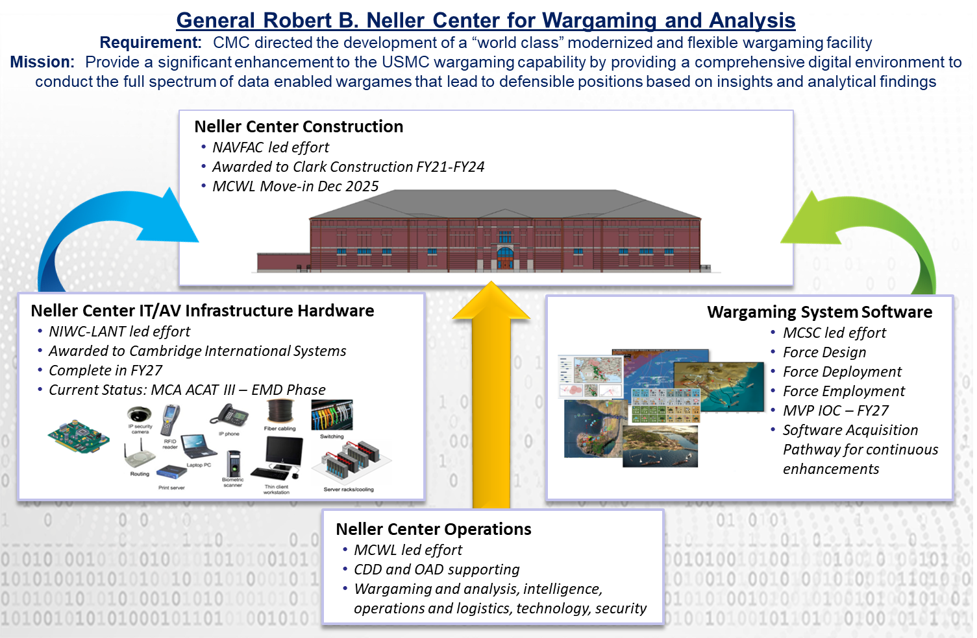
Wargaming Capability / Program Overview

Slide 3
Wargaming Capability / BACKGROUND
USMC and Program Manager Wargaming Capability (PM WGC) has cancelled efforts to field the original materiel solution.
Conducting Market Research to identify alternate solutions that could meet USMC wargaming requirements
Transitioning to Software Acquisition Pathway.
Focus for the software acquisition:
Affordable
Available, Mature
Supports the end-to-end wargaming process
Allows access to model data “black box” for verification, validation & accreditation
Supports federated approach
Expandable, Modular, Open Architecture

Slide 4
Wargaming Capability / Next Steps
PM WGC released a Request for Information (RFI) to Industry on sam.gov for an enhanced software solution. (Released Nov 25)
PM WGC, RFI, WARGAMING SOFTWARE, M6785426I2600
Responses received 30 Jan 2026
49 received, evaluation in progress
End-State: Results feed into analysis of alternatives and refines Software Acquisition requirements
PM WGC working with NAWCTSD and Central Florida Tech Grove
Prize Challenge soliciting innovative software solutions (commencing Apr-May 2026).
UCF will market Prize Challenge communications via social media.
Analyze alternatives from the RFI, Prize Challenge, and existing GOTS to field end-to-end wargaming software.
Decision point following the Prize Challenge on initial software capability entering the software pathway (SWP) in 2QFY27.

Slide 5
Wargaming capability / opportunities
Current Efforts (Success)
TITLE | Dates
Small Business Innovation Research (SBIR) Phase 2 efforts: Develop conceptual models for civilian pattern of life. | FY25 - FY26
Kill Web Conceptual Modeling for Wargaming Phase 1 | FY26 - FY27
Future Opportunities
TITLE | Planned RFP
Prize Challenge soliciting innovative software solutions (Central Florida Tech Grove) | 3QFY26
Kill Web Conceptual Modeling for Wargaming Phase 2 | 4QFY26

Slide 6
Questions?

Slide 7
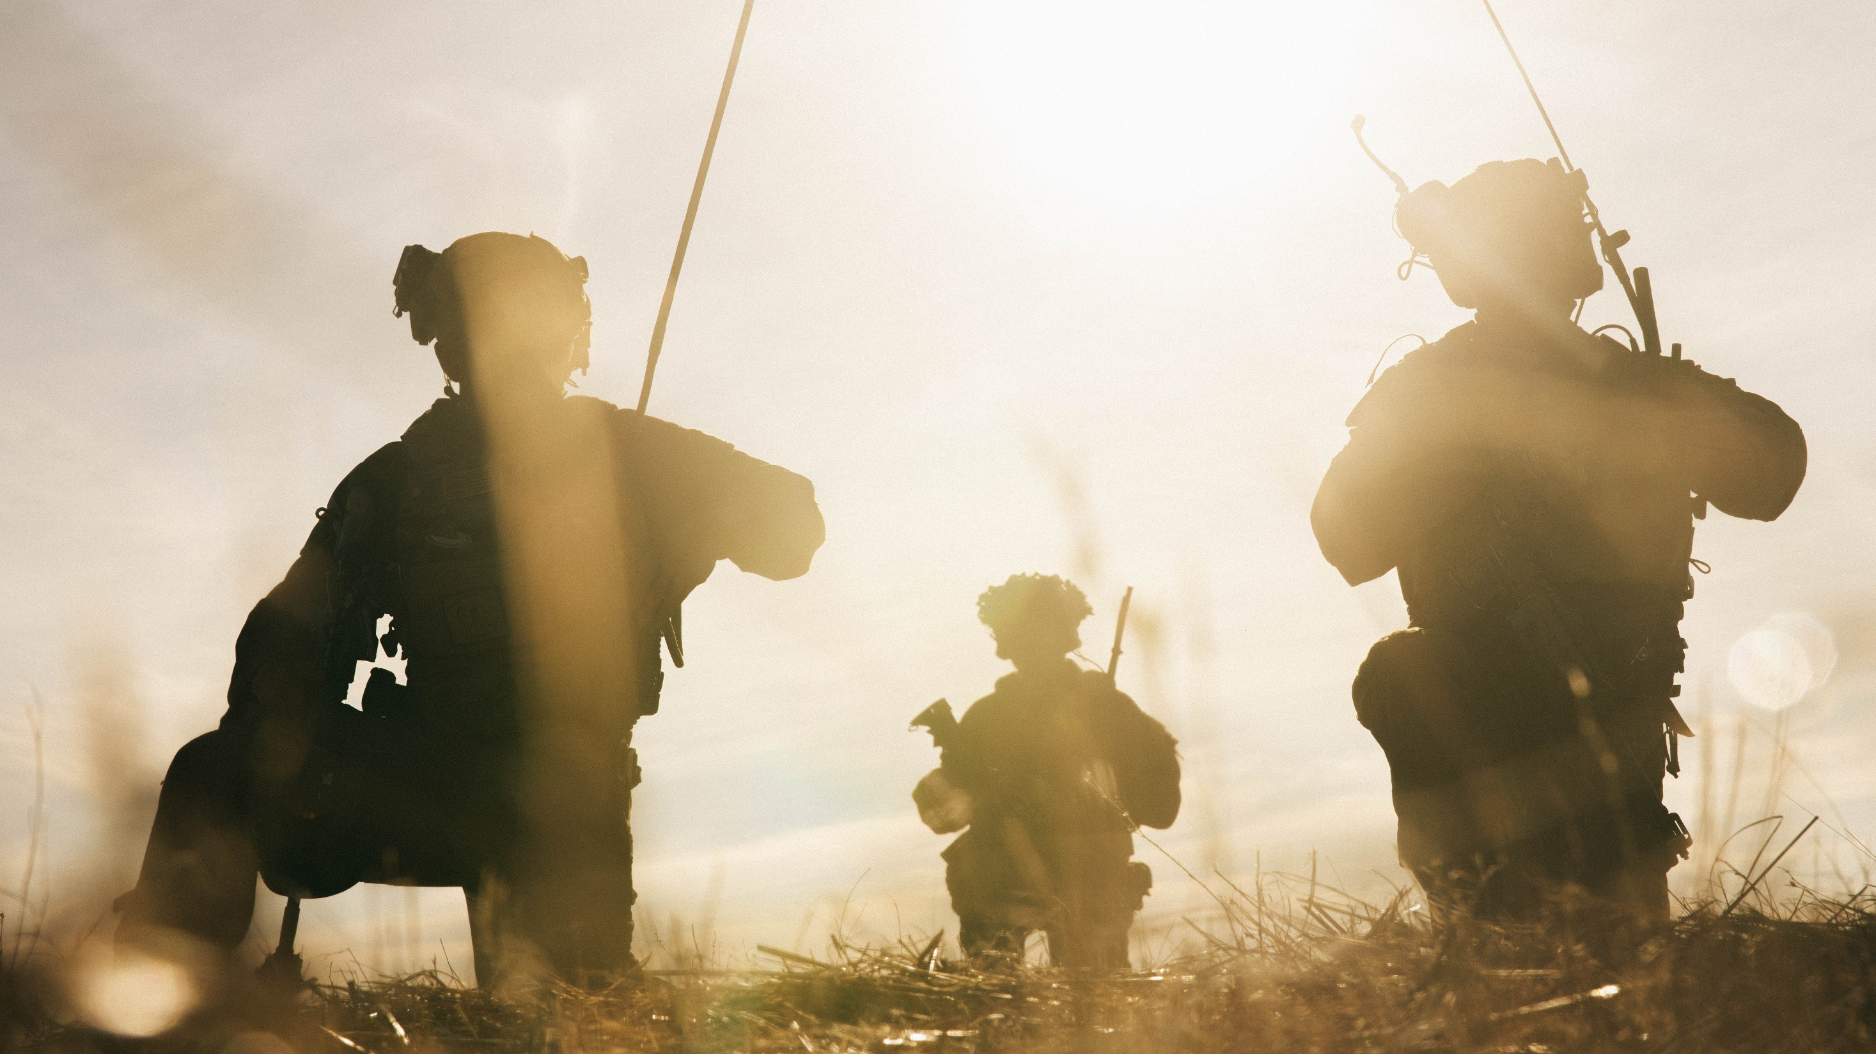

Equipping our WARFIGHTERS

