Slide 1
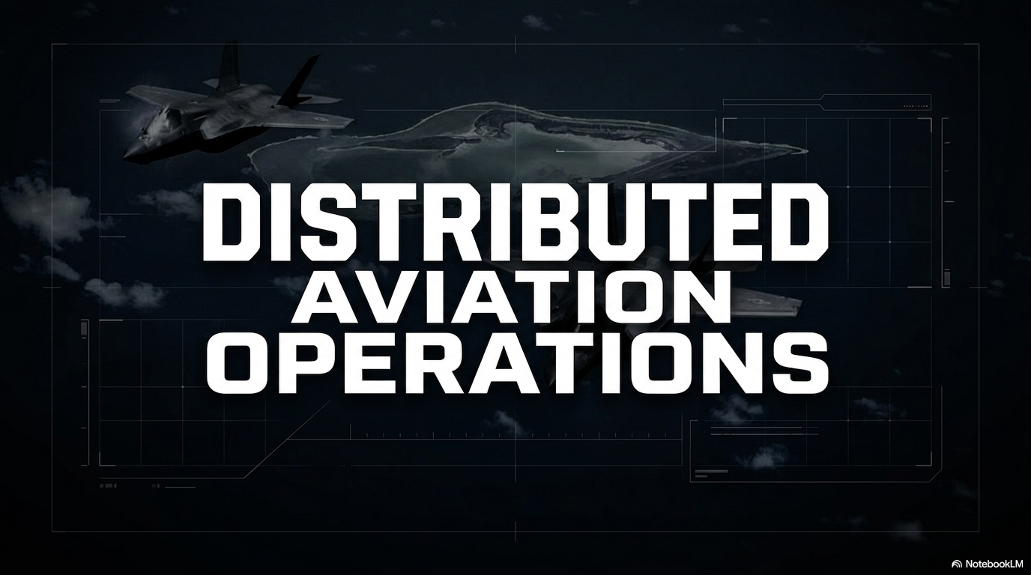
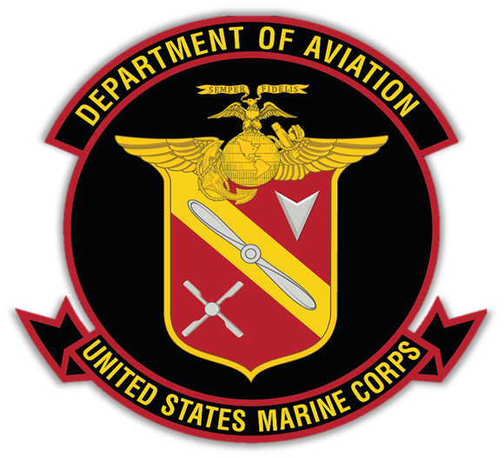
Notes:
Good morning/afternoon. Today I’ll discuss Distributed Aviation Operations—Marine Aviation’s central operating concept for succeeding in contested maritime environments.
DAO is how we ensure the Aviation Combat Element remains survivable, lethal, and sustainable—while we balance crisis response readiness with modernization for the future fight.

Slide 2
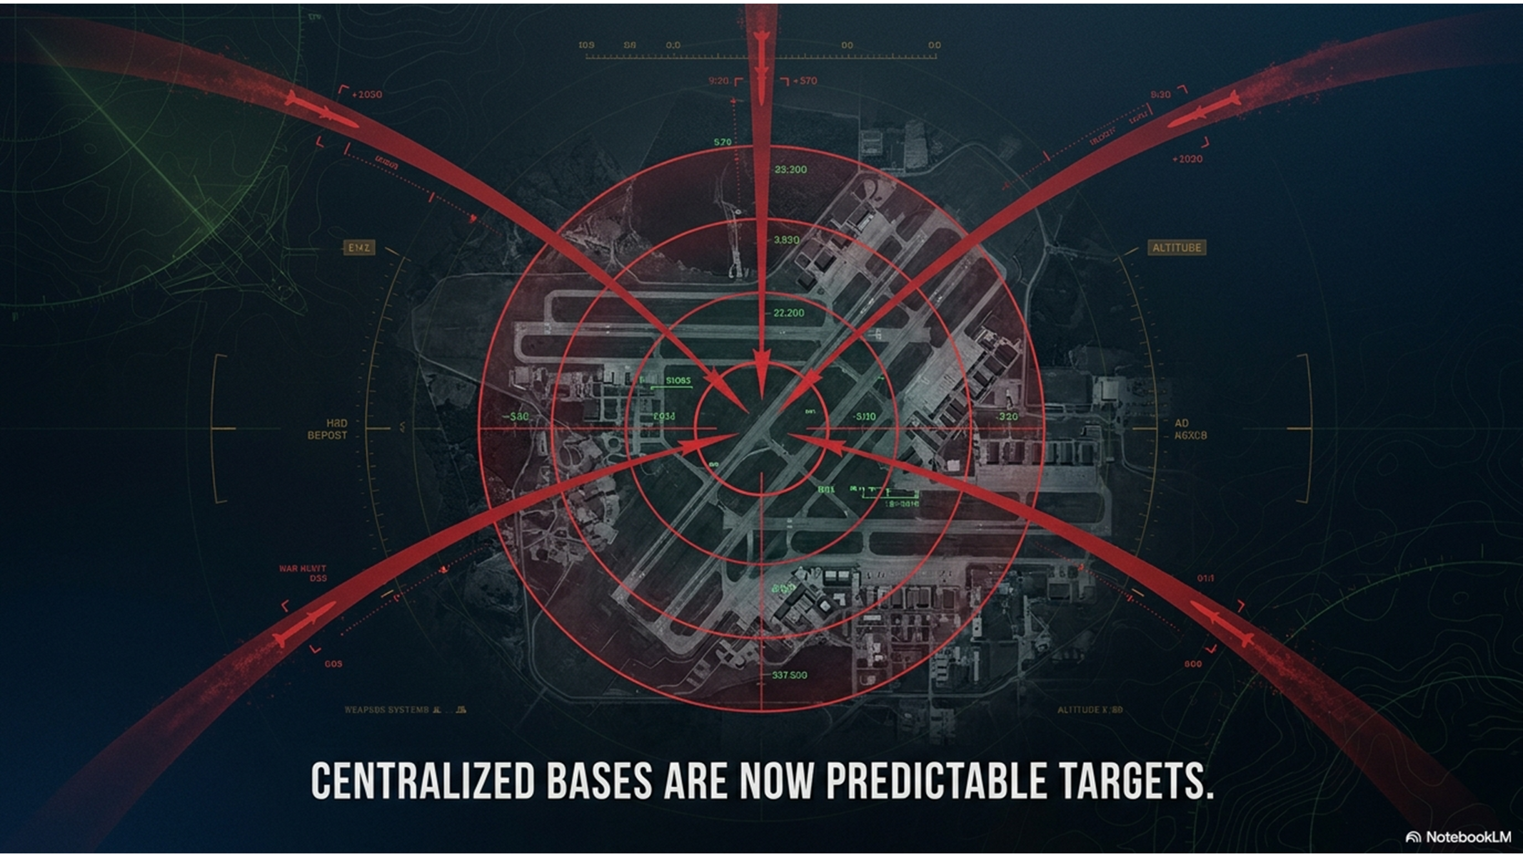
Why DAO
Notes:
The operational environment has fundamentally changed.
We are no longer operating from secure, centralized bases with assured logistics and communications. Instead, we face a contested battlespace characterized by long-range precision fires, degraded networks, and persistent surveillance.
If we continue to operate the way we have in the past, we become predictable—and therefore vulnerable.
DAO is our answer. It changes how we posture, sustain, and fight aviation forces to remain effective inside that contested environment.

Slide 3
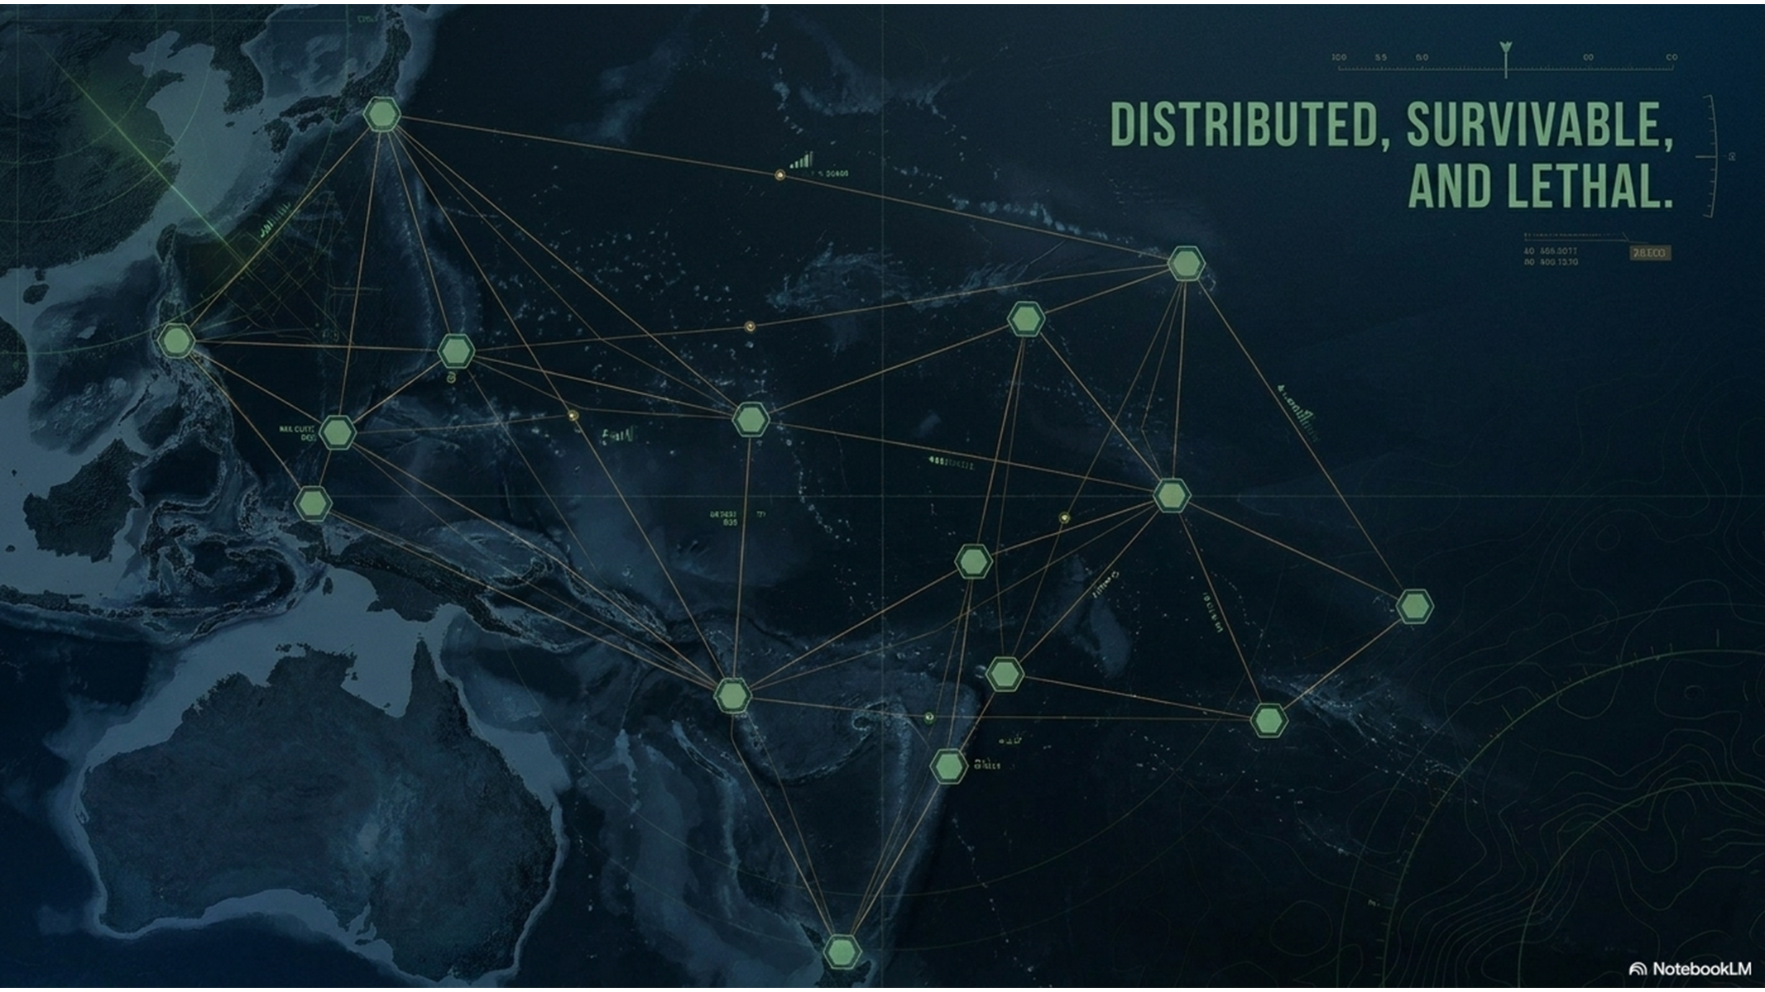
What is DAO
Notes:
Distributed Aviation Operations is the deliberate dispersion of aviation forces across multiple austere and expeditionary locations.
But dispersion alone is not the objective. The purpose is to increase survivability, complicate adversary targeting, and maintain operational tempo across distance.
DAO allows us to operate forward, persist longer, and generate combat power even when our traditional infrastructure is degraded or denied.

Slide 4
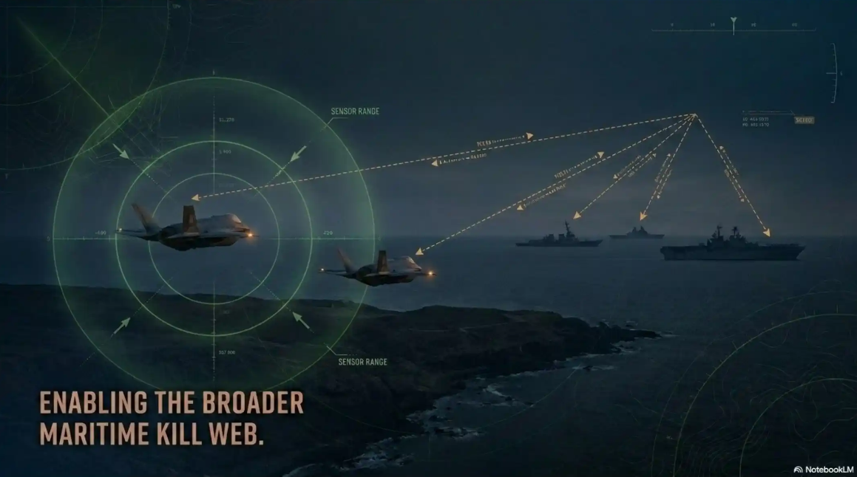
DAO in the MAGTF / Naval Context
Notes:
DAO is not a standalone aviation concept—it is how Marine Aviation enables the broader fight.
It is the aviation component of Expeditionary Advanced Base Operations and supports the Stand-in Force concept.
We enable:
Forward sensing
Long-range fires integration
Distributed sustainment
And mobility across the maritime domain
DAO ensures the ACE remains fully integrated into the naval and joint kill web—not operating independently, but contributing to a larger, networked force

Slide 5
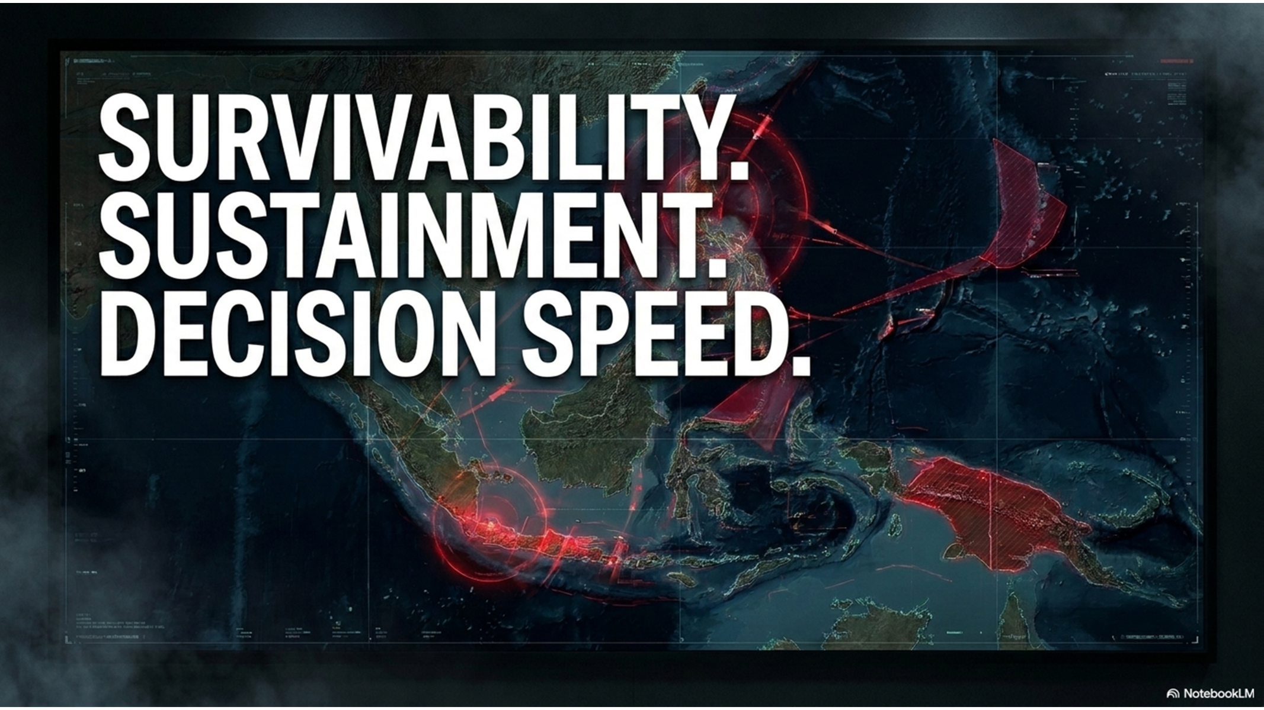
The problem DAO solves
Notes:
DAO addresses three core challenges:
First—Survivability. Centralized bases are increasingly vulnerable to precision strike.
Second—Sustainment. We cannot rely on uninterrupted supply chains or large logistics hubs.
Third—Decision speed. Contested communications degrade centralized command and control.
DAO mitigates these risks by distributing forces, decentralizing operations, and enabling local initiative.

Slide 6
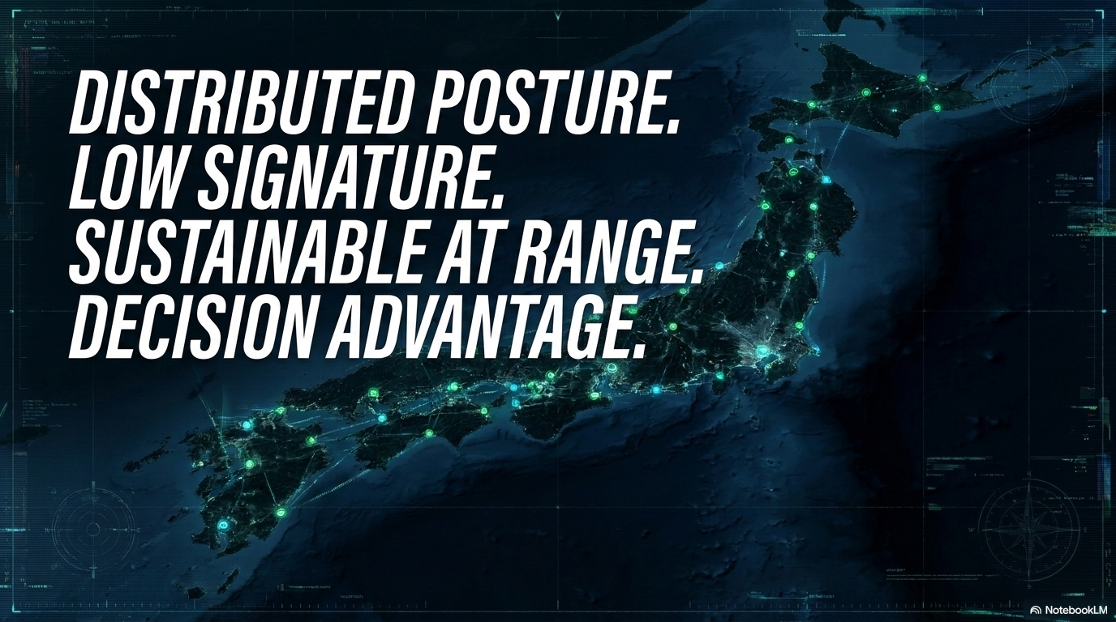
Key Characteristics of DAO
Notes:
DAO is defined by four key characteristics:
Distributed Posture – Forces operate from multiple, austere locations.
Low Signature – We minimize detectability across all domains.
Sustainable at Range – We reduce logistics demand and increase endurance.
Decision Advantage – We empower commanders at every level to act with speed and initiative.
This is not just a physical shift—it’s a cognitive and cultural shift in how we operate.

Slide 7

DCAO
Notes:
DAO is enabled by Decision-Centric Aviation Operations.
If DAO is how we position the force physically, DCAO is how we fight cognitively.
DCAO accelerates decision-making through:
Data integration
AI-enabled decision support
And interoperable networks
Our goal is to compress decision timelines and operate faster than the adversary can react.

Slide 8
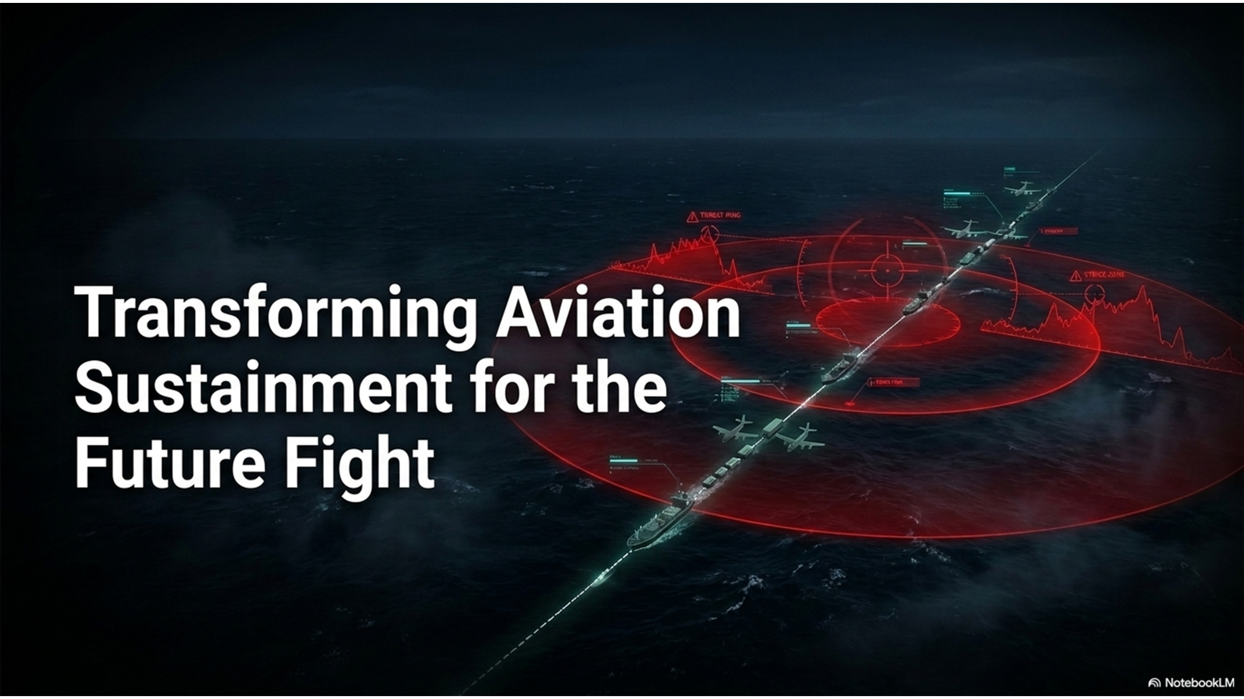
Sustainment
Notes:
Sustainment is the pacing function for DAO.
We are transitioning from a reactive logistics model to a predictive, data-driven sustainment enterprise.
This includes:
Predictive maintenance
Dynamic aviation supply
Optimized operations
These are not future concepts—they are the starting points of how we transform aviation sustainment today.
If we get sustainment right, DAO becomes viable at scale.

Slide 9
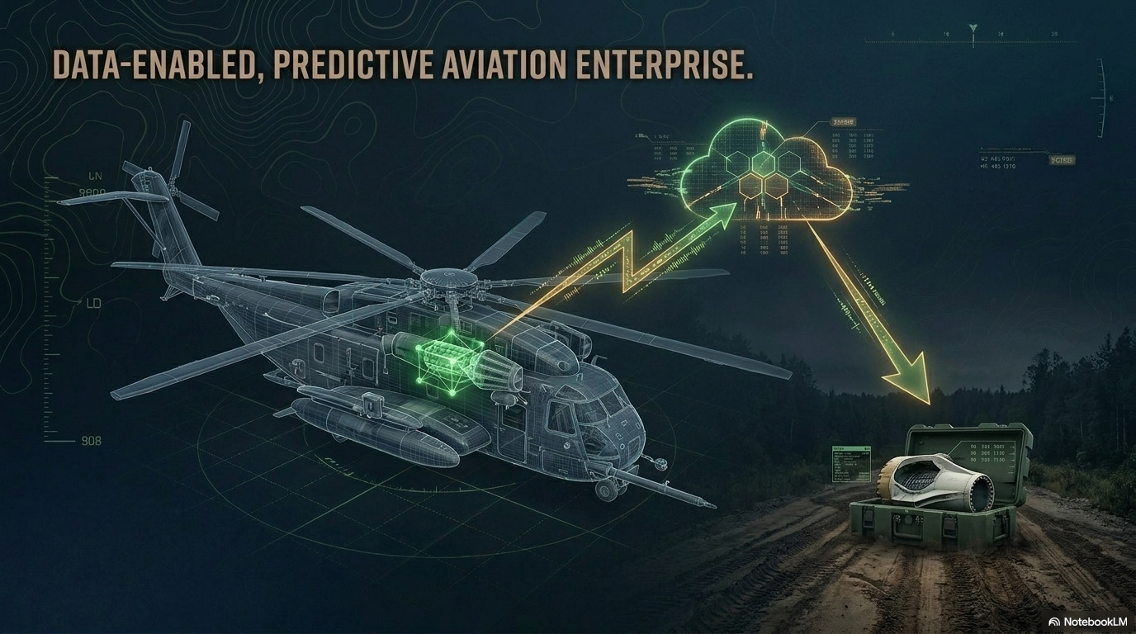

Slide 10
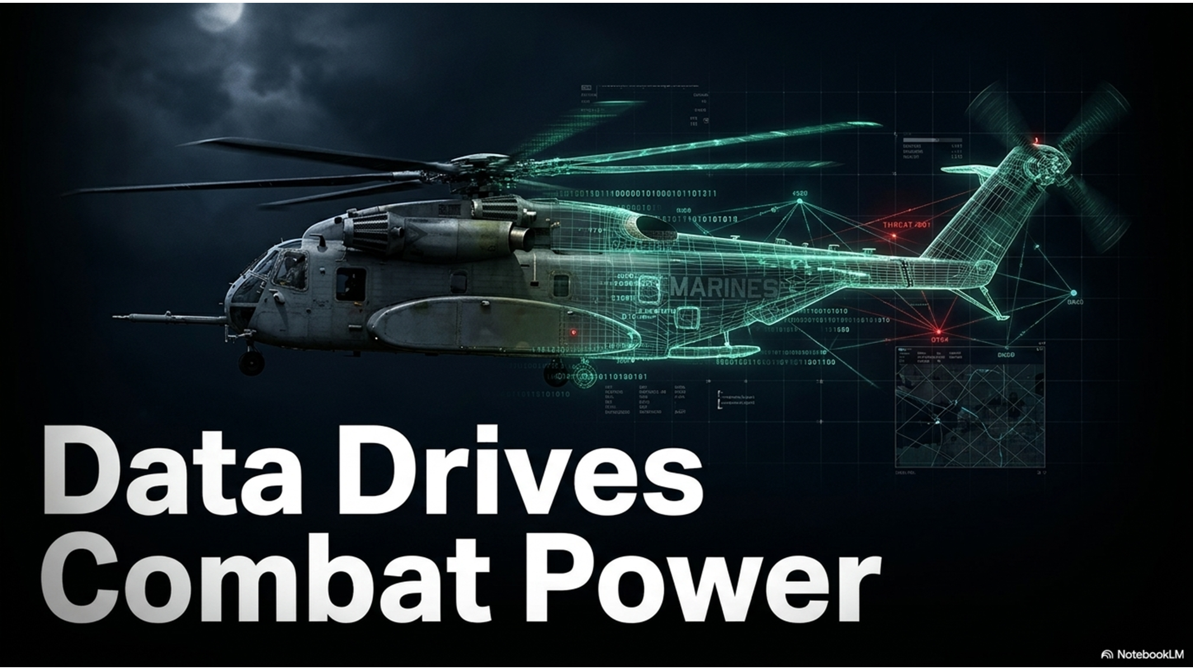
AI/ML
Notes:
Data is the foundation of DAO.
We are building a data-centric aviation enterprise that allows us to:
Anticipate maintenance requirements
Optimize logistics flows
Improve safety and risk management
And accelerate operational decision-making
AI and machine learning are not add-ons—they are enablers of readiness and lethality.
They allow us to move from reactive to predictive, and from centralized to distributed decision-making

Slide 11
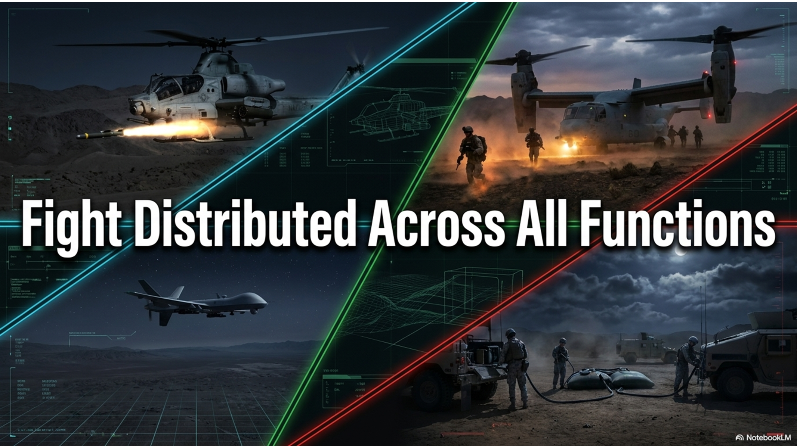
Functions of Marine Aviation
Notes:
DAO applies across all functions of Marine Aviation:
Offensive Air Support
Assault Support
Air Reconnaissance
Electronic Warfare and Cyber
Multi-Domain Command and Control
Aviation Ground Support
Each function must be able to operate in a distributed, contested environment.
This requires changes not only in platforms—but in how we train, sustain, and integrate those capabilities.

Slide 12
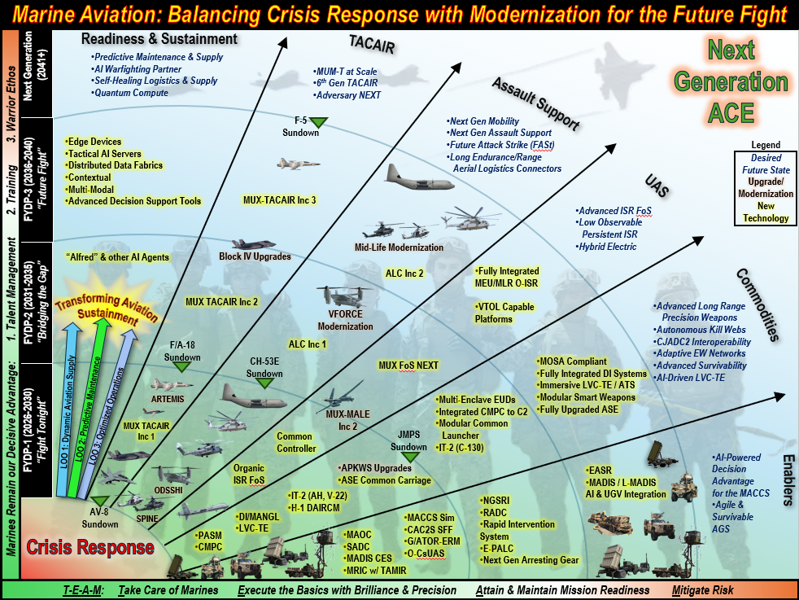
Notes:
As we implement DAO, we must acknowledge risk.
We are balancing:
Maintaining today’s readiness
While modernizing for tomorrow’s fight
We cannot accept a capability gap during this transition.
That is why our approach is deliberate—phased across near, mid, and long-term timelines—aligned to the Aviation Plan and Project Eagle

Slide 13
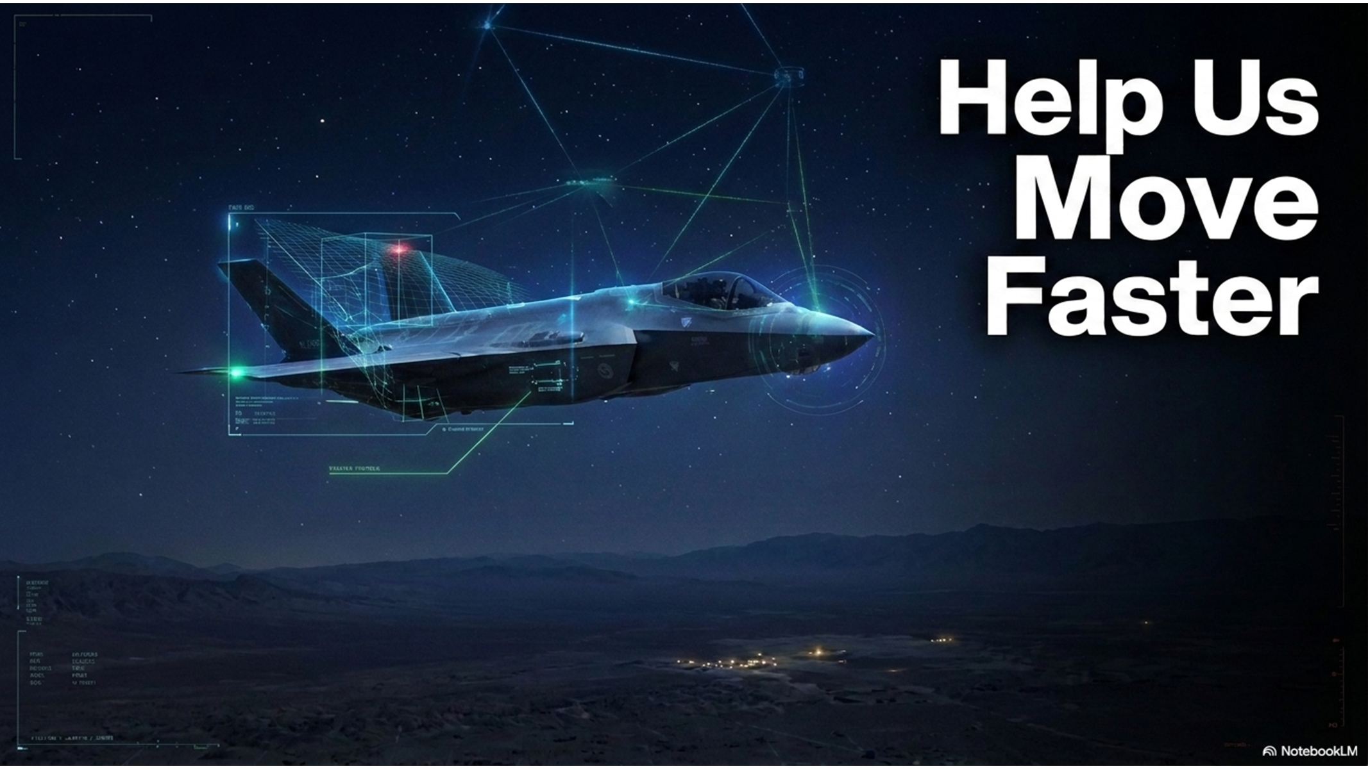
What we Need (industry)
Notes:
We cannot do this alone.
We need partners—across industry, the joint force, and the naval enterprise—to help us understand the art of the possible.
Specifically, we need:
Data architectures that enable interoperability
AI tools that function at the tactical edge
Resilient communications in degraded environments
And logistics solutions that reduce demand and increase agility
Our Aviation Plan is our signal to industry—this is where we are going, and we need your help to get there faster.

Slide 14
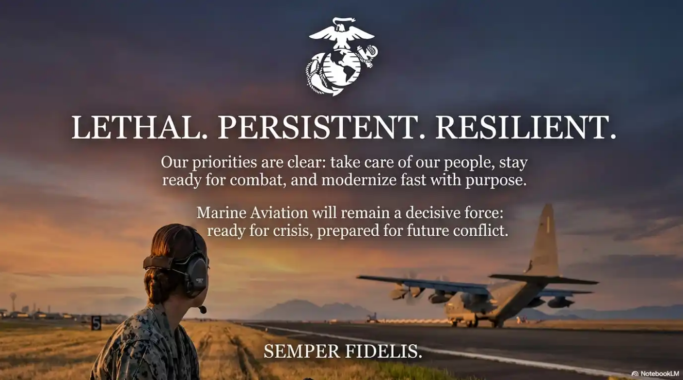
Notes:
The endstate is a Marine Aviation force that is:
Lethal across the kill web
Persistent in contested environments
Resilient against disruption
A force that can operate forward on day one—and continue to fight when conditions deteriorate.

Slide 15
Back Ups

Slide 16
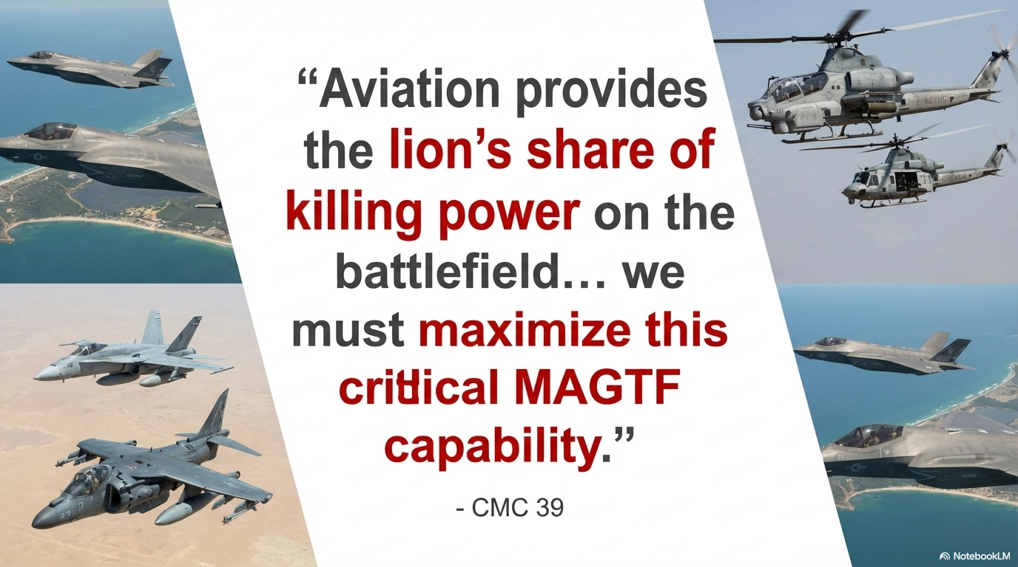
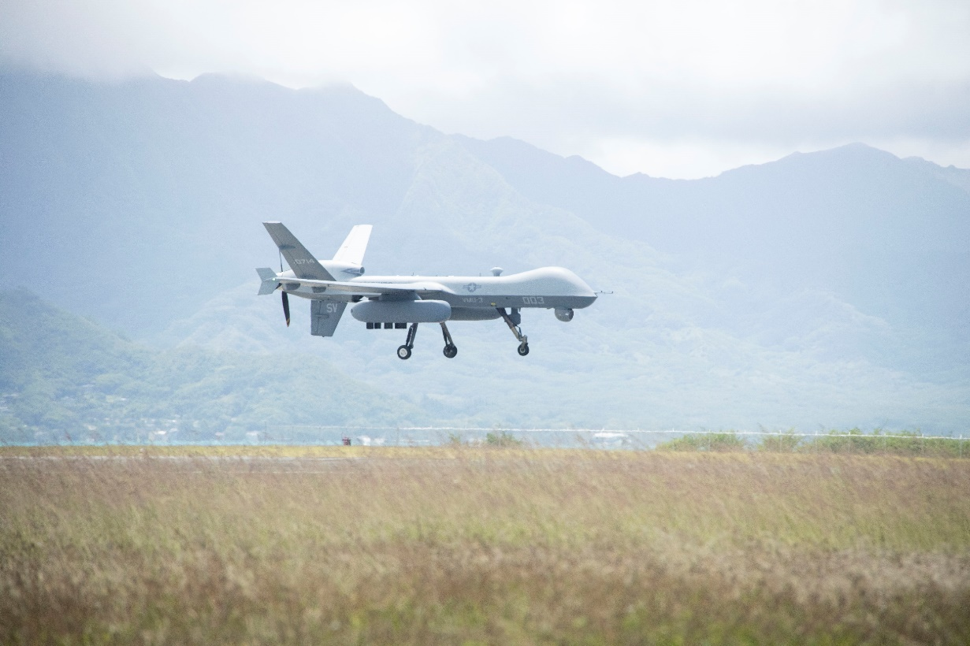
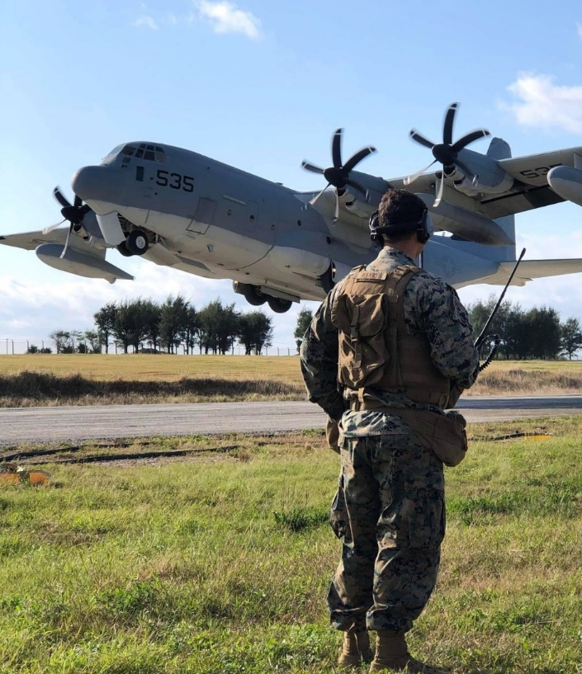
“Aviation provides the lion’s share of the killing power on the battlefield…we must maximize this critical MAGTF capability.”
-CMC 39
Notes:
Distributed Aviation Operations ensures that Marine Aviation remains relevant in the future fight.
It allows us to maintain our role as delivering the lion’s share of the MAGTF’s killing power—while adapting to a rapidly changing battlespace.
At the end of the day, this is about one thing: Ensuring our Marines remain the decisive advantage.
Thank you. I look forward to your questions.

Slide 17
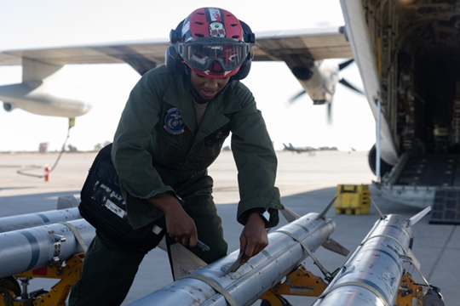
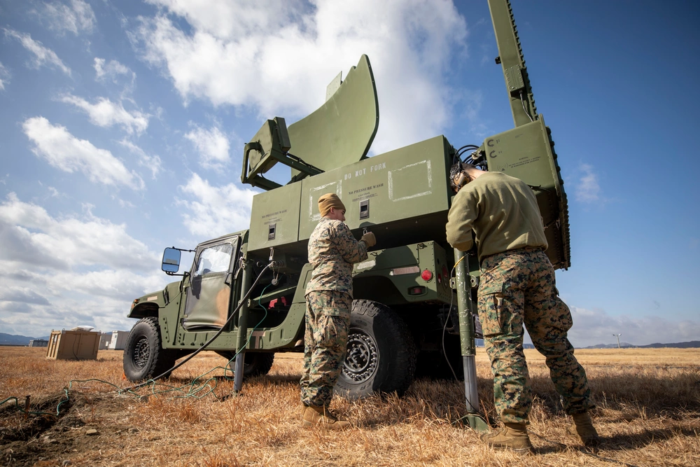
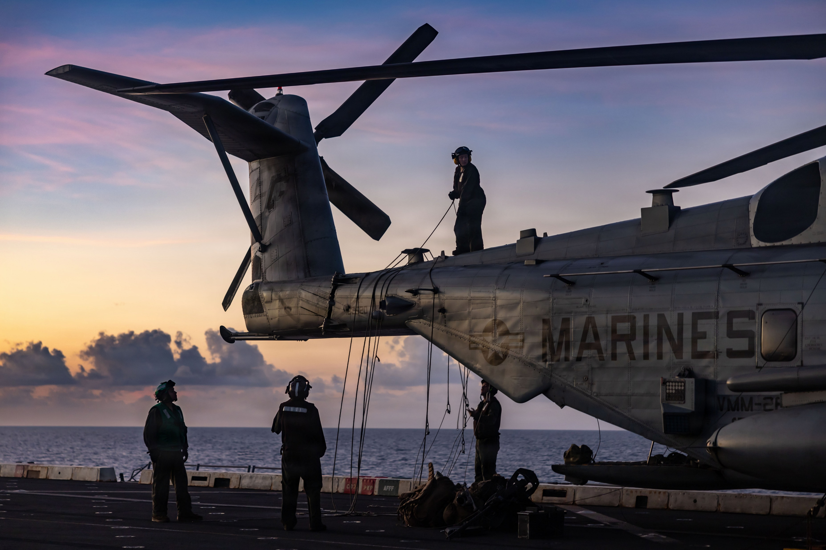
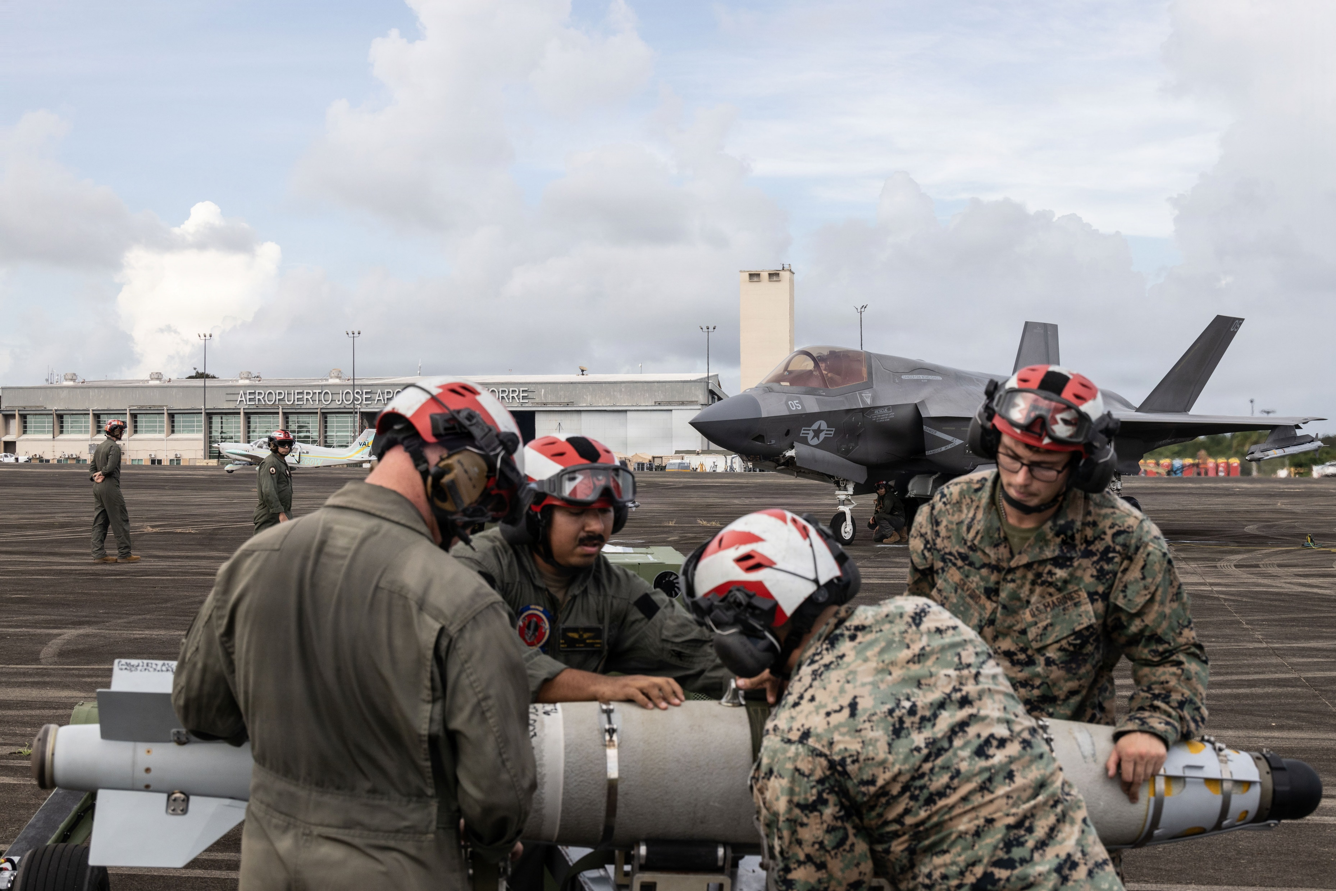

Slide 18
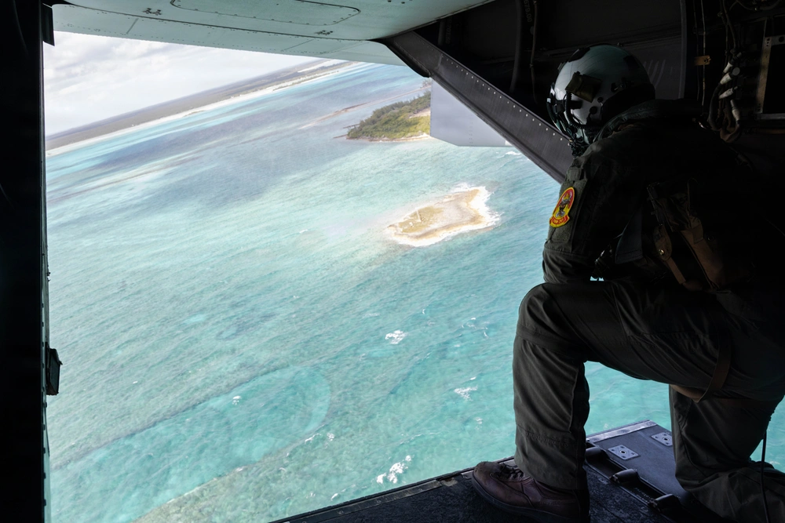
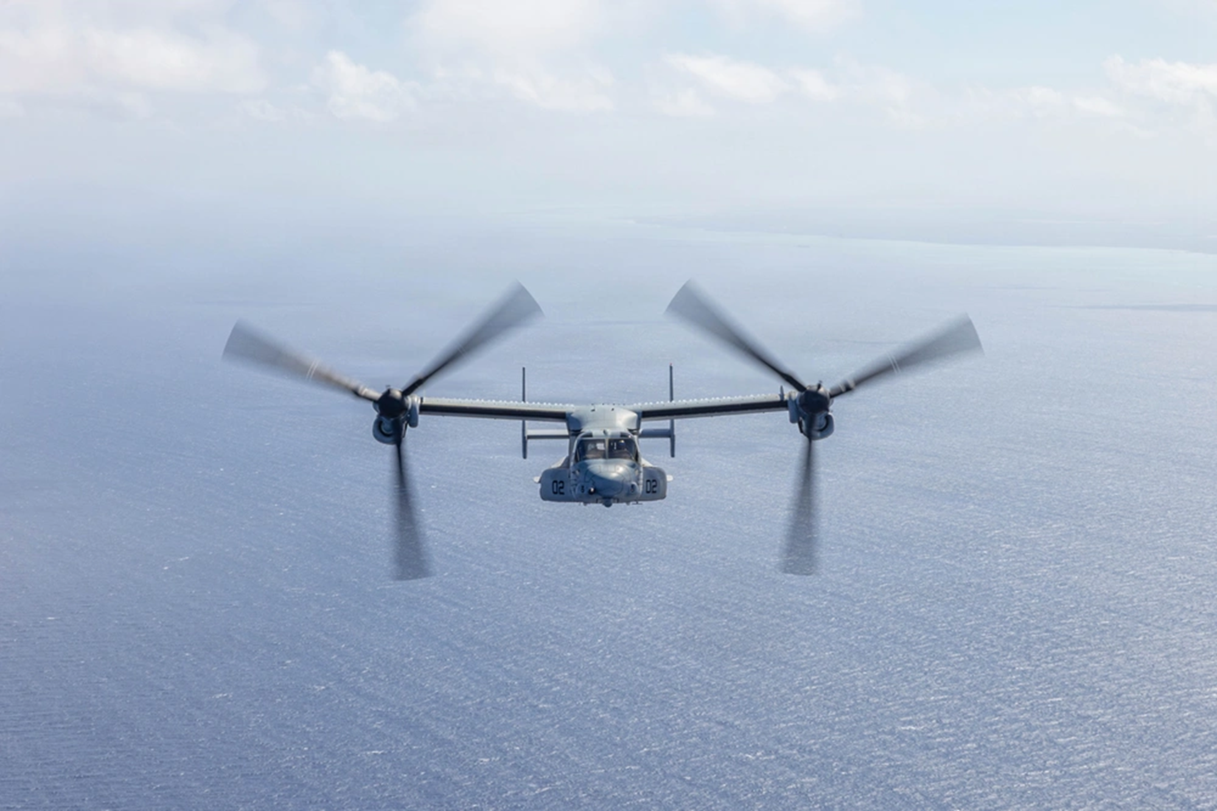
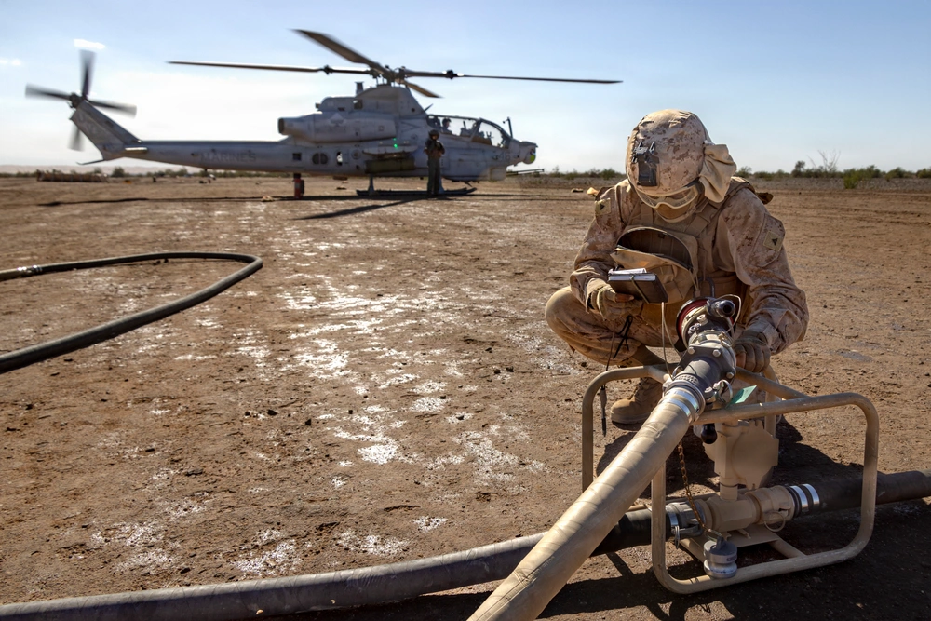
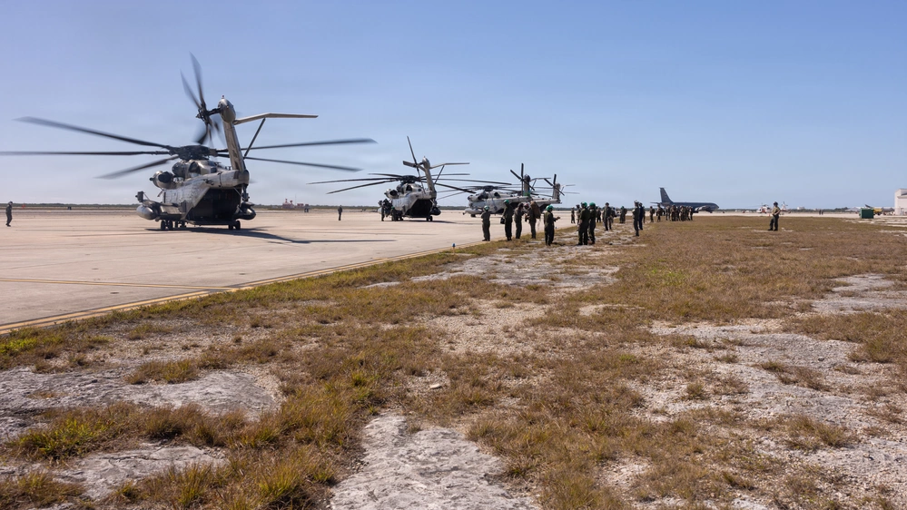

Slide 19
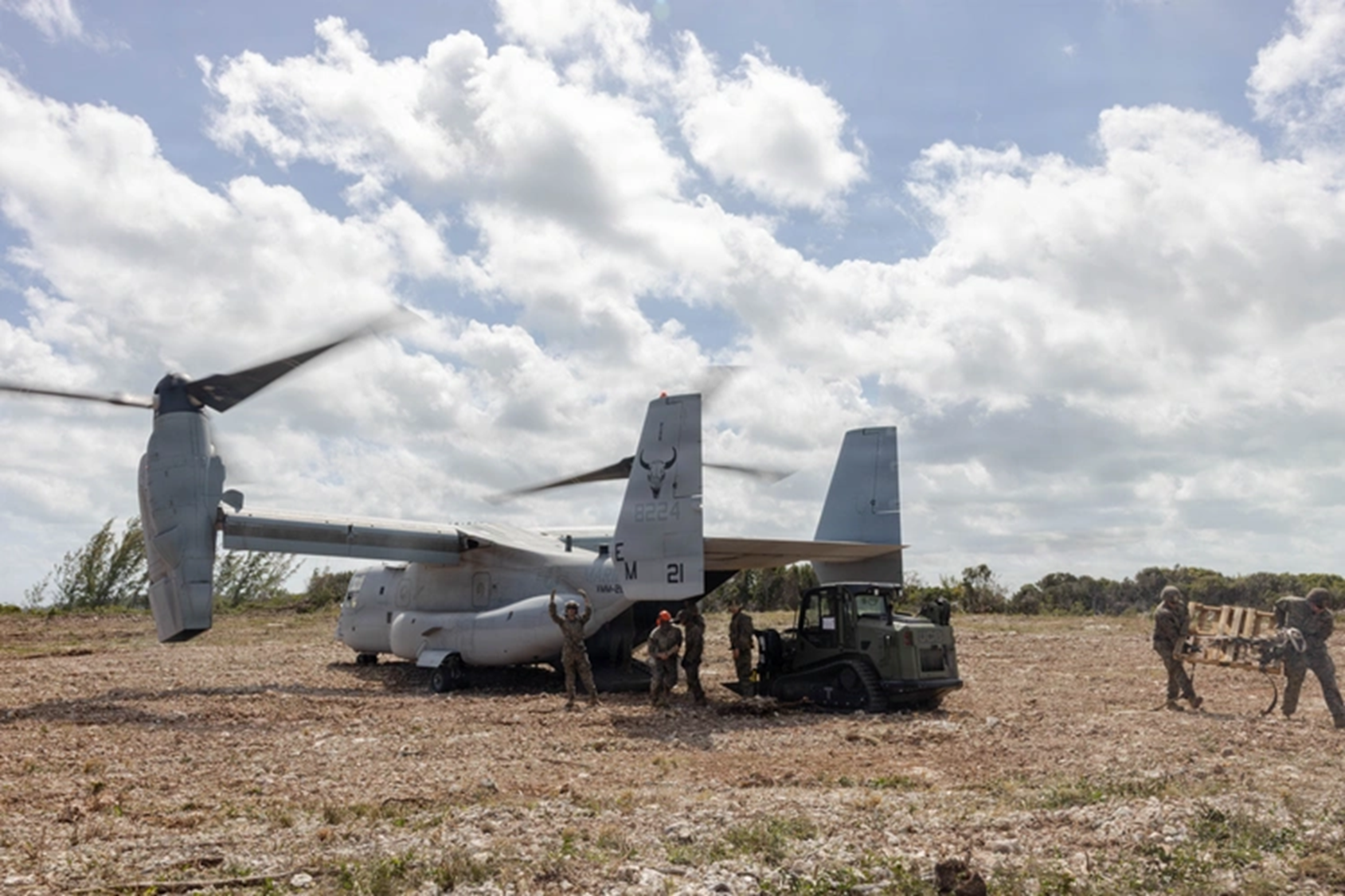
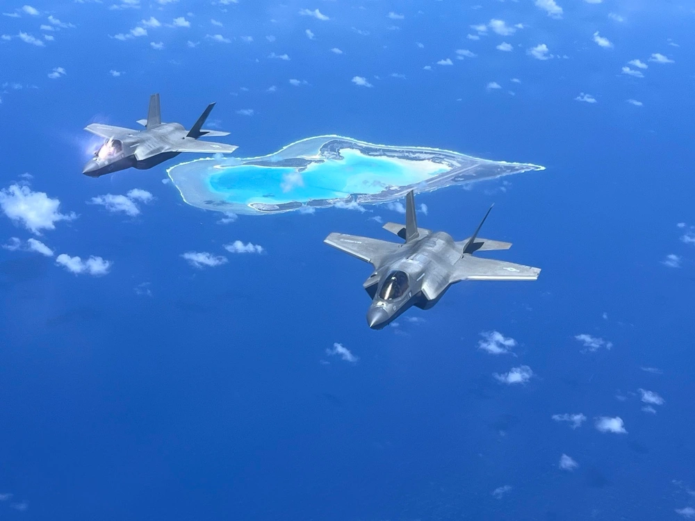
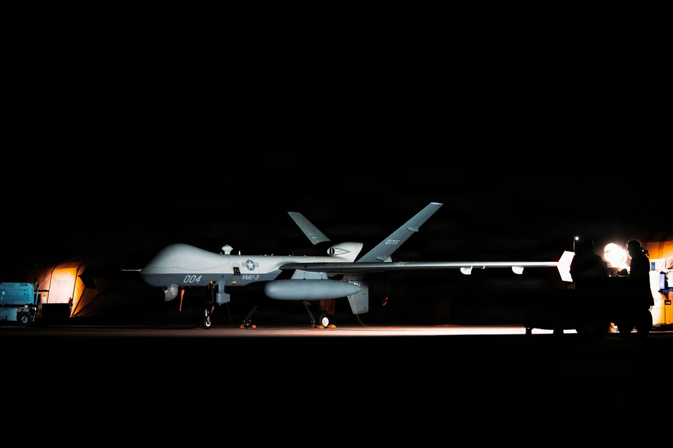
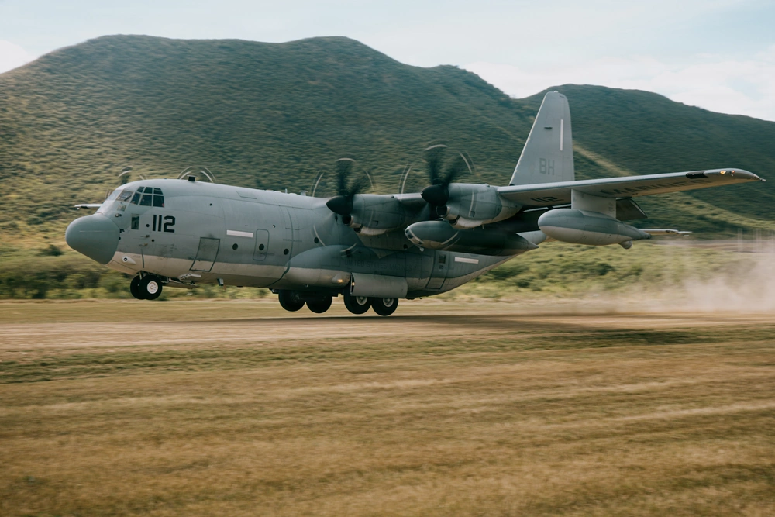

Slide 20
