Slide 1
UNCLASSIFIED
Capability Development and the New Joint Force Requirements Process
Modern Day Marine
LtCol Joshua “Tapeworm” Freeland
Marine Corps Integration Division
Capabilities Development Directorate
Combat Development & Integration
28 April 2026
April 17 2026
V1.2
UNCLASSIFIED
Notes:
Good afternoon, ladies and gentlemen. Today, we will be discussing Capability Development within the new Joint Force Requirements Process.
My name is Lieutenant Colonel Joshua Freeland, call sign "Tapeworm." I am a MAGTF Planner assigned to the Marine Corps Integration Division of the Capabilities Development Directorate. We are the Marine Corps organization dedicated to the planning of the Service’s Program Objective Memorandum.

Slide 2
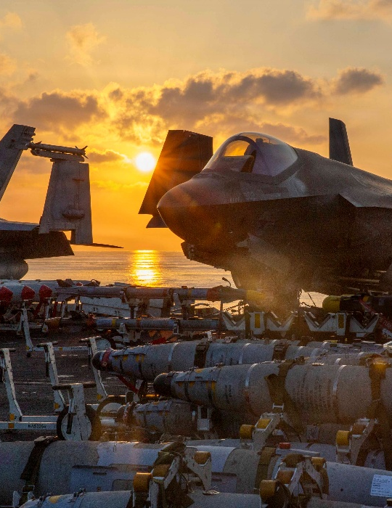
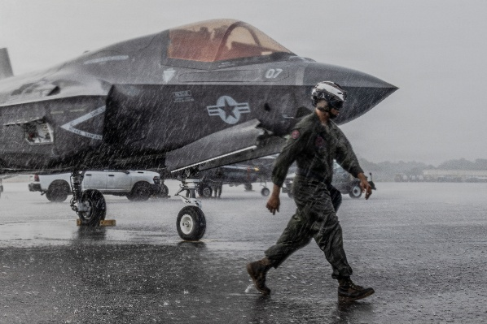
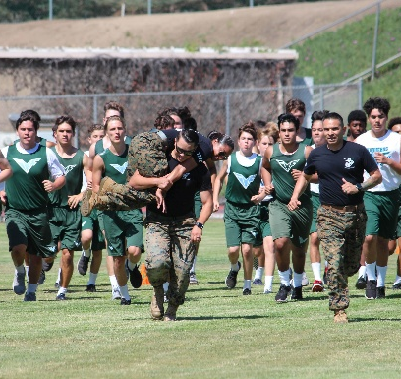
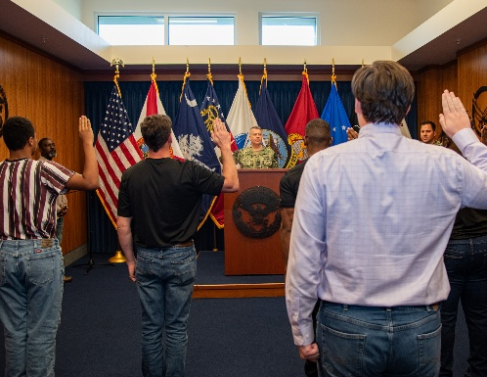


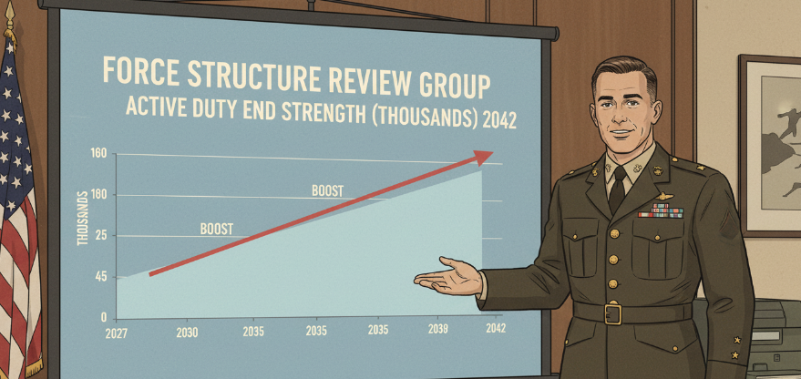

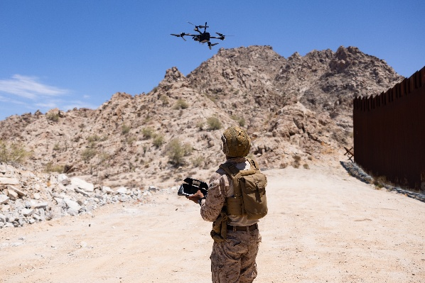
The Beneficiaries
Force Employment
Force Development
VMFA 255 supporting Operation SOUTHERN SPEAR
Orange County HS Combat Fitness Test
MEPS Oath Ceremony
McKinley HS Pearl Harbor Shipyard Visit
Force Design
VMFA 314 in Operation EPIC FURY
22d MEU in the Caribbean
“For clarity, when [the DoW] references Force Employment, it refers to the near-term efforts; …Force Development refers to the mid-term efforts; and …Force Design refers to the long-term efforts.”
CJCS Manual 5123.01 – Manual for the Joint Force Requirements Process
22d MEU in the Caribbean
CLB 15 supporting JTF SB
Notes:
What you see on the news, and what dominates our operational focus daily, is Force Employment. It is about the Marines on the ground right now—conducting operations like SOUTHERN SPEAR or EPIC FURY, operating from the littorals to the southern border. We are absolutely committed to ensuring these warfighters have everything they need to fight and win... tonight.
But our responsibility does not end there. At some point in the past, someone was focused on preparing for the battlefield we are operating on today. Now, it is our turn to prepare for the challenges of tomorrow.
[[Build 1]] So, we must ask the fundamental question: Who is focused on the force of the future? Who is designing the capabilities for the young men and women who haven't even enlisted yet, but who will be called upon to prevail in the contested environment of 2040?
That is the realm of Force Development and Force Design. It is the long, hard, analytical process of ensuring the next generation is prepared. This creates the central tension of our enterprise: how do we balance the urgent, non-negotiable needs of the warfighter on the left... with the critical, strategic needs of the future force on the right?
[[Build 2]] To navigate this challenge, we must use a common lexicon. For the remainder of this brief, we will use the official definitions from the Joint Force Requirements Manual to define our time epochs.
When we speak of Force Employment, we are referring to the near-term: from now to two years out.
When we speak of Force Development and Force Design, we are referring to the mid- and long-term, respectively.
Near-term, mid-term, and long-term. This is the framework that guides our entire capability development process.
/\/\/\/\/
Some criticisms from 2005 on the strategic thinkers and Force Designers which led to the Force we Employ today from Michael T. Klare’s 2005 Article “Revving Up the China Threat”:
"For at least some US strategists, not to mention giant military contractors, then, the “war on terror” was seen as a distraction that had to be endured until the time was ripe for a resumption of the anti-Chinese initiatives begun in February 2001. That moment seems to have arrived.“
"However, the shift in emphasis from blocking future rivals to fighting terrorism was troubling to many in the permanent-supremacy crowd who felt that momentum was being lost in the grand campaign to constrain China.“
"Moreover, antiterrorism places a premium on special forces and low-tech infantry, rather than on the costly sophisticated fighters and warships needed for combat against a major military power."

Slide 3


Purpose and Agenda
Purpose
Agenda
Demonstrate how the Marine Corps is operationalizing the Joint Force Requirements Process and integrating Mission Engineering to accelerate capability development.
Force Development and Design
Accelerating the Process
Organizations and Roles
Capabilities Based Assessment
Mission Engineering
Notes:
My purpose in today’s brief is straightforward: I want to demonstrate to you how the Marine Corps is operationalizing the Joint Force Requirements Process and integrating Mission Engineering to accelerate capability development.
But before we get into the mechanics of how this works, I want to establish the bottom line of what this transformation means for you, our Joint Force and Industry partners.
The Marine Corps is fundamentally upgrading our assembly line to become an industry customer of choice. As we go through this brief, I want you to look for three specific themes that define this upgrade:
First, a clearer demand signal. You will see how we are using Mission Engineering upfront to define exactly what our operational gaps are before we ever ask for metal to be bent.
Second, a flatter bureaucracy. You will see how we have eliminated the seams between requirement generation and acquisition by unifying our leadership under the new Portfolio Acquisition Executive.
And third, managing by portfolio and accepting risk. You will see how we are moving away from isolated programs to target integrated, multi-domain solutions at the speed of relevance.
To walk you through how we are achieving those three things, we will follow this agenda:
First, I’ll provide some context on Force Development and Design through a historical lens.
Then, I will use that history to discuss how we are Accelerating the Process through recent reforms.
Next, I will map out the key Organizations and Roles within the Marine Corps responsible for executing this new framework.
From there, we'll take a deep dive into the Capabilities Based Assessment itself.
And finally, we'll show how we are weaving Mission Engineering throughout the entire process to ensure analytical rigor.
To understand how all these pieces fit together, it is helpful to visualize this entire lifecycle—from the initial strategic demand signal to the final fielded product—as a continuous, interconnected factory floor. Let's move to the next slide and take a tour of our assembly line.

Slide 4
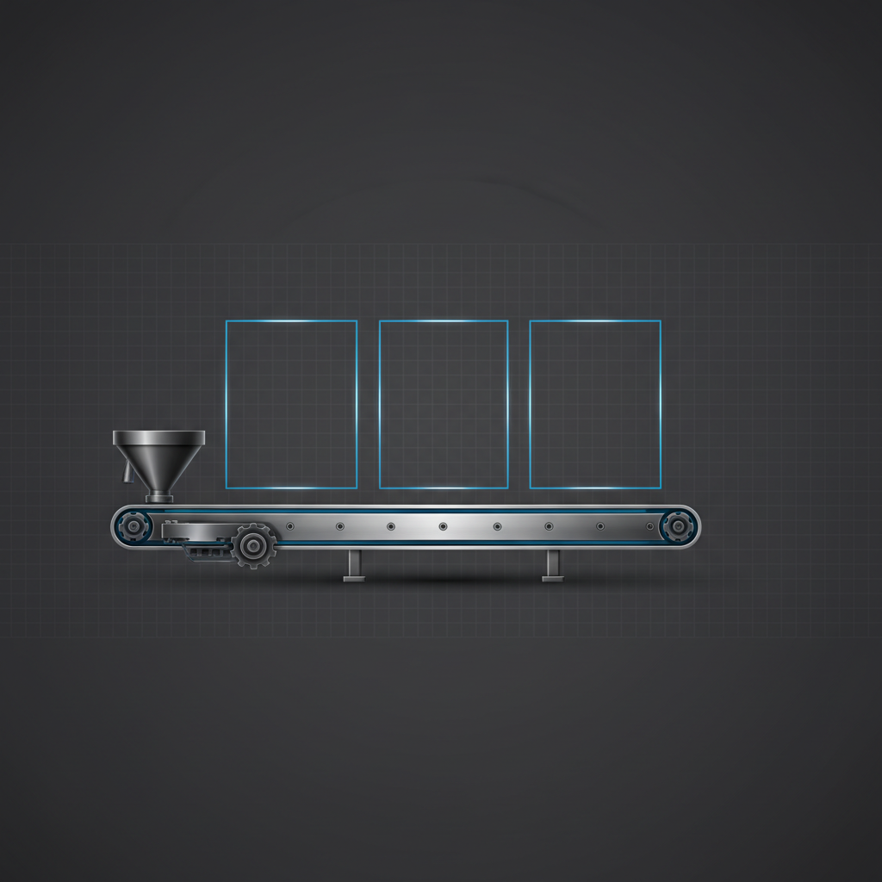
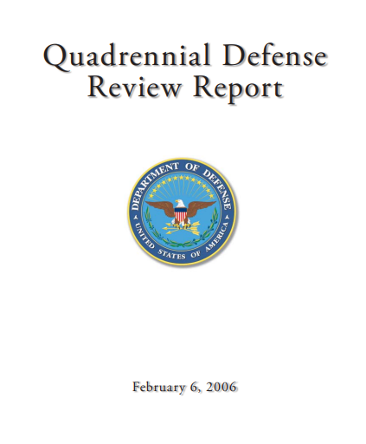
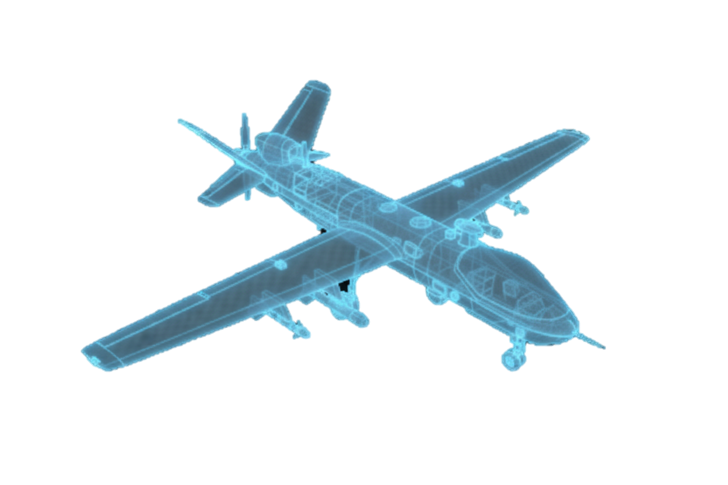
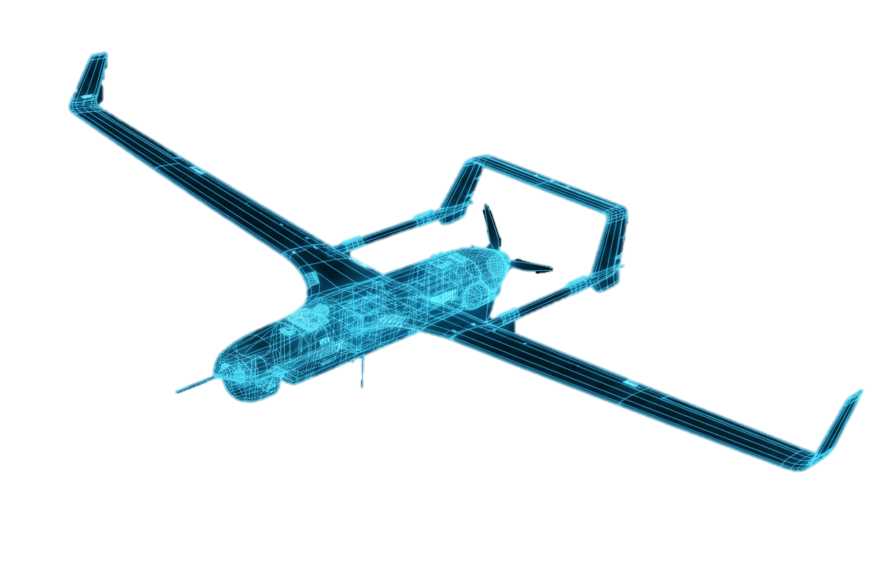
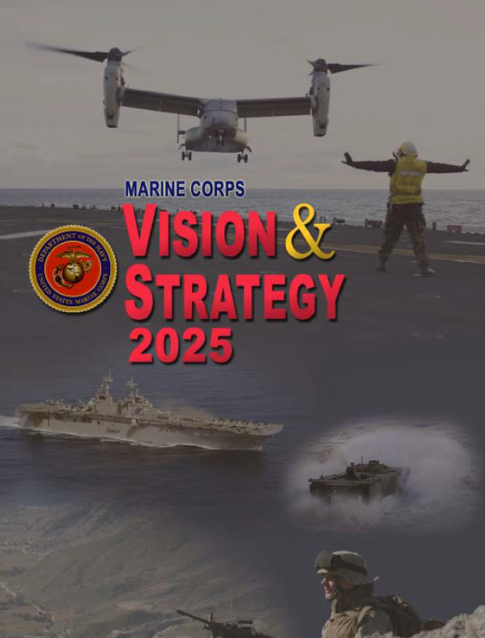
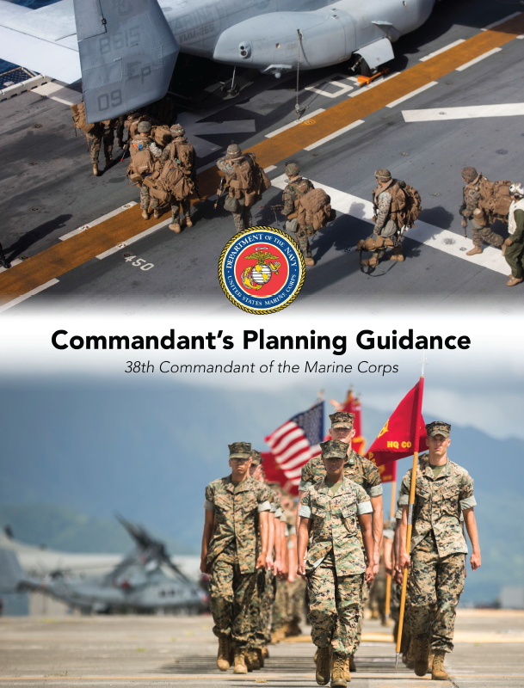
Force Development and Design
Strategic Guidance
25 – 7 Year Outlook
7 – 2 Year Outlook
2 – 0 Year Outlook
“We will prioritize short-term fielding of proven technology, and will significantly increase our efforts to mature unmanned capabilities in other domains.”
CMC 38 “Commandant’s Planning Guidance”
Force Design
Force Development
Force Employment
"...the art and science of developing and refining a shared vision for a future Joint Force..."
"...a deliberate process of planning, resourcing, and managing the development and integration of capabilities..."
"The daily use of the current force in operations, training, and exercises to build readiness and compete globally."
2013 Prototype Approved
2014 Prototype to Afghanistan
2017 Full
Production
2019 Fielding Complete
2020 RQ-21 Divestment Decision
2021 First
MQ-9A
“…we must pursue development of advanced ISR sensors that are linked to users at all echelons”
CMC 34 “Vision and Strategy 2025”
18 June 2008
“…I assess we are over-invested in…low endurance UAS incapable of employing lethal effects.”
CMC 38 “Force Design 2030”
March 2020
Notes:
Our assembly line that takes a raw operational concept and turns it into a fielded capability over a twenty-five year horizon is broken into the three interdependent phases we defined earlier: Force Design, Force Development, and Force Employment. I want to make this explicit right up front: Force Development is inherently oriented on the distant future. Because we are identifying the capability requirements for battlefields and threats that may not fully exist yet, patience is a necessary virtue across this enterprise. While the formal terminology for these epochs is relatively new, the underlying process has been operating for decades. To make this tangible, let's look at a concrete, historical example.
[[Build 1]] Every product on this line starts with a demand signal—our Strategic Guidance. Back in the mid-2000s, the Department was deeply engaged in counter-insurgency. The 2006 Quadrennial Defense Review set the stage, and our 34th Commandant translated that guidance into the Marine Corps Vision and Strategy 2025.
[[Build 2]] You can think of Vision & Strategy 2025 as the ancestor to today's Force Design. A key directive in that 2008 document was the explicit need for organic ISR for our small units. That guidance served as the blueprint for a capability requirement, triggering a Capabilities Based Assessment.
[[Build 3]] That blueprint then moved down the assembly line into Force Development. This is the hard part for the enterprise—the engineering, the testing, the production. This phase demands patience from all stakeholders because we cannot bypass the physics, the integration, or the rigorous testing required to ensure a system is ready for combat. For over a decade, the ISR solution was hammered into reality. By 2017, the system designed to meet that 2008 requirement was ready for the Fleet.
[[Build 4]] However, right as the final systems were being fielded in 2019, the strategic foundation shifted. The 2018 National Defense Strategy pivoted the entire Department toward Great Power Competition, and the 38th Commandant launched Force Design 2030.
[[Build 5]] This created a collision between the Force Employment phase and a new strategic reality. The ISR solution developed was a tool for the previous fight, but the new operating environment revealed a critical gap: the Marine Corps now lacked long-endurance, weaponized ISR.
[[Build 6]] Because this assembly line does not operate in a vacuum, it had to adapt. The Service made the call to divest of our old systems. Reallocating those resources permitted us to pivot rapidly to acquire the MQ-9A Reaper and contract for Group 3 UAS, which are supporting our operating forces globally today.
The bottom line is that this continuous, adaptive cycle works. While we must have the strategic patience to see complex development through, this history proves the system is capable of making difficult choices—trading an asset for a better one to ensure the force is equipped for the war it will actually face.
But even with the understanding that long-term development requires patience, a factory this complex cannot afford an unnecessary decade-long lag between a demand signal and a fielded solution. Let's move to the next slide and look at exactly how we are reforming this enterprise to make this assembly line run faster.

Slide 5
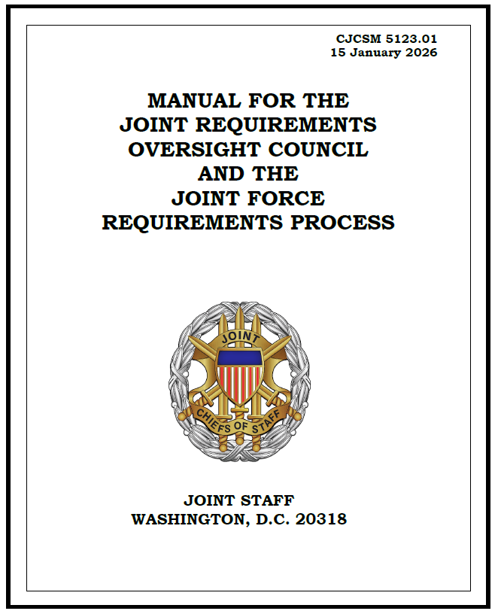
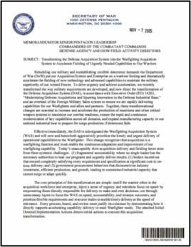
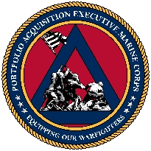
Accelerating the Process
Process
JFRP Reforms
Services validate requirements and Joint Staff reviews
Strategic Guidance
25 – 7 Year Outlook
7 – 2 Year Outlook
2 – 0 Year Outlook
Force Design
Force Development
Force Employment
Service document formats
"...the art and science of developing and refining a shared vision for a future Joint Force..."
"...a deliberate process of planning, resourcing, and managing the development and integration of capabilities..."
"The daily use of the current force in operations, training, and exercises to build readiness and compete globally."
Comments information only
Acquisition Reforms
Codified in 2003
Assign accountable leaders to optimize purchase and fielding.
10 reform efforts through 2003-2023
Capability Portfolio Management.
Mission Engineering in Force Development and Design.
2013 Prototype Approved
2014 Prototype to Afghanistan
2017 Full
Production
2019 Fielding Complete
2020 RQ-21 Divestment Decision
Requirement Validation
Operational Tests, Evaluation and Fielding
MCSC: Powering the Enterprise
Owning and Accepting Risk
Notes:
To figure out exactly how to make it run faster, we have to look closely at what caused those decade-long lags in the first place. Returning to our ISR example from the War on Terror, we know the capability was a direct response to the Commandant's guidance, but the delays in fielding it were systemic.
[[Build 1]] To understand the delays, we have to look at the root cause: the legacy JCIDS process. It was designed for thoroughness, but it created a massive administrative bottleneck. Before we could spend a single dollar on bending metal, we had to navigate a rigid Joint Staff gatekeeping process. A validation that was supposed to take 100 days routinely stretched to 300—and sometimes over two years. The system simply couldn't adapt, forcing the Service into urgent workarounds just to get Marines the gear they needed in combat.
[[Build 2]] That brings us to our first major reform: the transition to the Joint Force Requirements Process, or JFRP. This is a fundamental shift. By moving validation down to the Service level—with the Joint Staff providing only 'by-exception' reviews—we have broken the gridlock. We are now empowered to validate our own requirements, ensuring our demand signal actually keeps pace with the threat.
[[Build 3]] Our second major reform is organizational. Last November, the Secretary of War directed the transition to the Warfighter Acquisition System, calling for fully accountable leadership. On the 10th of this month, the Marine Corps answered that call by establishing the Portfolio Acquisition Executive Marine Corps, or PAE – Marine Corps.
[[Build 4]] Under the leadership of Lieutenant General Austin, we are no longer managing isolated programs. Instead, Capability Portfolio Managers are making integrated, portfolio-wide decisions. By conducting upfront capabilities-based assessments that integrate mission engineering, we strip away the ambiguity. The result is a clear, data-driven, and stable demand signal for our industry partners.
[[Build 5]] Most importantly, the PAE-MC establishes unprecedented alignment. By bringing Marine Corps Systems Command under the Deputy Commandant for Combat Development and Integration, LtGen Austin, we have eliminated the bureaucratic seam between requirement generation and program execution. The leader who identifies the capability gap is now the exact same leader responsible for delivering the solution. This empowers our teams to accept risk at the right level and adapt to operational realities instantly.
[[Build 6]] Together, the JFRP and PAE-MC reforms fundamentally accelerate our assembly line. By keeping validation at the Service level and flattening our bureaucracy, we are rigged to field integrated capabilities to the warfighter at the speed of relevance.
Having laid this historical framework, let's step back onto the factory floor and look at how a capability requirement transitions into an acquisition requirement today.

Slide 6
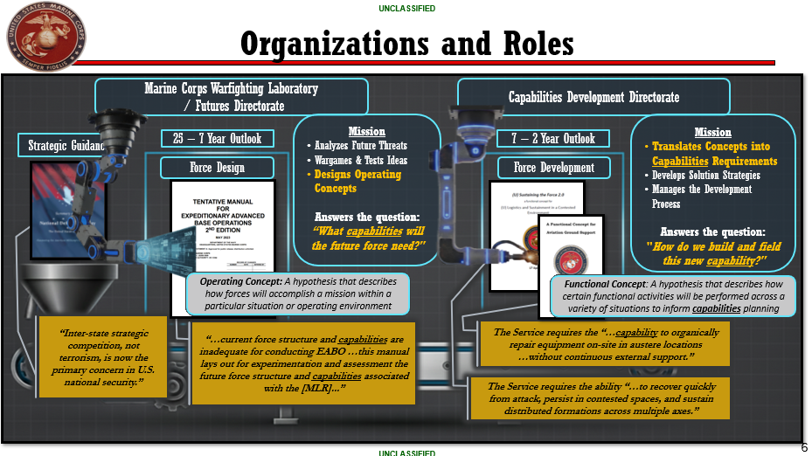
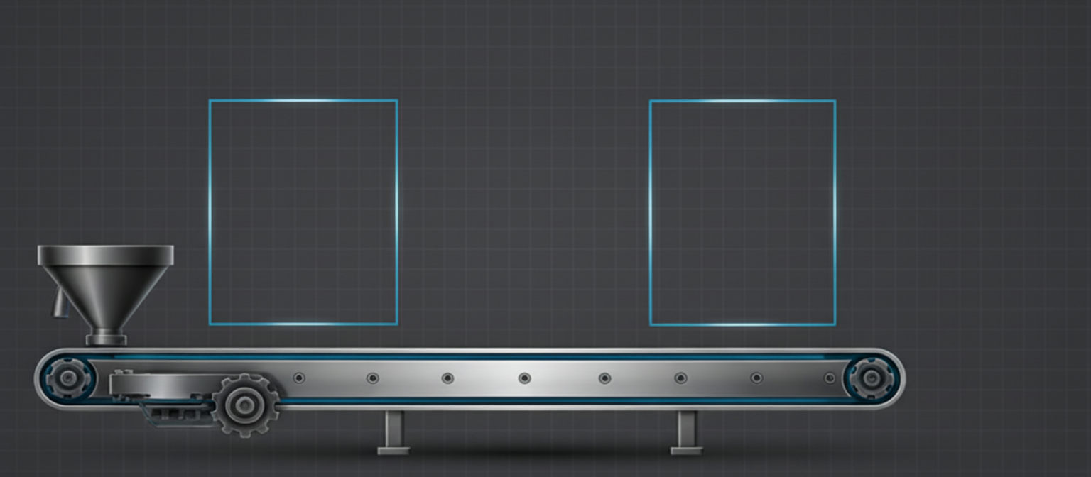
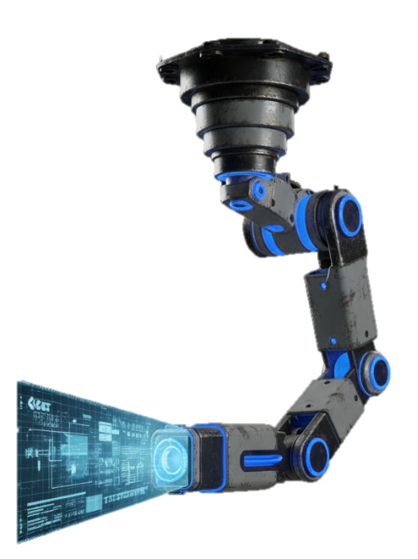
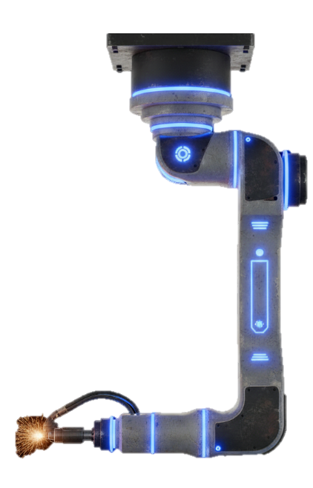
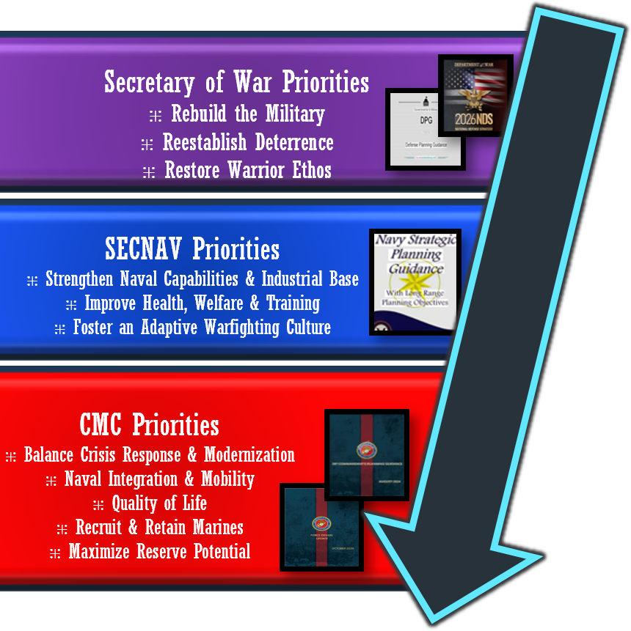
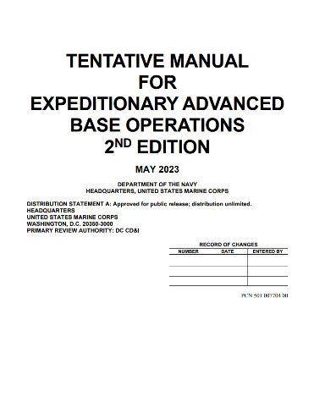
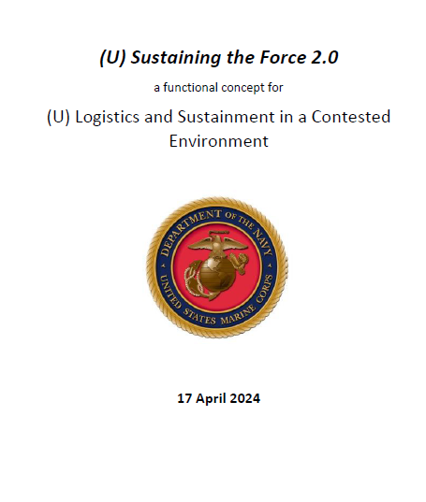
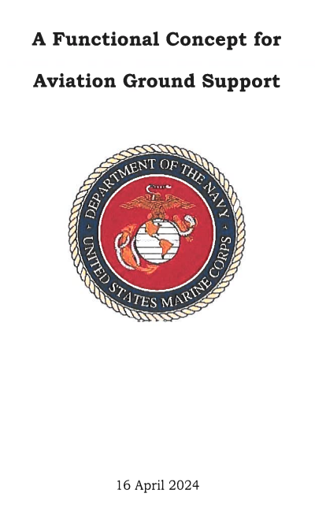
Organizations and Roles
Marine Corps Warfighting Laboratory
/ Futures Directorate
Capabilities Development Directorate
Mission
Analyzes Future Threats
Wargames & Tests Ideas
Designs Operating Concepts
Answers the question:
“What capabilities will the future force need?"
Mission
Translates Concepts into Capabilities Requirements
Develops Solution Strategies
Manages the Development Process
Answers the question:
"How do we build and field this new capability?"
Strategic Guidance
25 – 7 Year Outlook
7 – 2 Year Outlook
Force Design
Force Development
Operating Concept: A hypothesis that describes how forces will accomplish a mission within a particular situation or operating environment
Functional Concept: A hypothesis that describes how certain functional activities will be performed across a variety of situations to inform capabilities planning
“Inter-state strategic competition, not terrorism, is now the primary concern in U.S. national security.”
“…current force structure and capabilities are inadequate for conducting EABO …this manual lays out for experimentation and assessment the future force structure and capabilities associated with the [MLR]...”
The Service requires the “…capability to organically repair equipment on-site in austere locations …without continuous external support.”
The Service requires the ability “…to recover quickly from attack, persist in contested spaces, and sustain distributed formations across multiple axes.”
Notes:
All transformative change, and every requirement generated, starts with strategic guidance cascading from our civil authorities down to Force Designers and Developers. But it is never just a single document. As you can see here in our Priorities Funnel, we must ingest a massive, complex wave of directives—flowing from the Commander in Chief, Secretary of War, down through the Secretary of the Navy, and ultimately distilled into the Commandant's priorities. This funnel is the intake hopper of our factory. It takes the swirling chaos of the strategic environment and filters it down into a focused list of critical capabilities.
[[Build 1 - The 2018 NDS]] To understand how powerful this funnel is, let's look at a recent historical exemplar. For the Department of War and the industrial base that supports it, a tectonic shift in how we are modernizing started when the 2018 National Defense Strategy hit this funnel. It stated: “Inter-state strategic competition, not terrorism, is now the primary concern in U.S. national security.” That one sentence fundamentally altered the Marine Corps' demand signal, and it became the new baseline for force design.
[[Build 2 - MCWL]] The first step in that design process happens here, in the Marine Corps Warfighting Lab where they analyze the future operating environment, run high-level wargames, and experiment with emerging science and technology. Their critical contribution to the capability development process is highlighted in orange: they translate that filtered strategic guidance into Operating Concepts—blueprints for how the Marine Corps will fight.
[[Build 3 - EABO & Divestment]] The current edition of the Expeditionary Advanced Base Operations concept, or EABO was a direct response to that NDS pivot. Analysis of the NDS leading to that concept came to a stark conclusion: the legacy force structure was inadequate to execute EABO. This led to high-profile divestments, such as heavy armor. Heavy armor remains an awesome capability, but the analysis showed it was a capability optimized for a problem the Marine Corps is no longer tasked to solve.
[[Build 4 - CDD & Capabilities vs. Solutions]] A tank is a solution, but it was a solution to a problem that no longer matched the Service’s mission. If the Operating Concept is the blueprint, a dedicated team is needed to rigorously define the required capabilities. That happens here, at the Capabilities Development Directorate, or CDD.
The word 'Capability' is critical. Nobody at CDD is physically building a widget or a platform. They are developing the plan for how the Service will solve a shortfall in its ability to meet the requirements of that future force. While the acquisition enterprise and industry ultimately deliver the materiel solutions, CDD defines the capability shortfalls.
[[Build 5 - Functional Concepts]] The first step in that plan involves breaking down the overarching Operating Concept into smaller, functional components called Functional Concepts. Displayed here are just two examples from the Logistics warfighting function, out of a total of 27 discrete Functional Concepts that CDD analyzes.
[[Build 6 - CRCs]] Crucially, these Functional Concepts contain Concept Required Capabilities, or CRCs. These CRCs serve as the earliest demand signal for future development. As the examples show, they are not pieces of gear; they are required abilities. A CRC is a list of performance standards—a list of verbs—that defines what the future force must be able to do to execute the concept. These required abilities form the entire basis of Marine Corps assessments, plans, and ultimately, the formal requirements that drive future acquisition and innovation across the enterprise.
Now, let's take one step further down the assembly line, and look at just the Force Development phase to see exactly what takes a capability requirement and passes it into the acquisitions pipeline.

Slide 7
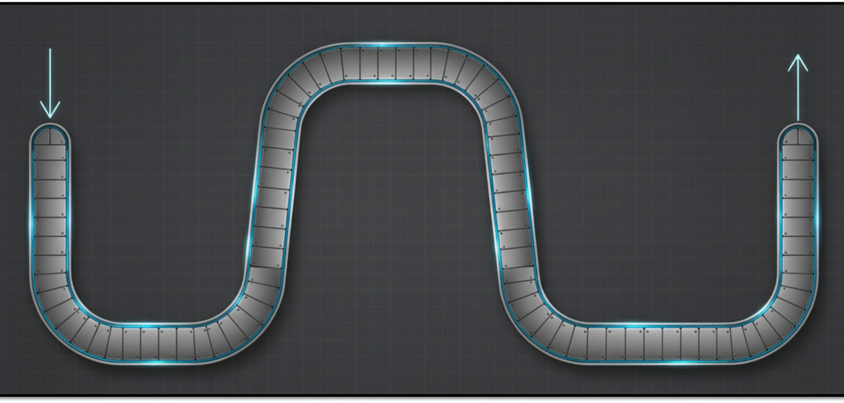
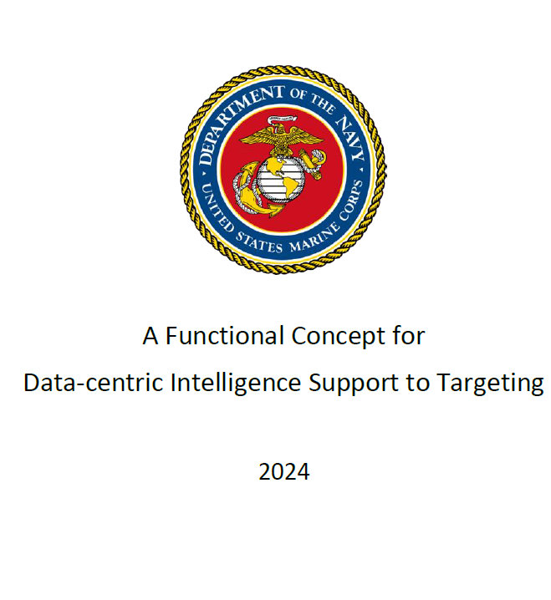
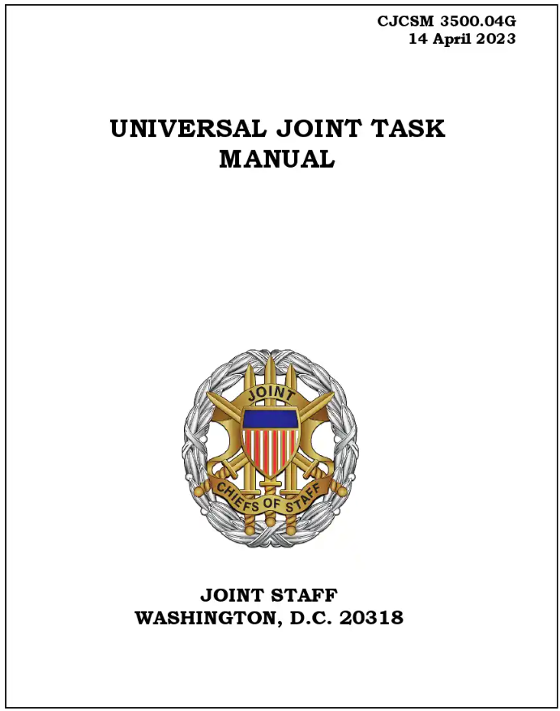
Capabilities Based Assessment
“JFRP Implementation. The JFRP does not dictate Service … requirements processes, but provides guidance [to] ensure interoperability.”
CJCS Instruction 5123.01 – Charter for the JROC and JFRP
Force Employment
Task a sensor for post-strike collection
The MAGTF has an inability to conduct a timely and scalable end-to-end battle damage assessment process from automated sensor tasking to AI-assisted characterization, reducing the ability to enable rapid and informed re-attack decisions due to a lack of an integrated materiel solution for automated BDA, doctrine for AI-assisted targeting, and training to operate and sustain the capability.
The Service requires the capability to conduct “…AI-enabled bomb hit assessment and battle damage assessment.”
Characterize battle damage via the AI model.
Gap Analysis
Capabilities Analysis
’How many of the tasks needed to accomplish the concept required capabilities of the future force can the current force already perform under the expected conditions of the Future Operating Environment to the standards needed to meet the future threat?'
Doctrine
Standards
Organization
Solutions Analysis
Attribute: Timeliness
Measure: Time (in seconds) from when the post-strike imagery is made available to the model to when the initial characterization is displayed to the user.
Criteria: <60 Seconds
Training
Gap Solution Strategy
Materiel
Tasks
Leadership
Task a sensor for post-strike collection
Conditions
Personnel
Characterize battle damage via the AI model.
Facilities
Policy
Notes:
Before we dive into the mechanics of this next phase, I want to draw your attention to the quote on the screen from the instruction chartering the new JFRP. It states that the JFRP “does not dictate Service requirements processes, but provides guidance to ensure interoperability.”
Think of the JFRP not as a heavy-handed corporate mandate that tells us how to run every machine, but as an overarching industry standard. The Joint Staff isn't dictating the exact layout of our factory floor; they are simply providing the standards to ensure our final product plugs seamlessly into the broader Joint Force. This gives us the explicit freedom to re-engineer our own assembly line for maximum speed and efficiency.
Within the Force Development window of that assembly line, there are three critical phases that make up the Capabilities Based Assessment: Capabilities, Gap, and Solutions Analysis. These three phases are the core machinery that processes a theoretical capability requirement to the point where it can become an actionable acquisition requirement.
The first step in Capabilities Analysis is to pull down exactly what we just discussed: a Functional Concept and its associated Concept Required Capabilities.
[[Build 1]] Here you can see an example: the Functional Concept for Data Centric Intelligence Support Targeting. From that, we pull one particular, unclassified Concept Required Capability: the requirement to conduct AI-enabled bomb hit and battle damage assessment.
[[Build 2]] Using this example we can see how Capabilities Analysis seeks to answer a specific set of questions regarding a Tasks, Conditions, and Standards. We are asking: how many of the tasks needed to accomplish this future capability can our current force already perform?
[[Build 3]] These tasks will be performed in an uncertain future operating environment, and we define these conditions using terms which comply with the Universal Joint Task List (UJTL).
[[Build 4]] Finally, for every Task, we then determine the standards the future force must meet to accomplish the mission. The vital point here is the emphasis on the future force—specifically forecasting on a seven-year time horizon. We are not just looking at Mission Essential Tasks the force performs today; we are defining what will be demanded of us tomorrow.
As we move into phase two, Gap Analysis, we review those tasks, conditions, and standards. In this example, the standard requires an AI model to assess post-strike imagery and display it to an operator within 60 seconds.
[[Build 5]] If a Capability Integration Officer assesses that the current force cannot meet that 60-second standard, we have identified a formal capability gap. For this specific example, the inability to perform these tasks highlights shortfalls in Materiel, Doctrine, and Training.
Over the course of a planning year, the Marine Corps assesses multiple gaps across the entire Service—identifying over 250 gaps last year alone. Headquarters Marine Corps then conducts a rigorous prioritization process to determine which of those gaps are the most critical to close.
[[Build 6]] That prioritized list is sent into Solutions Analysis, where we evaluate the shortfalls across the DOTMLPF-C spectrum. Because we identified Doctrine, Training, and Materiel shortfalls for this specific gap, those are the three areas we conduct solutions analysis against.
[[Build 7]] The output of Solutions Analysis is a Gaps Solution Strategy. Think of this as a checklist of what the Service needs to do to close a particular gap. Under the new Joint Force Requirements Process (JFRP), the Deputy Commandant for Combat Development and Integration can then validate this as a formal capability requirement that necessitates an acquisition requirement.
[[Build 8]] Once validated, the requirement continues towards Force Employment in the Fleet Marine Force. This handoff is where the true impact of our recent acquisition reform becomes clear. We have eliminated the traditional bureaucratic barrier between Capability Development and the Program Developer. Because the Deputy Commandant for Combat Development and Integration now serves in the dual-hatted role as the Portfolio Acquisition Executive – Marine Corps (PAE-MC), the exact same leader who validates the requirement is now ultimately responsible for its delivery. By bringing these authorities back into one place, we have directly tied the identification of a capability requirement to its delivery mechanism—rigging the enterprise for speed and accelerating the fielding of solutions to the warfighter.
[[Build 9]] Now, let's take a look at how we are actively integrating Mission Engineering into this Capabilities Based Assessment process to make it even more rigorous.

Slide 8

Mission Engineering
Naval Capabilities Integrated Process Marine Corps (NCIP-MC)
Misson Engineering Threads
The solutions analysis phase will
“…assign the actors—people, systems, organizations, etc.—that perform the tasks, activities, and events in the approach to conduct a mission.”
NCIP-MC is the Service’s Mission Engineering - throughout the CBA portfolio managers will align Capabilities Requirements to NCIP-MC Mission Areas:
Air Denial
Counter C5ISRT
Sea Denial
Logistics
Task 1
Task 3
Gap Analysis
Task 2
Task 4
Capabilities Analysis
Unit 1
System 1
Doctrine
Unit 2
System 2
Misson Threads
Each NCIP-MC mission area will contain mission threads which
“…describe a set of tasks, activities, and events in an approach to conduct a mission.”
Organization
Training
Task 1
Task 3
Materiel
Solutions Analysis
Tasks
Task 2
Task 4
Leadership
Task a sensor for post-strike collection
Personnel
Characterize battle damage via the AI model.
Facilities
Policy
Notes:
Now that we have walked through the core machinery of the Capabilities Based Assessment, let’s look at how we are actively upgrading that process. Starting with the Program Objective Memorandum 2029 (POM-29) planning cycle, we are fully integrating Mission Engineering into our assessments through the Naval Capability Integration Process – Marine Corps, or NCIP-MC.
This process aligns the Marine Corps with a broader naval construct, bringing rigorous mission engineering to the forefront of force development. For this cycle, we are focusing specifically on four critical mission areas: Air Denial, Counter-C5ISRT, Sea Denial, and Contested Logistics.
As we execute Capabilities Analysis, every capability requirement and its associated tasks will be evaluated for alignment with one of these four mission areas.
[[Build 1 - Mission Threads]] Within each of those mission areas are multiple Mission Threads. A Mission Thread describes the end-to-end sequence of tasks, activities, and events required to accomplish a specific mission. By utilizing AI-enabled datasets, we can metadata-tag every individual task as it is created and validated, firmly affiliating it to a specific mission area and Mission Thread.
This gives us a structured, operational baseline. As we advance into Gap Analysis, our highest-priority capability gaps are inherently linked back to these operational threads.
[[Build 2 - Mission Engineering Threads]] When we move those prioritized gaps into Solutions Analysis, we take that operational baseline and build out Mission Engineering Threads. We do this by overlaying the specific actors, people, systems, and organizations that perform those tasks across the DOTMLPF spectrum.
We are moving from a purely operational description to an engineered architecture. Because this engineering rigor is now built natively into our capability development process, it yields a far more precise, data-driven assessment at the end of the planning cycle. When these requirements are ultimately handed over to the PAE-MC, the acquisition community receives a crystal-clear, engineered demand signal, further accelerating our ability to field the right solutions to the warfighter.

Slide 9
Purpose and Agenda
Purpose
Agenda
Demonstrate how the Marine Corps is operationalizing the Joint Force Requirements Process and integrating Mission Engineering to accelerate capability development.
Force Development and Design
Accelerating the Process
Organizations and Roles
Capabilities Based Assessment
Mission Engineering
Notes:
Ladies and gentlemen, as we bring this factory tour to a close, let’s revisit the thesis we set at the beginning of our time together.
We set out to demonstrate how the Marine Corps is operationalizing the Joint Force Requirements Process and integrating Mission Engineering to accelerate capability development.
Looking back at our agenda, we walked the entire length of the assembly line today:
We started with a historical perspective, showing how our Service has anticipated future requirements and adapted to strategic shifts—moving from legacy systems to the capabilities required for tomorrow's fight.
We detailed how we are complying with DoW guidance to accelerate the process by stepping away from the 300-day delays of JCIDS and embracing Service-level validation under the JFRP.
We mapped the organizations and roles, highlighting the historic standup of the PAE-MC, which eliminates the barrier between capability development and program execution by placing both under one unified leader.
And finally, we took a deep dive into the Capabilities Based Assessment, showing how we translate strategic guidance into Concept Required Capabilities—the verbs of what the future force must do—and how we are using Mission Engineering to build data-driven, engineered architectures for our capability gaps.
So, what are the key takeaways for this enterprise, our Joint Force, and our industry partners? At the start of this brief, I promised you three specific themes defining our upgraded assembly line. Here is how we delivered on them:
First: The demand signal is clearer than ever. We are doing the rigorous, mission-level analysis upfront. Before we ever ask for metal to be bent, we are using Mission Engineering and data-centric threads to define exactly what the operational gap is.
Second: The bureaucracy is flatter. By aligning Marine Corps Systems Command under the dual-hatted leadership of DC CD&I and PAE-MC, the leader who validates the requirement is now the same leader responsible for its delivery. We are rigged for speed.
Third: We are managing by portfolio and accepting risk. We are no longer managing isolated programs in a vacuum. We are looking for integrated, system-of-systems solutions, and our teams are empowered at the 3-star level to accept smart risks that accelerate capability to the warfighter.
For our industry partners here at the Warfighting Stage today, I want to emphasize what this means for you. The Marine Corps represents a unique opportunity as your customer of choice. We have a proven record of making the hard choices, divesting of legacy platforms, and pivoting rapidly when the mission demands it. Because we are a truly expeditionary force, our warfighters—and the Concept Required Capabilities we generate—span all domains: land, air, sea, space, and cyber.
Now, under the unified leadership of the PAE-MC, you are no longer dealing with fragmented silos. You have a single, integrated partner capable of fielding multi-domain, system-of-systems solutions.
Our core machinery has been upgraded. The assembly line is ready to move faster, and it is built to adapt. We rely on the innovation and partnership of everyone in this convention center to help us deliver the ultimate warfighting system: modernized and lethal Marines.
Thank you for your time and attention today. I’d now like to open the floor for any questions or discussion.

Slide 10
Backups

Slide 11

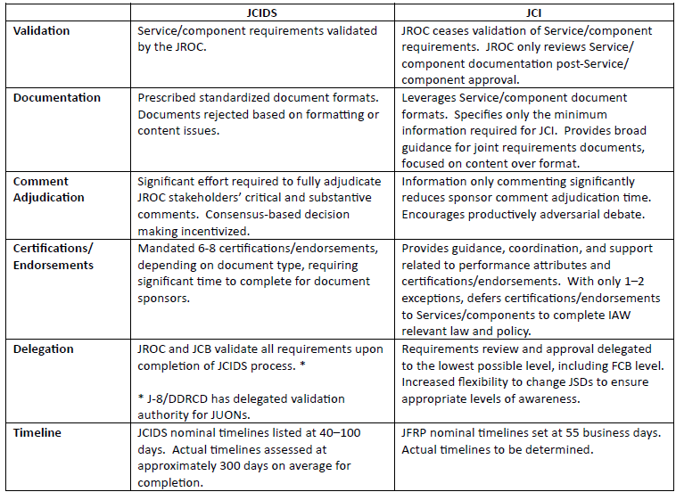
JFRP Changes

Slide 12
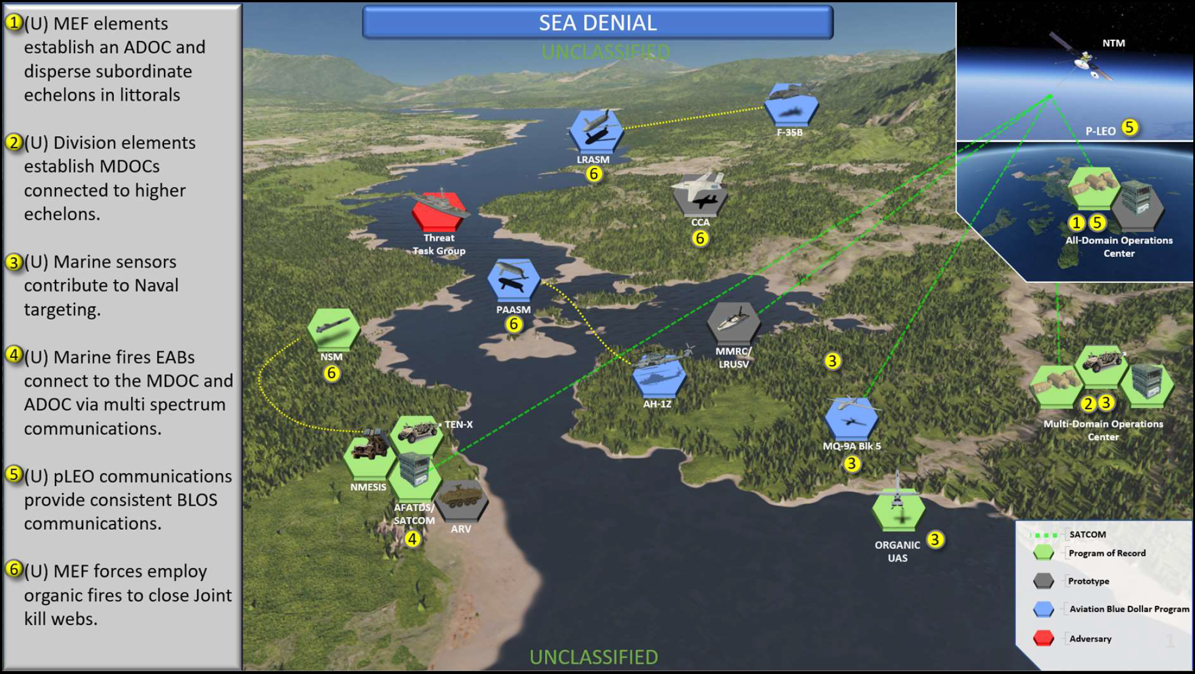
Operational View

Slide 13
Concepts vs Doctrine
Doctrine
Is a statement of beliefs about the best way to do something with the resources we currently have.
TECOM, Policy & Standards Division
https://usmc.sharepoint-mil.us/sites/MCEN_Support_MCDoctrine
---------------------
Concepts
Are ideas about how we might do something better with resources we may not have yet.
MCWL, Concepts & Plans Division
https://eis-op.usmc.smil.mil/sites/cdi_futures/SitePages/CAP-Concepts.aspx
Note
The difference between the two is the basis for how we identify gaps during a CBA.

Slide 14
Concepts vs Doctrine
Concept Required Capabilities (CRCs)
“Capabilities the force must poses in order to execute the concept”
(1) Directly map to one or more of the concept’s ideas, should address a single capability and should not be duplicated within the same concept.
(2) Are measurable in their ability to solve the military problem and sufficiently detailed to facilitate transition to capability development processes.
(3) Propose a new capability or describe how an existing capability may be modified or applied differently to improve the joint force’s ability to operate as described in the concept.
(4) Use existing doctrinal terms or propose new terms.
(5) Are prioritized within the concept to enable implementation and provide a clear understanding of the CRCs that are most critical to the concept.

Slide 15
References
Marine Corps receives final RQ-21A Blackjack UAS, 24 June 2019, https://www.navair.navy.mil/news/Marine-Corps-receives-final-RQ-21A-Blackjack-UAS/Mon-06242019-1445
RQ-21 FY15 ODT&E Test Summary, July 2015, https://www.dote.osd.mil/Portals/97/pub/reports/FY2015/navy/2015rq21a_blackjack.pdf?ver=2019-08-22-105645-677
3rd MAW procures Marine Corps’ first MQ-9A “Reaper”, 7 Sept 2021, https://www.marines.mil/News/News-Display/Article/2766284/3rd-maw-procures-marine-corps-first-mq-9a-reaper/

