Slide 1
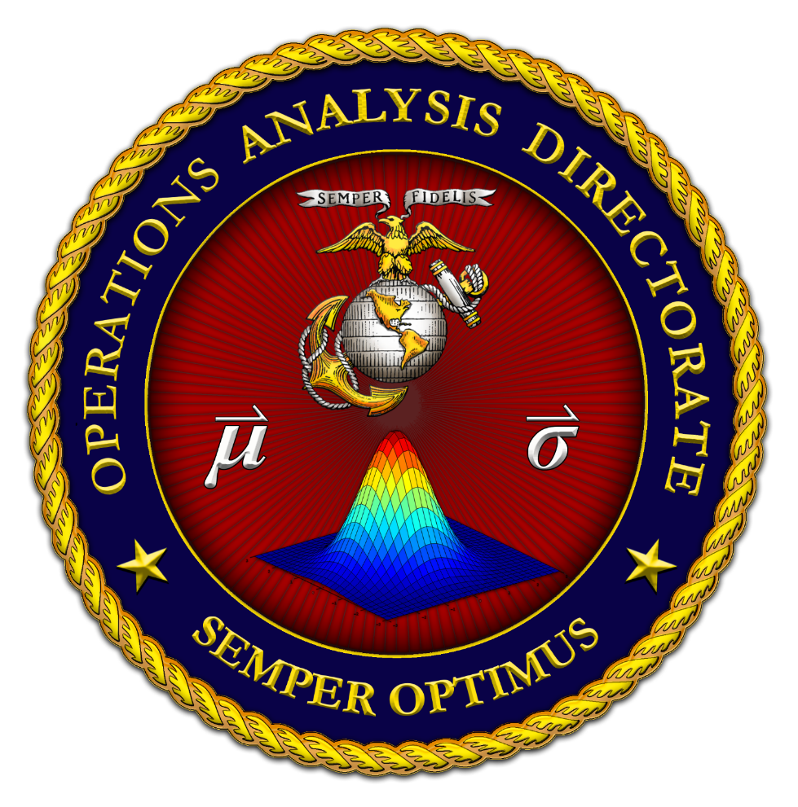
Modeling & Simulation at the Tactical Edge
Panelists:
Dr. Todd Calhoun
Assistant Deputy Commandant for Combat Development & Integration / Executive Deputy, Marine Corps Combat Development Command
Mr. Anthony J. Greco, Jr.
Executive Deputy, Marine Corps Training & Education Command
COL Wynndee M. Young
Program Manager, Marine Corps Systems Command
Moderator: Mr. John Lawson
Marine Corps Modeling & Simulation Office
Operations Analysis Directorate

