Slide 1


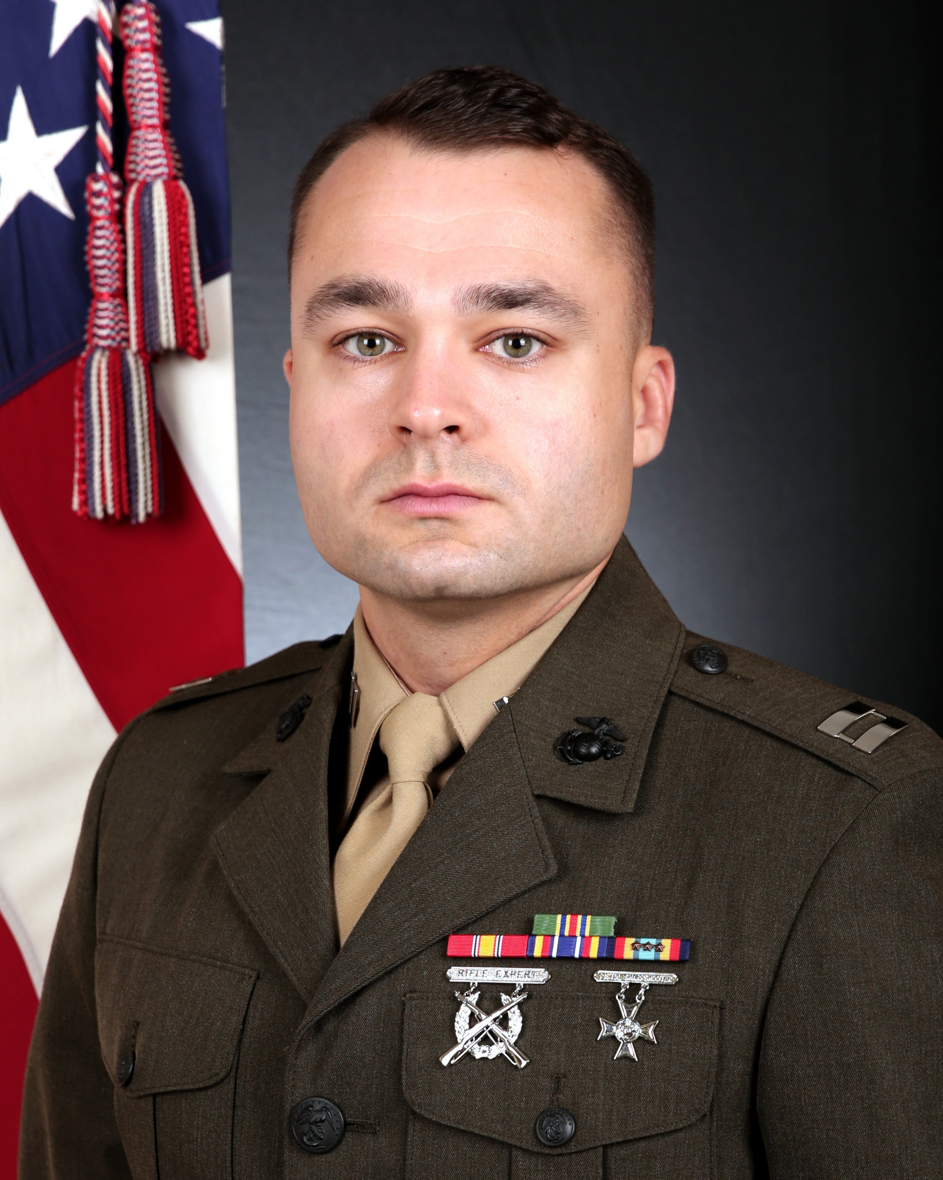
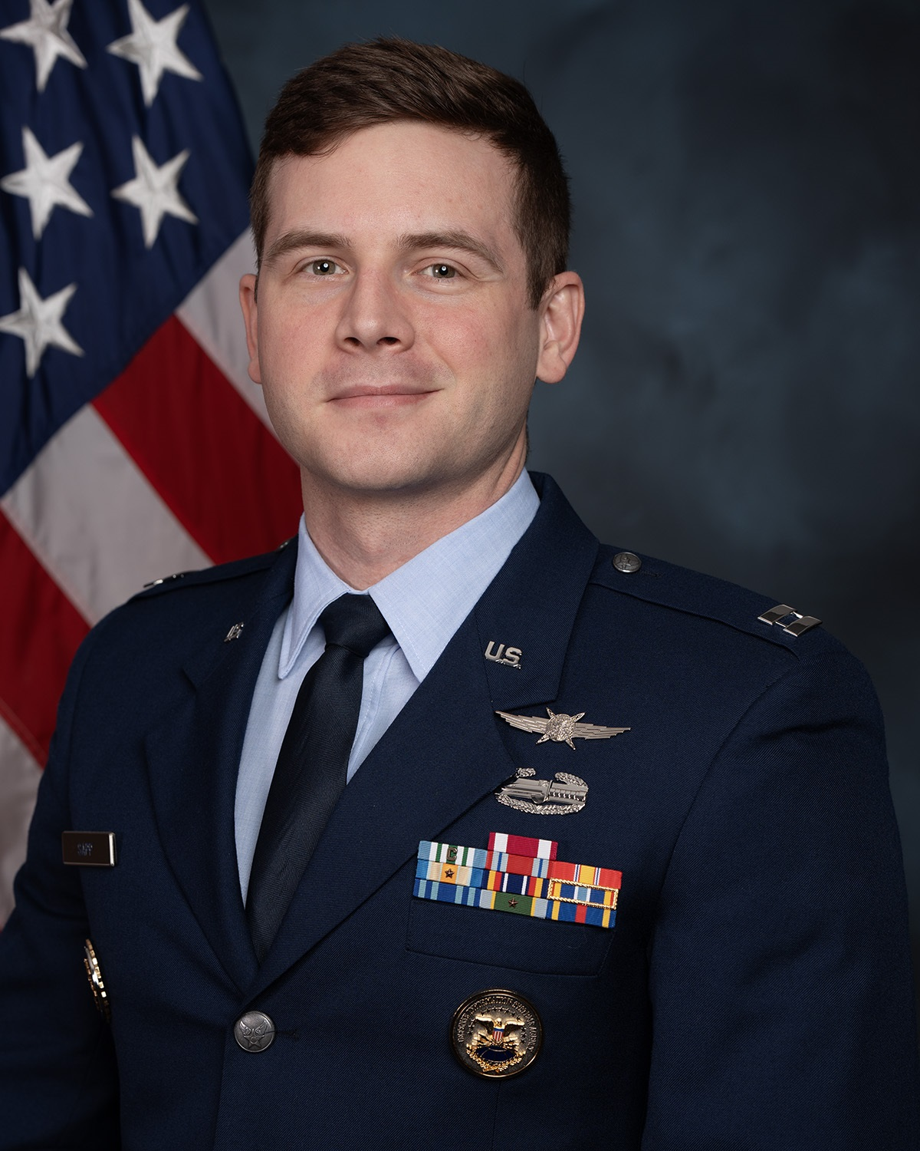
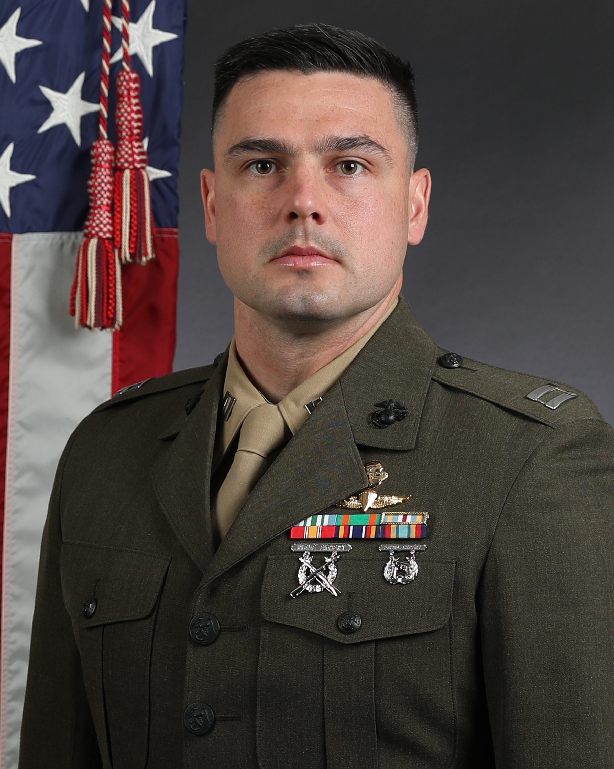
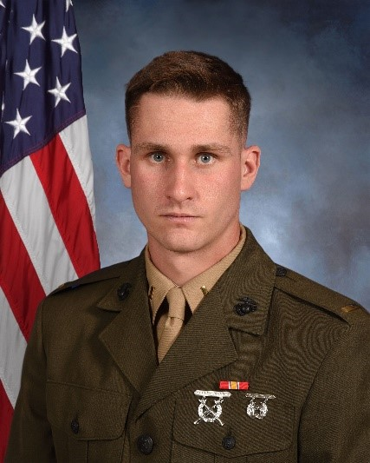
A Hitchhiker’s Guide to RxR in the WEZ
Unmanned Attritable Deception and Sensing
RESEARCH TEAM
Faculty Mentor: Major Rudd
Captain Riley
Team Lead
USMC
7209 – Air Command and Control Officer
Captain Sapp
Rules Steward
USAF
17D3B – Expeditionary Comms Officer
Captain Knudson
Ombudsman
USMC
0203 – Ground Intelligence Officer
Captain O’Brien
Research Lead / Deputy Ombudsman
USMC
0206 – Signals Intelligence Officer

Slide 2
Disclaimer
THE OPINIONS AND CONCLUSIONS
EXPRESSED HEREIN ARE THOSE OF THE
INDIVIDUAL SPEAKERS AND DO NOT
REPRESENT THE VIEWS OF
EITHER THE UNITED STATES MARINE
CORPS UNIVERSITY OR ANY OTHER U.S.
GOVERNMENTAL AGENCY. REFERENCES
TO THIS PRESENTATION SHOULD
INCLUDE THE FOREGOING STATEMENT.

Slide 3
Research Process
RESEARCH PROMPT
How can the USMC Intelligence, Surveillance, and Reconnaissance Enterprise (MCISRE) leverage AI and/or disruptive technology to effectively operate as a Stand-in Force to meet competition-to-conflict operational requirements?
Problem Framing Brief
Solutions Proposal
Stakeholder Brief
Modern Day Marine Brief
PHASE 1:
PROBLEM FRAMING
PHASE 2:
SOLUTION DEVELOPMENT
PHASE 3:
COUNTERARGUMENTS
PHASE 4:
MODERN DAY MARINE
Topic Selection
&
Team Composition
Research
&
Solution Generation
Solution Selection
&
Case Study Review
Brief Prep
&
Model Development
Research
&
Problem Statement Development
Counter Argument
&
Resolution Development
Product Refinement
&
Review

Slide 4
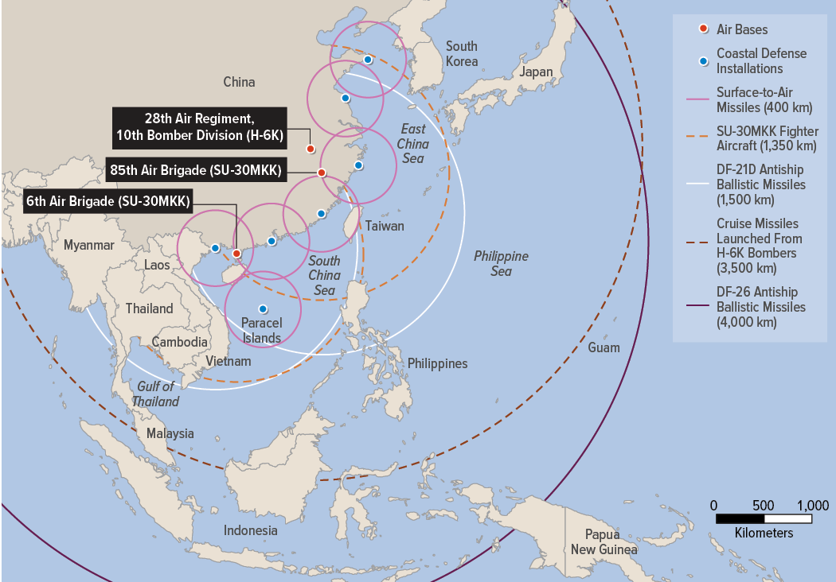
Problem Framing
PROBLEM FACETS
Stand In Forces (SIF)
Anti-Access Area Denial (A2/AD) bubble
Electromagnetic spectrum (EMS) threat increasing exponentially
AI and disruptive technology lens
PROBLEM STATEMENT
The SIF must leverage AI and disruptive technology to enable targeting and persist inside a peer adversary’s A2/AD bubble from competition to conflict.
Source: Congressional Budget Office
Notes:
Image credit – Congressional Budget Office 58929-Hypersonic.pdf

Slide 5
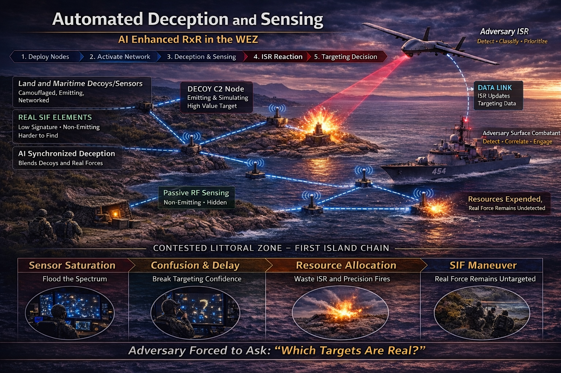
Operational Vignette
PROBLEM STATEMENT
The SIF must leverage AI and disruptive technology to enable targeting and persist inside a peer adversary’s A2/AD bubble from competition to conflict.
PROPOSED SOLUTION
Low-cost COTS platforms
AI-enabled autonomy
Isolated mesh network
Flexible deployment
Sense and deceive
IMPACT TO SIF
Feeds CIP - joint fires orchestration
EMSEC/survivability
Counter-reconnaissance
Inject uncertainty into adversary targeting cycle

Slide 6
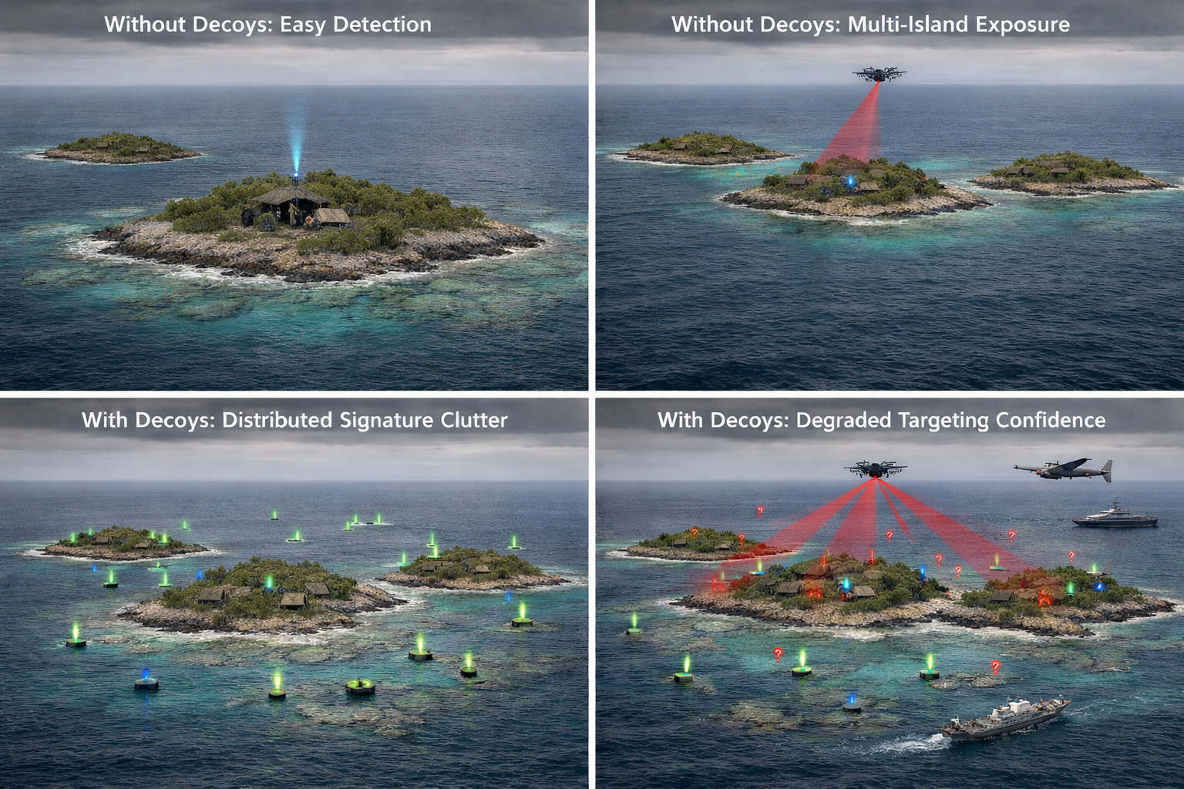
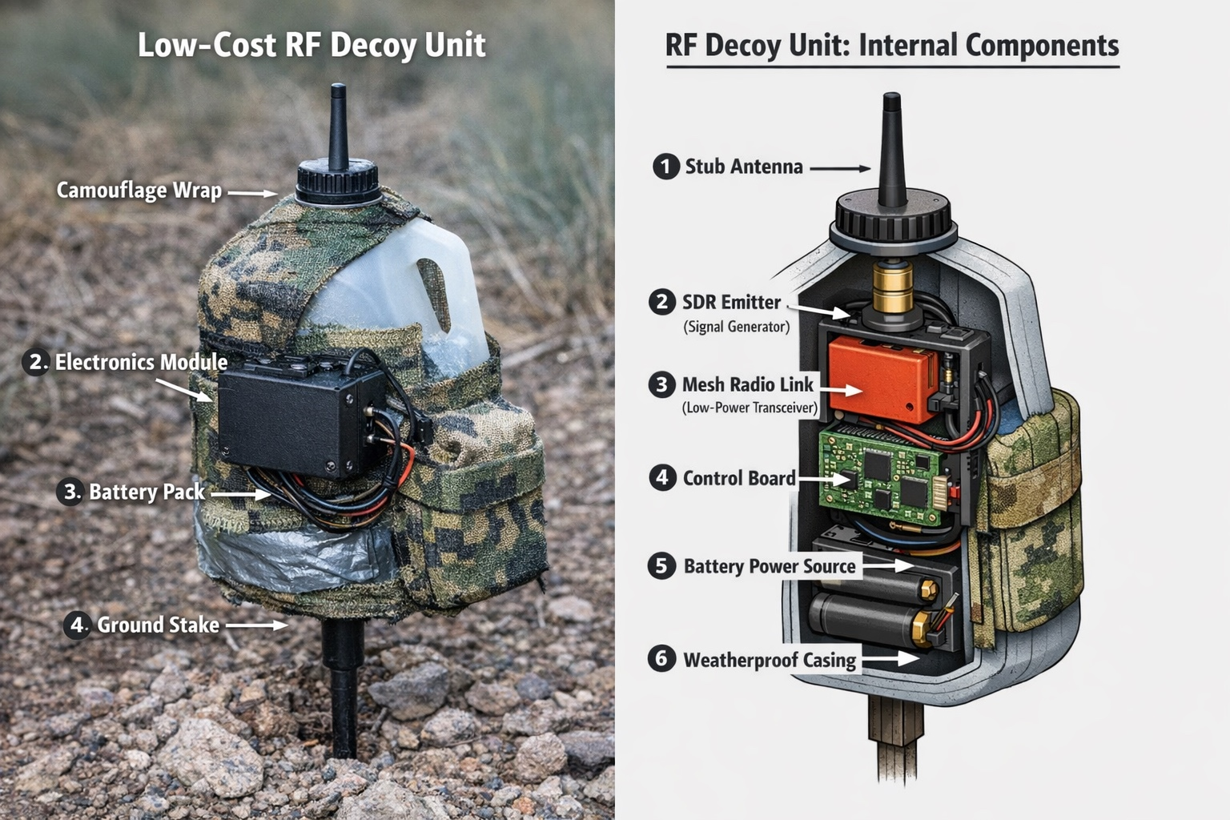
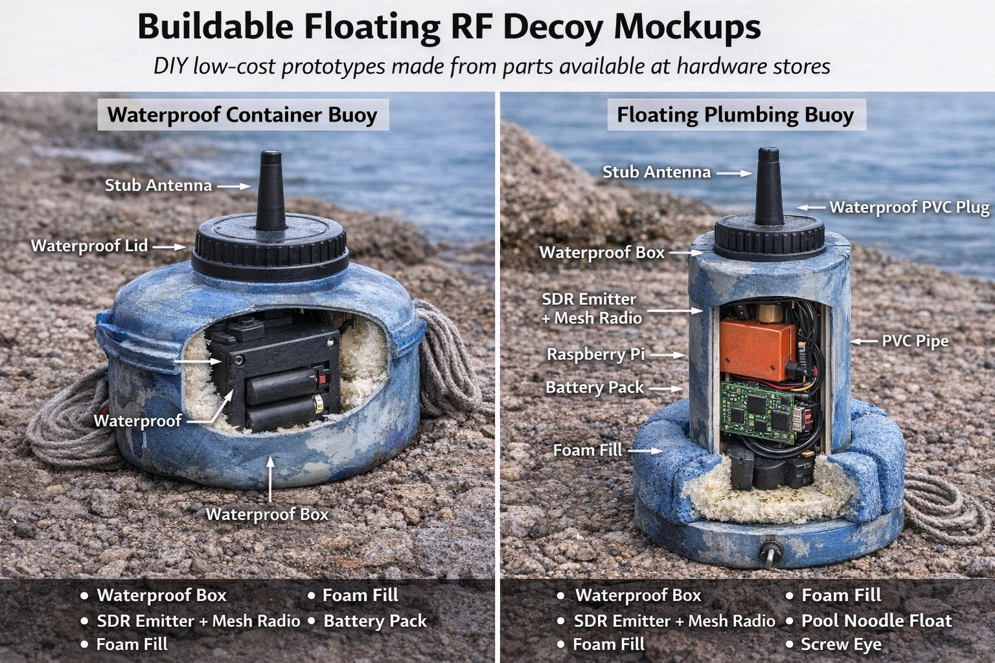
Platform Deployment Concept
Land-Based Platform
Maritime Platform

Slide 7
Questions?
CONTACT INFORMATION
Captain Patrick Q. Riley
Email: patrick.q.riley@usmc.mil

Slide 8
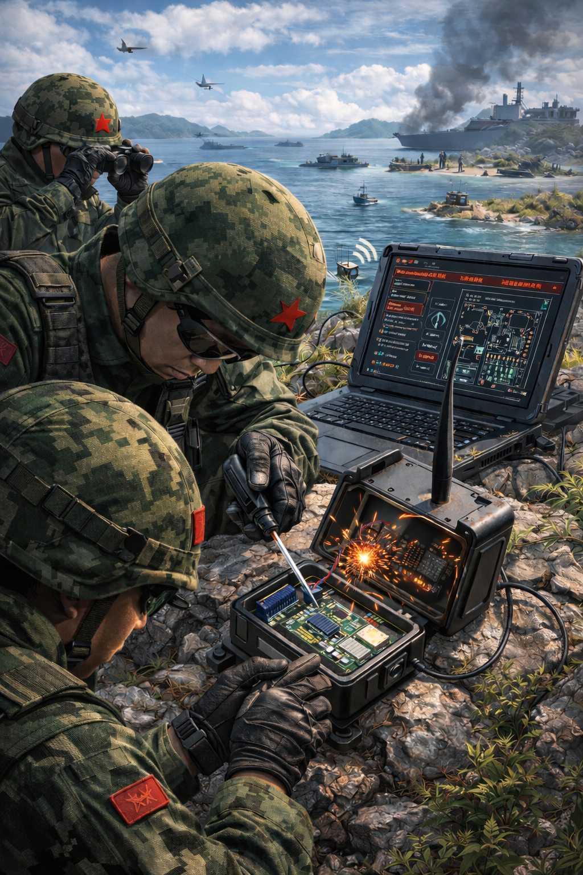
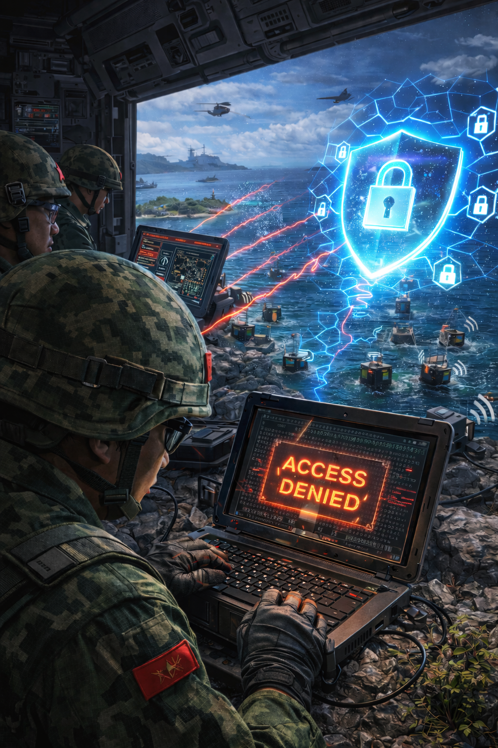
Counterarguments
Cybersecurity Threats
Threat
Threat
Physical Compromise
and reverse engineering
Logical Comprise
Mitigation
Mitigation
Tamper circuits
Simplicity, compartmentalization, and encryption

