Slide 1
Redefining Wargaming and Analysis
Col Charles Anklam III, PhD
Director
Wargaming Division
Marine Corps Warfighting Lab

Slide 2
Agenda
MCWL Overview
Wargaming Division Mission
Wargame Characteristics / Process / Methods
Digital Wargaming Tools
Robert B. Neller Center for Wargaming and Analysis
Question / Discussion

Slide 3
Command Overview
Mission. MCWL generates and examines threat-informed operating concepts and capabilities and provides analytically supported recommendations in order to inform subsequent force design and development activities.
Wargaming
Live-Force Experimentation
S&T/RCO
Futures
MCWL informs service-level decisions by the Commandant of the Marine Corps. This is accomplished in partnership with the Office of Naval Research, Department of Defense labs, industry, and academia.
The expertise of MCWL personnel blends science with operational experience across the spectrum of competition to conflict.
MCWL is comprised of four divisions operating under the authority of a one-star general.
Notes:
Guidance for Slide :
- Provide command overview and command mission
- Discuss niche contribution

Slide 4
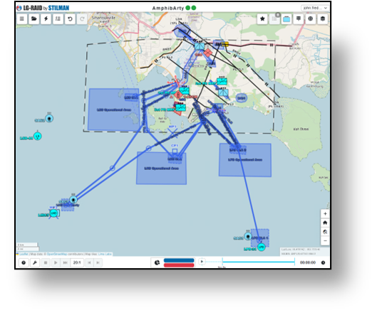
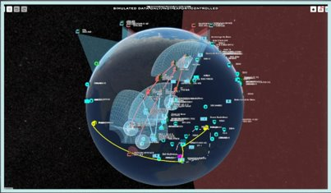
Wargaming Division Mission
Plan and execute the Marine Corps Wargaming Program. Formally report analytical and assessment results. Identify wargame results for further exploration through live-force experimentation, doctrine and policy review, and science and technology examination.

Slide 5
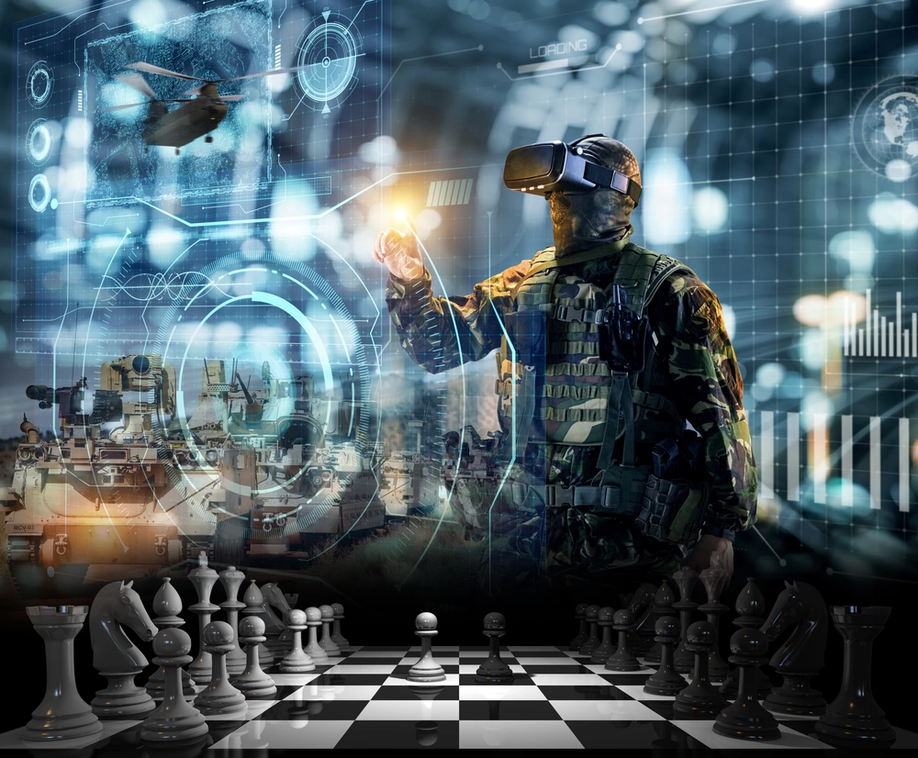
Next Generation Wargaming Concept
Establishes a human-centric, technology-enabled, collaborative gaming environment.
Leverages decision support tools, M&S, artificial intelligence (AI), and visualization technologies to enhance quantitative and qualitative assessments.
Allows participants to:
Dynamically adjust variables
Explore multiple courses of action (COAs)
Assess potential outcomes in a controlled setting—providing invaluable insights unattainable through live experimentation or traditional analog wargaming.
Enables fully-informed wargames:
All levels of classification
Comprehensive operational picture based on a full suite of capabilities
Provides for a cloud-based distributed capability:
Enables seamless collaboration across commands, regardless of location
Vital for unified strategies and collective problem-solving
Result is invaluable insights unattainable through
live experimentation or traditional analog wargaming
Source: Naval Information Warfare Center Pacific

Slide 6
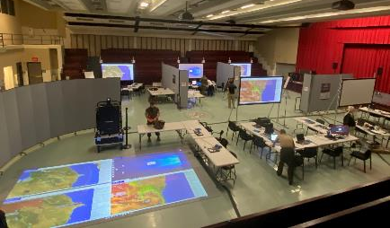
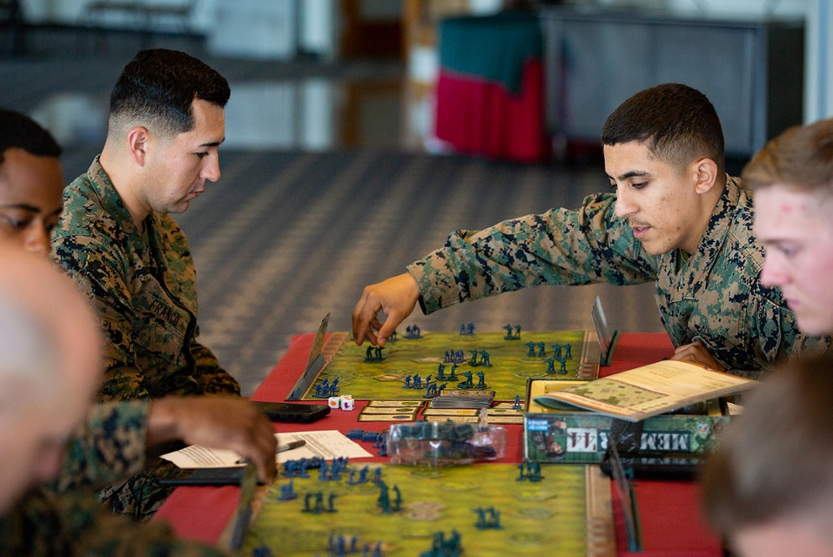
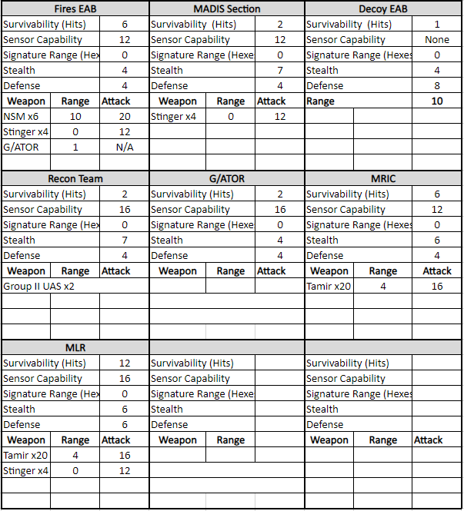
Why Wargame?
Artificial replication of a real situation
Low cost - does not require live forces
Human decision making
Interaction of opposing forces
Rules, data, procedures
Notes:
4
3

Slide 7
Wargaming Process
Wargame: An artificial environment designed to allow people to make decisions about real problems.
WARGAME DESIGN / DEVELOPMENT
WARGAME EXECUTION
WARGAME ASSESSEMENT
Initiating directive
Draft the problem statement and wargame purpose
Determine the wargame objectives
Design and develop methodology of wargame play
Scenario
Mechanics
Deliverables
Coordinate with desired/required participating organizations
Prepare final game design and plan for collection, assessment, and production
Train and rehearse
Final Report
Proceedings
Findings
Conclusions
Recommendations
Communication strategy
WARGAME
EXECUTION
SHAPE, INFORM, AND INCORPORATE OTHER WORK FOR FOLLOW-ON EFFORTS

Slide 8
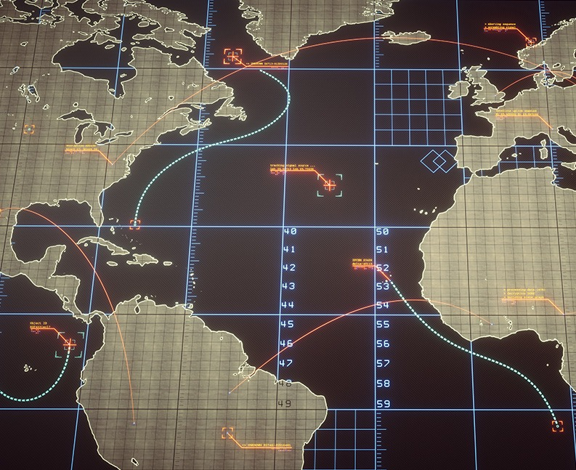
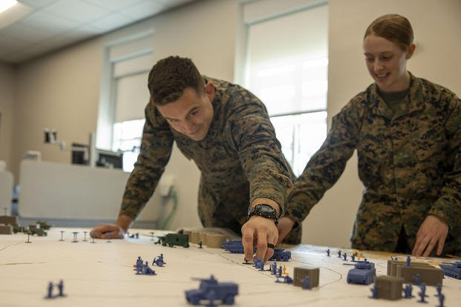
Wargaming Methods
Computer-Aided Wargame
(Computer Algorithm Adjudication)
Seminar / Matrix Wargame
(Subject Matter Expert Adjudication)
Conceptual
Detailed
Table Top Wargame
Virtual or Manual
(Applied Rules Adjudication)

Slide 9
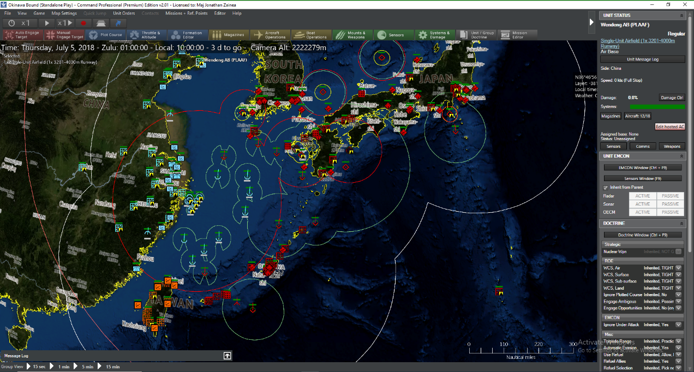
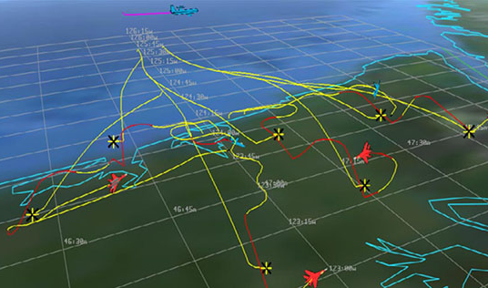
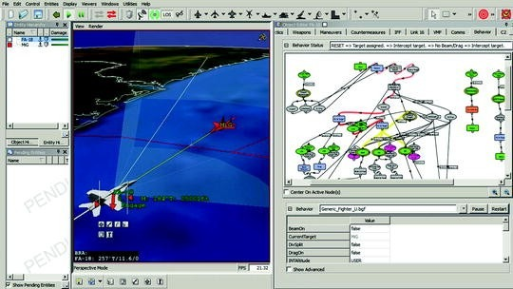
Digital Wargaming Tools
- Today -
Command PE: medium-fidelity combat model that allow for 1-vs-1 tactical engagements all the way to regional and global conflicts. Employed currently for visualization, force tracking, and limited analysis.
AFSIM: a high-fidelity modeling and simulation framework across multiple domains, particularly aerospace systems, for capability analysis.
NGTS: a simulation system that integrates with training platforms and generates a synthetic environment that supports platform training, testing, and analysis.
JTLS-GO: a multi-sided wargaming system; models combined joint and coalition air, land, naval, and Non-Governmental Organization (NGO) environments.
Builder: a three-dimensional radio frequency tactical decision aid, often used for communications planning.
SPEED: a communications planning tool that provides path-profiling analysis and rapid communications planning.
Screenshot of Command PE
Screenshot of AFSIM
Screenshot of NGTS

Slide 10
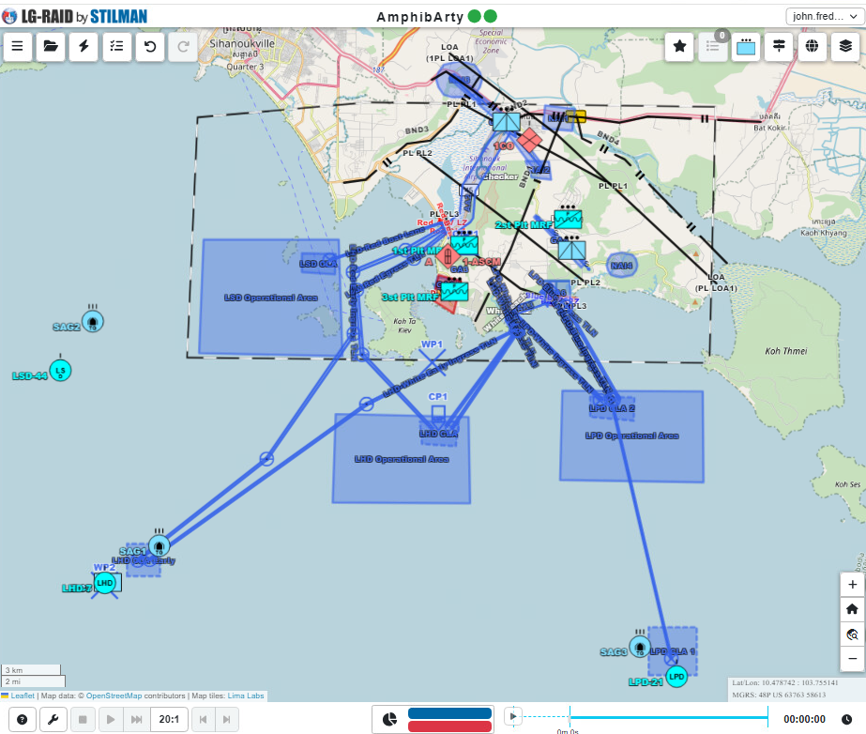
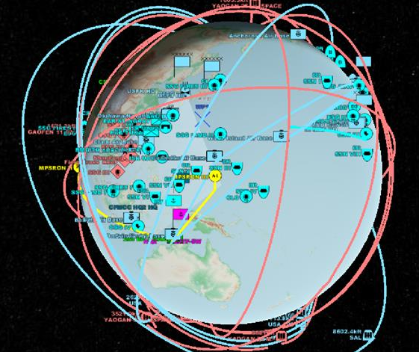
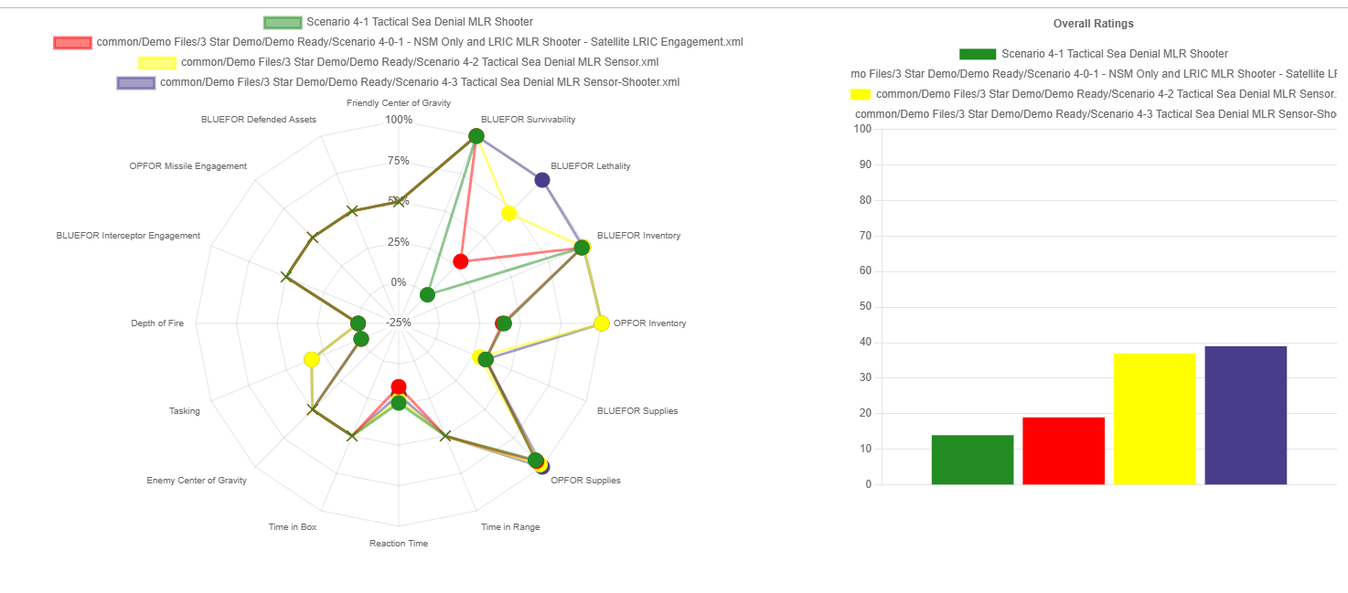
Digital Wargaming Tools
- Tomorrow -
Material Solution
Pioneer is the material solution under development to meet the requirements stipulated in the wargaming capabilities development document. Pioneer employs integrated means of data ingest, model federation, and in-stride analytics which synthesize the computational (machine) and cognitive (human) analyses to produce a comprehensive assessment of wargame outcomes.
Fully integrated wargaming/analytics process.
Cornerstone of PIONEER artificial intelligence architecture is the linguistic geometry language.
Simulation engines integrated for specific warfighting domains.
Land, air, surface, subsurface, space, cyber
Unclassified, Secret, Top Secret, and coalition systems.​
Data ingestion from multiple authoritative sources​
Real-time adjudication; in-stride and post-game analytics​
Simulates millions of people and platforms in real-world conditions​
Defensible positions based on rigorous, deep quantitative analytics​

Slide 11
Digital Wargaming Tools
- The Future -
Artificial Intelligence and Machine Learning
AI-Informed Decision Making
Adaptive Adversaries
Immersive Technologies
Augmented Reality (AR) and Virtual Reality (VR)
Next-Generation Visualization
Advanced Simulation and Modeling
Federated Multi-Fidelity Simulation Environments
AI-Driven Agent-Based Modeling
Data-Driven Insights
Big Data Analytics
Predictive Modeling
Human-Machine Teaming
Augmented Intelligence
Enhanced Insight Generation
Continuous Learning and Adaptation
Adaptive Learning Systems
Human Bias Mitigation

Slide 12
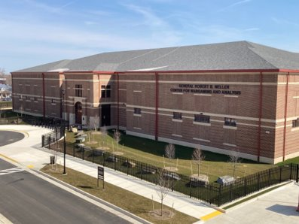
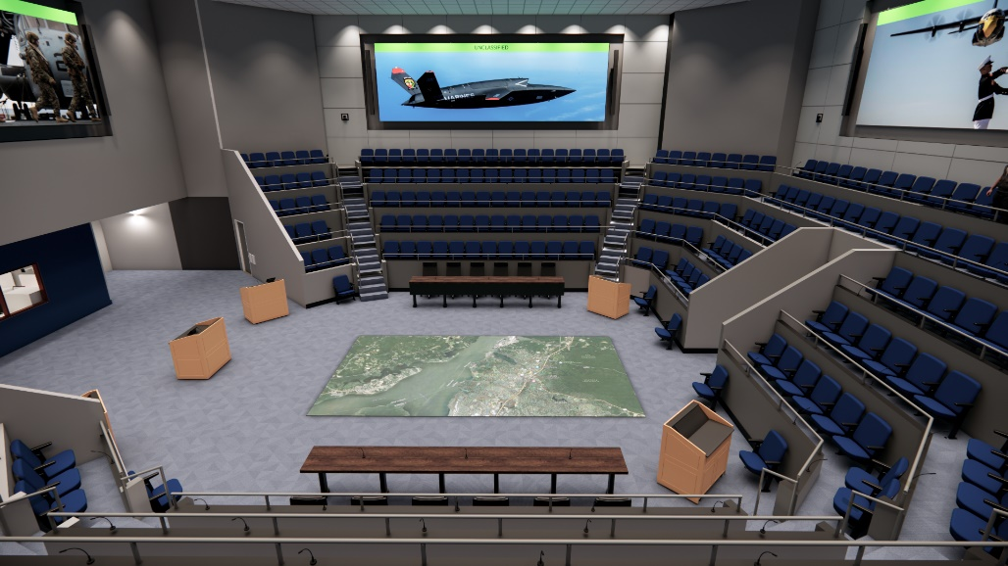
Robert B. Neller Center for
Wargaming and Analysis
Key Attributes:
Facilitates up to 20 wargames per year, with up to 250 participants each.
Multiple level security environment to enable more fully-informed wargames.
Leverages data sources across a multitude of DoD networks to ensure the most accurate data is used to design and adjudicate wargames.
Tailored, modular software suite to meet dynamic learning demands and enable use of best available tools.
Authoritative data repository to provide common, consistent data to all wargame systems and tools.
Employs artificial intelligence to “train” synthetic forces on doctrine and TTPs to provide higher fidelity adjudication.
Using AI, collects and compiles data on a previously unachievable scale, enabling rapid, data-supported wargame reporting.
Key Milestones:
Began construction: April 2021
Initial operating capability: FY27
14

Slide 13
Questions / Discussion
MCWL Wargaming Division Points of Contact:
Col Charles Anklam III, PhD
Director, Wargaming Division
charles.anklam@usmc.mil | 703-784-3278
Mr. Mitch Reed
Wargame Branch Head, Wargaming Division
mitchell.l.reed.civ@usmc.mil | 703-732-8076
LtCol Scotty Black, PhD
Plans Officer | M&S and AI Integrator, Wargaming Division
scotty.black@usmc.mil | 703-784-6880

