Slide 1
Force Design
Threat Driven, Concept Informed
30 April 2025
Overall classification: Unclassified
Notes:
The Marine Corps remains the United States’ global expeditionary force – the leading edge of the United States’ deterrence and crisis response capability in any clime and place. We will continue to train and deploy task-organized Marine air-ground task forces (MAGTFs) that employ all-domain combined arms to conduct maneuver warfare, recognizing that the whole of a MAGTF is greater than the sum of its parts. The ethos of Marines has not and will not change. We are warriors who are proud to be the “first to fight”—and we do so with honor.
The Marine Corps remains an amphibious force, ready to win the race for key maritime terrain and prevail in a fight tonight. But we also recognize the need to have part of our force persistently present before the crisis unfolds. These Stand-in Forces (SIF) conduct intelligence, surveillance, reconnaissance, and targeting (ISRT) for the Joint force, deny an adversary’s ability to operate uncontested, and set conditions for follow-on forces. While the Fleet Marine Force (FMF) as a whole is capable of conducting expeditionary advanced base operations (EABO), it is not designed exclusively for EABO. MAGTFs may be organized as Marine Expeditionary Units (MEUs) or Marine Littoral Regiments (MLRs), depending on the mission.

Slide 2
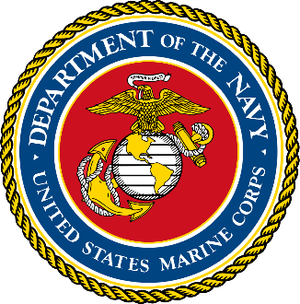
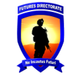
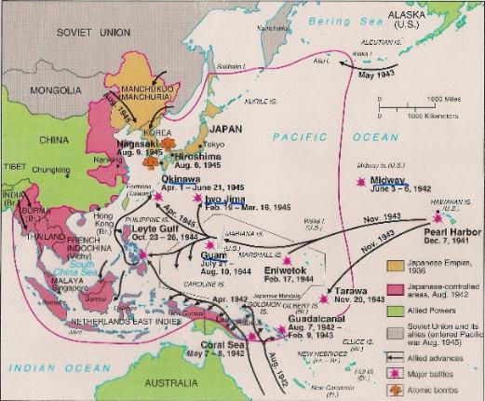
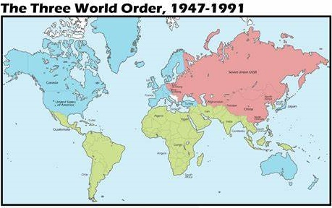
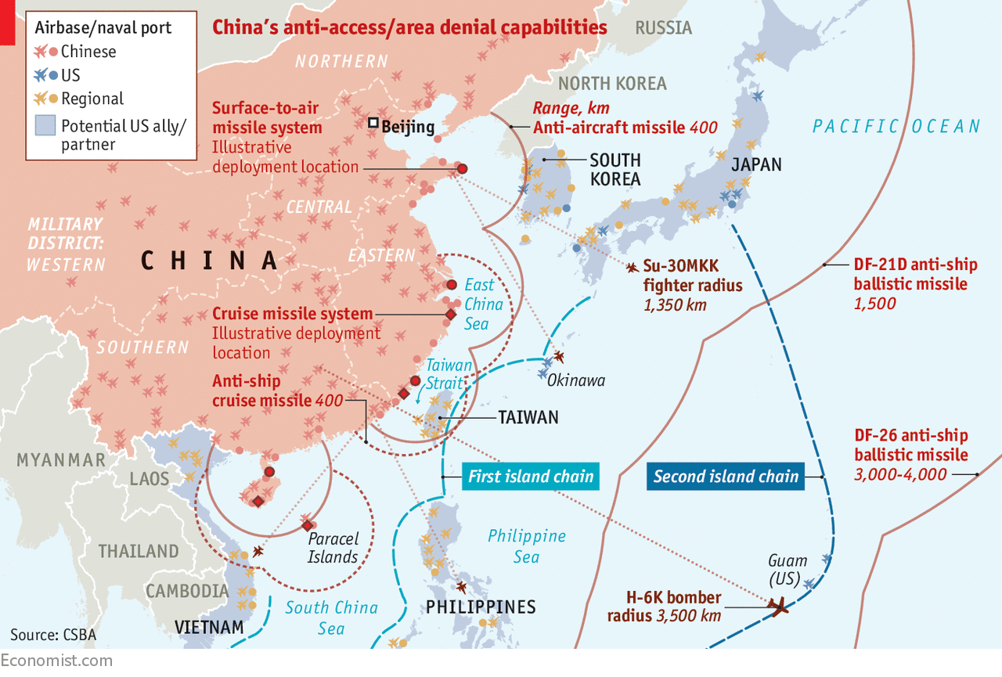
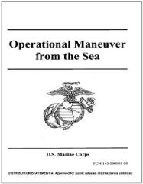
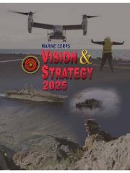
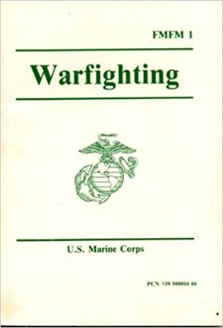
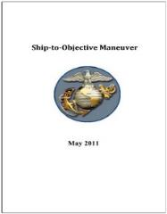
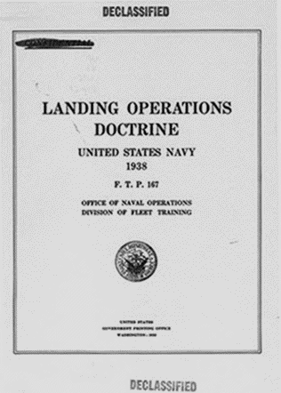
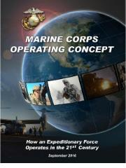
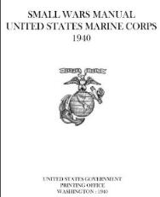

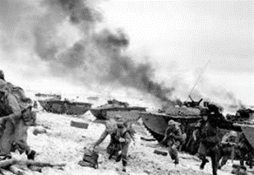
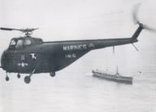
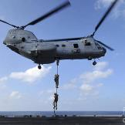
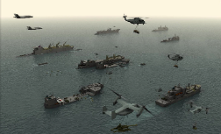
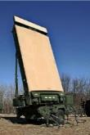
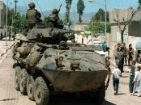
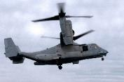
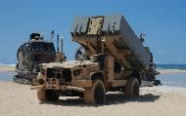
A Century of USMC Innovation
In every era, the Marine Corps established a focus area for force development that was pertinent to national and naval strategy.
Operational employment of Marine Corps forces consistently retains the flexibility to conduct a wide variety of missions to meet national objectives.
Influences and Forecasts.
Events and developments outside the Service force or invite changes.
Implications and Responses.
Anticipating or reacting to external forces leads to new approaches.
USMC Tentative Manual for Landing Operations
USMC Amphibious Vertical Envelopment
Ship-to-Objective Maneuver
Concepts and Doctrine.
Dedicated thinking and experimentation leads to future concepts.
July 1997
Enablers.
Concepts lead to new capabilities required to accomplish objectives.
1920 | 1930 | 1940 | 1950 | 1960 | 1970 | 1980 | 1990 | 2000 | 2010 |  | 2020 | 2030->
 | WWII. Shift to a naval force with sea control and power projection capabilities required to fight our way across the ocean |  | Cold War. Evolve into a naval force capable of supporting a joint campaign that was continental in character. |  |  |  | Sole Superpower. No clear pacing threats. Enjoyed the luxury of presumptive air, maritime, and information superiority. |  | Rise of peer pacing threats. Air, maritime, and information superiority cannot be assumed. Current capabilities insufficient relative to the threat.
20s to 40s - Paradigm Shift: Advanced Base Force was disbanded in favor of the Fleet Marine Force Published Tentative Manual for Landing Operations, Landing Operations Doctrine and Small Wars Manual Force development focused on amphibious assault operations; doctrine and capabilities designed for the DoN pacing threat were applied in all theaters during WWII |  |  | 50s to 80s - Paradigm Shift: Fleet Marine Force construct endures Published Landing Force Bulletin 17 on Amphibious Vertical Envelopment Force development focused on vertical envelopment, MAGTF integration, cold weather amphibious operations on NATO’s northern flank, and maritime prepositioning |  |  |  | 90s to 2015 - Paradigm Shift: Publication of FMFM 1 Warfighting (1989) FMF conducted sea-based crisis response at double the Cold War rate FM 3-24 Insurgencies and Countering Insurgencies Force development focused on power projection to deal with episodic, rapidly emerging crises and countering insurgencies |  |  | 2015 - Emerging Paradigm: Published Naval concepts (Littoral Operations in a Contested Environment, Distributed Maritime Operations, Expeditionary Advanced Base Operations) Published TM EABO and Stand-In Forces Force development focused on littoral maneuver and sustainment, maritime reconnaissance/counter-reconnaissance, long-range precision fires, and operations in the information environment
Notes:
This is not the first time the Marine Corps has faced a maritime challenge in the Pacific, but these concepts recognize that this is not the Pacific of Pete Ellis.
For the first century of our existence, the Marine Corps’ primary purpose was to provide detachments aboard the ships and stations of the Navy.
1st Paradigm Shift: //1850s-WWII: The Spanish-American War resulted in the U.S. adopting a global outlook and overseas possessions, to include fleet coaling stations.
How does the naval service project power in support of national strategic objectives to expand global commerce and extend influence
2nd Paradigm Shift: During the 1920s and ‘30s the pacing threat led us to build a naval force with the sea control and power projection capabilities to fight its way across the ocean.
Marine divisions focused on amphibious assault operations; doctrine and capabilities designed for the DoN pacing threat were applied in all theaters during WWII.
Our WWII incarnation remains the common perception of the Marine Corps.
3rd Paradigm Shift: During the Cold War, a new pacing threat caused us to evolve into a naval force capable of supporting a joint campaign that was continental in character.
Bipolar struggle for influence over the Third World; development of crisis response force packages in Med as counter to Soviet capabilities
Marine air-ground task forces (MAGTF) designed to transition from a sea-based posture into a corps-level maneuver element for sustained operations ashore.
4th Paradigm Shift: During the immediate post-Cold War era, the United States did not have clear pacing threats and also enjoyed the luxury of presumptive air, maritime, and information superiority.
Unipolar world, maritime superiority, “chaos in the littorals’
Force development focused on power projection to deal with episodic, rapidly emerging crises and contingencies…
…without the corresponding need to invest in the capabilities required to fight for air, maritime, and information superiority.
Current and future: contest for global competition, challenged by the proliferation of persistent surveillance and long-range precision fires (kinetic and non-kinetic)

Slide 3
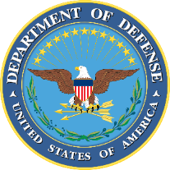

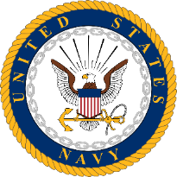
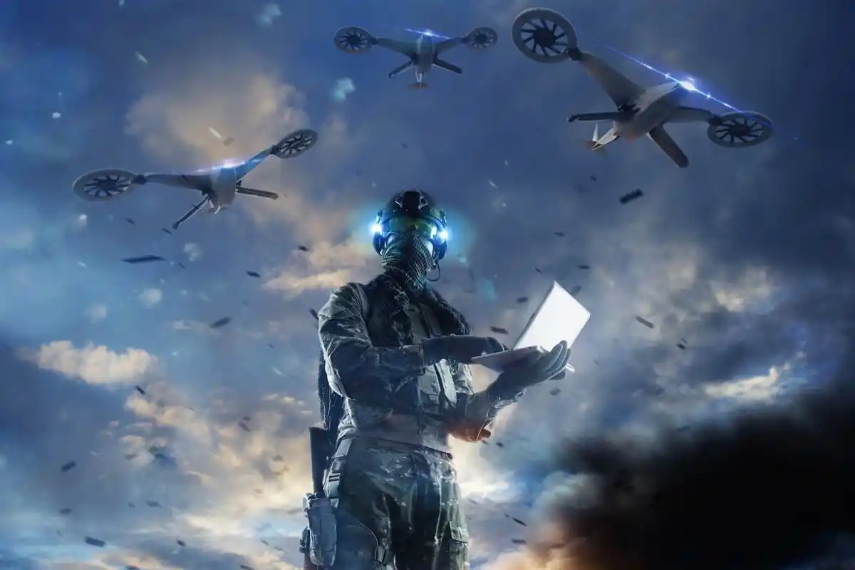

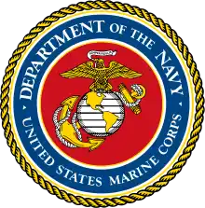




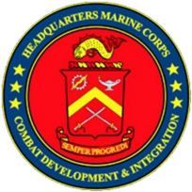

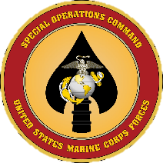
MCWL Campaign Plan
MCWL CORE PRINCIPLES:
    1. Train as you fight! Be connected to the Warfighter…
    2. Be morally, mentally, and physically tough
    3. Take care of and respect each other always. Our strength is our people...
    4. Never forget who we are and where we came from. Make a difference…it matters…
COMMANDING GENERAL’S ROLE:
1. Fight the Marine Corps Warfighting Laboratory
2. Ensure unity of effort across MCWL…nested with higher
3. Ensure MCWL has a clear road map with clear priorities
4. Ensure the development and welfare of the entire MCWL team
JOINT FORCE
MODELING & SIMULATION
Campaigning Mindset
Threat-Informed Assessments
LOE 1: Future Concepts & Capabilities
5+ yrs
ANALYSIS TECHNIQUES
LOE 2: Sense, Counter-Sense, Make Sense
FUTURE FORCE ASSESSMENT
UNITED STATES NAVY
LOE 3: Close Coalition, Joint & Naval Kill Webs
CONCEPT REQUIRED CAPABILITIES
CONCEPTS
LOE 4: Enable Coalition, Joint & Naval Maneuver
STUDIES
WAR-GAMING
LIVE FORCE
EXPERIMENTS
Tempo
FUTURE OPERATING ENVIRONMENT
Exploit Opportunity
LOE 5: Conduct Contested Logistics
Messaging & Engagement
FLEET MARINE FORCE
LOE 6: Enable Global Contingency & Crisis Response
SCIENCE & TECHNOLOGY
COMBAT DEVELOPMENT & INTEGRATION
People are the MCWL Center of Gravity
MCWL ENDSTATE: Develop threat-informed, future-focused, analytically supported force design and development endorsements relevant to the stand-in force concept, global contingency operations, and crisis response operations in order to establish enduring positional advantage.
MARSOC
Notes:
It is helpful to understand the concept generation and development process to better understand how we should read and understand these documents.
New concepts are triggered by significant changes in strategic guidance, the operating environment, or capabilities developed or employed by either the Marine Corps or our adversaries.
Operating Concepts are hypotheses about how the Marine Corps should adapt to fight in the future environment – they are meant to describe innovative ways of operating and needed capabilities. These concepts are not meant to be doctrine, chiseled in stone and delivered from on high.
They are threat informed and based on research of previous wargames, experimentation, academic studies, etc. We think they are right, but it isn’t until they are properly tested that we can confidently say the hypothesis is correct.

Slide 4
Era of Strategic Competition
Peer competition and pacing threats have returned
Battlespace is persistently surveilled
Proliferation of precision weapons
Air, maritime, and information superiority cannot be assumed
Rather than optimizing a force to fight its way across
the ocean in the event of war - as we began doing over
a hundred years ago…
…We are migrating towards a force capable of persisting
forward despite the threat to influence events in our Nation’s
favor
  “Hold the access door open” instead of “beating it down” when needed
  Counter malign behavior, deter conflict, and in the event of war contribute to a joint campaign that is maritime in character
  Continue to provide global crisis response
  Retain the ability to seize key maritime terrain
Notes:
U.S. national strategic guidance describes an operating environment marked by the return of strategic competition.
Because of technological advances and rapid military build-up, persistent surveillance of the battlespace, and the proliferation of long-range precision weapons, uncontested superiority across domains should not be assumed.
China, then Russia, are the two most significant threats facing the United States today. These peer competitors threaten the international order by leveraging all instruments of national power for their advantage.
China has a strategy that aims right at the heart of the United States’ maritime power. It seeks to corrode international maritime governance, deny access to traditional logistical hubs, inhibit freedom of the seas, control use of key chokepoints, deter our engagement in regional disputes, and displace the United States as the partner of choice in countries around the world. To enable this strategy, China is aggressively growing and modernizing its military—with naval forces as the cornerstone of its efforts.
Russia remains a significant threat as well… and one we can’t ignore. In day-to-day competition, Russia is trying to fragment our alliances and the international order. Its pursuit of an expanded sphere of influence has been defined by opportunism and a willingness to use military force, as we see with their invasion of Ukraine, and previously in Georgia and Syria.
Other threats, including Iran, North Korea, and violent extremist organizations, will continue to be of concern. But unlike China and Russia, these are generally more regional threats, not global ones. We will need to be able to address them using forces developed for our most significant military threats.
============================================================
IF you believe that we will get limited (less than we’d like) warning of adversary military action; and
IF you believe that the US military will be contested in all domains, starting at home bases here in CONUS;
THEN that leads you to this idea that if America does not already have a combat credible force positioned forward in the future conflict area before escalation begins, we will be challenged to get it there on an operationally relevant timeline.
Projecting a massed fleet from a cold start in, say, Hawaii (as Ellis advocated for) may not be viable—we need to already be present (“inside”) when crisis arises. As these concepts say, we can’t afford to wait to kick down the door; the door must already be held open.

Slide 5
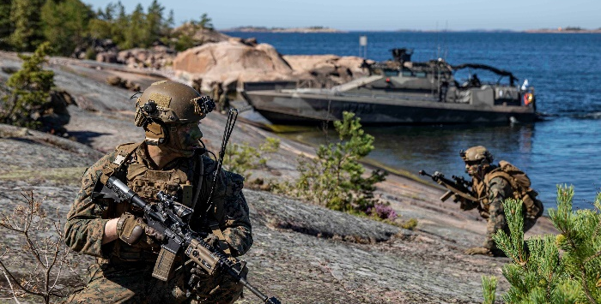
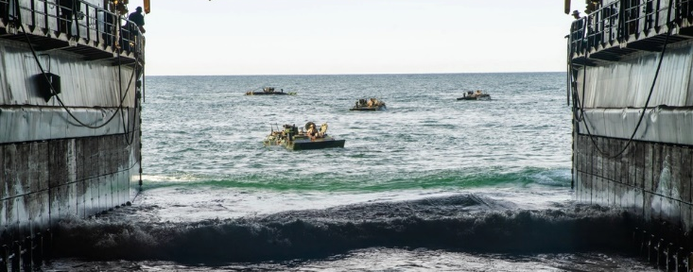
What Remains the Same
“We are and will remain a naval expeditionary force that fights from the sea as task-organized combined arms air ground task forces…
Modernization’s effect on how we fight is evolutionary, not revolutionary. Our foundation as our Nation’s expeditionary force in readiness, will not change.”
“… the inherent mobility, flexibility and lethality of our amphibious forces enable them to hold potential adversaries at risk globally…
—Gen Smith, CMC (April 2024)
Notes:
The Marine Corps remains the United States’ global expeditionary force – the leading edge of the United States’ deterrence and crisis response capability in any clime and place.
We will continue to train and deploy task-organized Marine air-ground task forces (MAGTFs) that employ all-domain combined arms to conduct maneuver warfare, recognizing that the whole of a MAGTF is greater than the sum of its parts.
The Marine Corps remains an amphibious force, ready to win the race for key maritime terrain and prevail in a fight tonight.
The ethos of Marines has not and will not change. We are warriors who are proud to be the “first to fight”—and we do so with honor.
Given this mission and the challenges and threats we face, one is faced with several strategic implications.
Countering malign behaviors short of armed conflict and preventing fait accompli attempts require sufficient naval capacity and targeted capabilities to maintain forward presence and expand our response options.
Incremental gains from activities below the threshold of war can accumulate into long-term advantages.
Finally, strong, mutually beneficial alliances and partnerships are crucial to protecting collective interests.

Slide 6
Why “Force Design”
“If you don't know where you are going, you'll end up someplace else.”
Yogi Berra
“If you don't know where you are going, every road will get you nowhere.”
Henry Kissinger

