Slide 1
UNCLASSIFIED
Capability Development – Innovation to Implementation
Modern Day Marine
Marine Corps Integration Division
Capabilities Development Directorate
Combat Development & Integration
29 April 2025
April 10, 2025
V1.0
UNCLASSIFIED
Notes:
Communication Goals:
Reaffirm the USMC's commitment to modernization aligned with NDS priorities during Calendar Year 2025.
Increase understanding of Marine Corps acquisition priorities for CY2025.
Congress better understand the CMC's legislative priorities and how they enable the Marine Corp's relevance in the current security environment.
Modern Day Marine 2025 attendance reaches 10,000 visitors, a 7% increase from 2024.
Col Wittnam Intro: Good afternoon…
Intro to the brief (The panel will address operational innovation, functional capability development, the role of concepts, the capabilities-based assessment, materiel and non-materiel solution implementation, and resourcing.)
We appreciate the variety of audience (Congress, industry, Marines, spouses, allies and partners, and VSOs) that MDM has brought in to support the future of the Marine Corps.
Intro of the panel:
Tony Mattaliano - Deputy Director, Marine Corps Integration Division, Capabilities Development Directorate. Retired Marine LtCol with 25 years of experience working at Combat Development & Integration on active duty, as a support contractor, and civilian Marine. Specialist in doctrine development, concept development, and the Joint Capabilities Integration Development System.
Lt Col Jim Lawson RM – Future Plans Branch Head, Marine Corps Integration Division, Capabilities Development Directorate. A UK Royal Marines Commando with 18 years of service, currently on exchange with Combat Development & Integration. An experienced observer and student of USMC Force Design, having served in the US since 2020. Initially assigned to the Royal Marines Staff at the British Embassy in Washington, DC, before graduating as an Honor Graduate from the USMC Command and Staff College.
Lieutenant Colonel Joshua Freeland – MAGTF Planner, Marine Corps Integration Division, Capabilities Development Directorate. LtCol Joshua "Tapeworm" Freeland has been assigned to POM planning for nearly two years, supporting the POM-26 and POM-27 planning cycles. He is a graduate from the Air Force School of Advanced Air and Space Studies, served as a Command-and-Control Instructor at MAWTS-1, and was assigned to VMX-1 where he was the Operational Test Director for phase 2 of the Common Aviation Command and Control System (CAC2S).
And I am Col Wittnam…..
Not here is the remainder of the Marine Corps Integration Division (MCID) comprising of Future Plans Analysts and Mission/Systems Architects.
MCID falls within the Capabilities Development Directorate (CDD). CDD analyzes, develops and integrates requirements and capabilities through Marine Corps Force development process that provide for integrated services wide capability solutions, current and future, anticipating strategic challenges and opportunities for the Nations defense.
On behalf of CDD and CD&I, MCID leads the planning for Capabilities Development, integrating the outputs from a strategy driven, concept based, threat informed plan, to create a fiscally responsible, analytical defendable, integrated and executable annual Force Integration Plan that addresses all materiel and non-materiel requirements. As well as the FIP, MCID develops and maintains the solutions architecture.

Slide 2
Agenda
Integrated
Concept Based
Fiscally Responsible
Threat Informed
Strategy Driven
Notes:
Col Wittnam - As mentioned in the opening, the panel will address operational innovation, functional capability development, the role of concepts, the capabilities-based assessment, materiel and non-materiel solution implementation, and resourcing. We will proceed through the agenda connecting back to MCID mission in the development of the annual Force Integration Plan.

Slide 3
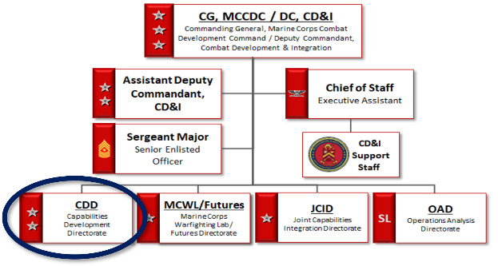
Combat Development and Integration
Integrated
Concept Based
Fiscally Responsible
Threat Informed
Strategy Driven
Capabilities
Innovation
Joint Capabilities
Analysis
Notes:
Col Wittnam:
CD&I overview:
CD&I is focused on evolving the Marine Corps to be a highly effective fighting force for today and tomorrow. We do this by designing and building modern capabilities – everything from technology to tactics – so that Marines can deter threats and win any fight, while working alongside the Navy, Joint, Coalition and mission partners.
CD&I is where the Marine Corps looks to the future – and it's powered by four key directorates, working together to shape the future of our Marine Corps:
We begin with MCWL—our innovators, who develops and tests threat-informed concepts and capabilities through various modes of experimentation.
Next, we have OAD, our analytical engine. OAD delivers timely, credible, and relevant analysis that informs our most critical decisions—providing the insights we need to make informed decisions.
JCID (in purple) keeps us connected to the broader joint force. As our link to Combatant Commanders and joint partners, JCID ensures we remain aligned with joint priorities.
Finally, CDD—our capability development experts—analyze, develop, and integrate requirements across the Service. Their work ensures the Marine Corps develops the right capabilities, at the right time, for the right fight.
Together, these efforts drive a unified mission: "to design and develop a modernized Marine Corps to campaign, fight, and win, in an evolving threat environment, in order to deny, deter, and if necessary, defeat adversaries as part of a naval, joint, combined, and interagency construct."

Slide 4
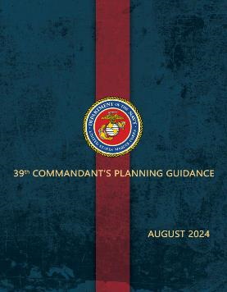
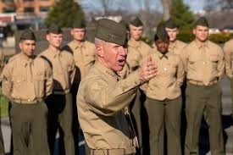
Commandant’s Planning Guidance
Overarching Priorities
Balancing Crisis Response and Modernization
Naval Integration and Organic Mobility
Quality of Life
Recruit, Make and Retain Marines
Maximize the Potential of Our Reserves
Investment Guidance
Logistics in a Contested Environment
Enabling Joint and Coalition C2 and Kill Webs
Long Range and Precision Fires
Integrated
Concept Based
Fiscally Responsible
Threat Informed
Strategy Driven
Notes:
Josh/Jim:
At the service level, the CPG reaffirm the USMC's commitment to force modernization and remains tightly aligned to the new interim NDS.
We are focused on rapidly fielding capabilities that give the Marine Corps a decisive edge, especially in the Indo-Pacific.
A significant portion of this modernization is happening in the classified space, and we have grown our classified portfolio investments by 435% since the beginning of Force Desing, which is critical for maintaining a strategic advantage against our pacing threat and operating effectively as the Stand-in Force.
The final chapter of the CPG outlines the Commandants "critical capabilities and future investments", and these include:
"Contested Logistics and Littoral Mobility covers our Maritime Pre-Positioning Force, Global Positioning Network, but also solutions for littoral surface connectors, and emerging tactical resupply capabilities like autonomous aerial, surface, and subsurface vehicles to close the last tactical mile. You only need walk around the Expo to see how these capabilities are becoming increasingly prevalent.
"Enabling Joint & Coalition C2 & Kill Webs means Marines, acting as the forward element of the Joint Force, sensing, making sense, and communicating to any shooter from smaller form factor C2 nodes leveraging AI to enhance decision making at the tactical edge.
"Long-Range and Precision Fires expanding our ability to deter adversaries, impose costs and enable sea denial at range, but must be achieved with smaller form factor capability compatible with our expeditionary nature.
While these warfighting capabilities are paramount, we also recognize the importance of foundational investments, many of which center on the weapon system that mans all other weapons systems, the individual Marine. As the Marine Corps integrators, it falls to use find that balance by insuring we invest in our Marines through world class training, PME, quality of life initiatives, and recruiting & retention.

Slide 5
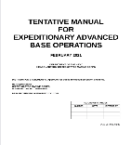
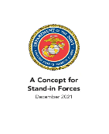
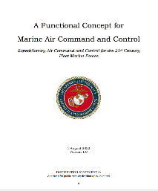
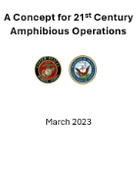
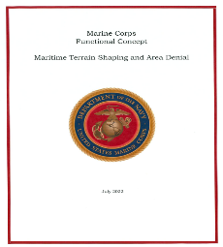
Marine Corps Concepts
Strategic/Capstone Concept
Operating Concepts
Functional Concepts
Integrated
Concept Based
Fiscally Responsible
Threat Informed
Strategy Driven
Concept Required Capabilities (CRCs)​
“Capabilities the force must possess in order to execute the concept”​
Notes:
Concepts serve as the seed corn from which most capability requirements grow. They bridge the gap between strategic guidance and the development and employment of military capabilities by articulating future military challenges and proposing how future operations may be conducted. Essentially, concepts are a hypothesis that propose innovative approaches to address how the force could operate in the future operating environment. Additionally, they can identify new opportunities presented by technological advancements that could create new dilemmas for adversaries.
The Marine Corps predominantly uses a concept-based approach to force modernization, guided by a family of Joint, Navy, Naval, and Service-level concepts. You may be familiar with some of these, such as Joint Warfighting Concept 3.0, Distributed Maritime Operations, and Expeditionary Advanced Base Operations, to name just a few.
At the Service level, the Marine Corps has its own hierarchy of official concepts. This hierarchy begins with a strategic concept that outlines the Service’s role in executing national strategy. Currently, a new Marine Corps Strategic Concept is in development. Below this, we have operating concepts, which provide detailed descriptions of how Marine Corps forces will accomplish specific missions, such as the Concept for Stand-in Forces. Both strategic and operating concepts are developed by the Marine Corps Warfighting Laboratory’s Futures Directorate.
Next, we have functional concepts, which describe in detail how specific activities could be performed, such as the Marine Corps Concept for Command and Control, and these are developed by the Divisions within the Capabilities Development Directorate (CDD).
So, how do we move from concepts to requirements? Well, these concepts generate force development and design implications that are tested through various modes of wargaming & experimentation, but in simple terms, expressed as Concept Required Capabilities (CRCs).
But what exactly are Concept Required Capabilities (CRCs)? CRCs are the capabilities the force must possess in order to execute the concept, and they should directly align with one or more of the concept’s ideas. They are not a problem statement, task, or system attribute; rather, they provide a framework from which a subsequent Capabilities-Based Assessment (CBA) will define tasks, conditions, standards, and performers to generate Capability Requirements (CRs). Add example
Today, some of the key ideas emerging from our latest concepts that are shaping force modernization efforts include the need for increasing dispersed: C2, littoral maneuver, and sustainment; managing and manipulating signatures; broadening sensing capabilities and capacity; exploiting domain seams; and enhancing integration with allies and partners.
So, what are my takeaways? First, to understand the Marine Corps' force modernization efforts, it's essential to study the new and emerging concepts—especially the Concept Required Capabilities. Second, don’t miss tomorrow’s session at 10:00 AM, where Mr. Andy Garlington from MCLW will delve deeper into Concept Driven Force Design.”

Slide 6
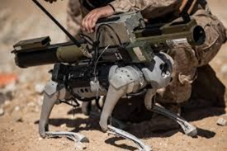
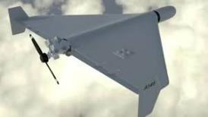
Threat Informed
The National Defense Strategy prioritizes the pacing threat.
Intelligence community collaboration is critical to ensure awareness of adversary capabilities.
The changing character of war:
Range & Precision
Sense & Make Sense
Proliferation of technologies
Electronic Warfare
Organic mobility & Maneuver
Logistic and sustainment
Integrated
Concept Based
Fiscally Responsible
Threat Informed
Strategy Driven
Notes:
Josh/Tony/
Everything we do is threat informed, the focus is provided to us by the NDS and we collaborate with the Intelligence community, specifically MCIA, our Neighbours down in Quantico to ensure our concepts, capability requirements, capability gaps, and solutions are informed by the changing character of war. This means we utilize the National Security Strategy, Joint Operating Environment 2045, Joint Strategic Assessment 2016-2036, Marine Corps Strategic Assessment, MCIA Enemy Course of Action, and MCIA Future Force Threat Assessment Briefing Quarterly Series to ensure awareness of geopolitics, emerging technology, strategic trends, and adversary capabilities.
Not only do we study and define our requirements based on threat, but we are constantly learning and acutely sensitive to the conflicts in Ukraine and Gaza – where technology and TTPs are evolving faster than ever before.
In particular, we are focusing on precision, electronic warfare, drones, mobility, and logistics in contested environments. But we are also considering how we set the force for protracted conflict, how we improve the resilience of our installations, and the value of a strong reserve component.

Slide 7
Fiscal Environment
Congressional support to strategic priorities
OSD investment priorities as directed in Defense Planning Guidance (DPG)
Cost of modernization increase
Sequencing of investments for modernization
Finite Budget
Clean Audit
Integrated
Concept Based
Fiscally Responsible
Threat Informed
Strategy Driven
Cost imposing strategy to achieve asymmetric advantage
Notes:
Col/Josh:
Force modernization is not cheap, and we remain challenged by limitations in resources. As ever, it's math problem, because we have $10 worth of requirements and only $6 in our pocket. The Department of the Navy relies on consistent congressional support, with timely and predictable funding being crucial for continued progress.
Given a limited budget, it is our role as the integrators to plan for a balance of investment across the enterprise, incorporating both OSD and CMCs investment priorities which means we must strategically time investments while maintaining financial accountability. Untimely the goal is to ensure taxpayer dollars are used effectively and efficiently to achieve the mission.
However, what we have seen in recent years is the associated cost of modernization. Technological advances, the rate of change, recruiting the and retaining the people we need and the associated materiel and non-materiel cost are all rising.
To give you a clearer picture of the numbers, think of an iceberg. The portion below the waterline represents ongoing or existing costs, many of which are non-discretionary, such as Marine wages. These total around $287 billion across the Future Years Defense Plan (a five-year period). Above the waterline are our unfunded initiatives, which in our most recent plan amounted to $12 billion in new projects, capability enhancements, and capacity increases. However, this only tells part of the story. There are also tens of billions of dollars' worth of unfunded requirements that aren't prioritized high enough to receive funding at this time.
Finally, its worth saying out loud that despite our fiscal constrains, the Marine Corps passed two clean audits in a row, demonstrating that we are responsible stewards of taxpayers money.

Slide 8
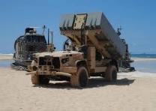
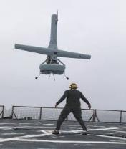
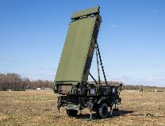
Capability Requirements and Operational Needs
Threat Assessments
Strategy
Concepts
Materiel & Non-Materiel Solutions
Integrated
Concept Based
Fiscally Responsible
Threat Informed
Strategy Driven
Top Down
Capability Requirements
Future Force
Bottom Up
Operational Needs
UUNS & DUNS
OAGs
Lessons Learned
Notes:
Tony/Col Wittnam:
In simple terms we have two complementary approaches to build the future force. A Top Down Capability Requirements Process and a bottom up Operational Needs Process.
Our Top Down Capabilities-Based Assessment (CBA) approach incorporates everything you have already heard as an analytic basis to define capability requirements, identify capability gaps and solution recommendations (Materiel or Non Materiel).
Our bottom up approach includes both Urgent-Universal Needs and Deliberate-Universal Needs processes, which are exceptional requests needed by HQ, supporting establishment, and operating forces.

Slide 9
Capabilities Based Assessment & Industry Opportunities
Planning Priorities
Logistics in a Contested Environment
Sea Denial
Integrated Air and Missile Defense
Capability Requirements
Gap Analysis
Solutions Analysis
Plan Development
Problem Framing
Plan Approval & Transmission
Integrated
Concept Based
Fiscally Responsible
Threat Informed
Strategy Driven
Industry
Engagement
Notes:
Col Wittnam:
The Marine Corps Capabilities Based Assessment (MC CBA) process is a structured, annual procedure used to assess the Marine Corps' capabilities within the ‘Planning’ phase of the Marine Corps’ Planning, Programming, Budgeting, Execution , and Assessment (PPBEA) process. It involves several steps, which you can see depicted on the slide.
It begins with Problem Framing, to ensure the Marine Corps capability developers adhere to the strategic objectives for the Marine Corps.
With this understanding we move to Capabilities Analysis, which involves identifying, defining, and characterizing, the Marine Corps Capability Requirements in the MCCRL.
With our requirements defined, next we conduct Gap Analysis, where we identifies gaps by evaluating the ability of the current Marine Corps force to perform the our capability requirements. Capability gaps are identified by the inability to achieve a task to standard under the given set of conditions and recorded in the MCGL.
Next we conduct Solutions Analysis, and produce solution strategies which simply identify materiel and non-materiel ways to address each gap in the MCSDD
The last analytical task is to priorities all the solutions and develop Force Integration Plan (FIP) for approval by DC CD&I and then the E-MROC.
The annual process culminated in with CMC approval of the FIP, which is used to guide P&Rs resource allocation for the year ahead. This process also supports requirements for the Joint Capabilities Integration and Development System (JCIDS) and the Defense Acquisition System.
For our industry partners out there:
Many of our concepts are unclassified.
Solution Analysis – Market Research via MCSC
Classified Industry Days. (MCWL) – When Where, etc
CUI version of the FIP.

Slide 10
Questions
Integrated
Concept Based
Fiscally Responsible
Threat Informed
Strategy Driven
Notes:
Panel: The panel will address operational innovation, functional capability development, the role of concepts, the capabilities-based assessment, materiel and non-materiel solution implementation, and resourcing.

