Slide 1
Maritime Reconnaissance Company
LtCol Brian Lusczynski
HQMC, CD&I

Slide 2
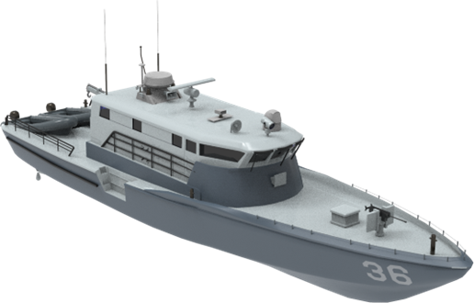
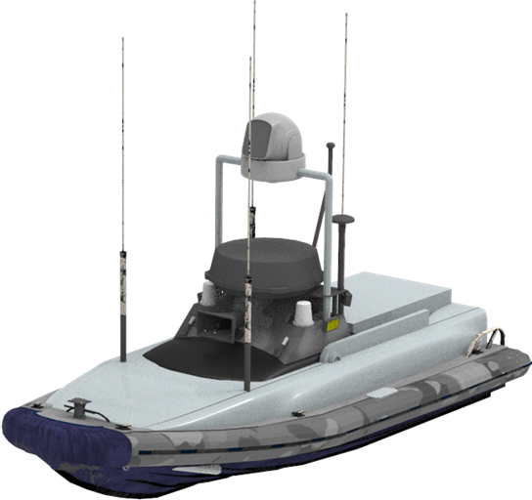
Maritime Reconnaissance Company
Multi-Mission Reconnaissance Craft
Unmanned Surface Vessel
*Representative Images

Slide 3
Requirements Drivers

Slide 4
Extensive
Over-Water Distances

Slide 5
Contested C2

Slide 6
EMCON Operations

Slide 7
Concept of Operations

Slide 8
Analysis of Alternatives
Multi-Mission Recon Craft (MMRC)

Slide 9
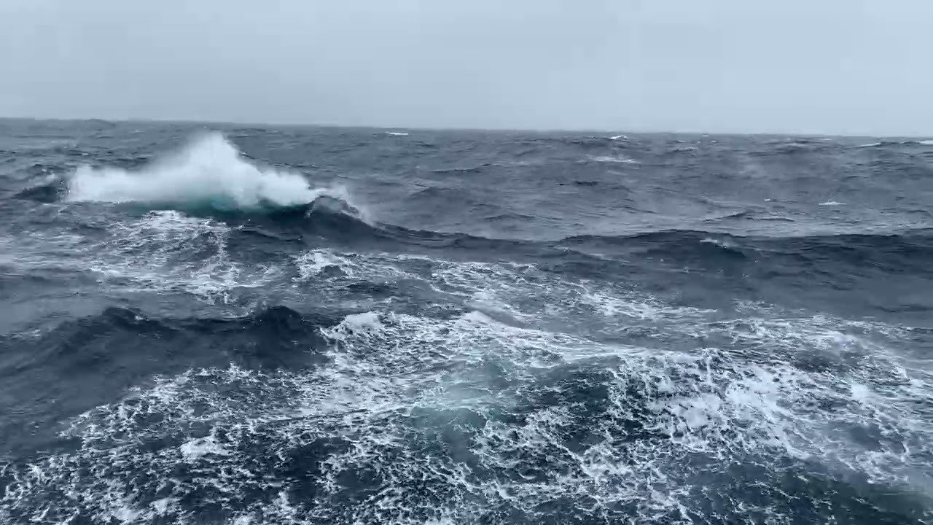
31% of the year, seas are 0-3.3ft (7.1 sec)
42.5% of the year, waves are 3.3ft - 6.6ft (7.5 sec period)
Environmental Conditions
31% of the year, seas are 0-3.3ft / 7.1 sec
42.5% of the year, seas are 3.3ft - 6.6ft / 7.5 sec
17.5% of the year, seas are 6.6ft - 9.8ft / 8.2 sec
6% of the year, seas are larger than 9.8ft / 9.2sec
“Medium” Class Craft

Slide 10
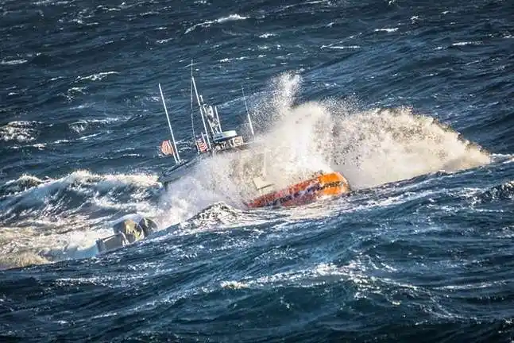
Dave Philipps, Chronic Brain Trauma is Extensive in Navy’s Elite Speedboat Crews, New York Times, 12 Nov 2024.

Slide 11
Complexity / Risk
Over-the-Horizon Mission Profile
Peer Threat Environment
Grey Zone Actors
(New) Primary MOS

Slide 12
Facilities / MILCON

Slide 13
Enterprise-wide Effort
MARCORSYSCOM (PM GWS, PdM LRUSV)
Operations Analysis Division (CD&I)
Marine Corps Warfighting Lab (MCWL)
1st Light Armored Recon Battalion
2d AA Battalion, II MLG, 4th AA Bn, and others
G3s at 1st, 2nd, and 3rd MARDIVs
NAVSEA
Combatant Craft Division
Naval Special Warfare Group IV
USCG Office of Boat Forces
USCG Cutter Hamilton and MFPUs -PAC & -LANT

Slide 14
Status / Way Ahead
Initial Capabilities Document (CY24)
Concept of Employment (CY24)
Analysis of Alternatives (CY25)
Funding Determination (CY25)
Service-level Decision (CY25)






