Slide 1
LtCol Johnson
20250501
Dynamic Maritime Sustainment

Slide 2
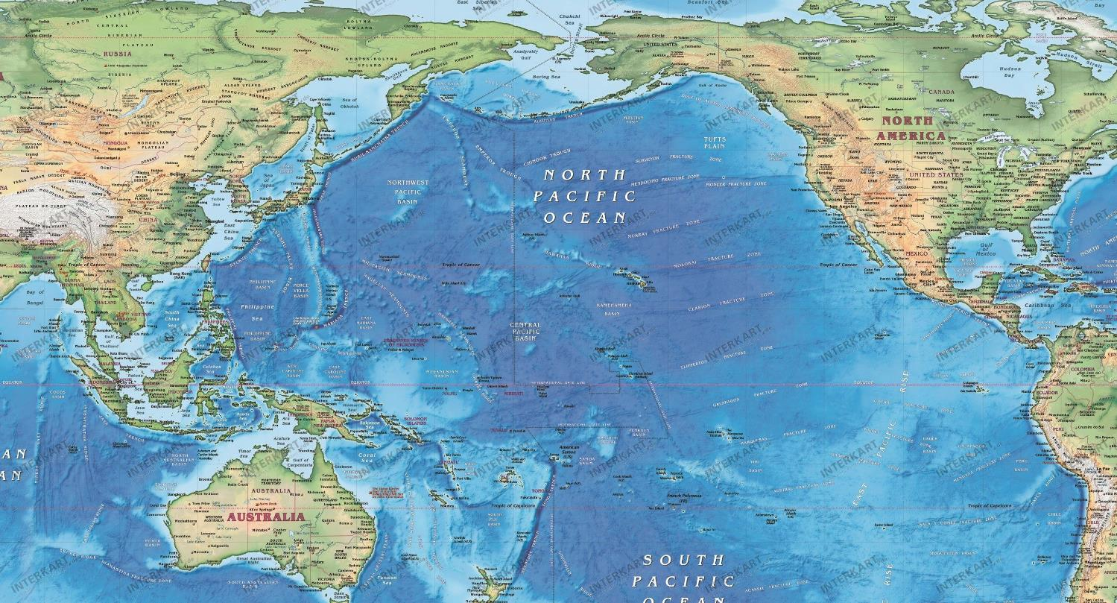
Sustainment Network
Level of Contestation
Legend
The existing JLENT architecture post WWII maintained maritime and air supremacy between CONUS and OCONUS sustainment hubs. As technology and capabilities advance, so to must the sustainment network.
Key Hubs
LOCs
Key Terrain
Notes:
When I think about contested logistics, I start with the end in mind. Who is that force operating at the furthest edge and how do I develop a sustainment framework that can support them and anyone in between.
When John Sattely and I sat down and brainstormed this concept, we looked at the from the perspective that the vast majority of our logistics network will remain the same for quite some time but there is opportunity to “adjust the system” to how it operations. The way I describe it is the ‘Money Ball’ approach to logistics. I have a lot of capability out there and if utilized in a different manner could provide a different result. We all realize there are competitors in the world who are looking to disrupt the world order. They have a fairly good understanding of how most of our logistics operates.
(build 1) – We have major logistics hubs
(build 2) – Sustainment flows via surface or air through those hubs
(build 3) – There is key terrain, namely Panama Canal & Malacca Straights from which a vast majority of maritime traffic passes
The reality is, the physical world is what it is. We’re not developing more land. We’re not just picking up our OCONUS bases and repositioning them.
Most of our developed logistics network, that series of hubs and nodes that has been established for 80 years post WWII cannot just be repositioned overnight.
Understanding that our competitors know this; how to we operate in a contested environment?
NOTE – The rings are for illustrative purposes only to represent an increasing degree of contestation (Whether it be ISR, surface/subsurface threats, long/medium/short range missile systems, etc.)

Slide 3
Contested Environment
Level of Contestation
Legend
“At the operational and strategic levels, we can anticipate our potential adversaries will attempt to interfere with our deployment and sustainment plans by targeting all elements of the MCILE and the FMF both kinetically and non-kinetically”
General Berger, I&L 2030
Fixed Sites
SIF & OPFOR
LOCs
Highly Contested
Contested
Notes:
Marine Corps Installations & Logistics Enterprise (MCILE)
If I’m to envision how the Marine Corps operates during Force Design in this type of scenario (INDOPACIFIC Region), I likely have distributed forces operating throughout the entire region:
(Build 1 – Black dots). I have forces that are operating in the “blunt layer”, these inside forces either already stationed in that region or campaigning in various countries.
I have forces operating in the surge layer who are coming to establish Advanced Naval Bases, Expeditionary Advanced Bases, Logistics HUBs etc. These forces are either providing sustainment to or repositioning themselves to move into the blunt layer.
The interior lines of communication between these layers is characterized by vast spaces of open ocean. No longer can I just put together a truck convoy and deliver sustainment like we did in OIF/OEF. I have to either ship it via surface or air.
These environment is heavily characterized by a lack of improved infrastructure.
(Build 2 – Contested Signs).
My adversary will likely challenge me to disrupt my movements and plans.
Some locations they will have the ability to highly contest me, others moderately
Cyber and information contestation will be global
(Build 3 – Blunt Layer Sustainment)
I have to develop a way of sustaining the inside forces DURING contestation
-----------
How do we close the force?
Some of those forces and equipment will already in in position, some of it will not?
So where are those forces and equipment coming from?
What resources do I have to close that force to where it’s needed? – Connectors (organic and non-organic)(surface and aerial)
What resources do I NOT HAVE that must be requested to close the force?
How do we sustain the force?
How much sustainment and where?
Who is responsible for managing that sustainment?
What can I ‘forward position’ and what can’t I ‘forward position’? –Authorities, HN agreements, etc.
When you think through the requirement to execute these two operational logi

Slide 4
Problem Set
Complexity
Current System
Future System
Centralized model
Economic / Efficiency
Developed infrastructure (nodes)
Large connectors
Non-contested
Decentralized model
Effectiveness
Infrastructure lite
Variable connectors
Contested
Notes:
Principles of Logistics:
Responsiveness
Simplicity
Flexibility
Economy
Attainability
Sustainability
Survivability
-----------------
Opening: “When I step back and think about the current sustainment system broadly, I see a system that is”
Centralized
Built economy & efficiency
Utilizes well developed infrastructure (nodes) at all points
Utilizes large connectors to gain economy (T-AK supply vessels, and large cargo aircraft, C-17)
Non-contested
This model worked well when we controlled the sea lanes and air domain. As technology has improved, our ability to control those domains in the future is being challenged. Look no further than the impacts the Houthi rebels are having on Red Sea shipping where 40% of European goods and services flow through or what Ukraine did to Russia’s Black Sea Fleet. Low-cost high-impact systems are forcing traditional operating models to change.
A contested environment shifts toward a decentralized model that must be:
Decentralized
Built for effectiveness
Interact with less developed infrastructure (what I call Infrastructure Lite)
It needs a multitude of connectors
Withstand contestation
The complexity between a centralized model and decentralized model is factorially more difficult.
----------
Undoubtedly there are huge tradeoffs when you shift from one system to the other. Notably the number of people it takes to operate in a decentralized manner increases.
The number and mix of connectors necessary to flow sustainment through the system will be required to change.
In a peacetime environment, the current system is highly effective and cost effective but in a contested environment effectiveness is what matters.

Slide 5
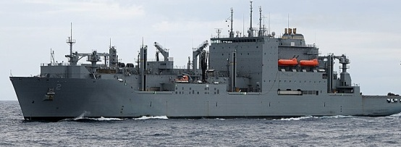
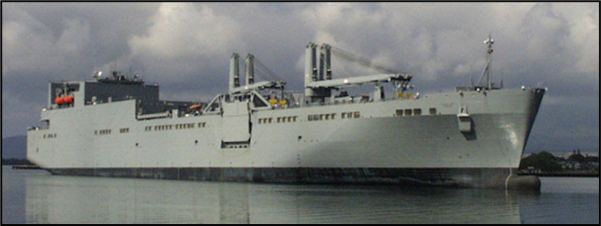
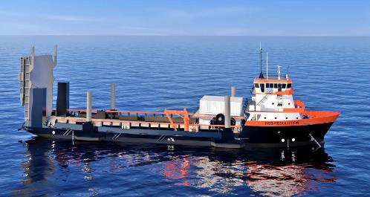
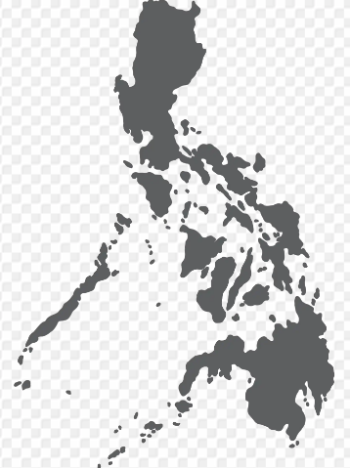
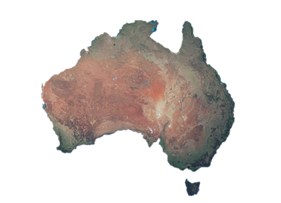
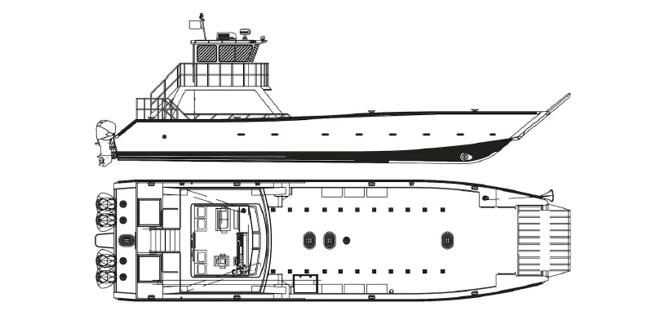
Dynamic Maritime Sustainment
Is an operational approach through an expanded and flexible distribution architecture that can better sustain stand-in forces in both uncontested and contested environments.
How do we position and distribute to the point of need?
T-AKE
LMSR
Afloat
Ashore
Connectors
Allies & Partners
Contracted Network
Notes:
Read Caption then follow-up with statement below:
1) The key to a successful logistics network begins with establishing a solid framework; a base from which you can expand from.
When the Marine Corps campaigns in the maritime environment that is almost exclusively through a Marine Expeditionary Unit or MEU
That MEU afloat is sustained by the Navy’s supply network (NAVSUP); predominantly by the Combat Logistics Force (CLF) which are sustained by multiple Fleet Logistics Centers (FLCs) and Fleet Logistics Sites (FLS) - the MEU is a rider on that network and is easily sustained because they’re collocated.
The CLF primary mission is to sustain naval fleets (CSG, DESRON, PHIBRON, etc). As naval fleets are contested, the stress on the CLF increases and their ability to support secondary missions is reduced. A limited inventory of connectors become highly prioritized. Simultaneously strategic lift resources will become prioritized.
At this point in time, you’re likely to have distributed stand-in forces and other regional forces who are repositioning themselves. Each of these forces will require sustainment, from a stressed network.
Dynamic maritime sustainment aims to address the challenge between the afloat & ashore networks who are no longer able to utilize their long-standing sustainment models.
Connectors
The current connector fleet is purpose built to predominantly utilize PROTECTED improved infrastructure
The MEU has some organic connectors that are tethered to the amphibs, but to utilize them repeatedly requires proximity to the ships and CLF, exposing them to increased risk by proximity.
Assault support can provide limited sustainment for some critical items; however, distributed maritime operations will challenge this capability.
Afloat & Ashore Relationship
To sustain contested distributed stand-in forces requires redesigning how the throughput of sustainment flows.
Understanding the NODES from which sustainment flows is critical to the architecture. (I’ll touch on this later)
Protected HUBS area are a necessity, and the further into contestation sustainment flows, the more distributed and decentralized your sustainment must be (survivability)
Leveraging Allies & Partners / Contracted capabilities to ‘Connect’ the Network
How can we utilize HN networks to position capabilities?
Access
Maintain, sustain, issue/recover, and manage the site. Who ‘should’ do this?
How to we leverage connectors to reduce risk in the contested environment?
If I don’t know exactly where I want to go but have a good idea of w

Slide 6
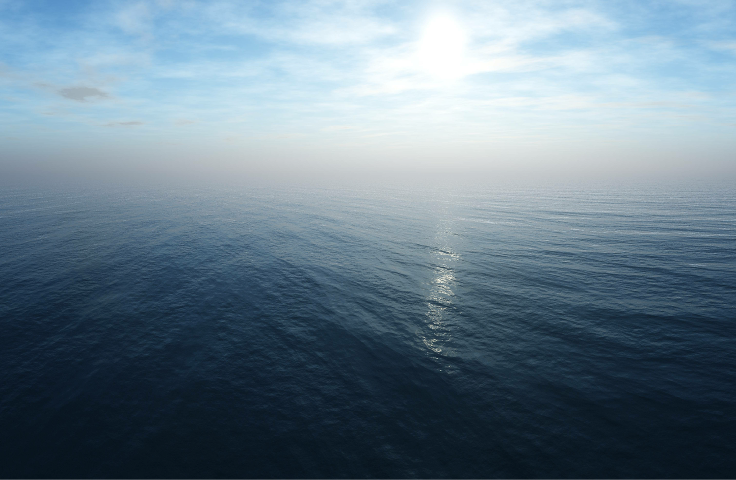
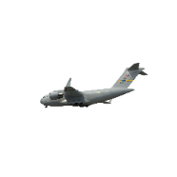
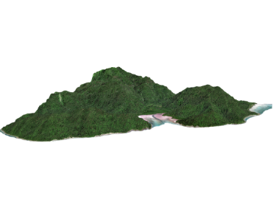
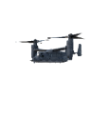
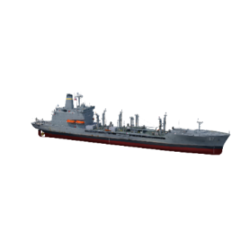
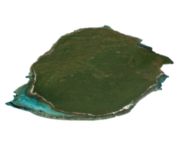
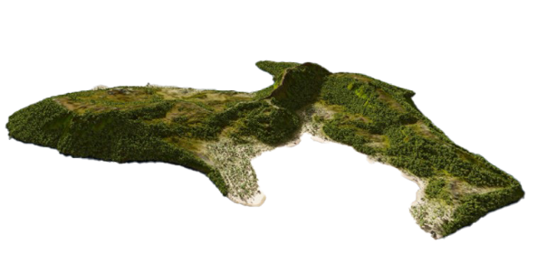
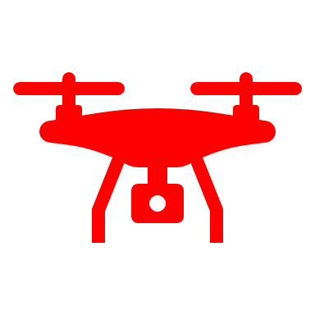
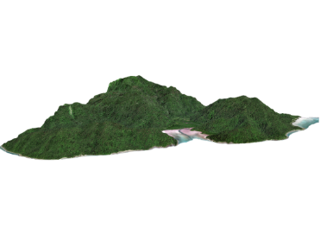
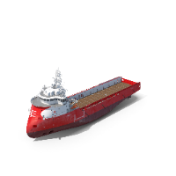
Connecting the Network
Contestation
Decentralization
ANB
HUB
GPN
SIF
At Sea Transfer
MPF ‘mothership’
GPN
SLV STS
ANB
OSV Type Vessels
Logistics Drones
SLV
GPN
Notes:
When I envision a contested distributed maritime operating environment, I envision something that looks this:
At the end forward end are the stand end forces who have their organic equipment, maybe a GPN site they have access to. Likely a limited supply, particularly things that matter (Class V).
They’re disaggregated, operating in remote areas characterized by undeveloped infrastructure. This is a difficult logistics scenario.
How do you sustain those forces with the realization that all major infrastructure hubs are contested or denied
The CLF is likely tethered to their naval fleets. Traditional logistics channels will be disrupted. Aviation resupply will be limited to most critical items.
In Dynamic Maritime Sustainment model, I think there is an opportunity to re-envision how certain vessels operate and conduct logistics sustainment. MPF vessels (LMSRs, T-AK or future MPS(NexGen)) that have not been offloaded still have a vast amount of viable resources. How do you connect that to the warfighter?
I think there is an opportunity to configure these vessels as a ‘mothership platform’
(BUILD 1) MPS can easily do at sea transfers. Equipment, supplies, even personnel could RSO&I onto the MPS and marry up with equipment. This can occur in a safe, protected location.
(BUILD 2) Once transferred to a smaller connector, SLV STS for example could deliver a capability set to a location, recover broken equipment, and supplies or displace the entire unit to a new location.
(BUILD 3) Another option is having the ability to utilize logistics delivery drones. Depending on the operating environment, you could launch and deliver drones (both aerial or semisubmersible) to a site.
Being able to deliver sustainment from the sea and mask our logistics signature as far away as possible complicates adversarial actions. They don’t have unlimited ISR, fires, sustainment to find, fix, target, and complete the kill chain everywhere. The more mobile I am, the more resources they have to expend looking for logistics resources and the better that is for the Naval Fleets.

Slide 7
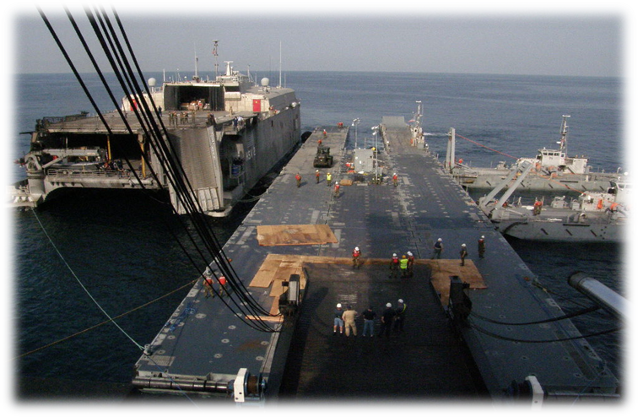
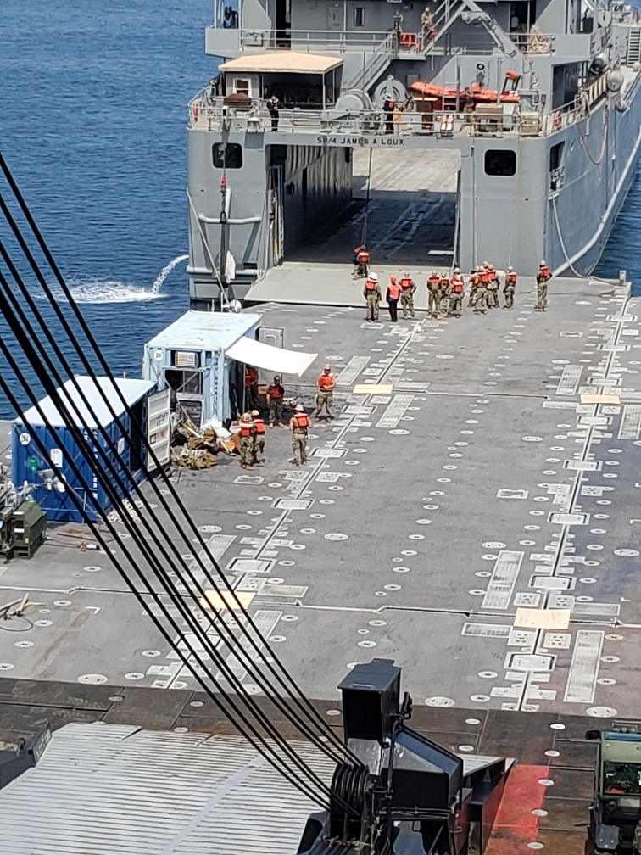
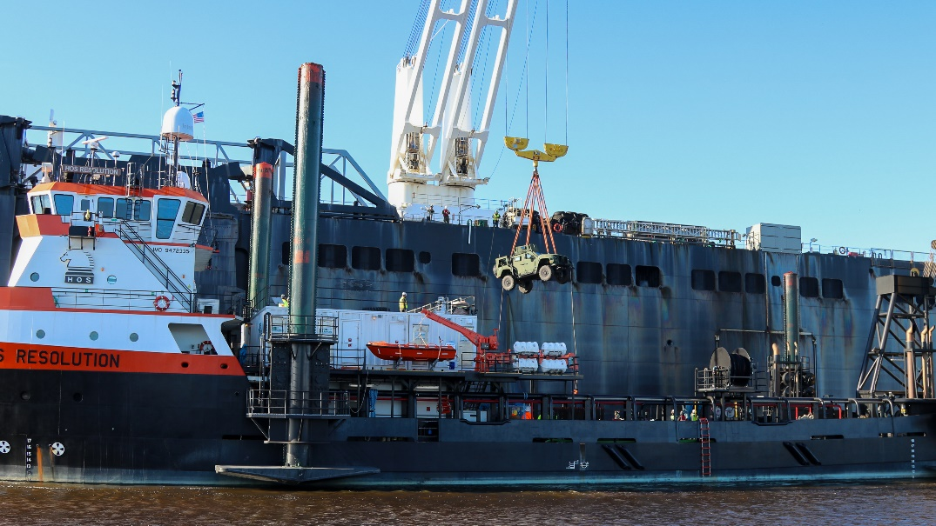
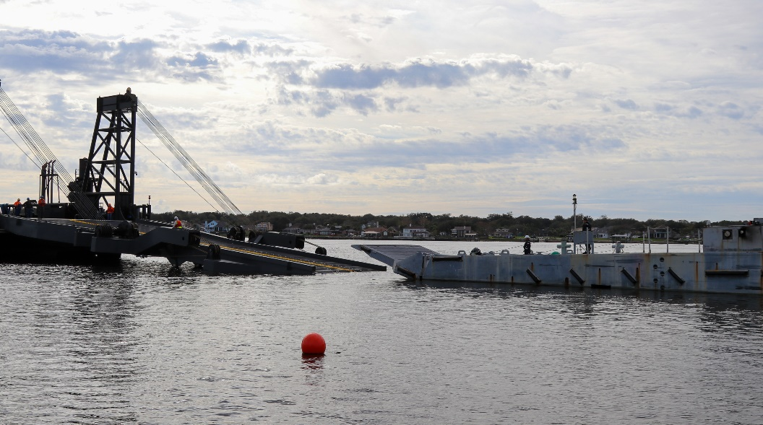
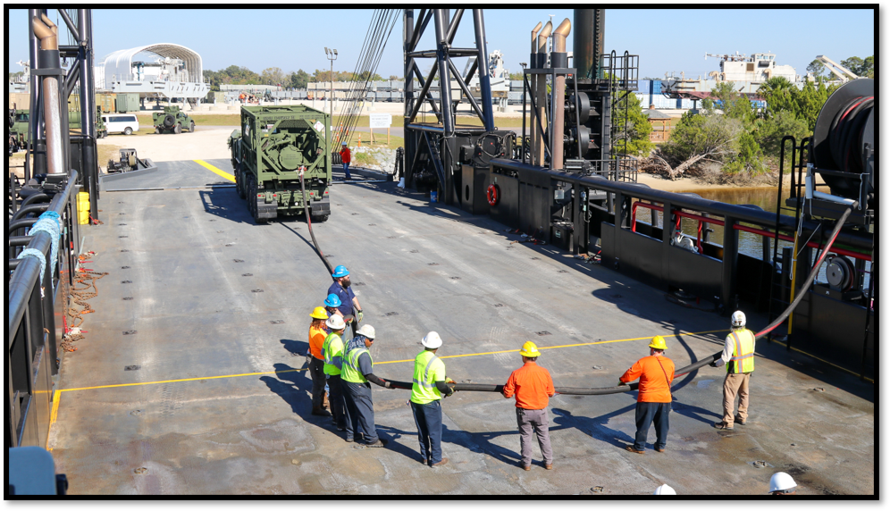
Interoperability of Connectors
Notes:
The ability for connectors to interoperate are critical to sustaining a distributed maritime force. The distance between HUBS and Advanced Naval Bases will be vast, so having connectors with the ability to interoperate with one another opens the ability to sustain forces in a much wider array of locations that are characterized by unimproved ports and various types of beach gradients.
Logistics ‘motherships’ need to be able to bridge the gap between HUBs, ANBs and stand-in forces.
Dock systems like the Roll-on, Roll-off discharge facility (RRDF) are great for transferring large amounts of equipment between an MPS and a Logistics Support Vessel (LSV) or an Expeditionary Fast Transport (T-EPF), but they do have some drawbacks. Notably they take multiple ships and a large amount of Naval Beach Group forces to establish.
What if I can cut out the middleman, or at the least, reduce the amount of “intermediary nodes” it takes to transfer sustainment?
NEXT SLIDE

Slide 8
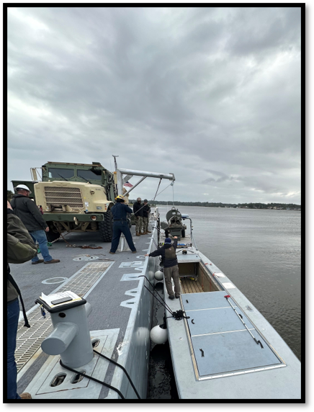
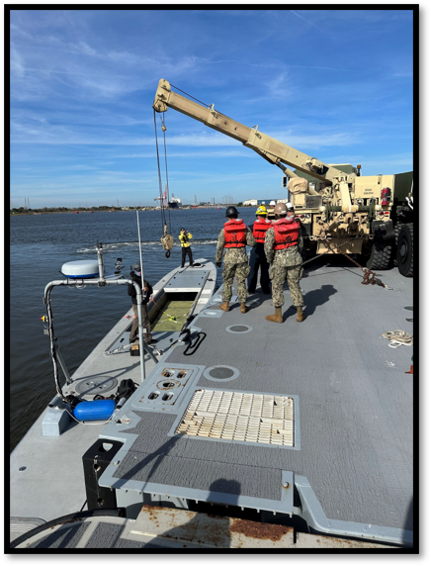
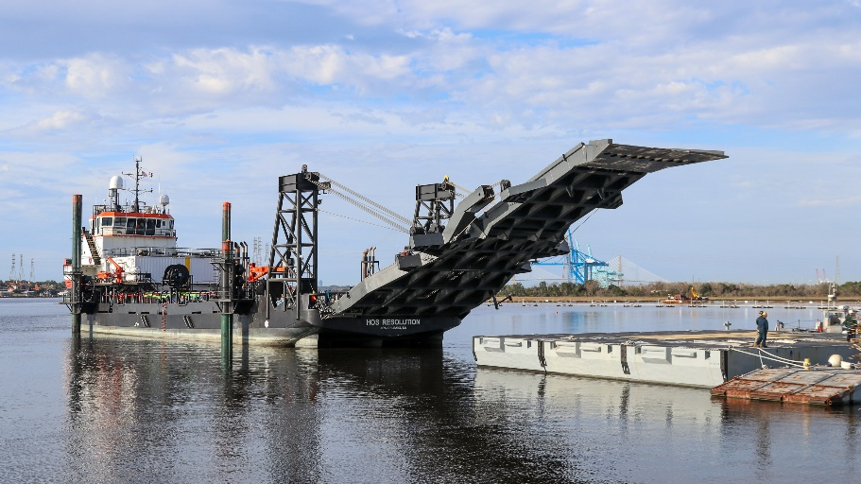
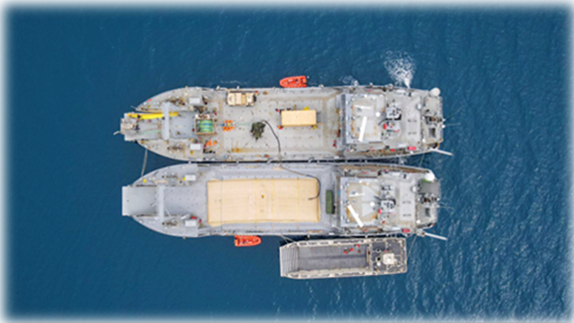
Interoperability of Connectors
ALPV & INLS
Bulk Fuel transfer w/ SLV
SLV ramp to INLS
Fuel from LCU-2000 to LCM-8
Notes:
How do you do direct transfers between systems?
Top Left: INLS using its manual hoist to lower a sustainment package into a ALPV (semisubmersible)
INLS with a MK-36 wrecker using the boom to transfer a simulated Naval Strike Missile into an ALPV
Top Right: SLV transferring fuel to a Flatrack Refueling Container. The vehicle can then go execute a mobile refueling operation.
Bottom Left: SLV simulating the ability to dock onto a INLS or a barge-type connector
Bottom Right: LCU-2000 with fuel bladders demonstrating the ability to pump fuel to an LCM-8 boat
The takeaway from this slide is, how do we develop connectors that can transfer sustainment to a land-based force that both protects the connectors and the force.

Slide 9
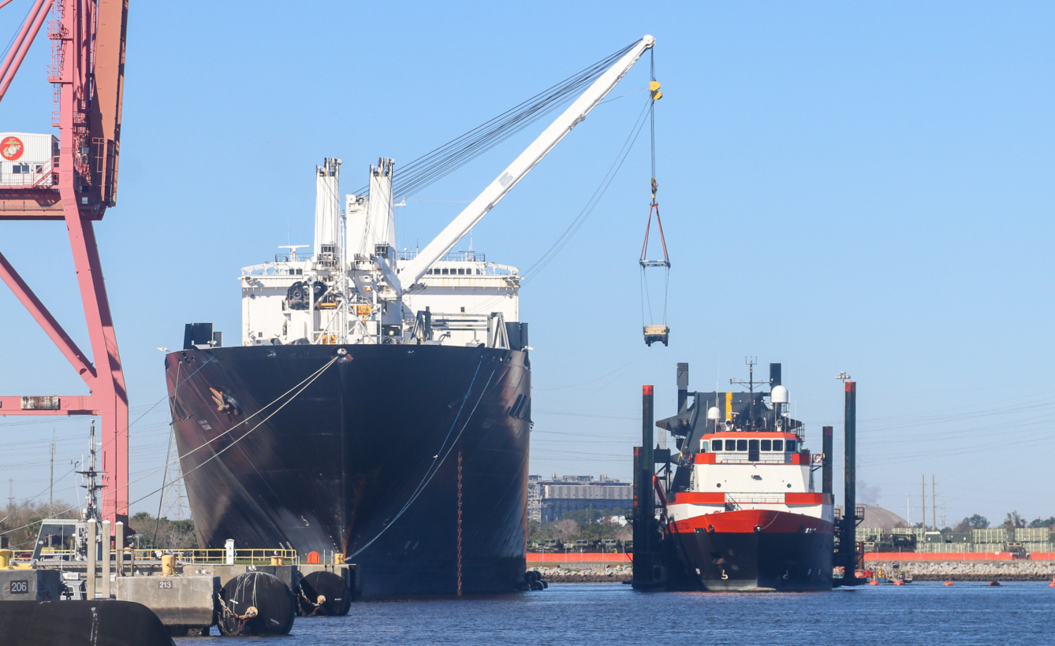
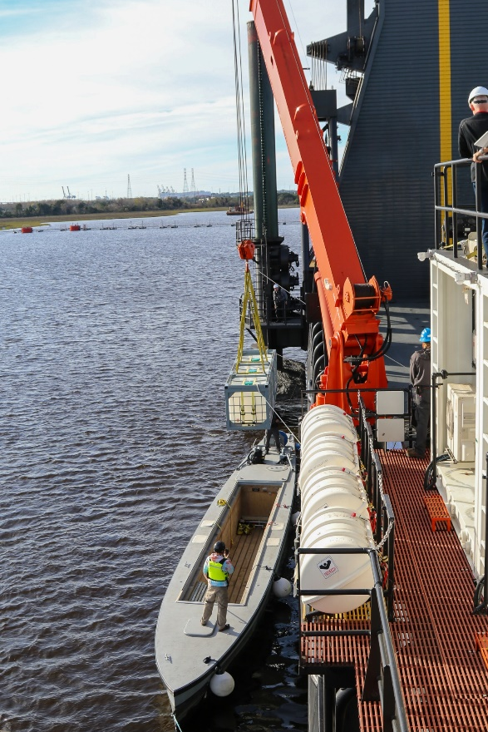
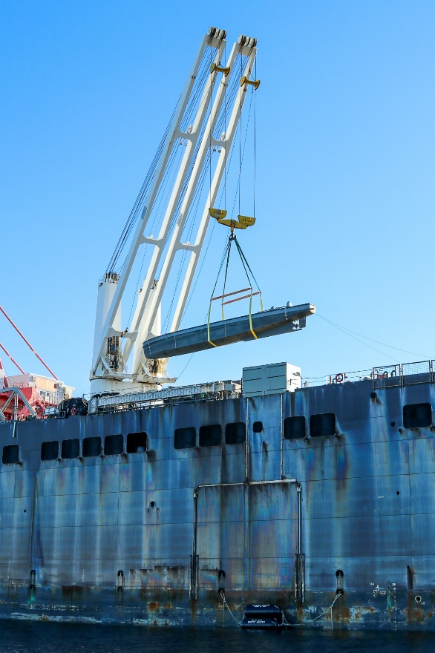
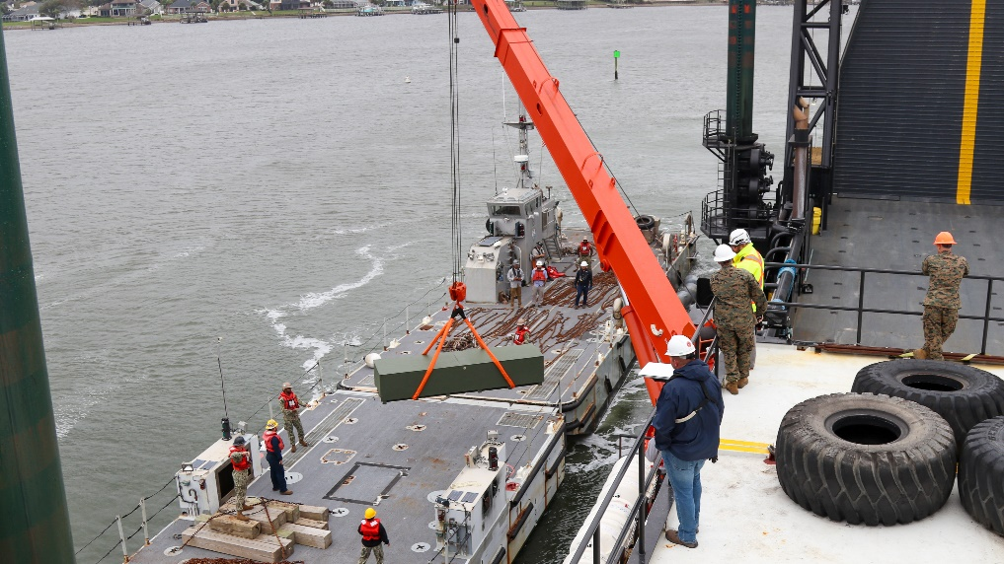
Transportability & Transfers
MPS & SLV
SLV & ALPV
MPS & ALPV
SLV & INLS
Notes:
The ability to execute Lift-on / Lift-off (LO/LO) transfers provide the most compelling way to transfer equipment and supplies while complicating your adversaries ability to target you?
You can execute this anywhere these systems can link-up. That makes it extremely difficult for your adversary to target you.
Certain conditions must be considered to execute transfers, namely:
sea state
dynamic positioning systems
fendering between vessels
proficient crane operators
material handling capabilities
However, those can be overcome:
What you’re seeing in these pictures are some of the example transfers our command was involved in to highlight Dynamic Maritime Sustainment:
(Top Center) MPS interoperating with SLV, demonstrating the ability to transfer a capability set to a smaller connector.
(Right) Showing MPS as a mothership capable of deploying semisubmersible sustainment packages directly into the water. You could have dozens of these capabilities pre-loaded or with an organic crew on the MPS, tailored directly to a specific requirement.
(Bottom) Showing how a SLV with a crane can transfer a NSM package to a INLS or barge-type connector
(Left) Showing how a NSM could be transferred directly into an ALPV
Depending how connectors are configured, particularly the intermediate size (SLV, SLV STS, LSM of the future, etc.) you could have these connectors built with a shipboard crane that is also capable of directly deploying and recovering autonomous vessels.

Slide 10
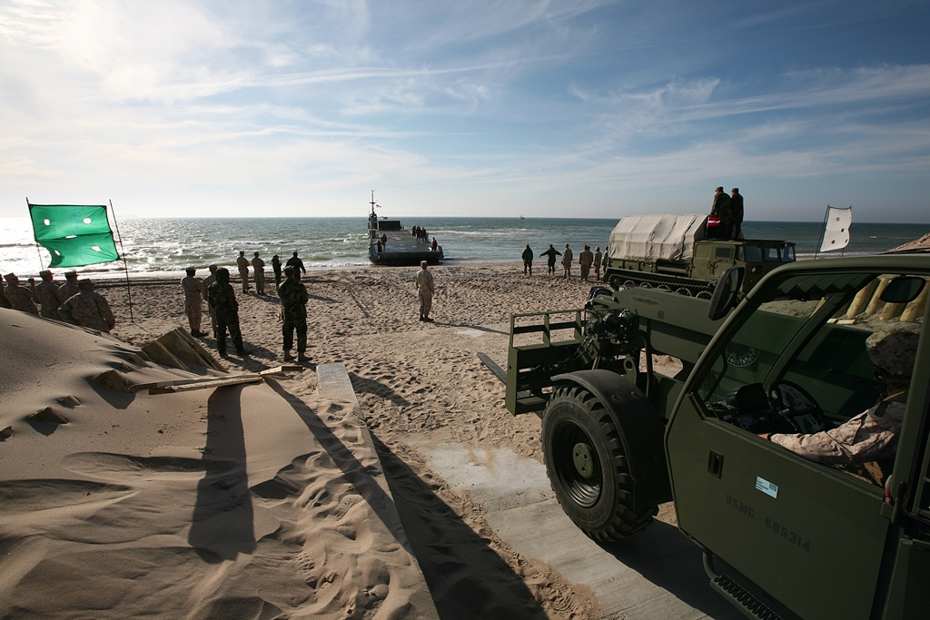
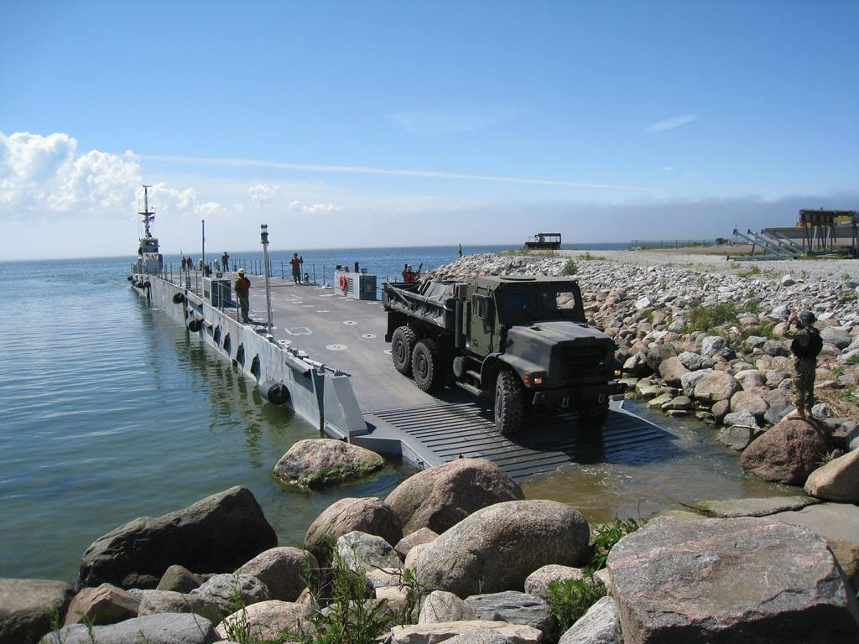
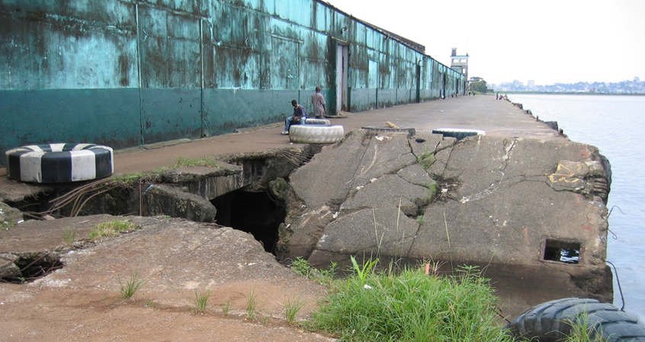
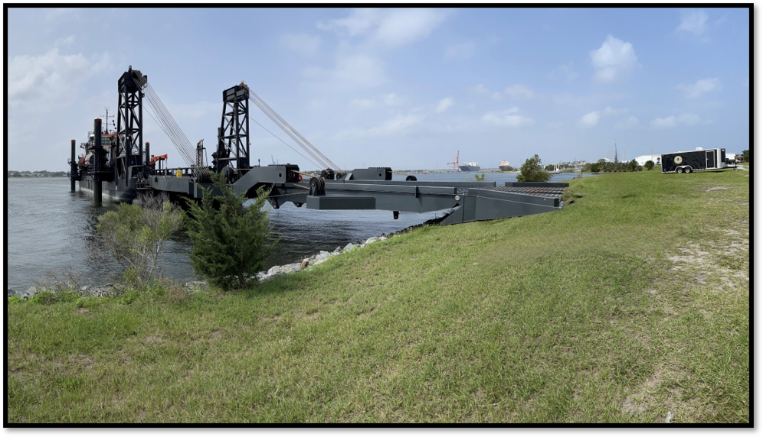
Littoral Transfer Sites
Notes:
After the at-sea transfer has taken place, the next consideration is the littoral transfer site.
What type of site do I have? (discuss the four pictures)
What are the material handling requirements at the transfer site?
How does the sustainment package I’m delivering get moved to its destination?
The overarching takeaway is that the movement of sustainment throughout the entire chain is a complex series of events involving thousands of items that must process through nodes and connectors to and end user.
How do you develop that system to operate when the end user destination is extremely variable AND CONTESTED.

Slide 11
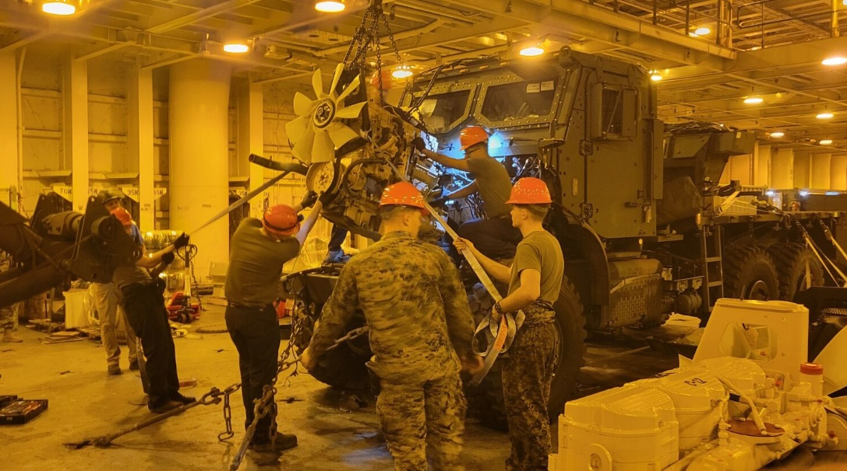
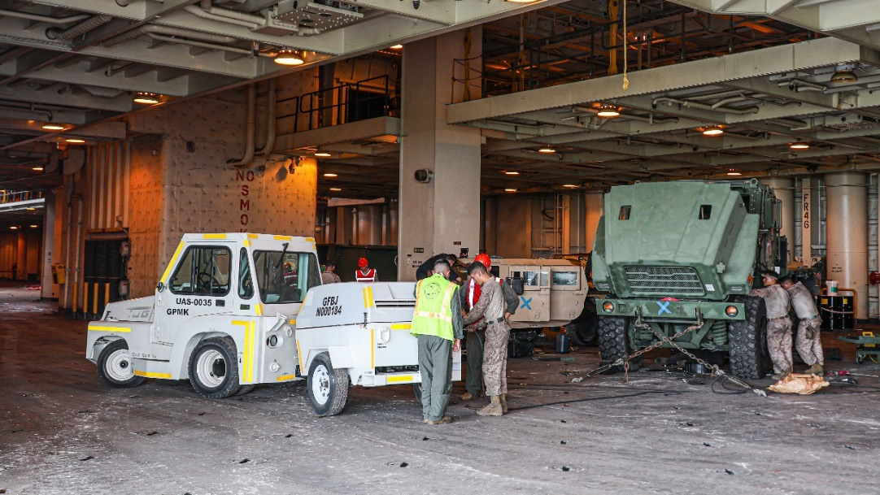
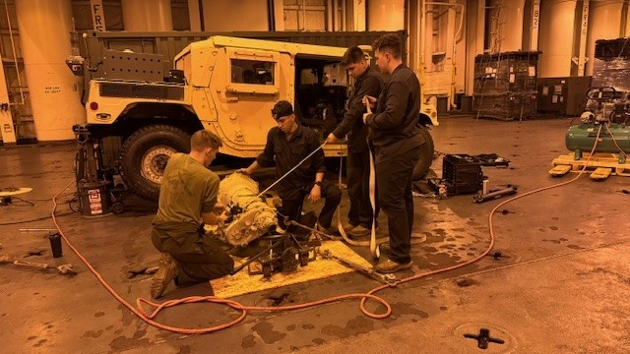
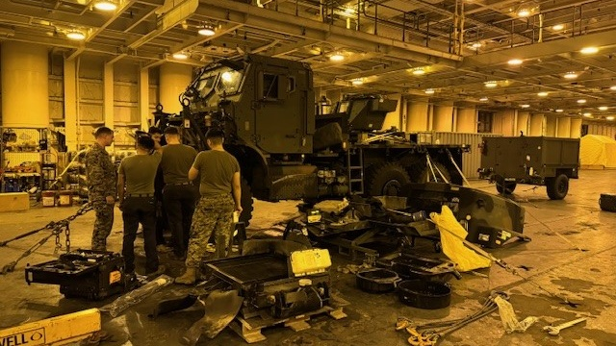
Afloat Maintenance
Engine Replacement
Engine Replacement
ASE supporting Ground Maint
Transmission Replacement
Transfer Case Replacement
Notes:
The last piece I want to highlight is the opportunity to do critical logistics functions such as maintenance in different methods.
The concept of Force Design and stand-in forces looks to avoid large bases and footprints forward, minimizing that it to only the essential functions (C2, ISR, fires, intel, etc.)
Large logistics footprints increase sustainment requirements and signature, stress the logistics chain.
How can I do some of those activities differently? I think certain maintenance functions could be executed in a maritime environment that traditionally are done ashore.
Intermediate maintenance activities such as secondary repairables (engines, transmissions, etc.) that are done at a higher echelon, not a stand-in force, could be executed afloat in closer proximity.
I could envision an embarked detachment aboard an MPS doing these actions and then transferring equipment back onto connectors.
What you see in this slide are some actions conducted while the USNS PILILAAU transited to Norway in the winter of 2024.

Slide 12
Final Thoughts
Develop an interoperable connector network
Surface / subsurface / aerial
Final recipient and work backwards
Forward position new capabilities
Additive manufacturing / 3D printing
Leveraging contracting solutions
Portfolio options across countries
Joint force solutions

Slide 13
Questions?

