Slide 1
LtCol Johnson
20250429
Global Prepositioning

Slide 2
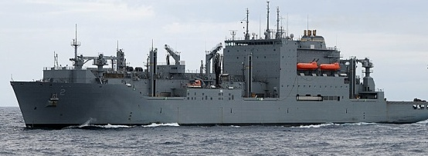
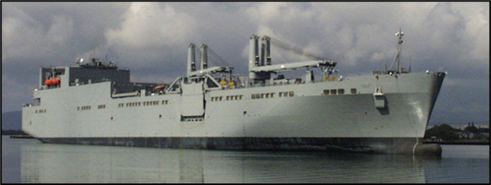
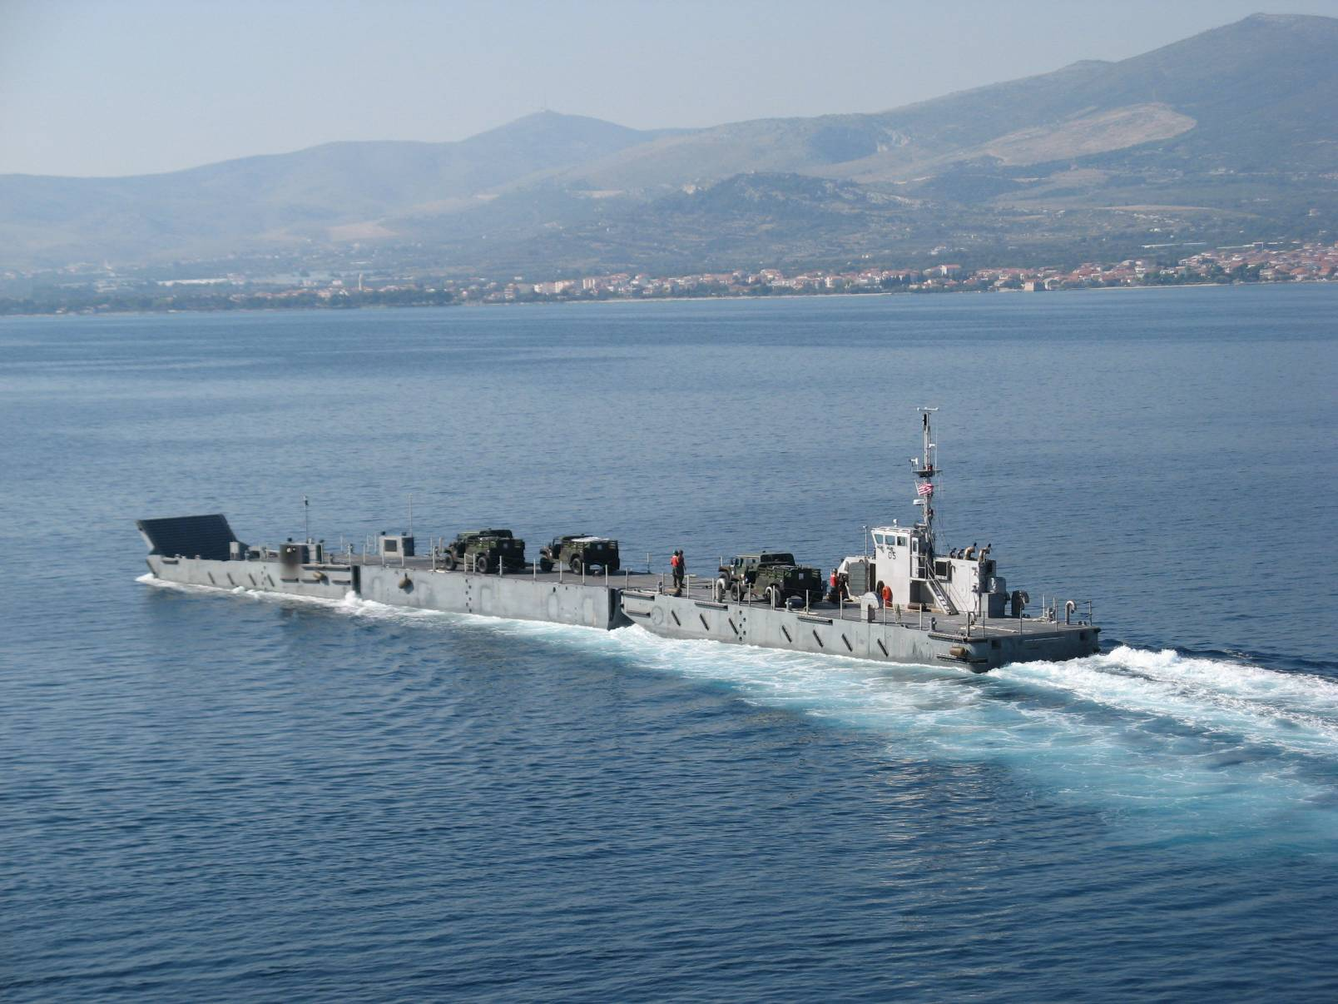
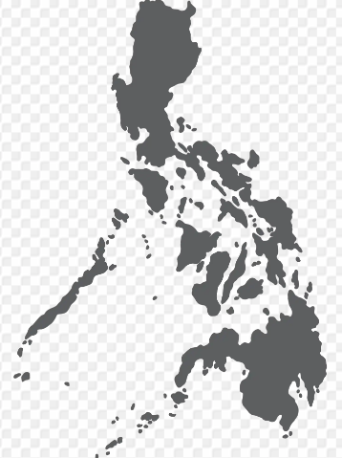
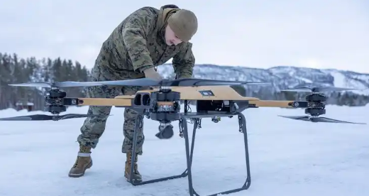
The ‘GPN’
The Marine Corps Global Positioning Network is an integrated network of material positioned afloat and ashore in key strategic locations in support of active campaigning by the Fleet Marine Forces as it deploys to and operates in key maritime terrain in order to deter adversaries during competition and, if necessary, prevail during armed conflict.
(Global Positioning Network Functional Concept, Jan 2024)
Afloat
data
Ashore
Connectors
Notes:
Prepositioning is just one aspect of the Global Positioning Network. FMF operating stocks and programs like MRF-D and sustainment stocks positioned throughout the AOR all encompass the GPN.

Slide 3
Prepositioning Overview
Blount Island Command
ROS MPS
USNS BUTTON
USNS SEAY
Marine Corps Prepositioning Program-Norway
Diego Garcia
MPSRON 2
USNS PILILAAU
USNS WILLIAMS
USNS LEWIS & CLARK
Guam/Saipan
MPSRON 3
USNS DAHL
USNS LUMMUS
USNS SISLER
USNS SACAGAWEA
Marine Corps Prepositioning INDOPACOM
LEGEND
Maritime Prepositioning Force
Ashore Prepositioning
Ashore sites in development/assessment
ROS – Reduced Operating Status
MPS – Maritime Prepositioning Ship
MPSRON – Maritime Prepositioning
Ships Squadron
Global prepositioning is aligned with Force Design by retaining our core global maritime capability while establishing new ashore sites in the priority geographic combatant commander’s area of responsibility.

Slide 4
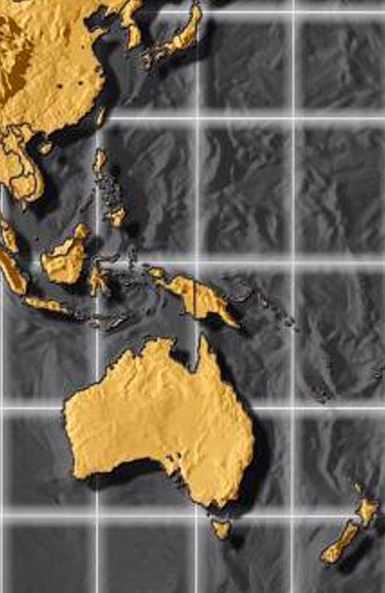
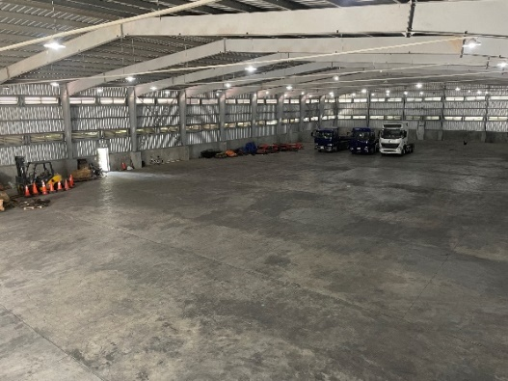
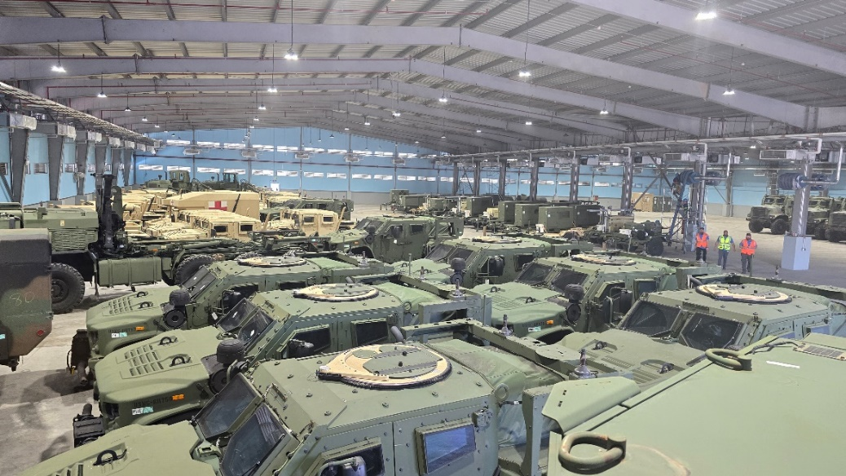
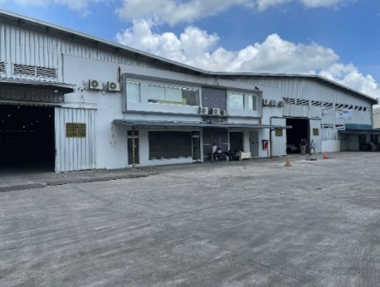
MCPP - INDOPACOM
Overview
Forward positioning capability sets supporting the Host Nation, Service and Combatant Commander requirements
Regionally aligned – globally responsive – globally integrated
Logistics web
Combined approach utilizing host nation & commercial storage with contracted maintenance operations
Government oversight & management
Contracted maintenance provides flexibility under a global IDIQ contract with other programs
Expands fleet marine forces campaigning opportunities by reducing timelines and transportation costs
3

Slide 5
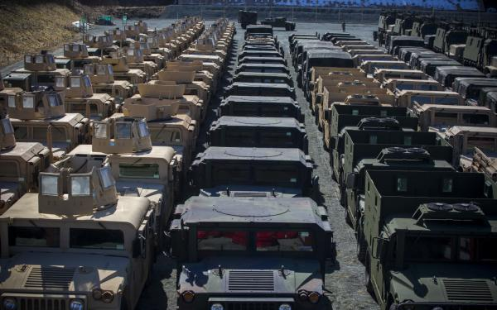
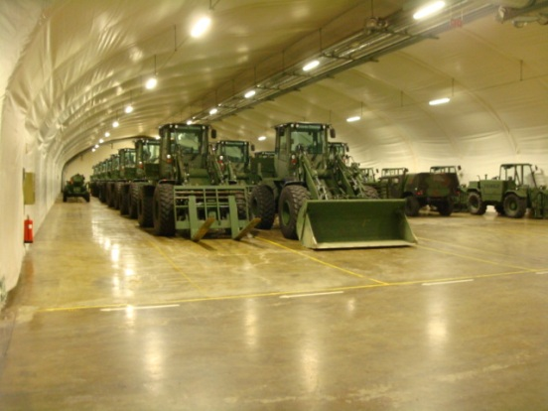
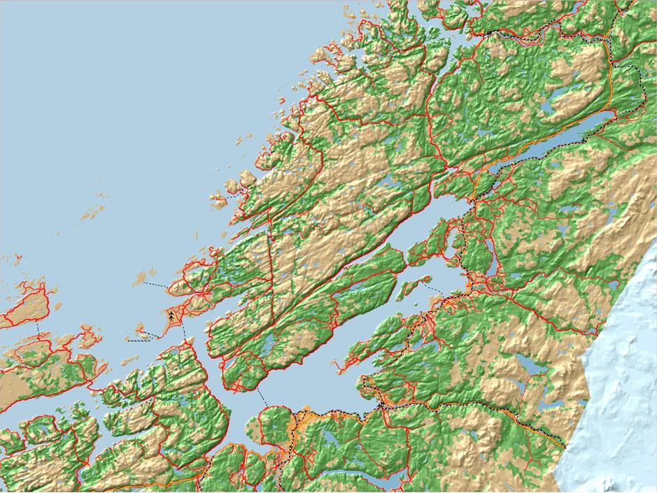
Marine Corps Prepositioning Program – Norway (MCPP-N)
Mission
MCPP-N supports the reinforcement of Norway, crisis response and limited sustainment for USMC expeditionary operations in support of EUCOM and other Geographic Combatant Commanders in order to provide assurance to allies and deterrence to potential actors of concern.
Notes:
*50/50 Cost burden share of the program
*BICmd manages (3) ground equipment caves
*Support 1-2 exercises annually & Service campaigning (i.e., SPMAGTF, MRF-E)
MCPP-N
CONTINGENCY SUPPORT
OPERATION IRAQI FREEDOM
OPERATION ENDURING FREEDOM
GEORGIA DEPLOYMENT PROGRAM
GOVERNMENT OF RUSSIA (GOR) FIREFIGHTING EFFORTS
EARTHQUAKE HADR EFFORTS
BLACK SEA ROTATIONAL FORCE (BSRF)
SPECIAL PURPOSE MARINE AIR GROUND TASK FORCE CRISIS RESPONSE
(SPMAGTF-CR)
Presidential Draw Down
3
Ground Equip. Caves
2
Aviation Spt. Equip.
Airhead
Railhead
Seaport
Bjugn
Tromsdal
Værnes Garrison
Frigård

Slide 6
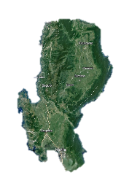
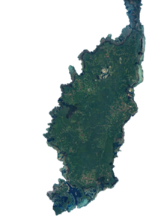
Force Design & MPF
Existing MPF Doctrinal Concept
Force Design Concept
MEB
A
B
C
Global
Single Ship – Multiple Simultaneous Offloads
Single Location
(OIF)
Supporting distributed maritime operations requires a layered approach of multiple surface and air connectors connected to a data network to securely command and control operations in a contested environment.
Notes:
Risks
Availability of MPS (less vessels, no redundancy, maintenance issues)
NSE reliance (NBG & NCHB capacity)
Task Organization of AAOG/LFSP/etc. with future force structure

Slide 7
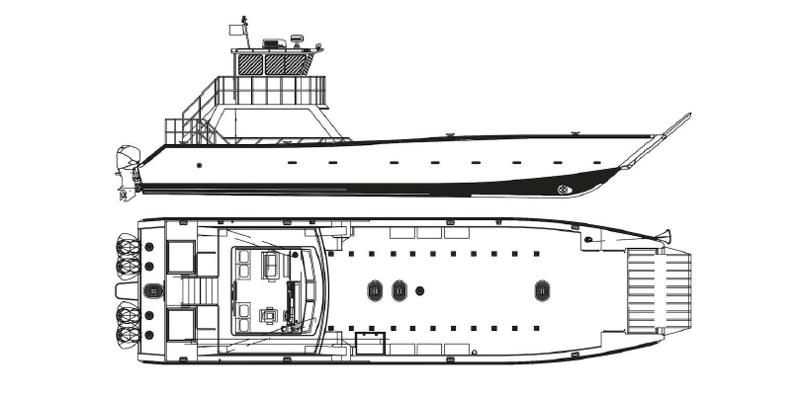
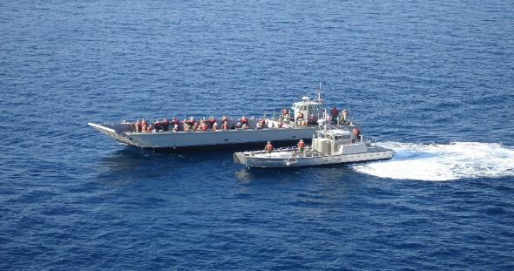
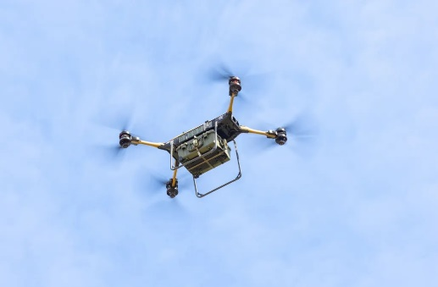
Stern Landing Vessel Ship-to-Shore Connector (SLV STS)
Connectors
Current Connectors
Potential Future Connectors
Improved Navy Lighterage Systems (INLS)
Beachable Watercraft
Semi-Submersible Autonomous Vessels
LCM-8 & MPF Utility Boat
Medium & Long-Range Logistics Drones
Connectors are integral to prepositioning, ensuring combat ready capability sets can be delivered to the point of need
ManTech, SeaLease, SeaTransport Proprietary Data
7

Slide 8
MCPIC – Marine Corps Platform Integration Center
Secure Data
Disconnected Operations are a necessity
Start disconnected and build backwards
Execute application specific tasks offline using tablets and mobile device
Once connection is restored, burst transmit all data back to MCPIC
DevSecOps is paramount
Build Cyber Security in first not last
DoD PKI based identity management
Allows secure Internet of Things integrations
Agile Development enables quick integrations
Flexible to support new initiatives
Secure Interfaces to APSRs – “Pings replace keystrokes”
Legacy System Data Integration: LOGCOM’s legacy pRFID project data imported and utilized to streamline MCPIC implementation
Vendor agnostic architecture is key
Fosters client-centric approach for best value
Raspberry Pi ecosystem allows secure integration of commercial products
Not tied to a particular vendor or technology

Slide 9
Future of Prepositioning
Maritime prepositioning remains relevant (39th CMC Planning Guidance, Aug 2024)
Globally responsive
Day-to-day campaigning
Reduces force closure distance & time
Complete autonomy
Connectors
Surface & aerial
Layered approach between operational & tactical layers
Prepositioning New Capabilities & Systems
Autonomous delivery systems (surface & aerial)
C2 systems
Radar systems
3D Printing & Additive Manufacturing
Logistics as a Service
Operational contracting
Forward deployed maintenance support
Integrating prepositioning stocks into FMF equipment lifecycle maintenance

Slide 10
Questions?

