Slide 1
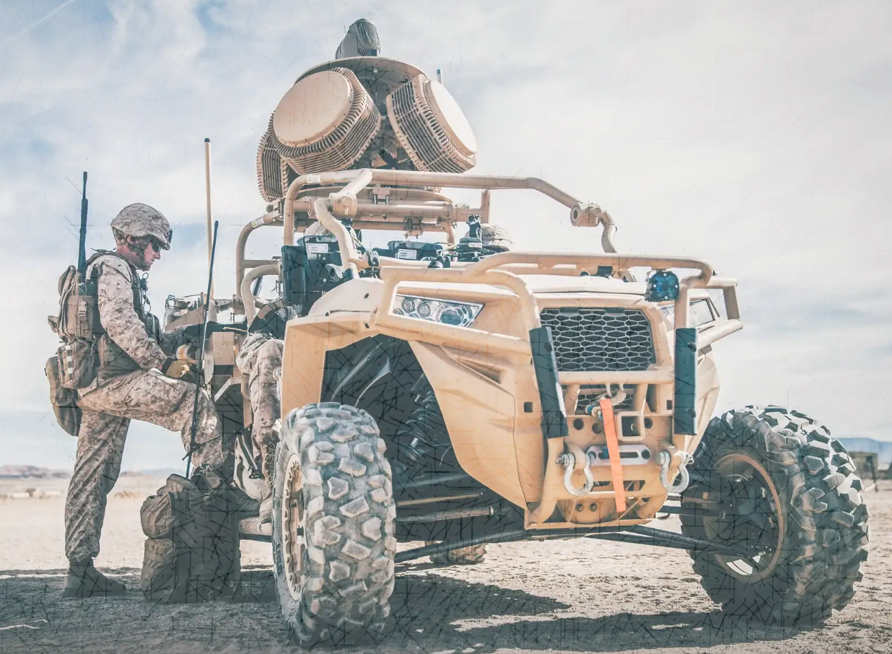
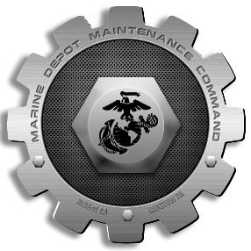
Presenter: Col Kirk M. Spangenberg
Date: 29 April – 1 May 2025
Topic: Lethality Forge
Event: Modern Day Marine
Marine Depot Maintenance Command
“In a contested environment, the art of logistics helps mitigate enemy actions and threats by providing multiple options to achieve our sustainment and support goals.” – MCDP 4, Logistics
Notes:
Opening
Introduce myself.
“Good morning and thank you for joining us as we share how Marine Depot Maintenance Command powers Lethality’s Forge and drives the fight to generate readiness.”
“I want to take a few minutes to introduce you to MDMC — who we are, what we deliver, and how we are modernizing to meet the needs of today’s and tomorrow’s warfighter.”

Slide 2
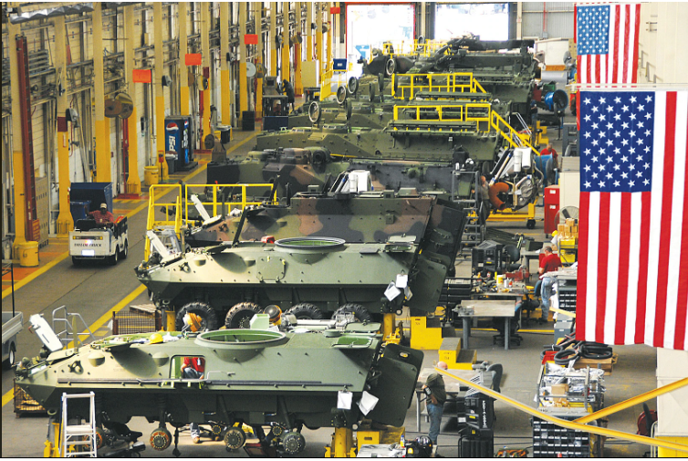
Outline
MDMC Website
MDMC Introduction
AM COE
GBAD
MDMC MEF Support
Deployable Maintenance
MARFORRES
Deployable Maintenance Teams
Mixed Reality Tele-maintenance
MDMC Industry 5.0
Summary
Notes:
I want to introduce MDMC and discuss our capabilities and a few of our key modernization efforts.
QR code to MDMC’s public website.

Slide 3
Organization
Commanding General
Sergeant Major
CIV
CIV
CIV
CIV
Communication Strategy and Operations
Command Security Manager
Command Inspector
General
Office of
Counsel
Staff Judge Advocate
Equal Opportunity Advisor
Executive Deputy
CIV
Command Audit Office
Chief of Staff
Weapon
Systems
Management Center
CIV
Supply Chain
Management Center
G1
G3/5
CIV
CIV
CIV
CIV
CIV
Contracts Department
Small Business Program Office
Command
Data and Analytics Office
G4
G6
G8
Staff
Headquarters Battalion
Blount
Island
Command
Marine
Depot Maintenance Command
Marine Force
Storage Command
NWCF
Production Plant
Albany
Production Plant
Barstow
1st
Force Storage Battalion
2nd
Force Storage Battalion
Command Elements
General Staff
Centers
UNCLASSIFIED

Slide 4
Marine Depot Maintenance Command
Purpose of the OIB:
OIB is “a ready and controlled source of technical competency and industrial capability that can be surged and expanded in time of national emergency to provide needed military equipment and supplies.”
-2018 NDAA Section 845
MDMC Mission:
Provide the Fleet Marine Force (FMF) with worldwide organic field level and depot-level maintenance support for rebuild, repairs, engineering solutions, modifications, calibrations, manufacturing and technical services to maximize the operational readiness, lethality, and sustainability of ground combat and combat support weapon systems and equipment.
MDMC End State:
Increase capability and lethality by delivering combat readiness and sustainment solutions across all levels of maintenance, in both physical and virtual domains, at home station and across the globe.

Slide 5
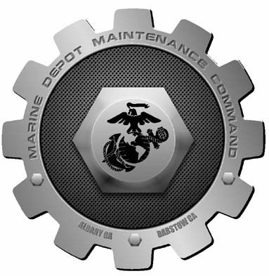
Marine Depot Maintenance Command
MDMC Mission: provide the Fleet Marine Force (FMF) with worldwide organic field level and depot-level maintenance support for rebuild, repairs, engineering solutions, modifications, calibrations, manufacturing and technical services to maximize the operational readiness, lethality, and sustainability of ground combat and combat support weapon systems and equipment.
Albany, Ga.
625 Civilian
12 Military
Barstow, Ca.
500 Civilian
2 Military
CLEJ, N.C.
88 Civilian
CPEN, Calf.
1 Civilian
BIC, Fla.
7 Civilian
Charleston, S.C.
9 Civilian
Okinawa, Japan
4 Civilian
Quantico, Va.
2 Civilian
K-Bay, Hi.
5 Civilian
Production Plant Albany
Production Plant Barstow
RBE/CRF/TMDE
TOTAL END STRENGTH: 1,241
1,221 Civilian
14 Military
9 Enlisted
5 Officer
6 Contractor
TMDE
CRF/MTVR Integration
Air Force Maint. Support
CRF
TMDE
CRF
1,241 Personnel, employees across 9 locations, executing 48 skillsets
Notes:
DATA AS OF EOM DEC 2024/END OF QTR1 FY2025
***Generalize our mission statement so it’s not like you are reading from the slide.
“Marine Depot Maintenance Command’s mission is to provide responsive, depot-level maintenance support to sustain Marine Corps weapon systems and equipment. We ensure the readiness, modernization, and operational capability of the Fleet Marine Force and other customers through superior maintenance, manufacturing, and technical services.
Our Workforce total end strength is approximately 1,365 personnel, comprised of a highly skilled civilian workforce, active-duty Marines, and dedicated contractors. These numbers can change at any given time based on workload.
We consists of two production plants – Albany, GA and Barstow, CA – as well as several smaller detachments around the FMF and supporting establishment. MDMC is not limited by geography. At any given time, our employees are deployed across more than 10 locations — supporting operations permanently or on contact teams.
-Nuances in workload, e.g., M777-PPB & Small Arms-PPA
-ELMP Workload-80%, Other Customers-20%, i.e., Navy, SYSCOM, Air Force, other gov agencies, etc.
MDMC is built on flexibility, responsiveness, and expertise — a force ready to project depot-level and field level capabilities wherever and whenever required. We are not just plants in Albany and Barstow — we are a national and global maintenance capability supporting Marine Corps readiness at every level.
***Closing comment to end slide.
Whether it's depot-level maintenance at a plant or direct support forward at a military base, training site, or deployed environment, MDMC personnel stand ready to deliver wherever the Marine Corps needs us.”

Slide 6
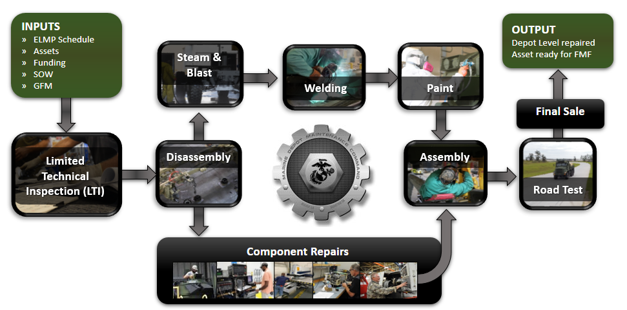
Marine Depot Maintenance Command (MDMC)
Notes:
“Traditional thinking of Depot Operations…At MDMC, depot maintenance is a carefully orchestrated process designed to deliver the highest quality equipment back to the warfighter — fully mission-ready and aligned with customer requirements.
Induction Based on a Negotiated Schedule, the maintenance begins with the induction of assets according to a negotiated production schedule coordinated with the customer. This ensures alignment with operational needs, availability windows, and resource planning.
Once inducted, workload enters detailed engineering planning. MDMC engineers develop a technical plan based on customer requirements, and specific technical data packages. This planning phase defines the exact processes, inspections, repairs, modifications, and testing that will be performed.
Equipment is fully disassembled into their major subcomponents and assemblies. Disassembly is carefully documented to ensure full traceability, accountability, and adherence to technical standards.
Routing to Specialized Component ShopsMajor subcomponents are routed to specialized back shops for repair, overhaul, or replacement: Engines, Transmissions, Frames and hulls, Body and structural repair, communications/electronics repair shops, Welding operations, Hydraulic systems, Blasting and painting facilities (including corrosion repair and coating applications)
Once all components are repaired and certified, assets are reassembled according to engineering specifications. Systems then undergo rigorous functional testing to verify performance, safety, and compliance with technical standards.6. Final Quality Assurance and Sale Back to Customer,. A final quality assurance inspection ensures the asset meets or exceeds all acceptance criteria. Once certified, the asset is formally "sold" back to the customer, restoring critical combat capability to the operating forces.
At every step — from induction to delivery — MDMC ensures transparency, technical rigor, and a relentless focus on quality. Our process guarantees that warfighters receive equipment they can trust to perform in the most demanding operational environments.”
Transition to Rapid Design & Fielding
“Throughout Operations Iraqi Freedom and Enduring Freedom, MDMC demonstrated the agility, innovation, and responsiveness critical to meeting urgent warfighter needs.
MDMC was a key enabler in the rapid design, prototyping, and fielding of critical modifications to support Marine Corps and Joint Force operations in combat environments.
Working alongside operational units and program offices, MDMC provided engineering solutions under urgent timelines to protect lives, enhance survivability, and improve mission effectiveness.
Some examples are:
Mobile Trauma Bay. MDMC designed, fabricated, and fielded the Mobile Trauma Bay, an armored container outfitted as a surgical station that was transported on an LVSR, 22.5 ton truck. This innovation allowed surgeons to operate closer to the front lines, dramatically improving casualty survival rates by reducing evacuation times.
Vehicle Armor Packages. MDMC engineered and fabricated armor solutions for a wide range of Marine Corps and Navy military vehicles. These included interim and final armor packages that provided critical protection against improvised explosive devices and small arms fire. Our armor designs became standard features across many Marine Corps and Navy vehicle fleets, saving countless lives during combat operations.
Additionally, MDMC developed modifications and equipment upgrades to extend the life, enhance performance, and survivability of critical combat systems. We rapidly prototyped, tested, and deployed modifications directly in response to operational feedback from Marines in theater.
When Marines needed protection, mobility, and survivability enhancements — MDMC delivered. Our rapid design, fabrication, and fielding capability continues today, ready to support urgent operational needs whenever and wherever they arise.”
Transition to
***Transition to NWCF portion of slide
As a Naval Working Capital Fund organization, MDMC operates more like a business than a traditional appropriated fund entity. We are customer-funded: this means we recover our costs through the services and products we provide, not through direct Congressional appropriations. This model allows MDMC to be a force multiplier for combat readiness by responding quickly to changing customer needs, surge requirements, and unplanned workload without waiting for new appropriations or budget cycles. As a NWCF entity, MDMC has a built-in incentive to continuously modernize operations, streamline processes, and invest in new technologies to remain cost competitive and responsive.
-PPA = Steel, Titanium, and Polymer
-PPB = Aluminum and Polymer

Slide 7
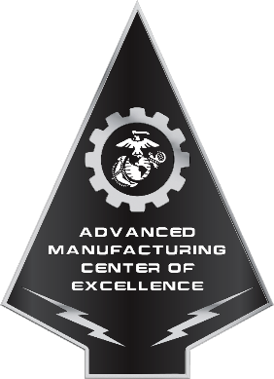
Advanced Manufacturing Center of Excellence
The Marine Corps Advanced Manufacturing Center of Excellence’s (AM COE) objective is to leverage AM technology to increase depot production, bolster supply operations, enhance expeditionary capabilities, and optimize material readiness to the Fleet Marine Force.
StratasysFortus400MC Polymer Printer​
StratasysFortusF900 Polymer Printer​
StratasysFortus450MC Polymer Printer​
EOS M400-1 Metal Printers (3)​
CreaformHandyscan700 Laser Scanner (2)​
Capability
Reverse Engineering Services
Laser 3D scanning to produce 3D models
Tooling/part CAD design
Traditional machining services
Additive Manufacturing
Printable Materials
Metals
MS1 Maraging Steel
AISi10Mg Alum. Alloy
Ti64 Titanium
Polymers
PC-ABS
Nylon 12
Nylon 12 (Carbon Fiber Infused)
ASA
ABS
Flexible Material
Obsolescence Mitigation
ULTEM 1010
Polycarbonate
Notes:
Introduce the AM COE
“What it is – what it can do –
Our AM Mission & Vision
MDMC leverages additive manufacturing (AM) technology to increase depot production, strengthen supply operations, enhance expeditionary capabilities, and optimize material readiness in direct support of the Fleet Marine Force and other services.
MDMC is advancing the Marine Corps' sustainment capabilities through cutting-edge additive manufacturing (AM) and cold spray repair technologies. The USMC’s Advanced Manufacturing Center of Excellence (AM COE) specializes in metal and polymer 3D printing, producing high-quality components in steel, aluminum, titanium, and advanced polymers including flexible materials to meet urgent and long-term fleet needs. Cold spray technology further enhances our ability to repair and restore critical parts without the heat and distortion of traditional welding methods.
To drive innovation and collaboration across the Marine Corps, MDMC hosts the annual USMC Digital Manufacturing Summit, bringing together the Marine Corps, other government agencies, and other military service leaders to advance the Corps’ digital manufacturing and sustainment capabilities.
With enduring themes and expeditionary goals, our AM Vision is to unify efforts to reduce the quantity of spare parts units must bring or request for resupply. By leveraging AM capabilities at critical nodes in the logistics supply chain, MDMC is expanding the role of 3D printing to shorten the logistics tail and enhance sustainment operations in complex, rapidly changing environments. Our AM Vision will actively support the Marine Corps’ shift toward more agile, resilient, and expeditionary logistics.
StratasysFortus400MC Polymer Printer
StratasysFortusF900 Polymer Printer
StratasysFortus450MC Polymer Printer
EOS M400-1 Metal Printers (3)
CreaformHandyscan700 Laser Scanner (2)

Slide 8
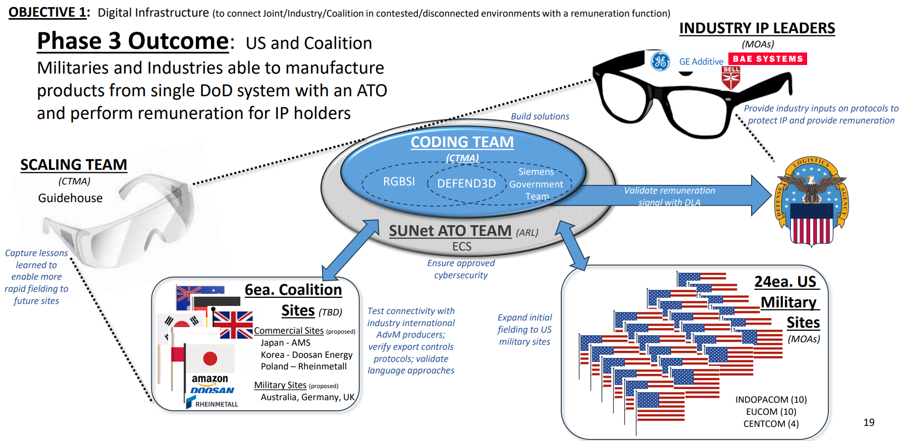
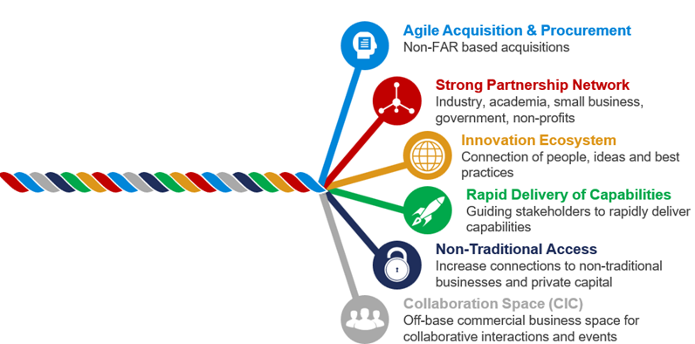
Advanced Manufacturing Strategy
Keys To Success
Digital Transformation
Strategic Partnerships
Advanced Manufacturing Ecosystem
What We Are Doing
Advanced Manufacturing Competitive Advantage Pathfinder (AdvM CAP)
Partnership With Naval Information Warfare Center Atlantic (NIWC)
Partnership With Naval Expeditions (NavalX)
What Problems Are We Solving
Access to Intellectual Property
Protection of Intellectual Property
Rapid Scaling
Streamlined Approval
AdvM CAP Initiative
NavalX/NIWC Partnership
Notes:
Digital transformation and partnerships are the foundation of our strategic initiative with advanced manufacturing. Capabilities are important but it’s the establishment of a mature advanced manufacturing ecosystem that will give our warfighters the competitive advantage necessary to win wars.
MDMC has been designated as a lead by OUSD A&S to support the Advanced Manufacturing Competitive Advantage Pathfinders initiative. Through this initiative MDMC has established strategic partnerships with OUSD A&S, DIU, OSD CDAO and DLA to develop a globally connected digital supply chain fully integrated with U.S. DOD sites, coalition partners and private industry. This includes establishing the ability to securely transmit and protect IP to the point of manufacture, accurately remunerate the activity against the IP, and accelerate the deployment and use of advanced manufacturing technologies in strategic locations around the globe.
MDMC is also forming new partnerships with NavalX and Warfare Centers to bridge the gap between R&D and production. We recently established a new partnership with NIWC Atlantic. This will provide MDMC with increased design capacity, gain access to new AM capabilities and establish a new advanced manufacturing hub in the Southeast integrated with academia and industry.

Slide 9
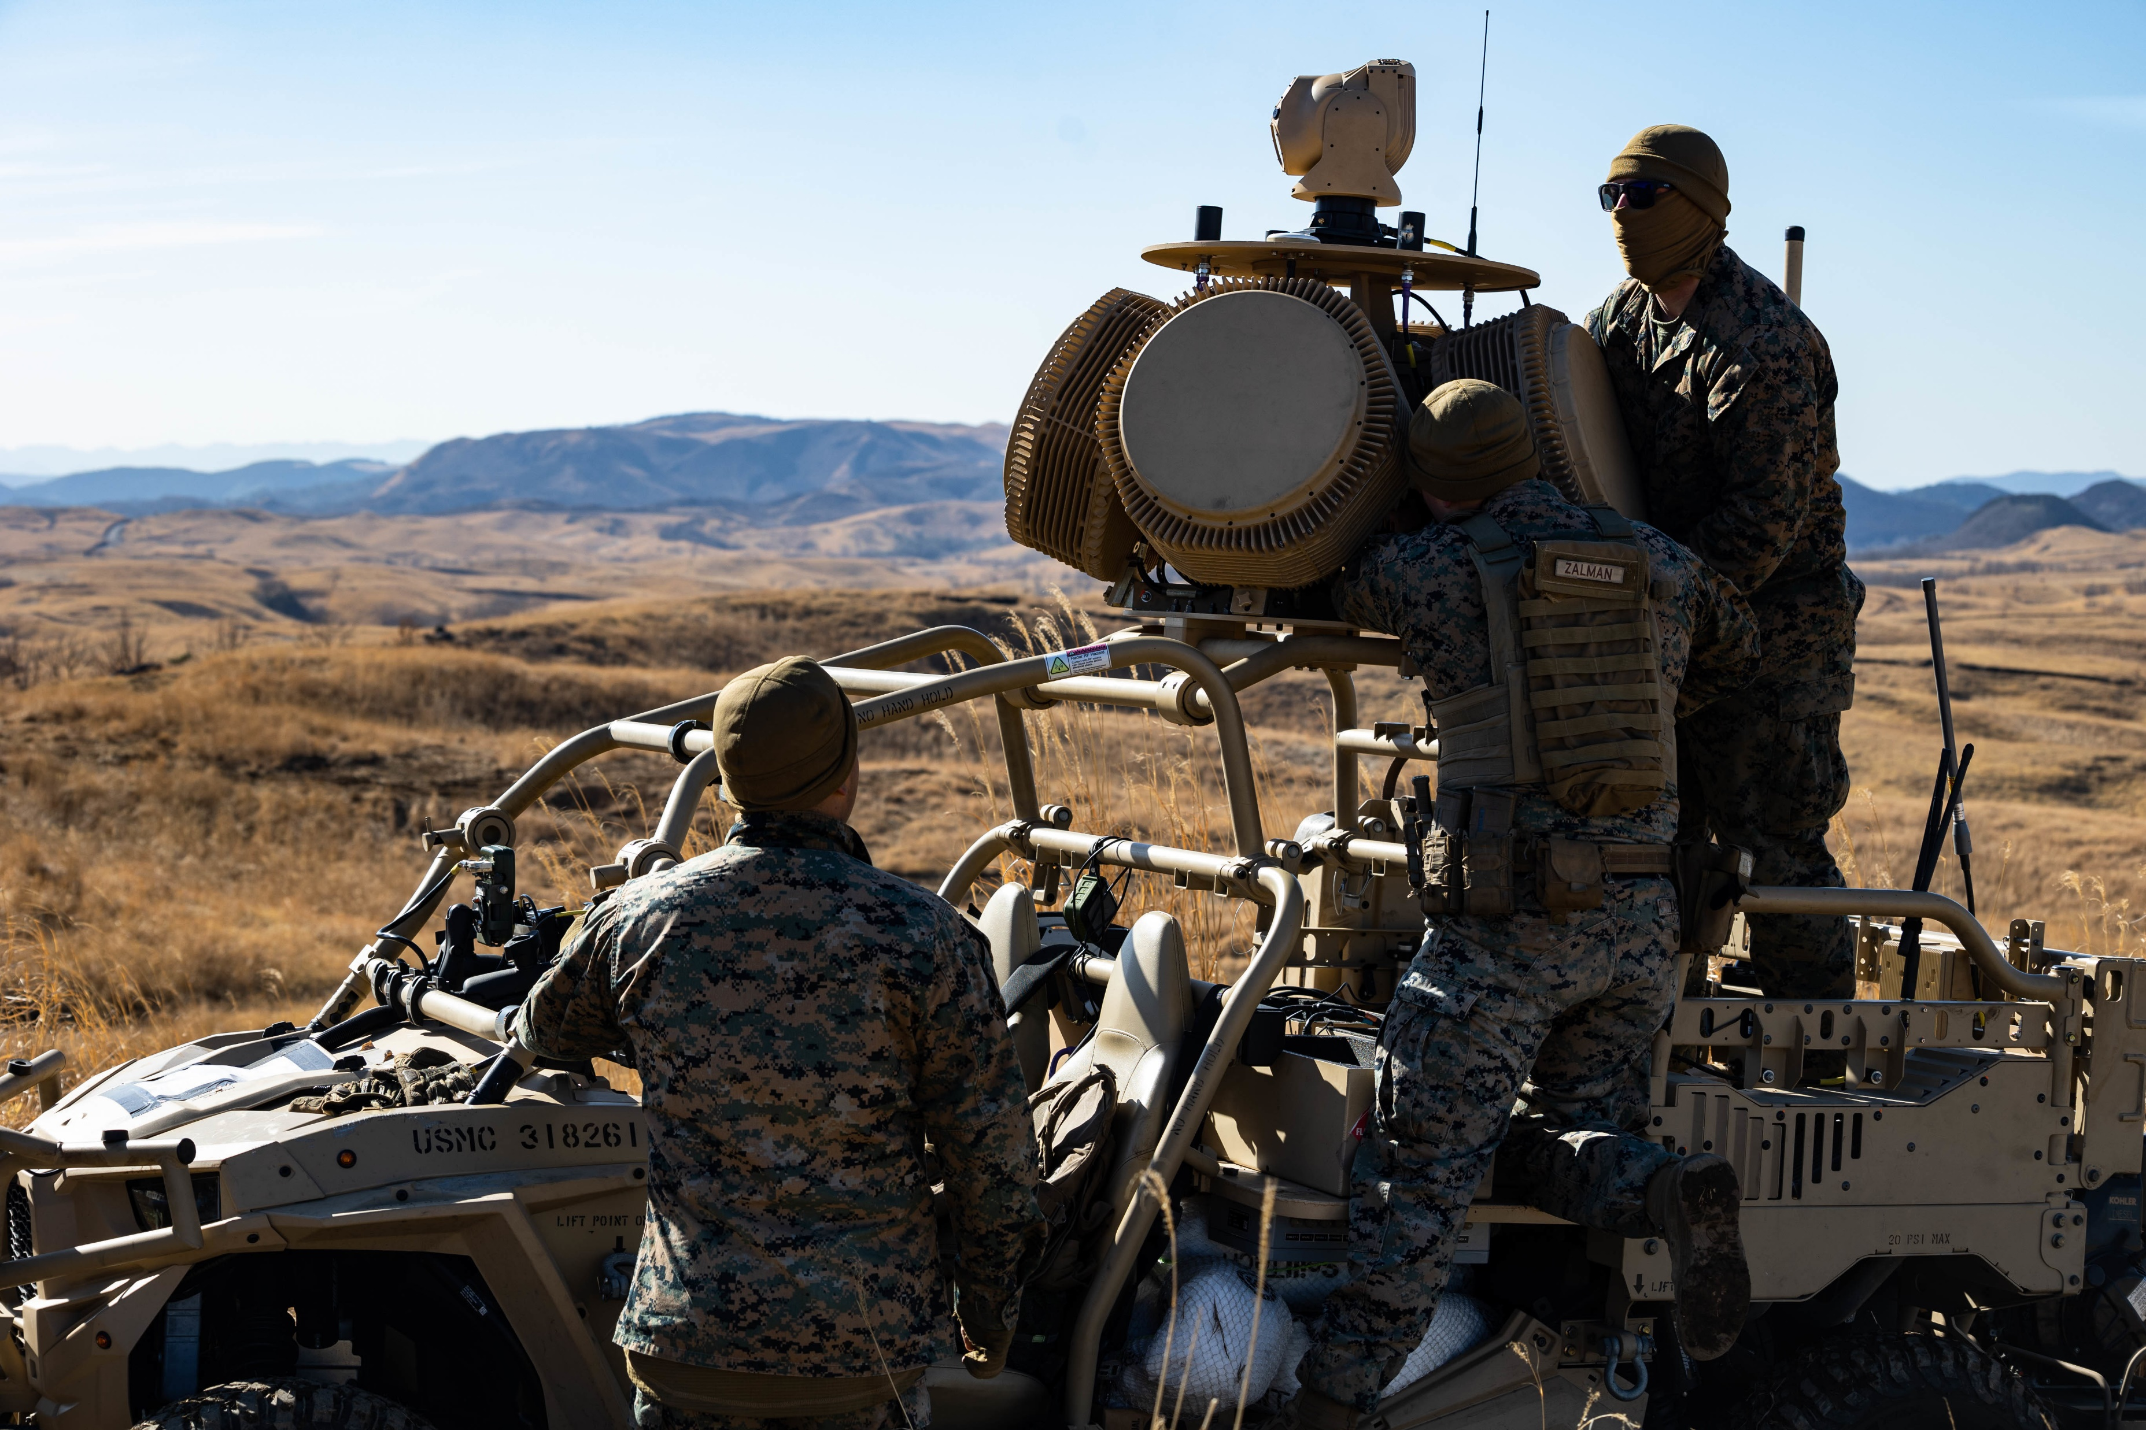
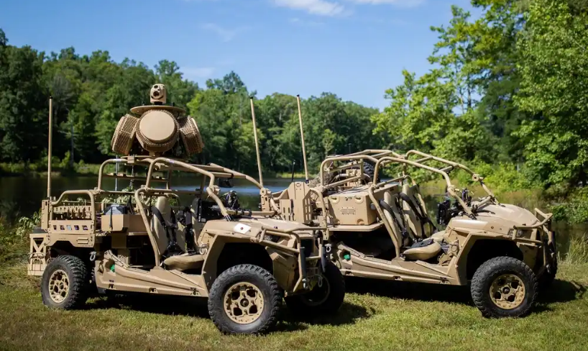
Program Office Integrated Support Program
Pioneering Organic Depot Support for Emerging Capabilities
MDMC's support to the Ground Based Air-Defense Program Office eliminates the need for traditional contractor-based sustainment by offering a full-service, single-point-of-contact depot solution. This includes:
Depot-level maintenance support well in advance of standard seven-year post-fielding timelines.
Integrated support for engineering, technical data management, and configuration control.
On-site Government Acceptance Testing (GAT), system refurbishment, and delivery management.
BENEFIT: This program unifies the acquisition and logistics communities by bridging the gap between system development and sustainment – integrating engineering, maintenance, and supply support early in the lifecycle.
Notes:
Marine Depot Maintenance Command is honored to highlight its critical role in supporting the U.S. Marine Corps’ Ground-Based Air Defense (GBAD) Family of Systems. In recent years, MDMC has led a transformative shift in how we can sustain new emerging military platforms. Historically reliant on contractors and dispersed support channels, the GBAD program is now benefiting from a centralized, fully integrated organic support model—developed and executed by MDMC. This approach fuses logistics, engineering, asset management, and depot-level maintenance into a cohesive framework that not only increases warfighter readiness and responsiveness but also accelerates sustainment timelines and reduces lifecycle costs. More importantly, this effort showcases how the Organic Industrial Base can evolve to meet the needs of modern warfare by bridging the traditional divide between acquisition and sustainment.
It’s a model of efficiency, innovation, and Marine Corps-led capability that ensures our systems remain operational, supportable, and combat-ready—today and into the future.
One of those systems, the Light Marine Air-Defense Integrated System, LMADIS, is on display at the Marine Corps Logistics Command and MDMC booth located just behind you.

Slide 10
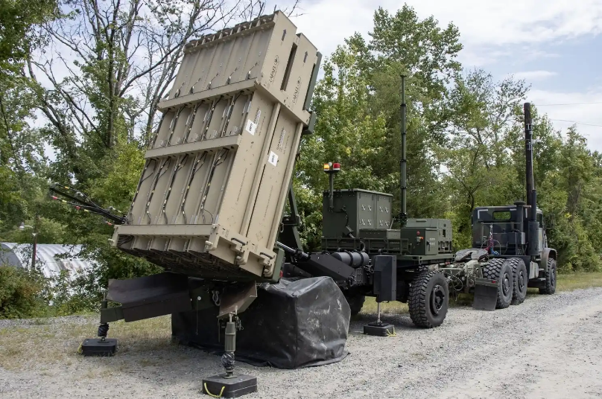
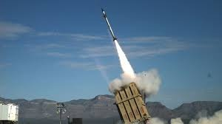
Program Office Integrated Support Program
Groundbreaking Logistics and Material Management
End-to-end management of transportation, refurbishment, and fielding operations.
Rapid response capabilities to track, receive, inspect, and turn systems in theater-ready condition.
Integrated Program Management & Engineering Excellence
End-to-end management of transportation, refurbishment, and fielding operations.
Rapid response capabilities to track, receive, inspect, and turn systems in theater-ready condition.
BENEFIT: This approach enhances collaboration with Program Offices, improve material availability, enables rapid technical responses, and ensures Marines receive mission-ready systems when and where they need them most.
Notes:
MDMC provides vital logistical and material management assistance to Program Managers by serving as a centralized sustainment partner. By integrating logistics and depot-level support, MDMC ensures timely repairs, informed decision-making, and continuous readiness for Marine Corps systems throughout their lifecycle.
Additionally, MDMC delivers integrated program management and engineering excellence through close alignment with the GBAD Program Managers, ensuring technical, schedule, and cost objectives are met. This includes the development of technical work instructions, engineering change integration, configuration control, and rapid prototyping. Cross-functional collaboration enables MDMC to rapidly adapt to emerging requirements and deliver innovative solutions that enhance sustainment, readiness, and lifecycle support for critical Marine Corps systems.

Slide 11
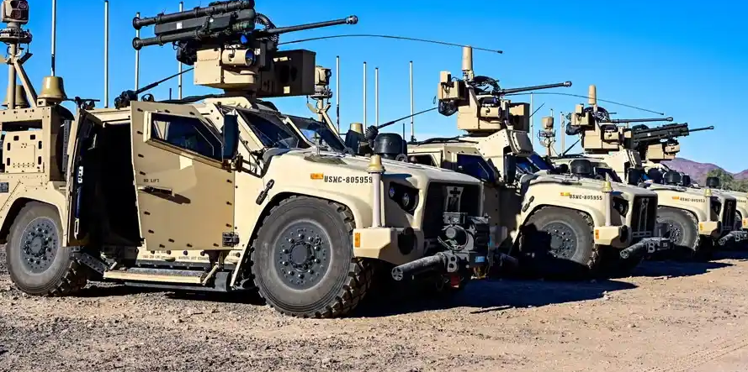
Program Office Support
Impact to the Warfighter and Organic Industrial Base
Accelerated Readiness. Maintains critical warfighting assets with near-zero downtime.
Innovation in sustainment. Demonstrates a repeatable model for other Program Offices seeking to bring sustainment in-house.
Workforce Development. Trains artisans and engineers to maintain next-gen systems early in the lifecycle.
OIB Modernization. Positions MDMC as the premier organic depot for warfighting platforms.
Notes:
Our integrated approach to sustainment delivers tangible results for both the warfighter and the Organic Industrial Base. By accelerating readiness, reducing lifecycle costs, and returning combat-capable systems to the field faster, MDMC ensures Marines remain equipped, protected, and mission-ready. Simultaneously, its innovative practices and unified support model strengthen the OIB by enhancing workforce capability, modernizing depot operations, and securing long-term viability for future sustainment missions.

Slide 12
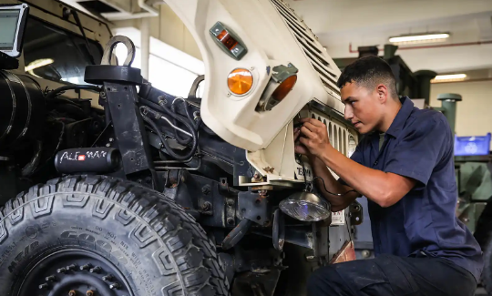
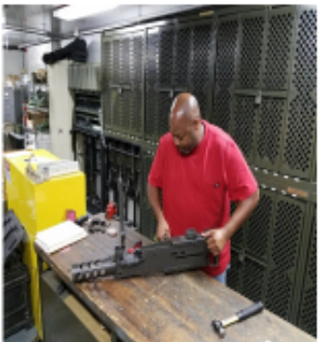
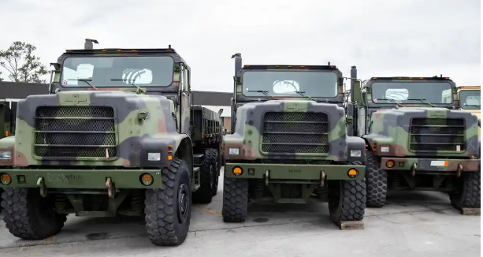
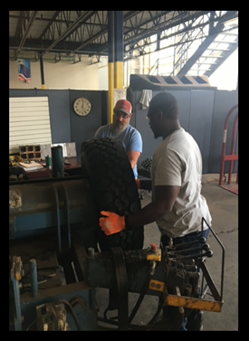
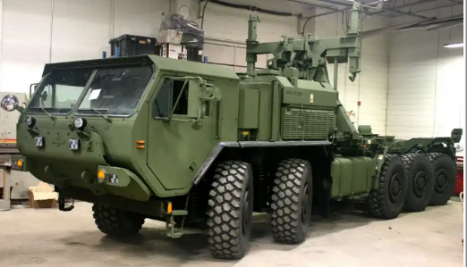
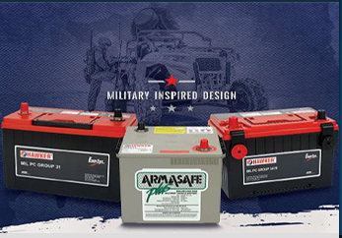
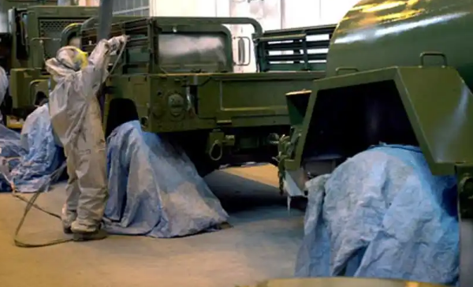
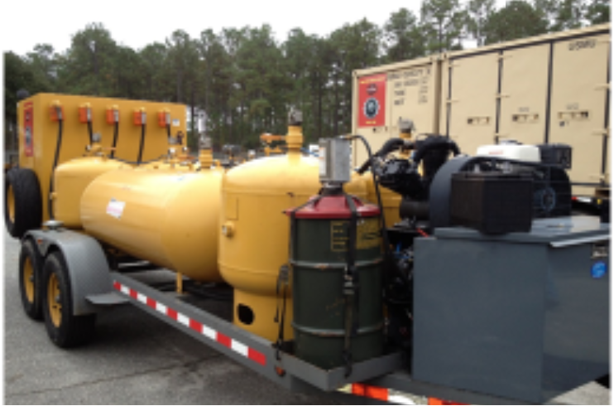
MDMC -Program Offerings
Mobile Maintenance
MFR SMART Teams
Fixed-Site Maintenance
Tire Exchange Program
Left Behind Equipment
Corrosion Repair Facility
Battery Exchange Program
MFR LMMT Teams
“Understanding available resources informs what is possible and provides the basis for developing support options.”
– MCDP 4, Logistics
12
Notes:
Opening Remarks: In 2007, II Marine Expeditionary Force (II MEF) and Marine Corps Logistics Command (MARCORLOGCOM), specifically Marine Depot Maintenance Command (MDMC), established a highly successful materiel readiness collaboration. MDMC's diverse maintenance activities support II MEF Major Subordinate Commands (MSCs) through funded programs, continually adapting to II MEF’s dynamic operational needs. The current partnership sees MDMC's workforce as a readiness force multiplier, handling maintenance, storage, rehabilitation, and support functions beyond MSC Commander capabilities. Notably, MDMC's capabilities have resonated beyond II MEF, reflecting a widespread demand for tailored support. Offering scalable and flexible programs, MDMC can address maintenance gaps precisely according to budget, with options for a Civilian Government workforce, adaptability to uniformed structures, and comprehensive coverage of the maintenance spectrum, both Depot and Field.
MDMC can provide tailored maintenance requirements to I and III MEF as well. Opportunity to mention current initiatives with both…
Summarized - FY23 Total Cost Excluding CPAC was $7.5M:
-$3.25M for Maintenance of Customer Equipment (ASP/LBE)
-$3M for Mobile Maintenance (LST)
-$1.25M for Other Services (Tire and Battery Exchange Program)
MDMC and II MEF FY24 Data Points:
Maintenance & Support Programs
Program Output Impact
Admin Storage
573 assets in / 406 assets out
1,827 service requests closed
Tire Exchange
670 tires built
$1.38M cost avoidance (50 units supported)
Battery Reclamation
4,028 received / 1,375 issued
$548K cost avoidance (78 units supported)
Nitrogen Exchange
122 bottles exchanged
$37K cost avoidance (32 units supported)
Calibration/ELMACO
589 items calibrated / 392 radios processed
Quality assurance on calibrated equipment
LOGCOM Support Teams
5 units supported
7,992 labor hours / $856K labor cost
Left Behind Equipment
8 units supported (completed/active)
977 service requests closed / $1.54M labor cost
GSM Integration
26 engines inducted / 19 returned Code A
2,074 labor hours / $222K labor cost
Armor Program
129 assets inducted
Readiness Enhancement Key Results
Total Labor: 17,673 hours
Total Labor Cost: $1.89M
Cost Avoidance Across Programs: Over $1.96M
Units Supported Across Programs: 100+ different units
MDMC’s Forward Team provides critical depot-level support directly to II MEF, delivering tangible readiness improvements, major cost avoidance, and maintenance lifecycle extension across a broad range of ground systems and support equipment. By embedding maintenance and logistics expertise at the point of need, MDMC is actively ensuring II MEF remains operationally ready for current and future missions.

Slide 13
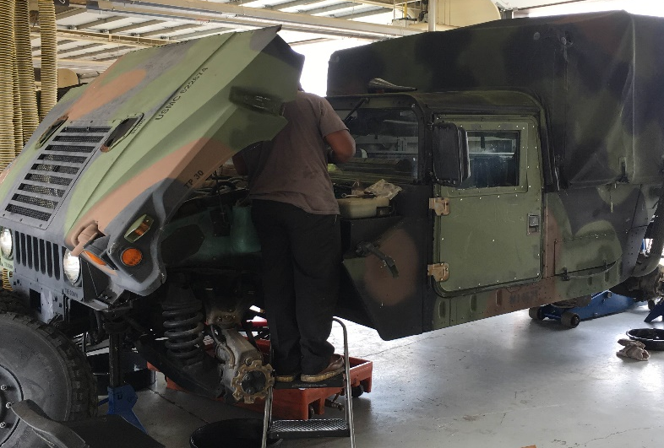
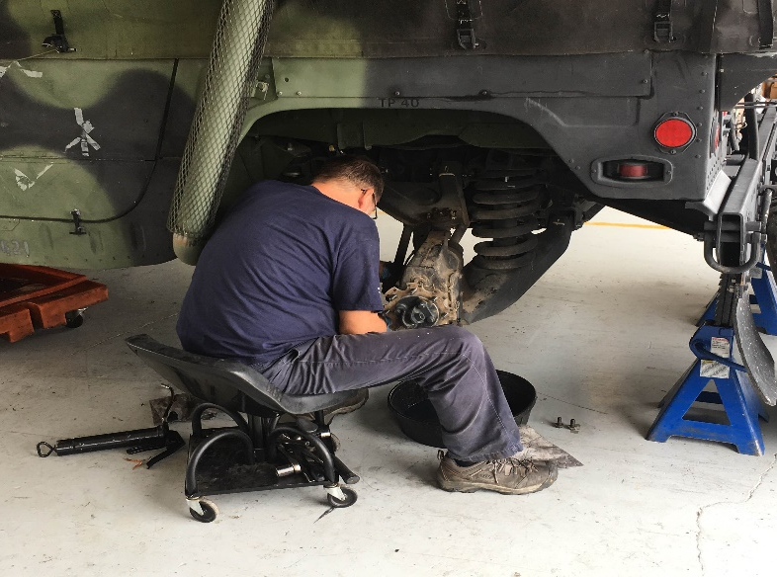
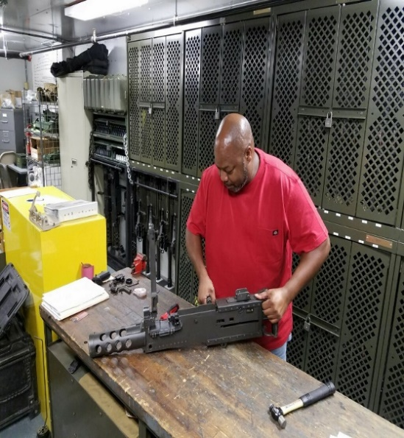
MARFORRES Support LMMT and SmART Teams
Logistics Mobile Maintenance Teams (LMMT) and Small Arms Repair Teams (SmART) support MARFORRES centers by moving from site-to-site performing inspections, preventive and corrective maintenance, and biannual and annual services on ground equipment (wheeled and tracked) vehicles and small arm weapons.
Each MARFORRES site visited every 12-18 months
Augment 40-100% of PM ground equipment needs at each unit
Motor T Chiefs select the equipment worked on IOT maintain a viable PM schedule
BENEFIT: On-site support - MDMC supports extending life-cycle of weapon systems due to organic uniformed deficiencies inherent to MARFORRES – READINESS ENABLER
Notes:
Logistics Mobile Maintenance Teams (LMMT)
Support MARFORRES centers by moving from site-to-site performing the following on ground equipment (wheeled and tracked) vehicles
Limited Technical Inspection (LTI)
Preventative Maintenance (PM)
Corrective Maintenance (CM)
Biannual and Annual Services (PMCS)
Training is available in all the above.
Three Teams: North, South, and West
Each MFR site is visited every 12-18 months.
Perform services at nearly all sites (95%) every 18 months
Augment 40-100% of PM needs at each unit
Motor Transport Chiefs select the equipment the LMMT teams work IOT maintain a viable PM schedule.
CY24
252 PM
54 CM
Skills Sets:
Welders
Electricians
Quality Assurance/Quality Control (QA/QC)
Certified Welding Inspectors (CWI)
Management
Production Controllers
Planners
Heavy Mobile Equipment Mechanics and Helpers
Electricians
Communication
Wood Workers
Small Arms Repairers
COTR
CY18 Numbers
1025 PMs
375 CMs

Slide 14
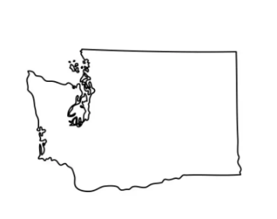
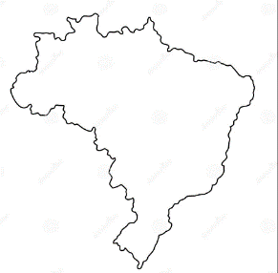
Deployable Maintenance Capabilities
MDMC is a CAPABILITY - not a location.
Ability to deploy skilled and experienced artisans to execute maintenance CONUS and OCONUS for USMC and other customers
KINGS BAY & BANGOR, WA
Inspections for Bearcat Armored Vehicles (Spring 2024)
Installation of Antilock Braking Systems on HMMWVs (Fall 2024)
AUSTRALIA (Spring 2024)
Welding support for dead-lined M777s which were restored to an operational status
CHARLESTON, SC (Summer 2024)
Maintenance executed on over 50 USAF MRAP assets to become fully mission capable for AF Ukraine efforts
BRAZIL (Spring 2024)
AAV Anti-Fire Suppression installations
AAV Engine Overhauls
BENEFIT: On Site Support - MDMC brings the maintenance to you. Augmenting and overcoming skill and resource capacity gaps to execute maintenance that supports extending the life-cycle of weapon systems – READINESS ENABLER

Slide 15
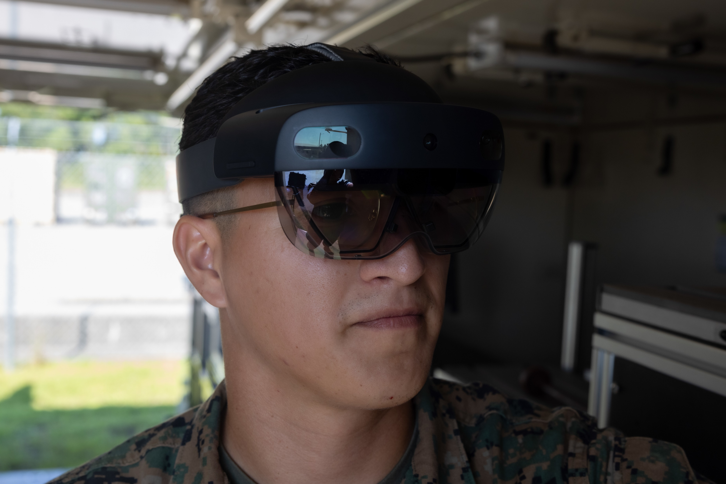
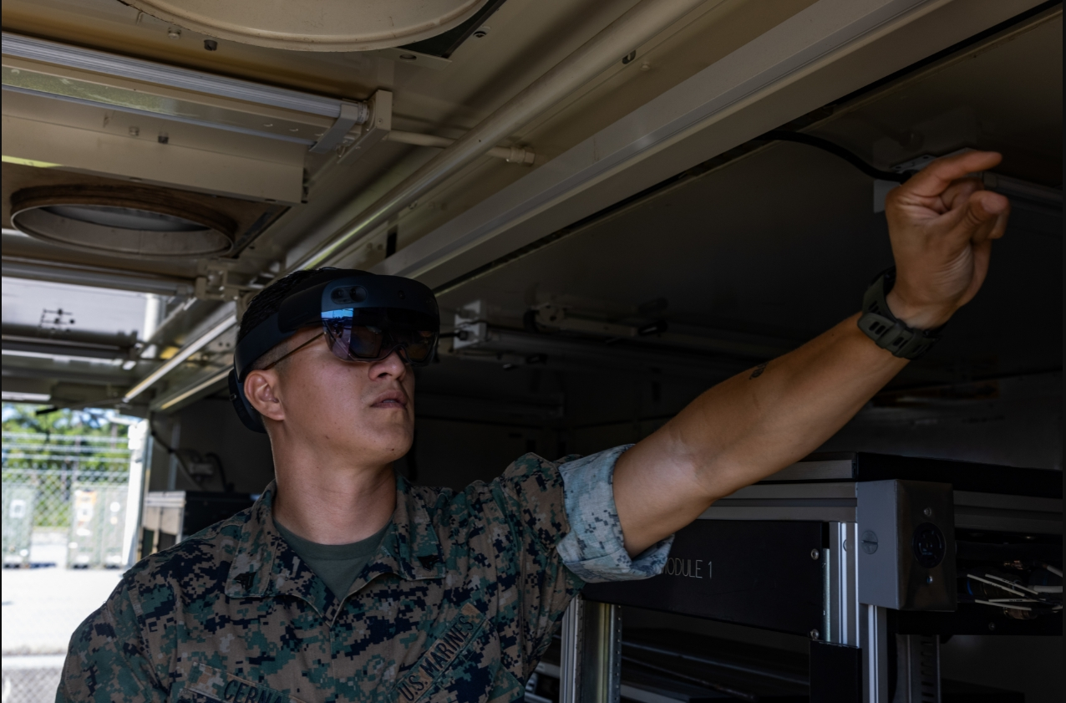
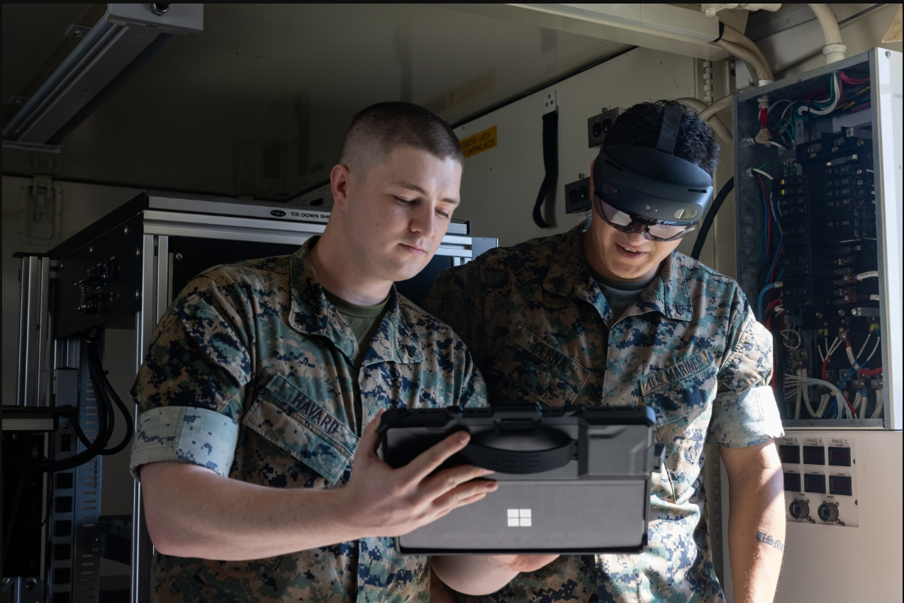
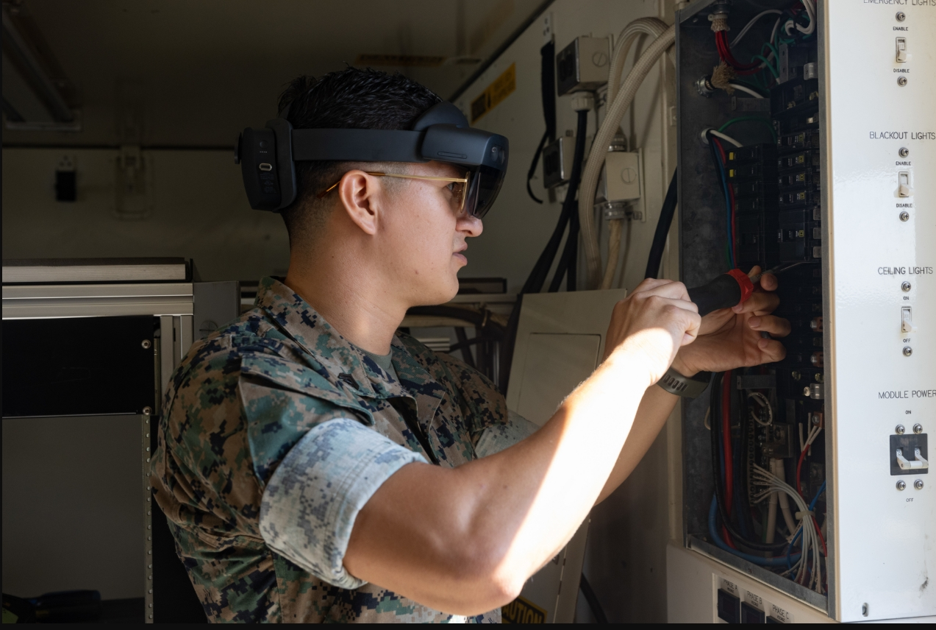
Mixed Reality
Tele-Maintenance
Mixed reality headset tele-maintenance system with digital work instructions provides warfighters with expert coaching on equipment and tasks by enabling quick access to depot and industry experts for faster fault diagnosis and repairs.
Real World Applications in 2024:
Working with maintainers, MDMC depot team was able to remotely identify and resolve maintenance issues.
Four non-operational electronic maintenance shelters with electrical issues - Marine Wing Communications Squadron 28 (MWCS 28) at MCAS Cherry Point, NC
Electrical safety awareness and mitigation of potential electrical damage for NAVAIR Shelters – 2D Maintenance Battalion Marines and MWCS 28
PHOTOS: Cpl Tyler Havard and Cpl Vradley Cerna of 2D Maintenance Battalion using mixed reality tele-maintenance to consult with MDMC SMEs (U.S> Marine Corps Photos by Lance Cpl. Orlanys Diaz Figueroa)
BENEFIT: Deploying “You see what I see” capabilities to the field will increase the warfighter’s ability to diagnose and conduct field level repairs. Reduces travel costs, logistical challenges, and equipment downtime by eliminating the need for on-site SMEs. Enhancing equipment readiness and unit combat effectiveness – READINESS ENABLER

Slide 16
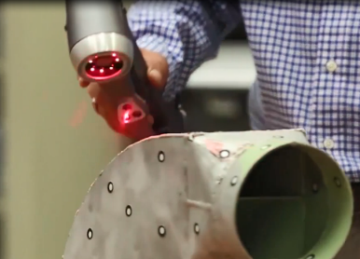
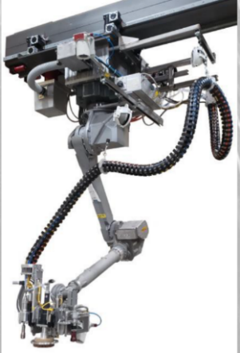
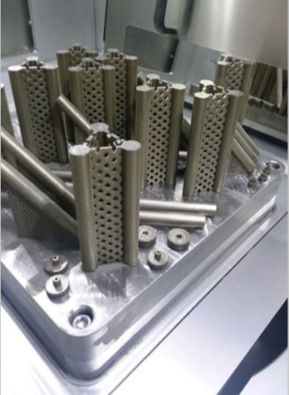
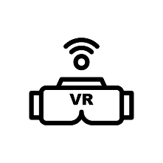
Industry 5.0 Framework
Vision: MDMC’s vision is to increase capability and lethality by delivering combat readiness and sustainment solutions across all levels of maintenance, in both physical and virtual domains, at home station and across the globe.
INTERNET OF THINGS
LOCATION DETECTION
SMART
SENSOR
CLOUD COMPUTING
INDUSTRY 5.0
FRAMEWORK
ADVANCED ROBOTICS
AUGMENTED REALITY
BIG DATA ANALYTICS
3D
PRINTING
https://www.youtube.com/watch?v=p571DpY0KY0
Impact: Through enhanced Forward Support Team capabilities and an active modernization campaign encompassing all elements of Industry 5.0, MDMC will continue to move the FMF readiness needle and improve sustainment capabilities for the Marine Corps.
Notes:
Narrative: MDMC is continually executing and refining its deliberate modernization and digital transformation campaign, driven by factors such as audits, declining workload, Force Design 2030, congressional interest in the Organic Industrial Base (OIB), technological advancements, and evolving customer needs. The goal is to make MDMC the Department of Defense’s first fully digital depot by FY2027, ensuring excellence in Relevance, Agility, Competitiveness, and Innovation. Audit findings focused efforts on key targets: improving data accuracy, streamlining workflows, investing in IT, and enhancing asset visibility. MDMC’s landscape integrates established technologies alongside emerging ones. Internet of things (IOT), smart sensors, advanced robotics, advanced analytics, 3D printing, augmented and virtual reality (AR/VR), cloud computing, and location detection – together with our workforce’s innovative spirit – compromise the Industry 5.0 Framework. While some of these technologies are more established than others, each is present in some form or fashion in MDMC today and play an important role in our future landscape.
MDMC) is at the forefront of enhancing field repair capabilities through the integration of emerging technologies. MDMC’s groundbreaking use of mixed reality and telemaintenance earned the 2024 DoD Maintenance Symposium Innovation Award, demonstrating how AR/VR technology can be leveraged to provide real-time remote repair support, reduce equipment downtime, and minimize the need for forward-deployed specialists.
Play video. Link is on slide. (COMMSTRAT will coordinate)
“The Marine Corps organic industrial base (MCOIB), which includes our supply and maintenance depots, requires modernization to support rapid deployment and sustainment.” - Installations and Logistics 2030

Slide 17
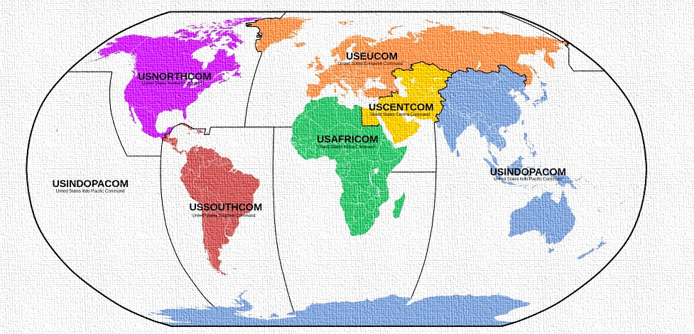
Summary
OPPORTUNITIES:
MDMC Represents a Capability, Not a Location
Foundation for Projecting Sustainment Capabilities to the FMF
Global Reach at the Point of Need to Improve Readiness Outcomes
Tailored Field and Depot Levels of Maintenance
Ability to “Buy” Only Required or Desired Capabilities
Flexibility of Civilian Government Work Force
Ability to Augment or Replace Uniformed Structure
Maintenance Consulting for Establishing Customer Scalable Models
Notes:
Opportunities:
We are your readiness solution…
We will come to you, tailor your requirements to your exact needs and budget posture and serve as your maintenance solution for future growth. MDMC wants to assist with combat readiness across all MEFs and MFR. What can we do for you?
QR Code is for MDMC’s website. In case you did not get opportunity at the beginning, here is another opportunity.
Please visit our booth right behind the stage area (point to it). MDMC will provide a Production Plant virtual tour for you to see on the monitor inside the LOGCOM/MDMC booth. (TBD, have to coordinate with COMMSTRART)

Slide 18
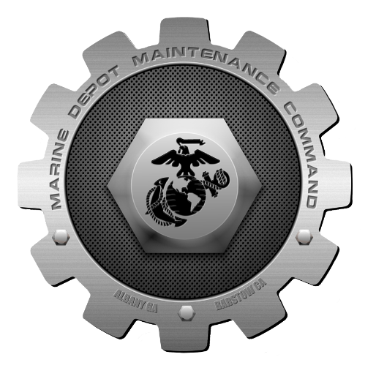
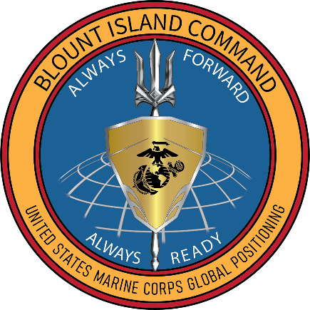
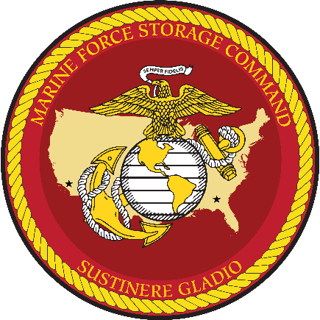
Questions?

Slide 19
II MEF Support
MDMC and II MEF FY24 Data Points
Maintenance & Support Programs
Program Output Impact
Admin Storage
573 assets in / 406 assets out
1,827 service requests closed
Tire Exchange
670 tires built
$1.38M cost avoidance (50 units supported)
Battery Reclamation
4,028 received / 1,375 issued
$548K cost avoidance (78 units supported)
Nitrogen Exchange
122 bottles exchanged
$37K cost avoidance (32 units supported)
Calibration/ELMACO
589 items calibrated / 392 radios processed
Quality assurance on calibrated equipment
MDMC’s Forward Team provides critical maintenance support directly to II MEF, delivering tangible readiness improvements, major cost avoidance, and maintenance lifecycle extension across a broad range of ground systems and support equipment.
By embedding maintenance and logistics expertise at the point of need, MDMC is actively ensuring II MEF remains operationally ready for current and future missions.
LOGCOM Support Teams
5 units supported
7,992 labor hours / $856K labor cost
Left Behind Equipment
8 units supported (completed/active)
977 service requests closed / $1.54M labor cost
GSM Integration
26 engines inducted / 19 returned Code A
2,074 labor hours / $222K labor cost
Armor Program
129 assets inducted
Readiness Enhancement Key Results
Total Labor: 17,673 hours
Total Labor Cost: $1.89M
Cost Avoidance Across Programs. $1.96M
Units Supported Across Programs. 100+ different units
Notes:
In 2007, II Marine Expeditionary Force (II MEF) and Marine Corps Logistics Command (MARCORLOGCOM), specifically Marine Depot Maintenance Command (MDMC), established a highly successful materiel readiness collaboration. MDMC's diverse maintenance activities support II MEF Major Subordinate Commands (MSCs) through funded programs, continually adapting to II MEF’s dynamic operational needs. The current partnership sees MDMC's workforce as a readiness force multiplier, handling maintenance, storage, rehabilitation, and support functions beyond MSC Commander capabilities. Notably, MDMC's capabilities have resonated beyond II MEF, reflecting a widespread demand for tailored support. Offering scalable and flexible programs, MDMC can address maintenance gaps precisely according to budget, with options for a Civilian Government workforce, adaptability to uniformed structures, and comprehensive coverage of the maintenance spectrum, both Depot and Field.

Slide 20
III MEF
Current State:
MDMC is delivering direct maintenance and sustainment support to III Marine Expeditionary Force (III MEF), by operating the Corrosion Repair Facility for ground equipment.
This embedded expertise enhances equipment readiness by extending equipment service life and ensures mission success in the Indo-Pacific theater.
Future State:
Designed to be scalable and flexible to the meet the dynamic needs of the III MEF maintenance operations
Support includes:
Intermediate maintenance / surge maintenance support
Supporting Corrosion Prevention & Control Program (CPAC), Component Rebuild, Welding/Fabrication, & Advanced Manufacturing (GSM Augmentation)
Operation of the Combat Readiness Staging Program (CRSP)
Limited depot maintenance support
Notes:
Explain the services we’re providing to III MEF
MDMC currently provides support to II MEF with Corrosion Repair Facility (CRF) support for ground equipment.
MDMC is also currently undergoing planning efforts to provide maintenance support to III MEF. This support is designed to be scalable and flexible to meet the dynamic needs of III MEF maintenance operations, as outlined in III MEF's Feasibility of Support (FOS) request from Dec 2024. It would be capable of performing all GCSS-MC functions required to record all maintenance/supply actions that align with current orders and directives. These personnel would ensure that III MEF’s maintenance requirements are met efficiently and can be adapted as necessary to accommodate future operational changes. Support includes:
Intermediate maintenance / surge maintenance support
Supporting Corrosion Prevention & Control Program (CPAC), Component Rebuild, Welding/Fabrication, & Advanced Manufacturing (GSM Augmentation)
Operation of the Combat Readiness Staging Program (CRSP)
Limited depot maintenance support

Slide 21
Marine Forces Reserve
Marine Depot Maintenance Command (MDMC) plays a vital role in directly supporting Marine Forces Reserve (MARFORRES) through two key programs that sustain operational readiness and extend the life cycle of critical ground and small arms equipment.
Logistics Mobile Maintenance Teams (LMMT)
Small Arms Repair Team (SmART)
Notes:
Marine Depot Maintenance Command (MDMC) plays a vital role in directly supporting Marine Forces Reserve (MARFORRES) through two key programs that sustain operational readiness and extend the life cycle of critical ground and small arms equipment.
Logistics Mobile Maintenance Teams (LMMT)
Small Arms Repair Team (SmART)
Next Slide

