Slide 1
Democratizing Data: An Intelligent Querying System for Marine Corps Data
Captain Lane Johnson, USMC
LL Mentor: Dr. Kevin Nam
Notes:
Greeting
Name
Mentor
Project seeks to make the Marine Corps a more data-driven organization

Slide 2
Overview
Bottom Line Up Front
We developed a system that allows anyone* to chat with a Marine Corps database
Problem framing
Solution
Static Demo
Results
Way Ahead

Slide 3
Motivation
“What are the top 5 common repair parts utilized in corrective maintenance over the past 5 years in II Marine Expeditionary Force (East Coast)?”
Operator
(>99.5% of force)
Analyst
(< 0.5% of force)
Task is sent down and back up through multiple levels of subordinate units At each level, time intensive process of navigating GUI, downloading reports, manually crunching numbers (Hours to days) | Execute a simple SQL query on the logistics database (minutes)
Notes:
Consider the scenario in which a Commander has a question about maintenance cost drivers. Suppose he or she asks the following: “what are the top 5 common repair parts utilized in corrective maintenance over the past 2 years in II Marine Expeditionary Force?”
This question is typically answered through some sort of tasking statement that is sent down through multiple levels of subordinate commands. At each level, subject matter experts have to go into our supply and maintenance system, navigate through multiple webpages, apply the appropriate date and unit filters, download reports, and then manually crunch the numbers to answer the commander’s question. This process is done by each subordinate unit and then they are aggregated together before being routed back up through the chain of command. Depending on each level’s proficiency and technical ability, this could take hours or even days.
On the other hand, a skilled analyst (Ops research analysts - 15A) with the technical knowledge and access to work within the Marine Corps logistics database, can write a SQL query of a handful of lines and produce an answer in less than 2 minutes. The only problem is that the subject matter experts or operators, drastically outnumber the analysts by more than 100:1 and that is probably being generous.

Slide 4
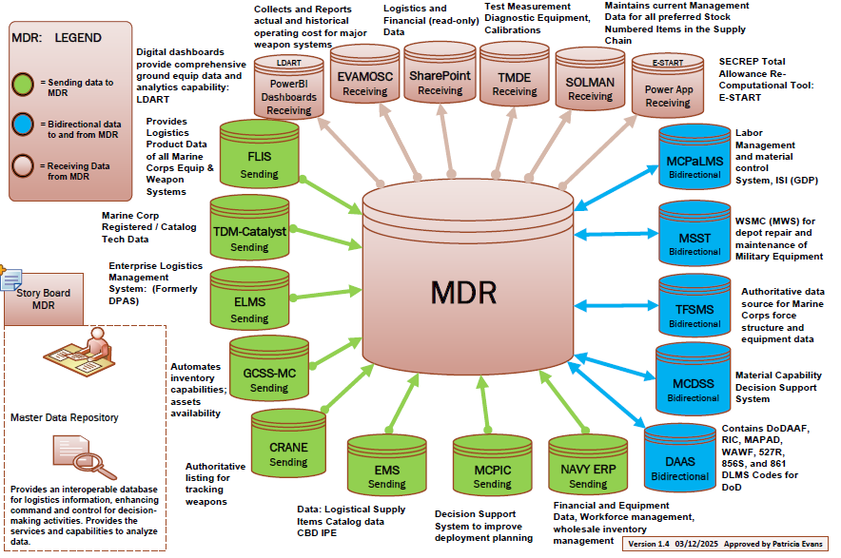
Problem Statement
Marines at the edge are not equipped to make data-driven decisions
The Marine Corps Logistics Command has 17+ terabytes of logistics data that are underutilized
Interacting with data at scale is not feasible for non-technical Marines
Without a solution, decisions cannot be made at the speed of relevance
While cloud migration is in progress, there is no promise that existing services will meet needs
Notes:
What does this mean? - Simply put, Marines/operators at the edge are not equipped with the right knowledge or tools to make data-driven decisions
The Marine Corps Logistics Command, where I work, maintains a database with terabytes of logistics data collected from logistics systems across the Marine Corps, but only a handful of people across the Marine Corps fully leverage this data resource in decision making.
Marines at the edge currently interact with the data for their specific units through a web interface but cannot do so at scale.
While cloud providers like Amazon and Microsoft have services that can address these issues, we have yet to see them successfully employed
Without a solution, we will continue taking days to answer questions that can be answered in minutes.

Slide 5
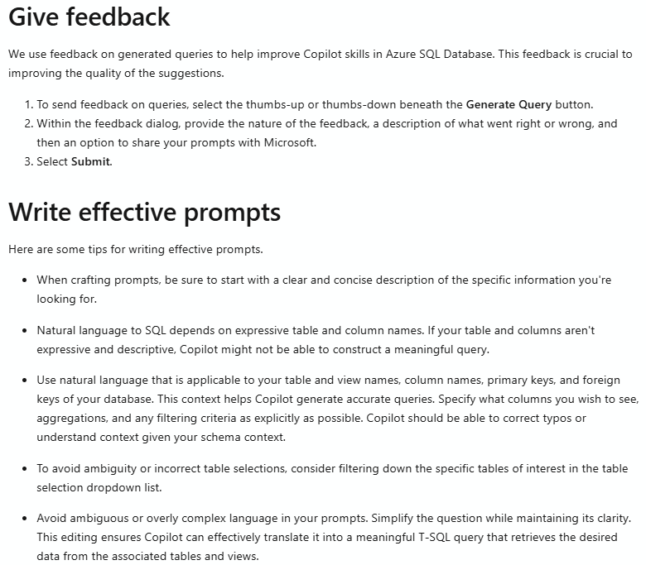
Problem Statement
Industry acknowledges challenges associated with translating natural language to SQL
The Marine Corps Logistics Command has 17+ terabytes of logistics data that are underutilized
Interacting with data at scale is not feasible for non-technical Marines
Without a solution, decisions cannot be made at the speed of relevance
While cloud migration is in progress, there is no promise that existing services will meet needs
Microsoft Azure - Natural Language to SQL*
*Natural language to SQL in the Azure portal query editor - Azure SQL Database | Microsoft Learn
Notes:
What does this mean? - Simply put, Marines/operators at the edge are not equipped with the right knowledge or tools to make data-driven decisions
The Marine Corps Logistics Command, where I work, maintains a database with terabytes of logistics data collected from logistics systems across the Marine Corps, but only a handful of people across the Marine Corps fully leverage this data resource in decision making.
Marines at the edge currently interact with the data for their specific units through a web interface but cannot do so at scale.
While cloud providers like Amazon and Microsoft have services that can address these issues, we have yet to see them successfully employed
Without a solution, we will continue taking days to answer questions that can be answered in minutes.

Slide 6
Solution
Fine-tune an existing model to perform text-to-SQL tasks specific to Marine Corps logistics data
Fine-tuning
Dataset
Model
Question | SQL Context | SQL Query | Explanation
… | … | … | …
Llama-3.2-1B-Instruct-4-bit
1
2
3
Lightweight model
Parameter Efficient Fine-Tuning
Custom curated dataset
Notes:
So, how do we address this issue
Model name components - LLama_3.2 (Meta LLM) / 1B - 1 billion parameter vice hundreds of billions of parameters / Instruct - tuned to follow task instructions / 4-bit - quantized model (less precision for the sake of reducing memory)
Fine-tuning use Unsloth parameter efficient fine-tuning method where instead of performing full fine tuning of all 1Billion parameters in the model, model weights are frozen and a small additional layer is applied and then fine tuned for new task
Use our own dataset to tweak the model to perform for our needs

Slide 7
System - Overview
Transparent to user
User’s question supplemented with context
User inputs natural language question
Contextual question translated into SQL query
Query executed against database
Notes:
So what does this look like: Like chatgpt, a user should be able to ask a question in some sort of intuitive user interface and receive an answer to that question.
Under the hood && transparent to the user,
their natural language question is being combined with some additional context that is relevant to answering the question.
The combination of those two elements is passed to the language model to convert into a SQL statement.
that sql statement is executed against the database
the result is returned to the user

Slide 8
System - Example
Transparent to user
List all of the vehicles in Combat Logistics Battalion 4 that have been in the maintenance shop for more than 120 days
Knowledge Injection
Database metadata
Examples fetched from index
Persona:
Maintenance Officer
Fine-tuned Model
Llama-3.2-1B-Instruct (4bit)
Query the Maintenance Table:
Service Request Header Table
Serial Number | Days in Shop
12345 | 131
98765 | 159
29030 | 121
… | …
SELECT SERIAL_NUMBER, DAYS_IN_SHOP
FROM GCSS SR Header
WHERE UNIT = ‘M29030’
AND DAYS_IN_SHOP > 120
Everyone* has the ability to derive insights and inform decision making
Notes:
*doesnt need to know database information (table name, columns, etc.) Suppose a user asks, “list all of my vehicles, by serial number, that have been in the maintenance shop for more than 90 days?”
Behind the scenes,
information about the maintenance data is combined with the question
The combination of those two elements is passed to the language model to convert into a SQL statement.
the appropriate sql query is generated that answers the user’s question
the maintenance officer gets a list of all vehicles that have been in maintenance more than 90 days

Slide 9
System Demonstration

Slide 10
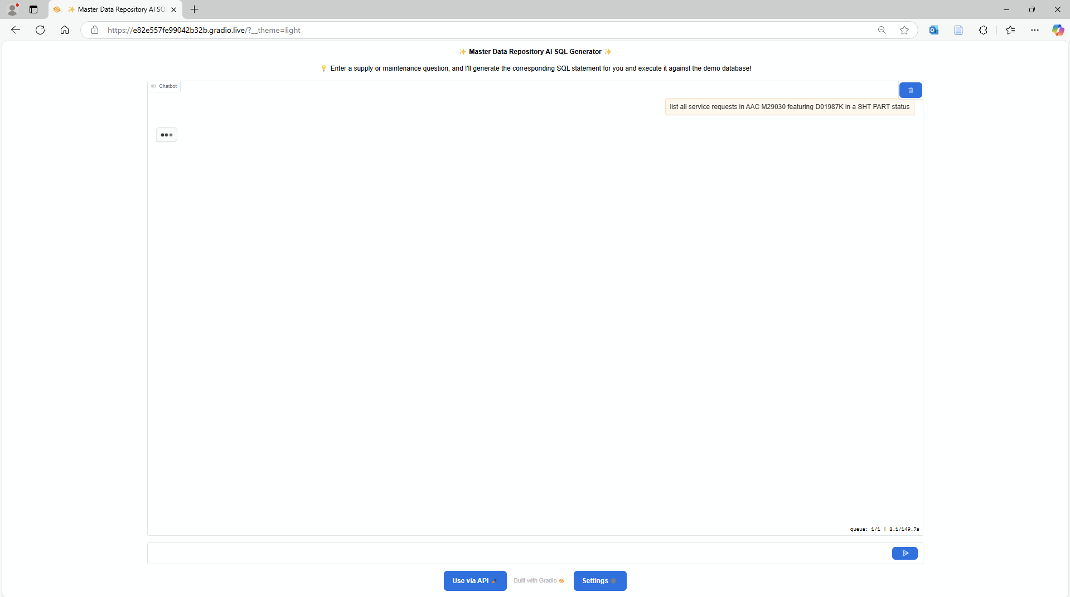

Slide 11
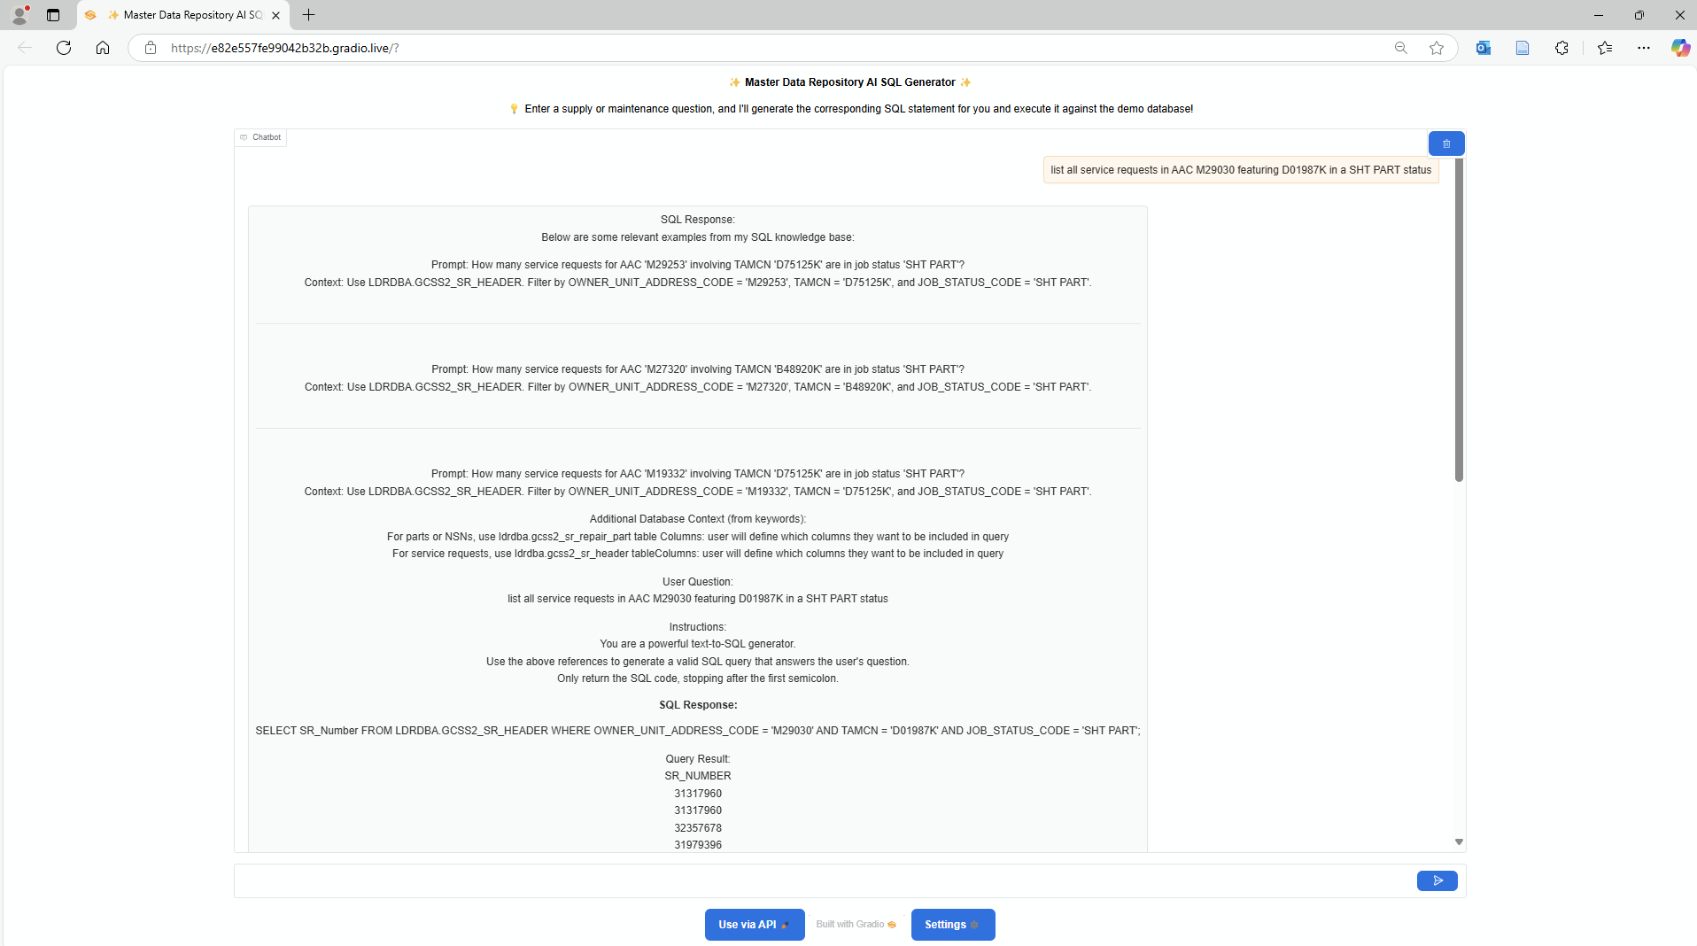
User
question
Transparent to user
Additional context constructed by system
System Response

Slide 12
User
question
Examples retrieved from knowledge base
Dynamic database context
Instructions
Generated SQL Query
System Response (44)

Slide 13
Evaluation
100 queries sampled from test set were manually* evaluated
More work to do before deploying
System performance ∝ Dataset quality (quantity, complexity, diversity)
Evaluation Standard | Accuracy
0-error | 39%
1-error | 60%
2-error | 67%
Notes:
we do not require exact matching because - SQL queries can be structurally different than expected but still return the correct results
We notice that a lot of the queries are close to being correct so we perform a relaxed evaluation where consider a query to be correct if it has only 1 error
We observe that the system struggles to perform with queries requiring joins of multiple tables, aggregations, and complex filtering
We observe that system’s performance is proportional to the dataset quality (diversity of examples, complexity, quantity)

Slide 14
Way Ahead
*
Use Case Approved
Cluster Provisioned
Finished Phantom Fellowship
Cloud Migration
Deployment
March 2025
April 2025
August 2025
December 2025
*Image generated by ChatGPT 4o
Notes:
Allow users to provide recommended corrections to generated SQL statements - detailed feedback
Need assistance in coming up with new, diverse examples
Incorporate feedback mechanism to allow users to refine system-generated queries
Work with subject matter experts to craft more examples (diversity and complexity) for inclusion in our dataset
Migrate to and host in Jupiter (Advana)

Slide 15
Questions
DATA-DRIVEN
^
Lane Johnson
Marine Corps Logistics Command
lanej@mit.edu
lane.johnson@usmc.mil

