Slide 1
Command Data and Analytics Office (CDAO)
UNCLASSIFIED
Type, Purpose, Output:
Type: Information Brief
Purpose: Provide mission overview of the CDAO.
Required Action: N/A
Modern Day Marine Overview Brief
Presentation Date: 1 May 2025
Maj Gabra Bailey
Contact Information: 229-639-8966
Overall Classification: UNCLASSIFIED
Agenda
Marine Corps in 2025
Data Science Pyramid
Organizational Structure
Why this is not just Technology
LOGCOM Campaign Plan
Projects Underway
Summary
CDAO Point of Contacts
UNCLASSIFIED
Notes:
We will begin with a strategic overview of the Marine Corps’ direction in 2025, and walk through how CDAO’s mission, structure, and efforts directly support Force Design modernization goals.
We will dive into how we organize and operate, our project portfolio, and conclude with key takeaways and contacts.
This brief is built to inform, but also to spark collaboration—the CDAO is not just a technical capability; it’s a cultural transformation engine.

Slide 2
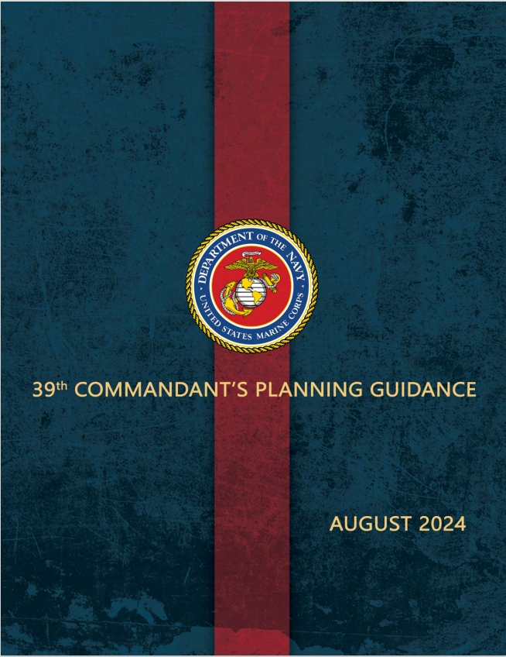
MARINE CORPS FORCE DESIGN
“We generate and rely on a tremendous amount of data that has to be integrated and used to inform our decisions and enable our actions.”
~ Dr. Radha Plumb
To Win on the Future Battlefield …
We must continually refine our modernization through experimentation, force-on-force exercises, data, and analysis
No platform, operating concept, or strategy is as important to the Service as the investments we make in our individual Marines’ performance
We must possess sufficient depth of magazine supported by a resilient and distributed logistics network to persist throughout a protracted high-intensity fight
We will continue to leverage advances in artificial intelligence to enhance decision making at the tactical edge
39th CPG – August 2024
Notes:
CDAO is the enabler that connects data, analytics, and AI with the warfighting objectives set by the Commandant:
Modernization through experimentation
Individual performance investment
Resilient logistics networks
AI for tactical edge decision-making
Craig Martell, the Pentagon’s Chief Digital and Artificial Intelligence Officer, or CDAO
Not a soldier but a data scientist, Martell headed machine-learning at companies including LinkedIn, Dropbox and Lyft
The Marine Corps is nested with higher and industry – Excerpts from the CPG, 2019

Slide 3
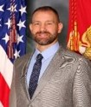
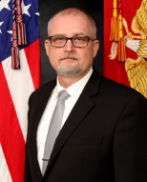
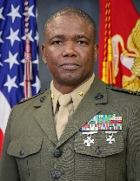
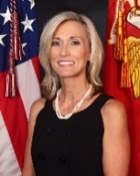
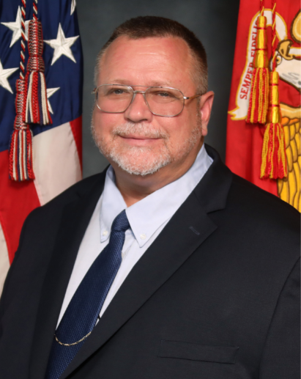
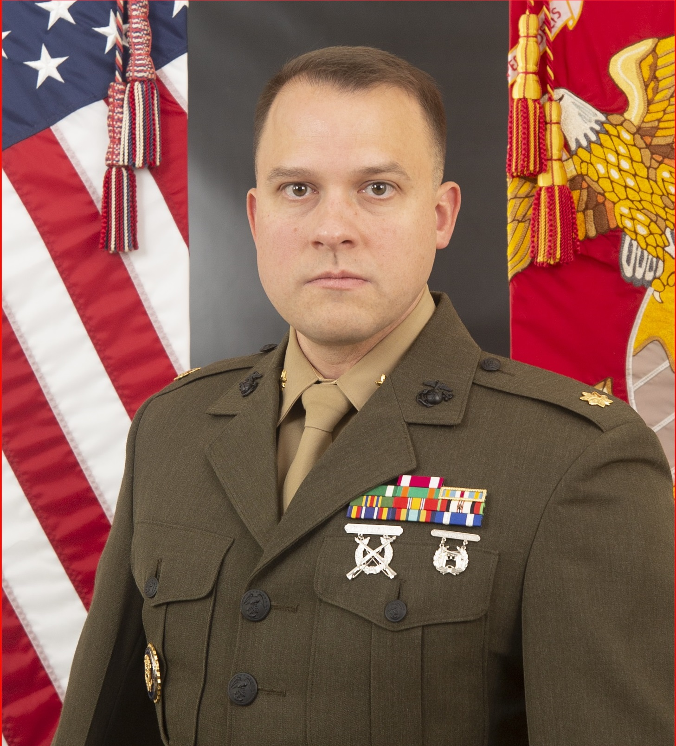
CDAO ORGANIZATION
MISSION STATEMENT:
To be the engine of a data driven culture whose confidence is inspired by analytic tools which empower us to make better decisions, faster in order to create value and build trust in our Command through the eyes of the Fleet Marine Force whom we serve.
Director, CDAO
Mr. Craig Clemans
Deputy Director, CDAO
Mr. Larry (Tony) Stevens
CDAO Operations
Maj Gabra Bailey
Data Governance and Strategy Division
Mrs. Michelle Blalock
Business Enablement Division
Mr. David Dougherty
Analytics Support Division
Maj Matthew Miller
Finance
Personnel Management
Training
Admin
Safety
Taskers
Strategic Planning
Contract Management
Project Scoping and Tracking
Data Strategy / Policy
Information Architecture
Data Literacy/Training
Report Repository Management
Data Quality Management
Data Governance
Data Integration
System Functional Support (GCSS-MC, ELMS, MCPIC, MDR, L-DART)
System Change Requirements
Data Support Analysis Teams
Data Science Lab
Innovation Strategy
Analytic Governance
Reporting and Visualization
Long-Term and Short-Term Studies
Notes:
Our mission is to be the engine of a data driven culture whose confidence is inspired by analytic tools which empower us to make better decisions, faster in order to create value and build trust in our Command through the eyes of the Fleet Marine Force whom we serve
This is our organization and its directorate
This structure ensures CDAO can support both enterprise-level initiatives and day-to-day mission-critical needs
Marketing / Project Development → Data Quality → Analytics → Policy / Governance
**Merging some DGSD and BED tasks**
KMI / MS Contract – 16 Data Analysts assigned.

Slide 4
DATA SCIENCE PYRAMID
AI
Machine Learning
Assurance
Collect Data
Analyze & Label
Governance
Transform & Aggregate
Store Data
Data Strategy & Governance Division
Analytic Support
Division
Policy & Training
Business Enablement Division
Notes:
The Pyramid emphasizes the link between operational success and its dependency on data-driven decision-making:
Where our Data Strategy & Governance Division ensures the quality, visibility, and integration of authoritative data to inform enterprise and force design-level decisions.
Business Enablement Division translates enterprise data strategies into actionable operational process-aligned systems, tools, dashboards, and workflow enhancements—bridging the gap between users and systems like Global Combat Support System-Marine Corps (GCSS-MC) , Enterprise Logistics Management System (ELMS), and others.
And the Analytics Support Division delivers AI/Machine Learning (ML) capabilities, visualization tools, and decision support applications that directly assist warfighters, maintainers, and logisticians at the point of action.
In short, the pyramid implicitly depicts why CDAO exists: to close the gap between data and decision-making across all levels of MARCORLOGCOM and FMF through the unified effort of our three divisions.

Slide 5
WHY THIS IS NOT JUST A TECHNOLOGY THING
A data scientist sets up and maintains the data architecture within an organization; however, they have limited control over the quality or accuracy of the data flowing through the architecture.
The accuracy and integrity of the data depend on the quality of the data sources feeding into the system and any data-cleansing processes that occur within the organization.
Ensuring data quality is ultimately the responsibility of the data owners, not the data scientist.
Notes:
This analogy reinforces the human and organizational responsibility in data transformation.
Data scientists and engineers build the structure—but data ownership, stewardship, and quality remain everyone’s responsibility.
Culture change is the goal—we are embedding a data-aware mindset in every level of decision-making.
Where CDAO is the catalyst for change but needs buy-in from leadership, process owners, and operators to succeed.

Slide 6
5-YEAR CAMPAIGN PLAN
Notes:
The 5-Year Plan reflects our deliberate, phased approach to maturing analytics capabilities across LOGCOM.
This is not a one-off endeavor; it is a long-term transformation plan aligned to Command priorities and Service-level objectives

Slide 7
5-YEAR CAMPAIGN PLAN
Notes:
Tying back to the strategic priorities of Force Design, LOE2 aims expands on the application of data & improved networks through:
Global Awareness and data-centric activities
The endstate of the LOE is that LOGCOM will possess the data application capabilities:
Develop and adopt capability: Tools, dashboards, applications
Build capacity: Train Marines, hire SMEs, partner with industry, academia, and other services
Deliver value: Translate analytics into readiness and efficiency gains

Slide 8
Projects Underway
Notes:
Each project showcased is a direct response to an operational pain point:
Container Management Dashboard: From enterprise to tactical—real-time container status and accountability.
War Reserve Material Planning Tool: Data-informed prepositioning and investment to ensure readiness during the first 30-60 days of conflict.
Enterprise Demand Planning Tool: Demand forecasting, DLA collaboration, and SMU-level visibility. It’s about being proactive, not reactive.
These projects show how CDAO is moving from insight to action, providing tools that will integrate into logistics planning cycles and contingency planning.

Slide 9
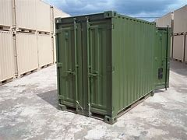
CONTAINER MANAGEMENT DASHBOARD
Purpose: To develop an automated Enterprise-level container management dashboard that provides container management visibility from Enterprise to battalion/squadron level units
Objective: Aggregate Global Combat Support System-Marine Corps (GCSS-MC) and Joint Container Management (JCM) system data to provide inventory and readiness visibility. Calculate quarterly and bi-annual statistics for required reports. Enable basic trend analysis.
Notes:
Container Management Dashboard: From enterprise to tactical—real-time container status and accountability.

Slide 10
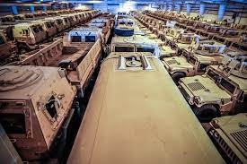
WAR RESERVE MATERIAL PLANNING TOOL
Purpose: Update enterprise capabilities by developing a War Reserve Material Planning Tool that enables LOGCOM to meet War Reserve Materiel Requirements (WRMR) in support of operational readiness.
Objective: Develop a War Reserve Material Planning Tool that enables LOGCOM to identify, assess, and source WRMR in support of initial Fleet Marine Force (FMF) sustainment. The tool will inform materiel positioning and investment decisions to reduce risk, ensure readiness, and enable rapid response to Geographic Combatant Commander (GCC) operational requirements during the initial phases of contingency operations.
Notes:
War Reserve Material Planning Tool: Data-informed prepositioning and investment to ensure readiness during the first 30-60 days of conflict.

Slide 11
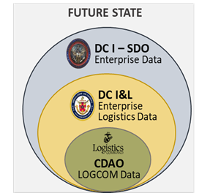
SUMMARY
Maturation of Command Data & Analytics Office (CDAO)
Marine Corps must evolve to meet Force Design objectives
Digital and Artificial Intelligence is our future
We commit to ensuring LOGCOM has the
skillsets necessary for digital transformation
NPS “Operations Research and Material Logistics Marines”, Supply Chain Experts, Gov Civ IT
Professionals
Unique opportunity to be a part of generational change
Notes:
In summary, CDAO is delivering value today while building the Marine Corps' digital future.
Our work supports the maturation of LOGCOM’s readiness, supports warfighting, Jointness, and gives decision-makers the confidence to act on data.
We are operationalizing data, analytics, and AI across logistics—this is generational change, and we invite the enterprise to help grip and shape it.
In summary, CDAO is actively working to mature and evolve its capabilities to meet the warfighter’s needs and achieve the Objs set fort in FD.
In our commitment to ensure LOGCOM has the skillset for digital transformation we collaborate and recruit practitioners from industry, academia, and Joint
NPS: Ops Research, Material Logistics, and SC experts, and IT professional Mil & Civ
Our future is clear and digital and artificial intelligence is at its forefront. As LOGCOM’s engine of a data driven culture, the CDAO is gripping this unique opportunity to be a part of generational change

Slide 12
LOGCOM CDAO POCs
CDAO Director: Mr. Craig Clemans
craig.c.clemans.civ@usmc.mil; 229.639.8341
CDAO Deputy Director: Mr. Larry “Tony” Stevens
larry.a.stevens@usmc.mil; 229.639.8045
CDAO Operations Division: Maj Gabra Bailey
Gabra.a.bailey.mil@usmc.mil; 229.639.8966
Analytics Support Division: Maj Matthew Miller
matthew.t.miller@usmc.mil; 229.639.6982
Data Governance & Strategy Division: Mrs. Michelle Blalock
michelle.Blalock@usmc.mil; 229.639.8581
Business Enablement Division: Mr. David Dougherty
david.a.dougherty@usmc.mil; 229.639.6854
Request for CDAO support: CDAO Request For Assistance
Distribution Statement A, Approved for public release, Distribution Unlimited

Slide 13
QUESTIONS/COMMENTS
UNCLASSIFIED
13

Slide 14
BACKUP SLIDES

Slide 15
CDAO OPERATIONS DIVISION
The mission of the Operations Division is to provide the support, services and assistance in the oversight of day-to-day operations and synchronization of the Director and Divisions within CDAO.
Vision: To provide internal support to CDAO as well as external messaging to HHQ, FMF, and other agencies.
Goal: Provide efficient and effective execution of day-to-day operational tasks that promote productivity, performance, and innovation internal and external of the CDAO. Decipher strategic plans and establish footholds for CDAO on behalf of MARCORLOGCOM as it relates to logistic data. Additionally, conduct outreach with external organizations, such as I&L, or FMF to support them with advanced data analytic capabilities.
Tasks:
Provides External and Internal Coordination
Administration
Supports Budgeting
Supports Contracting Actions
Provides Financial Management
Provides Technical Contract Management
Supports Manpower/Personnel Management
Provides Safety Oversight
Supports SharePoint
Provides Tasker Management
Coordinates Training
Acts as the Trusted Agent

Slide 16
DATA STRATEGY AND GOVERNANCE DIVISION
The mission of the Data Strategy and Governance Division is to serve as the principal advisor for data governance, data operations, and enable a culture of data literacy supporting informed decision making in order to foster customer trust and support efficient data operations.
Vision: Strengthen and nurture a data-driven and data-centric organization that leverages data to improve maintenance, sustainment, storage, distribution, and business processes across the Marine Corps logistics chain. Provide a dynamic data governance process that effectively manages data as an asset with unique properties while facilitating a data-driven culture within the workforce.
Goal: Turn data into information that enables enterprise knowledge and ultimately fosters leadership wisdom.
Tasks:
Develop and sustain MARCORLOGCOM’s Data Campaign Plan and ensure it is understood and actualized
Develop and sustain MARCORLOGCOM’s “Information Architecture” in accordance with the DoD Architecture Framework (DODAF)
Enable and ensure Data Security and Compliance Management
Ensure data management policy across functional stakeholders is mutually inclusive and effective
Develop, organize and manage an effective Data Governance Program
Establish standards and processes that strengthen, monitor, and report the quality of the data
Prepare and respond to evolving data innovation requirements that may impact the Data Campaign Plan and Data Policies ​
Develop, deploy, and monitor a curriculum necessary to mature MARCORLOGCOM’s Data Literacy competency
Integrate Organizational Change Management (OCM) strategies to drive understanding and importance of effectively working with data and making data-driven decisions

Slide 17
BUSINESS ENABLEMENT DIVISION
The mission of the Business Enablement Division is to function as the business functional representatives for all logistics systems supporting MARCORLOGCOM.
Vision: The Business Enablement Division will functionally support all logistics organizations in the areas of data quality, provide a logistics system helpdesk and act as a single voice of the customer while ensuring all logistics systems align to policy, law, orders, and regulations.
Goal: To ensure timely support to MARCORLOGCOM customers at all levels enabling timely command decisions through accurate and effective data analysis.
Tasks:
Ensure functional accuracy of APSRs​ (Accountable Property System of Record)
Provide functional system support for ELMS, GCSS-MC, MCPIC, and the MDR
Provide reporting capability for MARCORLOGCOM’s overall inventory
​Operate as the MARCORLOGCOM system change management advocate
Perform data quality evaluation
Ensure all account management functions align to system security protocols
Provide system application analytical support​
Provide support to internal and external audit efforts​
Provide a help desk root cause analysis​ to determine if it is a (people, process, or system) error
Provide Training on functionally supported systems
Determine system deficiencies and recommend modifications to align to policy​
Review logistic system policy​
Notes:
Top Action Items:
Strategic Forums:
Operations Impacts:

Slide 18
ANALYTICS SUPPORT DIVISION
The mission of the Analytics Support Division is to unlock the value in data and drive transformation to benefit the War Fighter. This is accomplished through the development of digital and AI-enabled solutions across the command while selectively scaling proven solutions for enterprise use-cases. Provide executive analytics to measure progress and performance as it relates to the LOGCOM mission set.
Vision: To establish an Advanced Analytics environment that quickly transforms data into intelligence allowing decision makers to make informed choices. To develop and foster a culture that fully embraces innovation and establish partnerships with agencies, private industry, and academia in order to exploit technologies that will help bridge capability gaps and improve current processes.
Goal: To become the analytic and innovative nerve center for MARCORLOGCOM and the Marine Corps Logistics Enterprise leveraging the latest technologies, techniques, and tools.
Tasks:
Define the Command Analytics Governance Policy
Develop automated tools that enable data driven decision making
Verify and Validate Command BI tools
Apply (application of) advanced scientific methods and modeling techniques to LOGCOM operations
Execute Long Term / Short Term Studies
Provide Mentorship and Training for Analysts
Support Innovation Outreach and Exploration with other Government Agencies, Academia, and Private Industry
Integrate the most suitable and innovative solutions
Notes:
Top Action Items:
Strategic Forums:
Operations Impacts:

Slide 19
CDAO PROJECT PROCESS
Initiate Project Request
Assign Project Lead
Assign Start Date
Assign Anticipated Completion Date
Documents complete and uploaded
Plan IPRs
Initiate Policy
Schedule Demo
Schedule Final IPR
In this initial phase, you define the project’s goals and objectives. It’s essential to understand what you’re trying to achieve and what success looks like. This step sets the foundation for the entire project. What is the purpose and endstate?
Designate a project lead who will oversee the project’s execution. This person will coordinate tasks, manage resources, schedule IPRs, and ensure alignment with the project’s objectives.
Determine the project’s official start date. This helps establish timelines, allocate resources, and plan for dependencies.
Set a realistic target for project completion. Consider factors like scope, resources, and potential risks. Having a clear completion date helps manage expectations.
Ensure all necessary project documents (such as requirements, specifications, and contracts) are complete and uploaded to a central repository. This step promotes transparency and collaboration.
Before diving into execution, conduct an IPR. Review the project plan, assess risks, and validate assumptions. Adjust the plan if needed to address any issues. (bi-weekly basis)
Establish project policies, guidelines, and procedures. These ensure consistency and adherence to best practices throughout the project lifecycle. 80% projected completion date.
Plan for a demonstration or milestone review. This allows stakeholders to see progress, provide feedback, and make necessary adjustments.
Just before project completion, conduct a final IPR. Evaluate deliverables, assess overall success, and capture lessons learned for future projects. Signed policy = completion
Notes:
Combine Demo and Final IPR
Add Signed Policy = completion
Add Ops follows up with the customer to ensure endstate was met
Add the document slides

Slide 20
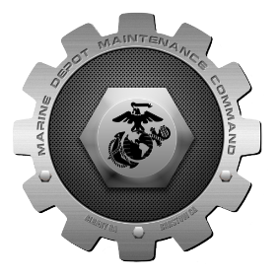
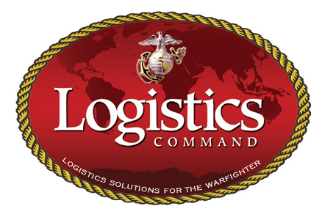
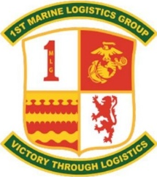
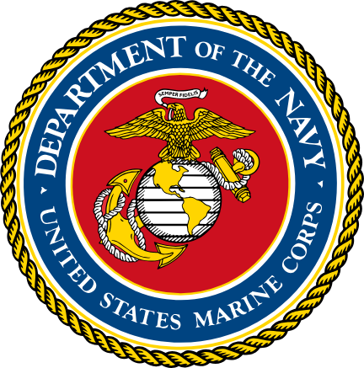
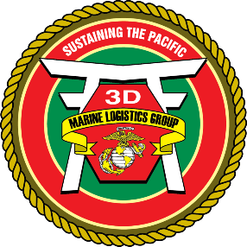
ENTERPRISE DEMAND PLANNING TOOL
Objectives:
Scope current EDP model to SMU level (Geographical Address Code)
Determine best methodology for non-OPFOR consumable demand
Model validation and DLA collaborative process testing
SMUs/RIPs
Feeding the POM process and forecasting funding
Retain Demand Trigger Data
CPI
Demand Information
Feedback
Notes:
Enterprise Demand Planning Tool: Demand forecasting, DLA collaboration, and SMU-level visibility. It’s about being proactive, not reactive.
Background: The Demand Data Exchange/Customer Collaboration (DDE/CC) is the formal process by which services transmit their demand forecasts for Class IX to the Defense Logistics Agency (DLA). Previous efforts have instilled confidence in achieving a demand plan at the enterprise level; however, macro forecasts at this level are not actionable via the DLA collaborative process. The EDP forecast solution must be geographically specific, maintaining the same accuracy and precision as expected in the enterprise model.

