Slide 1


The Challenge of Autonomous Systems
Col Kenny Jones
Science and Technology Director, MCWL

Slide 2


Slide 3
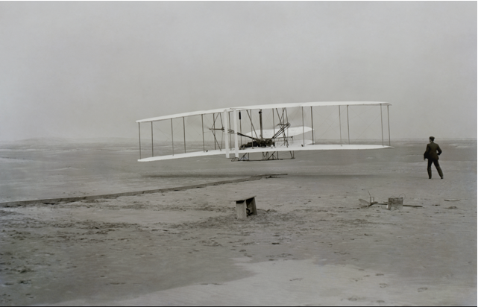
Innovation the Wright way.

Slide 4
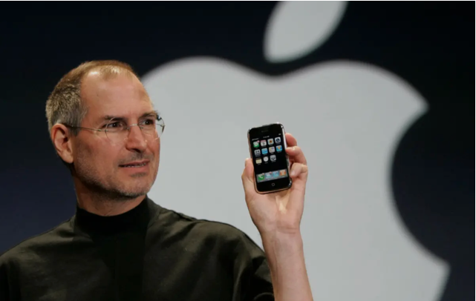

Slide 5
Keep it simple
One Step at a time
Meet people where they are

Slide 6
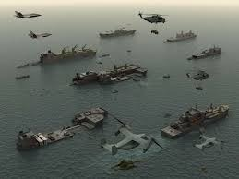

Slide 7
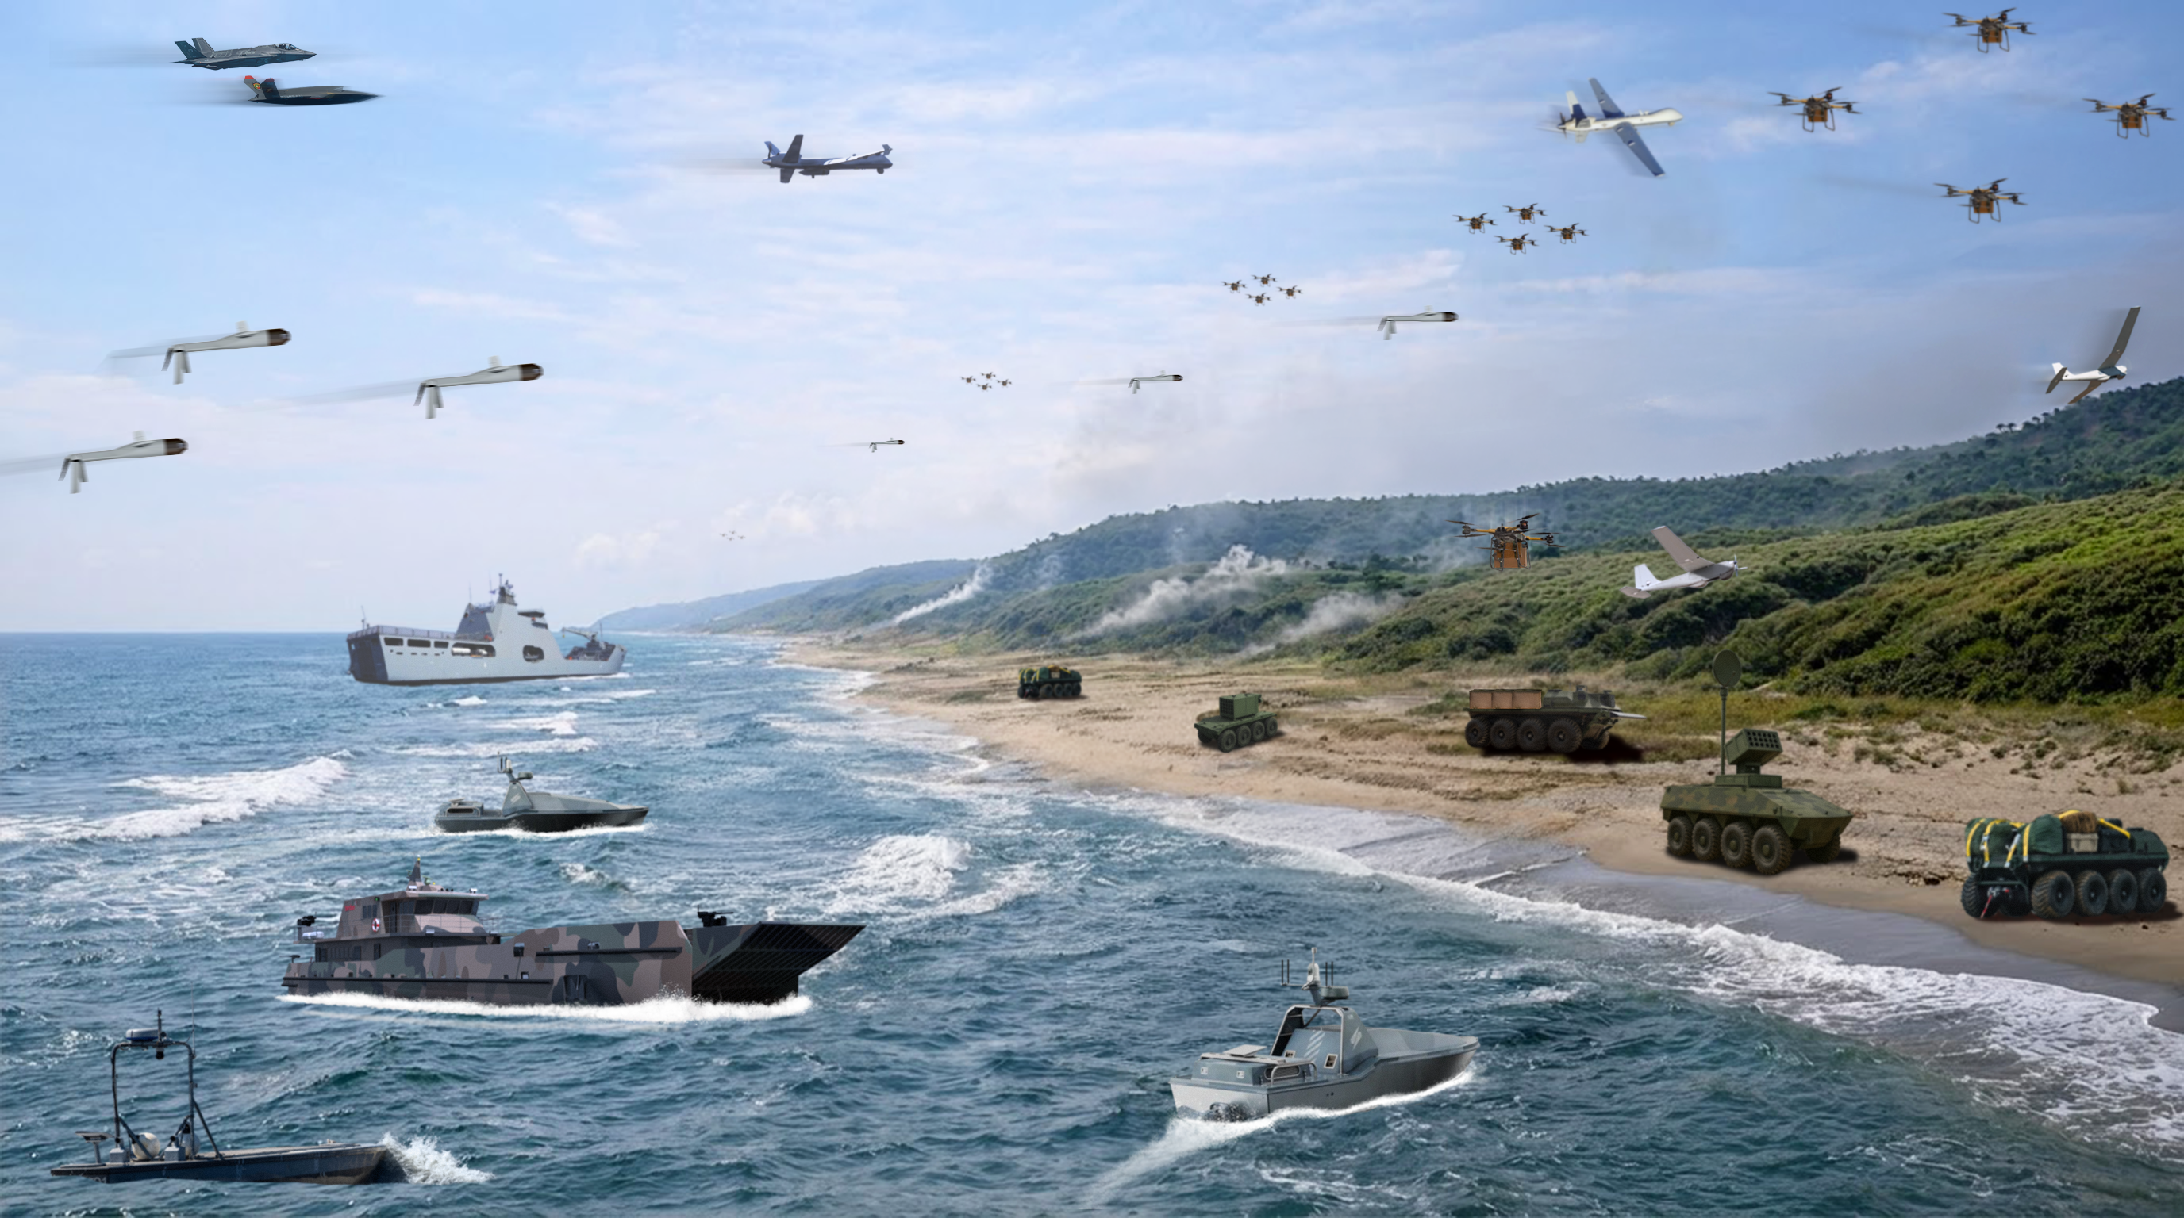

Slide 8
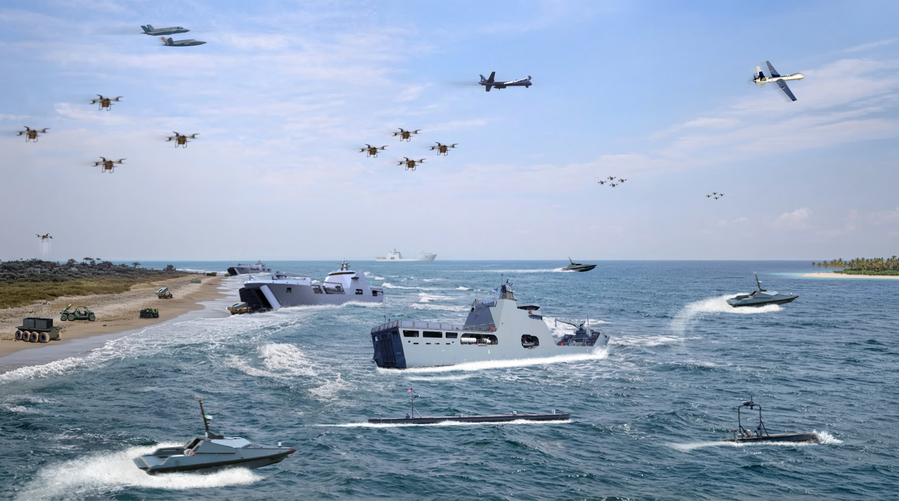

Slide 9
