Slide 1



From Perception to Decision: Fighting at the Edge
Presented By
Date
Headquarters
Ed Sullivan
ers@turbineone.com
April 2026
14120 Sullyfield Cir, Suite J
Chantilly, VA 20151
BUSINESS CONFIDENTIAL
Notes:
[Sources] - Internal brand reference: TurbineOne Brand Guide (Aug 2025) for typography, primary green (#41A762), reticle/radial background guidance, and minimalist near-future styling. - User-provided visual reference: /mnt/data/MDM.pptx (2).png [/Sources]

Slide 2

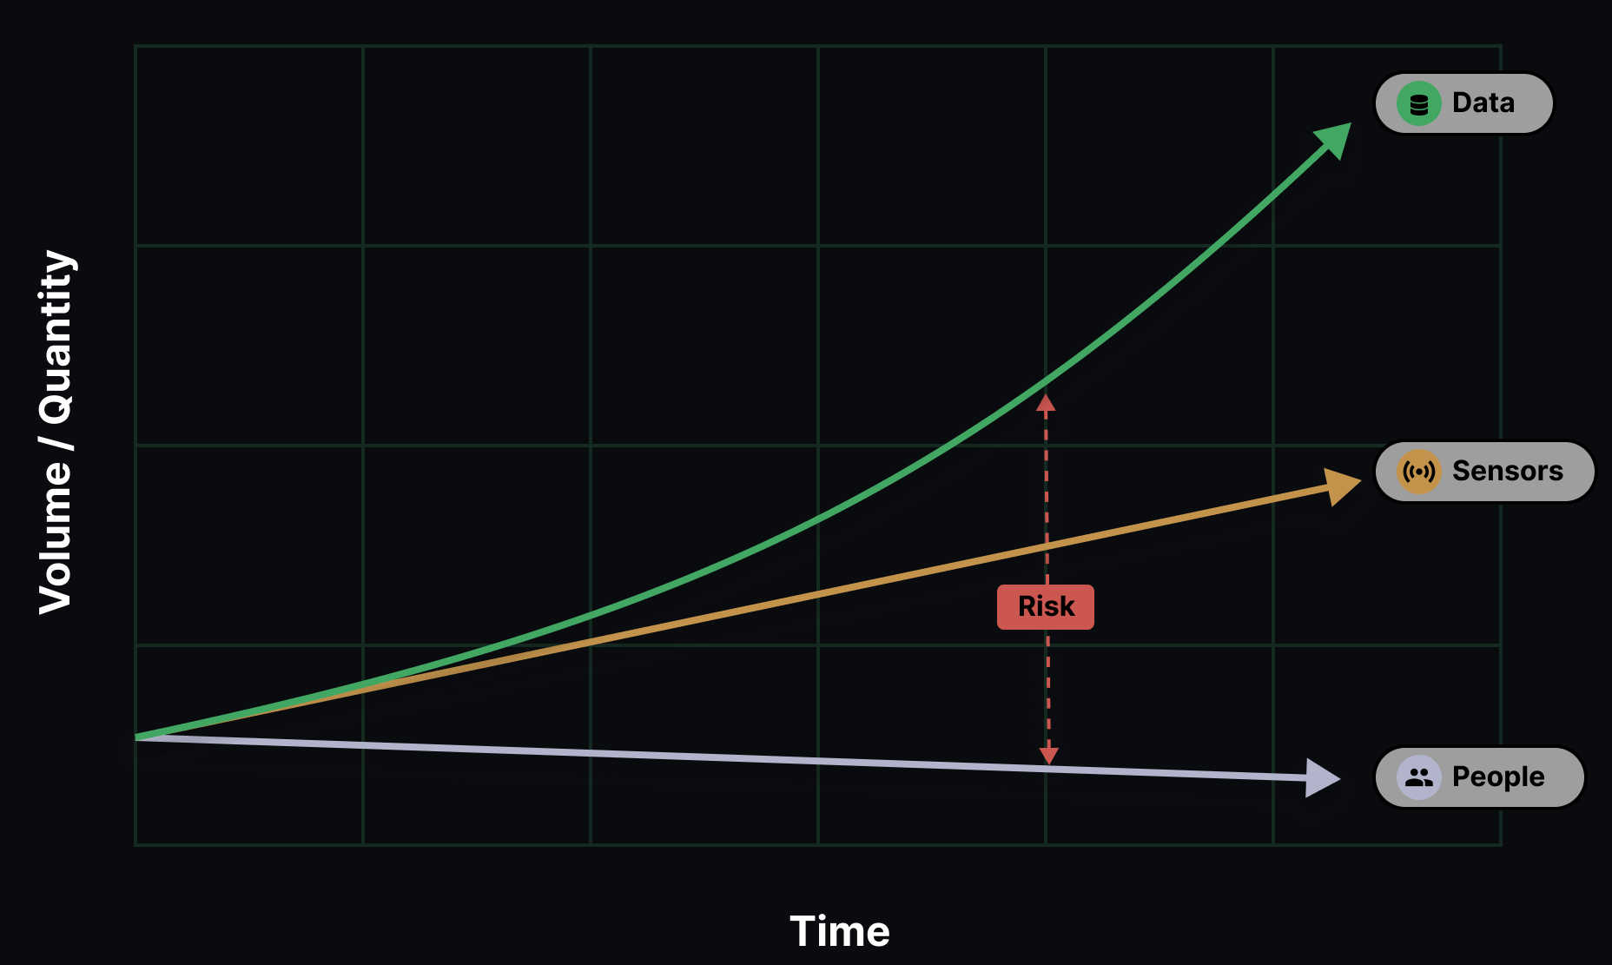
Everything on the Battlefield is a Sensor
02
BUSINESS CONFIDENTIAL
Notes:
[Sources] - Internal brand reference: TurbineOne Brand Guide (Aug 2025) for typography, primary green (#41A762), reticle/radial background guidance, and minimalist near-future styling. - User-provided visual reference: /mnt/data/MDM.pptx (2).png [/Sources]

Slide 3

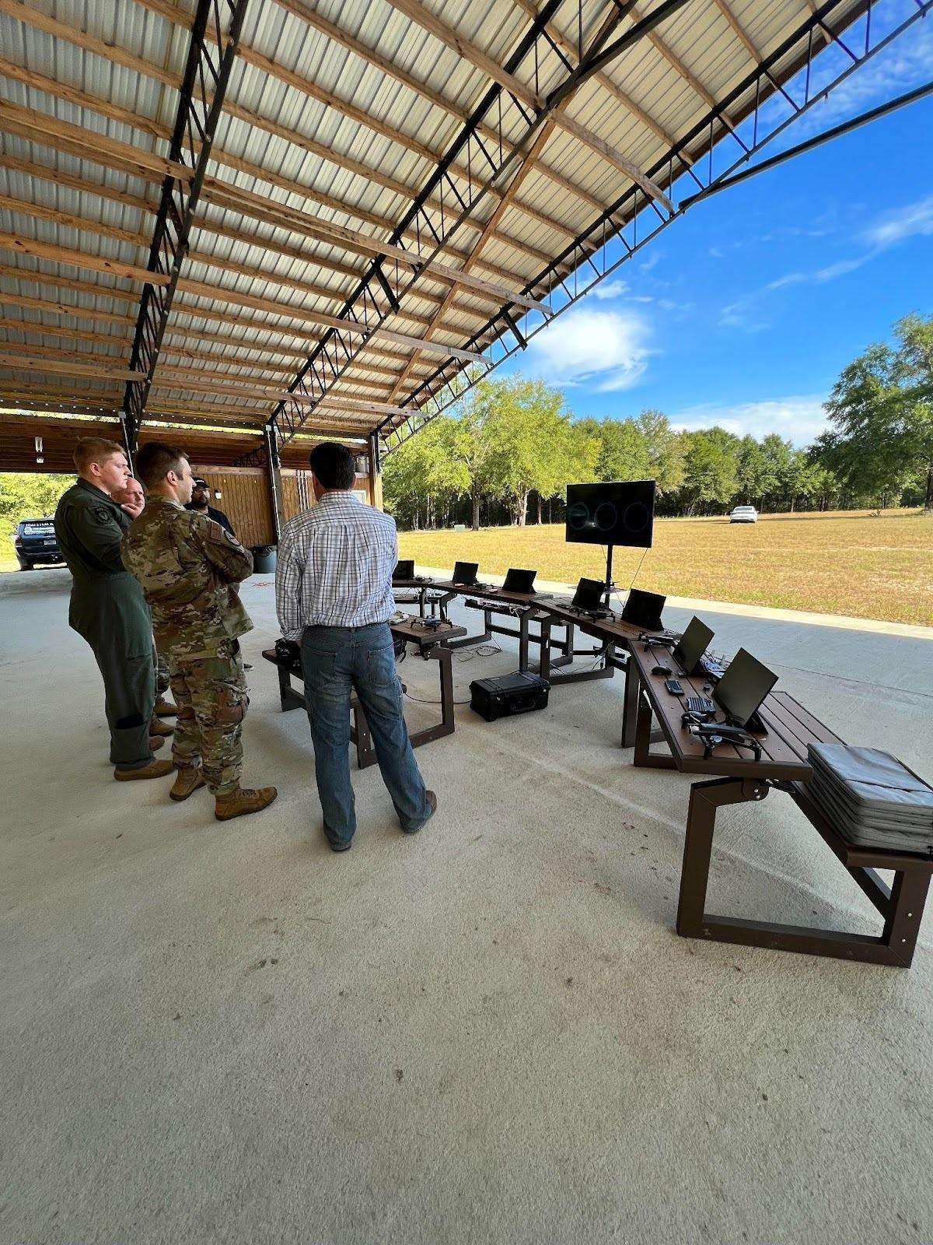
AFSOC SBIR
Oct 2022
Rapid Training
Low number of false positives
Few Airmen, many detections
03
BUSINESS CONFIDENTIAL
Notes:
[Sources] - Internal brand reference: TurbineOne Brand Guide (Aug 2025) for typography, primary green (#41A762), reticle/radial background guidance, and minimalist near-future styling. - User-provided visual reference: /mnt/data/MDM.pptx (2).png [/Sources]

Slide 4

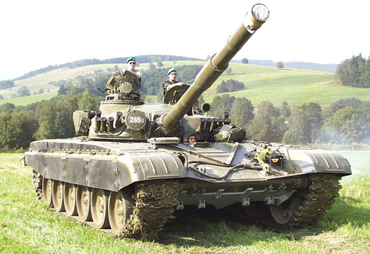
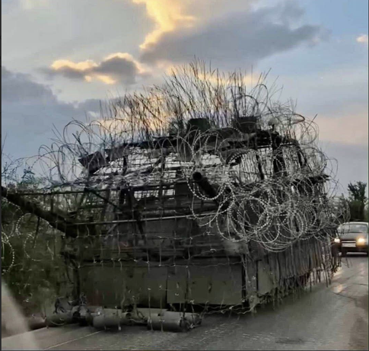
Object Detection: Fixed Models vs. User Refined Models
Current ML Model Options
Generalized ML models (e.g. YOLO) are inherently inaccurate
Specific ML Models have fixed/lengthy build times
Both are inflexible to change
Battlefield Reality
Continually changing with localized variations
Meaning generalized models break
Specific models fail/unable to adapt in time
A fixed model trained by this...
...will not detect this.
A fixed model trained by this...
...will not detect this.
04
BUSINESS CONFIDENTIAL
‹#›

Slide 5
The Frontline Perception System (FPS)
Build, Refine, and Tune ML Models at the Edge
Marines can build, refine, and deploy
their own target recognition models
in minutes to hours… not weeks to months.
05
BUSINESS CONFIDENTIAL
Notes:
[Sources] - Internal brand reference: TurbineOne Brand Guide (Aug 2025) for typography, primary green (#41A762), reticle/radial background guidance, and minimalist near-future styling. - User-provided visual reference: /mnt/data/MDM.pptx (2).png [/Sources]

Slide 6
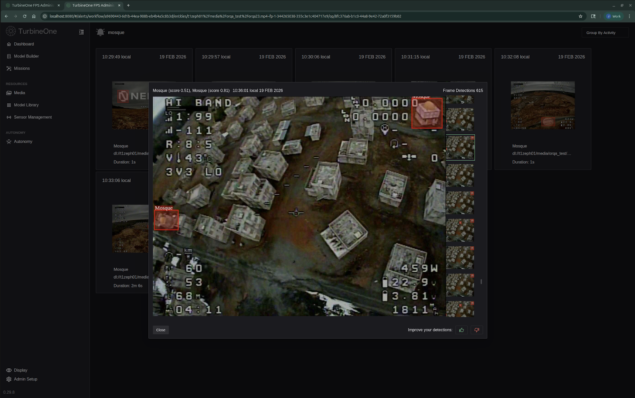
ATR in Action
Prevention of target overflight
94% reduction in CFF
Model anything
[DROP DIAGRAM OR TECHNICAL GRAPHIC HERE]
[Optional caption or source line]
06
MCB Quantico, UTC-D.
Feb 19, 2026
BUSINESS CONFIDENTIAL
Notes:
[Sources] - Internal brand reference: TurbineOne Brand Guide (Aug 2025) for typography, primary green (#41A762), reticle/radial background guidance, and minimalist near-future styling. - User-provided visual reference: /mnt/data/MDM.pptx (2).png [/Sources]

Slide 7
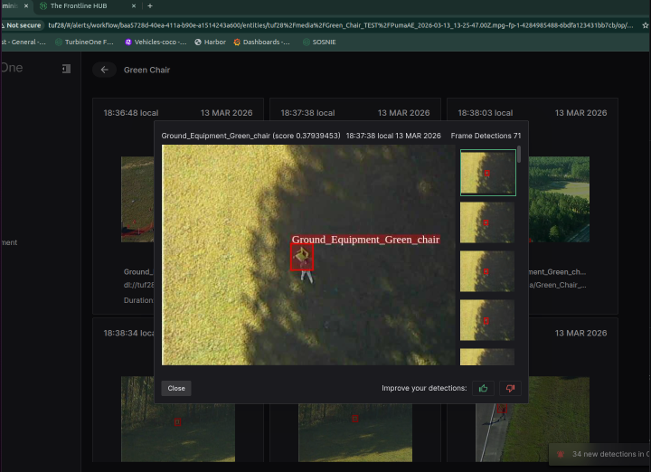
ATR in Action
Prevention of target overflight
94% reduction in CFF
Model anything
[DROP DIAGRAM OR TECHNICAL GRAPHIC HERE]
[Optional caption or source line]
07
BUSINESS CONFIDENTIAL
Notes:
[Sources] - Internal brand reference: TurbineOne Brand Guide (Aug 2025) for typography, primary green (#41A762), reticle/radial background guidance, and minimalist near-future styling. - User-provided visual reference: /mnt/data/MDM.pptx (2).png [/Sources]

Slide 8
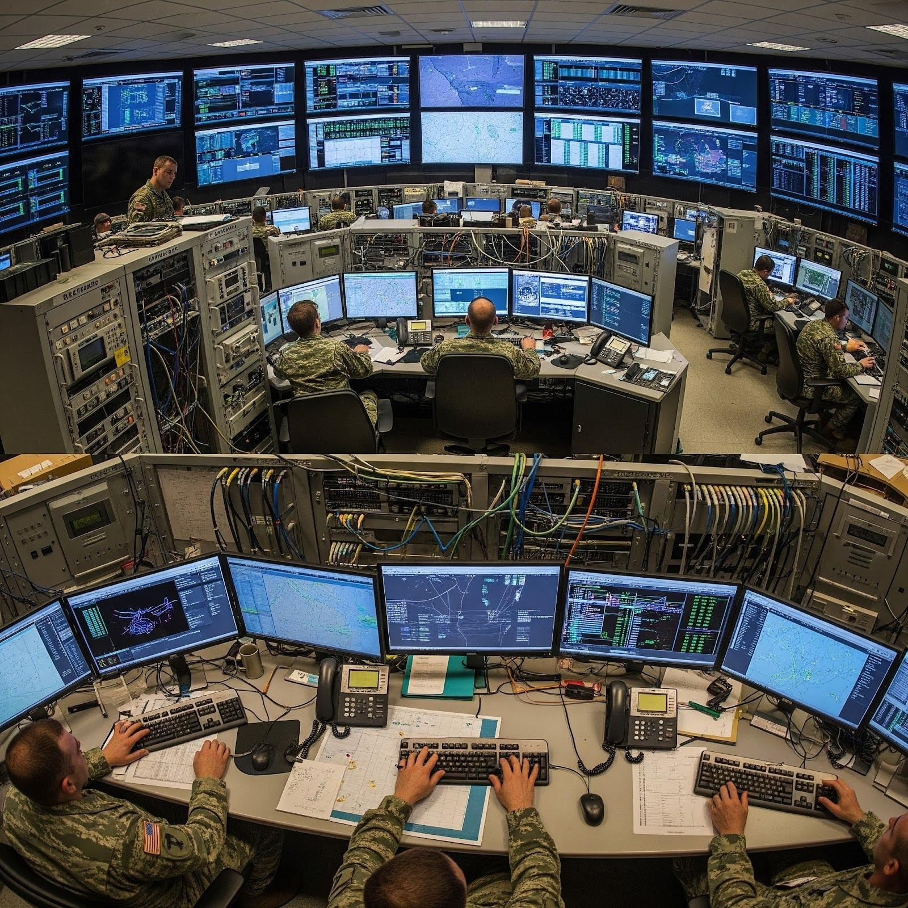
Sensor Proliferation
Increases manpower requirements
Draws from combat formations
Coordination becomes more complex
[Optional caption or source line]
08
BUSINESS CONFIDENTIAL
Notes:
[Sources] - Internal brand reference: TurbineOne Brand Guide (Aug 2025) for typography, primary green (#41A762), reticle/radial background guidance, and minimalist near-future styling. - User-provided visual reference: /mnt/data/MDM.pptx (2).png [/Sources]

Slide 9
Edge Autonomy
Beyond individual autonomy
Actions across sensors and platforms
Collaboration for Mission Benefit
[DROP DIAGRAM OR TECHNICAL GRAPHIC HERE]
[Optional caption or source line]
09
BUSINESS CONFIDENTIAL
Notes:
[Sources] - Internal brand reference: TurbineOne Brand Guide (Aug 2025) for typography, primary green (#41A762), reticle/radial background guidance, and minimalist near-future styling. - User-provided visual reference: /mnt/data/MDM.pptx (2).png [/Sources]

Slide 10
The Frontline Perception System (FPS)
Collaborative Autonomy
Faster, mission-relevant detection
Adaptation to new threats without waiting
Reduced cognitive load across distributed teams
And performance that holds up… even when the network doesn’t
05
BUSINESS CONFIDENTIAL
Notes:
[Sources] - Internal brand reference: TurbineOne Brand Guide (Aug 2025) for typography, primary green (#41A762), reticle/radial background guidance, and minimalist near-future styling. - User-provided visual reference: /mnt/data/MDM.pptx (2).png [/Sources]

Slide 11

The Problem with Swarms
Enormous data needs
Many nodes
Requires capable data layer forward
10
Artistic representation.
BUSINESS CONFIDENTIAL
Notes:
[Sources] - Internal brand reference: TurbineOne Brand Guide (Aug 2025) for typography, primary green (#41A762), reticle/radial background guidance, and minimalist near-future styling. - User-provided visual reference: /mnt/data/MDM.pptx (2).png [/Sources]

Slide 12
Under Frontline Perception System (FPS)
11
BUSINESS CONFIDENTIAL
Notes:
[Sources] - Internal brand reference: TurbineOne Brand Guide (Aug 2025) for typography, primary green (#41A762), reticle/radial background guidance, and minimalist near-future styling. - User-provided visual reference: /mnt/data/MDM.pptx (2).png [/Sources]

Slide 13
Under Frontline Perception System (FPS)
01
Our ATR gives you understanding.
12
BUSINESS CONFIDENTIAL
Notes:
[Sources] - Internal brand reference: TurbineOne Brand Guide (Aug 2025) for typography, primary green (#41A762), reticle/radial background guidance, and minimalist near-future styling. - User-provided visual reference: /mnt/data/MDM.pptx (2).png [/Sources]

Slide 14
Under Frontline Perception System (FPS)
01
Our ATR gives you understanding.
02
Collaborative autonomy gives you coordination between platforms.
13
BUSINESS CONFIDENTIAL
Notes:
[Sources] - Internal brand reference: TurbineOne Brand Guide (Aug 2025) for typography, primary green (#41A762), reticle/radial background guidance, and minimalist near-future styling. - User-provided visual reference: /mnt/data/MDM.pptx (2).png [/Sources]

Slide 15
Under Frontline Perception System (FPS)
01
Our ATR gives you understanding.
02
Collaborative autonomy gives you coordination between platforms.
03
Edge C2 is what allows those things to scale, function… and align.
14
BUSINESS CONFIDENTIAL
Notes:
[Sources] - Internal brand reference: TurbineOne Brand Guide (Aug 2025) for typography, primary green (#41A762), reticle/radial background guidance, and minimalist near-future styling. - User-provided visual reference: /mnt/data/MDM.pptx (2).png [/Sources]

Slide 16
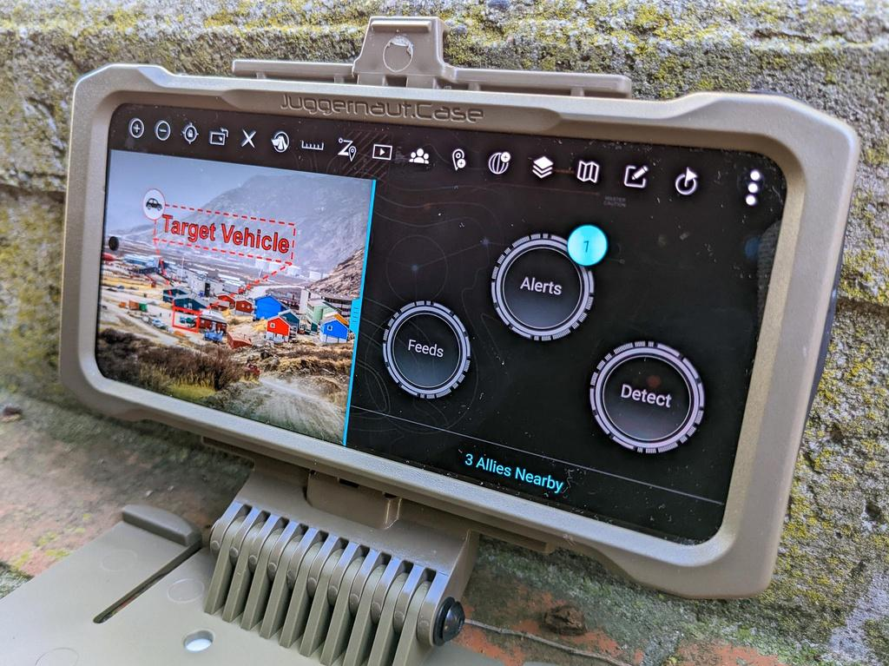
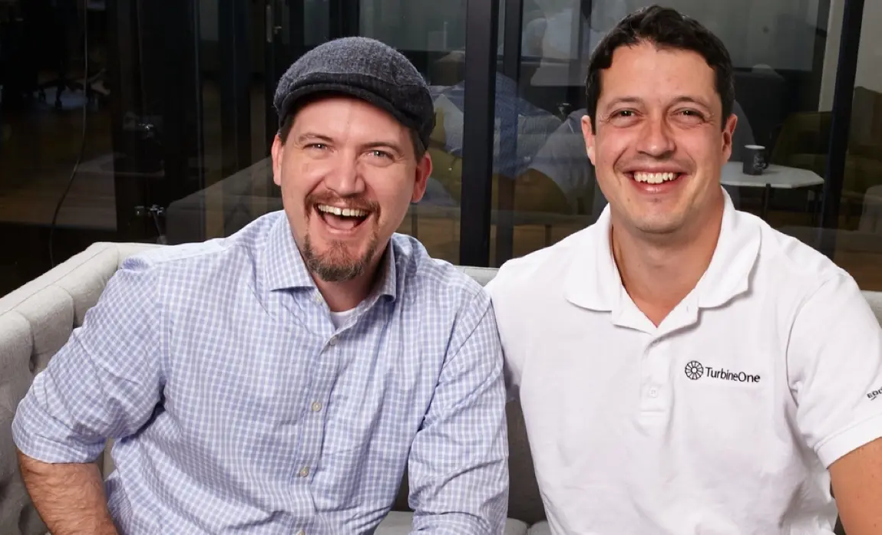
Where it All Started
[DROP IMAGE, SCREENSHOT, OR DIAGRAM HERE]
OBOS
Our Founders, Matt and Ian
15
BUSINESS CONFIDENTIAL
Notes:
[Sources] - Internal brand reference: TurbineOne Brand Guide (Aug 2025) for typography, primary green (#41A762), reticle/radial background guidance, and minimalist near-future styling. - User-provided visual reference: /mnt/data/MDM.pptx (2).png [/Sources]

Slide 17
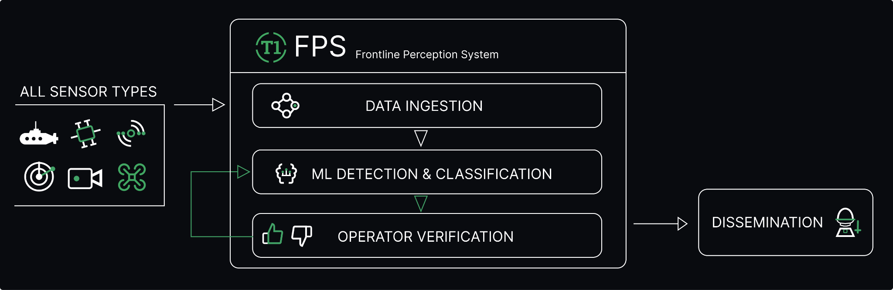
How it Works
16
BUSINESS CONFIDENTIAL
Notes:
[Sources] - Internal brand reference: TurbineOne Brand Guide (Aug 2025) for typography, primary green (#41A762), reticle/radial background guidance, and minimalist near-future styling. - User-provided visual reference: /mnt/data/MDM.pptx (2).png [/Sources]

Slide 18











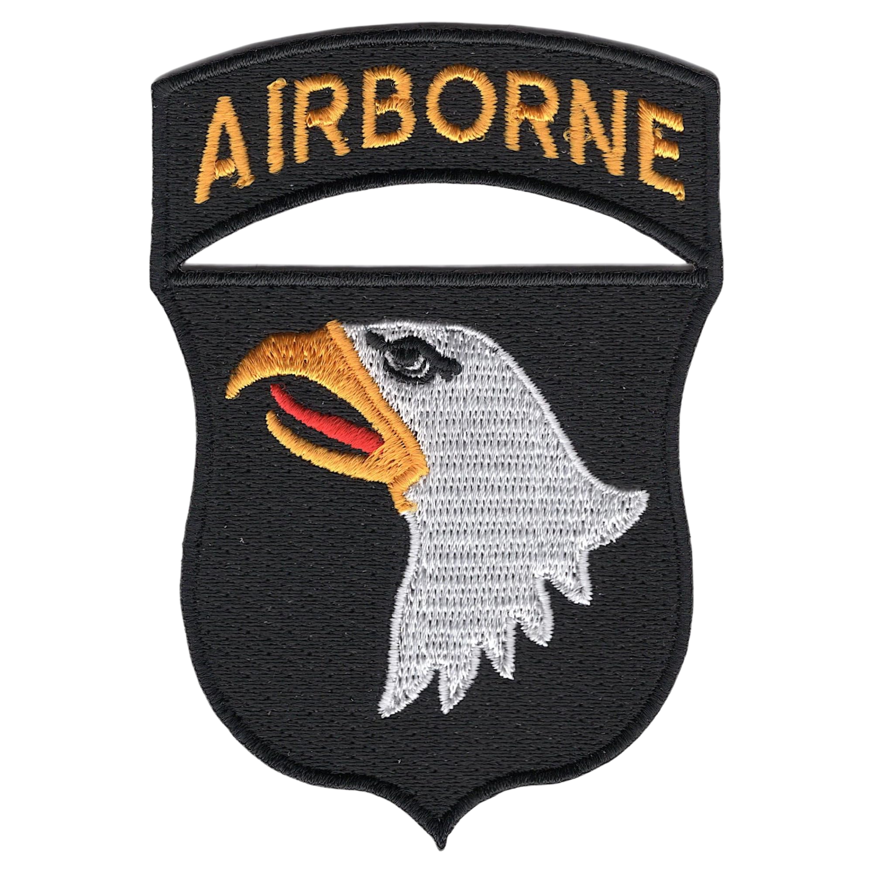
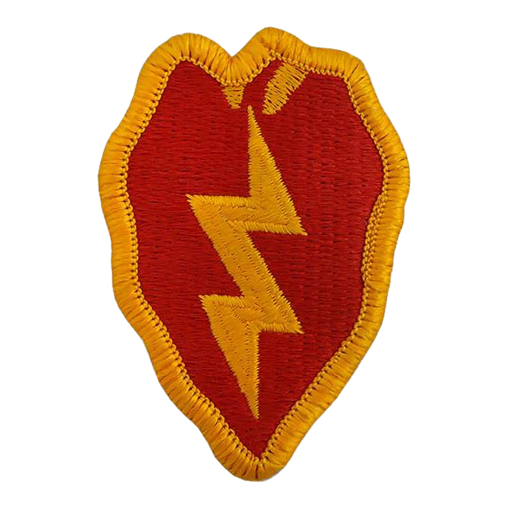







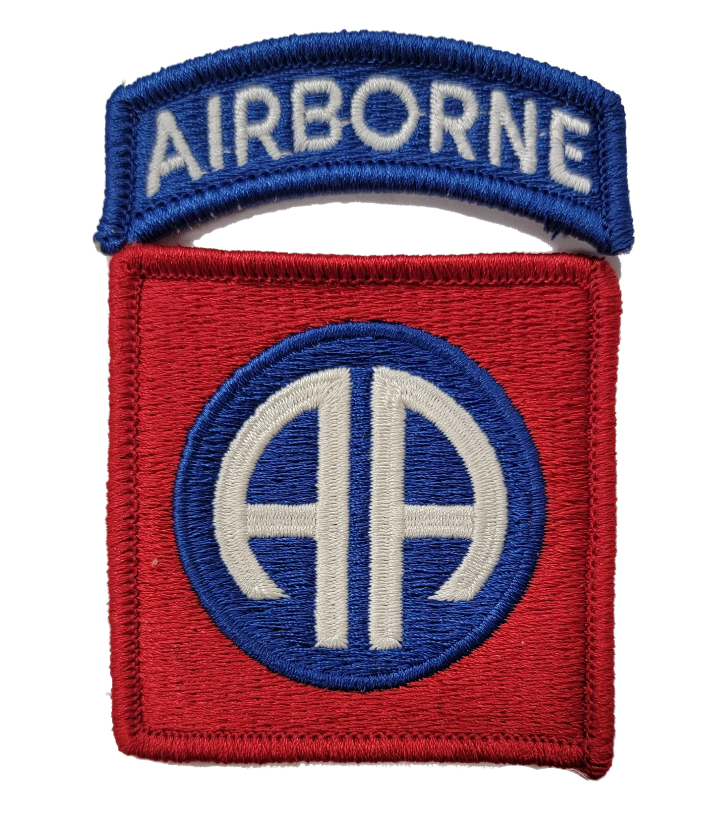







Proven at Scale
OVERVIEW
LEADERSHIP TEAM
2021
Founded
19
DoW contracts
$98.9M
Army IDIQ
IAN KALIN, CEO
Navy veteran, 1st Chief Data Officer @ Department of Commerce, Presidential Innovation Fellow, CTO @ eHealth
MATT AMACKER, CTO
Head of Amazon Applied R&D Lab, Google Head of Autonomy, Toyota Research Institute Lead, 115+ patents
25+
DoW Joint & Combatant Command Exercises
20+
patents & pending USPTO applications
ED PADINSKE, COO
Former Navy Intelligence Officer, Served in NSW and White House Situation Room, Led JSOC units
DAN PORTILLO, CO-FOUNDER
Co-Founder, The General Partnership, Led Talent, Greylock Partners, Co-founder, U.S. Digital Service
CORE ENGINEERING
CASEY BARKER
Edge ML inventor, Founded prototyping lab @ Google, Distinguished Engineer
KEITH GOLDBERG
Mesh networking pioneer, 20+ patents
ADAM MITCHELL, PHD
Advanced AI Researcher, 12+ Publications
JOSHUA HARRISON
Co-founding engineer of Google Maps and Google Pay
17

Slide 19
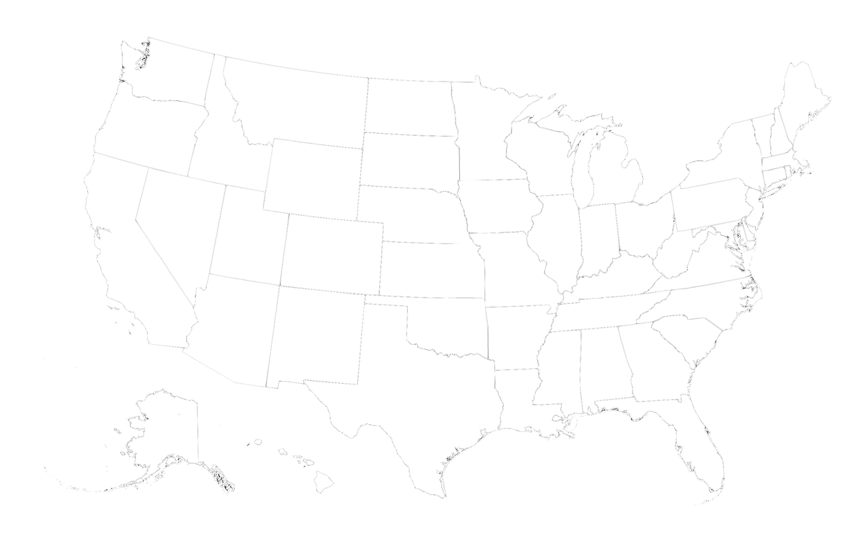

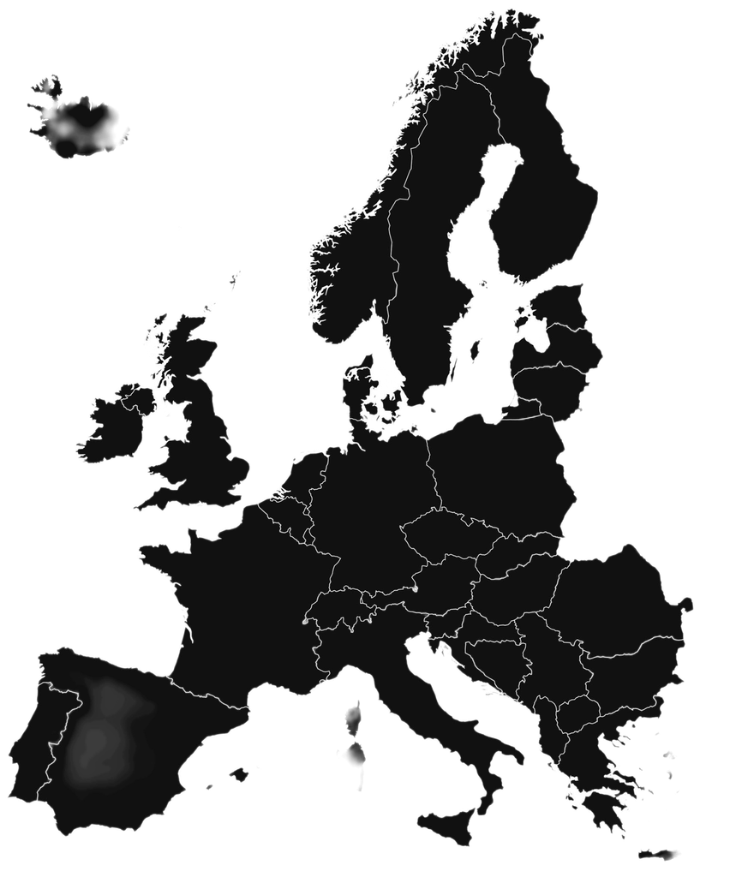














Where We Operate
Force Protection & cUAS
Automated Target Recognition
Collaborative Autonomy
cUAS Detection
Collaborative Autonomy
Automated Target Recognition
JTF-SB
Automated Target Recognition
Automated Target Recognition
Autonomous Maritime Swarm
18

Slide 20
Thank you
Presented By
Ed Sullivan
ers@turbineone.com
BUSINESS CONFIDENTIAL
Notes:
[Sources] - Internal brand reference: TurbineOne Brand Guide (Aug 2025) for typography, primary green (#41A762), reticle/radial background guidance, and minimalist near-future styling. - User-provided visual reference: /mnt/data/MDM.pptx (2).png [/Sources]

