Slide 1
Naval Surface Warfare Center
Dahlgren Division
Directed Energy Technologies and Marine Corps Missions
WELCOME
Modern Day Marine 2025
Presented by
Dr. Christopher Lloyd, ST
Distinguished Scientist for Directed Energy
christopher.t.lloyd2.civ@us.navy.mil
(540) 621-7985
April 2025

Slide 2
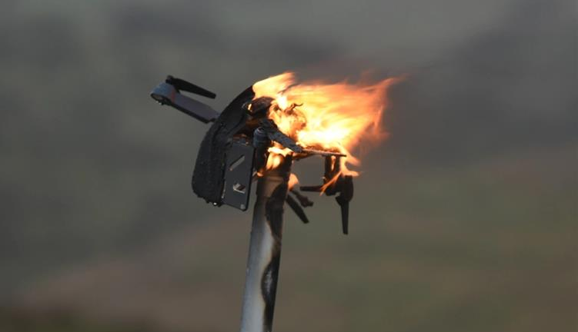
Directed Energy (DE) in Support of Asymmetric Threat Warfare
Directed Energy (DE) weapons have proven to be effective against asymmetric threats.
DE systems have similar upfront cost to kinetic solutions but provide:
Capability derived from a direct electrical conversion from fuel
Reduced logistics (no need to produce, transport, or supply specialized ammo)
Reduced collateral damage
Lower cost per shots ($3.5 per shot for DE vs on average $13,200,000 for kinetic missiles).
Can be designed to be platform agnostic and modular (scalable).
Weapon | Cost Per Shot
Standard Missile 3 (SM-3) Block IIA | $27M
Standard Missile 3 (SM-3) Block IB | $9M
Standard Missile 6 (SM-6) | $3M
Standard Missile 2 (SM-2) Block IV | $2M
Evolved Sea Sparrow Missile (ESSM) | $2M
NASAM AIM-9X | $1M
Stinger Missile/MANPADS | $480K
Directed Energy | $3.50
Cost of Different Missile Defense System Interceptors Per Missile Intercept
Missile Interceptors by Cost, Missile Defense Advocacy.org, Feb 2024
Notes:
Weapon Cost Per Shot
Next Generation Interceptor (NGI)
$111,000,000
Ground Based Interceptor (GBI)
$70,000,000
Standard Missile 3 (SM-3) Block IIA
$27,915,625
Standard Missile 3 (SM-3) Block IB
$9,698,617
Standard Missile 6 (SM-6)
$3,901,818
Patriot PAC-3
$3,729,769
Arrow 3
$62,000,000
Standard Missile 2 (SM-2) Block IV
$2,100,000
Aster 30 (SAMP-T)
$2,000,000
Meteor BVRAAM
$2,398,000
Evolved Sea Sparrow Missile (ESSM)
$2,031,875
NASAM AMRAAM 120
$996,736
Rolling Airframe Missile (RAM)
$921,310
48N6 (S-300)
$1,000,000
BARAK-8
$553,435
IRIS-T
$450,000
NASAM AIM-9X
$1,181,018
Mistral M3
$545,600
Aspide Mk1/Mk2
$100,000
Stinger Missile/MANPADS
$480,000
VAMPIRE Missile/MANPADS
$1,400,000
Tamir (Iron Dome)
$20,000-100,000
C-RAM
$8,100
Directed Energy
$3.50

Slide 3
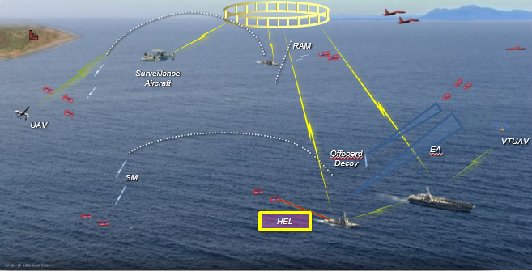
Modernizing the Navy/Marine Corps for Full Spectrum Combat
https://www.youtube.com/watch?v=Z3yQHYNXPws
Threat interdiction has traditionally centered around engaging at max effective range and gaining depth of fire.
A significant doctrine shift and absolute confidence in non-kinetic systems will be required to use terminal defense systems to their fullest capacity.
Directed Energy is
only one component of a system of systems. Directed energy capability will be optimized with its integration into hard and soft-kill systems.

Slide 4
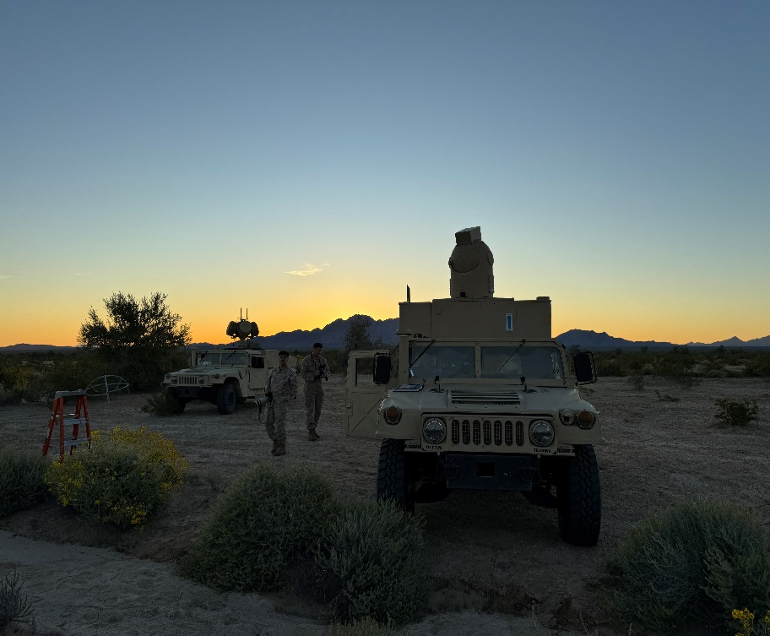
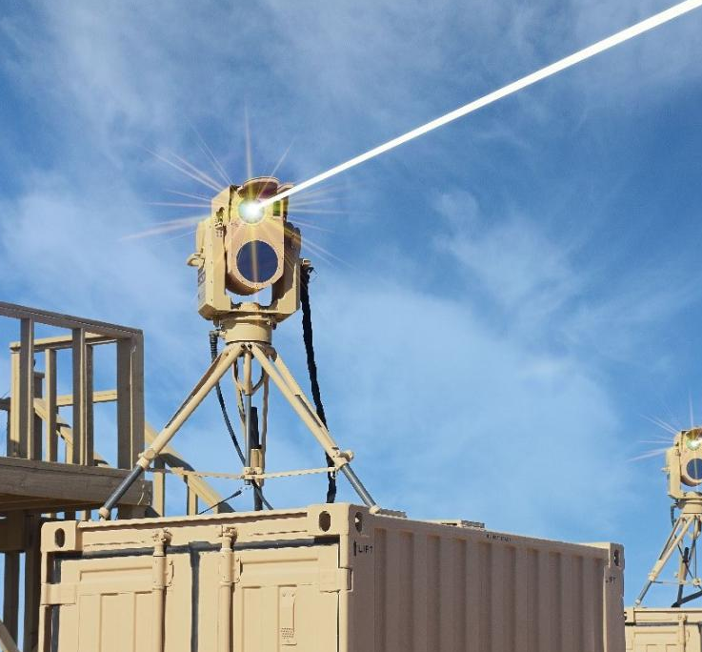
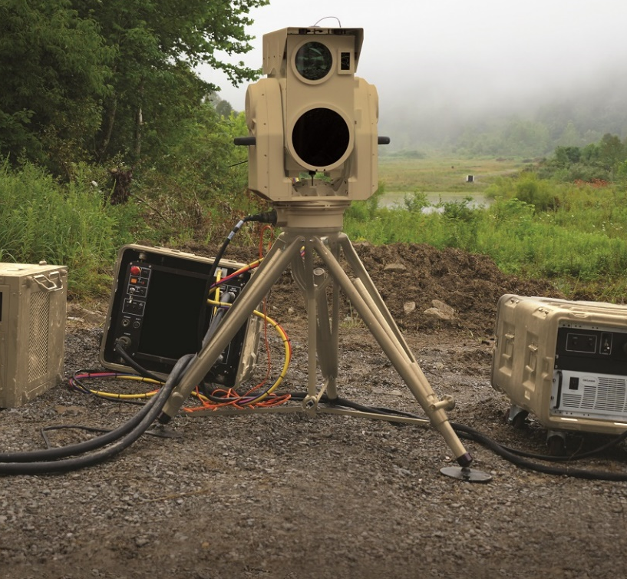
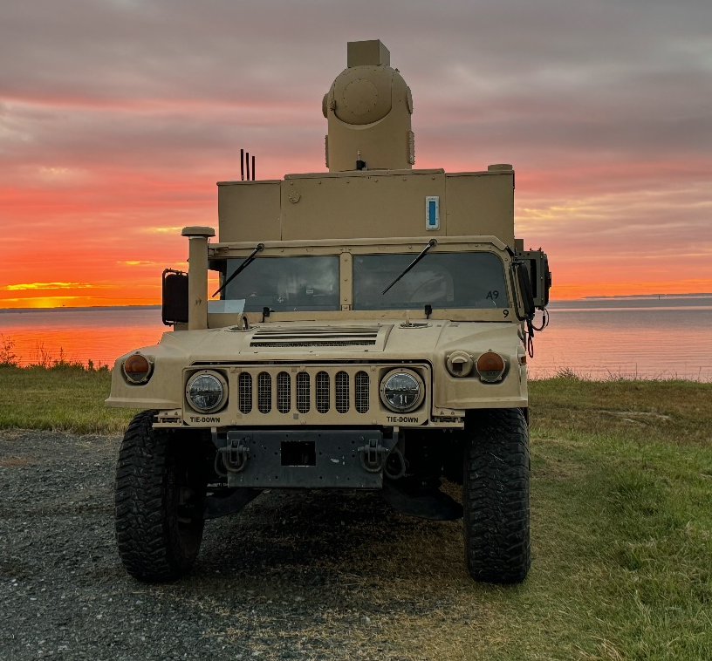
Current DE Efforts (High Energy Laser)
Vision for Force Design
Directed energy will be central to our stand-in forces, giving us the edge in contested maritime spaces
Scalable systems
Emerging Capabilities
Lethal applications
Non-lethal roles
Integration with artificial intelligence (AI)
Strategic Impact
Logistical revolution
Global Reach
Modernizing the Fleet
Integration with hard-kill and soft-kill defensive systems
Allowing threat to be engaged by shorter-range weapons
Naval directed energy teams are working closely with the USMC to understand requirements and gaps where DE weapons can help fill and with the Joint Services to conduct experimentation and rapidly field the technology.

Slide 5
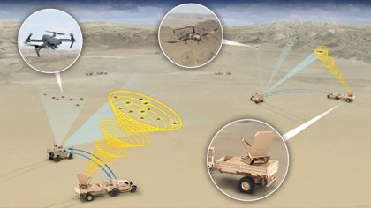
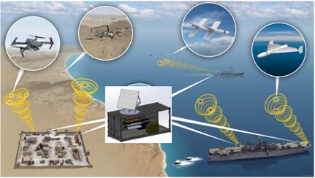
Current DE Efforts (High Power Microwave)
https://www.youtube.com/watch?v=Z3yQHYNXPws
Expeditionary
Increasing interest in the applicability of HPM for C-sUAS:
Support USMC requirement development activities
Provide information for consideration to incorporate HPM in air defense operations
Assessing commercial HPM technologies developed for various applications to include C-sUAS
Maturing technologies and developing prototypes to inform the warfighter of capabilities
Performing test and evaluation efforts as well as requirement verification
Assessing the applicability of utilizing UxS as the delivery platform for HPM weapons for improved performance
Fixed Site

Slide 6
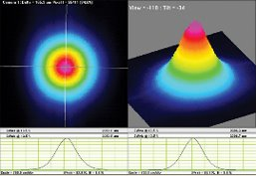
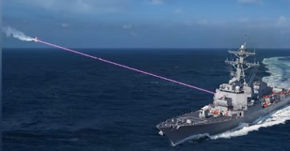
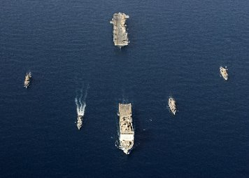
Considerations for Optimization
Importance of Critical Technologies (DE, Autonomy, Hypersonic Vehicles, EW, etc.) and Complementary Effects
Need for continued industrial base simulation
Push common components and architecture where possible
Bring overall system and (LRU) component costs down
Increasing HEL output power, beam quality and efficiency will provide enhanced lethality
Increased optical tracking
Precise engagements via advanced beam control and automation
Integrated kill chains
Target/weapon pairing decisions:
Acquisition/ cueing
Re-engage timelines
Engagement geometry
Threat vectors
Coverage of fires in DMO and non-DMO ship formations
Engagement
Mission
Campaign level modeling

Slide 7
Questions?
Thank You!
Christopher Lloyd, ST
christopher.t.lloyd2.civ@us.navy.mil
(540) 621-7985

