Slide 1
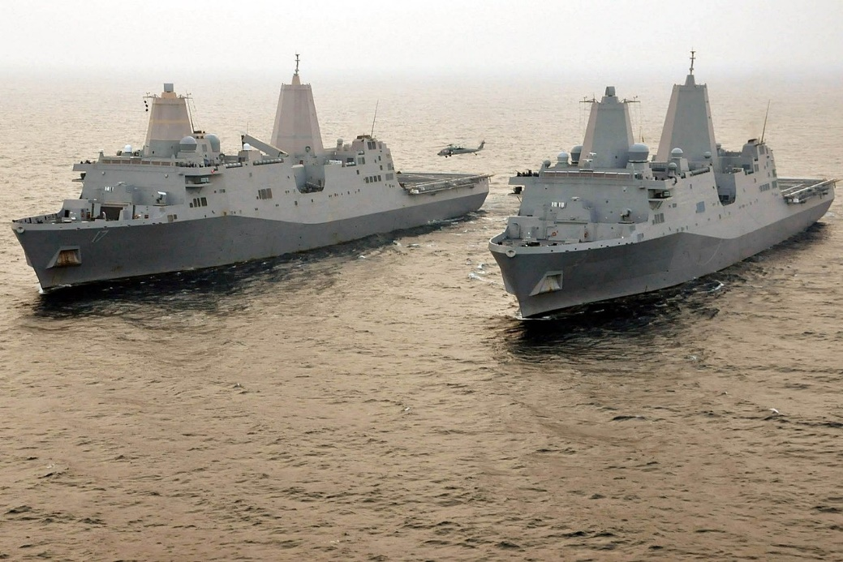
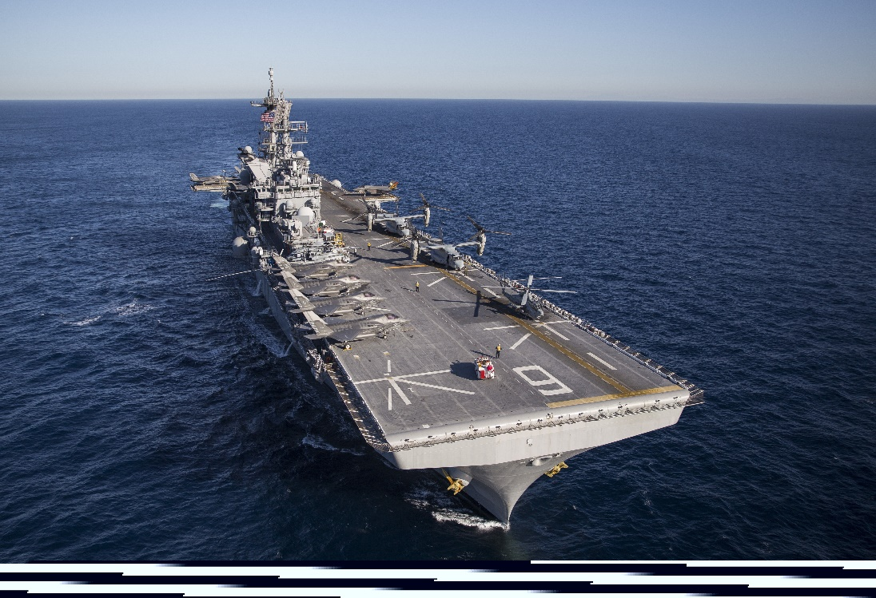
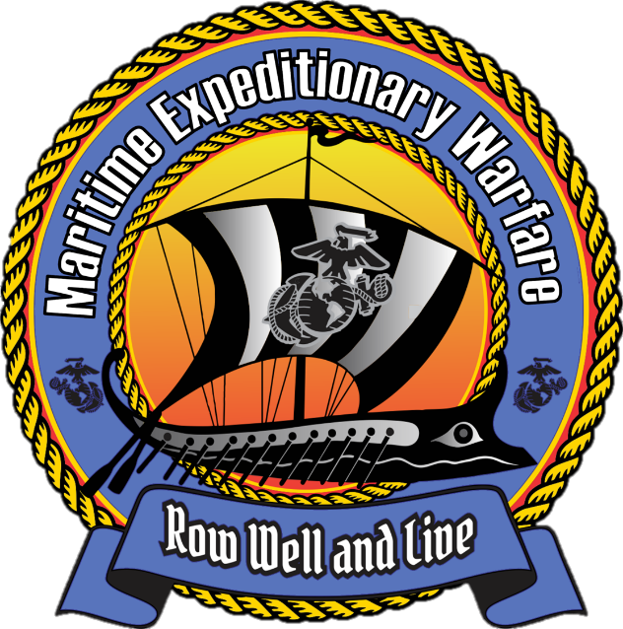
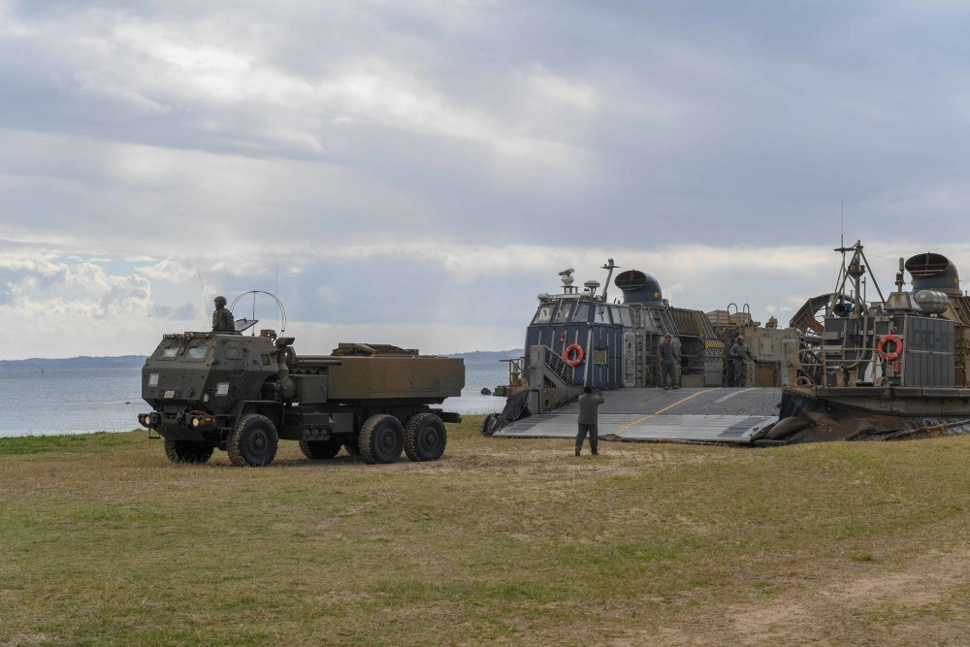
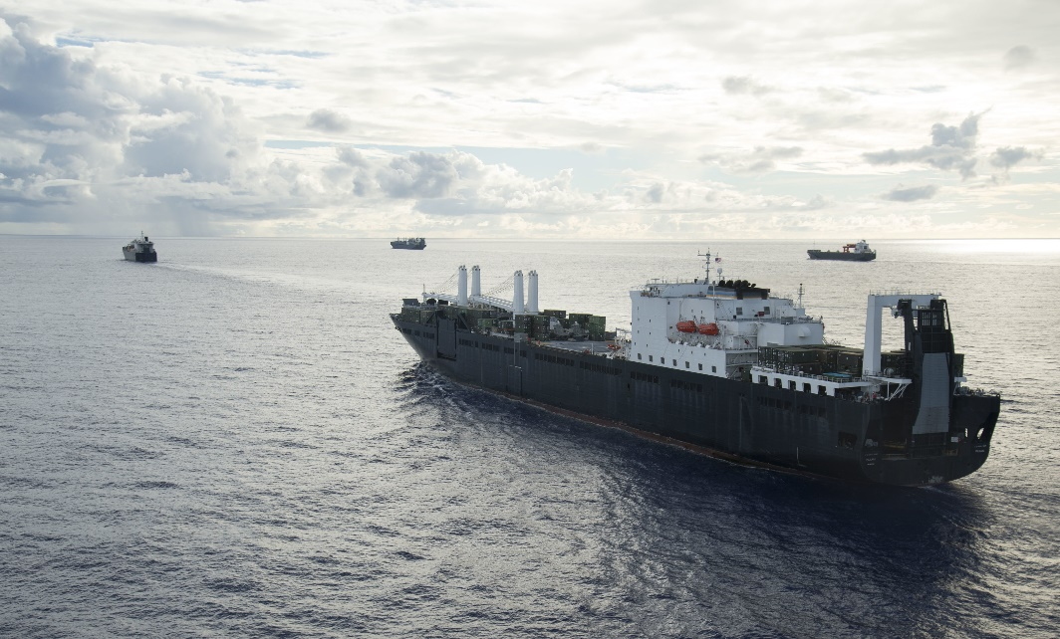
Maritime Expeditionary Warfare
Updated 04/21/2025
Right-time Deterrence

Slide 2
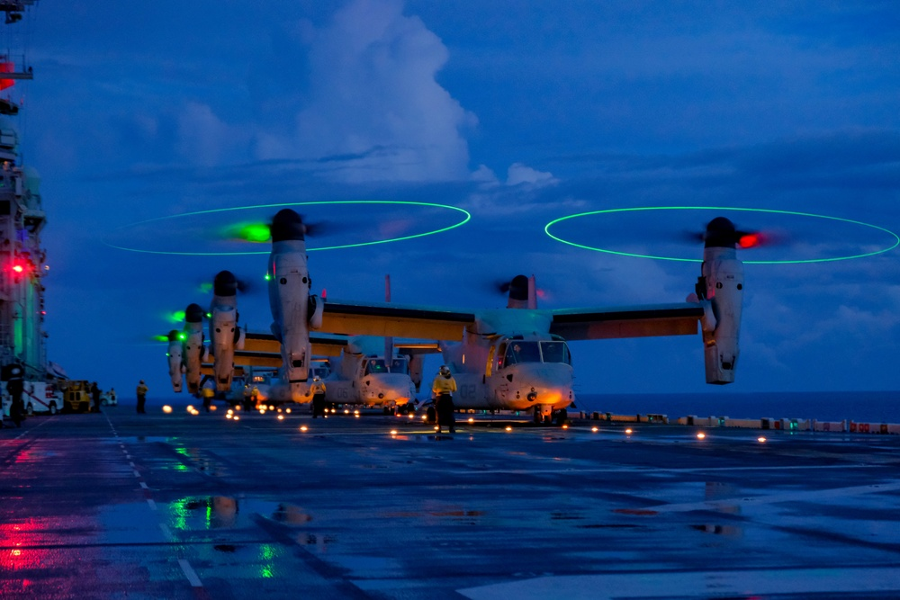
Maritime Expeditionary Warfare Agenda
MExW Guiding Principles
MExW Key Operational Problems
MExW Solicitation for Solutions
MExW 2.0
MExW Governance
UNCLASSIFIED

Slide 3
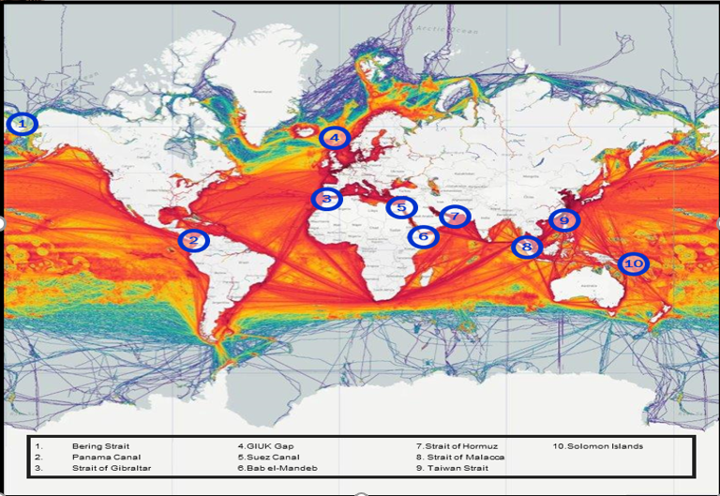
Maritime Expeditionary Warfare Guiding Principles
We are a maritime nation. Freedom of movement and freedom of access are key to our national security and global economic stability.
The littorals contain key global engagement points. The Navy – Marine Corps team is uniquely organized, trained and equipped to compete, deter, assure and influence in the littorals.
A defensive strategy of denial demands a naval expeditionary force persistently operating forward, conducting naval campaigning-synthesizing sea-based MAGTFs with operational and strategic objectives, and containing credible lethality for combat operations.
Maritime expeditionary warfare platforms with sea-based MAGTFs are part of a naval network of surface, sub-surface, air, space, cyber-space and other joint capabilities supporting fleet operations.
The Marine Corps shall be organized, trained, and equipped to provide fleet marine forces of combined arms, together with supporting air components, for service with the fleet in the seizure or defense of advanced naval bases and for the conduct of such land operations as may be essential to the prosecution of a naval campaign.

Slide 4
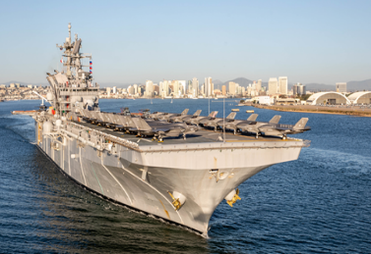
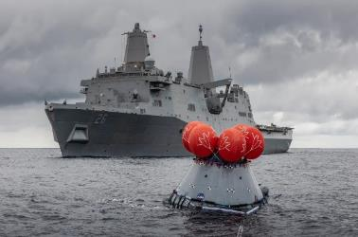
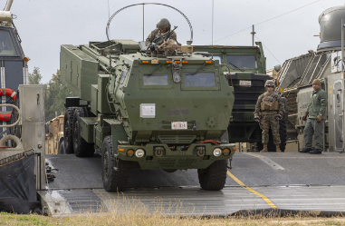
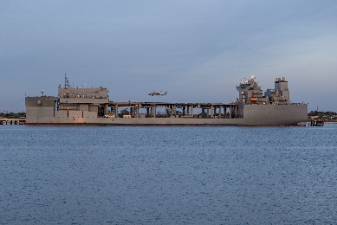
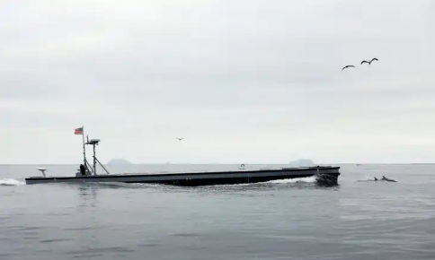
Maritime Expeditionary Warfare Concept Driven / Threat Informed
Five Key Operational Problems
Amphibious Operations to enable Naval Campaigning, Crisis & Contingency Response
NO LESS than 31 AWS (10 LHA/D and 21 LPD)
Amphibious Warfare Type Craft (72 LCAC 100 and 32 LCU 1700)
Maintenance, Readiness and Modernization to support 3.0 MEU
Littoral Maneuver to enable the Stand-In Force
Operational Mobility, Tactical Maneuver
Littoral Access
MPF to enable Distributed Maritime Operations
MPS (X) Required to enable regionally aligned forces greater access and to enable global sufficiency
T-AVB (X) to support distributed ground and air operations across a maritime environment
Afloat C5I to enable the Naval Expeditionary and Joint Force
Resilient and robust interoperable warfighting networks
Influence naval modernization to reflect afloat MAGTF needs
Integrate emergent capability and modernize AC5I infrastructure
Maritime Robotic & Autonomous Systems to enable Naval Expeditionary Force Technology Integration and Acceleration
Survey wide range of capabilities, anticipate most significant opportunities and shape afloat integration

Slide 5
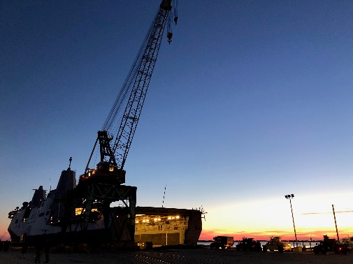
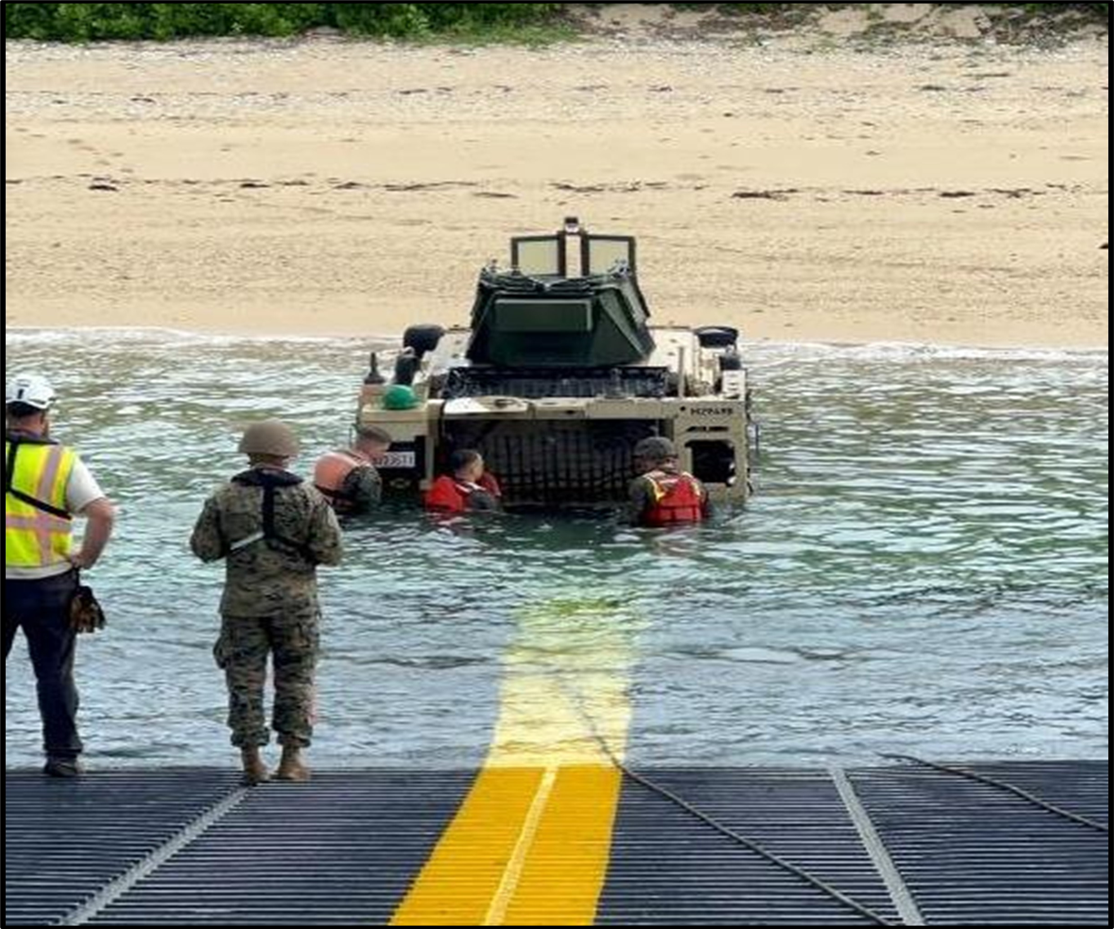
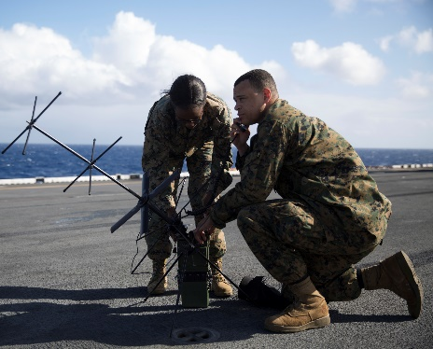
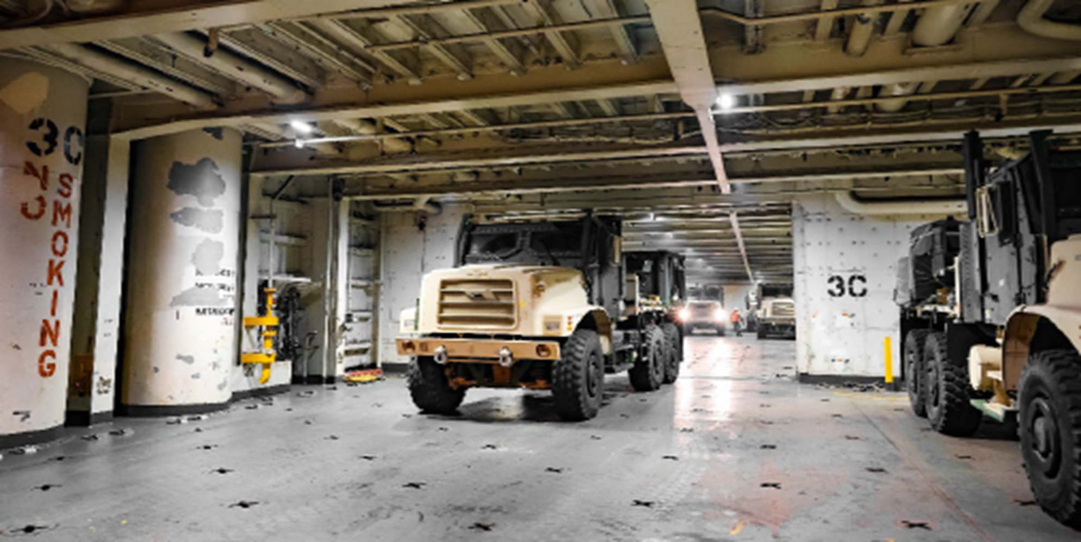
Maritime Expeditionary Warfare Search for Solutions
Amphibious Warfare
Improve Readiness
Accelerate shipbuilding
Enhance life-cycle cost and performance
Littoral Maneuver
Sustained operations from austere beaches
Near-shore discharge
Expeditionary husbanding and maintenance
Maritime Prepositioning
Afloat C5I
Agile, software-defined systems
Robust and scalable computing platforms
Assured access to all operational domains
Prioritize cyber resilience, leverage open standards like CMOSS and MORA, and enable interoperability with the joint force and coalition partners
Modern design techniques for MPS (X)
Innovative techniques for surface, vertical and digital interoperability
Innovative techniques for power generation and equipment and munitions stowage

Slide 6
Maritime Expeditionary Warfare 2.0
Dynamic Analysis - Decision Making at the Speed of Relevance
Vision
Achieve decision-making at the speed of relevancy – informed, proactive, and accelerating capability delivery.
Key Pillars
Talent and Skills: Join, Train & Retain, foster cross-functional collaboration, & drive data literacy.
Process Optimization: Automated Workflows & Continuous Monitoring
Technology Enablement: Leverage Cloud, AI/ML (Predictive Readiness, Risk Assessment), Digital Twins, & Real-time Dashboards.
Data Integration: Connect all lifecycle data (Procurement, Maintenance, Operations, Modernization) – standardized & accessible.
Technology: Leverage cutting-edge technologies, including:
Cloud and edge computing to enable secure, scalable, and efficient data processing and storage.
Generative artificial intelligence to enable accurate, timely information for decision makers.
Integrate Computational Modeling & Data Analytic Skill Sets.
Key Operational Problem Dashboards synchronized with enterprise systems
AI enabling human decision making at the speed of relevance
Tools: Data analytics platforms to process and visualize large datasets, identifying trends and patterns necessary to inform decision-making.
AI and machine learning (ML) algorithms to enhance predictive capabilities, automate tasks, and improve situational awareness.
Volumetric MAGTF Embarkation Tool- V: develop strategies for emerging embarkation plans.
Shipboard Internal Transit Tool: route of travel access and barriers.
Transportability Analysis Model for Modes & Individual Equipment: stowage space assessment.
Models: Utilizing advanced modeling and simulation tools that can help analysts understand complex MExW scenarios, predict potential outcomes, and evaluate the effectiveness of different courses of action.
Analytic based predictive forecasts for Title 10 consideration:
Sufficiency, Capabilities, Capacities
Cost, performance, schedule
Readiness, Maintenance, Modernization
Risk (Programmatic, Force Generation, Mission, Policy)
4/14/25 ver 3.2

Slide 7
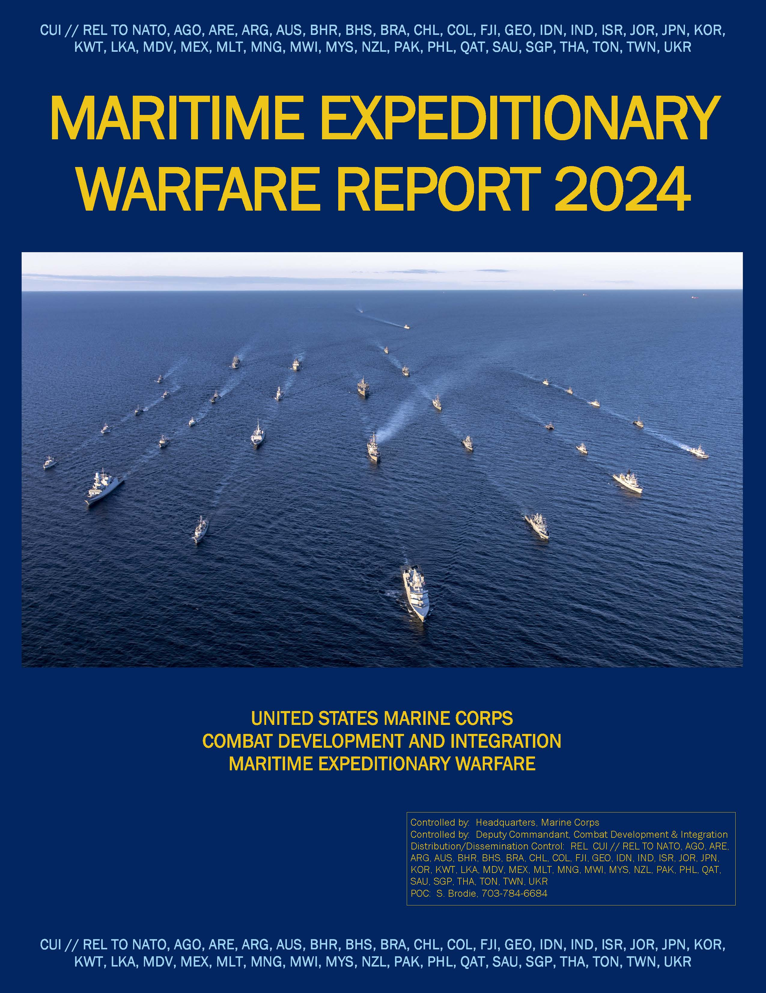
Maritime Expeditionary Warfare Governance
FY24 NDAA Amended Title 10:
Sec 352 – SECNAV shall submit… a plan to schedule maintenance and repair for the amphibious warship in a manner that provides for the continuous operation of a total of three Amphibious Ready Groups and Marine Expeditionary Units as soon as practicable.
Sec 8026 – SecNav shall ensure that the views of CMC are given appropriate consideration before a major decision is made by DoN outside the USMC on a matters that directly concerns USMC aviation or amphibious force structure and capability.
Sec 8062 - The naval combat forces include not less than 11 operational aircraft carriers and not less than 31 operational amphibious warfare ships, of which not less than 10 shall be amphibious assault ships.
Sec 8695: CMC shall be specifically responsible for developing the requirements relating to amphibious warfare ships and for naval vessels with the primary mission of transporting Marines.
MCO 5000.27 Marine Corps Roles and Responsibilities for Acquisition and Sustainment Processes
“DC CD&I MExW Executive Agent for the Marine Corps, as such the organization is aligned to support CMC title 10 authorities and responsibilities…”
“… MExW Systems across the requirement, resource and material solutions phases to include sustainment…”
Naval Integration Council (NIC)
Chartered partner NAVSEA
Inform Programmatic Actions
Naval Engagement Board (NEB)
HQMC Alignment on Title 10 issues related to shipbuilding and integration
MEU Summit
15-17 Apr: 2025 Summit
12 June: Qtrly
XOAG
12 May: Quarterly (SVTC)
9-11 Sept: 2025 XOAG
MExW Report
2025 13th year in publication
Synchronize knowledge base
Naval Amphibious Baseline (NAB)
Chartered
Develops, Executes, and Tracks AWS Modernization Priorities IRT Landing Force
E - Naval Amphibious Baseline (NAB)
Chartered
Develops, Executes, and Tracks C5IRST Req
Develops Integrated Priorities to inform investments.
UNCLASSIFIED
Notes:
MExW Overview
MExW Capability Design
Progress Summary
Amphibious Warfare Ships
Maritime Prepositioning Ships
Expeditionary and Seabasing Support Ships
Amphibious and Expeditionary Operations Enablers
Navy Expeditionary Combat Command
MExW S&T
Small Boat Integration
Afloat C5I
Military Partners
Expeditionary Warfare Excellence Award

Slide 8
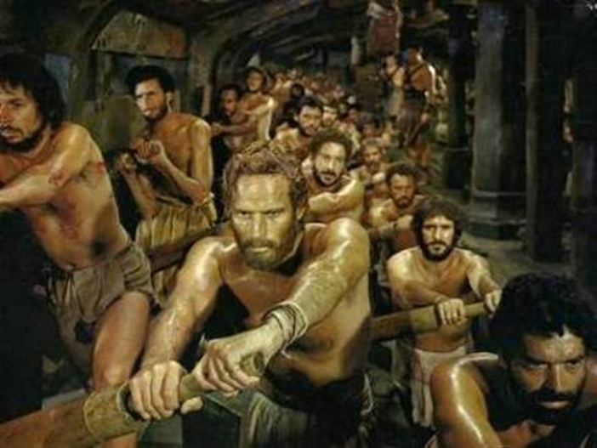
Maritime Expeditionary Warfare
....Row Well and Live
Director
Mr. Shon Brodie
703-784-6684
Operations, Admin
& Fiscal
Mr. John Morrison
703-432-8575
Deputy Director
Mr. Rick Betsinger
703-432-8050
Amphibious Warfare Branch
Kevin Dart
703-432-4746
Maj Dustin Bailey
703-432-8255
Littoral Maneuver Branch
Mr. Bobby Burns
703-784-6227
Maj Andy Lester
703-784-6185
Littoral Maneuver Branch
Mr. Bobby Burns
703-784-6227
Maj Andy Lester
703-784-6185
Afloat C5I Branch
Mr. Ryan Janosek
703-784-6445
Maj Andrew Piech
703-432-8486
Maritime Prepositioning Branch
Mr. Kevin Dart
703-432-4746
Maj Doug White
703-432-8172
Afloat C5I Branch
Mr. Ryan Janosek
703-784-6445
Maj Andrew Piech
703-432-8486
Develop, integrate, and articulate Marine Corps maritime expeditionary warfare capabilities enabling the sea-based MAGTF to operate at and from the sea.

