Slide 1
Understanding the Reserves from the Active Component Perspective
Col William M. Smyth
Overall Classification of this brief is:
UNCLASSIFIED

Slide 2
IRR
AT
12304(b)
IDT
RAID
12302
MCRAAM,
12301(b)
AFTP
SMCR
AD
Mobilization,
HTC
RIDT
AR
Activation
ATP

Slide 3
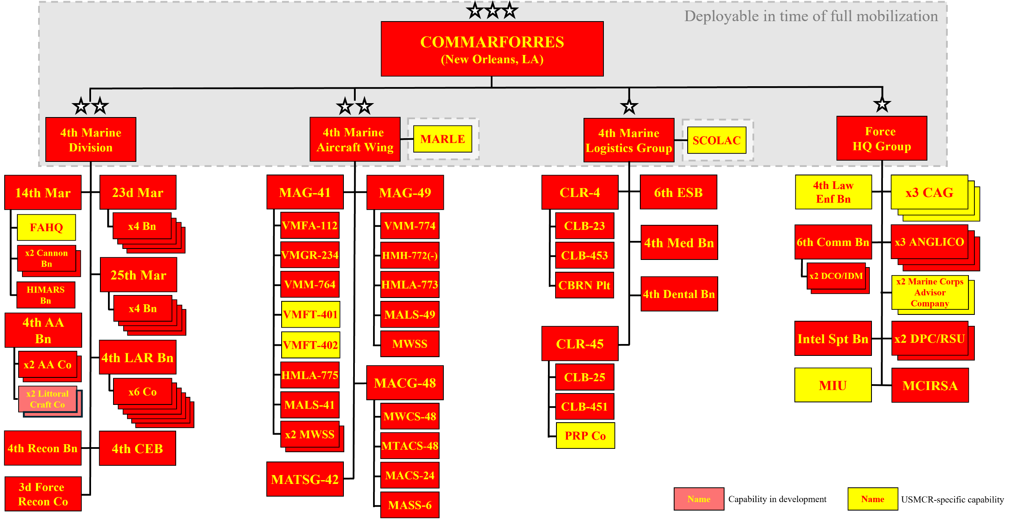
Marine Forces Reserve Structure

Slide 4
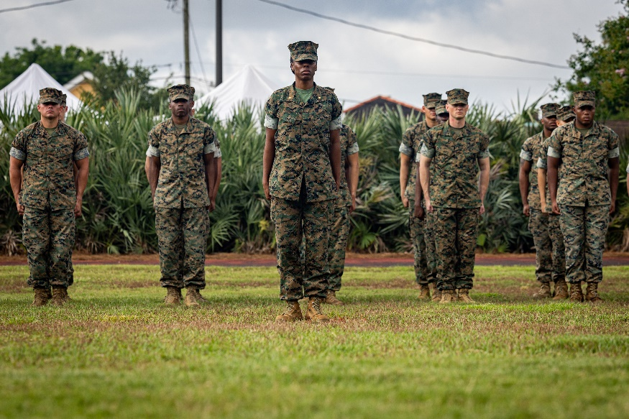
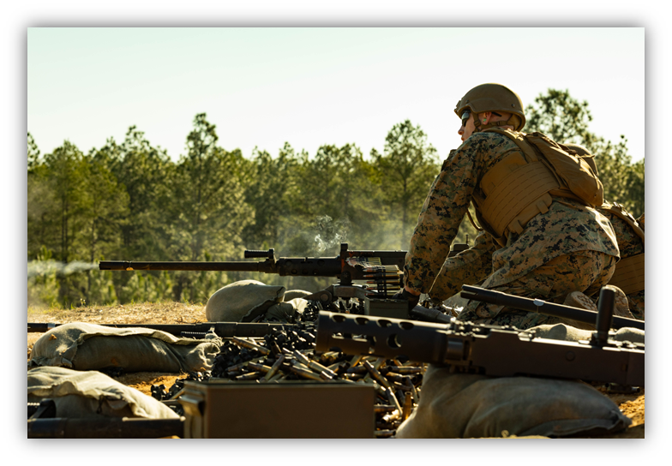
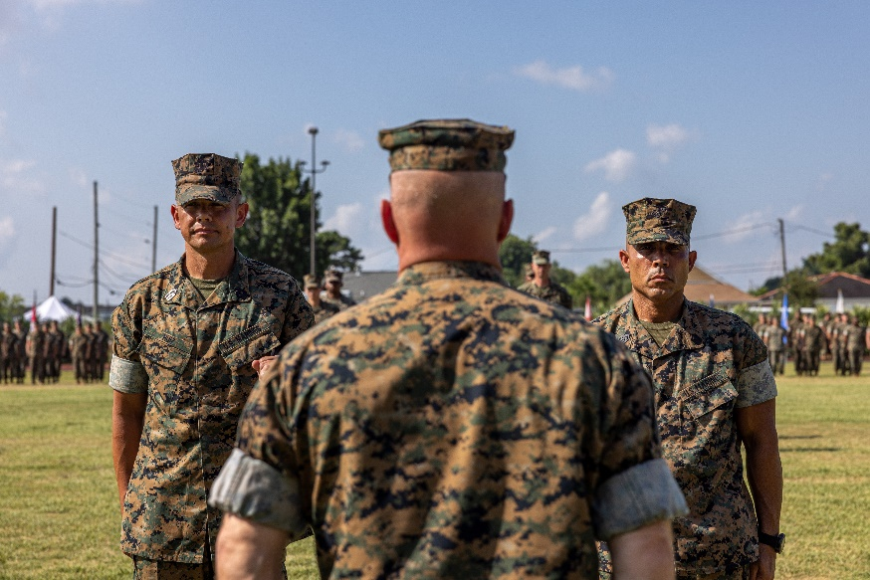
Leadership

Slide 5
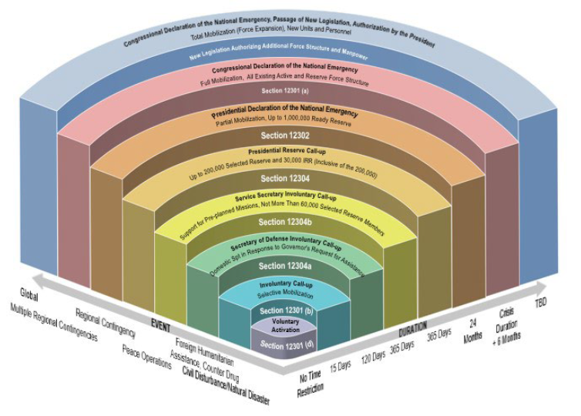
Authorities

Slide 6
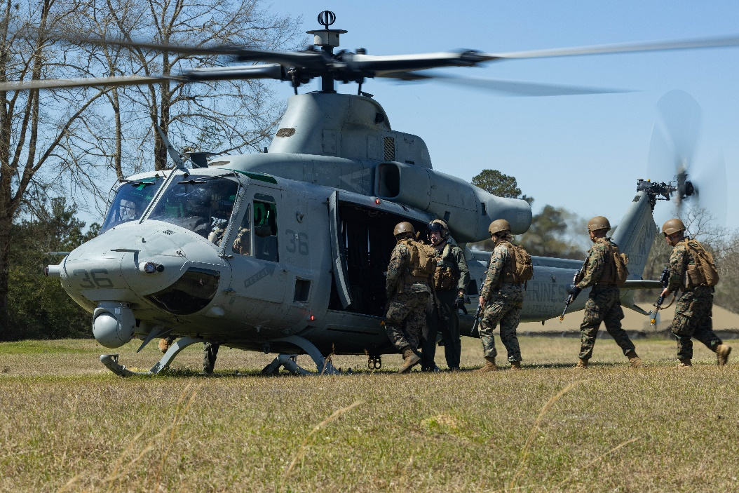
Training

Slide 7
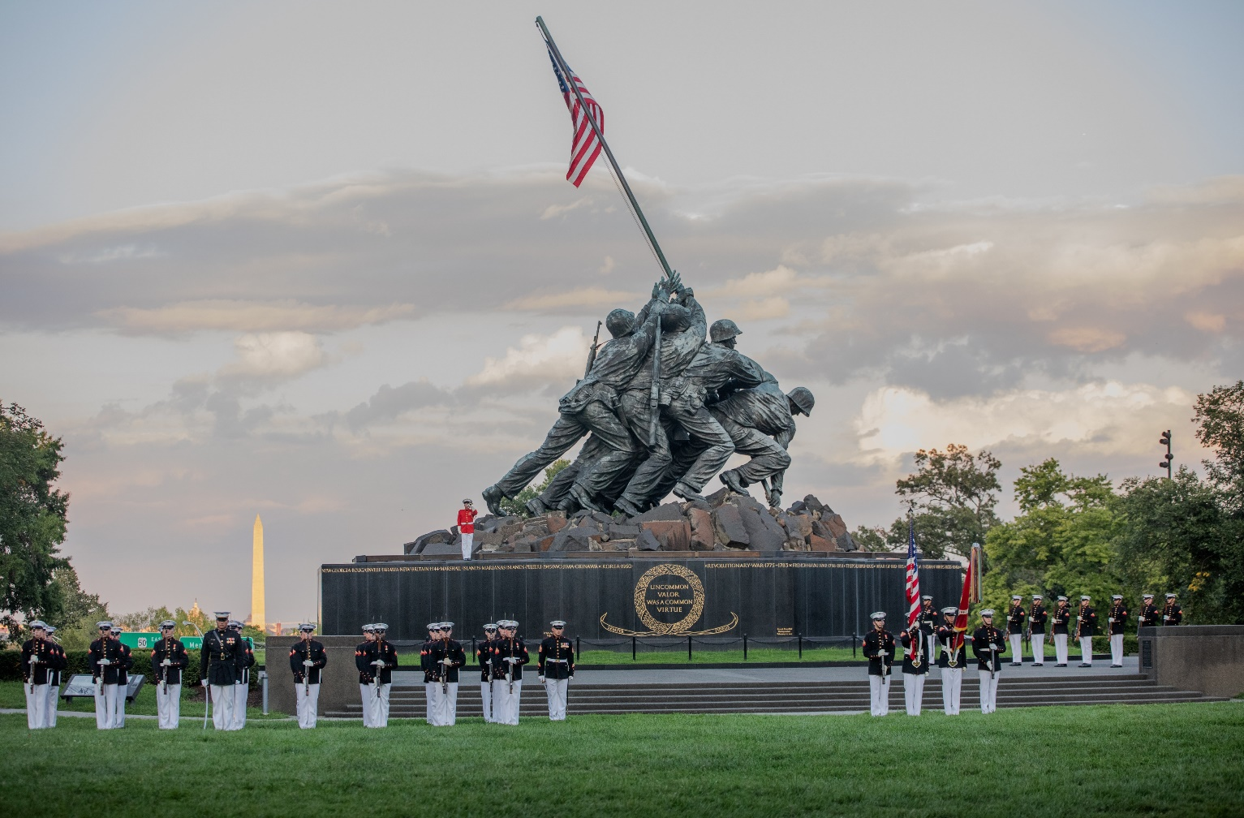
Discussion

