Slide 1

USMC Light/Attack Helicopter Program
(PMA-276) Col Jason T. Duke “Dookie”
“NAVAIR Public Release 2026-0284. Distribution Statement A – “Approved for public release; distribution is unlimited””

Slide 2


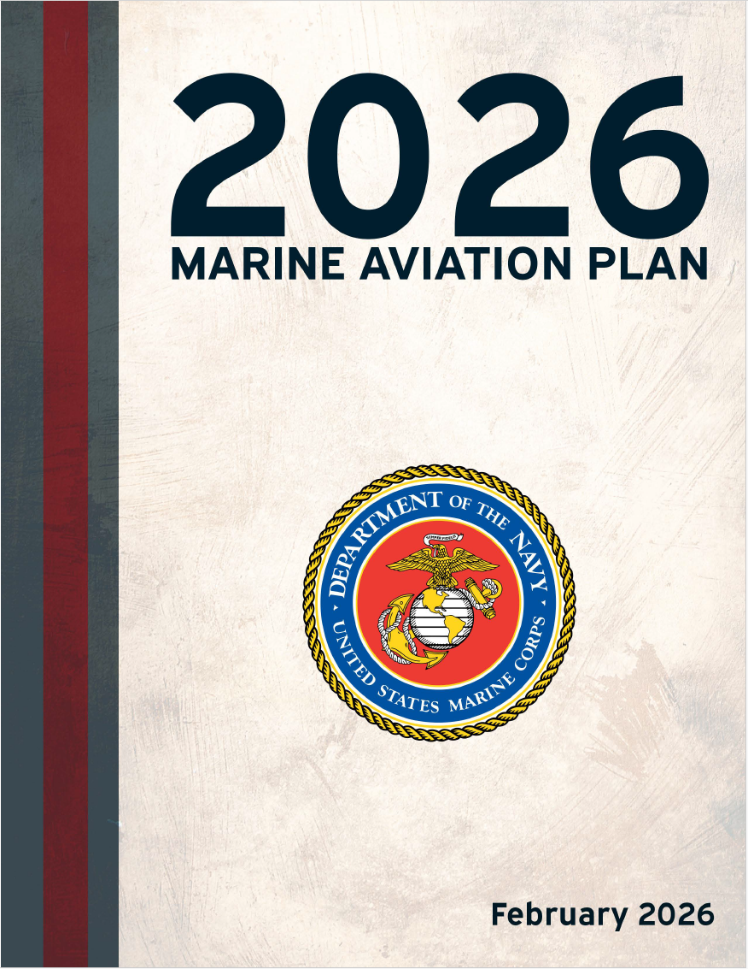

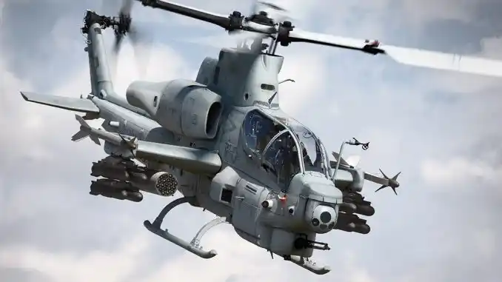

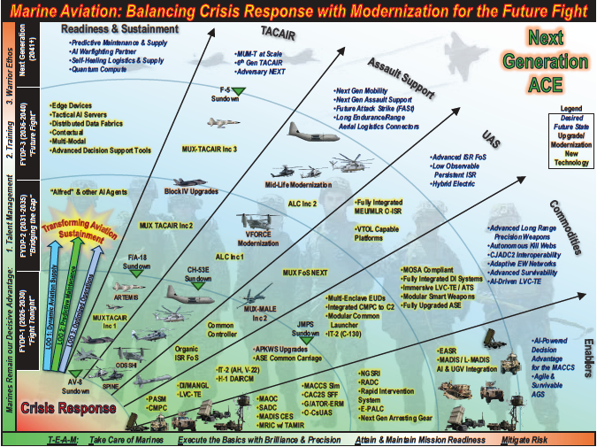

250 years of Fighting Forward supported by 60 years of H-1s
Balancing Crisis Response with Modernization for another 25
H-1 MID-LIFE MODERNIZATION
“NAVAIR Public Release 2026-0284. Distribution Statement A – “Approved for public release; distribution is unlimited””

Slide 3
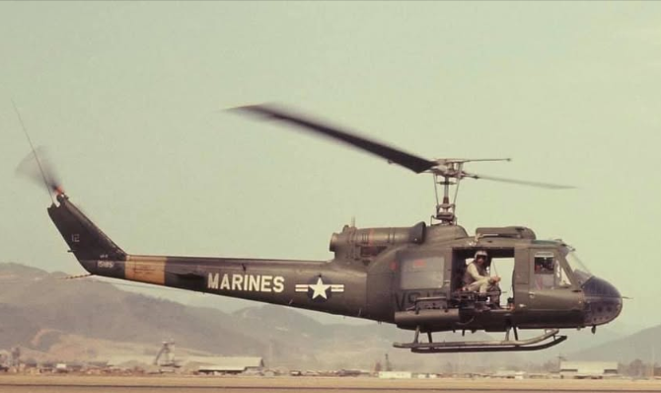
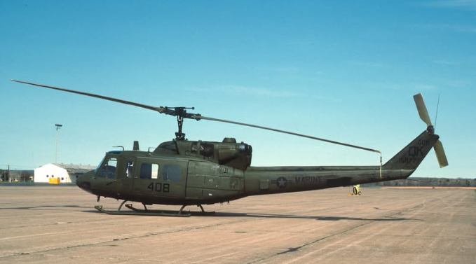
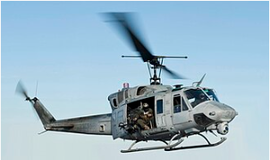

*1964 UH-1E fielded
1971 UH-1N Fielded
Star SAFIRE
Brite STAR ASE Upgrades
1981
1991
2001
2014
Viet Nam War
Beirut
Gulf War
OEF – OIF – GWOT
H-1 MODERNIZATION
APKWS
2008 UH-1Y Fielded
2018
2028
2038
2048
2058
OEF OIR
EPIC FURY
Next Conflicts TBD
H-1 MID-LIFE MODERNIZATION
PROJECT EAGLE 15-YR TIMELINE
DI → ASE → SPINE → TIER 2 → Field Future Attack Strike (FASt)
“NAVAIR Public Release 2026-0284. Distribution Statement A – “Approved for public release; distribution is unlimited””

Slide 4
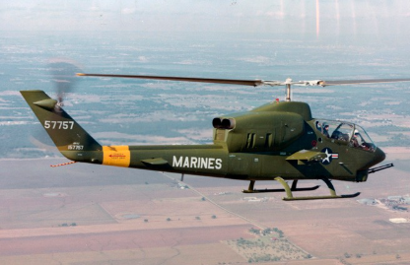
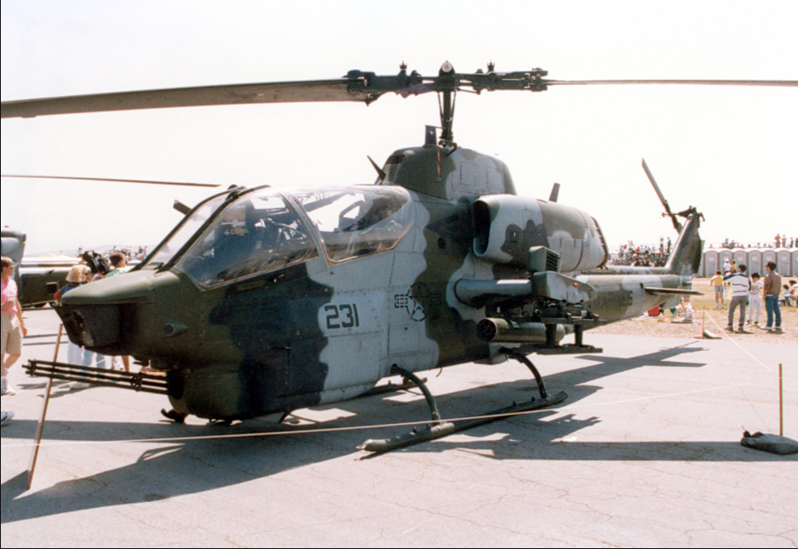
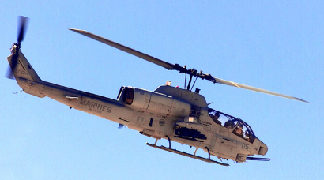
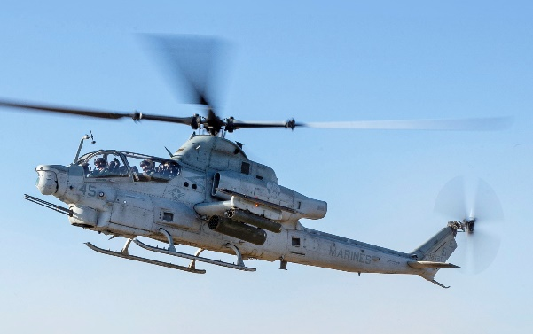
*1969 – AH-1G fielded
*1971 – AH-1J fielded
*1977 – AH-1T fielded
Hellfire; AIM-9L, TOW
ASE Upgrades
APKWS
1986 AH-1W Fielded
1996
2006
NTSU
2016
2020
Viet Nam War
Gulf War
OEF – OIF – GWOT OIR
H-1 MODERNIZATION
APKWS
2011 AH-1Z Fielded
2031
2041
2021
2051
2061
OEF OIR
EPIC FURY
Next Conflicts TBD
H-1 MID-LIFE MODERNIZATION
PROJECT EAGLE 15-YR TIMELINE
PROJECT EAGLE 15-YR TIMELINE
DI → ASE → SPINE → TIER 2 → Field Future Attack Strike (FASt)
“NAVAIR Public Release 2026-0284. Distribution Statement A – “Approved for public release; distribution is unlimited””

Slide 5
H-1 Mid-Life Modernization is a Bridge to the Future
FY26 – Every MEU Deployment Link-16 Capable
FY31 - Every H-1 Deployment equipped fully with all Modernization Initiatives.
FY32 – TIER 1 Current GFM requirements only can be sustained with significant risk to fleet readiness
FY34 – TIER 2 – All active duty squadrons fully equipped
FY35 – TIER 3 – Reserve squadrons and BAA fully equipped
A wholistic approach aligned with National, CMC, DCA Guidance and Project Eagle
”Balancing Crisis Response and Modernization” – CMC Planning Guidance
Enhanced Lethality - C-Maritime / C-UAS and Long Range Precision Fires (LRPF)
Resilient Platforms and Kill Webs - Digital Interoperability and Survivability
Contested Environment Operations – Rapidly fielding to support Stand-In Force
H-1 Mid-Life Modernization is fully aligned with H-1 Top 3 Priorities
1. Lethality: Structural and Power Improvements for Next-gen Effects (SPINE)
2. Digital Interoperability: LINK-16 baseline with BLOS solutions downrange
3. Survivability: Theater criteria for joint force operations
APR-39 DV2 / DAIRCM / Common Carriage
SPINE is the backbone of H-1 Modernization
Lethality - Essential for maximizing H-1s current and future capabilities, including Long Range Precision fires, C-UAS, and C-Maritime.
Provides critical excess power and a platform for FASt technology maturation and risk reduction.
Warfighting Capability Fielding Tiers
Tier 1: 108 [60 AH-1 / 48 UH-1]
12 of 18 HMLA AD UOE
Tier 2: 173 [96 AH-1 / 77 UH-1]
All HMLA AD UOE + 11 BAA
Tier 3: 224 [125 AH-1 / 99 UH-1]
All HMLA AD & Reserve + 17 BAA
Tier 4: 313 [TOAI]
T1
T2
T3
T4
“NAVAIR Public Release 2026-0284. Distribution Statement A – “Approved for public release; distribution is unlimited””

Slide 6
H-1 program, through fully-informed analysis of the operating environment in the 2030s and Project Eagle strategic vision, has focused the modernization roadmap with a transition framework to the H-1 replacement platform in the 2040s.
Lethality Endstate:
Kill web contributor capable of providing kinetic and non-kinetic payloads to disrupt or destroy enemy ground, air (inclusive of Small Unmanned Aircraft System (sUAS)), and surface targets.
Survivability Endstate:
Persist as a Stand in Force (SiF) unit in competition and conflict with mitigated Risk to Force.
Digital Interoperability / Communication Endstate:
Redundant means of integration into Combined Joint All Domain Command and Control (CJADC2) with agility to maintain pace with Tactical Data Link modernization.
Service Results
Operational Results
Adversary Effects
Narrow current service gaps
Support distributed MLR operations
Adversary risk recalculation
Provide service decision space through the 3x Future Years Defense Program (FYDP) modernization
Protect aerial and surface logistics connectors
Restrict adversary freedom of maneuver
Risk reduction in transition to H-1 replacement platform
C2 node extension and kill web contributors
Complicate adversary targeting decision making
“NAVAIR Public Release 2026-0284. Distribution Statement A – “Approved for public release; distribution is unlimited””

Slide 7
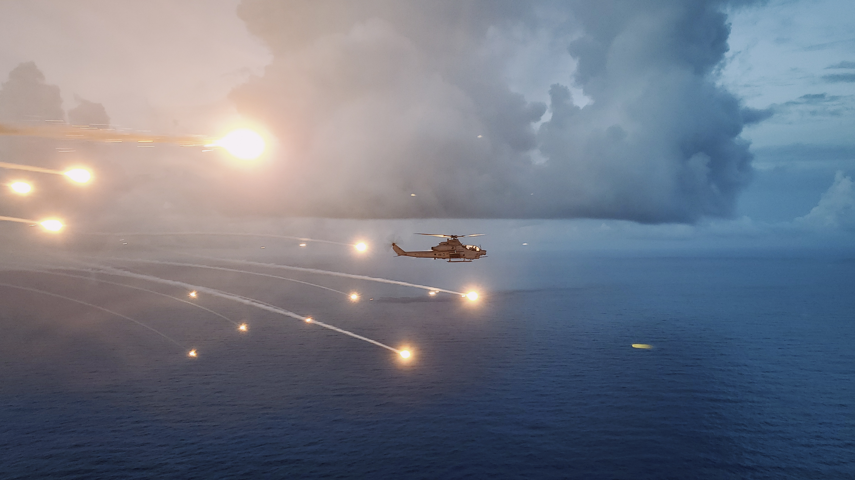
Questions?
“NAVAIR Public Release 2026-0284. Distribution Statement A – “Approved for public release; distribution is unlimited””

