Slide 1
“USMC Reserve Connect”
The MFR App
Overall Classification of this brief is:
Unclassified

Slide 2
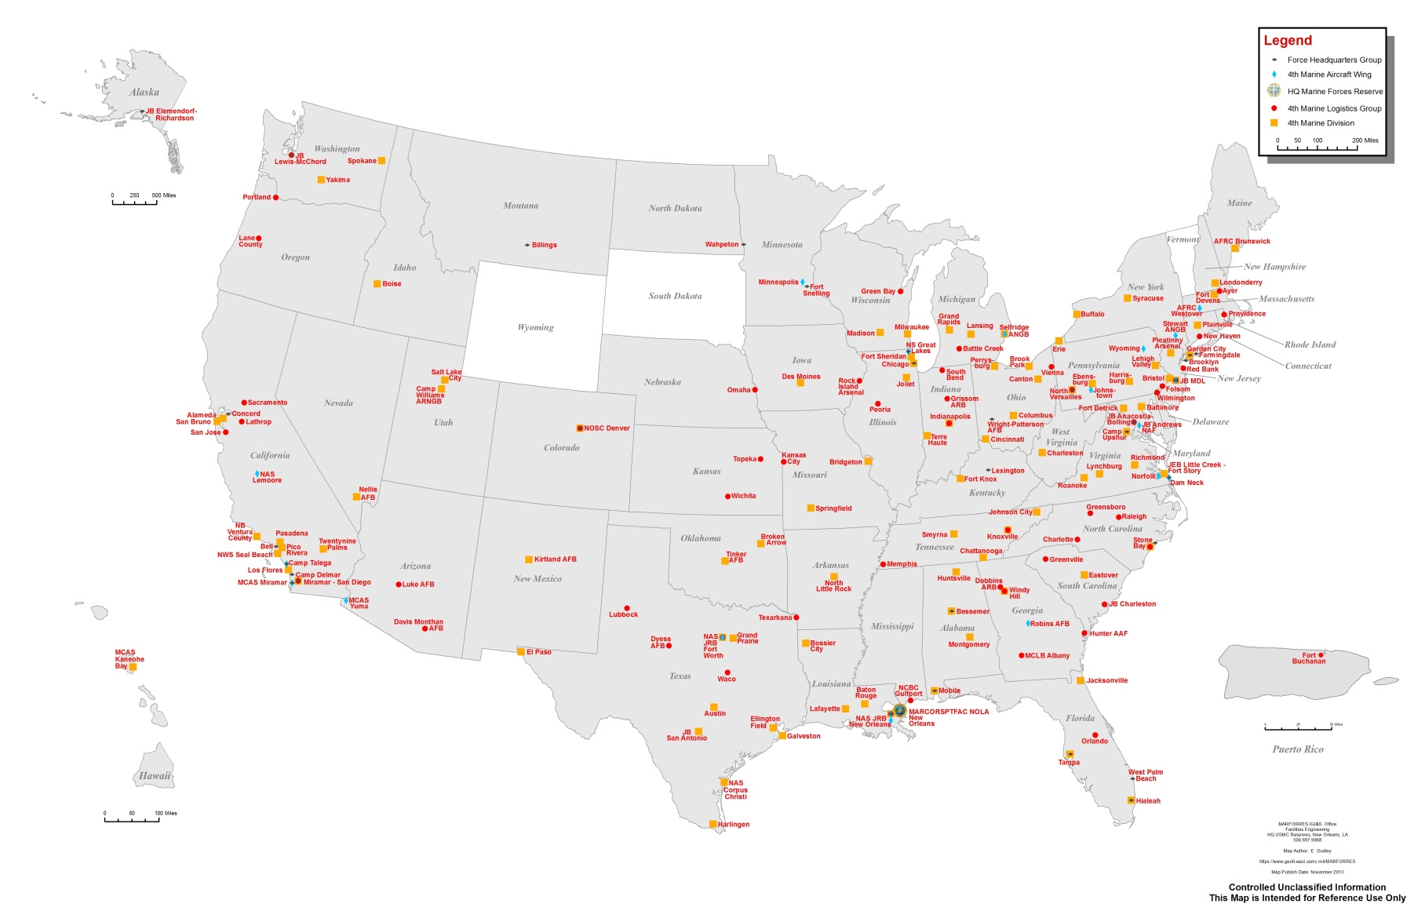
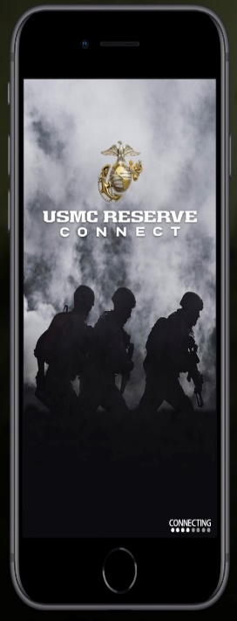
THE MARINE CORPS RESERVE
Notes:
MARFORRES Facilities Summary
160 Reserve Centers (12/05/2013)
27 MARFORRES
11 USMC
56 Navy/Navy Reserve (with 2 OSD Joint Bases)
31 Army/Army Reserve (with 1 OSD Joint Base)
16 Air Force (with 5 OSD Joint Bases)
19 Nat Guard
5 housing sites
3 Public-Private Ventures (Stewart Terrace, Chicopee, Kansas City)
1 BHA (Stewart Enclave), 1 GOFQ (New Orleans)
(Only owned Barracks is Stewart, NY)

Slide 3
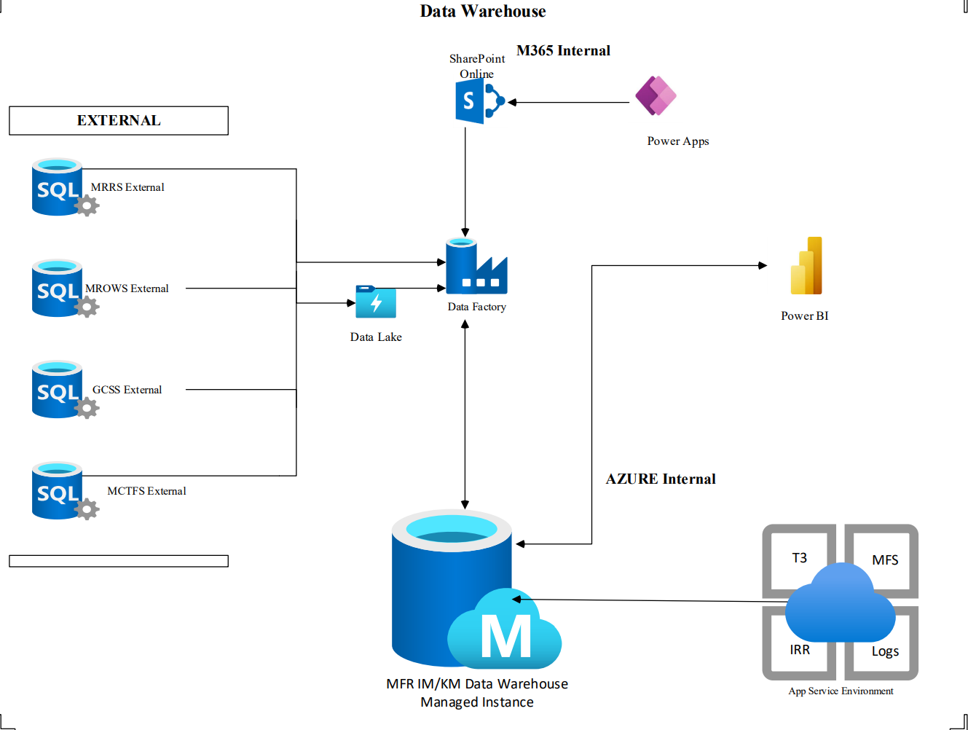
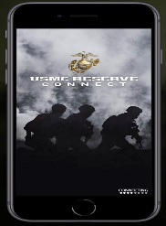
THE MFR KM ENVIRONMENT

Slide 4
USMC RESERVE CONNECT
Communication, Connectivity, Interventions, and Resources.
Continual, dynamic, personal connection beyond drill weekends.
Strengthening family bonds.
https://www.marforres.marines.mil/Resources/Connect/

Slide 5
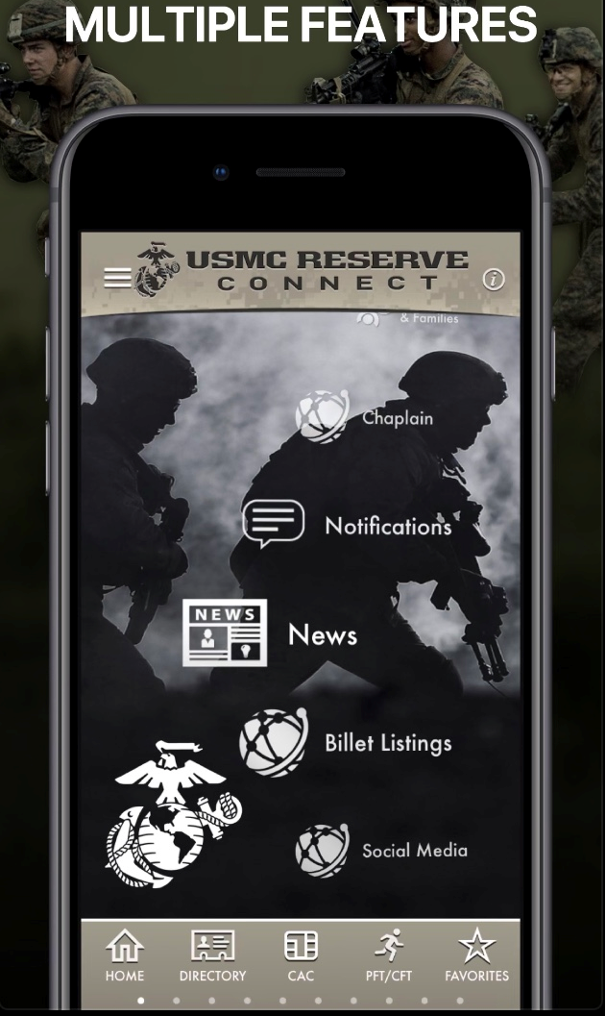
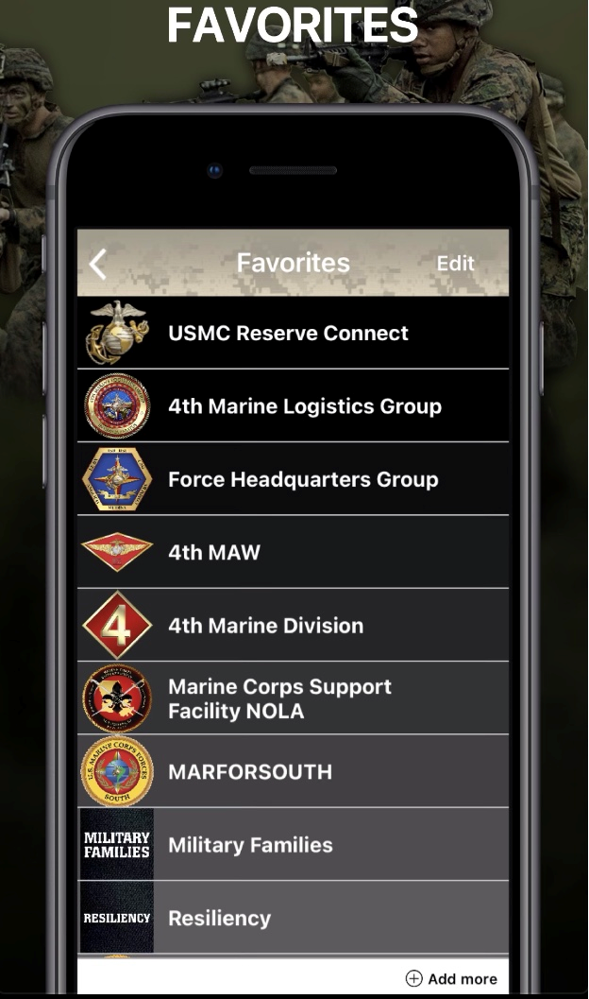
USMC RESERVE CONNECT

Slide 6
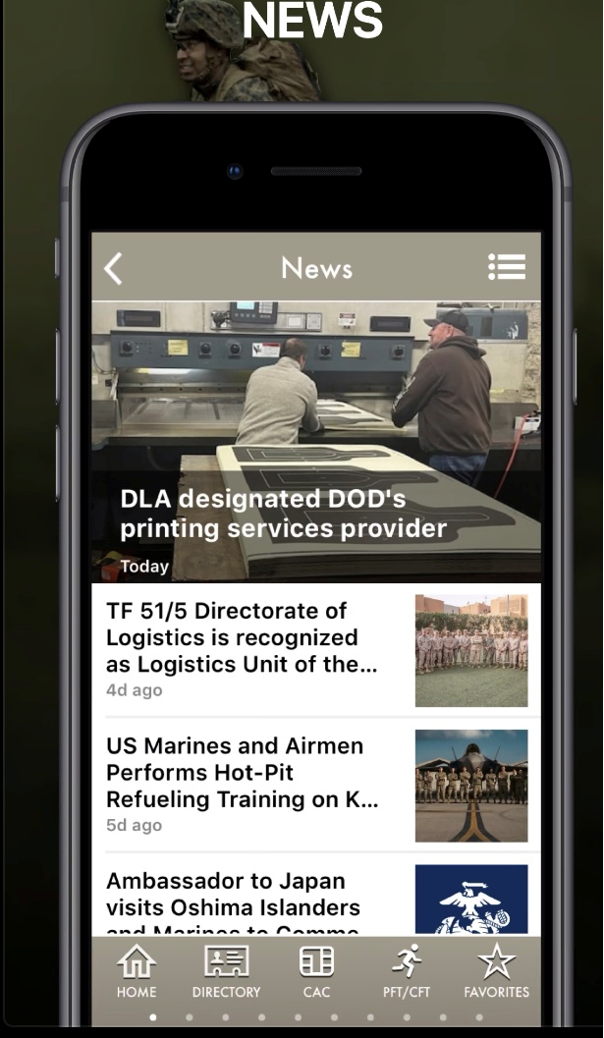
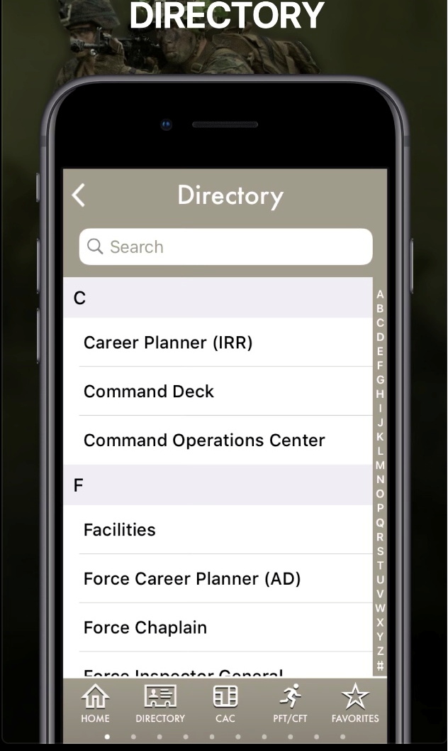
USMC RESERVE CONNECT

Slide 7
POPULAR FEATURES
EMERGENCY NUMBERS: behavioral health, suicide prevention, sexual assault and resiliency resources
CHAPLAIN: spiritual resources; submit questions/comments
MARINE & FAMILY RESOURCES: career, training, education, community & financial information
FITNESS: links to DOD approved fitness programs and resources
MEDICAL: links to TRICARE reserve select information, MTF locator tool, Network and Non-Network medical provider search and the 24/7 nurse advice line
RESILIENCY: links to videos, information, handouts, programs and presentations that promote resiliency
PUSH BUTTON NOTIFICATIONS: notifications include social media challenges, positive affirmations and Cognitive Behavioral interventions sent directly to the mobile device
ACCESS CAC-ENABLED SITES (with a CAC READER)

Slide 8
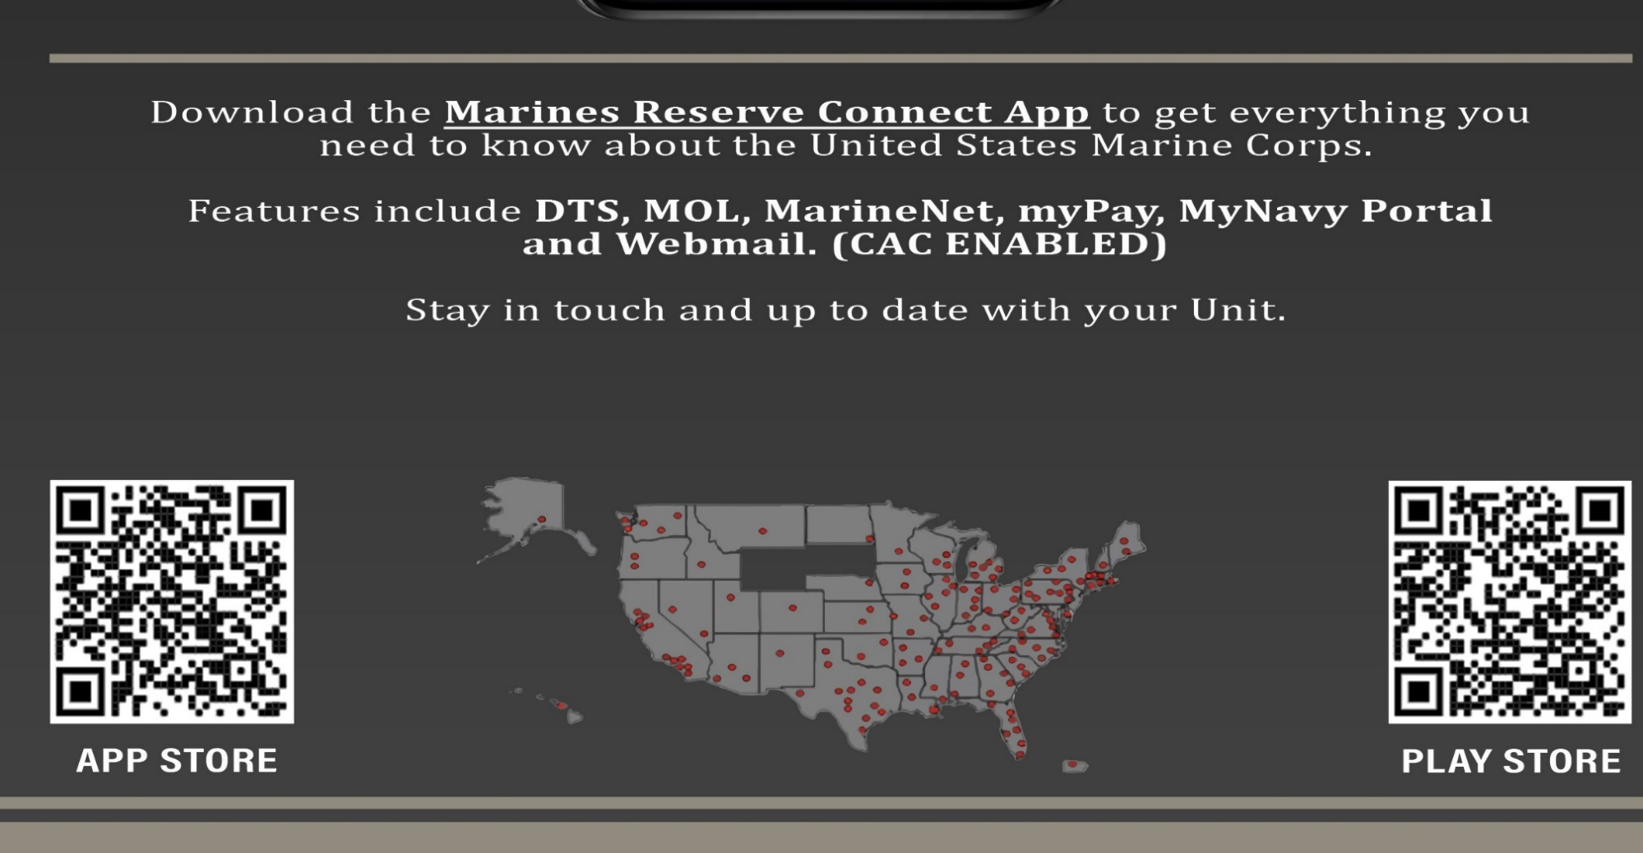
USMC RESERVE CONNECT

Slide 9
90-DAY USAGE: FEATURES, REGIONS, UNITS
Activity heat map in descending order: light blue, dark blue, dark green, light green.

Slide 10
90-DAY USAGE: USERS AND OPERATING SYSTEMS

Slide 11
USMC RESERVE CONNECT - POCS
Tracy Touchard, MCCS Director
tracy.touchard@usmc.mil
504.697.8123
Jennifer Duhon, Prevention Director
jennifer.duhon@usmc.mil
504.697.8122
Dr. Sarah Anacker, Force Psychologist
sarah.anacker@usmc.mil
504.697.8048
Dr. Robert McGuiness, Information Management/Knowledge Management,
Robert.mcguiness@usmc.mil
504.697.7433

Slide 12
USMCR CONNECT POCS
4TH MARINE DIVISION
GySgt Alice Ramos - alice.ramos@usmc.mil
Capt Mariatam Pham - mariatam.pham@usmc.mil
GySgt Mary Massingill - mary.massingill@usmc.mil
4TH MARINE LOGISTICS GROUP
MSgt Esther Arabie - esther.arabie@usmc.mil
GySgt Jamal Bailey - jamal.bailey@usmc.mil)
4TH MARINE AIR WING
GySgt Charlee Law - charlee.law@usmc.mil
Sgt Michael Rodriguez - michael.s.rodriguez2@usmc.mil
FORCE HEADQUARTERS GROUP
Sgt Isaiah Curtis - isaiah.curtis@usmc.mil
SSgt Brittney Boyd - brittney.boyd@usmc.mil
MARINE CORPS SUPPORT FACILTY NOLA
SgtMaj Kabiru Labaran - kabiru.labaran@usmc.mil
GySgt Nathan Lovett - nathan.lovett@usmc.mil
SSgt Jamario Douglas Cain - jamario.cain@usmc.mil
Cpl Tony Gomez - tony.gomez@usmc.mil
RESERVE REACH
MSgt Gary Smith - gary.l.smith2@usmc.mil
Sgt Julian Stewart - julian.d.stewart@usmc.mil
MARFORSOUTH
Mr. Michael Fermin - michael.fermin.ctr@usmc.mil

