Slide 1
Transforming Training with Cutting-Edge Capabilities
Lieutenant Colonel David B. Bain
Deputy Program Manager

Slide 2

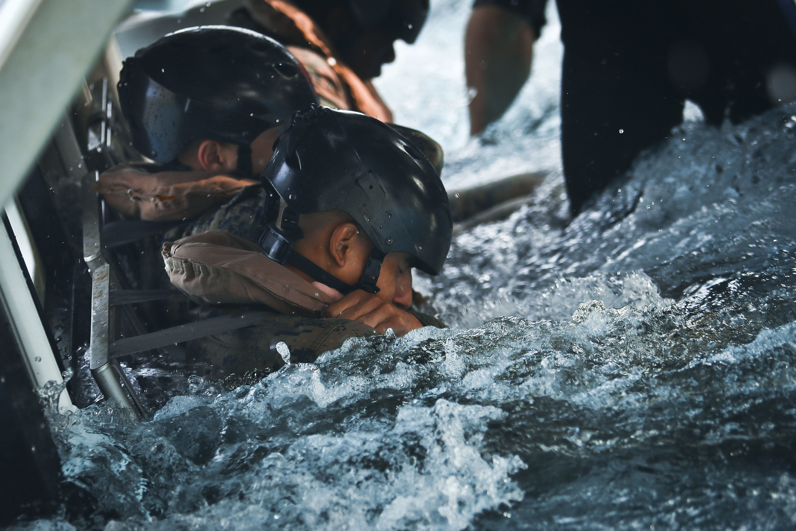

OUR MISSION
Quickly deliver the training systems our warfighters need to master new missions and defeat any adversary.
OUR VISION
Ensure every Marine has access to solutions across the training continuum to be prepared, lethal, and victorious.

Slide 3
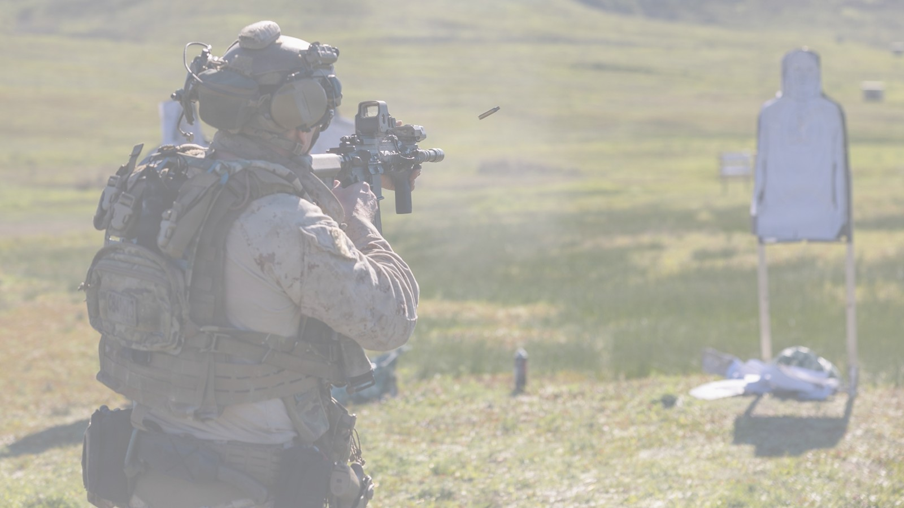
Programs & Services
RANGE TRAINING SYSTEMS
Force on Force (FoF) Personnel Kits Combat Vehicles Weapons Surrogates SESAMS Infantry Immersion Trainer (IIT) Tactical Video Capture System (TVCS) Live Fire Training Systems (LFTS) Combat Training Environment (CTE) Range Training Aids Portfolio (RTAP) Targets Atmospherics Battle Effects Simulator (BES) Electronic Warfare Ground Instrumentation (EWGIR) Computer-Generated Forces (CGF) Emerging Requirements Live Fire Evaluation Tool (LFET) Mobile Immersive Training Environment (MITE)
SYNTHETIC TRAINING SYSTEMS
Marksmanship Training Systems Indoor Simulated Marksmanship Trainer (ISMT) Advanced Small Arms Lethality Trainer (ASALT) Vehicle Training Systems Operator Driver Simulator (ODS) Combat Vehicle Training Systems (CVTS) Emerging Requirements Cyberwarfare Trainer Virtual Drone Trainer MADIS Maintenance Trainer NMESIS Driver Trainer New Vehicle Training System
WARFIGHTER TRAINING SUPPORT
Family of Egress Trainers (FET) Underwater Egress Trainer (UET) Multi -User Egress Trainer (MUET) Knowledge-Based Services Contract: SEAPORT Support: Formal Schools, MSTP, ASALT Role Players: IIT and Home-station Trackless Mobile Infantry Targets (TMIT) Contracted Operations and Logistics Contracts: SBA, SEAPORT Support: ISMT, CVTS, ODS, DRET, CCS (USN/USMC) Range and Training Area Support Ground Training System Support (GTSS), East, West, OCONUS

Slide 4
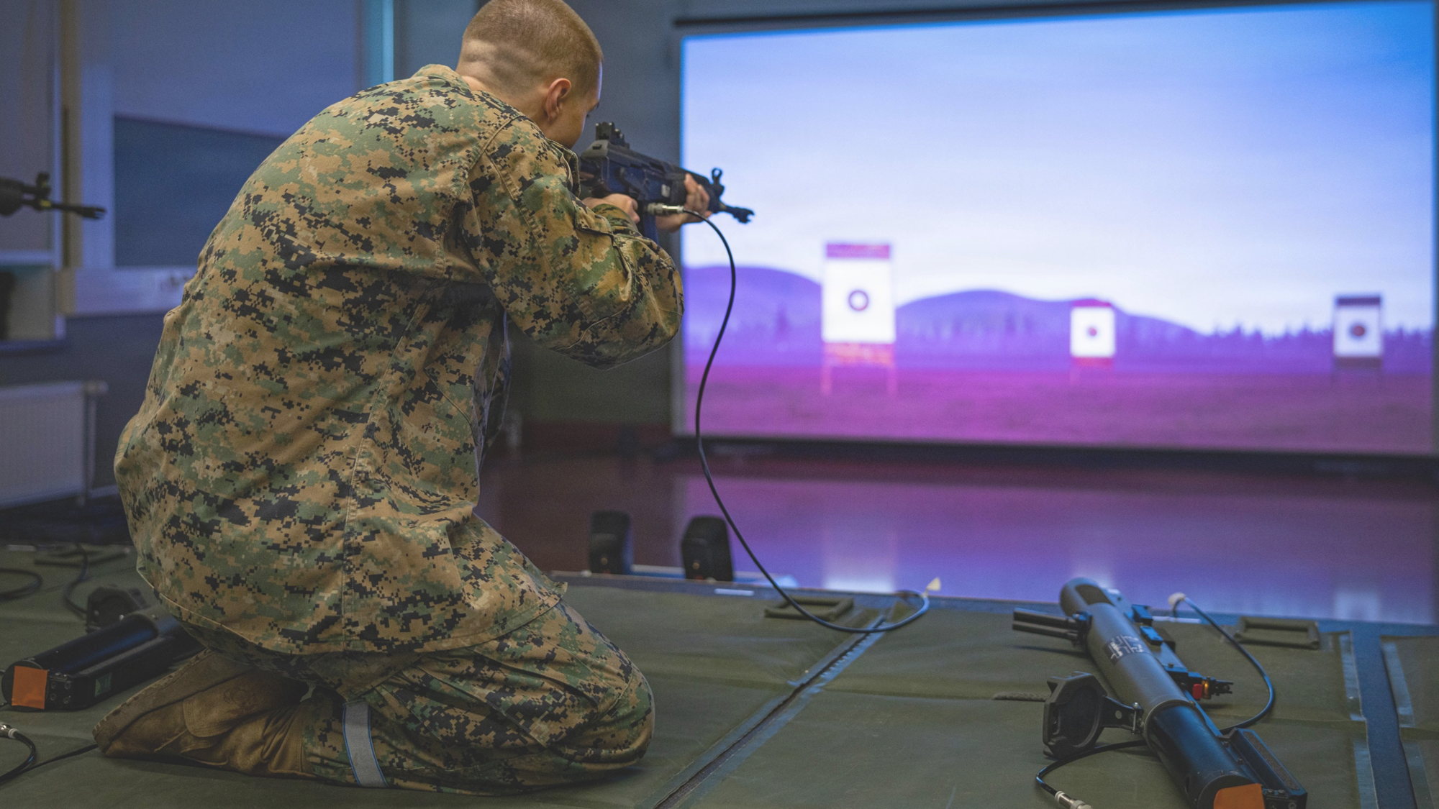
Where we’ve been
Establishing a new $44M Indefinite Delivery/Indefinite Quantity contract to deliver Training Analysis and Evaluation Products
Awarded recompete CLS contracts for the Indoor Simulated Marksmanship Trainer (ISMT) & Vehicle Training Systems (VTS)
Delivered Multi-Use Egress Trainer (MUET) capability to Camp Pendleton, Del Mar Underwater Egress Trainer (UET) facility, and Camp Lejeune

Slide 5
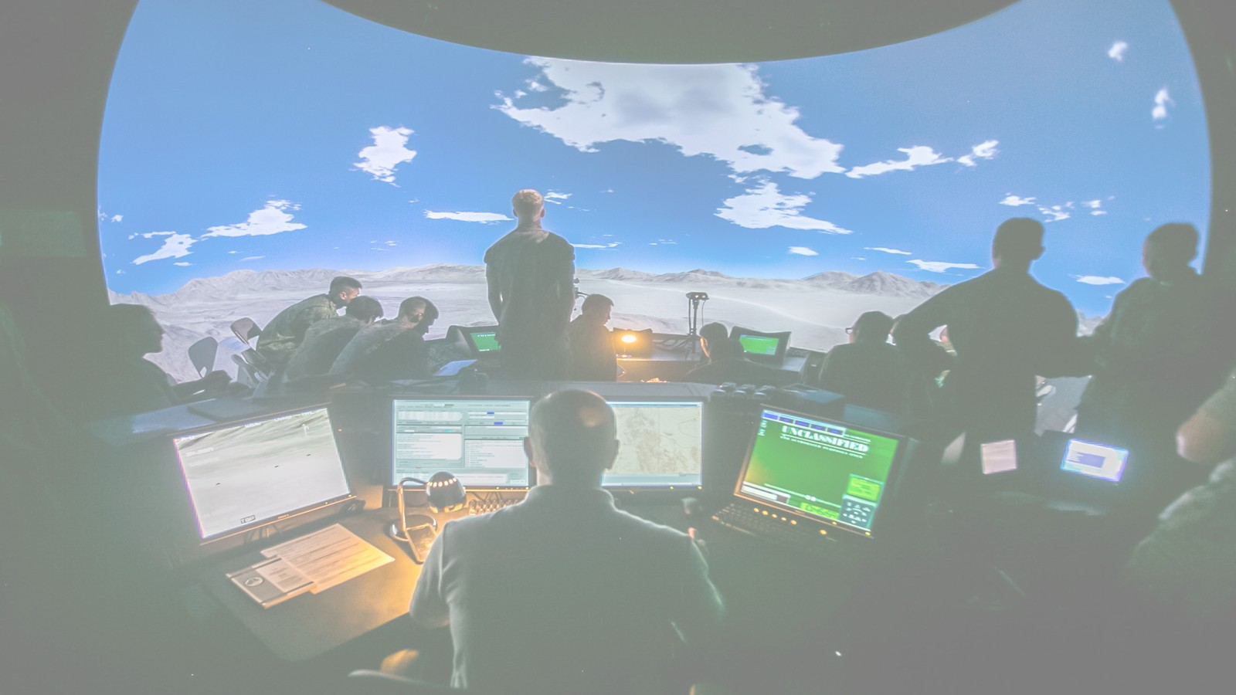
Our Approach
Guiding Principles
How We Get There
Force Design and the Training & Education Command Campaign plan are our guiding documents
Support deployment of integrated live, virtual, and constructive training tools
Forge adaptive, cognitively agile warfighters
Leverage acquisition agility and partnerships
Rapidly field cutting-edge simulators, instrumented live-fire ranges, and immersive training areas
Replicate the complexities of the modern battlefield

Slide 6

Community Support
Programmatic Priorities
Continue to support sustainment efforts
Leverage Commercial Off-the-Shelf (COTS) solutions in lieu of extensive R&D efforts
Other Transaction Authority (OTA) agreements to enable faster prototyping and fielding of critical technologies
Technological Priorities
Leverage existing mature technologies (TRL 7-9) ready to be fielded in ~12 months
Incorporate AI into existing and new systems to improve readiness and lethality of the Marines in the battlefield?
Technologies available in the next 3-5 years that will enhance or modernize existing Marine Corps training capabilities
Emerging Requirements – Drone and Cyber Trainer

Slide 7
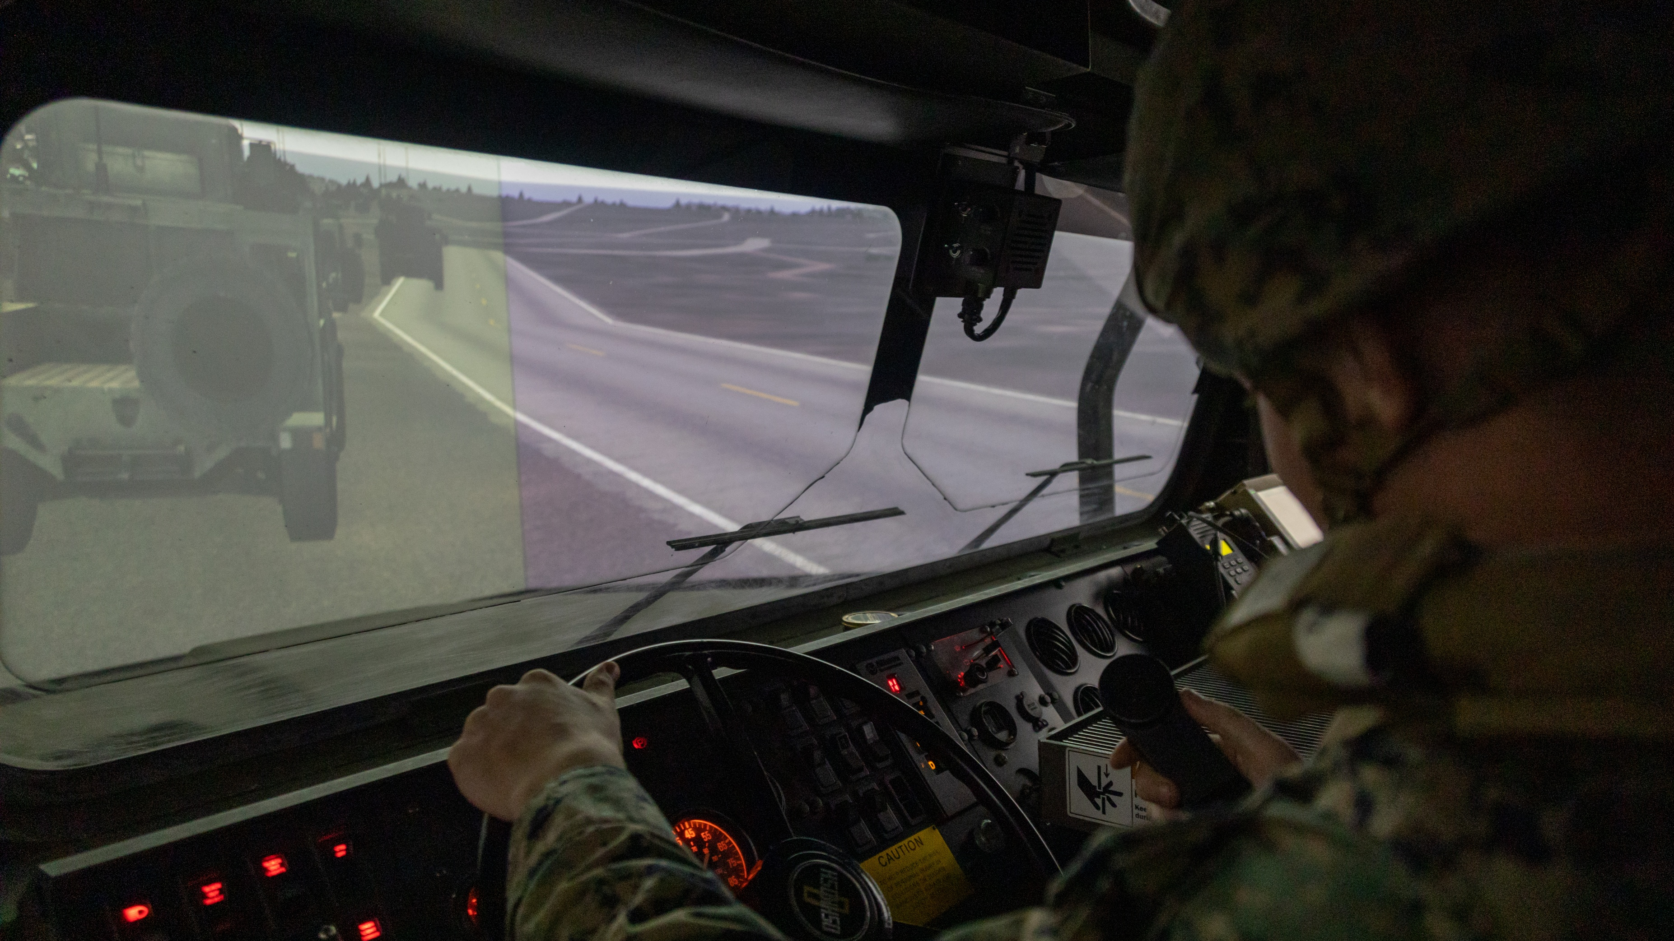
Questions?

Slide 8
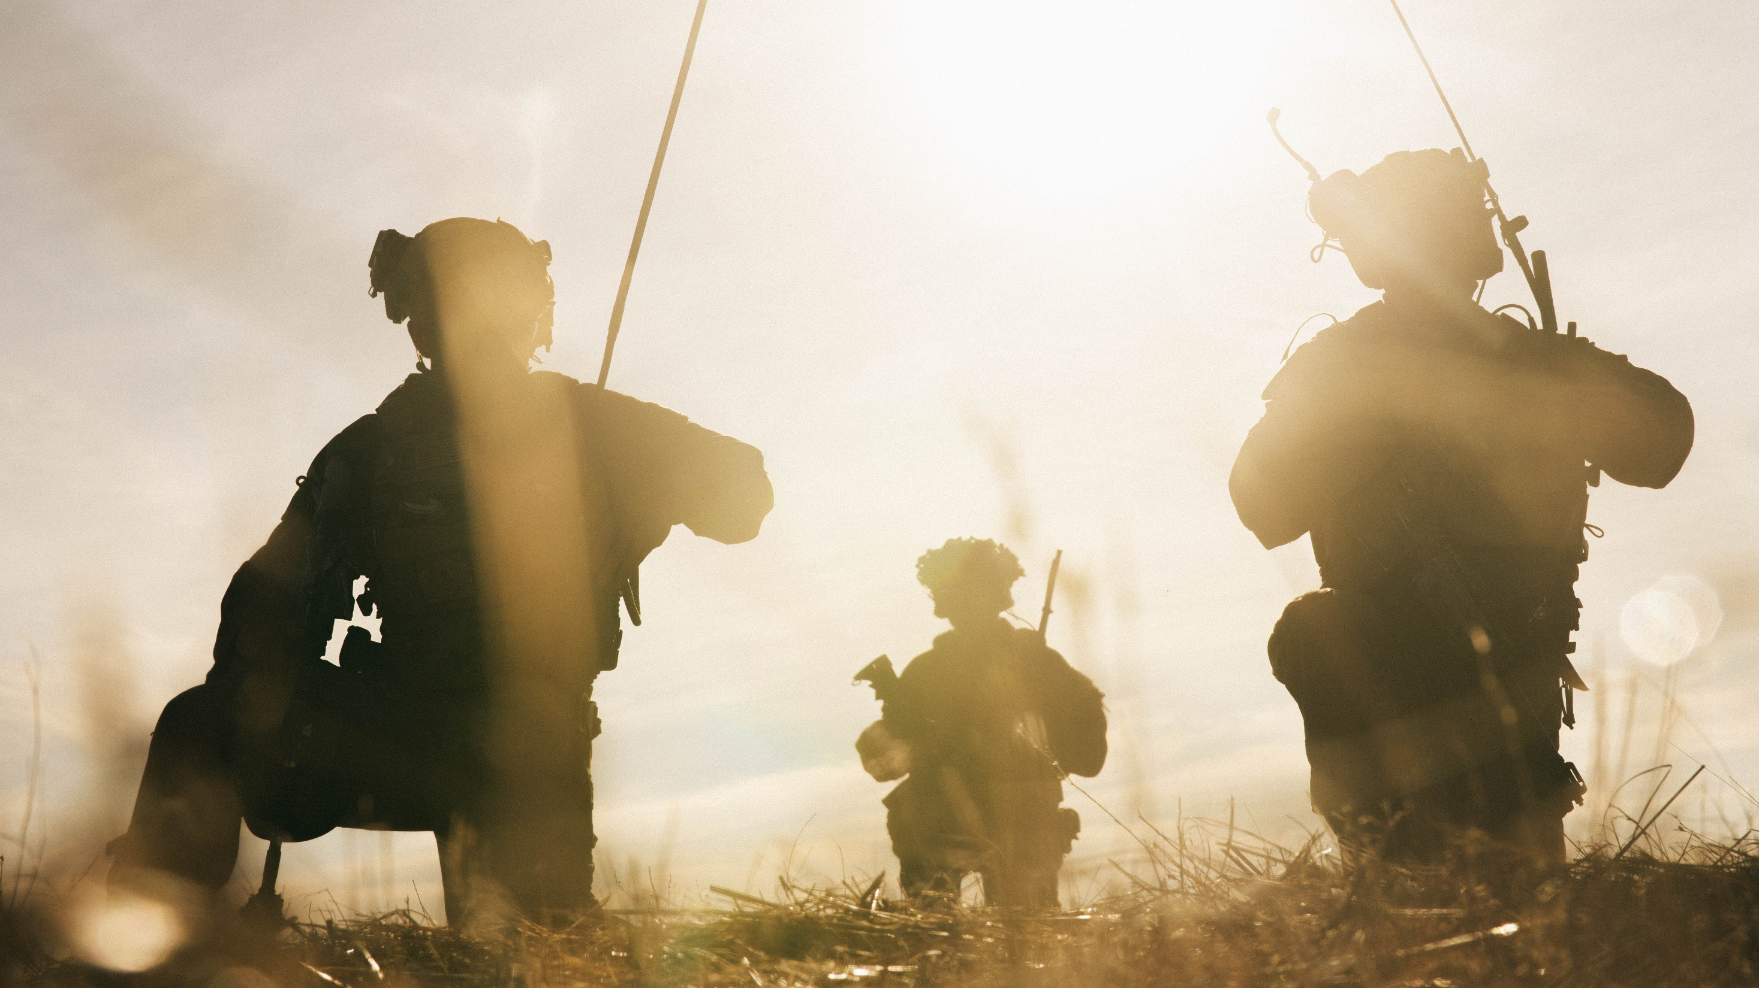

Equipping our WARFIGHTERS

