Slide 1
Program Manager Tactical Communications & Electromagnetic Warfare Systems
Mr. John Mithun
Program Manager

Slide 2
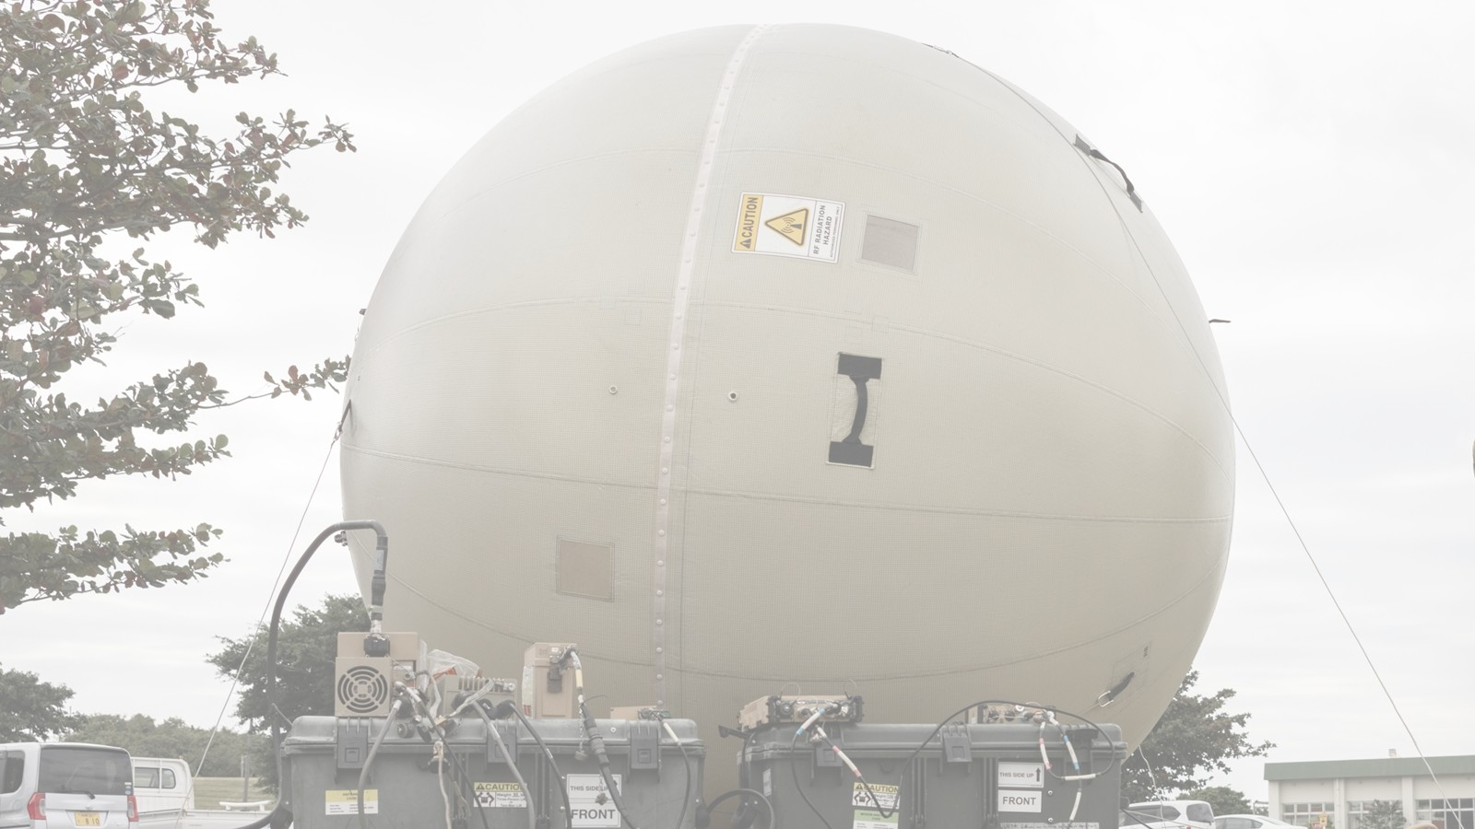
Organization & Mission
MISSION: Transform the way Marines communicate and fight in the Electromagnetic Spectrum
Program Manager (PM) Tactical Communications & Electromagnetic Warfare Systems (TCE)
Mr. John Mithun
Deputy Program Manager
Mr. Frank Mello
Product Manager (PdM) Tactical Radios
PdM High-Capacity Communications
PdM Position, Navigation, & Timing
Team Lead (TL) Ground Radios
TL Wideband SATCOM
TL PNT Mounted
TL Comm & Security
TL Electromagnetic Warfare Systems
TL PNT Handheld & Future
TL P/CIS

Slide 3

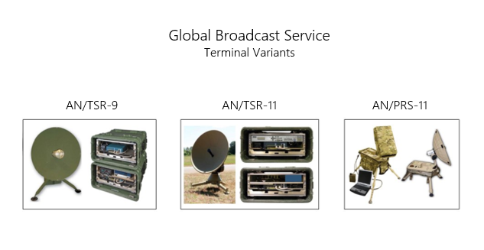
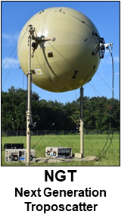
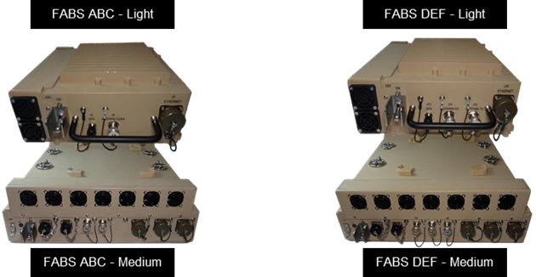
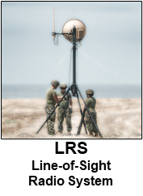

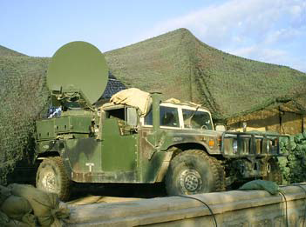
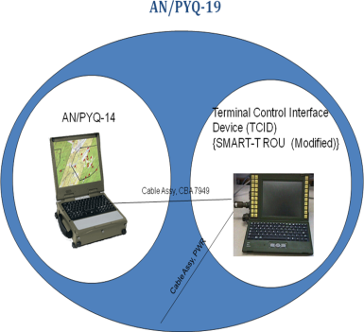

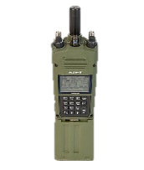
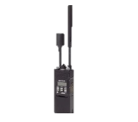
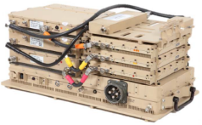
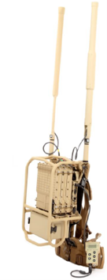

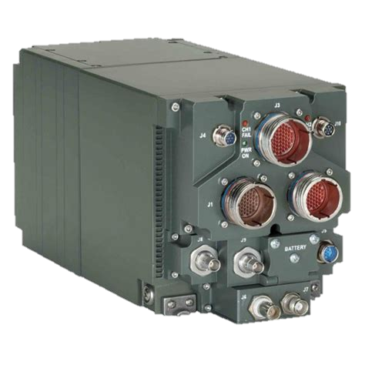
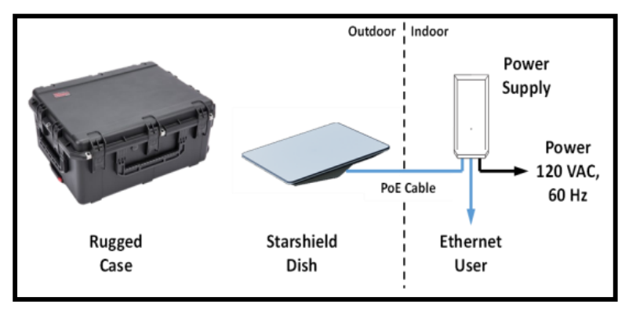


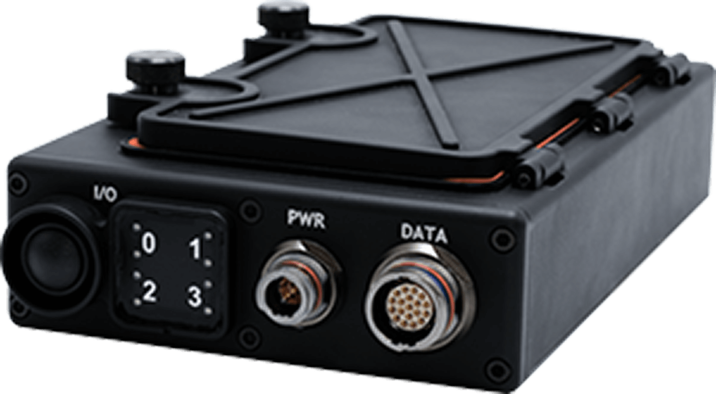
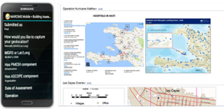




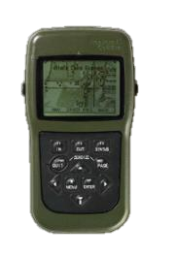


Pm TCE systems portfolio overview
GBS
Next Generation Troposcatter (NGT)
FABS
MCWS L/H
SMART-T
Line-of-Sight Radio System (LRS)
MFEW Mounted
MCR FoS
Product Manager
High-Capacity Communications (HCC)
SCAR
Ground Link-16 System of Systems
Product Manager Tactical Radios (TR)
SCC
MARCIMS
MFEW Dismounted
COMSEC
Product Manager Positioning, Navigation & Timing (PNT)
MBR II
HFR II
DMS
MGUE Inc 2
DAGR
MARNAV
Lightweight Direct Current Generator (LDCG)
Increment 4: Unmanned Surface Vehicles (USV)

Slide 4
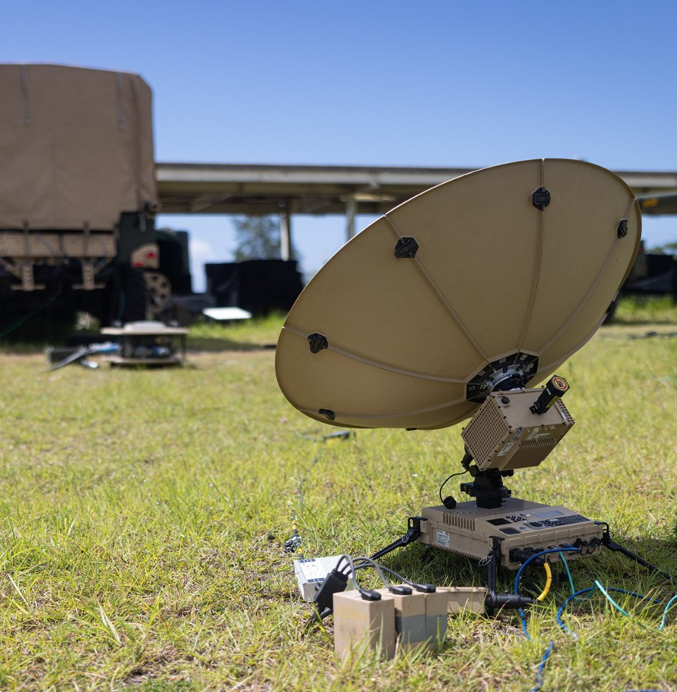
MOSA approach to Electromagnetic Warfare
MOSA will enable PMs within PAE Marine Corps rapid modernization capability
Modularity at HW & SW levels through adherence to open industry standards & SW containerization
Any HW components can evolve w/requirements to maintain peer threat parity/superiority w/o recapitalization of entire system (more processing power, increased frequency range, evolving cryptography to meet NSA’s CM2 & Quantum Resistance goals)
Contrast w/Radio Cryptographic Modernization – in a MOSA environment, only the Cryptographic Subsystem would need replacement
Contrast w/M-Code PNT challenges for Tactical Radios – MOSA M Code Cards available today vs significant integration challenges (performance, cost, schedule) for tactical radios
The SW components easily transition to new HW baselines through containerization
Sizeable SWaP reductions w/shared chassis, network switching, amplifier & power resources
Transition opportunity/pipeline for a multitude of S&T efforts
Government owned IP & baseline aligned to USMC priorities drastically reducing vendor lock

Slide 5
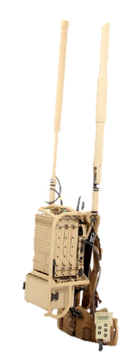
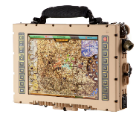

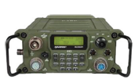

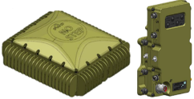




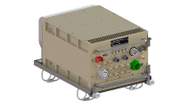
Notional Platform swap implications
Current Systems
Modular System
Embedded C2 Systems
Software Defined Radio (Comm)
Crypto Sub-System (TSVCIS, HAIPE, CSfC)
M-Code PNT
Ultra Wideband Software Defined Radio (EW)
POM 28
Initial Radio Capability: FY30
Significant Reduction in SWaP when compared to legacy, individual system installation while adding flexibility/capability

Slide 6
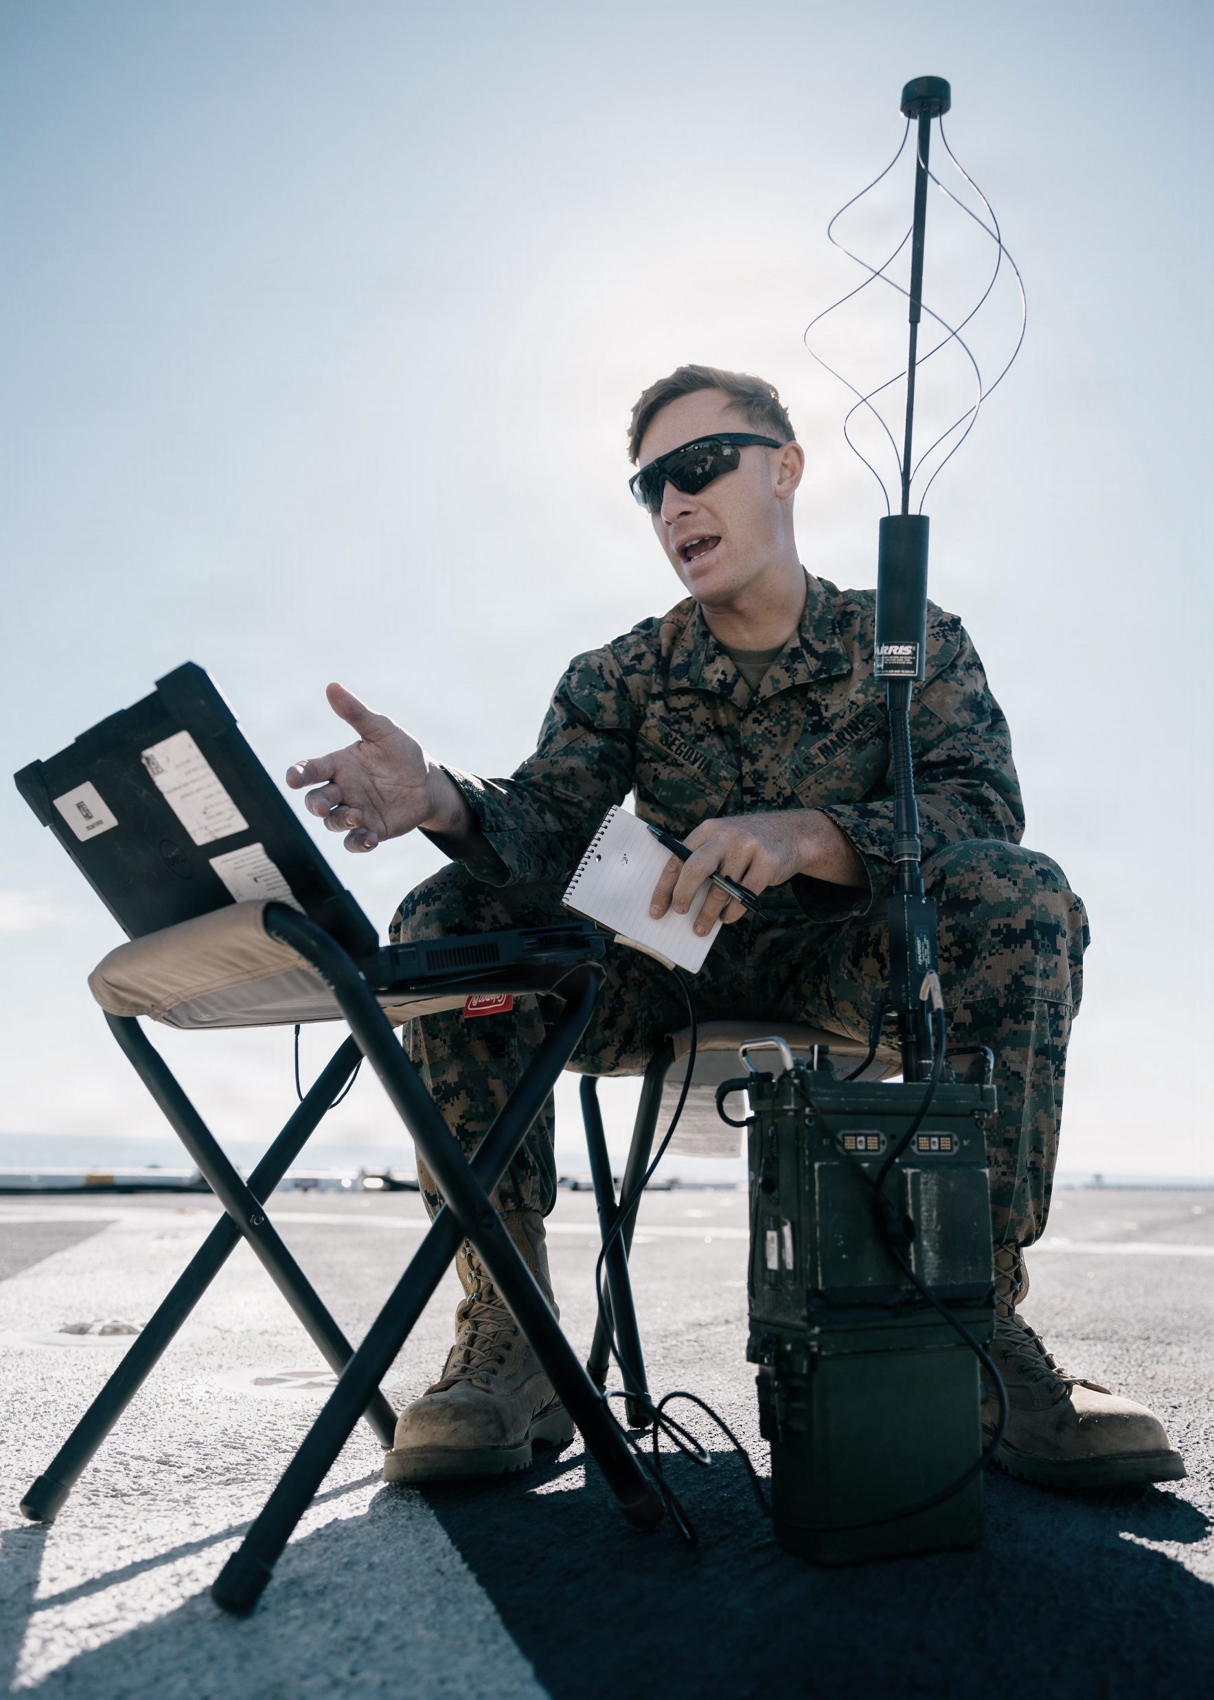
Areas where industry can help
The US Marine Corps is conducting market research and experimentation to inform acquisition strategy to modernize ground Electromagnetic Warfare (EW) capabilities employed throughout the FMF to provide:
Coordinated EW in support of Fires and Maneuver (Electromagnetic Attack)
Force Protection (Electromagnetic Protection)
Battlespace Awareness / Spectrum Management (Electromagnetic Support)
Vision: Family of networked systems in an open architecture environment based on non-proprietary hardware and software using modular chassis variants with diverse plug-in card loadouts and enabling peripherals.
Opportunities
Proof of concept complete EW system, demonstrating viability as a (C5ISR)/Electromagnetic Warfare (EW) Modular Open Suite of Standards (CMOSS)/Sensor Open Systems Architecture (SOSA) compatible EW successor to the MFEW system.
AI/ML for threat identification and mitigation, defeat protocol development, library/catalogue solutions
Lead integrator approach
SWaP reduction (VNX+, Nano)
“SOSA” peripherals (amplifiers, antennas, radioheads, etc.)
RF distribution & Simultaneous Rx/Tx
Notes:
Changes
Restart effort replaces MEGFoS program (terminated Dec 2025); leverages MEGFoS, joint force lessons learned
Focus of effort is mounted solution (original strategy prioritized backpack solutions)

Slide 7
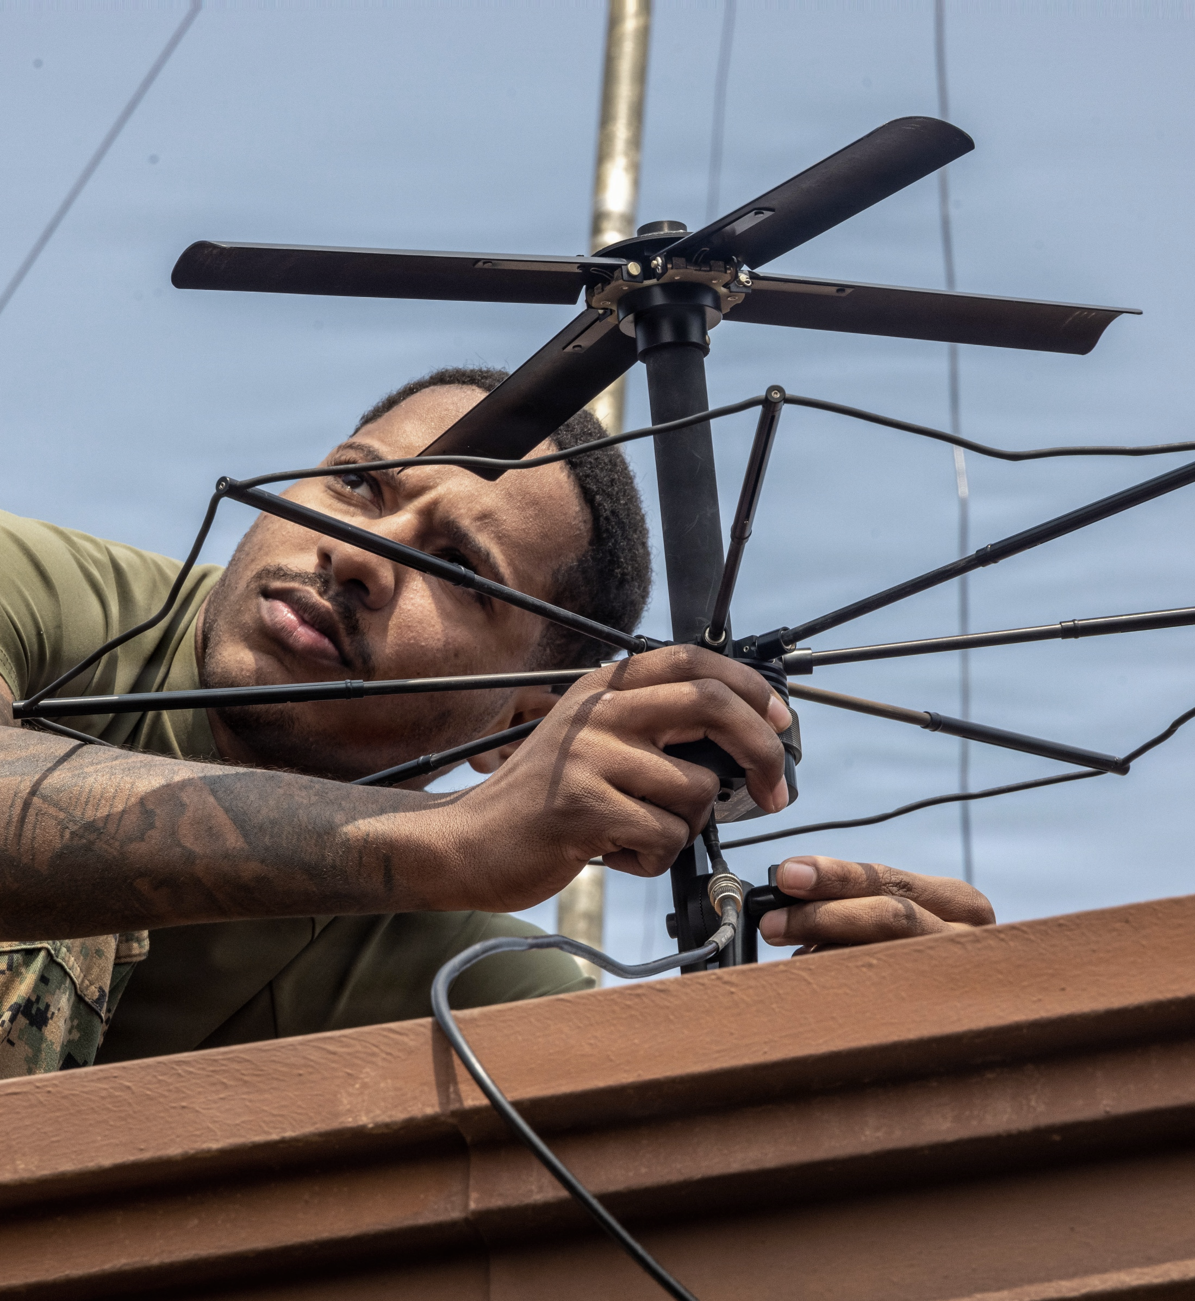
Areas where industry can help
The US Marine Corps requires resilient, reliable, and secure PNT capabilities for effective operations in GPS-denied environments. The current reliance on GPS creates unacceptable risks, necessitating the acquisition of M-Code capable GPS receivers and alternative PNT solutions.
Focus Areas:
M-Code Mounted and Handheld Solutions
Anti-Jam/Anti-Spoof antennas/receivers
Embedded GPS Solutions
Alternative Navigation / Non-GPS Solutions
Inertial Navigation Systems / Inertial Measurement Units
CMOSS-compliant / SOSA compliant cards / common chassis
Military GPS User Equipment Increment II
Technology Readiness Levels/ Prototype status of capabilities

Slide 8
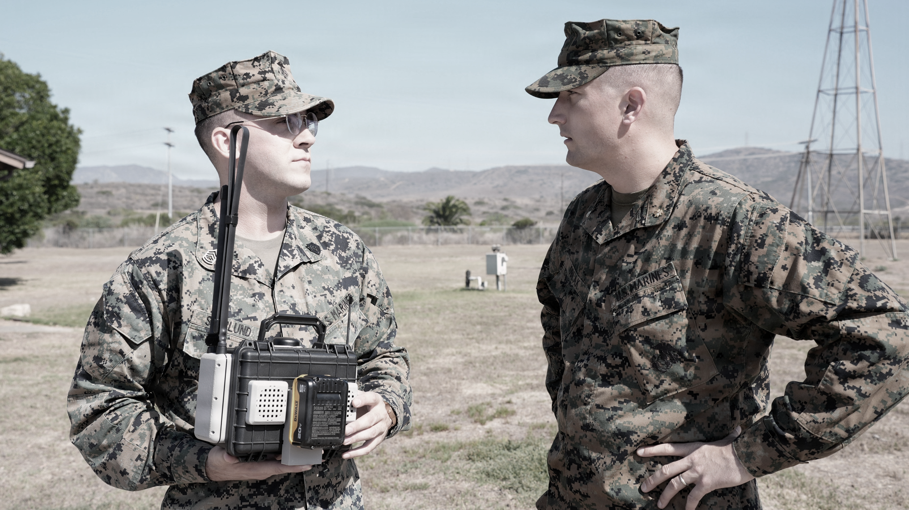
Questions?

Slide 9

Equipping our WARFIGHTERS

