Slide 1
Program Manager Motor Transport
Ms. Jenn Moore
Program Manager

Slide 2
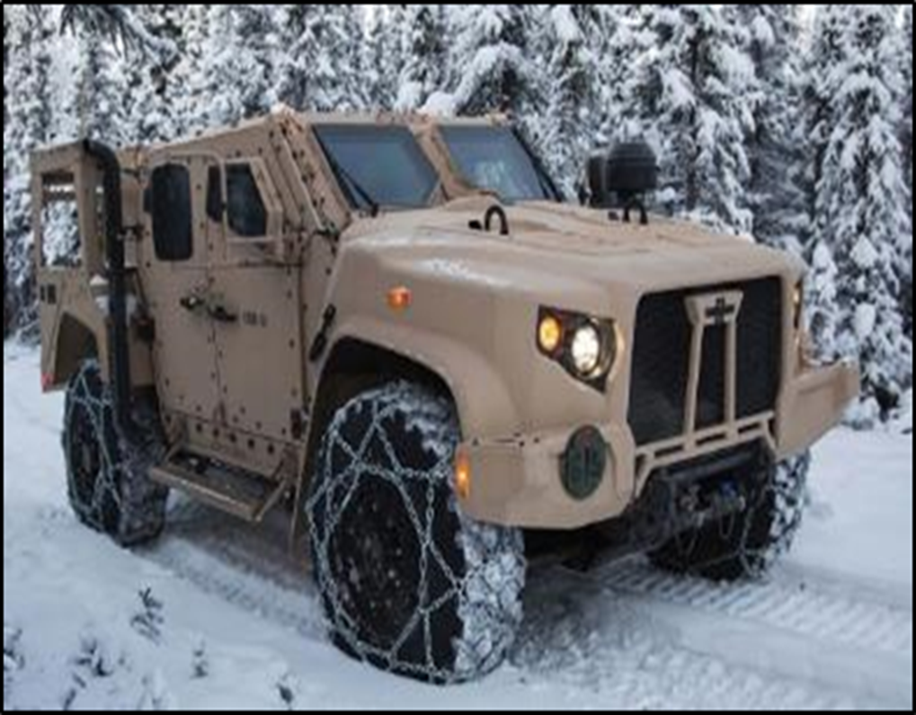
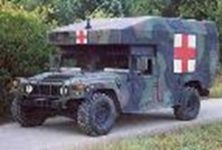
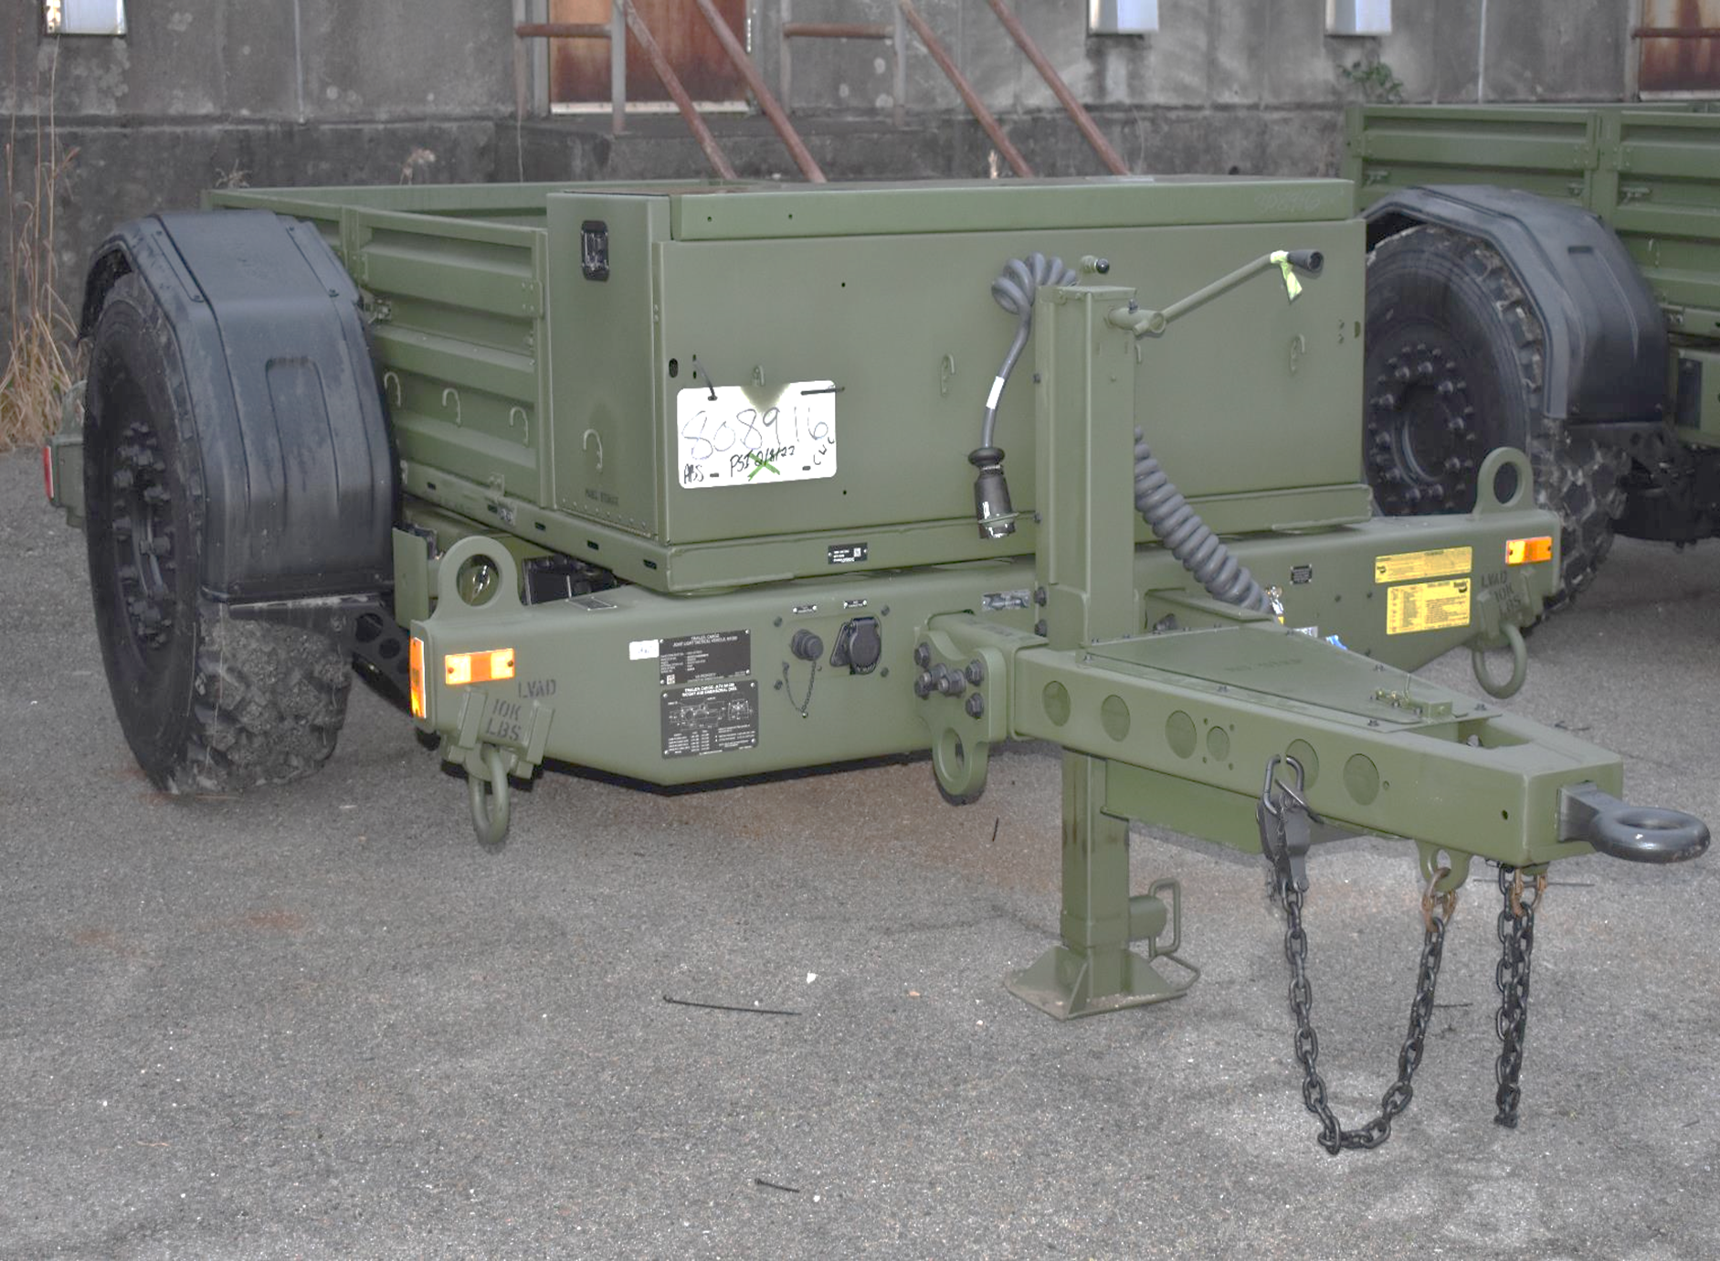
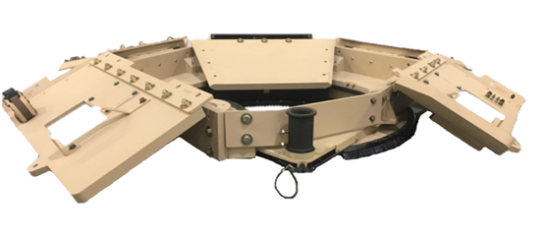
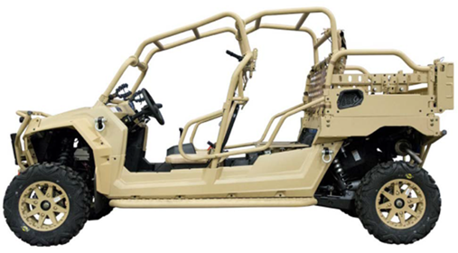
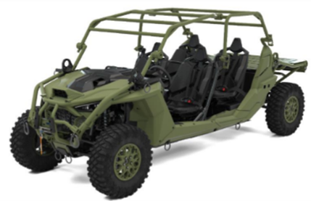
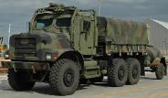
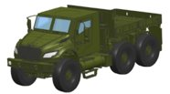
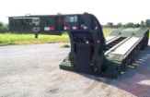
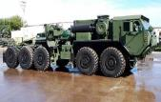
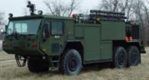
PM MT PORTFOLIO OVERVIEW
Light Tactical Vehicles & Trailers – Jeff Wade
Joint Light Tactical Vehicle (JLTV) & JLTV Trailer
Ultra-Light Tactical Vehicle (ULTV) & Utility Task Vehicle (UTV)
High Mobility Multipurpose Wheeled Vehicle (HMMWV) Ambulance
Reducible Height Gunner Protection Kit (RHGPK)
JLTV
JLTV Trailer
HMMWV
RHGPK
UTV
ULTV
Medium Tactical Vehicles & Trailers
Medium Tactical Vehicle Replacement (MTVR)
Medium Tactical Truck
Medium Trailers
MTVR
MTT
Trailers
Heavy Tactical Vehicles & Trailers
Logistics Vehicle System Replacement (LVSR)
P-19 (Tactical Fire Truck)
M-870A2 Medium Heavy Equipment Transporter (MHET)
LVSR
P-19

Slide 3
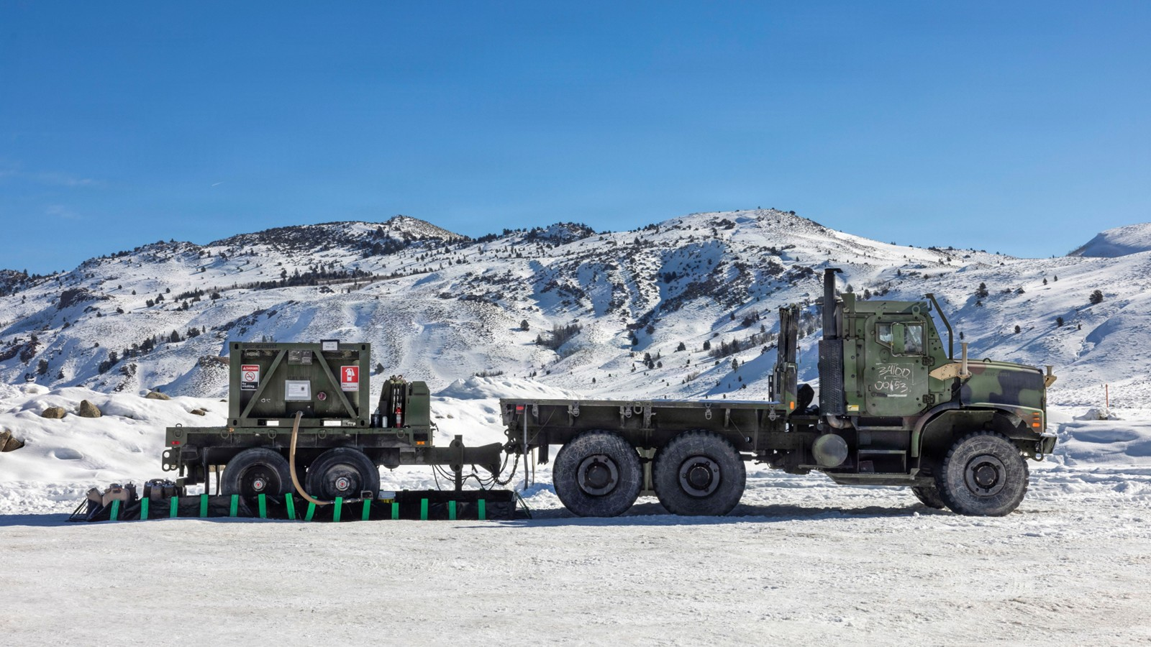
Questions?

Slide 4
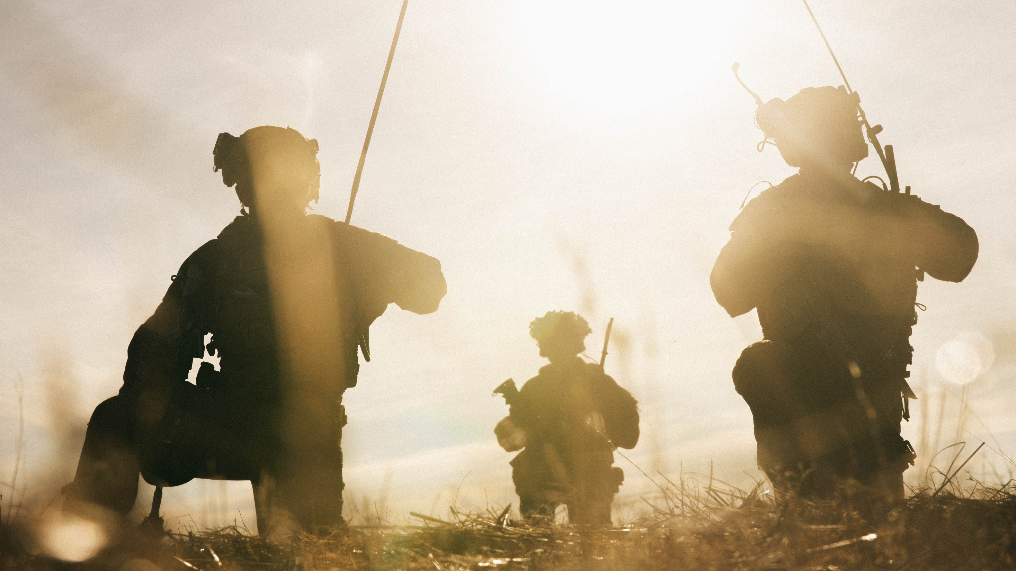

Equipping our WARFIGHTERS

