Slide 1
Program Manager
Ground Weapons Systems Program Overview
Colonel Bradley Sams
Program Manager

Slide 2

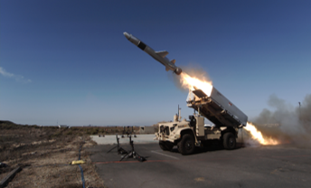

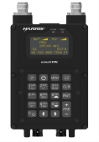

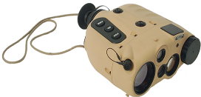
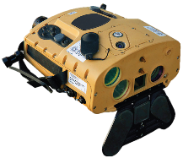
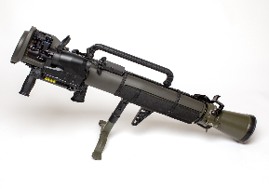

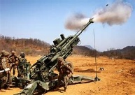
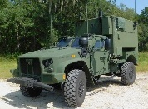
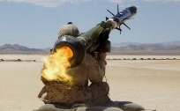
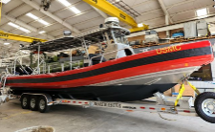

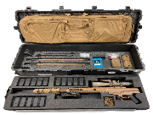
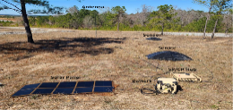
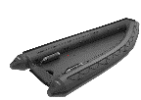
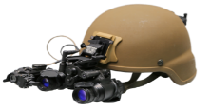
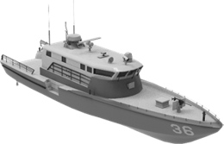
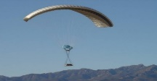
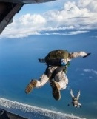
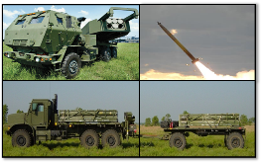
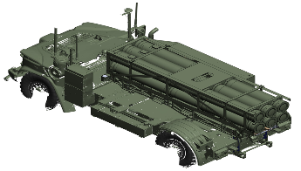
Pm Ground Weapons systems portfolio overview
OPF-L / OPF-M
NMESIS
Product Manager
Navy/Marine Expeditionary Ship Interdiction System
HH-VDL
CLRF-IC
NGHTS
Product Manager Organic Precision Fires
Product Manager Fires Support Systems
MAAWS
Product Manager Infantry Weapons
Javelin
AASB
LW155
MCV
SASS
Product Manager High Mobility Artillery Rocket System
ASR
E-CRRC
Product Manager Long Range Unmanned Surface Vessel
SBNVG
SPARTN
JPADS
MMRC
Notional Image –
Representative Only
PS-2
HIMARS
MLU
Lightweight Direct Current Generator (LDCG)
Increment 4: Unmanned Surface Vehicles (USV)

Slide 3
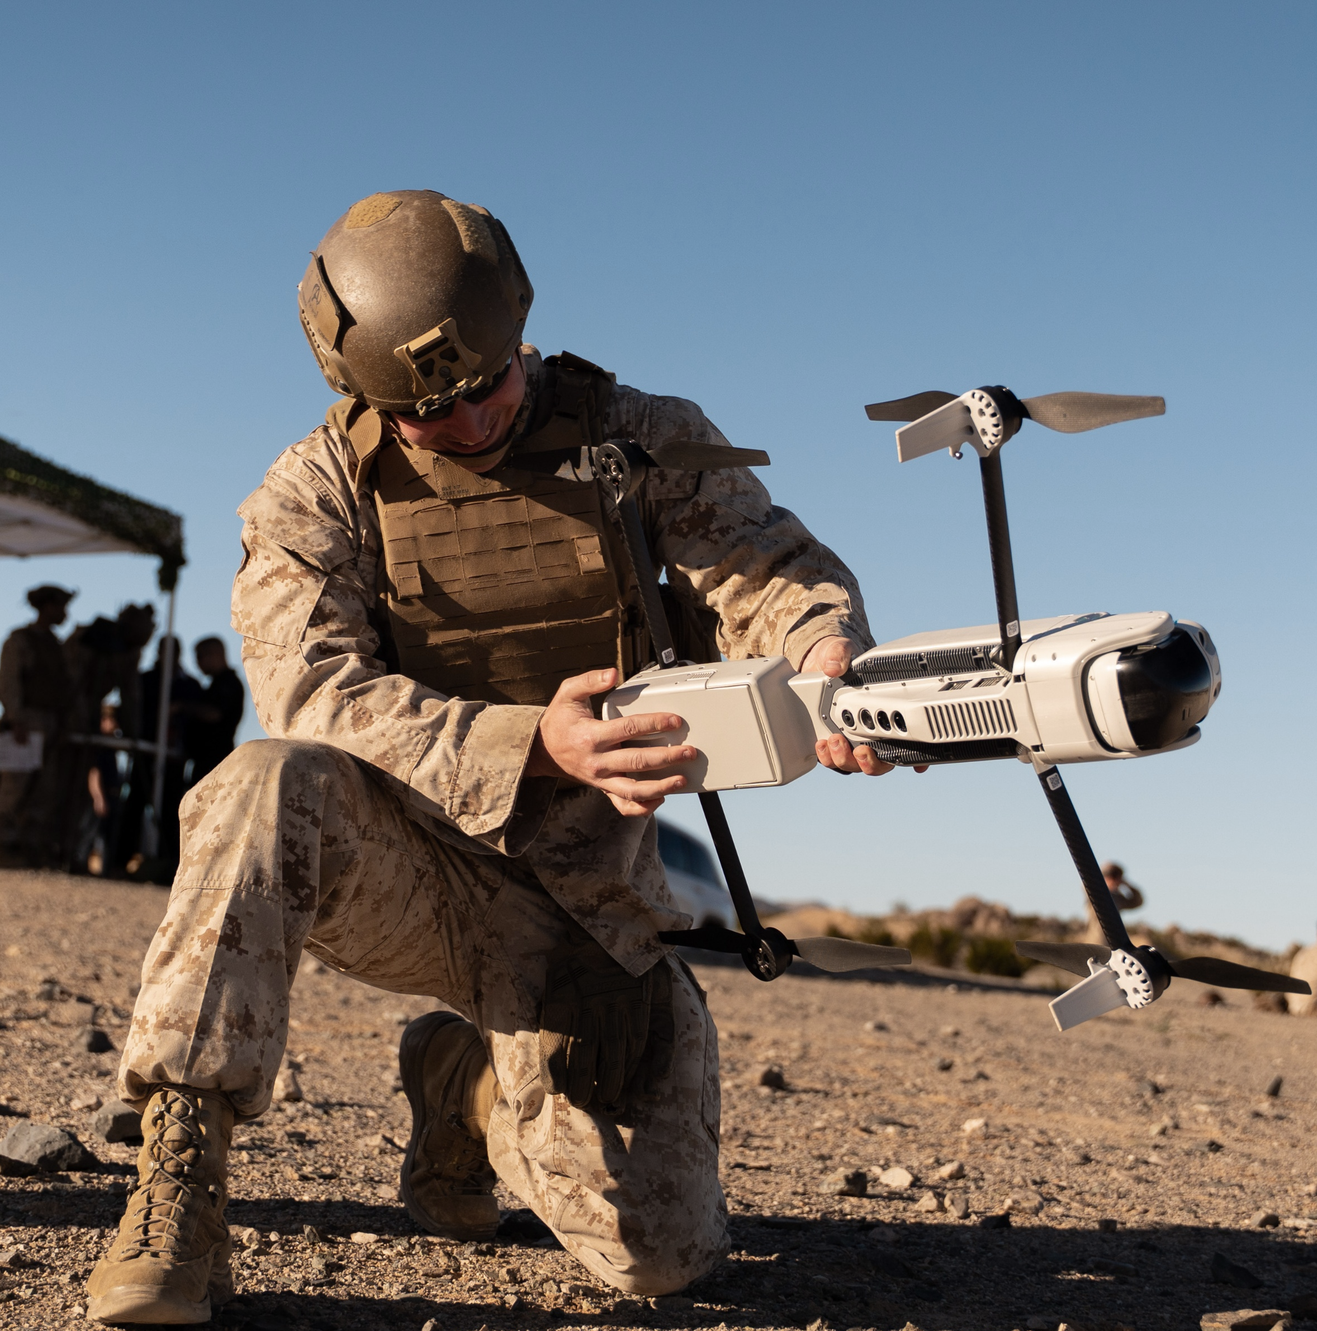
Areas where industry can help:
Loitering Munitions & Fires Capabilities
  General (Organic Precision Fires Light/Medium (OPF-L/M)
    Higher energy density batteries; rechargeable and/or single use
    Improved autonomous and semi-autonomous target recognition and tracking
    Assured Positioning, Navigation, and Time (A-PNT) Solutions
    Common controller
  OPF-Medium
    Anti-armor & anti-materiel payload and able to accept other payloads (modular design)
    Transportable by two Marines
    Automatic target tracking of stationary and moving targets
    Ability to charge, and maintain charge of, lithium battery separate from the warhead
    Cost effective design solutions to make affordable at scale while being able to detect and recognize targets at distance in cluttered environments and battlefield obscurants
    Resilient and adaptable communication systems with ability to operate in an electromagnetically contested environment to include GPS denied
    Warhead/fusing and Electronic Safe and Arm Device (ESAD) approved
    Ability to store aboard ships/munition storage system for systems using electric propulsion

Slide 4
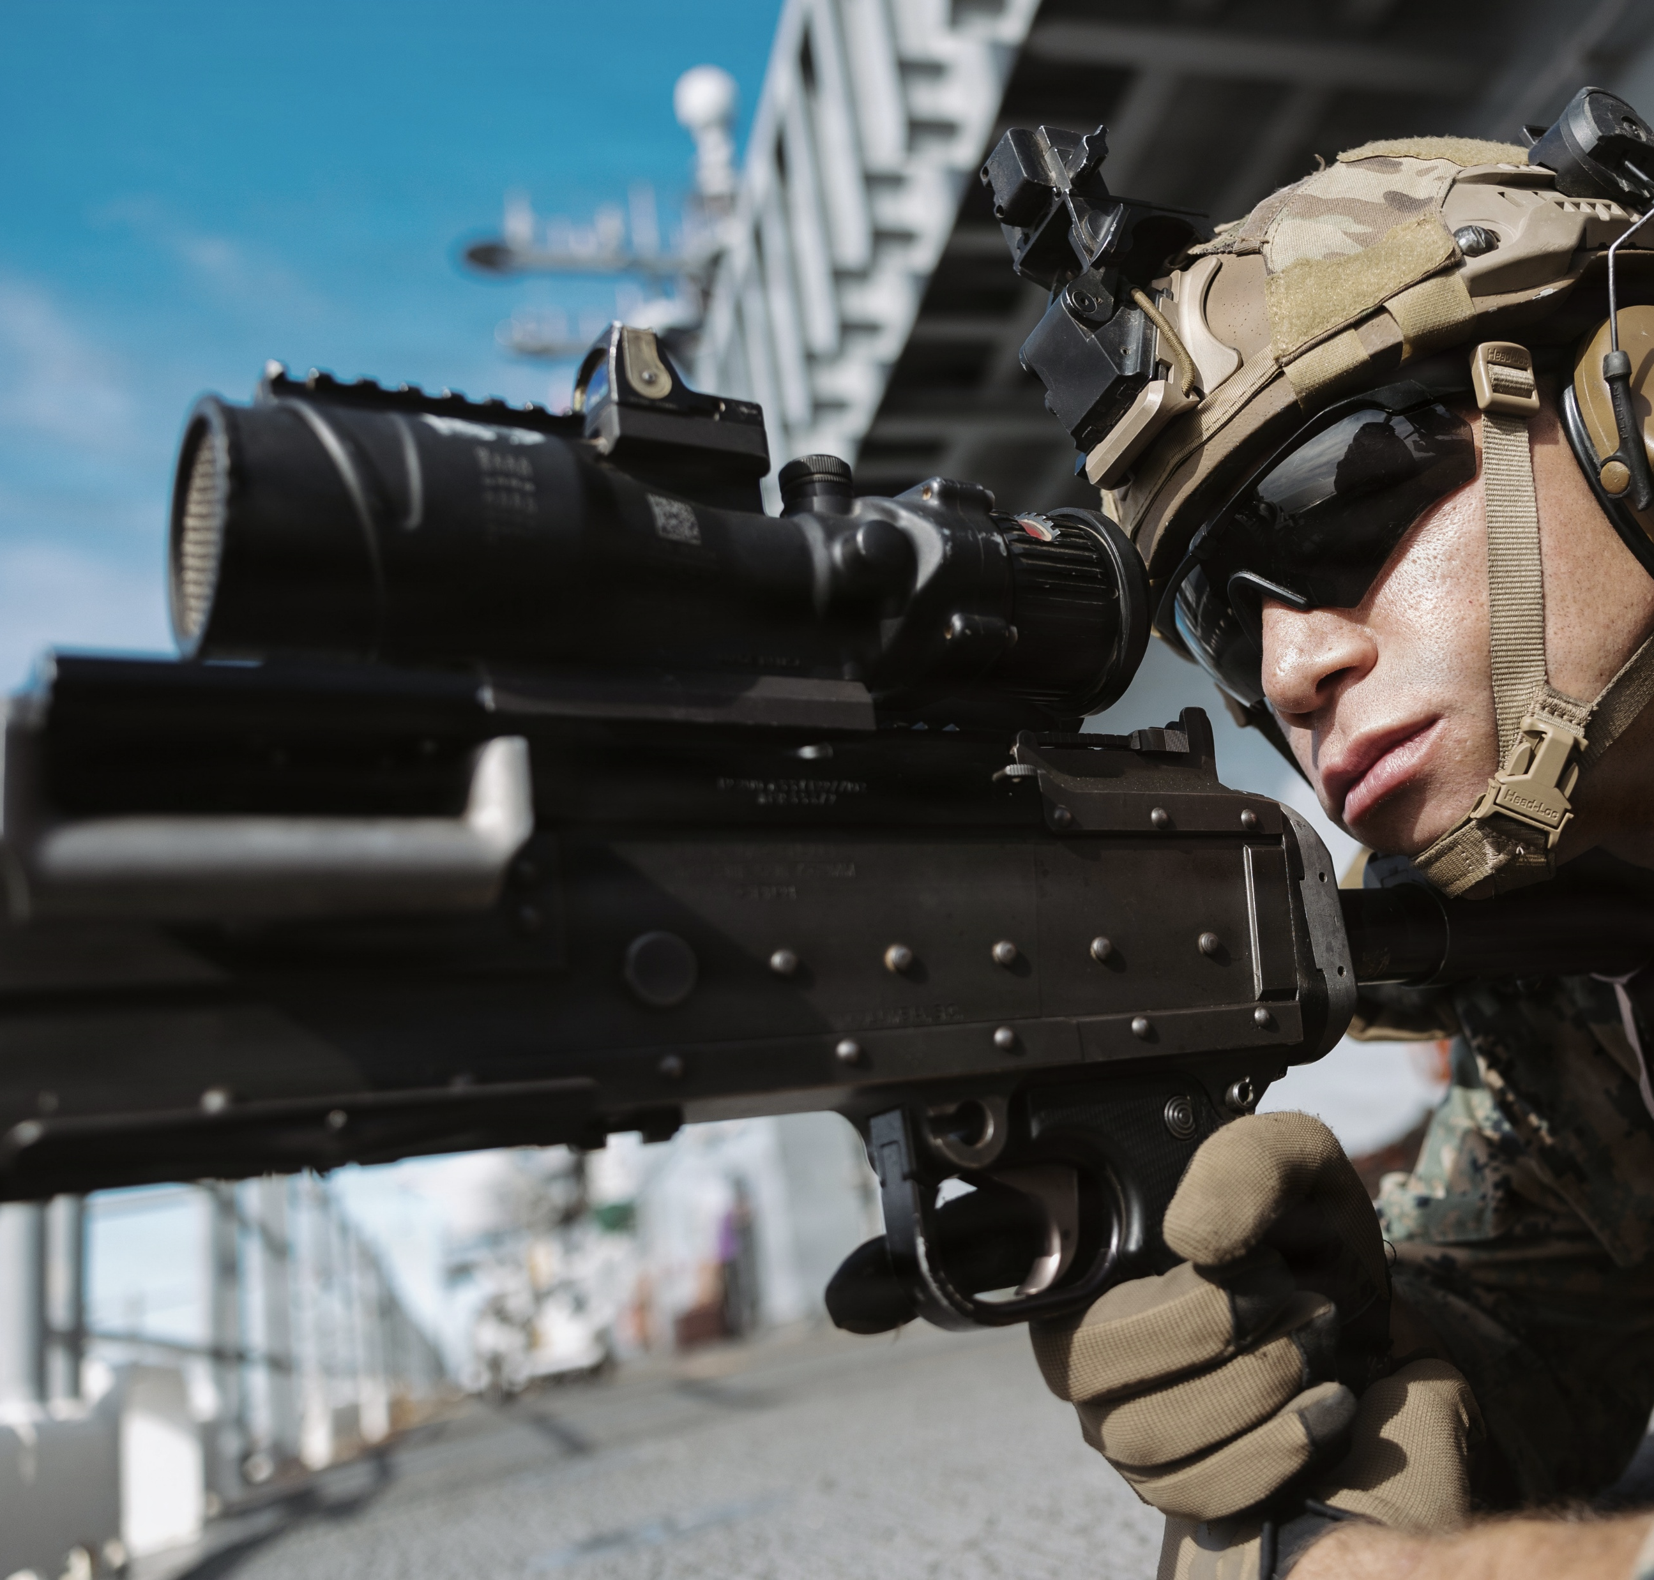
Areas where industry can help:
Improved small arms capabilities & sensors
  Small Arms:
    Suppressors – reduced sound, flash, and thermal signature
    Weight reduction in heavy and medium machine guns
    Improved effects on target and target suppression without sacrificing size, weight, performance, and cost
  Sensors:
    Navigational tracking of jumpers & cargo parachute systems
    Tactical Ranging Devices
        Passive ranging
        Ranging utilizing uncommon wavelengths
      Lightweight multi-spectral imagers and rangefinders
      Man-portable day and night capable long-range detection and identification technology

Slide 5
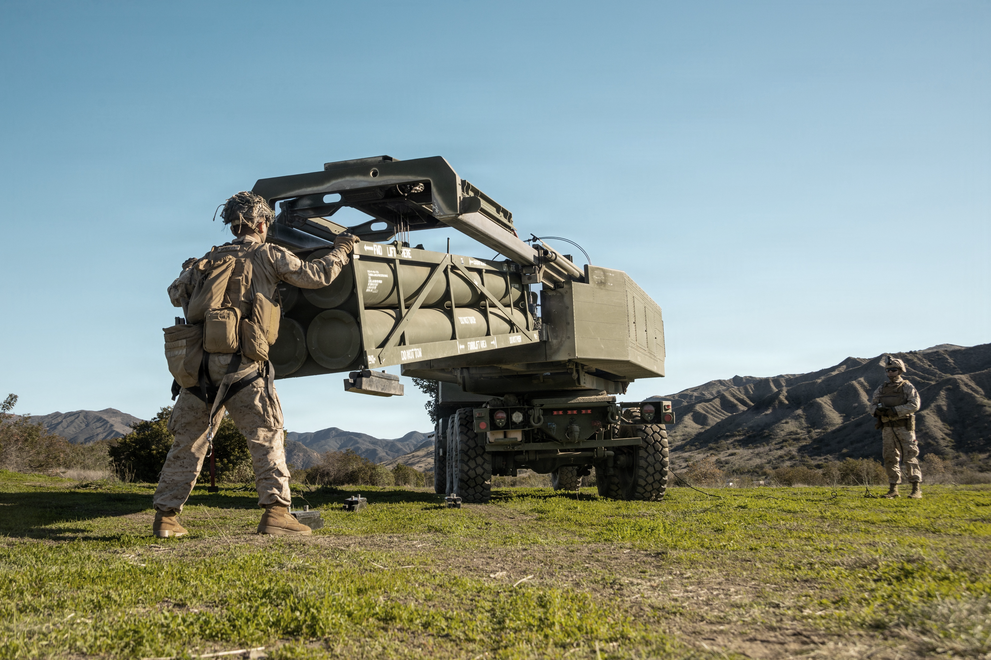
Areas where industry can help:
  Missile subcomponents that will increase range and lethality (engines, fuels, and data links, etc.)
  Coatings or removable coverings for missile cannisters that can provide camouflage and concealment
  Munitions capable of integrating with existing launch platforms and fire control systems (HIMARS/NMESIS)
missiles

Slide 6
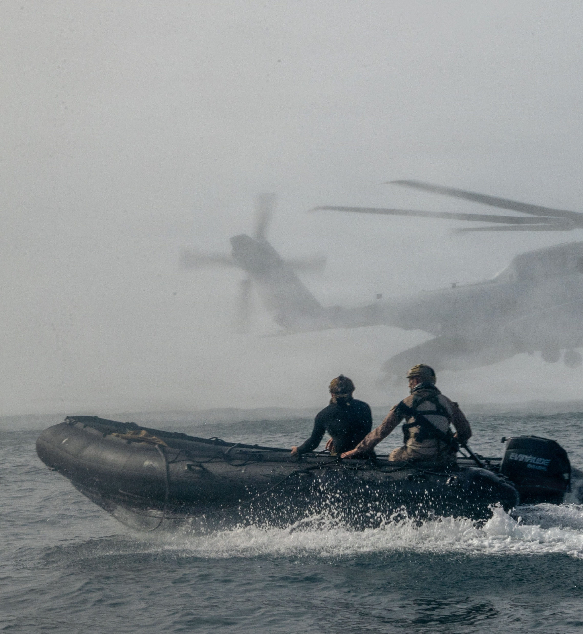
Areas where industry can help:
  Low-cost comms that provide:
    Beyond Line of Sight
    High bandwidth (off-load sensor data)
    Low probability of detection/interception
  Multi-sensor/platform data and track correlation
  Compact, marinized, electro-optical and radar sensors
  Outboard engine for inflatable boats (E-CRRC) capable of being submerged in water and returned to function without maintenance/minimal operator actions
Technologies for Vehicles, boats, & munitions

Slide 7
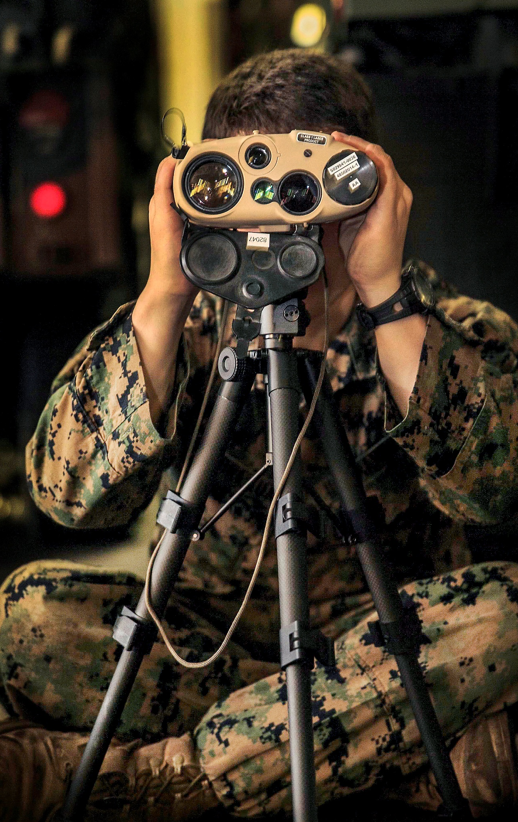
Areas where industry can help:
general
  Highly experienced general systems trainers
  Improved autonomous navigation in GPS denied environments
  Emerging commercial technologies (GOTS/COTS NDI) that will assist our portfolio in addressing capability gaps
  Opportunities to improve contracting and production timelines in delivering critical capabilities
  Systems to reduce probability of detection and extended operation in challenging logistics environments
  Capabilities that allow the massing of cost-effective fires munitions or other key enabling systems

Slide 8

Equipping our
WARFIGHTERS

