Slide 1
Program Manager Ground Based
Air Defense
Colonel Andrew J. Konicki
Program Manager

Slide 2

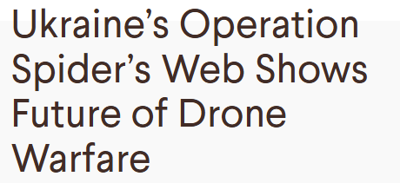



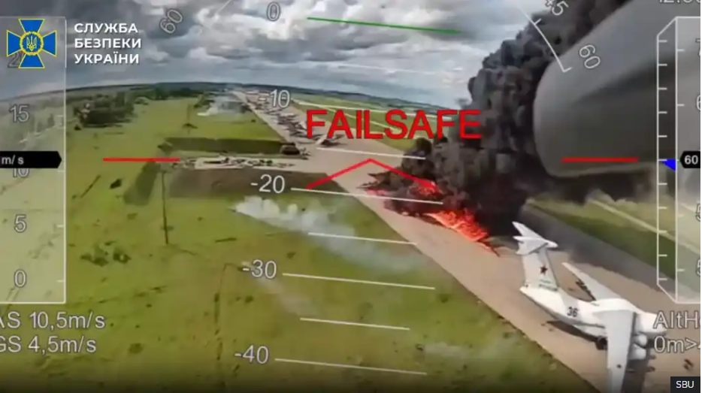



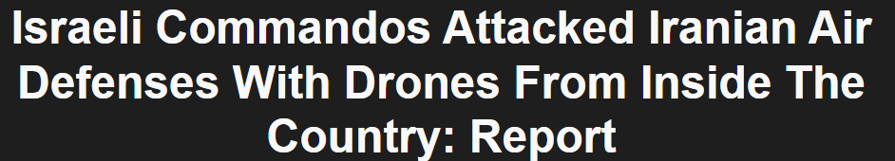

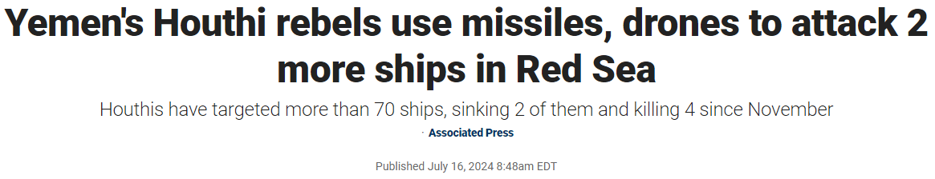

The threat is now…indiscriminate, highly prolific!
Drone Swarms Pose New Threat to US Bases, Official Says
May 8, 2024

Slide 3
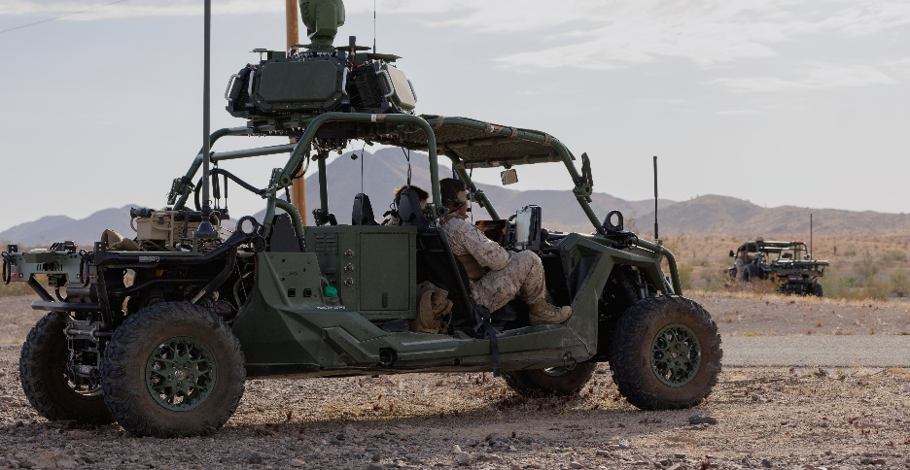
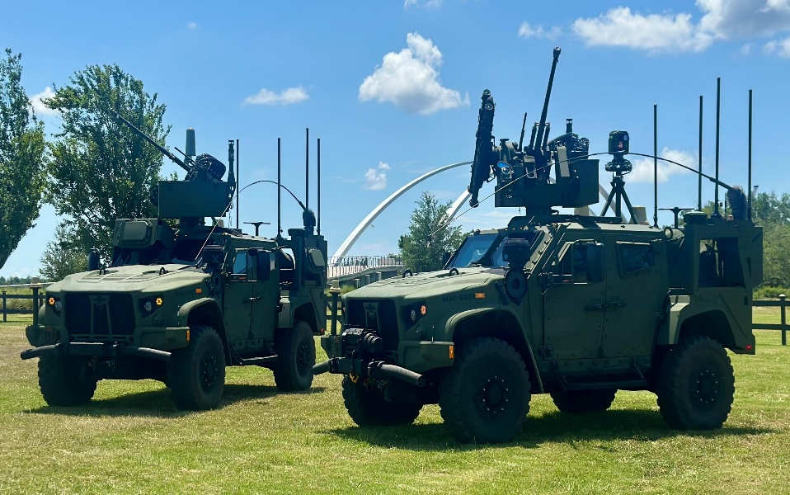
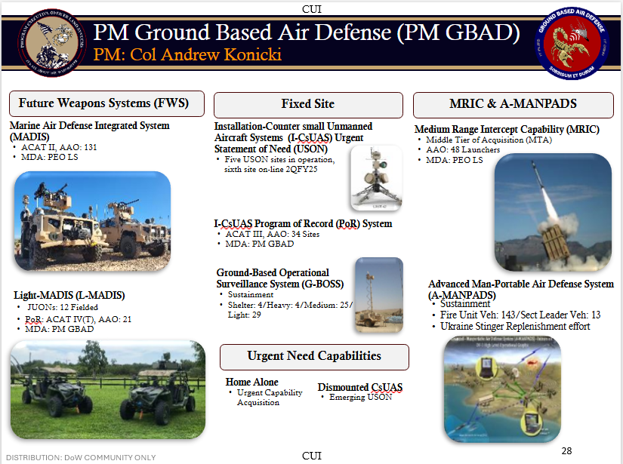
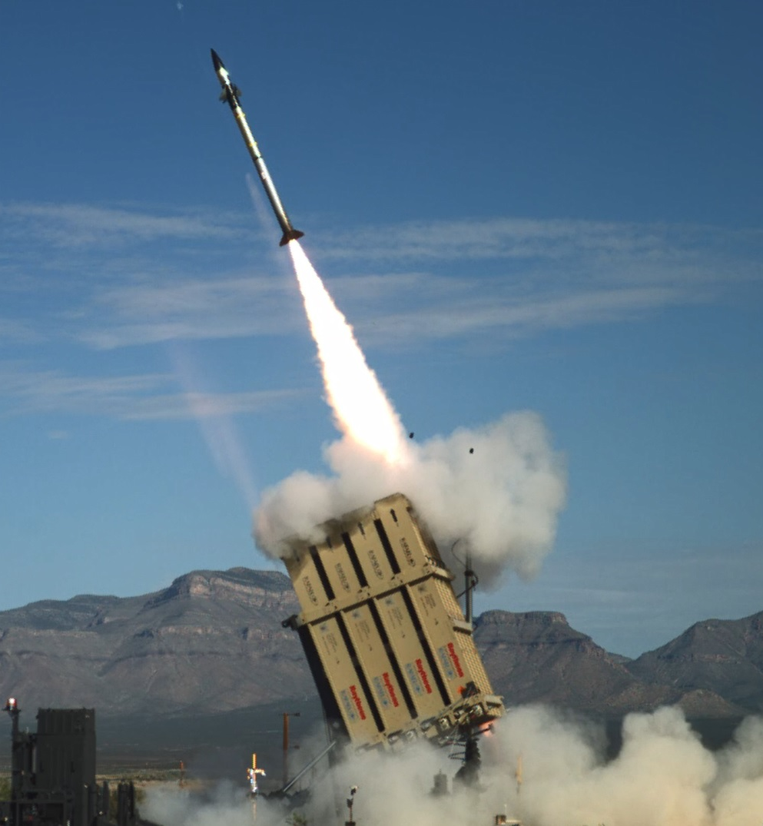
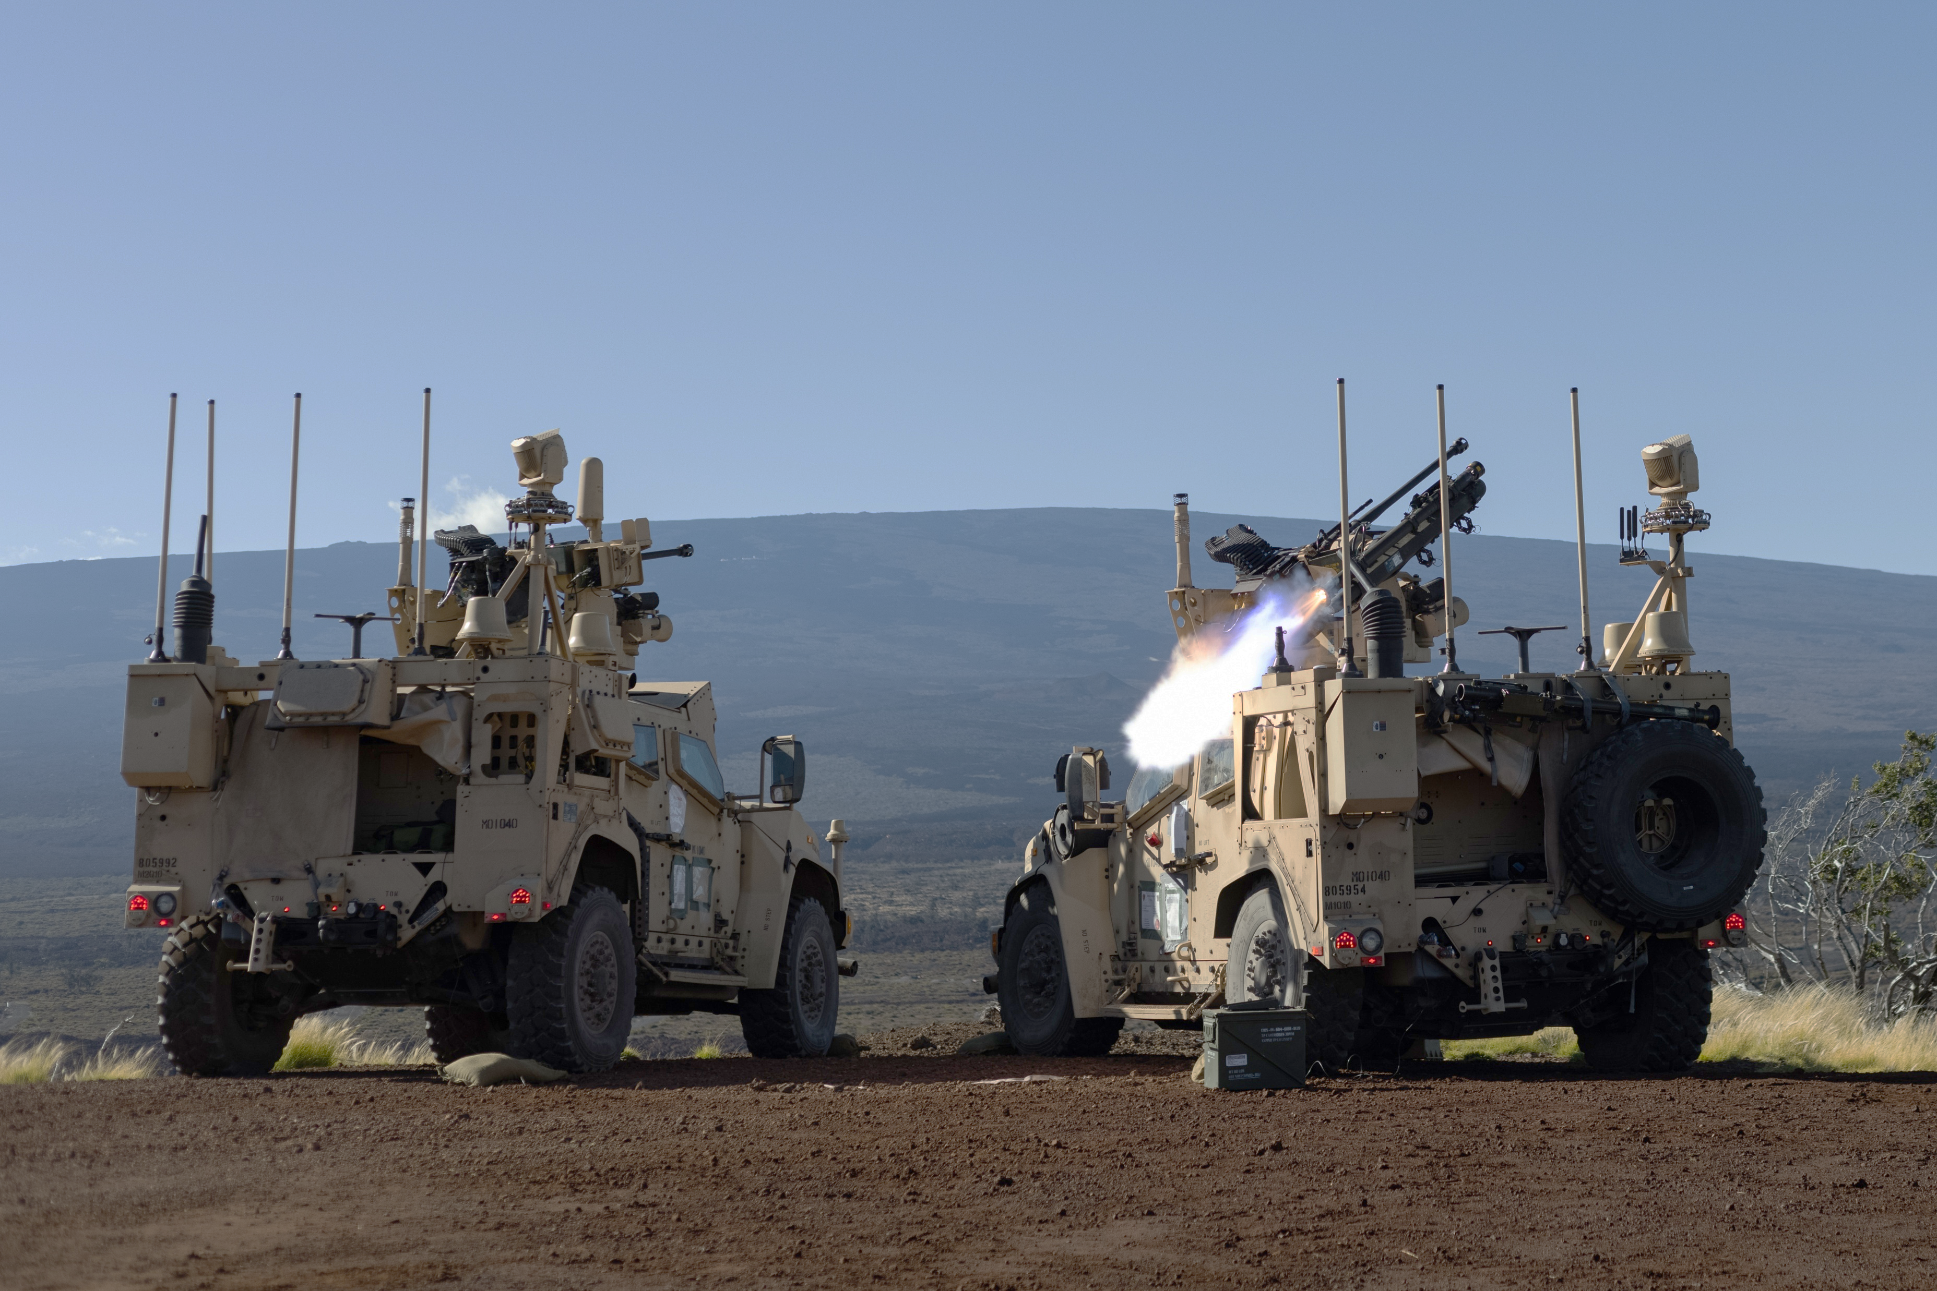
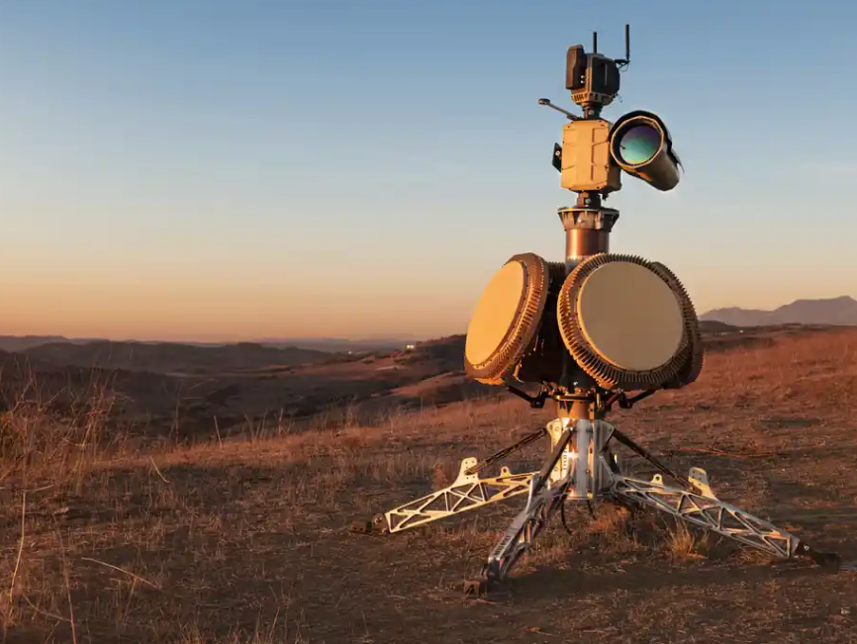
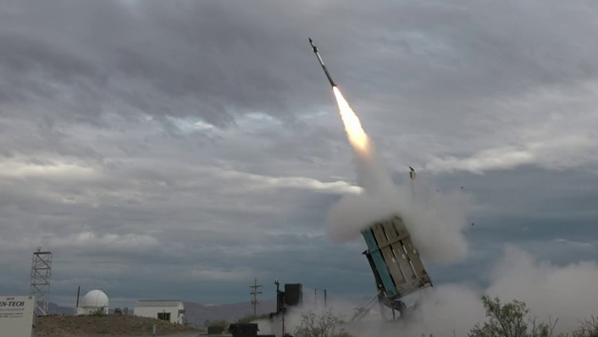
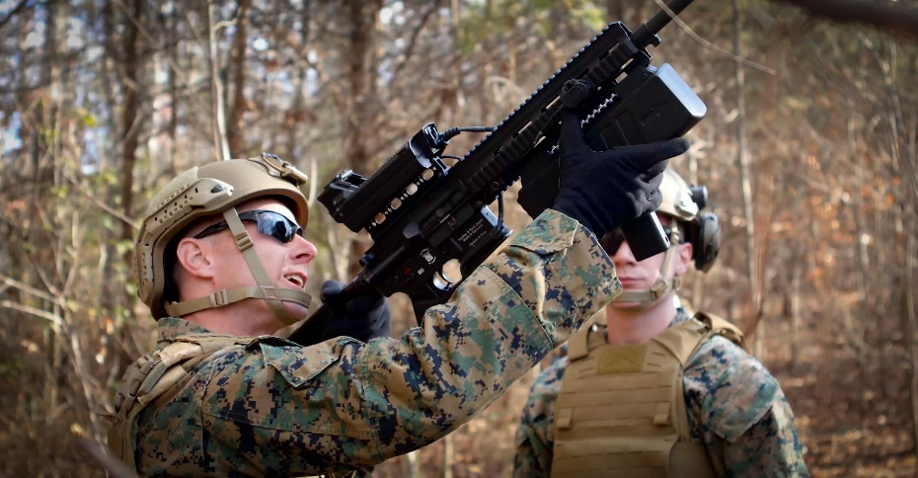
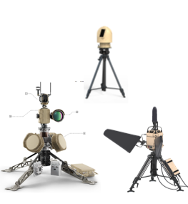
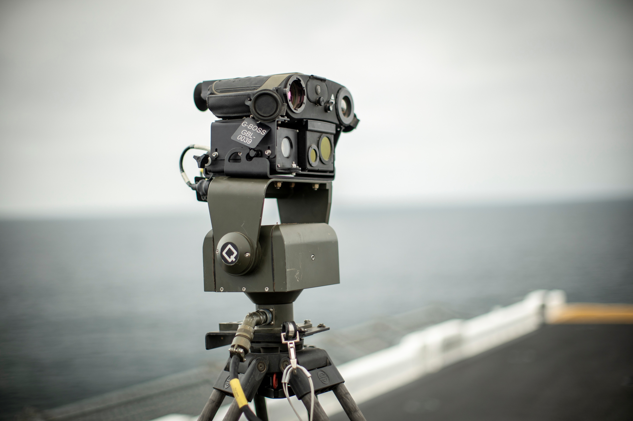
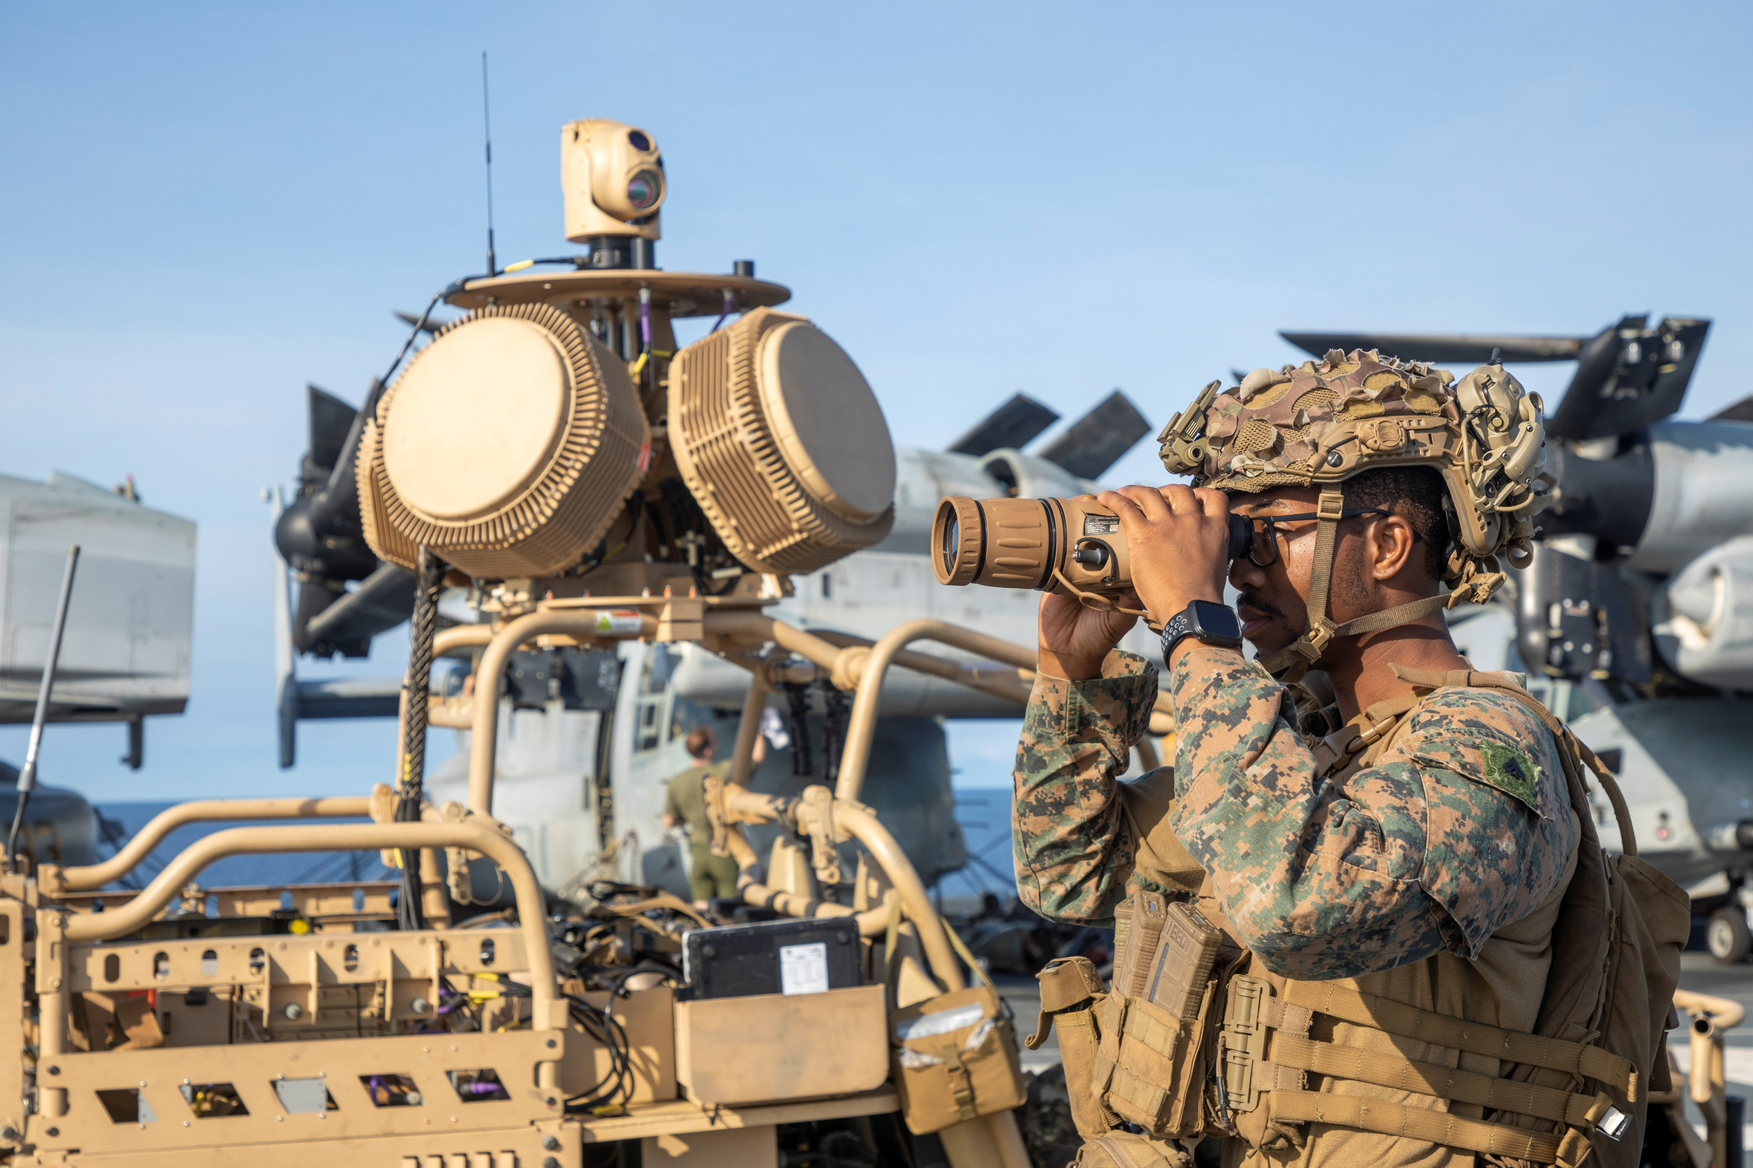
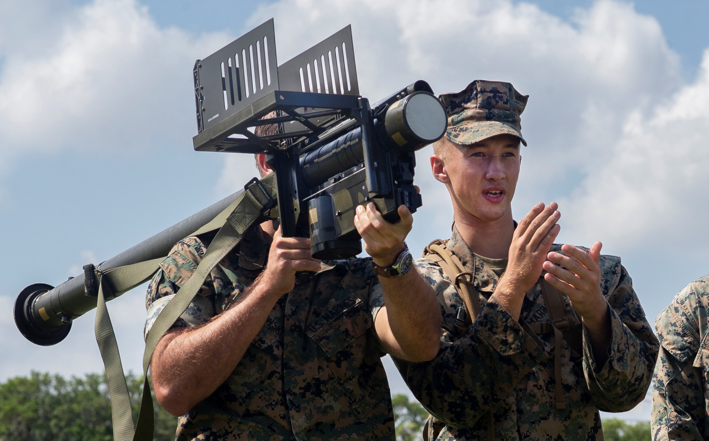
Pm gbad – usmc center of excellence for counter air capabilities
Future Weapons Systems (FWS)
Fixed Site
MRIC & A-MANPADS
Marine Air Defense Integrated System (MADIS)
ACAT II, AAO: 131
MDA: PEO LS
Installation-Counter small Unmanned Aircraft Systems (I-CsUAS) Urgent Statement of Need (USON)
Five USON sites in operation, sixth site on-line 2QFY25
Medium Range Intercept Capability (MRIC)
Middle Tier of Acquisition (MTA)
AAO: 48 Launchers
MDA: PEO LS
I-CsUAS Program of Record (PoR) System
ACAT III, AAO: 34 Sites
MDA: PM GBAD
Light-MADIS (L-MADIS)
JUONs: 12 Fielded
PoR: ACAT IV(T), AAO: 21
MDM: PM GBAD
Ground-Based Operational Surveillance System (G-BOSS)
Sustainment
Shelter: 4 | Heavy: 4 | Medium: 25 | Light: 29
Advanced Man-Portable Air Defense System
(A-MANPADS)
Sustainment
Fire Unit Veh: 143/Sect Leader Veh: 13
Ukraine Stinger Replenishment effort
Urgent Need Capabilities
Home Alone
Urgent Capability Acquisition
Dismounted CsUAS
Emerging USON
Notes:
Add: EW Capability outside MFEW, CM262 Gen 3 (or equivalent alternative)
Discuss priority shifts w/ TLs, APdMs

Slide 4
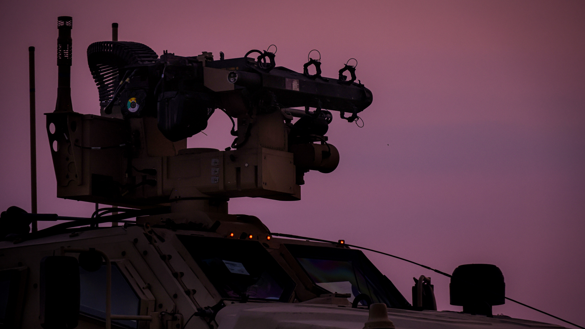
Acquisition Approach
High TRL (6+ and greater)
Ability to integrate and function with multiple technologies (i.e. USMC C2, active/passive sensors, kinetic/non-kinetic effects)
Reduce cognitive load of user – AI/ML enabled, one screen across the system
Ability to operate and sustain in communications degraded/denied environment
Fielding everything across the portfolio –
continual improvements and evolution of capabilities.

Slide 5
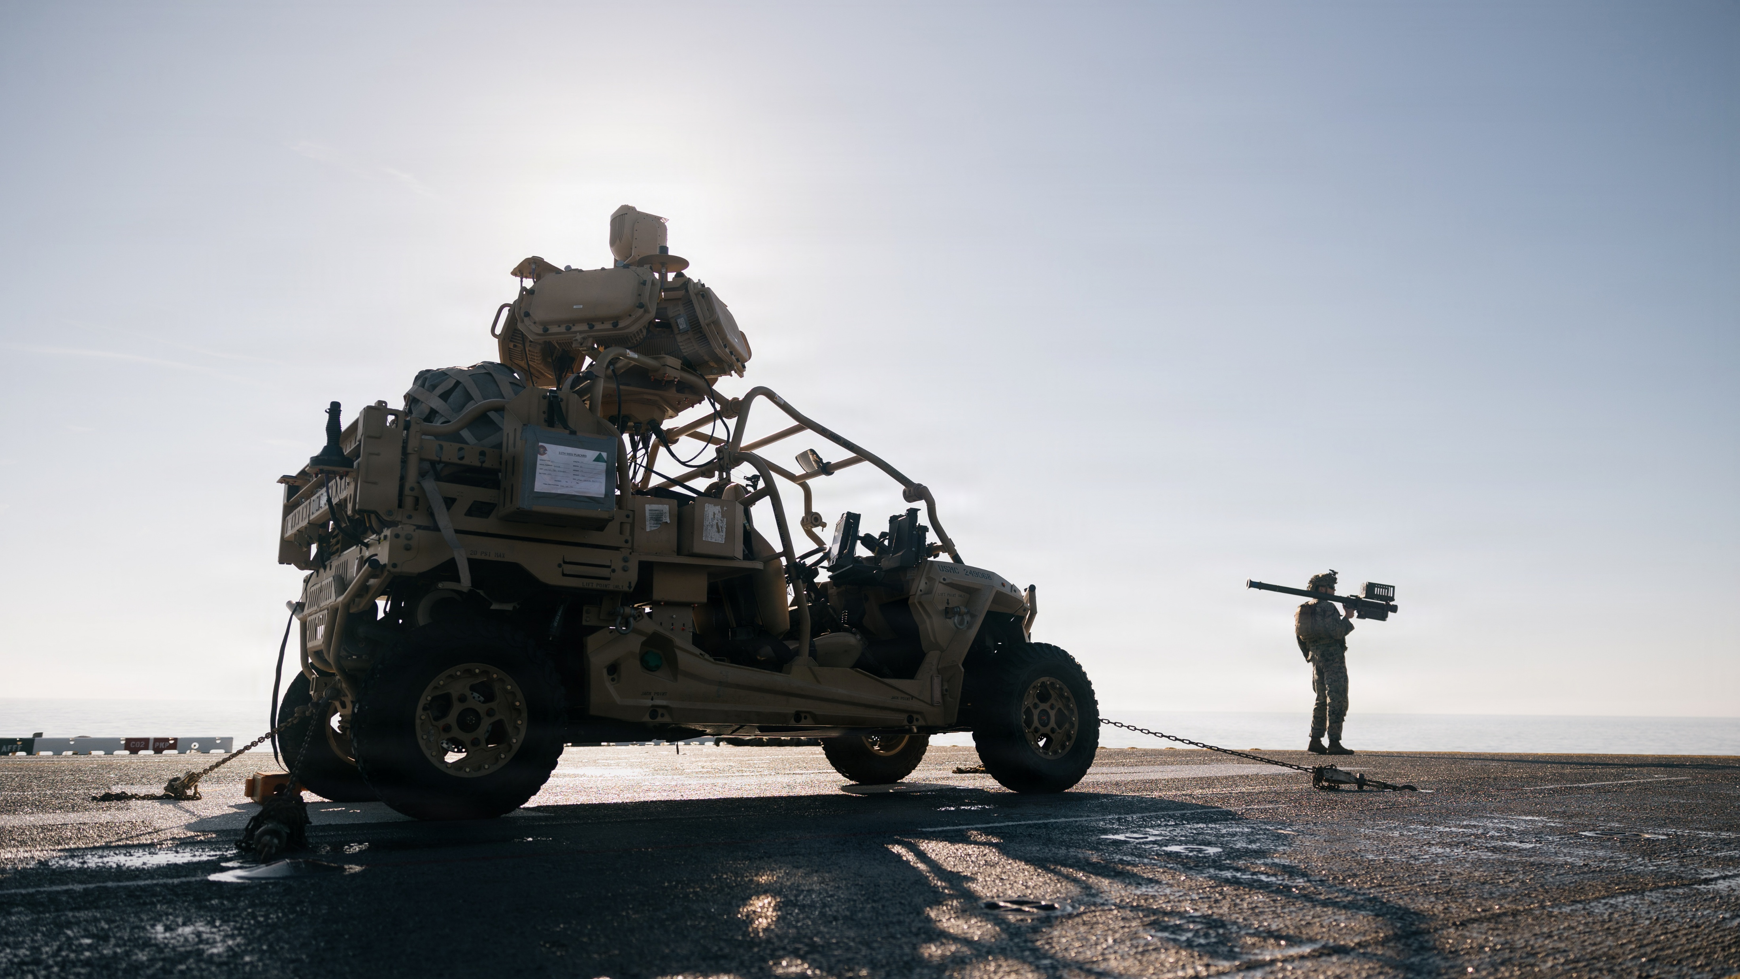
Gbad – future technology needs
BLUF: Today’s increasingly congested and contested airspace requires the acceleration of AI/ML tools to support C2/BM and new technology to optimize detection, identification and defeat of UAS, RW and FW platforms.
Significant gaps include:
  Battle management/C2 at the micro-level/edge
  Inclusion of GCE networks and organic CUAS capabilities into traditional ACE-centric layered air defense & networks
  Inability to integrate and incorporate a growing number of DoW and industry C2/BM interfaces
  Utilization of passive sensor contributions to joint data networks
  Effector and sensor integration into unmanned & autonomous systems
  Limited magazine depth, cost per shot, and contested logistics result in mismatched threat to kinetic effector ratio
Acquisition Gaps:
C2/BM: SW that reduces operator workload and enhances SA in a crowded battle space
  Automated Track Recognition (ATR), track/sensor fusion, EID, external data ISO threat classification
  Technology enabling BLOS threat classification ISO maximum range engagements
  Need to synch service level C2 (CAC2S, Lattice) with tactical C2 (MANGL, TAK)
Networks & Interfaces: Edge integration and synchronization with information from inter-Service, Inter-Agency, GCE and industry systems
Sensors: Passive sensors capable of contributing to joint data networks and providing situational awareness in EMI conditions
Effectors: Development of autonomous ground and airborne systems capable of employing effectors
Today’s GBAD Marine must:
  Conduct localized C2/BM functions historically associated with higher echelons that have more resources
  ID friendly/enemy threats at a scale and pace required for high end warfare
  Understand and employ an increasing number of networks and link functions
  Employ multiple effectors - both kinetic and non-kinetic
  Employ and operate Radars
BL: Not enough manpower and training resources to accomplish additive tasks – AI/ML tools necessary to perform functions effectively at capacity and scale
* MOSA still requires additional excessive time and money for integration. Sensors/effectors to join a network without years of testing and millions of dollars

Slide 6
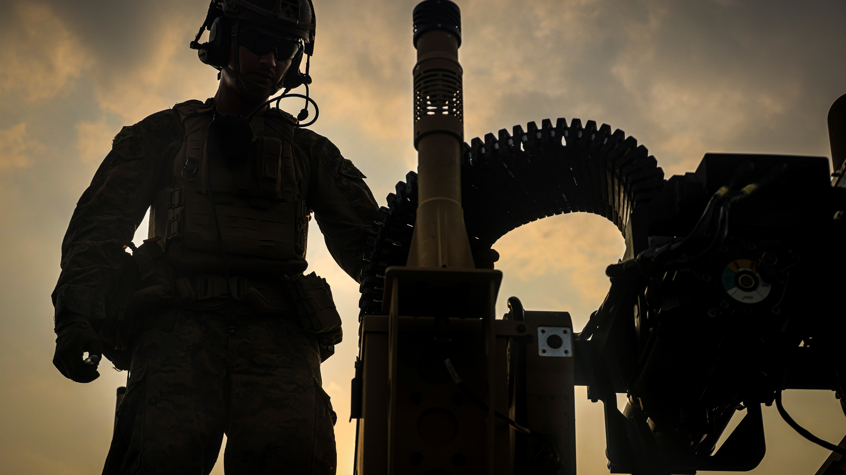
Questions?

Slide 7


Equipping our
WARFIGHTERS

