Slide 1
Program Manager Combat Support Systems
Colonel Paul Gillikin
Program Manager

Slide 2
Organizational chart
Mission: Equips and sustains the Fleet Marine Force with Combat Engineer Equipment, Individual Combat Equipment, Ammunition, Medical, and Maintenance systems and solutions to enable lethality.
Program Manager (PM)
Combat Support Systems (CSS)
Col Paul Gillikin
Deputy Program Manager
Mr. Jason Miller
Product Manager
Maintenance Support Systems
Product Manager
Ammunition
Product Manager
Engineer Systems
Product Manager
Combat Service Support Equipment
Team Lead
Advanced Manufacturing Systems
Team Lead
Ammunition Procurement & Support
Team Lead
Power Systems
Team Lead
Expeditionary Medical Systems
Team Lead
General Purpose Tools & Test Systems
Branch Head
Environmental & Explosives Safety
Team Lead
Fuel and Water
Team Lead
Clothing & Equipment
Team Lead
Automatic Test Systems
Branch Head
Inventory Management
Team Lead
Explosive Hazard Defeat
Team Lead
Individual Armor
Branch Head
Plans, Operations & Systems
Team Lead
Material Handling Equipment/
Construction Equipment

Slide 3
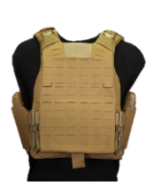
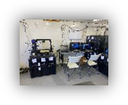

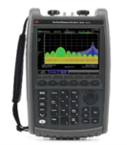

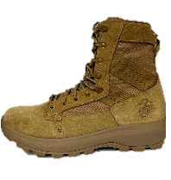
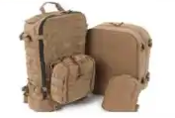
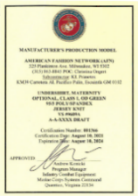
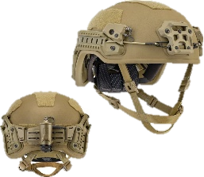
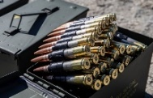

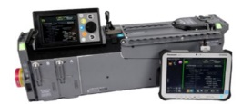


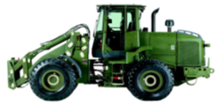
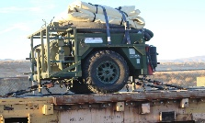
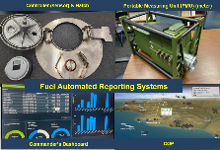
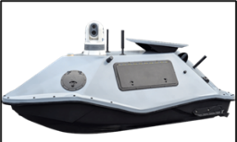
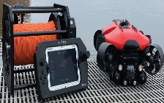
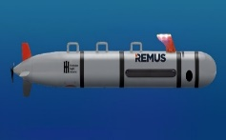

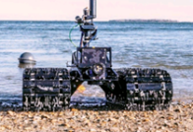
Pm combat support systems portfolio overview
Hand-held Radio Test Set
Advanced Manufacturing Data Warehousing / Parts Approval – per MCO 4700.4
Microwave Radio Test Set
USMC PPE Certification Program
Plate Carrier Generation III
Calibration and Maintenance Program - per MCO 4733.1D
Corrosion Prevention & Control
Expeditionary Fabrication (XFAB)
Inventory Control Point for all Class V Ground (W) Ammunition Stocks
Integrated Helmet System (IHS)
Product Manager
Maintenance Support Systems
Execute Enterprise Explosive Safety Management Program per MCO 5100.29C (Vol 8)
USMC Uniform Certification Program
Corpsman Assault Pack (CAP)
Ammunition procurements via the Single Manager for Conventional Ammunition (SMCA)
Product Manager Combat Service Support Equipment
Inventory Control Point for all Class VIII Expeditionary Medical Supplies
Product Manager Ammunition
Maintain the Marine Ammunition Knowledge Enterprise (MAKE) DBS and its associated applications (e.g. OIS-MC, Explosives Safety Portal, etc.)
.50 Caliber Polymer Ammunition
Ultra Lightweight Camouflage Net System Inc I
Author/maintain Multiple MCOs governing Class V(W) policy and procedures.
Portable Patient Transport Life Support System (PPTLSS) 2.0
Product Manager
Engineer Systems
Manage all Class V(W) for Prepositioning Programs
NexGen Marine Corps Combat Utility Uniform
Tractor Rubber-tired Articulated Steering Multipurpose (TRAM)
Tactical Aviation Ground Refueling System (TAGRS)
Multispectral Camouflage Overgarment (MCO)
Littoral Explosive Ordnance Neutralization (LEON)
Increment 1: Remote Operated Vehicle (ROV)
Increment 2: Dive Gear & Neutralization Kits
Increment 3: Unmanned Underwater Vehicle (UUV)
Increment 4: Unmanned Surface Vehicles (USV)
Increment 5: Amphibious Unmanned Ground Vehicle (AUGV)
Fuel Automated Reporting System
Lightweight Direct Current Generator (LDCG)
Lightweight Direct Current Generator (LDCG)
Increment 4: Unmanned Surface Vehicles (USV)

Slide 4
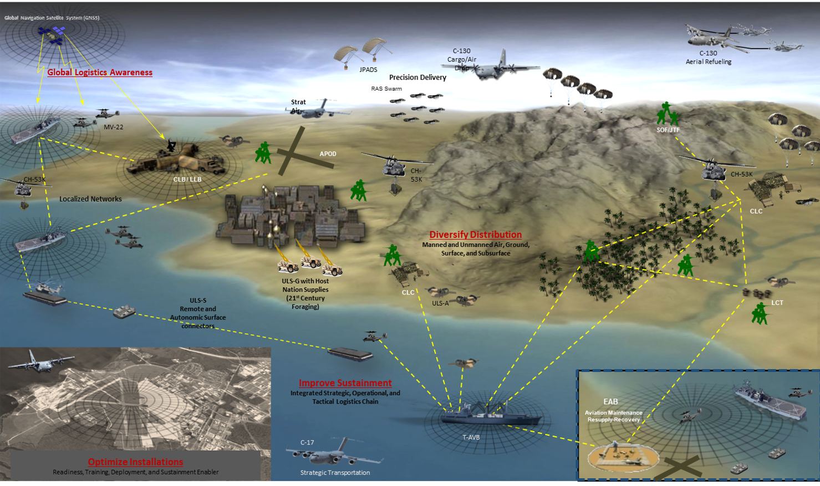
Logistics in a Contested Environment
KEY TERMS
EABO:
Expeditionary Advanced Base Operations
(CMC + CNO’s vision for Naval integration)
Attributes:
Distributed Operations
Low Signature
Tyranny of Distance
Naval Integration
Interchangeability/interoperability
Contested Logistics
Low signature
Stand-In Forces
Cost effective

Slide 5
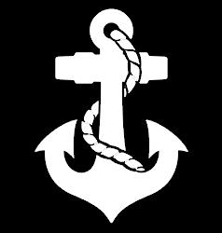

Pm css focus areas
Test Measurement Systems
Tools & Diagnostic Systems
Advanced Manufacturing Systems
Corrosion Prevention & Control
Ground Ammunition
Explosive Safety
Power Systems
Fuel, Water, & Field Feeding Systems
Explosive Hazard Defeat Systems
Material Handling & Construction Equip
Expeditionary Medical Systems
Individual Clothing & Equipment
Individual Armor
Shelters and Containers
PdM Maintenance Support Systems
  Advanced manufacturing
  ICD 705 compliant shelters
  Electronics repair
  Micro/Miniature circuit card repair
PdM Ammunition
  C-sUAS munitions
  Small base defense systems
  Accelerate delivery schedules
PdM Engineering Systems
  Expeditionary fuel distribution systems
  Material handling equipment
  Autonomous and robotic logistics systems
  Expeditionary power generation and storage
PdM Combat Service Support Equipment
  Expeditionary medical systems
  Signature management, flame resistance, ballistic protection
  Cold weather & mountaineering equipment
FY26
FOCUS
AREAS

Slide 6
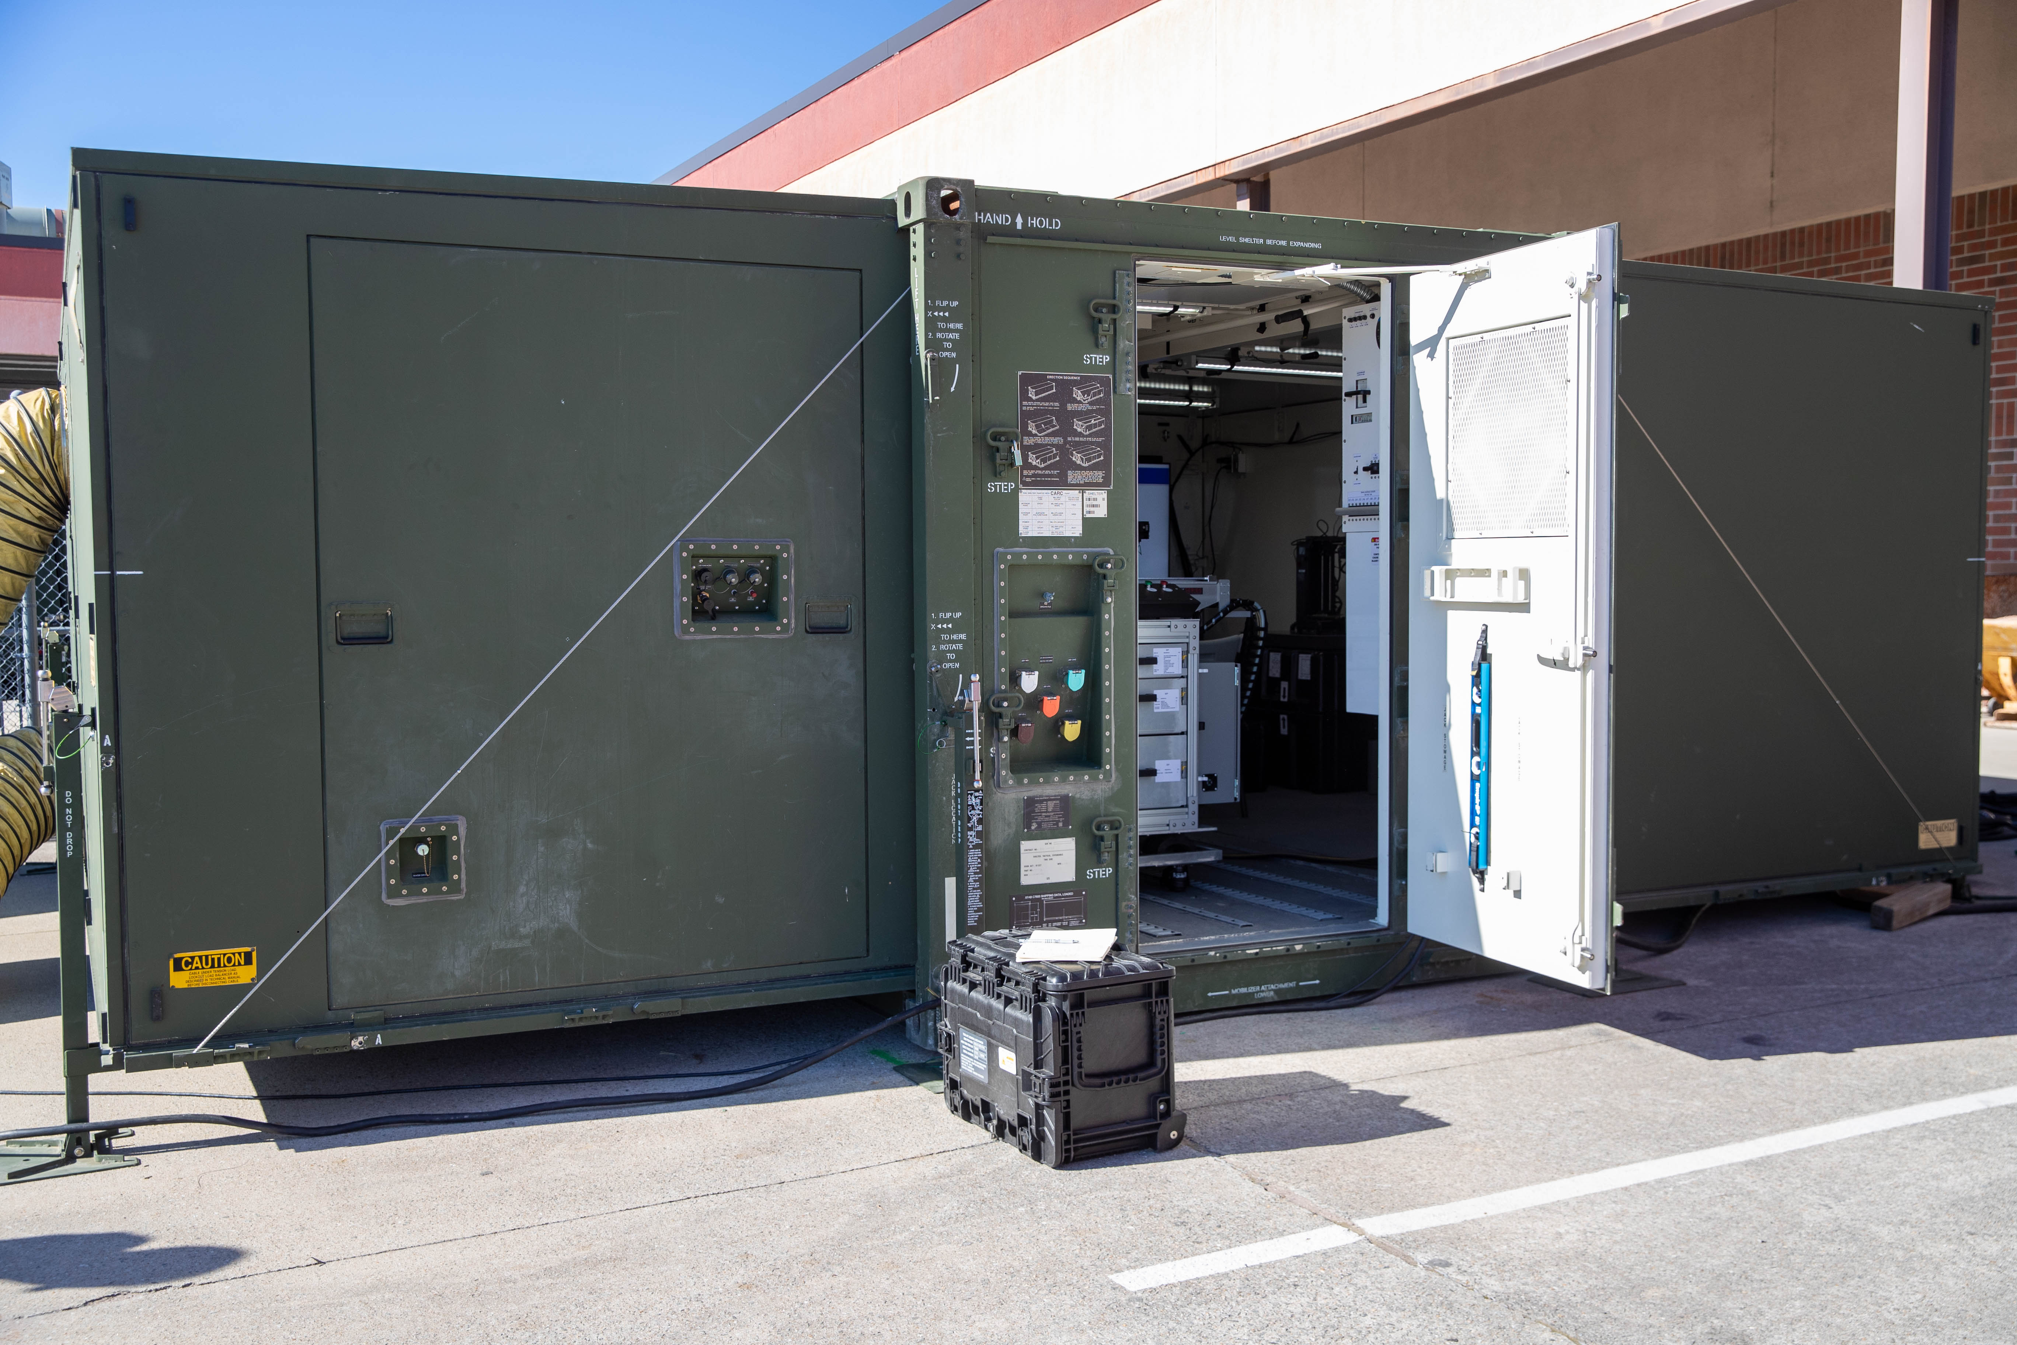
Pdm mss – areas where industry can help
Expeditionary fabrication / advanced manufacturing (metal print technologies)
AI & ML technologies to enable predictive maintenance and improve productivity, quality, and the user experience for the Marine Corps maintenance community
Deployable Secure Shelters-Scalable (DS3) w/accreditation
Next generation General Purpose Automatic Test Set (GPATS)

Slide 7
Pdm mss – opportunities
TITLE | PLANNED RFP
Tactical Radio Intermediate Test Set | FY26
Automated Circuit Card Test System | FY26
Tele-Maintenance / AR/VE | FY26
Next Generation General Purpose Automatic Test Set | FY26

Slide 8
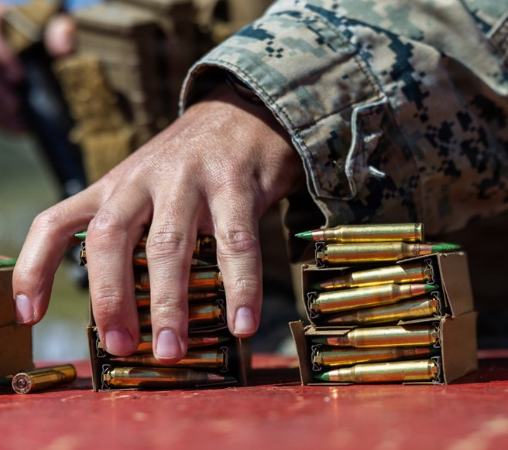
Pdm ammunition – areas where industry can help
C-sUAS munitions in existing weapon systems
Readily available, mobile, and light small defense systems
Increase mortar and artillery propelling production capacity
Improve production quality
Reduce production lead time
Increased range and lethality for all munitions
Reduce blast overpressure

Slide 9
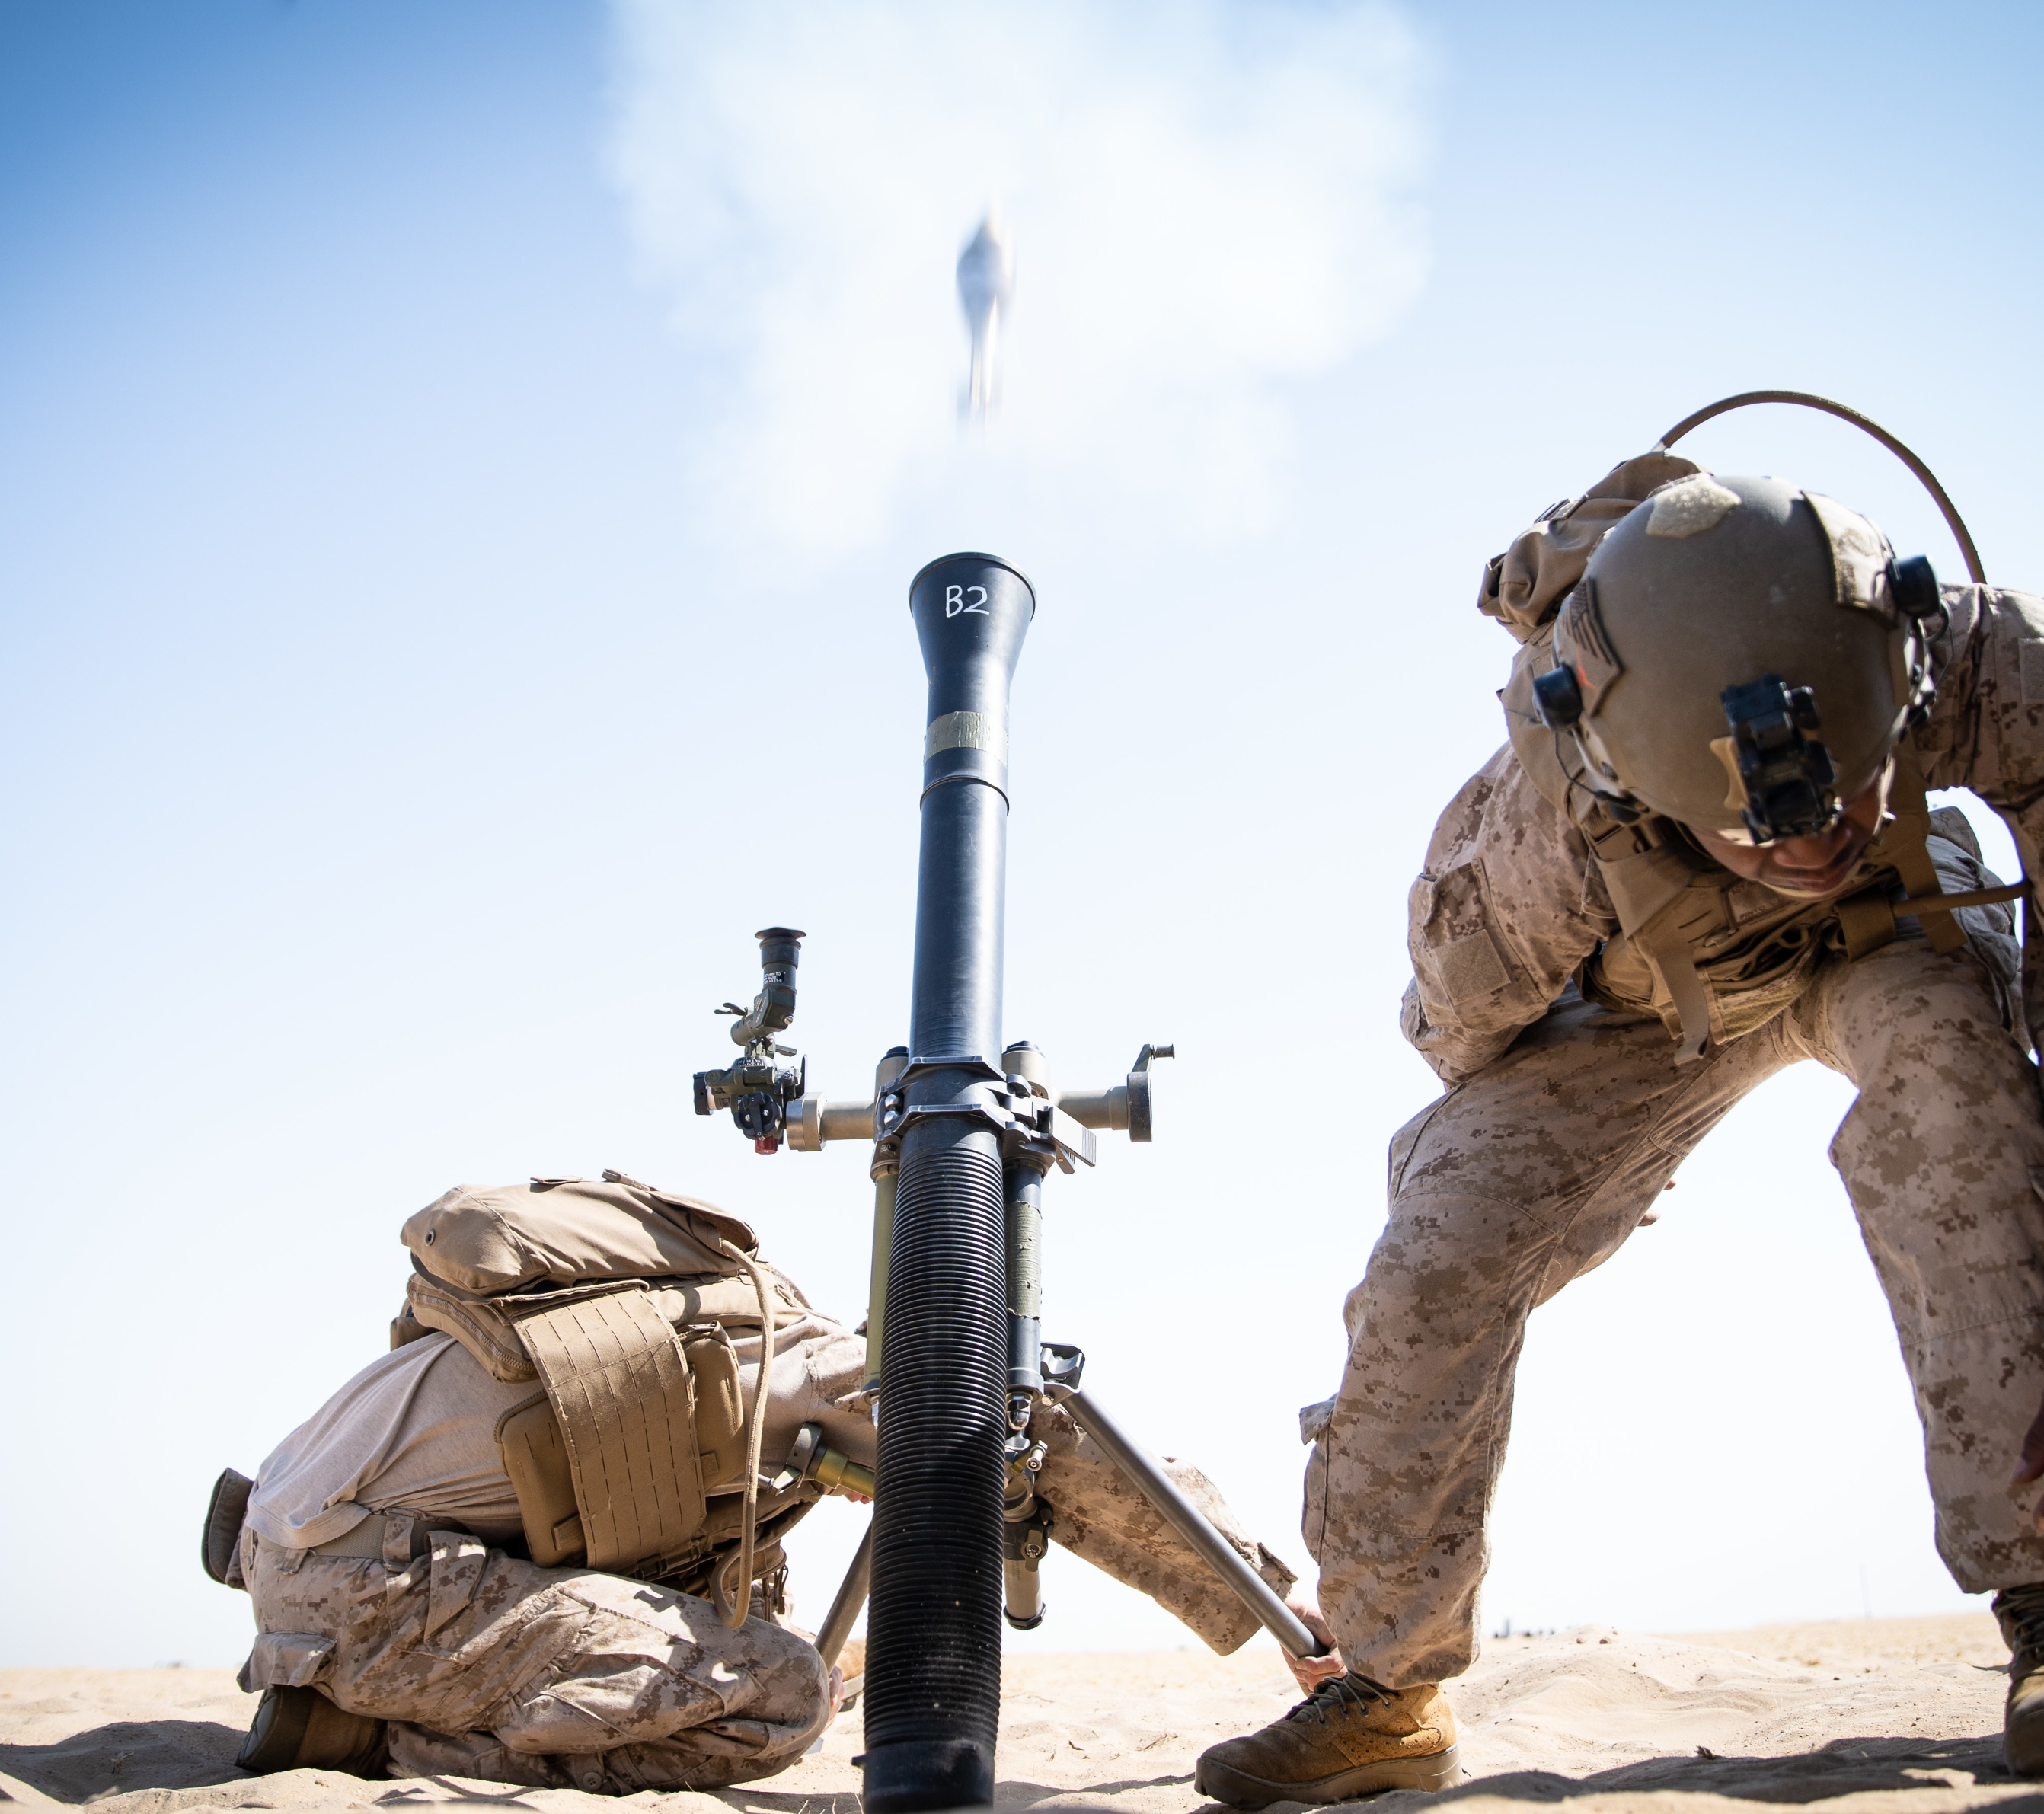
Pdm ammunition – 81mm mortar rounds
PdM Ammunition is seeking industry partners to increase 81mm mortar round availability
Prefer High Explosive (HE) rounds that meet military specifications and technical standards
Releasing a Request For Information (RFI) for 81mm mortar projectiles
Vendor must have a current capability and capacity
Will consider HE rounds that meet NATO standards (interchangeability)
Establish a bailment agreement to conduct technical evaluation and live fire testing

Slide 10
Pdm ammunition – opportunities
TITLE | PLANNED RFP
81MM Mortar Sources Sought | 2QFY26
MCAB Hawaii Air Show | 3QFY26
MCAS Beaufort Air Show | 4QFY26
MCAS Miramar Air Show | 4QFY26
USMC Shooting Team | 2QFY27

Slide 11
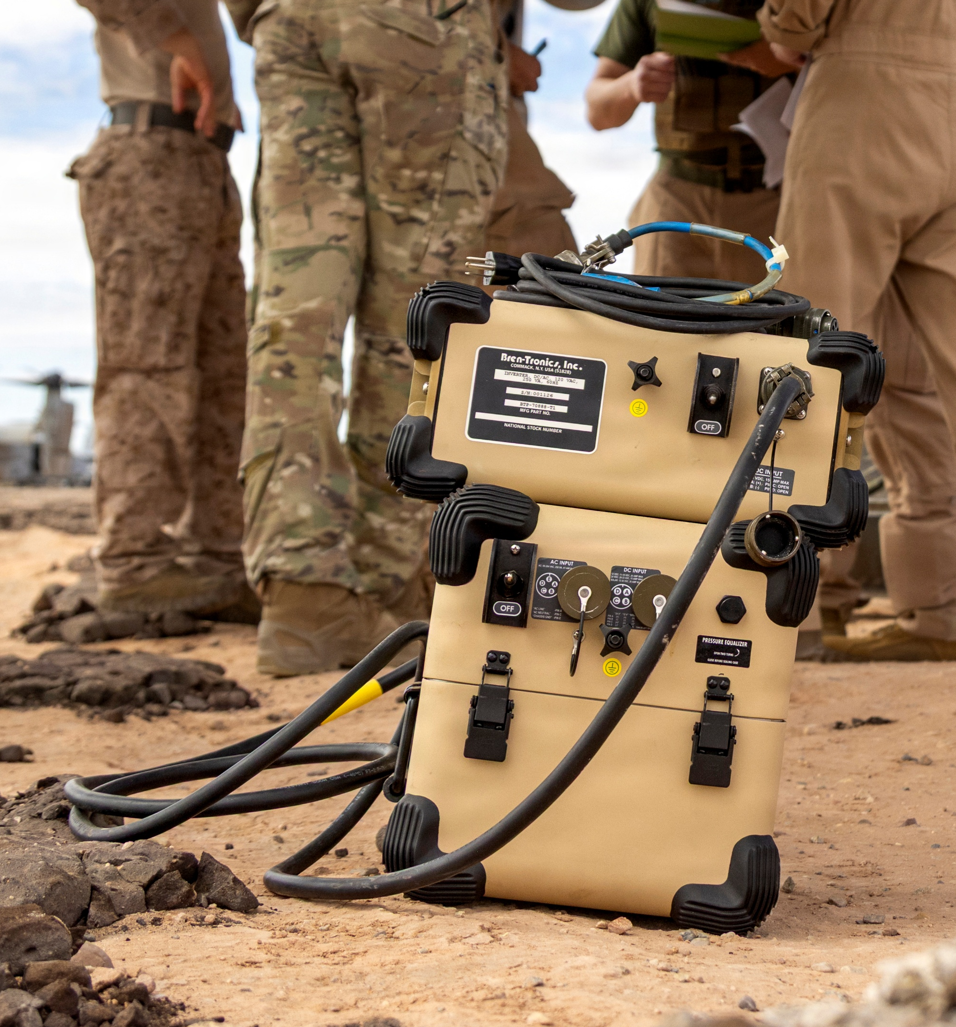
Pdm engineer systems – areas where industry can help
Autonomous Pallet Loader (APL) & Pioneer systems
Lithium-ion batteries built to military performance standards
  Higher density/lower weight/faster charge rate
AC & DC expeditionary load banks
Lightweight generators below 5kW – assist Army’s Small Tactical Electric Power program
Expeditionary bridging

Slide 12
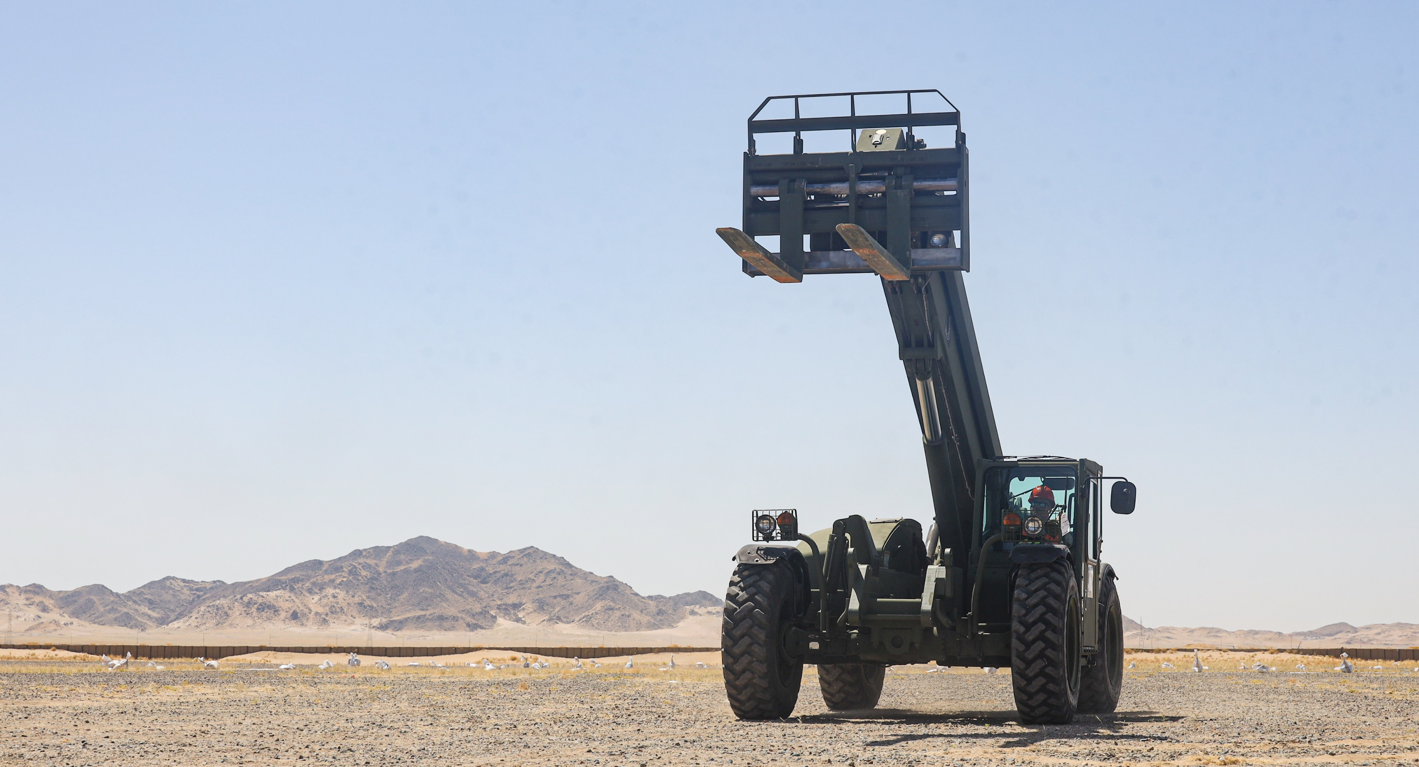
Pdm engineer systems - opportunities
TITLE | Planned RFP
Vibratory Compactor | 2026
Extendable Boom Forklift (EBFL) | 2026
Expeditionary Bridging | 2027
Family of Environmental Control Equipment | 2028

Slide 13
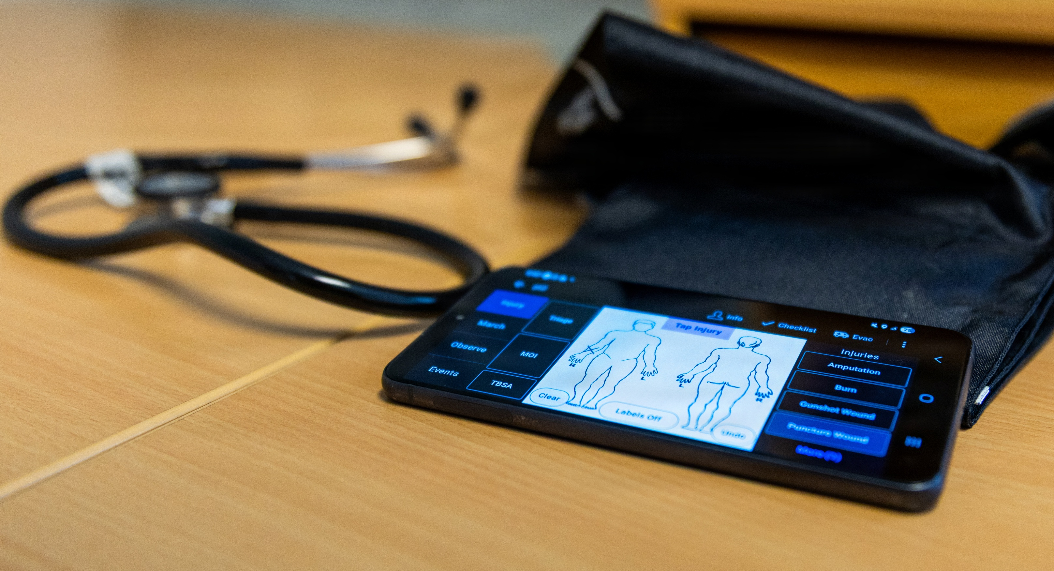
Pdm csse – areas where industry can help
En route care during operations in contested environments
Role 1 & Role 2 enhanced for Expeditionary Advanced Base Operations (EABO)
Portable ruggedized energy efficient medical sterilizer
Disposable surgical packs customized for various medical procedures
Ballistic protection – improved performance at less weight
Hearing enhancement & protection
Signature management (individual clothing & equipment)
Flame resistance
Constant market research for footwear innovation
Cold weather clothing, accessories, and footwear
Quality control and consistency

Slide 14
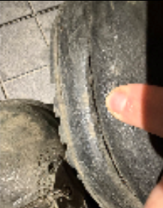
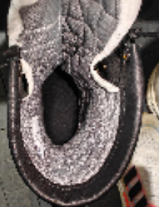
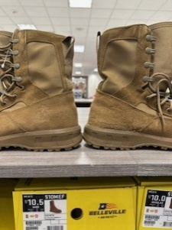
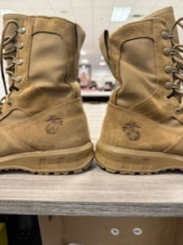
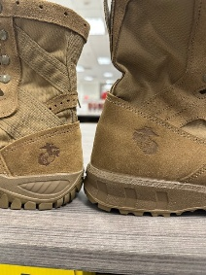
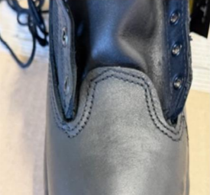
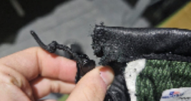
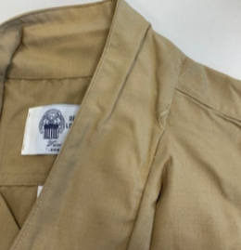
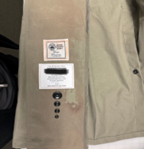
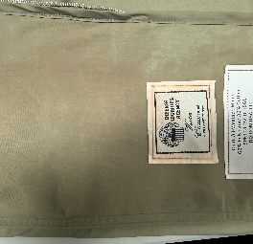
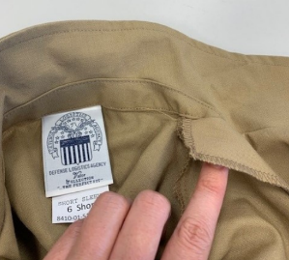
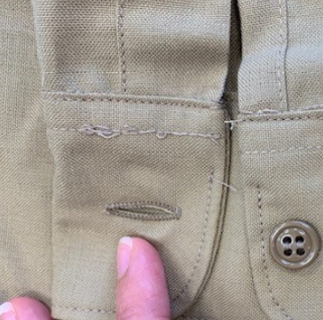
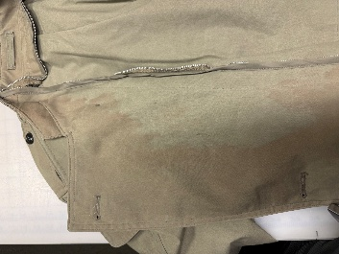
Uniform item defects
Intense Cold Weather Boot (ICWB)
Marine Corps Optional Combat Boot
Background: Workman defects observed with the ICWB for Marines during cold weather training, ISO Cold Response 26. These boots had less than 30 days of wear time. Marines were pulled out of the field during training ops due to this defect.
Defects:
Sole Separation
Heel cup digging into Achilles
Tread detaching from sole
Heel cup worn through liner
Defects:
Spot inspection identified workmanship concerns, which resulted in 29% of all stock throughout the Marine Corps Exchange enterprise having to be pulled from the shelves and returned to the vendor for a one-for-one replacement. The vendor agreed that these failures were unacceptable.
Defects included a poor grade of leather used
Improper placement of the Marine Corps Emblem (EGA) (location out of tolerance
EGA not visible
Khaki Shirts
All Weather Coat
Background: C&E clothing designers inspected Men’s and Women’s Khaki Shirts to identify defects and quality issues affecting form, fit, and/or appearance. DLA contracts with the Federal Prison Industry, which limits the DOD industrial base on quality manufacturing.
Defects:
Due to manufacturing practices, when the coat was exposed to water, the liner would bleed an orange color from the inside out, making the AWC unserviceable and potentially causing the uniform underneath the AWC to be ruined.
Additionally, the vendor is constantly failing to meet the color standard, resulting in delays in production, causing back orders
Defects:
Pocket and/or flap out of alignment
Sleeve cuff stitch line ends short of meeting cuff attachment seam
Crease in the collar due to the under collar piece being wider than the top collar
Facing not tacked

Slide 15
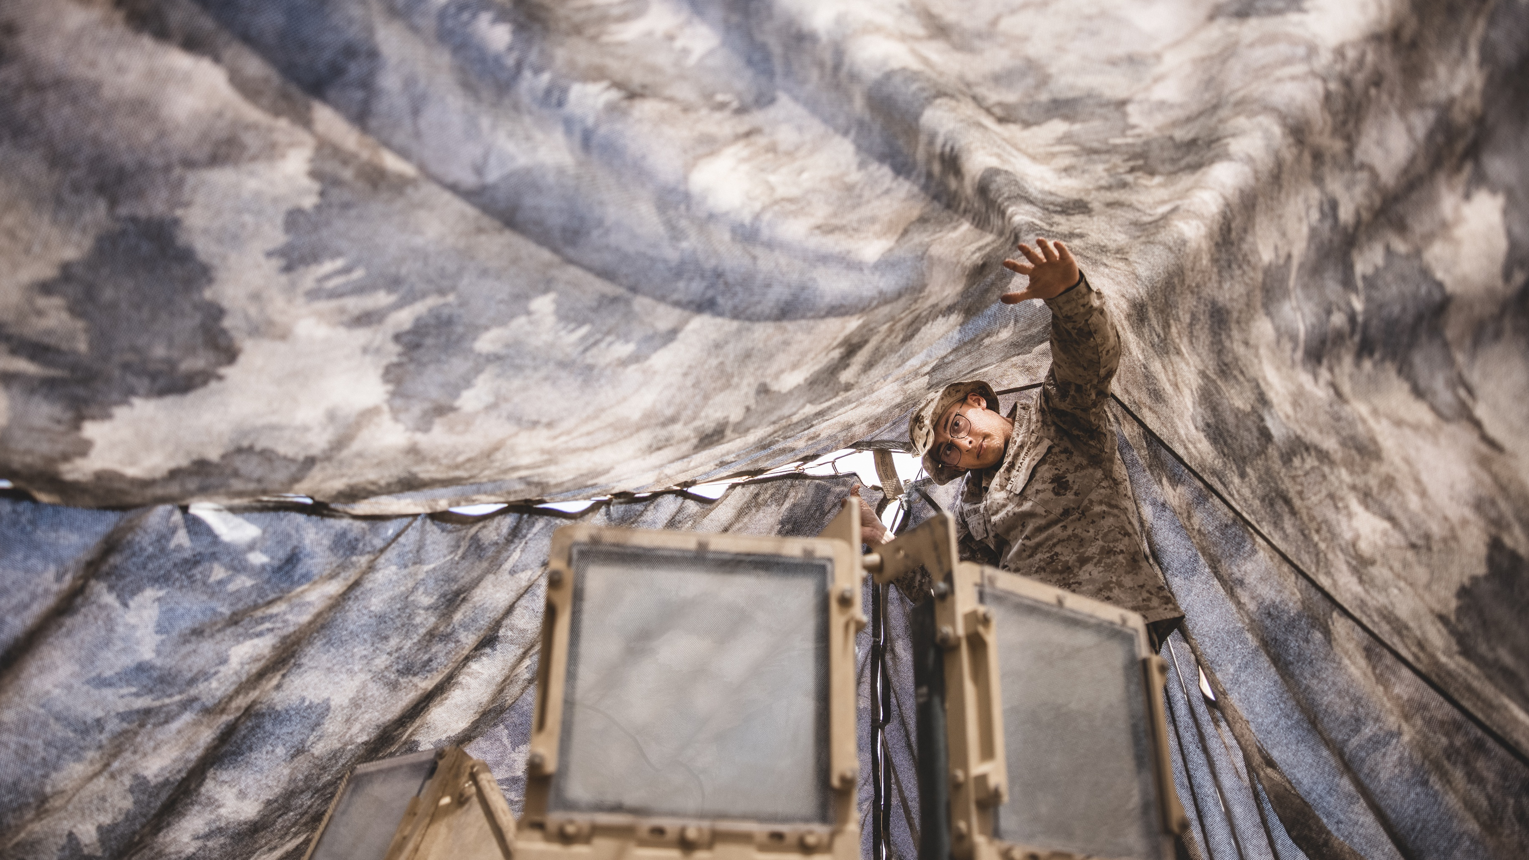
Pdm csse – opportunities
TITLE | PLANNED RFP
Enhanced Flame-Resistant Combat Ensemble (EFRCE) uniform (NATICK) | 3QFY26
Ultra Lightweight Camouflage Net System Increment I (ULCANS Inc 1) | 3Q-4QFY26
Multispectral Camouflage Overgarment (MCO) – RFI out | 4QFY26
NexGen Marine Corps Combat Utility Uniform - DLA to replace seabag uniform | 4QFY26 - 1QFY27
Hearing Enhancement Device (RFI closed 30 March 2026) | 2QFY27

Slide 16
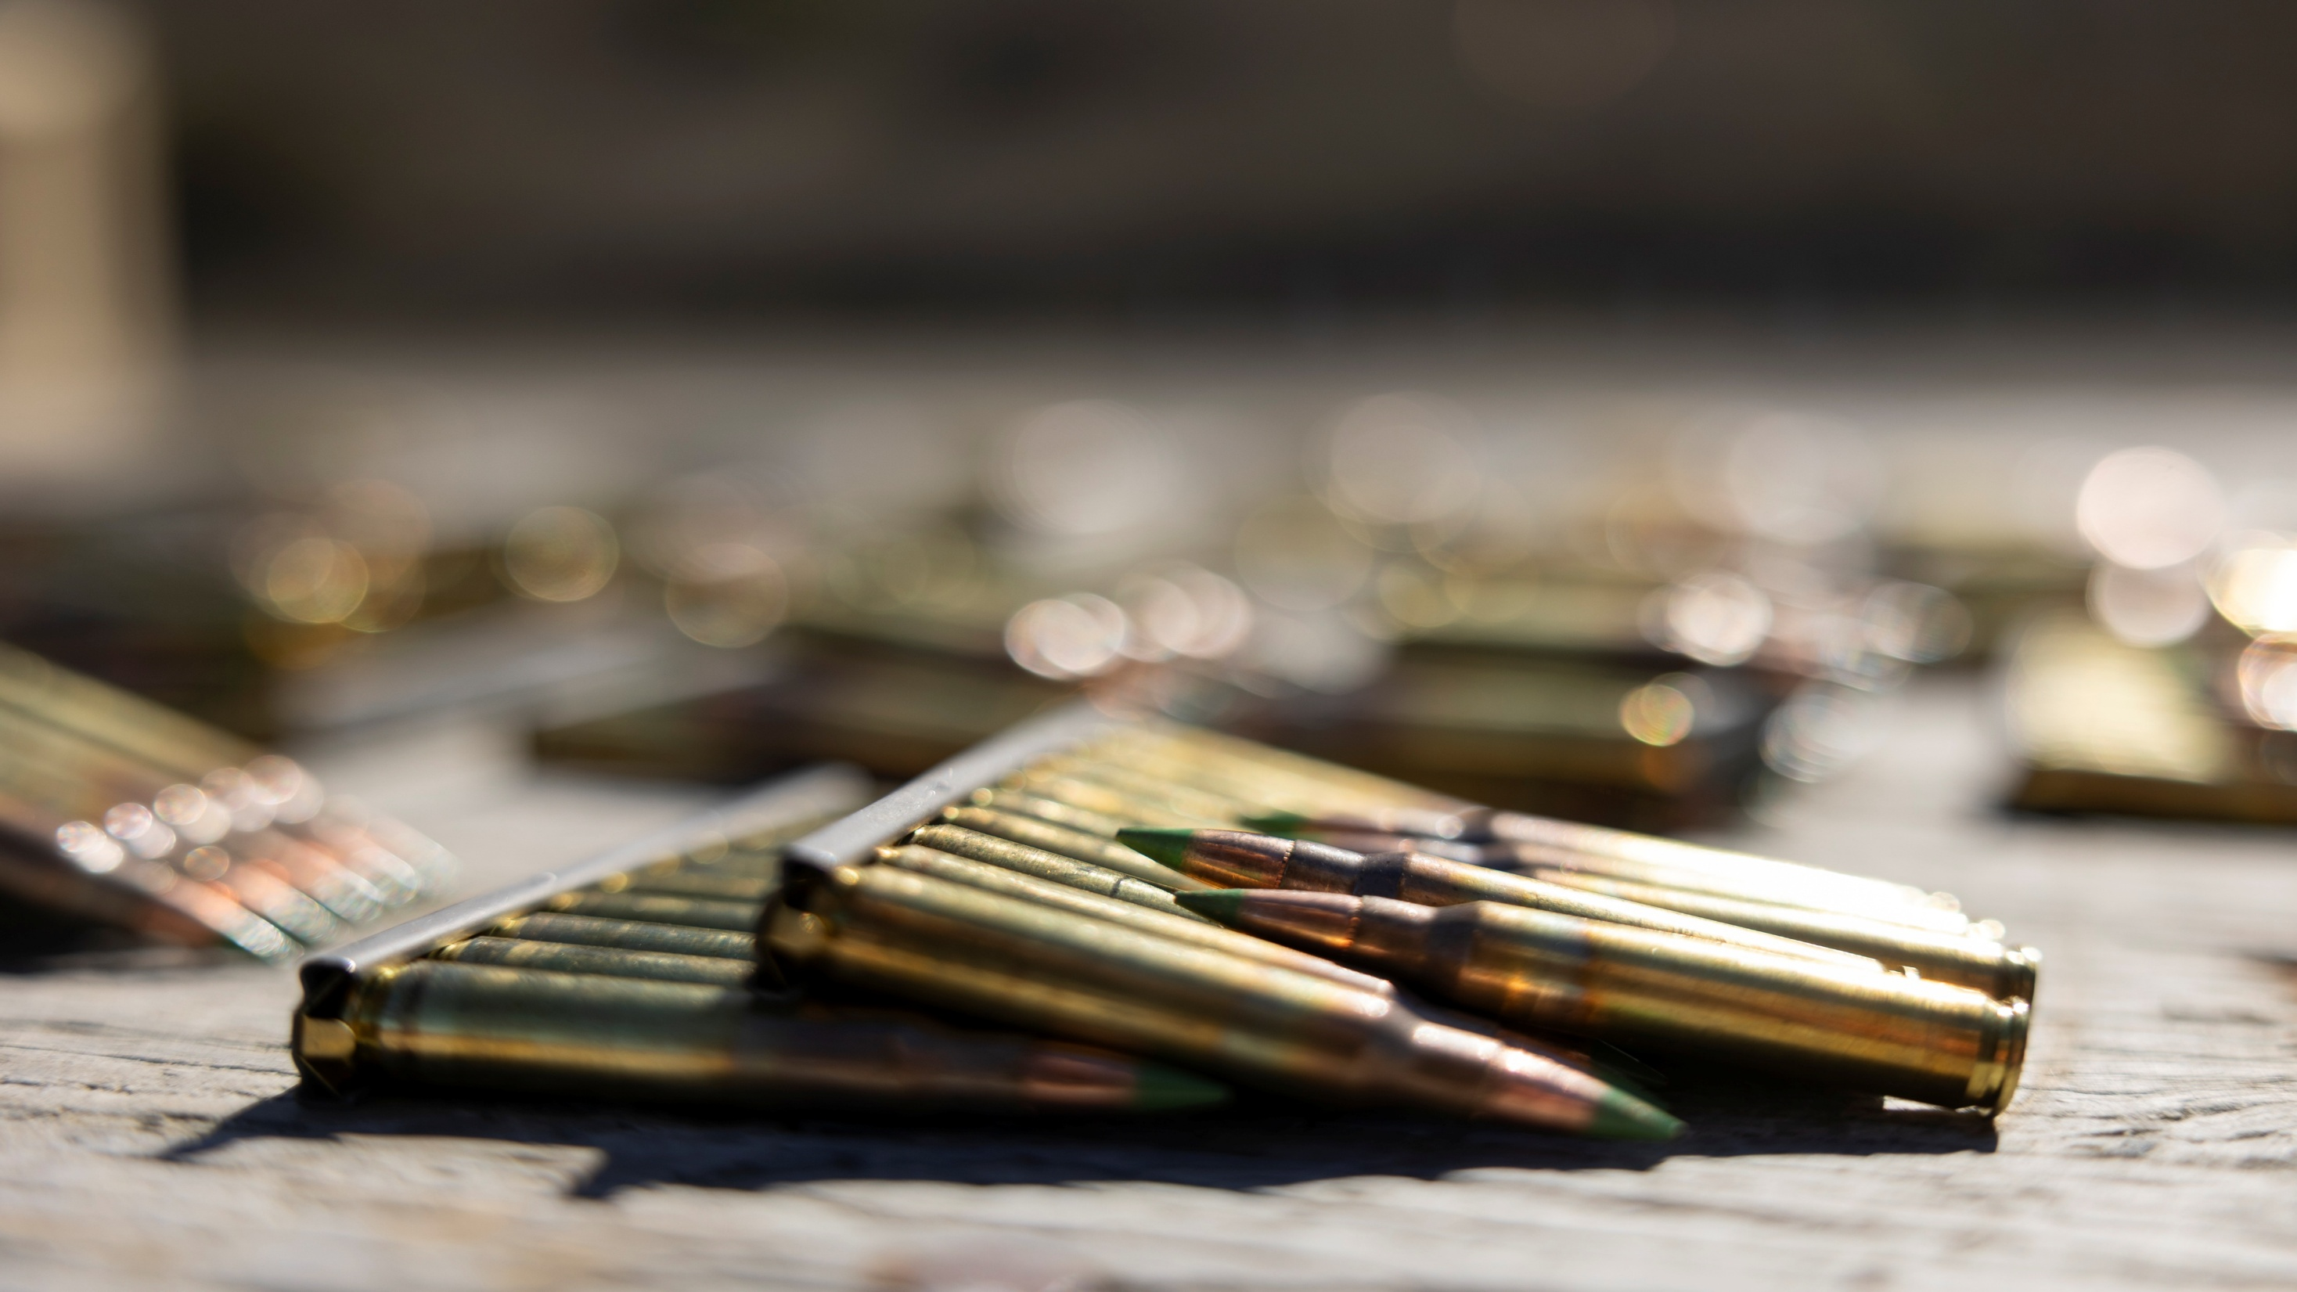
Questions?

Slide 17

Equipping our
WARFIGHTERS

Slide 18
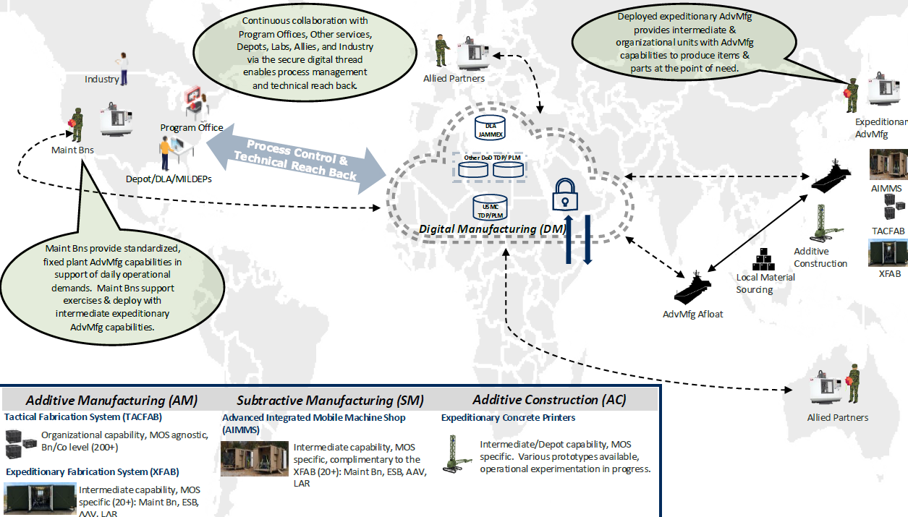
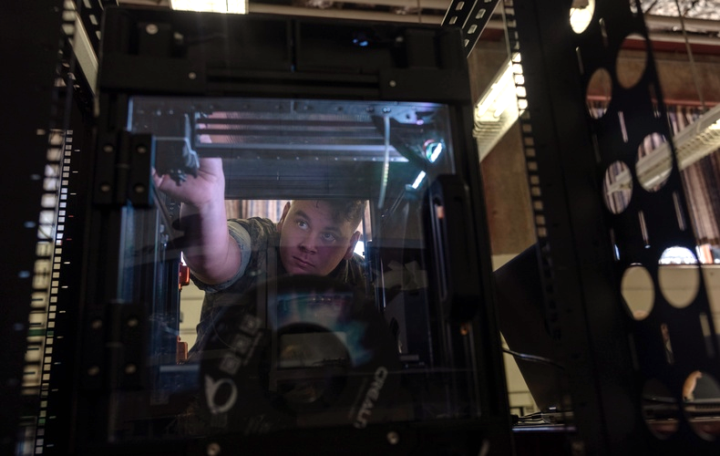
Advanced Manufacturing CONOP
KEY POINTS
Log IT – Integration
Initial rollout of an Expeditionary Metal Printing capability

Slide 19

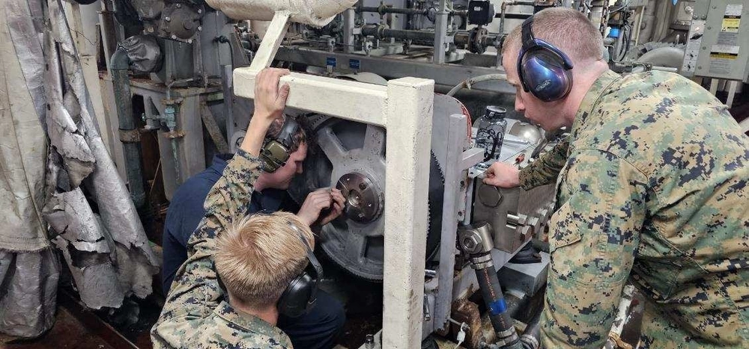
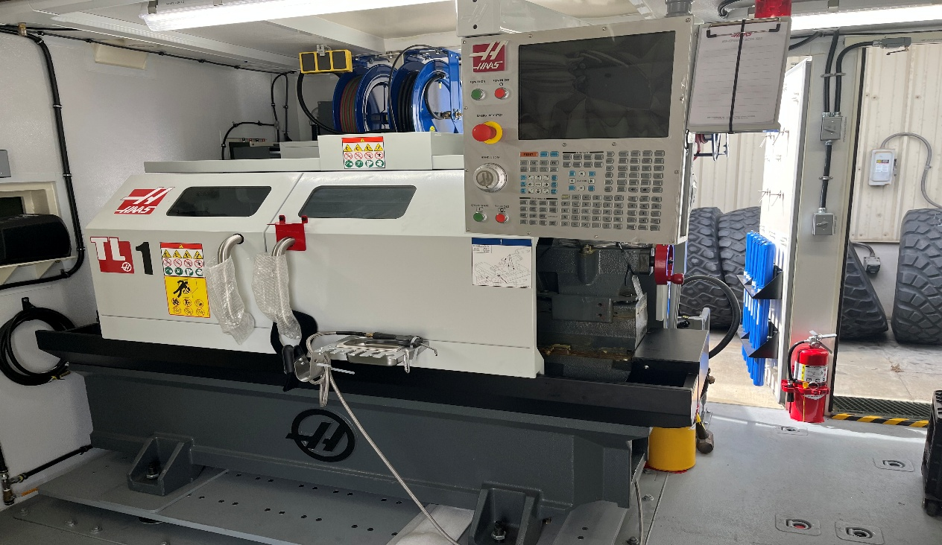
“During RIMPAC 2024, Marines and engineers from the Naval Post Graduate School’s Consortium for Advanced Manufacturing Research and Education (CAMRE) demonstrated the power of onboard 3D printing on the USS Somerset. Shortly after deploying a hybrid-metal printer, the team successfully printed a critical component for the ship’s reverse osmosis pump — vital for producing clean water — after the original part failed. This rapid response not only maintained the ship’s operational readiness but showcased the potential for Marines to use 3D printing to address urgent repair needs directly at sea”

Slide 20
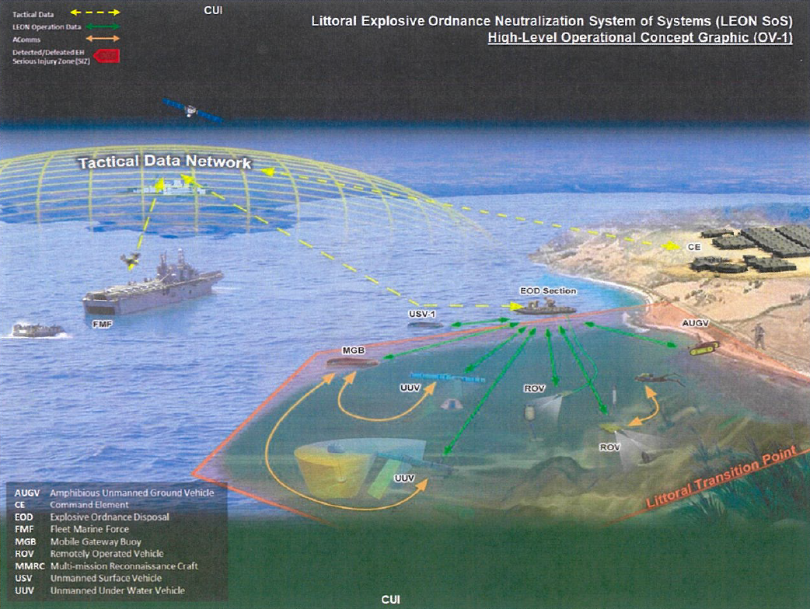
Littoral Explosive Ordnance Neutralization (LEON)
“Provides advanced capabilities integrated on unmanned surface, ground and underwater platforms to detect and defeat explosive hazards (EH) from littoral operations. This autonomous and remotely controlled deployable system of systems provides detection, virtual marking, near-real time reporting, and neutralization of EH. The LEON SoS facilitates the defeat of EH, keeps Marines outside the serious injury zone, ensures freedom of movement and maneuver in future operating environments, and increases the commander’s decision-making ability.”

Slide 21
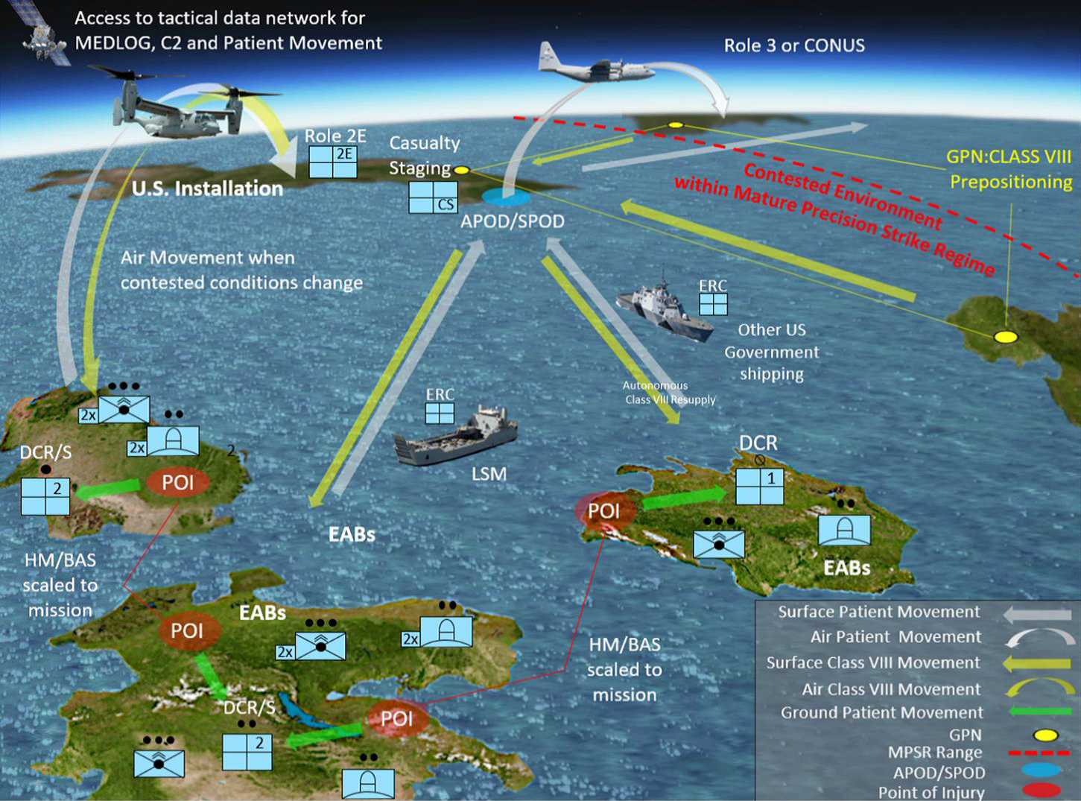
Expeditionary Medical Capabilities
KEY POINTS
Expectation is that we will not have complete air and maritime dominance.
This new reality now requires longer patient hold-times up to 4 days, moving away from the OIF/OEF Golden Hour.
Recapitalizing current systems into smaller deployable kits
Technologies of interest include:
  Freeze dried plasma
  Freeze dried platelets
  Sterilization
  Modernize medical warehousing (CONUS/Deployed)
  Portable oxygen generator

