Slide 1
Program Manager Advanced Reconnaissance Vehicle (ARV)
Colonel Chris Stephenson
30 April 26

Slide 2
Program manager Advanced reconnaissance vehicle (arv)
Overview
Mission
Program Description
Develop, provide, support and sustain effective Light Armored Reconnaissance systems that enable our Marines to win.
Successor to the legacy LAV in the Light Armored Recon Battalion
Key enabler of the Mobile Reconnaissance Battalion providing battlefield data ‘quarterbacking’, mobile recon, fire support, and recon movement.
A Family of Vehicles program comprised of six variants:
ARV-C4UAS, ACV-Logistics, ARV-30mm, ARV- Counter UAS (CUAS), ARV-Operational Precision Fires (OPF), and ARV- Recovery
Program Status
Key Events & Focus Areas
Acquisition Phase:
Pre-Production Development (EMD)
Capabilities:
Battlefield Quarterbacking, MRB Eyes and Ears
Risks/Opportunities:
Accelerating Development; Incorporate new capabilities
Apr 26: PPD Contract Award
Oct 26: Critical Design Review
2029: Production Down Select
2030: Production Award

Slide 3
ARV Family of Vehicles
ARV-C4UAS (Lead Variant) Crew: (2) - driver, VC Embarked Marines: (5)- Mission based. Cdr, Staff, UAS Operator, ... Sensor: Organic UAS, Mast mounted sensor {EO/IR), EW Support (ES) Lethality: EW C-UAS {MODI II-like), MMG | Provides the networked communication and workstation space for mobile C4, information processing, and long range UAS sensing. Mast for all weather enhanced communications and long-range visual detection. ES to sense EMS around the vehicle
ARV-LOG (Lead Variant) Crew: (2) - driver, VC Embarked Marines: (1)- Comm Tech {Objective) Sensor: None Lethality: EW C-UAS, MMG | Provides logistics sustainment including OPF munitions, Organic UxS, maintenance repair parts, Class I, Ill, and V supply, as well as CASEVAC capacity. Self recovery capability via winch Facilitates top hatch {via crane) and rear hatch {USMC forklifts) loading and unloading
ARV-30 Crew: {3) - driver, VC, gunner Embarked Marines: (4) - RAS controller, 2 x scouts, one enabler Sensor: sUAS {VTOL, 10 km range), Turret EO/IR Lethality: EW C-UAS, ATGM, 30mm, MMG | Provides mobile protected firepower for the formation and dismounted scouts. LOS Javelin-like ATGM {Threshold), BLOS Spike II-like ATGM {Objective). Programmable Air-Burst Munition {PABM) capable medium caliber cannon. Organic SUAS and USSV with dedicated control station and operator.
ARV-PF Crew: {2) - driver, VC Embarked Marines: (2)- Loitering Munition Operators Sensor: UAS "Hunter" imagery feed Lethality: EW C-UAS, 12 available rounds/PF {2 ready), MMG | This variant provides BLOS fire support to formation out to 40 kms, C-Recon., Electronic Attack {anti­radiation), and surface attack capability in the littorals. The UAS is designed to provide LOS telemetry to Loitering Munition.
ARV-CUAS Crew: {2) - driver, VC Embarked Marines: (2)- 2 x low air defense Sensor: 360-degree, air radar Lethality: 30mm air burst, Directed EW C-UAS, MMG | This variant provides kinetic and non-kinetic C-UAS capability out to ~1okm. Vehicle design, sensors, and manning are optimized for 24 hr sustained C-UAS threat but can detect and engage ground threats as well.
ARV-R Crew: (2) - driver, VC Embarked Marines: (1)- maintainer Sensor: None Lethality: EW C-UAS, MMG | The design driver for this variant is the crane and winch. Fuel foraging system. Metal welding and cutting capability.

Slide 4
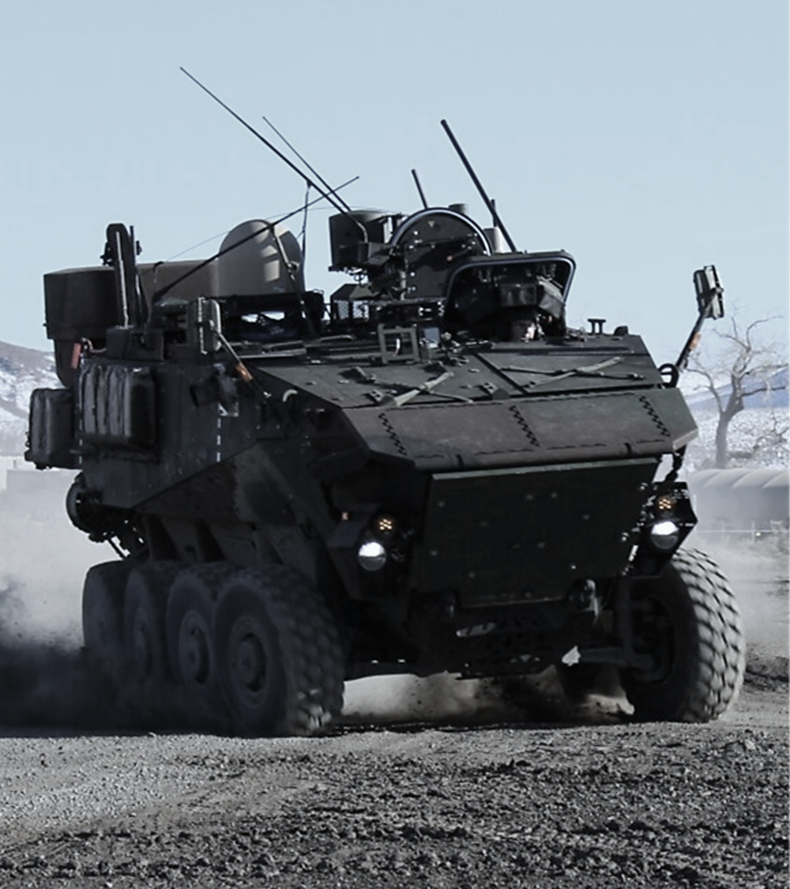
Acquisition Innovation & Industry Partnerships
  ARV is more of a mobile system than a traditional vehicle. ARV will leverage an open architecture that will both provide opportunities for more than just the OEM and will rapidly iterate and integrate capability to address threats and enable our Marines. Examples include sUAS, C-sUAS, signature management, autonomy, and cyber/information warfare.
  ARV embraced alternative acquisition vehicles from its inception, executing its Prototyping Phase with Other Transaction Agreements through the National Advanced Mobility Consortium.
  Award to Prototype in 15 months
  ARV then leveraged recent Acquisition Reform to award the Pre-Production Phase, using stand alone OTAs in less than one half the time of comparably sized efforts
  Government is moving faster, but it only works if industry does the same
  Reduced Acquisition cycle time is a win for both PMs and Industry, but the Marine is the biggest beneficiary the more quickly we can field capability
  Competitive Sustainment is now and will remain a key priority for ARV
  Even in such a construct the OEM remains a key partner and is keenly positioned to benefit in the sustainment phase

Slide 5
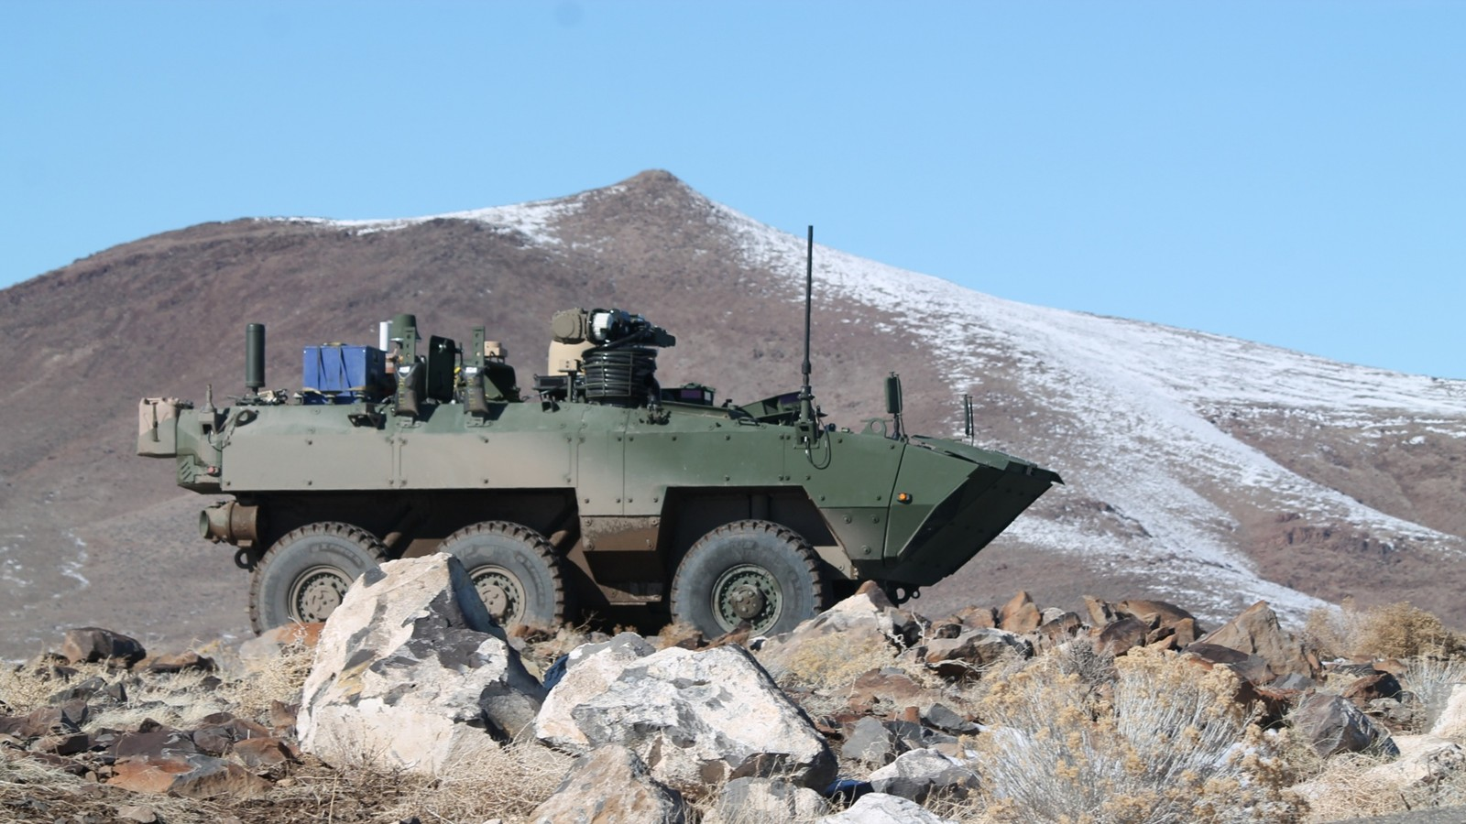
ARV/LAV OPPORTUNITIES
TITLE | DATES
Michigan Defense Expo | May 12-14 2026
Advanced Product Brief to Industry | August 2026
LAV Open Opportunities/Possible ARV Updates will be part of above events.

Slide 6
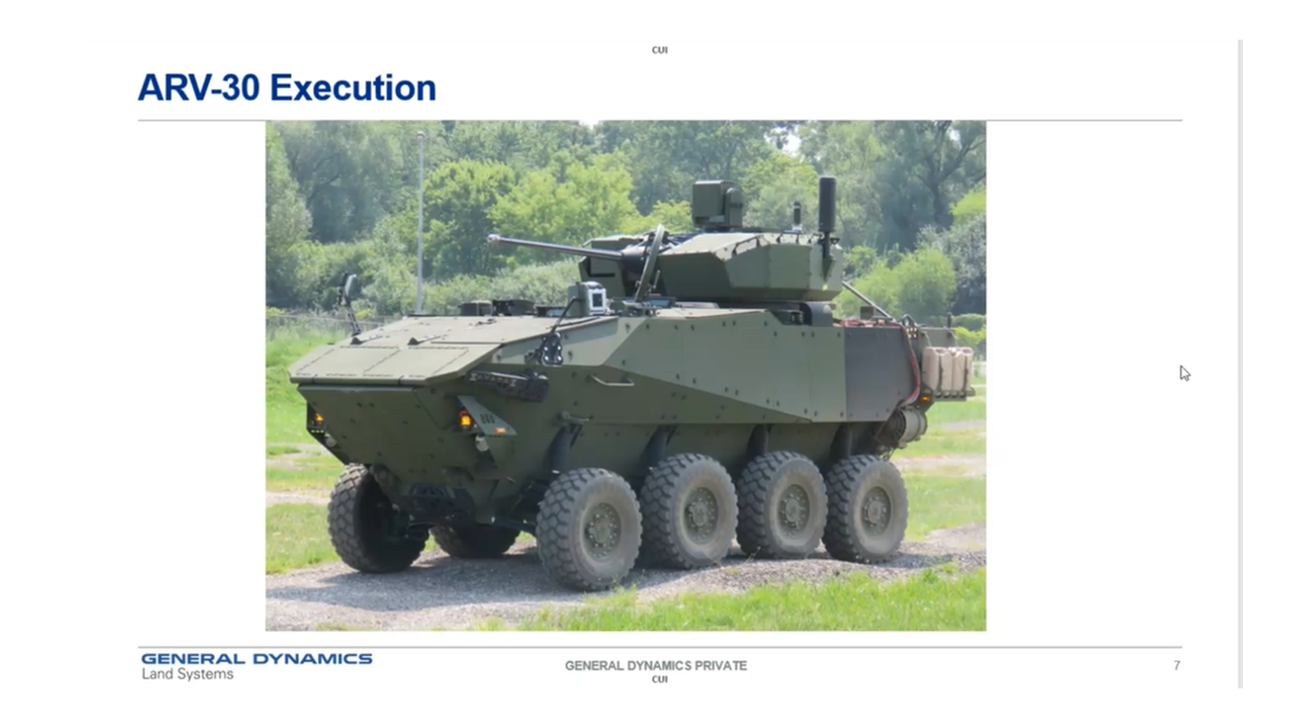
Questions/comments

Slide 7


Equipping our
WARFIGHTERS

