Slide 1
USMC Light/Attack Helicopter Program
(PMA-276) Colonel Jason Duke “Dookie”
Program Manager
Controlled By: Department of the Navy
NAVAIRSYSCOM: PEO (A); PMA-276
Distribution Statement: A
POC: PMA-276 Public Affairs, 240-434-3302
“NAVAIR Public Release 2025-0248. Distribution Statement A – “Approved for public release; distribution is unlimited””

Slide 2
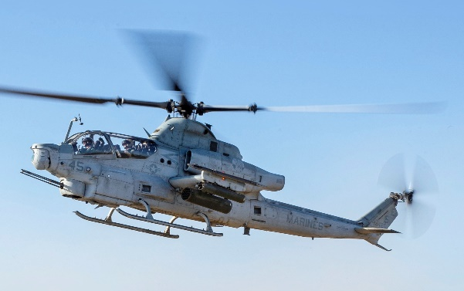
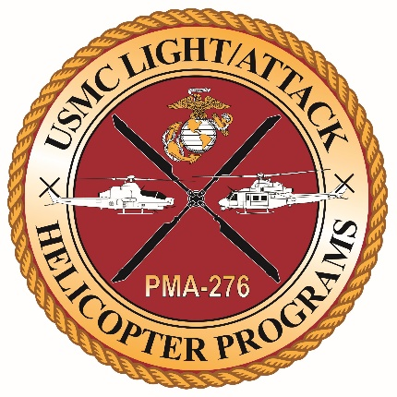
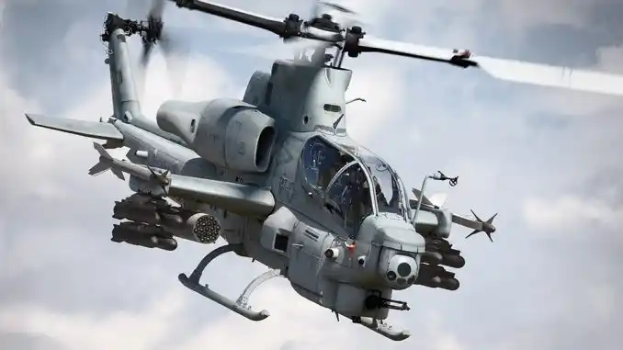
UH-1Y
Mission: The UH-1Y Venom multi-role utility helicopter is equipped with a wide range of weapons and mission support configurations to perform close air support missions, along with combat assault support, search and rescue/causality evacuation, armed escort/reconnaissance, command and control, and special operation support
UH-1Y: POR: 160 Contracted: 160 Delivered:160
Approximately 9,069 Flight Hours Flown in FY25 thru Mar
AH-1Z
Mission: The AH-1Z Viper attack helicopter provides rotary wing close air support, anti-armor, anti-air, armed escort, armed/visual reconnaissance and fire support coordination capabilities under day/night and adverse weather conditions for the USMC
AH-1Z: POR: 189 Contracted: 189 Delivered: 189
Approximately 10,687 Flight Hours Flown in FY25 thru Mar
PM Highlights
Program of Record (POR): 349 Aircraft (6) Active Duty / (2) Reserve Squadrons West coast – (4) squadrons established at 1.0 East coast – (2) squadrons established at 0.75 Last domestic production aircraft delivered November 22; FMS production continues Mission-capable readiness holding steady above goal of 140; fully mission-capable aircraft holding steady above threshold, periodically exceeding goal of 96 OAG Top 3: lethality / modernizing interoperability / survivability Foreign Military Sales (FMS): building opportunities to maintain industrial base and lower costs
H-1 Sustainment / FMS
Sustainment: Promote and leverage existing opportunities to maximize readiness and reduce cost by utilizing existing processes and infrastructure Enable H-1 to move capability and capacity close to the flight line, which will reduce maintenance man-hours, AVDLR, and Cost per Flight Hour. Work with Light Attack Aircraft Management Program (LAAMP) stakeholders to ensure dynamic and accurate inventory control throughout the life of the H-1 Program Utilize Sustainment Program Baseline (SPB) and to track, report, and collaborate across the enterprise Foreign Military Sales (FMS): Signed: Bahrain (12 AH-1Z) Signed: Czech Republic (8 UH-1Y / 4 AH-1Z) Signed: Nigeria (12 AH-1Z) (new build) Signed: Czech Republic: (2 UH-1Y / 6 AH-1Z) (USMC EDA) Pending Bahrain: (AMARG 24 to make 12 AH-1W) (USMC EDA)
H-1 Capability Milestones
Accomplishments AGM-179 Joint Air-to-Ground Missile (JAGM) initial operational capability (IOC) Distributed Aperture Infrared Countermeasure System (DAIRCM) Joint Urgent Operational Needs Statement (JUONS) On-going Modernization Efforts Digital interoperability (Link 16) Survivability improvements (APR-39D(V)2) Satellite communications upgrades (MUOS) Future Modernization Priorities Structural Improvement & Electrical Power Upgrade (SIEPU) Survivability improvements (DAIRCM Program of Record) Lethality improvements (AIM-9X, IT-2, LRAM) Satellite communications upgrades (PLEO)

Slide 3
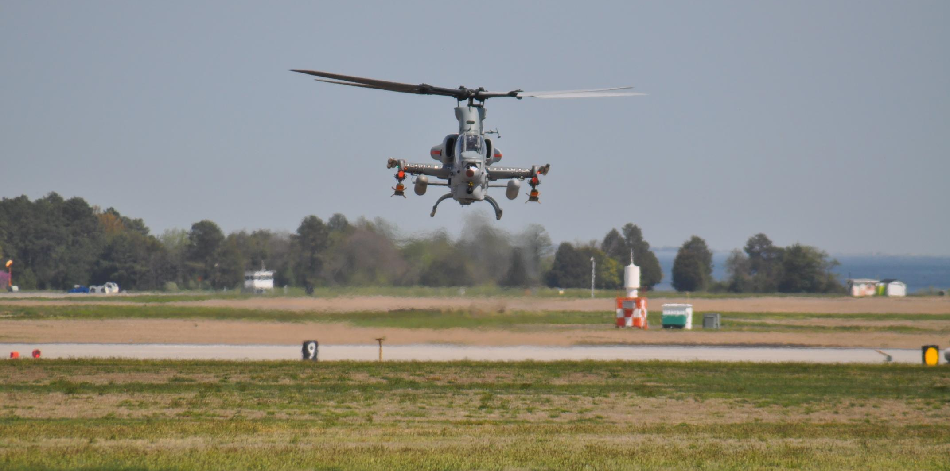
H-1 Project Eagle Alignment
Structural Improvement & Electrical Power Upgrade (SIEPU)
Lines of Effort
Lethality - Diverse portfolio of low-cost kinetic and non-kinetic fires Long-range precision fires Counter-UAS Maritime Militia Digital Interoperability - Link-16 is the baseline for interoperability with Joint Fires BLOS Tactical Data Links Multi-Spectral Apertures SOSA-compliant terminals Survivability - Enhancing our lethal contributions to the Joint Force will make H-1’s a high target DAIRCM APR-39D(V)2 Common Carriage
H-1 Modernization
2025 - The year of lethality Building upon DI, Survivability, and SIEPU [Foundational] The Gap By 2029 the only ACE fires platforms are F-35 and H-1s By 2029 H-1s are the only FAC(A) / TAC(A) platforms The Opportunity Long-range precision fires is the crown jewel Non-kinetic fires must be leveraged Manned/Unmanned teaming is a new frontier The Task - from DCA and DC CD&I Counter Maritime (Maritime Militia) Counter UAS
“NAVAIR Public Release 2025-0248. Distribution Statement A – “Approved for public release; distribution is unlimited””

Slide 4
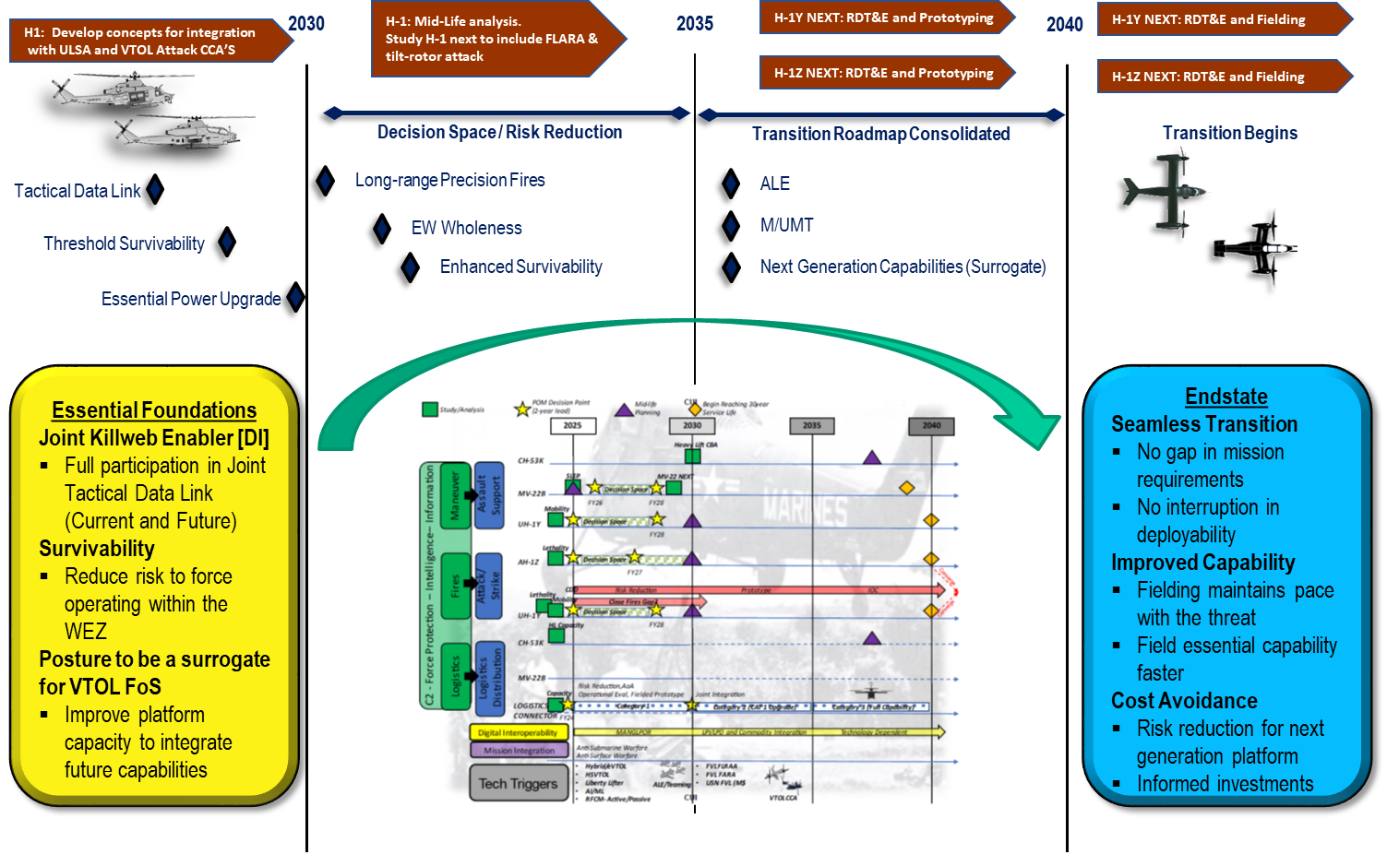
H-1 Bridge to the Future
“NAVAIR Public Release 2025-0248. Distribution Statement A – “Approved for public release; distribution is unlimited””

Slide 5
H-1 program, through fully-informed analysis of the operating environment in the 2030s and Project Eagle strategic vision has focused the modernization roadmap with a transition framework to the H-1 replacement platform no later than 2040.
Digital Interoperability / Communication
Endstate: Redundant means of integration into Combined Joint All Domain Command and Control (CJADC2) with agility to maintain pace with Tactical Data Link modernization.
Survivability
Endstate: Persist as a Stand in Force (SiF) unit in competition and conflict with mitigated Risk to Force.
Lethality
Endstate: Kill web contributor capable of providing kinetic and non-kinetic payloads to disrupt or destroy enemy ground, air (inclusive of Small Unmanned Aircraft System (sUAS)), and surface targets.
Enhance Expeditionary Deployability
Endstate: HMLA units can sustain for longer durations from austere sites with a smaller footprint and informed logistics support structure in Distributed Aviation Operation (DAO).
Service Results
Operational Results
Adversary Effects
Narrow current service gaps
Support distributed MLR operations
Adversary risk recalculation
Provide service decision space through the 3x Future Years Defense Program (FYDP) modernization
Protect aerial and surface logistics connectors
Restrict adversary freedom of maneuver
Risk reduction in transition to H-1 replacement platform
C2 node extension and kill web contributors
Complicate adversary targeting decision making
“NAVAIR Public Release 2025-0248. Distribution Statement A – “Approved for public release; distribution is unlimited””

Slide 6
Questions?
“NAVAIR Public Release 2025-0248. Distribution Statement A – “Approved for public release; distribution is unlimited””

