Slide 1
Modern Day Marine 2026
PRESENTED BY:
Col Leigh Irwin
United States Marine Corps
PMA-266 Program Manager
DISTRO STATEMENT:NAVAIR Public Release SPR-2026-0242. Distribution Statement A - Approved for public release; distribution is unlimited

Slide 2

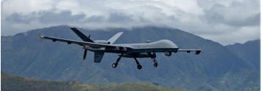
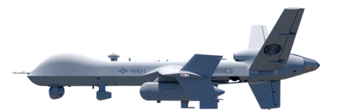
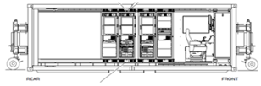

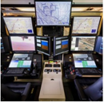




Portfolio Chart
MQ-9A Block -5 -25
MQ-9A Block 5
Secure MCE
Sky Tower II Pod
Sky Tower I Pod
Block 30
Ground Control Station (GCS)
Detect And Avoid System (DAAS)
Electronic Warfare Pod
COP/CIP
DISTRO STATEMENT:NAVAIR Public Release SPR-2026-0242. Distribution Statement A - Approved for public release; distribution is unlimited

Slide 3
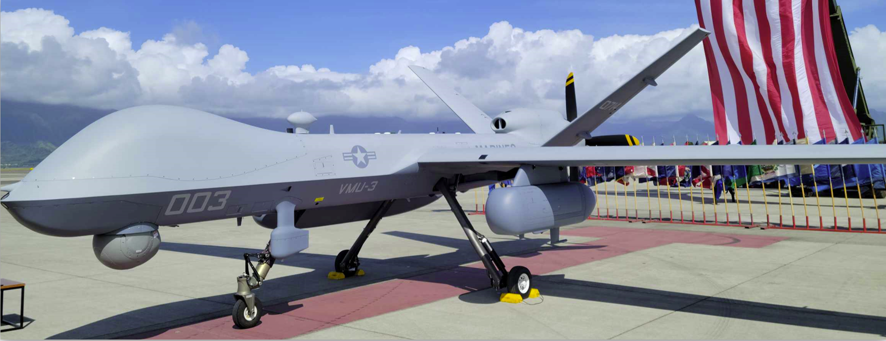
PROGRAM BACKGROUND
The Operational Problem (2016-present)
USMC lacked a long-endurance, expeditionary, persistent ISR platform to support Marine in distributed maritime operations
Legacy systems could not provide persistent ISR, maritime domain awareness or tactical relay at the needed range and tempo
Early Concept: A Single Ship-Based “Do It All” Platform
Initial MUX vision (2016-202) aimed at a Group 5 shipboard launch.
Program analysis showed it would be too costly, too complex, and too slow to field
Pivot to a Timely Fieldable Solution
Reset to a land-based MALE solution using MQ-9A to deliver capability faster (within 2 years)
Adopted a family-of-systems approach instead of a single exquisite platform- MAGTF UAS Expeditionary (MUX)
PMA-266 MISSION
To translate Unmanned Aerial System (UAS) Information Warfare requirements into Fleet Capabilities.
DISTRO STATEMENT:NAVAIR Public Release SPR-2026-0242. Distribution Statement A - Approved for public release; distribution is unlimited

Slide 4
MQ-9A MUX MALE Key Milestones
PMA-266, in collaboration with industry partners, has equipped the Marine Corps Unmanned Aerial Vehicle Squadrons (VMUs 1, T2, and 3) with the MUX MALE (MQ-9A). The MQ-9A is a remotely piloted aircraft (RPA) that can conduct a variety of mission sets, including Intelligence, Surveillance, and Reconnaissance (ISR) over land and sea. This modern aircraft improves the Marine Corps' situational awareness and operational flexibility, allowing them to carry out missions more precisely. It first flew in 2001 but was acquired for USMC use 20 years later.
The original MUX ship-based concept was canceled
The shift to the family-of-systems concept with the land-based strategy was announced as MUX MALE
2020
- Increment I IOC (April)
- 1st EW POD in Developmental Test -(D/T)
VMUT-2 Stood up
VMU-T2 GBSAA System Install
2024
MQ-9A -25 AC Upgrade Installs – OCONUS
UX-24 MQ-9A DAAS Install completed for test (1st)
MQ-9A OFP 2411.5 IOC
1st Smart Sensor in D/T
2026
- MUX MALE Inc II Accelerated to FY23
- ST2 Contract Award
- VMU-3 Stood up
2022
PLEO Installs continue
DAAS Installs
2028
VMU-1 begins operation MQ-9A in a pilot program with contractor support.
2018
2019
Requirements refocused under the Commandant’s guidance ​
MUX was recognized as overly burdened with requirements
2021
First MQ-9A Reaper acquired for USMC use (via USAF contract)
VMU-1 took delivery and began training with the platform
2023
- Increment I Early Operational Capability (Ability to conduct 1x 16 hour orbit, 7 days/week
- Inc II MUX Tier 1 started
- ST2 Contract Award
- VMU-3 Stood up
2025
1st ST2 Pod in D/T
(3) STII Pods Delivered to VMU-3
(3) Cloudsurfer Pods Delivered to VMU-3
VMX-1 MQ-9 Delivered
2027
MQ-9A PLEO Installs
UX-24 MQ-9A DAAS Install (2nd) for test
2029
DAAS Installs
PGWAS Installs
DISTRO STATEMENT:NAVAIR Public Release SPR-2026-0242. Distribution Statement A - Approved for public release; distribution is unlimited

Slide 5
Current Program
Operational Contribution:
The MQ-9A expands the Marine Corps’ ability to sense deep, maintain persistent maritime domain awareness, and connect Marines across distributed formations; all essential to stand-in force concepts and the Commandant’s priorities for Force Design. The platform provides long-range Intelligence Surveillance Reconnaissance (ISR), maritime domain awareness, and tactical data relay in theaters where range, geography, and contested electromagnetic conditions challenge legacy capabilities.
Modernization & Capability Growth:
The program is executing a focused and incremental modernization path.
1. SkyTower II: improves Joint, Navy, and Marine Corps C2 resiliency through multi-path, contested-environment networking
2. EW Pod and Smart Sensor Payload System: introduce advanced sensing, fusion, and autonomous processing at the tactical edge
3. Detect-and-Avoid (DAAS): expands global airspace access and safer integration into partner airspace. These upgrades keep the MQ-9A ahead of pacing threats while supporting Joint kill-chain integration.
DISTRO STATEMENT:NAVAIR Public Release SPR-2026-0242. Distribution Statement A - Approved for public release; distribution is unlimited

Slide 6
Conclusion & Way Forward
The MQ-9A MUX MALE is being decisively modernized to meet the challenges of a rapidly evolving battlefield. By integrating advanced capabilities, we are ensuring that this critical asset remains a cornerstone of the Marine Air Ground Task Force’s warfighting advantage. Our progress to date demonstrates a clear path to delivering a more resilient and connected capability to the warfighter.
The Way Forward
Expand autonomous capabilities to reduce operator workload and increase mission tempo
Improve onboard and offboard data compression to enable faster, more efficient information exchange
Enhance resilient C2 pathways with low‑probability‑of‑intercept/low‑probability‑of‑detect (LPI/LPD) communications
Increase integration of multi-domain sensors to provide timely, actionable battlespace awareness
Strengthen open architecture standards to accelerate tech insertion and interoperability
Advance edge-processing capabilities to enable decision-quality data at the point of need
DISTRO STATEMENT:NAVAIR Public Release SPR-2026-0242. Distribution Statement A - Approved for public release; distribution is unlimited

Slide 7
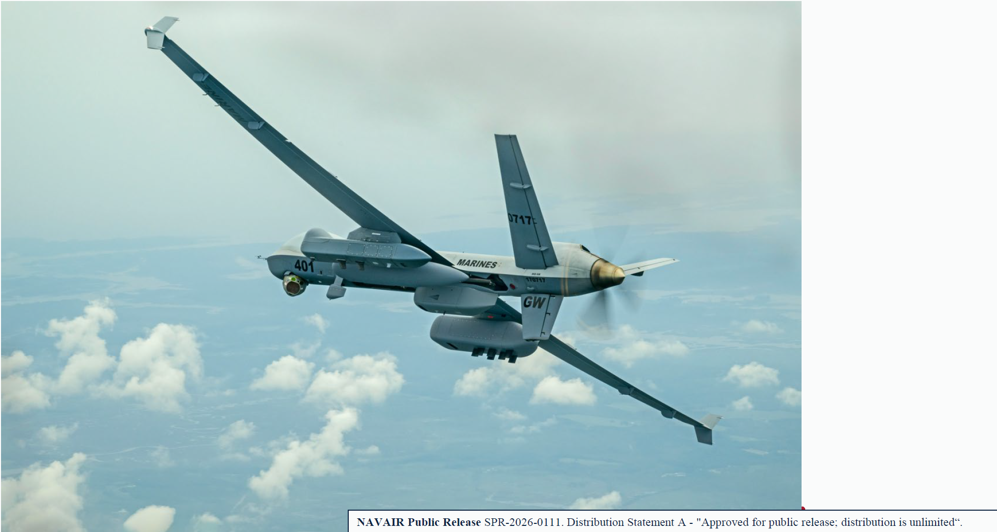


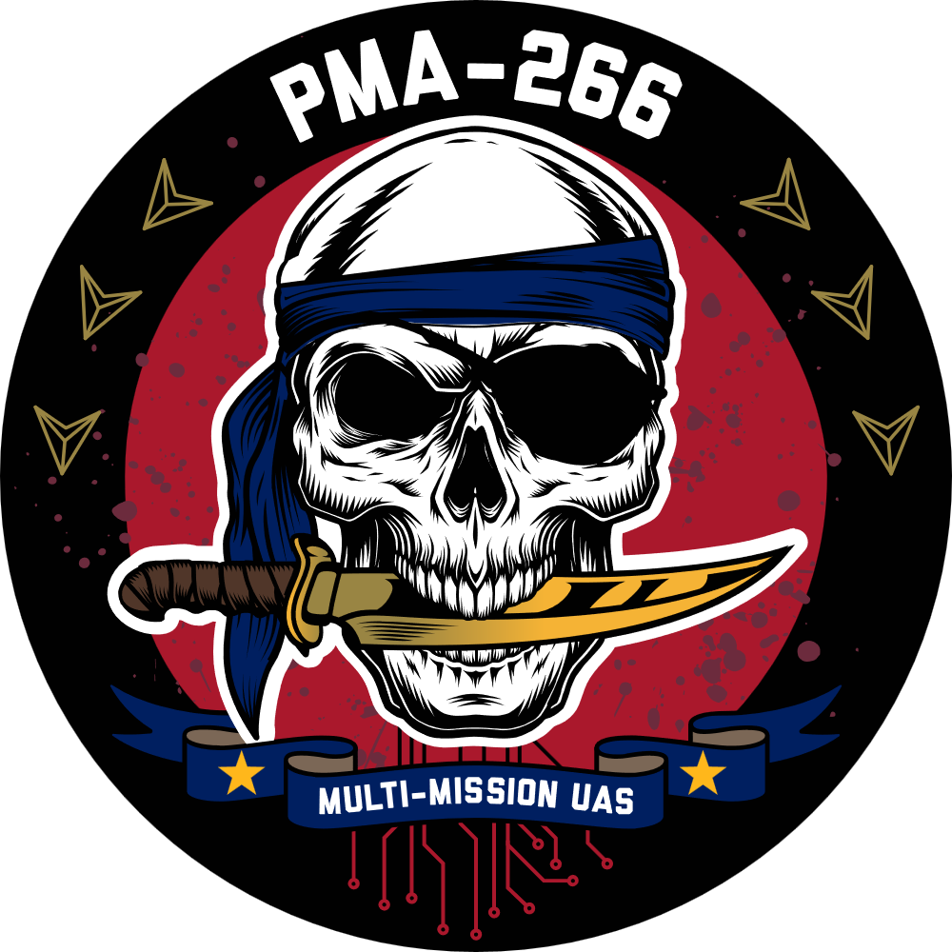
DISTRO STATEMENT:NAVAIR Public Release SPR-2026-0242. Distribution Statement A - Approved for public release; distribution is unlimited

