Slide 1
PM Marine Air-Ground Task Force Command & Control
Colonel Jeffery Van Bourgondien
Program Manager

Slide 2
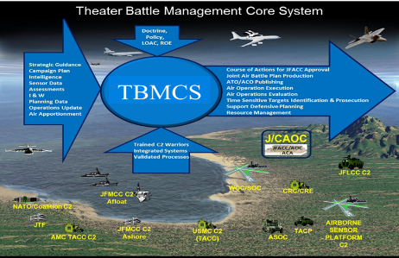
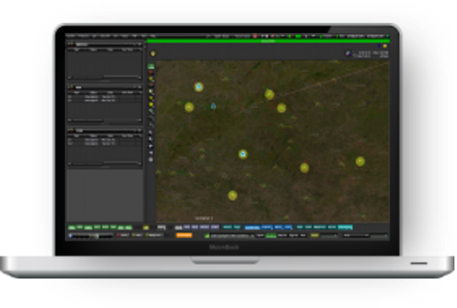
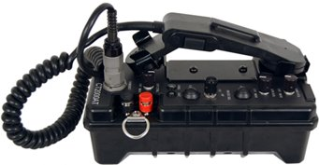
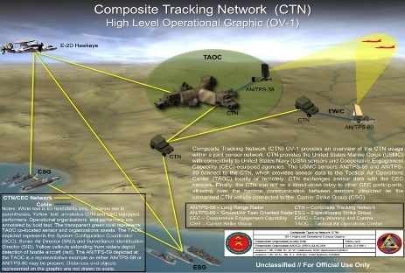
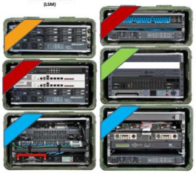
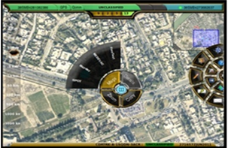
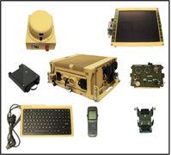
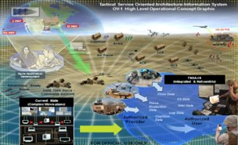
PORTFOLIO AGILE OVERVIEW
Portfolio Management Team (PMT) Themes/Epics/Enablers/Compliance/Demand Management
Solutions & Integration (S&I) Capabilities & Solutions Management
TBMCS-MC
CAC2S
Mission Command Applications
MMC-S JTCW/MCH TBMCS
GCCS JTIC2 GAIA
Hardware & Infrastructure
WID
Servers/Switches/Routers EUDs
Radios SATCOM Encryptors
NOTM
Combat Control Applications
CTN
Product Support & Sustainment (PS&S)
Fielded Capabilities SW Licenses
CAC2S CTN TWB AXS
JBC-P
JTCW
Common Services Applications
NOTM GCV
CHE VI CHAT TDOL C2 GW
TAK Server
TSOA/TDOL

Slide 3
AREAS WHERE INDUSTRY CAN HELP
Epics/Function | FY 26 |  |  |  | FY 27 |  |  |  | FY 28 |  |  |  | FY 29 | FY 30 |  |  | FY 30 |  |  |  | FY 31 | FY 32 | FY 33
 | 1Q | 2Q | 3Q | 4Q | 1Q | 2Q | 3Q | 4Q | 1Q | 2Q | 3Q | 4Q | 1Q | 2Q | 3Q | 4Q | 1Q | 2Q | 3Q | 4Q
Track Management & Correlation | Single All Source Interoperable Track Manager, certified MIL STD compliant message formats, for a unified COP
Sensor Netting | Common sensor data orchestration layer for prosecution of targets by removing stove-pipes and fragmentation
C2 Gateway | Consolidate Gateway Tools to a single solution
Common C2 User Interface | Provide a single application with role-based information
Data Orchestration | Access and utilize information across user communities and echelons to conduct data-centric warfare
Interoperability | Coordinated and integrated C2 capabilities across all domains for Joint and Coalition COP
Cyber / Zero Trust | Ensure a secure, resilient, and interoperable for multi-domain operations
Host Environment | Provide a standardized, scalable, secure platform for all applications, readily available at the tactical edge
Common Hardware | Converge Legacy Programs into common HW tiered solutions with layered capability sets at echelon
MAGTF C2 Solution
Consolidated Capability Sets
Ease of Use
Ease of Set-up
Interoperable
Aligned

Slide 4
PM MAGTF C2: OPPORTUNITIES
Title | Planned RFP
Program Management Office Support Contract (Eng/Log) | 3QFY26
Program Management Office Support Contract (FM/Ops & Admin) | 3QFY26
Training and NET Training Support Contract | 3QFY26
TBMCS SW Sustainment | 4QFY26
SW Maintenance & SW Tech Development | 4QFY27

Slide 5

Questions?

Slide 6


Equipping our WARFIGHTERS

