Slide 1

Modern Day Marine
Spouse Session
SES Gregory Goldstein
Director, Marine and Family Programs

Slide 2
MARINE CORPS TOTAL FITNESS: INTEGRATED PREVENTION
Prevention is essential to readiness.
Stressors like financial strain, relationship challenges, or behavioral health concerns often appear early.
Families and spouses are often the first to notice these signs. By investing in resources such as relationship education, financial literacy, and transition support, we strengthen family stability and Marine resilience—keeping the force mission-ready.
Meeting Marines and families where they are.
Prevention programs currently span multiple offices, requiring families to navigate different locations and staff before finding the right support.
We are working to integrate the Marine & Family programs portfolio, ensuring services are accessible both physically and digitally through enhanced online resources and virtual support.
Co-locating programs—such as Community Counseling within fitness centers—reduces stigma, improves awareness, and makes early help more attainable.
Streamlining services builds trust, reduces barriers, and ensures Marines and their families can access the right support at the right time.
MCTF and WARR: Tools for the Whole Family
All WARR resources are designed for spouses and families—not just warfighters.
The science-based approach applies to all humans—men, women, children, and youth.
WARR also addresses considerations specific to women's anatomy, physiology, hormonal cycles, fitness, and physical training—standardized across the enterprise—ensuring the full spectrum of Marine and family needs are met.
Bottom Line: By connecting families to streamlined, science-based resources, we enhance well-being and readiness across the force.
Notes:
Per Brad's email, he was not tracking a MARADMIN on MCTF for Spouses but provided these bullet points.

Slide 3

MILITARY SPOUSE EMPLOYMENT & PREFERENCE
Family Member Employment Assistance Program (FMEAP)
Offers job search support for military spouses.
Reimburses licensing, certification, and business expenses related to a PCS move.
Priority Placement Transfer Program supports direct care employees in transferring positions.
Impact: 162 successful transfers within Marine Corps Child and Youth Programs to date.
Early Application Advantage
Spouses can apply up to 30 days before their Marine’s reporting date, giving them a head start in the job search.
Transition Readiness Program (TRP) / Spouse Transition and Readiness Seminars (STARS)
Empowers spouses to plan ahead, build career pathways, and make a smooth transition during PCS or after a service member retires and returns to civilian life with practical tools and resources.
Bottom Line: Spouse employment programs help military spouses secure and maintain employment during PCS moves, supporting career continuity even amid relocations.
Notes:
STARS (Spouse Transition and Readiness Seminars)
FY24 data reflects 60 sessions to 183 participants
FY25 data reflects 50 sessions to 254 participants
So far, between October 1, 2025 to Febraury 28, 2026 we have hosted 24 sessions

Slide 4

FAMILY MEMBER TRAVEL SCREENING (FMTS) CELL
Family Member Travel Screening (FMTS) Cell
Acts as a help desk and resource hub for Marines, family members, MOS monitors, and losing/gaining commands involved in the overseas screening process.
It does not override or replace medical/dental suitability determinations — it only supports communication and navigation of the screening process.
It is intended to reduce confusion, support timely completion of requirements, and reduce stress/administrative friction for Marines and families.
Bottom Line: The FMTS Cell helps Marines, their families, and commands navigate the overseas suitability screening process, ensuring timely, clear, and coordinated support for PCS moves.
Notes:
STARS (Spouse Transition and Readiness Seminars)
FY24 data reflects 60 sessions to 183 participants
FY25 data reflects 50 sessions to 254 participants
So far, between October 1, 2025 to Febraury 28, 2026 we have hosted 24 sessions

Slide 5
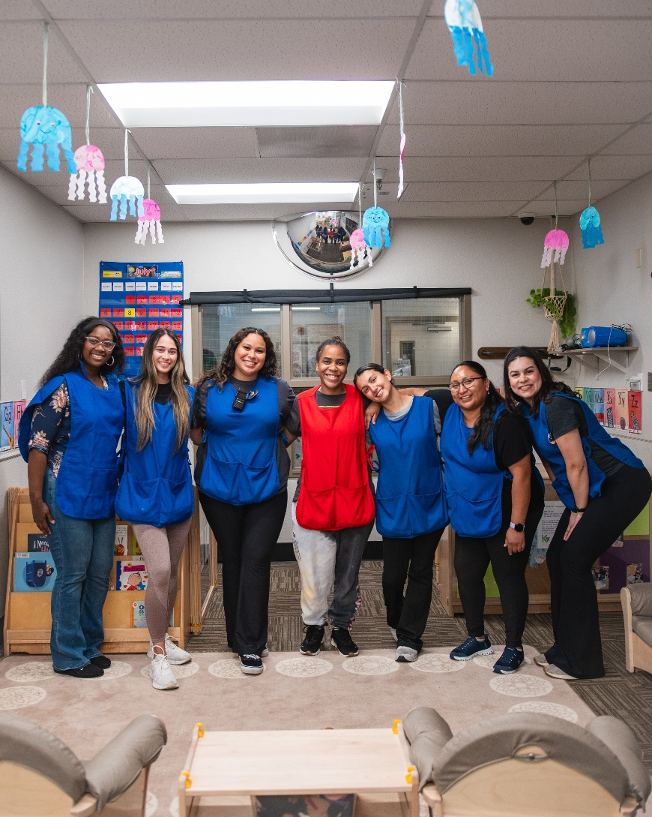
CHILDCARE
Attractive Incentives for Childcare Workers
Entry-level pay starting at $19.48 per hour to attract and retain qualified staff.
100% discount on childcare for the first child for employees working in childcare positions, for both CONUS and OCONUS locations.
Family Child Care (FCC)
Provides licensed childcare in the homes of trained Marines' spouses or other approved caregivers.
Benefits: flexible scheduling, small home-like environment, convenience, continuity and support during PCS moves
Military Child Care in Your Neighborhood (MCCYN)
MCCYN is the fee assistance program for Marine Active Duty and USMC Civilians (NAF and APF) families to use community-based childcare when stationed at installations that have extensive waitlists, or who are geographically disbursed.
MilitaryChildCare.com (MCC) is the go-to resource hub for military-connected families to learn about, search for, and request child care that meets their needs.
Bottom Line: These programs support both childcare staff and military families, ensuring quality care and accessibility for children.

Slide 6
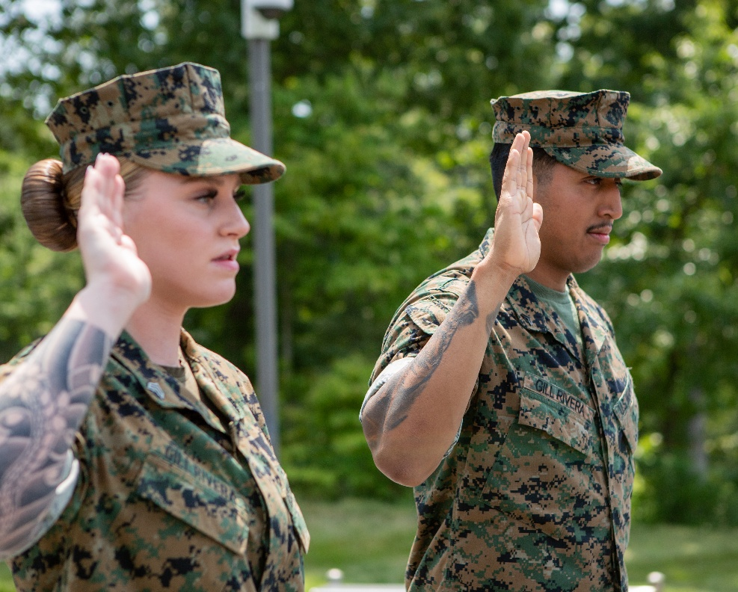
FOCUS ON SPECIAL POPULATIONS
Single Marines, Single Parents, Exceptional Families, Gold Star Survivors and Families, Geographically Separated and Special Duty Assignments
Tailored Support for Diverse Families
Develop and expand programs that meet the unique needs of 21st-century Marine Corps families, ensuring accessible, flexible, and stigma-free services.
Enhanced Prevention and Resilience Services
Provide targeted resources such as MCTF services, behavioral health support, financial planning, childcare, telehealth, and social engagement opportunities to strengthen family stability, readiness, and well-being.
Inclusive Coordination and Outreach
Improve communication, care coordination, and engagement for exceptional families, Gold Star survivors, and other special populations, ensuring they are aware of and can access all available support and legacy programs.
Bottom Line: Investing in tailored support for special populations ensures every Marine and their family has the resources, resilience, and connections needed to thrive—strengthening readiness, preserving talent, and reinforcing the Marine Corps’ commitment to its people.

Slide 7
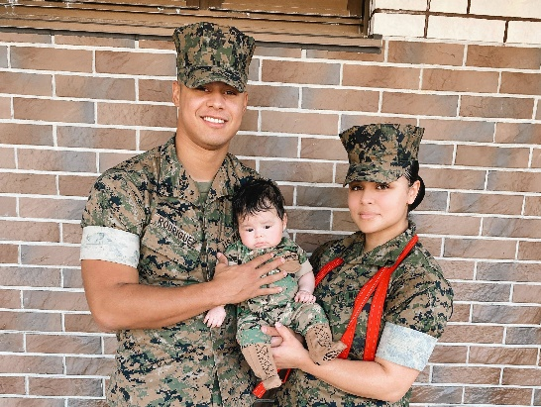
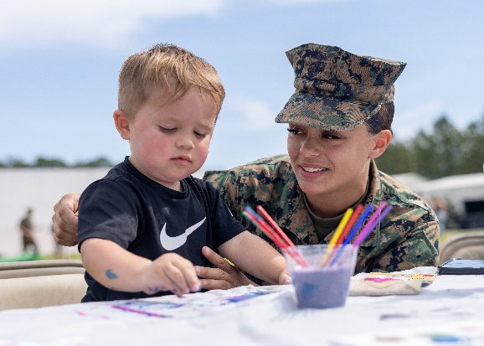
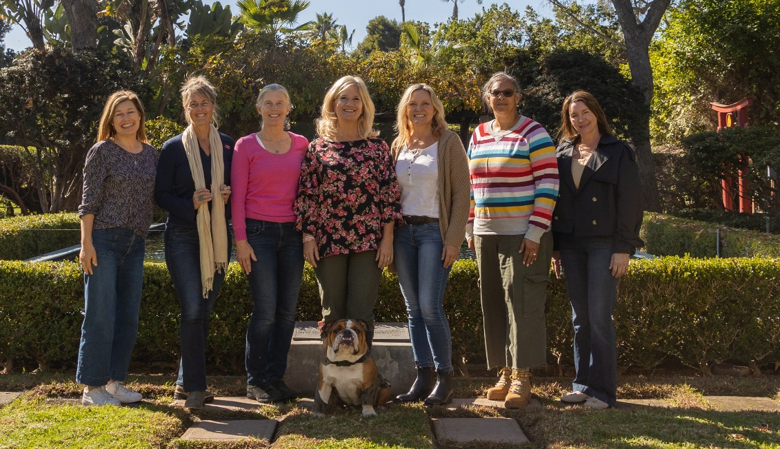
CLOSING REMARKS
In closing...
Today’s Marine Corps families are more diverse than ever—dual-career households, geographically dispersed support networks, and increased reliance on digital services.
Our programs must evolve to meet the needs of 21st century families, ensuring services are flexible, accessible, and responsive to modern lifestyles and challenges.
As spouses, you play a vital role in the strength and readiness of our Corps.
I invite you to visit the MCCS booth to learn how we support Marines and families from the yellow footprints through transition, retirement, and beyond through the Marine for Life Network.
General Bowers and I will be there following the summit and look forward to connecting with you. Thank you.

